Slide 1
WELCOME
Housekeeping Items
Please use the chat function to ask questions or to notify moderator of issues
Session will be recorded and emailed to participants following the webinar
Attendance certificates can be accessed following webinar
The webinar will begin shortly

Slide 2
AP Econ Unit 3: National Income and Price Determination
Fiscal Policy
Curriculum Written By: Steven Cullison
Live Webinar: February 7, 2022

Slide 3
Instructor Bio
Steven Cullison teaches AP Economics and Philosophy at Edina High School in Minnesota. He is a past winner of the Minnesota Secondary Economics Teacher of the Year Award (2019) and has coached teams to state championships in the Economic Challenge and finalists/winners in the Minnesota Federal Reserve Essay Contest. Steven holds master’s (Teaching) and professional (Educational Leadership) degrees from The University of St. Thomas, and a bachelor’s degree in psychology from The University of Minnesota. He is licensed in social studies, school administration, and special education. Steven also serves as a racial equity trainer for his district.

Slide 4
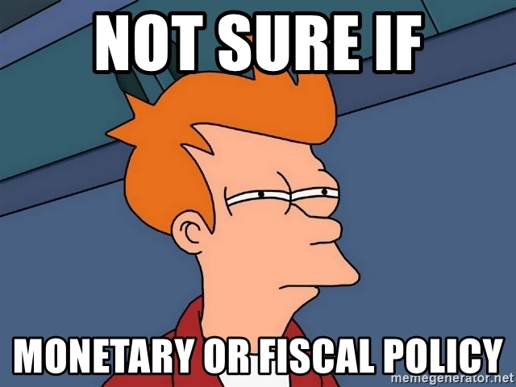
Webinar Objectives
To prepare educators to teach about fiscal policy in an engaging and effective manner.

Slide 5
Agenda
Instruction on fiscal policy
Areas where students struggle
Resources
Lessons
Questions

Slide 6
Learning Goals
To be able to:
describe the tools of fiscal policy, and when they would be best employed
explain the trade-offs involved in using fiscal policy
define automatic stabilizers
Notes:
I believe that it is best practice to explicitly state learning goals or objectives at the outset of a lesson. This is on the screen as my students enter.

Slide 7
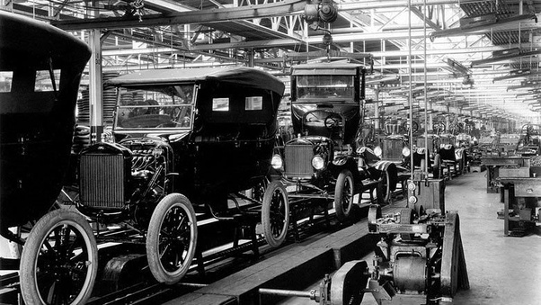
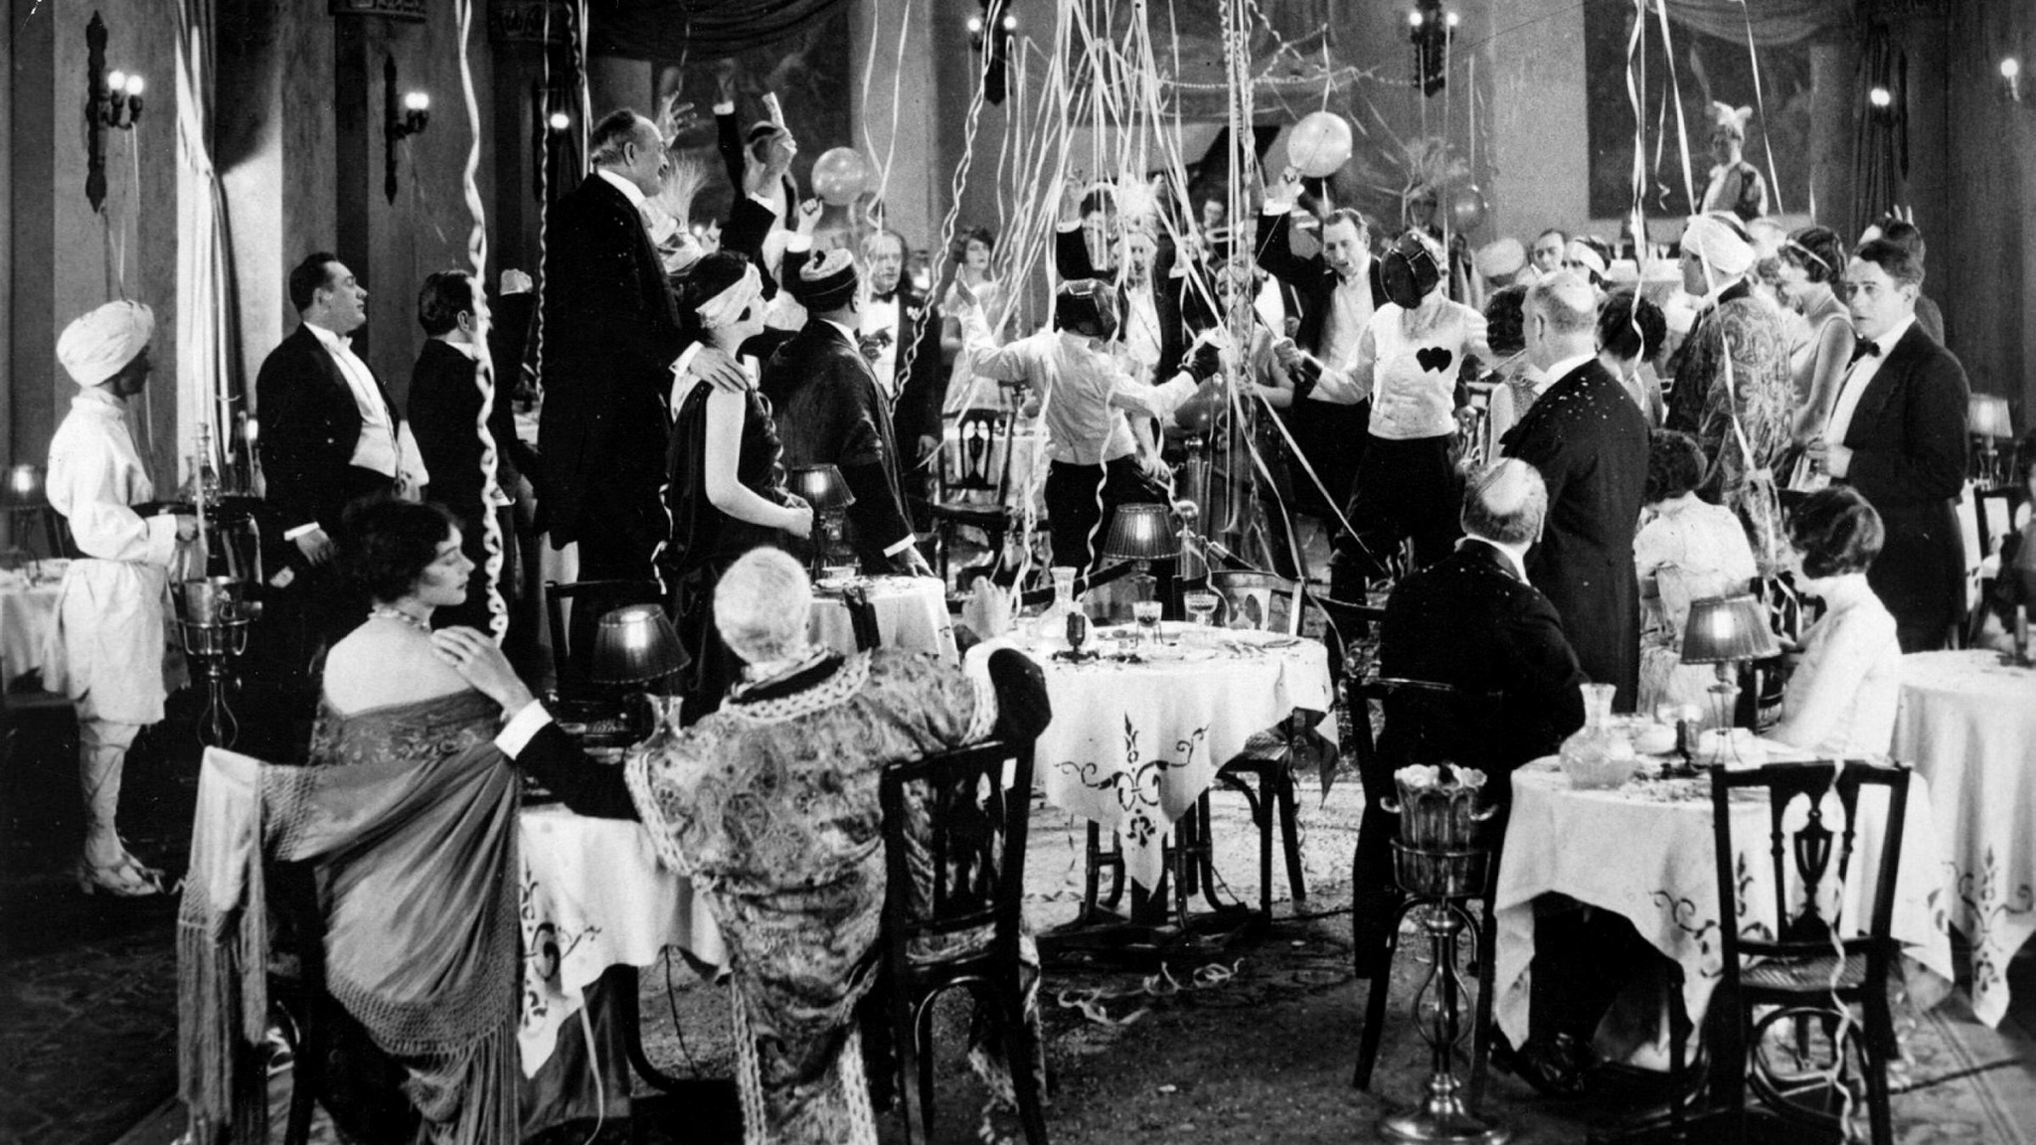
Notes:
So, for those who attended the presentation on the aggregate demand last month, please pardon a bit of overlap in our content. But we begin with a little bit of history, essentially the history of macroeconomics. Through the 1920’s, it’s safe to say that the U.S. government practiced a fairly lassez faire approach to managing the economy.

Slide 8
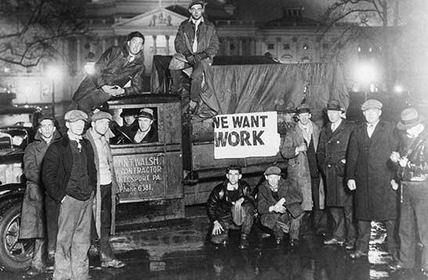
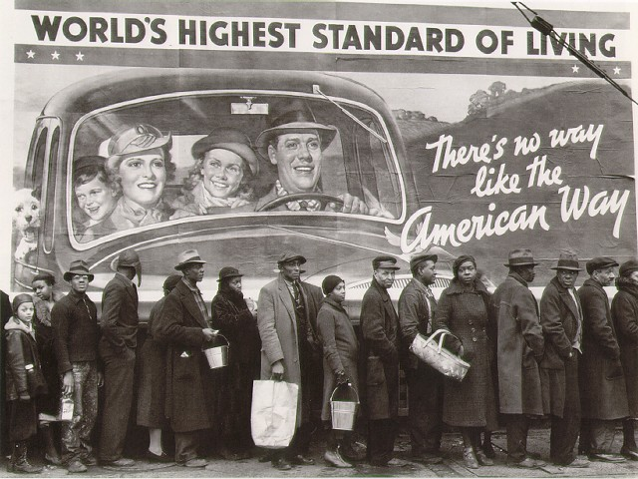
Notes:
But then The Great Depression happens. It was, to use the highly technical language used by economists at the time “the pits.” People, notably the economist John Meynard Keynes of England, asserted that the government should involve itself in the economy.

Slide 9
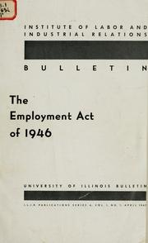
Employment Act of 1946
Mandate: Achieve a full-employment, non-inflationary economy.
Notes:
The U.S. Federal government set two goals for itself in 1946: maintaining full-employment and controlling inflation.

Slide 10
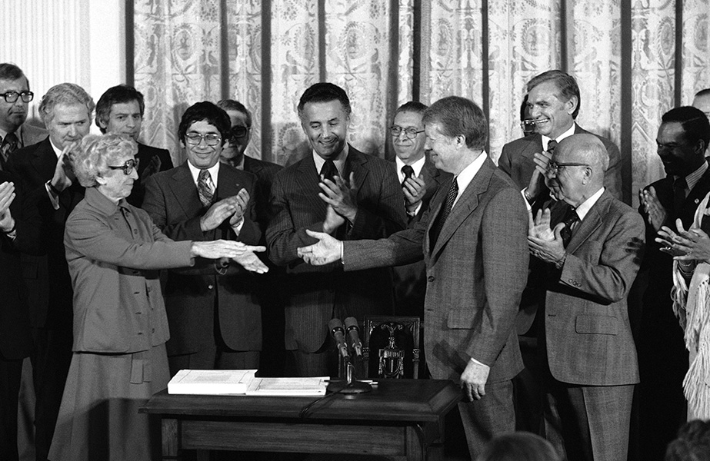
Employment Act (Ammended in 1978)
Sets specific goals:
Unemployment rate of no more than 3% for persons aged 20 or over, and not more than 4% for persons aged 16 or over
Notes:
The U.S. reached this briefly in the 1990’s and got pretty close before the recent pandemic.

Slide 11
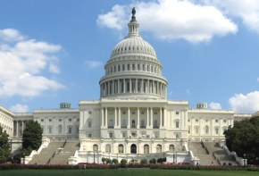
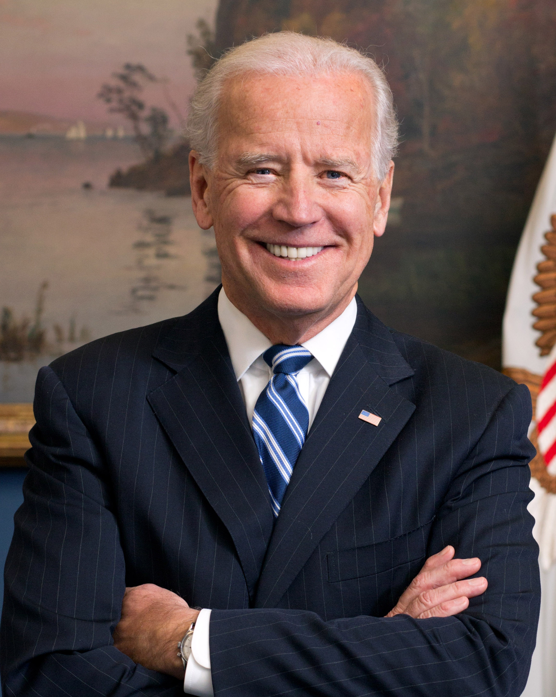
Fiscal Policy
Congress and the President influence the economy through changes in taxing and spending.

Slide 12
Fiscal Policy
Used to Solve 2 Problems:
1. aggregate demand is too low (recession)
2. aggregate demand is too high (inflation)

Slide 13
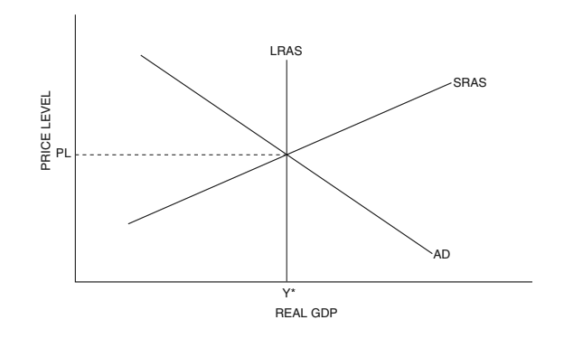
Notes:
Ah, there it is. The sweet-spot! We’re producing at the full-employment level.

Slide 14
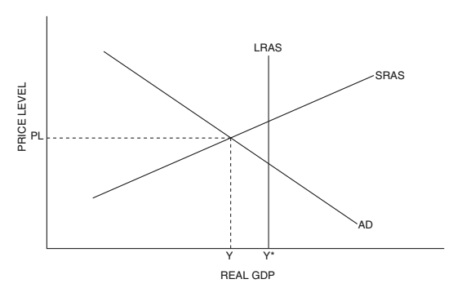
Recessionary gap:
the amount by which output falls short of the long-run equilibrium/ full-eployment level
Notes:
This is no good. We have a recessionary gap! Under ideal conditions, we’d produce at quantity Y asterisk, but we’re to the left of that, at Y. That means fewer goods and services for society to enjoy, and higher unemployment. Voters will NOT be happy.
Those of you who attended my last session will know that, in the long-run, if we wait long enough, the economy will return to full employment all by itself, but who knows how long that could take. Years!

Slide 15
Expansionary Fiscal Policy
Used when AD is too low (recession)
Two Options:
1. Increase government spending
and/or
2. Decrease taxes
Notes:
It’s time for some expansionary fiscal policy, intended to shift AD to the right. We’ve got two options. Read above. Either one could do the trick. If we increase government spending, the government can provide some extra demand all by itself. If it cuts income taxes, then consumers will buy more stuff.

Slide 16
PL1
AD1
Notes:
Nice! The increase in government spending, or cut in taxes, or maybe both, has done the trick! Aggregate demand has shifted right. The nation has more jobs and more stuff. Unfortunately, in this case, a byproduct of this action was inflation, higher price levels. If price levels fell when the economy fell into recession, then their return to previous levels won’t bother people much, and may even be welcome. If prices rise to new highs, then this will be the trade-off of job creation.

Slide 17
PL1
AD1
Notes:
Nice! The increase in government spending, or cut in taxes, or maybe both, has done the trick! Aggregate demand has shifted right. The nation has more jobs and more stuff. Unfortunately, in this case, a byproduct of this action was inflation, higher price levels. If price levels fell when the economy fell into recession, then their return to previous levels won’t bother people much, and may even be welcome. If prices rise to new highs, then this will be the trade-off of job creation.

Slide 18
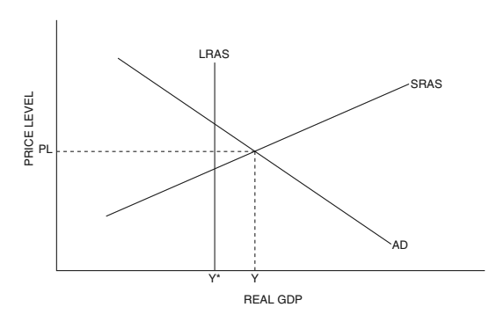
Inflationary gap:
the amount by which output exceeds the long-run equilibrium/ full-eployment level
Notes:
Inflationary gap. Lame. Prices are rising and the voters don’t like it. If we waited around long enough, the economy would fix itself, but forget that noise. It’s time for some contractionary fiscal policy!

Slide 19
Contractionary Fiscal Policy
Used when AD is too high (inflation).
Two Options:
1. Decrease government spending
and/or
2. Increase taxes
Notes:
Perhaps you won’t be surprised to find that the response to an inflationary gap is the opposite of that addressing a recessionary one. If the economy is over-producing, we need to shift aggregate demand to the left. There are two parts to fiscal policy, spending and taxes. We can either spend less or increase taxes so that consumers will spend less.

Slide 20
PL1
AD1
Notes:
There we go. The drop in AD has addressed inflation and returned us to the full employment level of production, and maybe we accomplished it a little faster than if we’d waited for the economy to fix itself.

Slide 21
Notes:
You, and your students, might wonder how this situation is even possible. If you attended my earlier sessions in this series, you’ll know that long-run equilibrium, at LRAS, is considered full employment. Am I suggesting that it’s possible to go beyond full employment?
I am, in fact. While the concept of unemployment isn’t our focus today, let’s touch on it briefly. Full employment doesn’t mean 0% unemployment. It means no cyclical unemployment. The full employment level of output in the U.S. probably still leaves somewhere between 2 and 3 percent of the workforce unemployed. We can exceed it temporarily if people delay career changes, moves, and retirements. If they agree to work unsustainable levels of overtime. Think of full employment as the equilibrium, sustainable, level of employment. Think of it as a situation in which, if someone lacks a job, its not because of a bad economy, it’s for some other reason.
But yes, it is possible to go beyond full employment, temporarily, but this will likely correspond with high inflation in an economy.

Slide 22
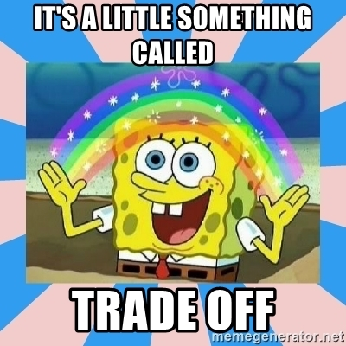
Notes:
So why don’t we just use fiscal policy all the time and always have a perfect economy? Well, there are always trade-offs in economics. Let’s explore some of these complexities.

Slide 23
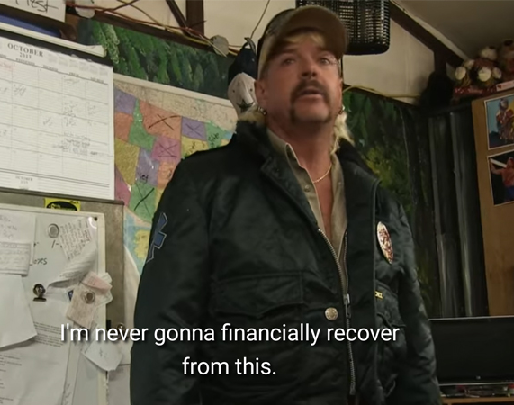
Increased Deficit/Debt*
Expansionary fiscal policy involves spending more, taxing less, or both.
Notes:
The good news? Contractionary fiscal policy actually helps to lower deficits or debt!

Slide 24
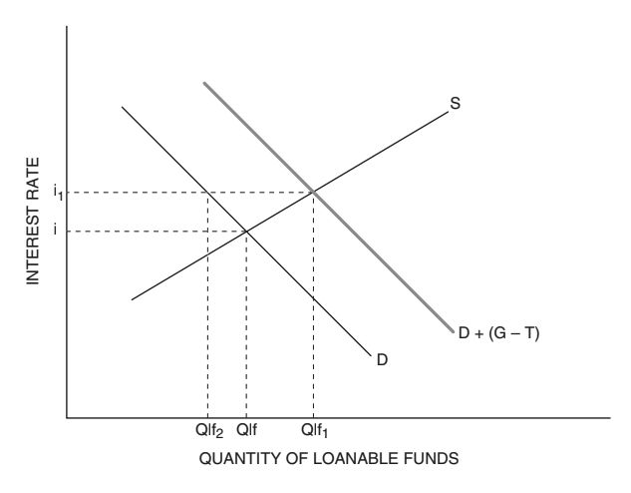
Crowding Out*
Increased government borrowing can drive up interest rates, leading businesses to borrow and invest less.
*Expansionary only
Notes:
This is a little bit involved, but here’s the short version. Read above. If firms invest less, that will be bad for the economy in the long-run. Private investment in their future productive capacity is important for economic growth and can contribute to improved standard of living, again, in the long run.
On the other hand, one upside of contractionary fiscal policy is that we get a reversed crowding-out effect. When the government borrows less, interest rates fall, encouraging private investment.

Slide 25
Inflation
Full Employment
Expansionary fiscal policy can lead to higher price levels
PL1
AD1
Notes:
People have more jobs and the economy is producing more! Hooray! Things cost more! Boo! Concern about rising prices may discourage expansionary policy. This had been the conventional expectation for decades. Then, for about twenty years, inflation seemed to stay low in the face of expansionary fiscal policy. A new theory proposed that, so long as there is slack in an economy, untapped productive capacity, inflation would not result.

Slide 26
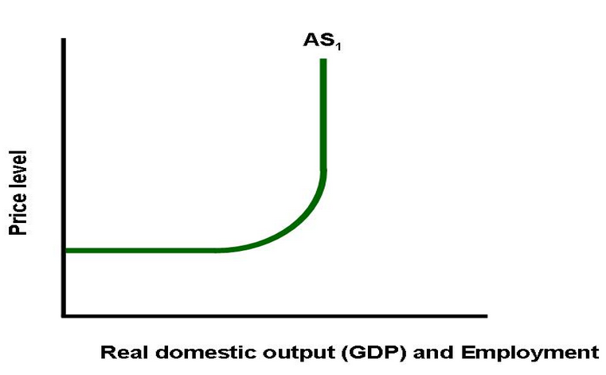
Inflation
Expansionary fiscal policy can lead to higher price levels
AD1
AD2
Notes:
That’s consistent with operating in the horizontal region of the more complex model of aggregate supply.

Slide 27
SRAS1
PL1
Y1
Notes:
In these examples, it was assumed that the cause of the recession was low aggregate demand. The tradeoff is even harder if a recession is caused by low short-run aggregate supply. Now we have high unemployment AND high inflation. This is sometimes called stagflation. It occurred in the 70’s and is occurring, to a degree, right now in the U.S. economy.

Slide 28
SRAS1
PL2
PL1
AD2
Y1
, Y2
Notes:
So we could fix it with expansionary fiscal policy, send out stimulus checks and such. That’ll save jobs BUT it’ll push inflation higher still. Hyper-inflation. This may sound familiar.

Slide 29
Lost Jobs
Contractionary fiscal policy will increase unemployment
PL1
AD1
Notes:
Contractionary fiscal policy has its trade-offs too. If we cut government spending, or raise taxes, to help fight inflation, people will lose their jobs. In a situation like that pictured above, where the economy is running hot, and there’s an inflationary gap, overall that may not seem like a big problem. But if you’re one of the people who loses their job, that’s small consolation.

Slide 30
Lags in Fiscal Policy
The impacts of spending and tax changes are not immediate. If the economy self-corrects before policy effects kick in, they can cause problems.
Notes:
Another problem with fiscal policy is that it can take a while to take effect. While this is happening, natural shifts in the economy can occur. This complicates things.

Slide 31
Lags in Fiscal Policy
Fiscal policy doesn’t work immediately because
it takes time to realise that there is a need
it takes time for Congress and The White House to agree on a solution
changes don’t take effect immediately
Notes:
Reasons that fiscal policy can take a while to take effect include:

Slide 32
Lags in Fiscal Policy
Fiscal policy doesn’t work immediately because
it takes time to realise that there is a need
it takes time for Congress and The White House to agree on a solution
changes don’t take effect immediately
Notes:
Reasons that fiscal policy can take a while to take effect include:

Slide 33
Notes:
Let’s look at an example. Looks like we’re wrestling with high inflation (according to data from a month ago.) We know what to do about that! Let’s cut government spending! So we debate a new budget over the course of six months, and then different departments of the government start making cuts.

Slide 34
SRAS1
Notes:
While all of this is happening, firms are making their own cuts because labor and materials have gotten expensive in this period of high inflation. This is an instance of an economy, given enough time, reverting to a long run equilibrium on its own.

Slide 35
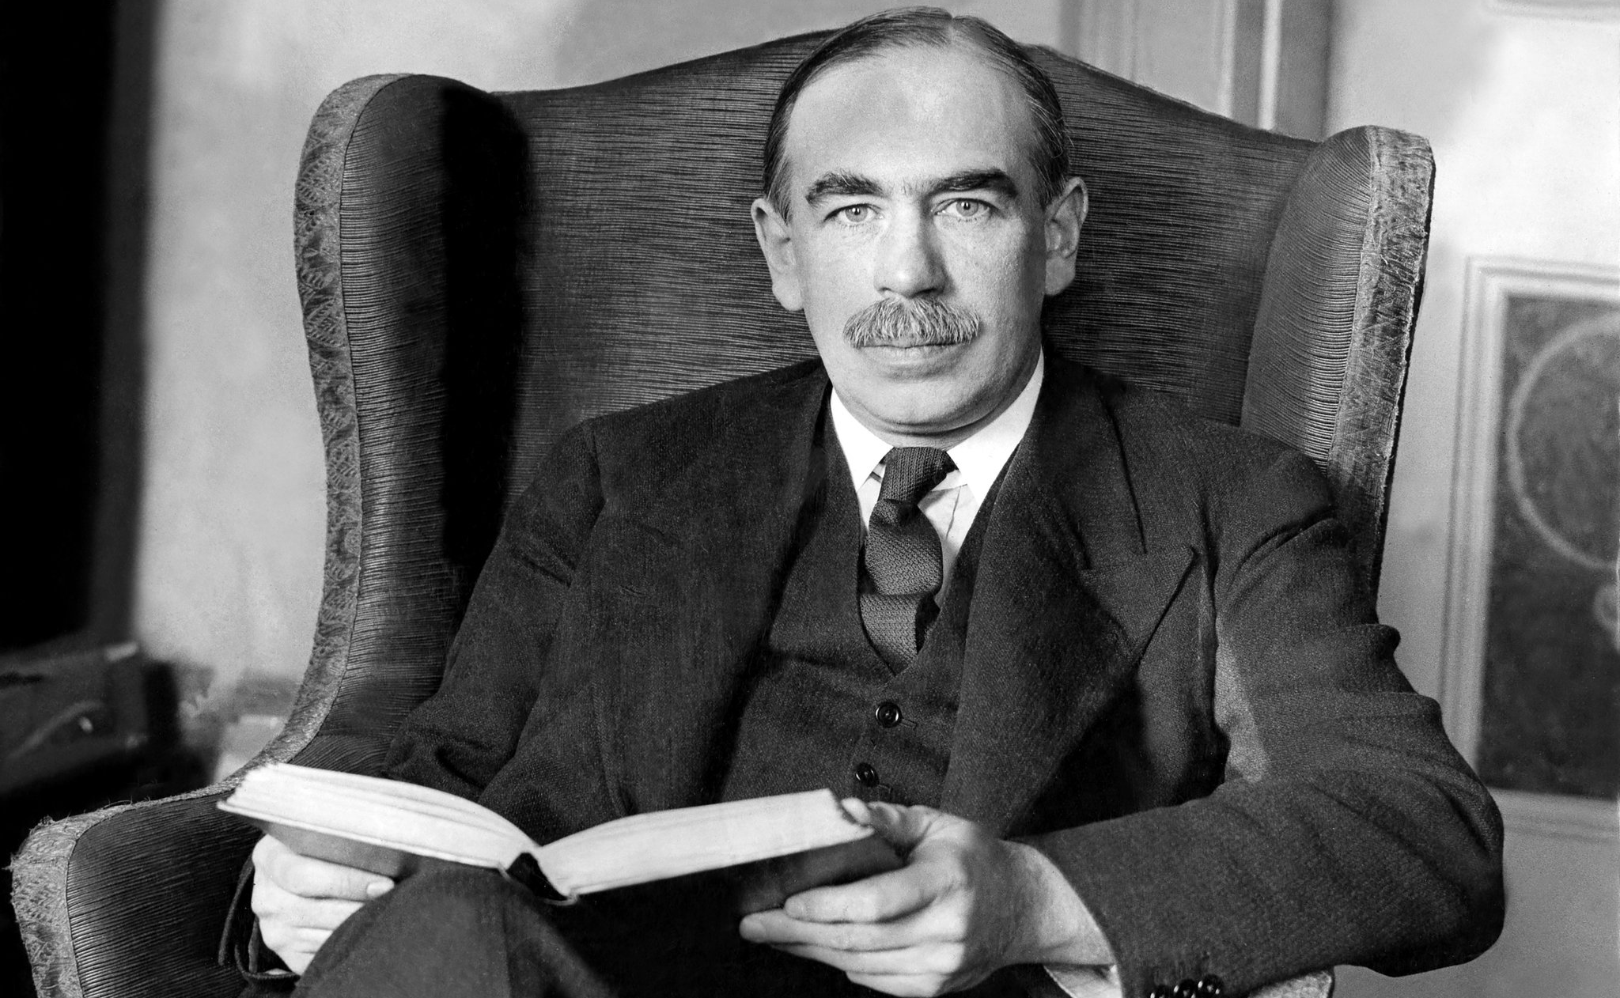
Notes:
So there are some trade-offs, some complications, surrounding the use of fiscal policy, especially expansionary fiscal policy in times of recession. What’s more, it was just suggested that, potentially, in the long-run, the economy might just fix itself. So why bother? John Meynard Keynes, likely the most influential economist of the past century, responds to that argument thusly:

Slide 36
“In the long run we are all dead.”
Notes:
That hands-off approach to economic downturns, you’ll remember, was exactly how things were done prior to the great depression. Let’s say we believe that, in the long run, the economy will fix itself. The Great Depression showed that could take many years. If there is a way to avoid that suffering, Keynes might argue, we should do so.

Slide 37
Non-Discretionary (Automatic) Fiscal Policy
During times of high employment:
Tax revenues rise automatically
Transfer payments fall automatically
“Higher” taxes and less government spending? That’s contractionary fiscal policy!
Notes:
Thus far, all of the fiscal policy we’ve discussed is what we would term ‘discretionary,’ meaning that it is active and intentional. But there’s another type of fiscal policy. Unsurprisingly, it is called ‘non-discretionary’ fiscal policy. It can also be described as automatic. Let’s examine it.

Slide 38
AD1
Notes:
Oh no! Inflation. Maybe we should do something!

Slide 39
PL1
AD1
Notes:
Oh yeah. We sent out fewer unemployment checks, because fewer people qualified, and collected more in taxes, because people’s incomes were hire. Good work us!

Slide 40
Non-Discretionary (Automatic) Fiscal Policy
During recessions:
Tax revenues fall automatically.
Transfer payments rise.
“Lower” taxes and more government spending? That’s expansionary fiscal policy!

Slide 41
Notes:
High unemployment! Voters ain’t gonna’ dig that! Maybe if we...

Slide 42
PL1
AD1
Notes:
Oh yeah. We collected less in taxes and sent out more food stamps. Nailing it!

Slide 43
Where Students May Struggle
The crowding-out effect
PL1
AD1
Notes:
I asserted that, when the government engages in expansionary fiscal policy this shifts aggregate demand to the right. That’s kind of the point. But I also said that this will increase government borrowing, driving up interest rates, leading to a decrease in investment. But isn’t investment part of aggregate demand? Shouldn’t this shift AD to the left, undoing the expansionary fiscal policy?
Good question, hypothetical economics student. It is true that the drop in investment will partially off-set some of the increase in AD. But the assumption is that the increase in government spending has a larger effect, so AD still shifts right. If that weren’t true, then fiscal policy wouldn’t be a thing.

Slide 44
Where Students May Struggle
The crowding out effect
The difference between discretionary and automatic fiscal policy
Notes:
The distinction I make is this: did the government make a brand new policy in response to an economic problem? If so, that’s discretionary. A tax cut, for instance, is discretionary, contractionary, fiscal policy. If not, if the government collects less tax revenue under previously existing laws, then that is automatic.

Slide 45
Where Students May Struggle
The crowding out effect
The difference between discretionary and automatic fiscal policy
When to use the kinked supply curve
Notes:
The answer is simple: don’t unless a question specifically refers to a horizontal or vertical region of the short run aggregate supply curve.

Slide 46
Ways to Teach This:
Lecture/Screencast/Textbook
Notes:
There are a great many topics in economics which I like to introduce through simulations and games. There are some things, and equilibrium in the macroeconomic model may be one of them, where some direct instruction can be valuable. Each of these traditional methods of instruction has its strengths and weaknesses, which is why I at least try to offer all three. One way or another, before we start on practice and review, you have to get the information out there somehow.

Slide 47
Ways to Teach This:
Lecture/Screencast/Textbook
Practice problems
Notes:
Once students have been introduced to aggregate the content, it’s time to practice. Practice problems are a vital part of instruction in an AP class. They not only provide practice with the content, but also practice understanding College Board’s writing style, which can sometimes be a bit confusing for students. Additionally, of course, they provide useful information for an instructor regarding ongoing areas of need for students.

Slide 48
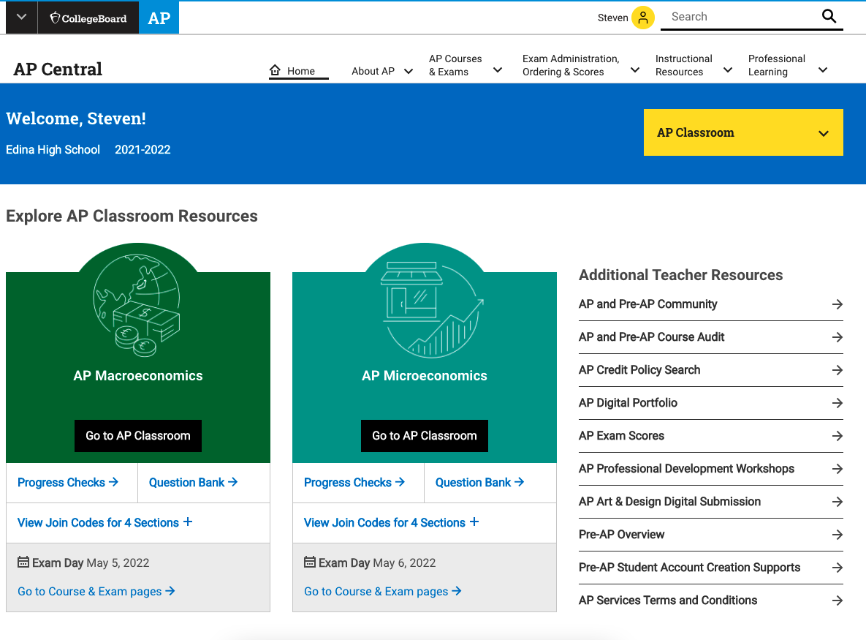
Notes:
If you’ve attended some of the earlier webinars in this series, you’ve already heard about the usefulness of AP Classroom. You will have access to it once your district registers you as an instructor of AP Macroeconomics with them.

Slide 49
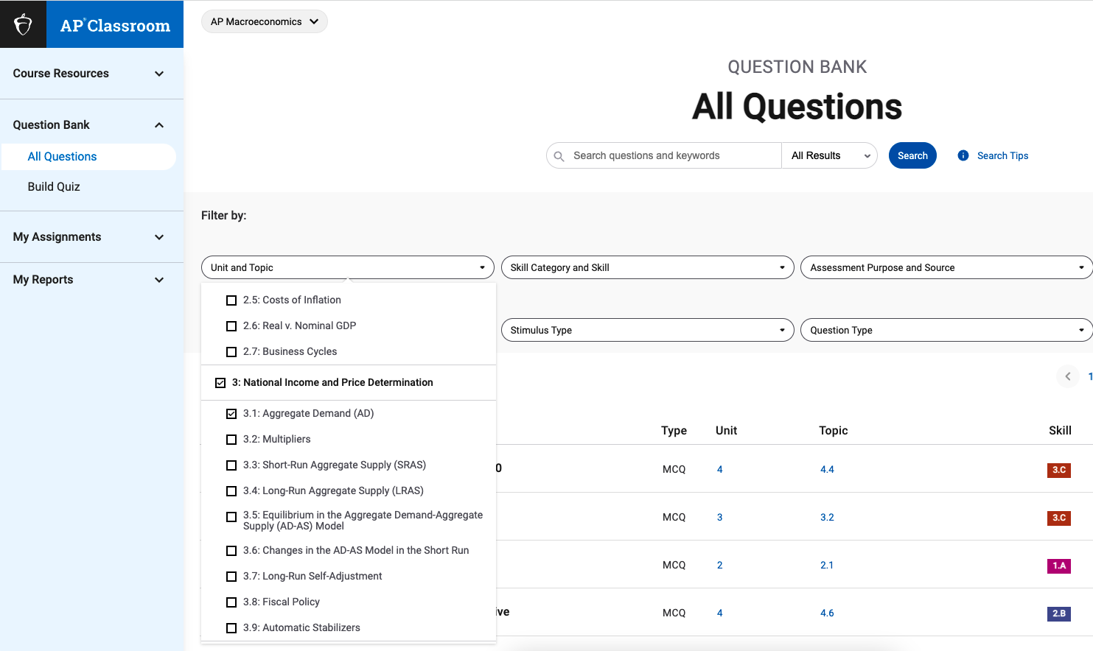
Notes:
In it you can specify a topic and type of question and get questions of identical style and difficulty to those which students will encounter on the AP test. If students are going to take the AP test, then they will need a login for this site anyway, so you can assign the questions to students directly through this system. It’s a good way to proceed, because AP doesn’t want you posting the questions elsewhere.

Slide 50
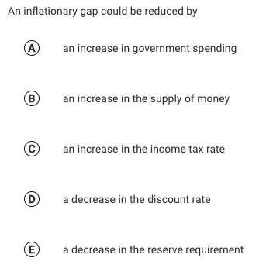
Notes:
Here’s an example question from AP Classroom.

Slide 51
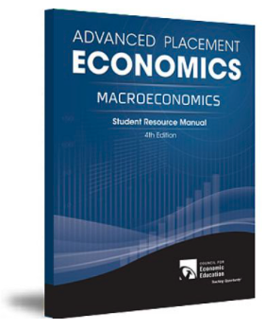
Ways to Teach This: Equilibrium in the AS/AD Model
Lecture/Screencast/Textbook
Practice problems
Worksheets
Notes:
The Council for Economics Education’s Advanced Placement 4th Edition Macroeconomics book provides a couple of things for you. (Click on the link above.) First, in the teacher’s manual, there’s a guide to help you in a lecture on aggregate supply. This will include a review of a lot of the information from this presentation, and will also try to anticipate places where students may make mistakes. Then, in the student book, there’s a worksheet. I like to have students work in groups on these. In this way, students support each other. When one student teaches another, they both benefit. And sometimes a fellow student can explain something in a different way than the teacher does, and it just clicks. If I’m honest, I frequently don’t grade these. Instead I’ll move throughout the room, providing feedback, and then we’ll go over the assignment together.

Slide 52
Ways to Teach This: Equilibrium in the AS/AD Model
Lecture/Screencast/Textbook
Practice problems
Worksheets
Review Games
Notes:
I don’t want to repeat my previous lessons too closely, but review games like Kahoot and Blooket are excellent classroom tools. I also suggest staging small quizbowl like competitions, old school, after the model of the finals in the National Economics Challenge.

Slide 53
Ways to Teach This: Equilibrium in the AS/AD Model
Lecture/Screencast/Textbook
Practice problems
Worksheets
Review Games
The Fiscal Ship
Notes:
This is a simulator in which students make changes to fiscal policy and see the results. The nice thing about this is that it acknowledges that there are reasons the government spends money other than fiscal policy: the government provides goods and services. When the government cuts spending in order to reduce inflation, that also entails a reduction in government services.

Slide 54
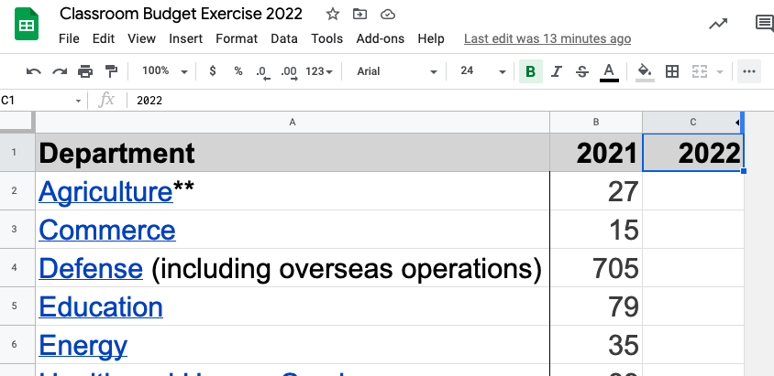
Ways to Teach This: Equilibrium in the AS/AD Model
Lecture/Screencast/Textbook
Practice problems
Worksheets
Review Games
The Fiscal Ship
Classroom federal budget simulations
Notes:
On a related note, I have students propose entire budgets for the federal government, and then vote on one as a class, as though they were congress. This involves making judgements about the best use of funds while also considering the effect on the economy. It’s easy to try to balance the budget or fight inflation if you don’t have to think about raising taxes or which government programs to cut.

Slide 55
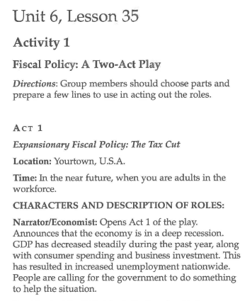
Ways to Teach This: Fiscal Policy
Lecture/Screencast/Textbook
Practice problems
Worksheets
Review Games
The Fiscal Ship
Classroom federal budget simulations
Theater
Notes:
The Council on Economics Education publishes a book of economics lessons called ‘Capstone.’ It’s not AP specific, but it’s very good. It includes an activity in which students act out a sort of radio play illustrating the chain of events involved in fiscal policy. You should check it out.

Slide 56
Time Permitting: Real Life
1
PL1
AD1
Y1
Notes:
Expansionary fiscal policy, in the form of increased government spending, stimulus checks, and delayed repayments on student loans have probably helped the U.S. keep unemployment under control. It’s only a little higher than usual, though not yet back to the very low levels the U.S. enjoyed before the pandemic.
Unfortunately, the expansionary fiscal policy has likely contributed to inflation. An adverse supply shock is also contributing to inflation, and fiscal policy can’t really fix that. The hope is that supply-chain issues will resolve themselves as COVID wanes, stopping the high inflation. Few economists expect price levels to fall at that time, though. Instead, prices would just rise at their normal rates, instead of the historically high rates of the last year or two.

Slide 57
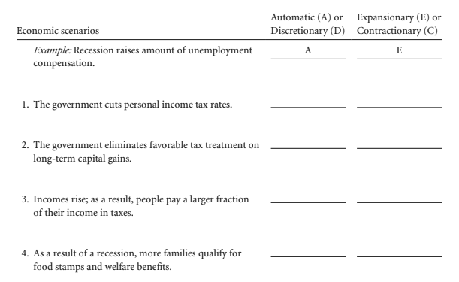
Time Permitting: Practice

Slide 58
Time Permitting: Practice
D
E

Slide 59
Questions?

Slide 60
MINNESOTA COUNCIL ON ECONOMIC EDUCATION (MCEE)
Our Vision
To equip all Minnesotans with the economic and personal financial understanding needed to succeed in today's complex economy.
Teaching Teachers, Engaging Students, and Reaching Communities
mcee.umn.edu | mcee@umn.edu | 612.625.3727
Notes:
Some upcoming webinars produced by the Minnesota council on economics education, which are open to educators world over include one titled Marvel Economics on February 22nd and another titled Culturally Responsive Personal Finance on March 29th.

Slide 61
NATIONAL COUNCIL FOR ECONOMIC EDUCATION (CEE)
The Council for Economic Education’s (CEE’s) mission is to equip K-12 students with the tools and knowledge of personal finance and economics so that they can make better decisions for themselves, their families, and their communities.
We carry out our mission by providing resources and training to K-12 educators and have done so for over 70 years. Nearly two-thirds of the teachers we reach in-person are in low to moderate income schools. All resources and programs are developed by educators and delivered by our 188 affiliates across the country in every state. We reach over 50,000 teachers a year through in-person professional development and those teachers, in turn, reach approximately 5 million students throughout the country. EconEdLink, our free online educator gateway for economic and personal finance lessons and resources, attracts more than 700,000 unique visitors per year.
We also advocate for more and better education in personal finance and economics, primarily through the biennial Survey of the States.

Slide 62
Thank You
Steven Cullison | steven.cullison@edinaschools.org
Notes:
Advertise upcoming sessions: Aggregate Supply on MLK Day in a week, Macroeconomic Equilibrium in which we bring AD and AS together on Monday Jan 31st, and Fiscal Policy on Feb. 7th.

