Slide 1
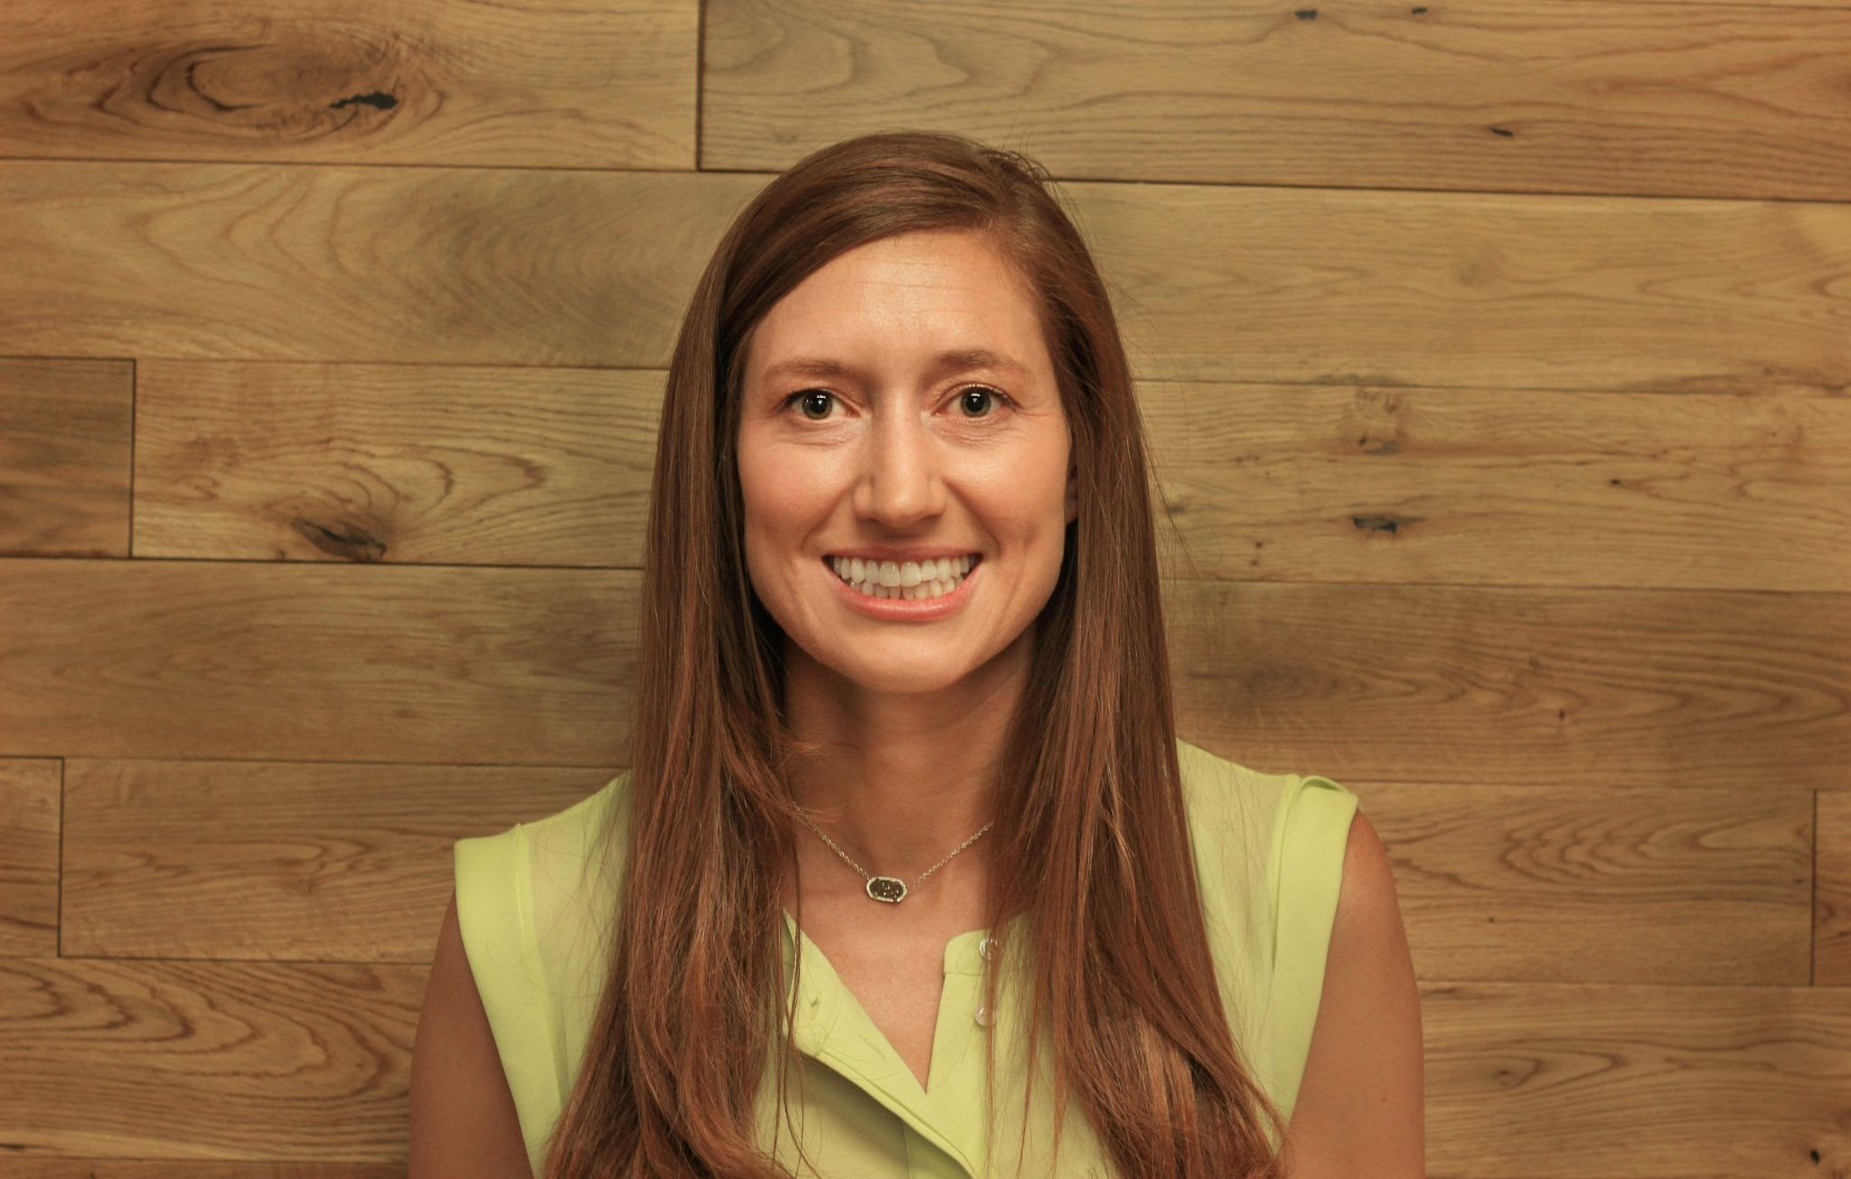
The Intricacies of Consumer Panic Buying Presented by Susanna McConnell February 3, 2022 Susanna.Pierce.McConnell@gmail.com

Slide 2
EconEdLink Membership
You can now access CEE’s professional development webinars directly on EconEdLink.org! To receive these new professional development benefits, become an EconEdLink member. As a member, you will now be able to:
Automatically receive a professional development certificate via e-mail within 24 hours after viewing any webinar for a minimum of 45 minutes
Register for upcoming webinars with a simple one-click process
Easily download presentations, lesson plan materials and activities for each webinar
Search and view all webinars at your convenience
Save webinars to your EconEdLink dashboard for easy access to the event
You may access our new Professional Development page here

Slide 3
Professional Development Certificate
To earn your professional development certificate for this webinar, you must:
Watch a minimum of 45-minutes and you will automatically receive a professional development certificate via e-mail within 24 hours.
Accessing resources:
You can now easily download presentations, lesson plan materials, and activities for each webinar from EconEdLink.org/professional-development/

Slide 4
Agenda
Consumer Insights: Check In (SEL)
Consumer Panic Buying Activities
Warm Ups
Class Discussions
Pre-Think
Article Analysis
Online Extensions
Reflection

Slide 5
National Standards
Standard 7:
A market exists when buyers and sellers interact. This interaction determines market prices and thereby allocates scarce goods and services.
Standard 8:
Prices send signals and provide incentives to buyers and sellers. When supply or demand changes, market prices adjust, affecting incentives.

Slide 6
AP Standards
Mkt-3.B.1:
Changes in the determinants of consumer demand can cause the demand curve to shift.

Slide 7
Let’s connect!
What’s something you bought more of during Covid-19?
Add your response in the Chat box!

Slide 8
Objectives
Participants will:
discover economic terminology associated with consumer behavior.
learn strategies to facilitate student thinking and discussions about consumer buying decisions.
connect with relevant media associated with consumer behavior.
reflect on the implementation into their own classroom.

Slide 9
Part 1: Warm Ups
How can you engage students when introducing consumer behavior?
Content Connections and Pre-Thinking Activities

Slide 10
Background Content
Demand
Consumer Expectations
Shortages
Consumer Preferences
Quizlet

Slide 11
How can you integrate this topic as a Warm Up?
Consumer Hoarding
Images, Polls, Google Question

Slide 12
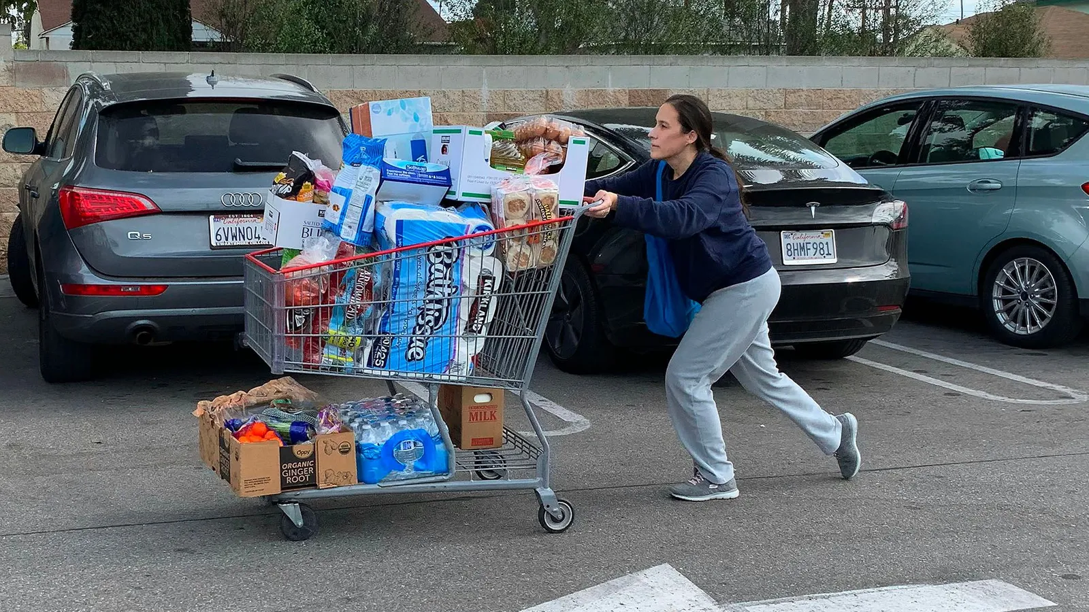
Warm Up #1:
See, Think, Wonder
See, Think, Wonder
What do you see? What do you think this means? What do you wonder?

Slide 13
Warm Up #2 Poll: My family hoarded groceries during the pandemic.
1- Strongly Agree, 2- Agree, 3- Disagree, 4- Strongly Disagree

Slide 14
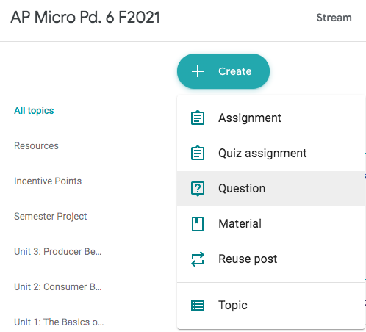
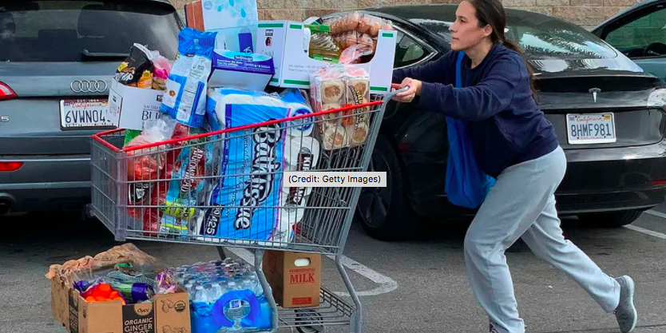
Warm Up #3: What is your major takeaway from the article?
Google Classroom Question
The Psychology of Panic-Buying

Slide 15
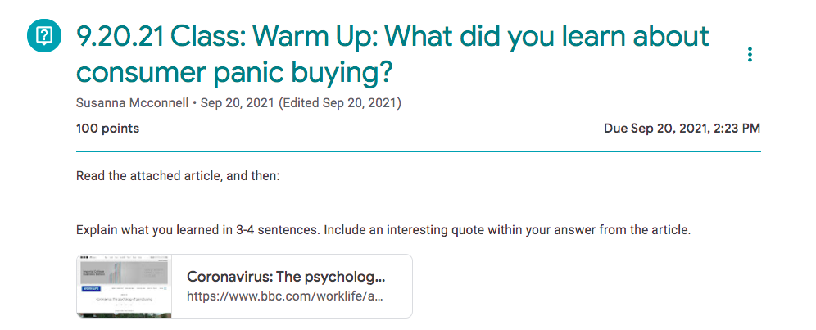

Slide 16
Part 2: Discussion Prompts
How can students discuss consumer spending changes since Covid-19 hit?

Slide 17
Option #1: Integrate Background Knowledge
Student voice

Slide 18
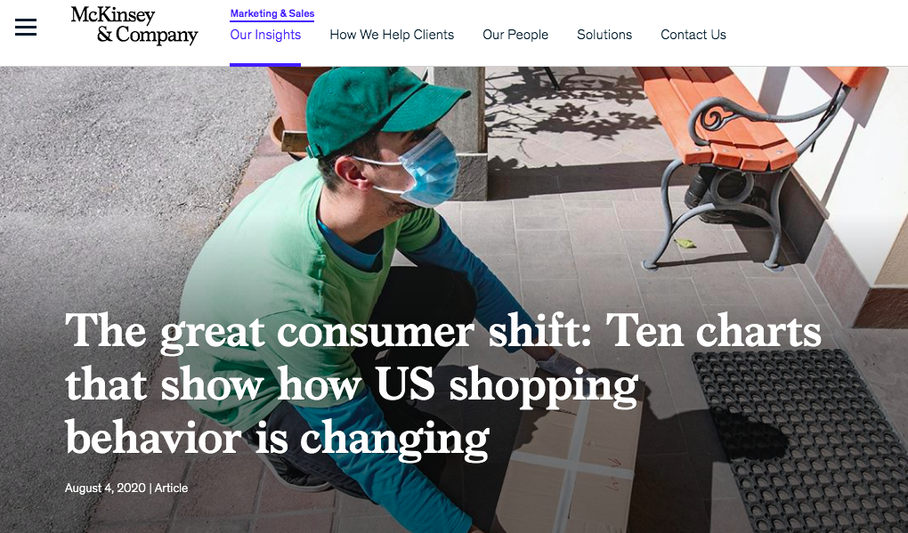
Option #2: Analyze and Discuss Research
https://www.mckinsey.com/business-functions/marketing-and-sales/our-insights/the-great-consumer-shift-ten-charts-that-show-how-us-shopping-behavior-is-changing

Slide 19
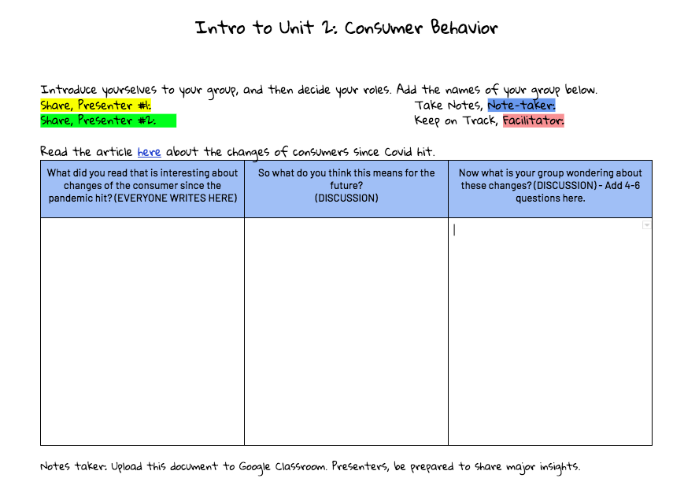
Discussion Explained
Post assignment.
Student groups share it.
Type in column 1 as you read.
Fill out 2 and 3 during discussion.

Slide 20
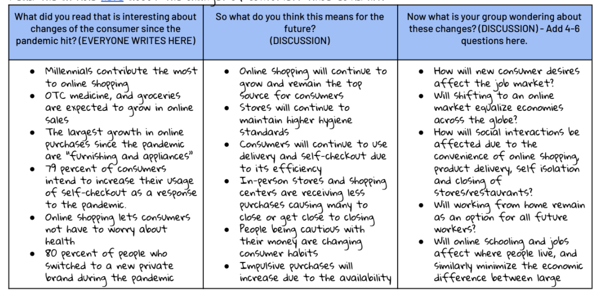
Group Example

Slide 21
Participant Chat (SEL):
How has Covid-19 changed your spending behavior?

Slide 22
Part 3: Extensions
How can students continue to discuss consumer changes?
Student choice
Online Discussion and Digital Webquests
Relevance

Slide 23
Online Discussions
1. Post the assignment online.
2. Select a podcast to listen to.
3. Answer the question with a quote.
4. Pose an open-ended question with a quote.
5. Write the question online and respond twice.

Slide 24
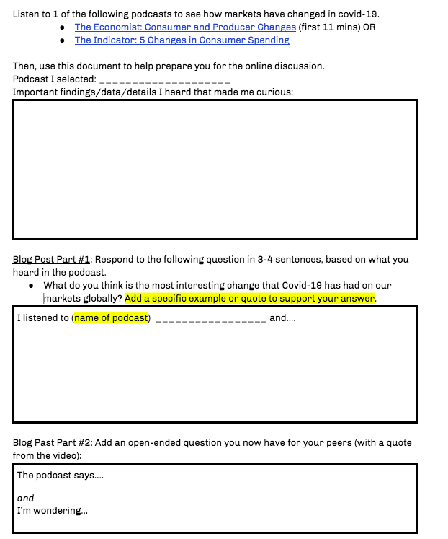
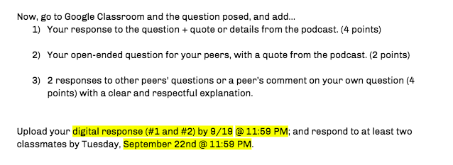
Discussion Template

Slide 25
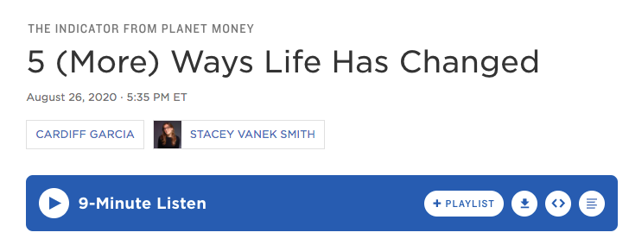
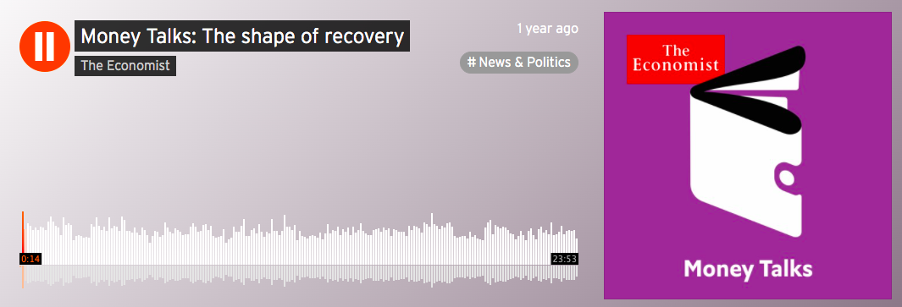
Podcast Choices
Notes:
5 More Ways: https://www.npr.org/2020/08/26/906346251/5-more-ways-life-has-changed

Slide 26
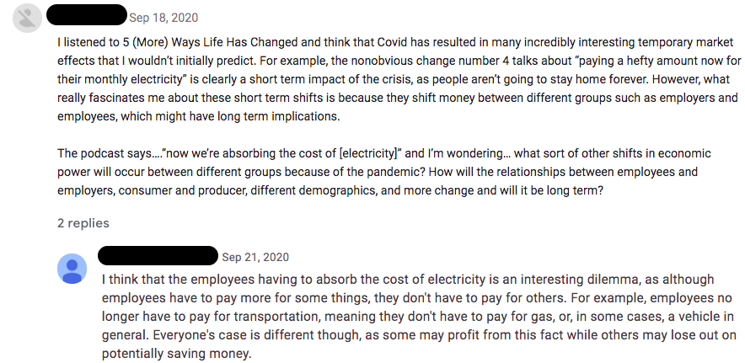
Example Online Discussion

Slide 27
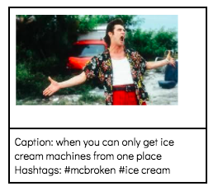
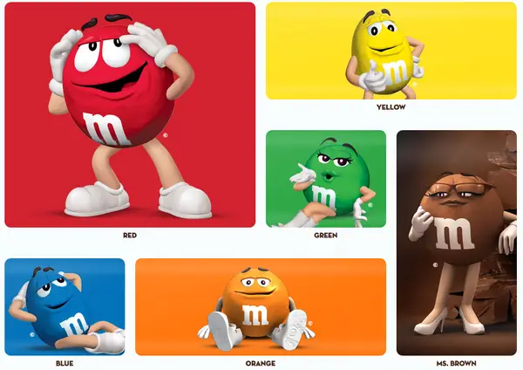
M&M Webquest
1. Post an article for students to read about consumer spending changes.
2. Have students write the main idea in 4-5 sentences.
3. Have students create their own Meme with a hashtag as a take-away.

Slide 28
Review
Strategies for Integrating Consumer Behavior Changes
Warm Ups
Image
Polls
Article + Reflection
Discussion Prompts
Pre-Thinking Brainstorming
Article Analysis Discussion
Extension Activities
Online Discussion
M + M
SEL Ideas
Covid-19 Hobby
Personal Spending Changes

Slide 29
Reflect
How can you use these ideas in your classroom?
Chat

Slide 30
References
Unsplash Photos
BBC: The Psychology of Panic Buying
McKinsey: The Great Consumer Shift
The Economist: Money Talks
The Indicator: 5 More Ways Life Has Changed
McKinsey - Consumer Behaviors Today
Bloomberg: Consumer Hoarding

Slide 31
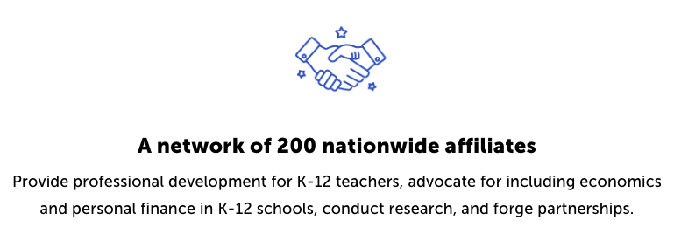
CEE Affiliates
https://www.councilforeconed.org/resources/local-affiliates/

Slide 32
Thank You to Our Sponsors!

