Slide 1
COVID Isolation Abroad: Economic Lessons from Barbados
Presented by Amanda Stiglbauer
January 18, 2022
astiglbauer@richland2.org

Slide 2
Agenda
Welcome and Introductions
Background - the Play-by-Play
Comparisons to Other Travel Destinations
Economic Lessons Learned
Inquiry Questions to Ponder
Question and Answer Session

Slide 3

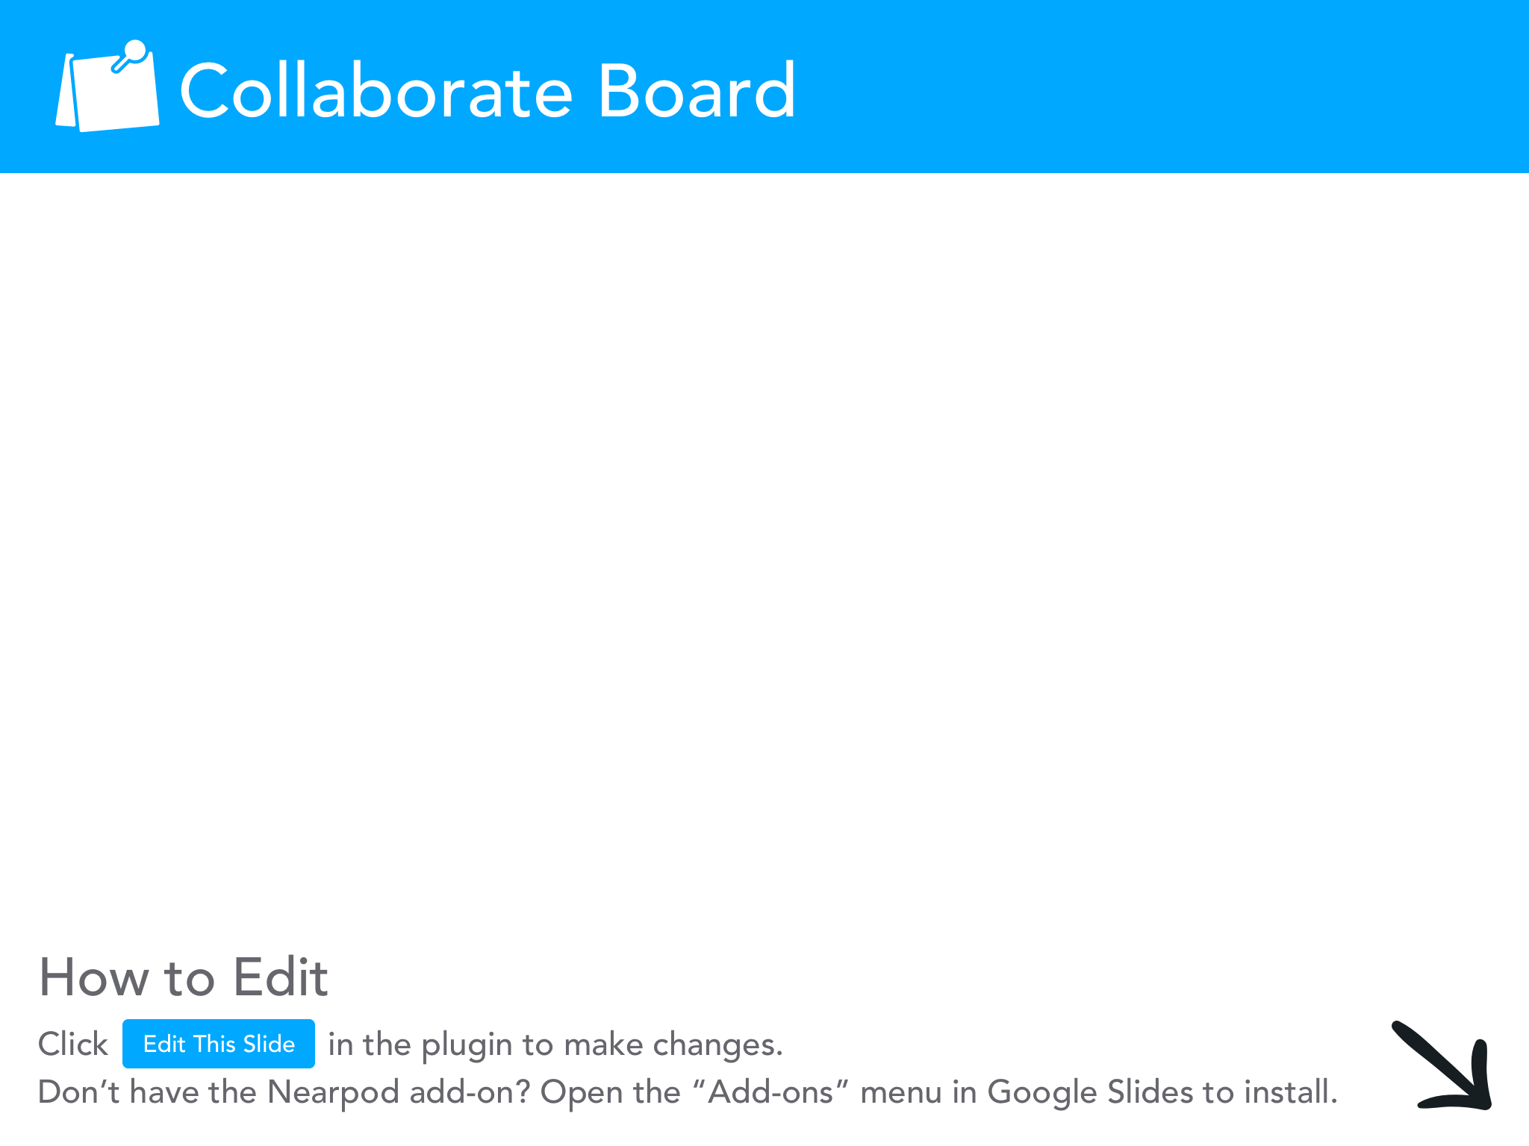

Slide 4
National Standards
National Standards for Economics
Role of Government and Market Failure Standard: 16
Students will understand that: There is an economic role for government in a market economy whenever the benefits of a government policy outweigh its costs. Governments often provide for national defense, address environmental concerns, define and protect property rights, and attempt to make markets more competitive. Most government policies also have direct or indirect effects on people's incomes.

Slide 5

Objectives
I can:
describe COVID isolation and quarantine policies in different countries.
evaluate the economic impact of being isolated in a foreign country due to COVID 19.

Slide 6
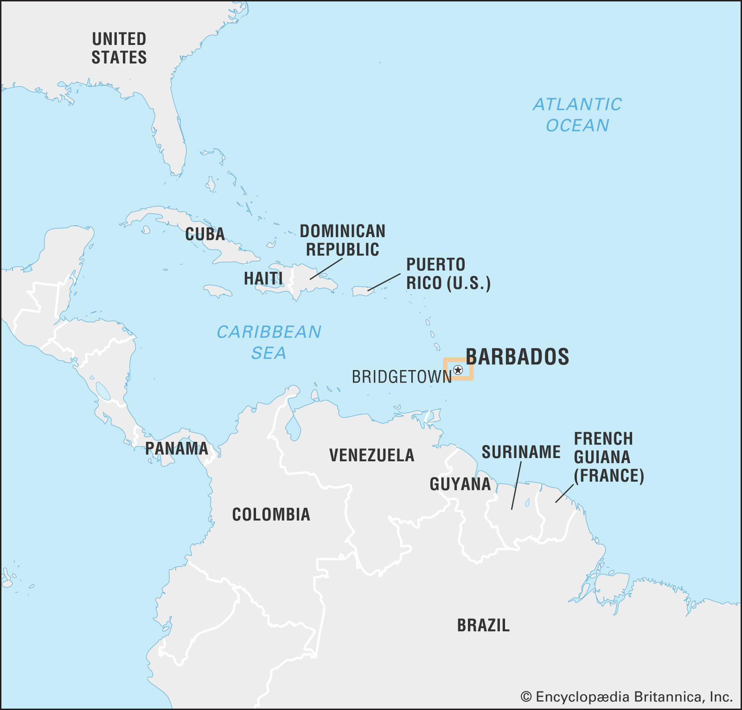
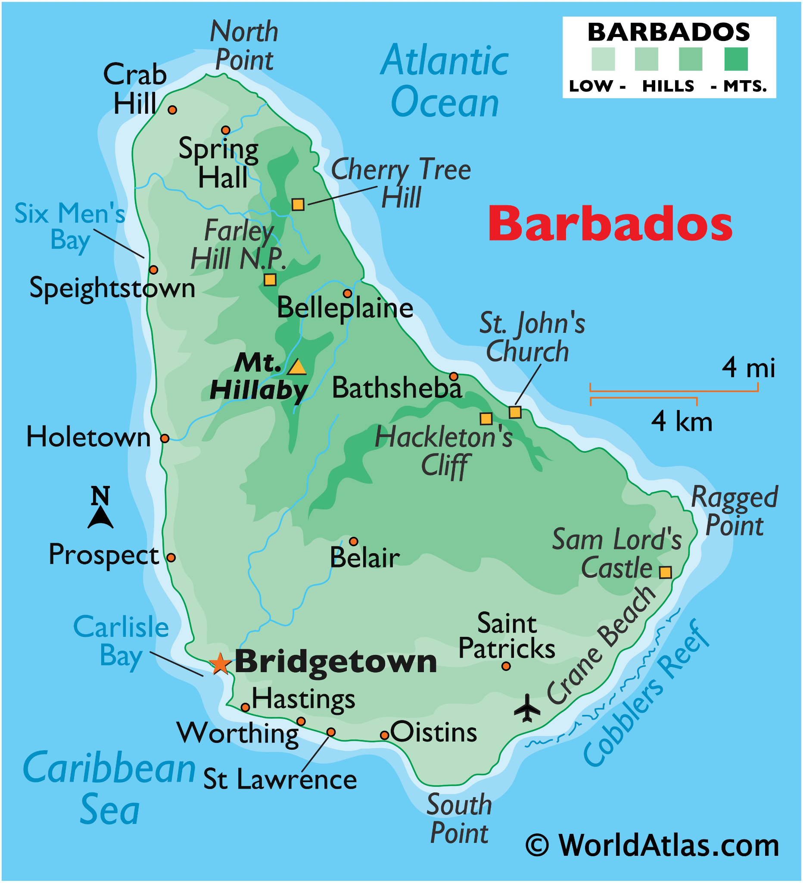
Where is Barbados?

Slide 7
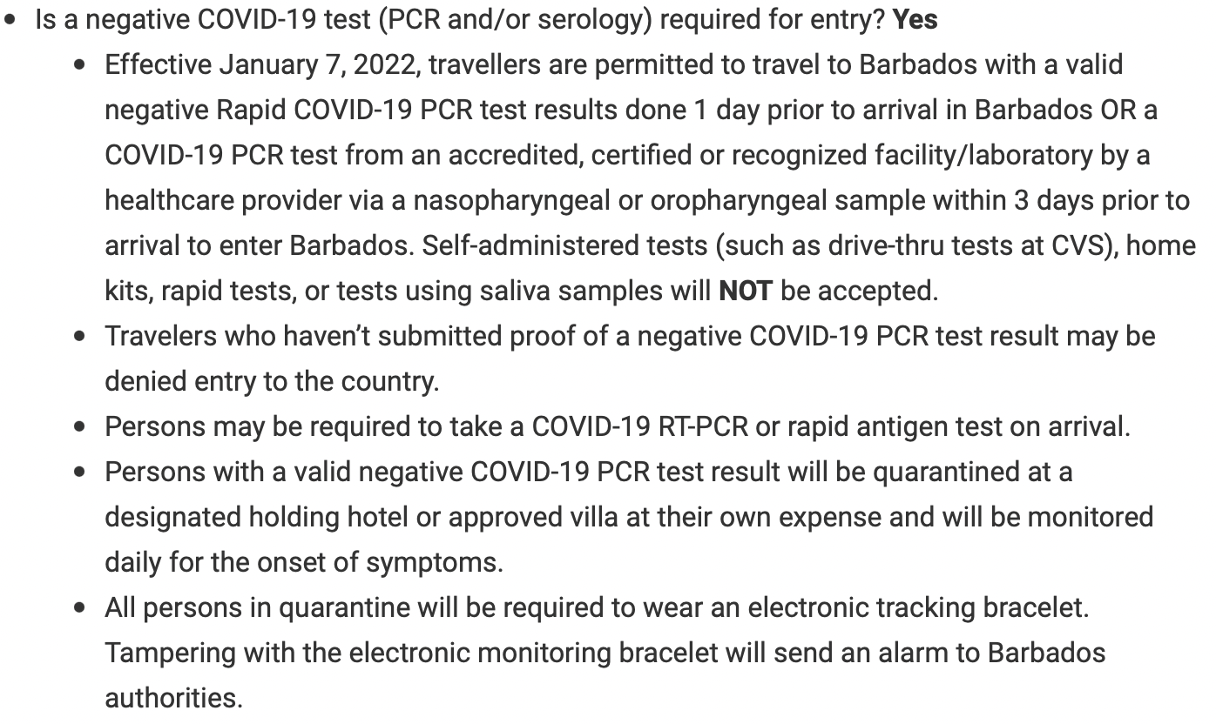
Entry Requirements
Source: U.S. Embassy

Slide 8
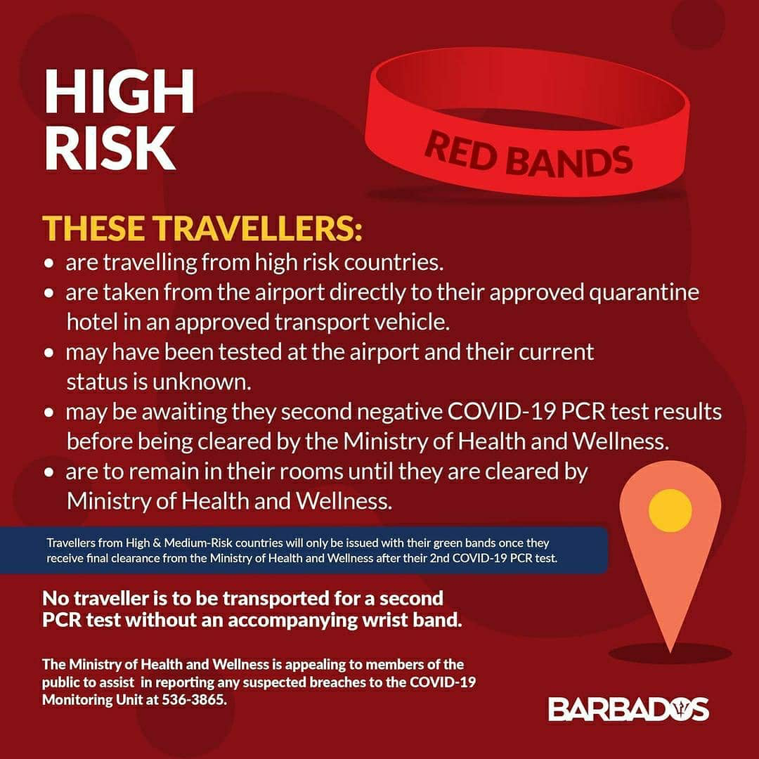

Armband Tracking
Red
Orange
Yellow
Green
Notes:
https://barbados.loopnews.com/content/what-you-need-know-about-colour-coded-armband-system-travellers

Slide 9
Comparison to Other Travel Destinations
St. Kitts and Nevis - Only fully vaccinated travelers
Mexico (Cancun)- “You will pass the COVID test”

Slide 10
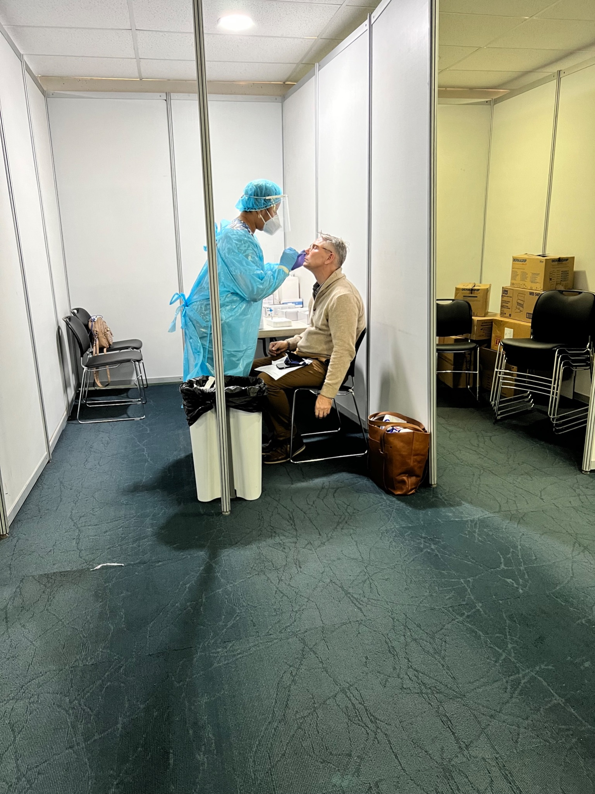
1st Stop
Airport COVID LAB!
Why? We had our negative PCR Results!
One day quarantine until results emailed from lab

Slide 11
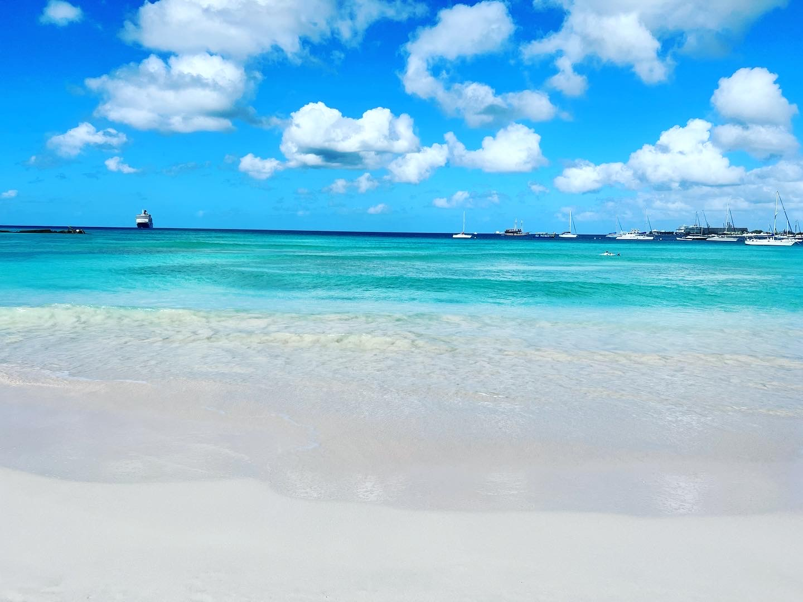
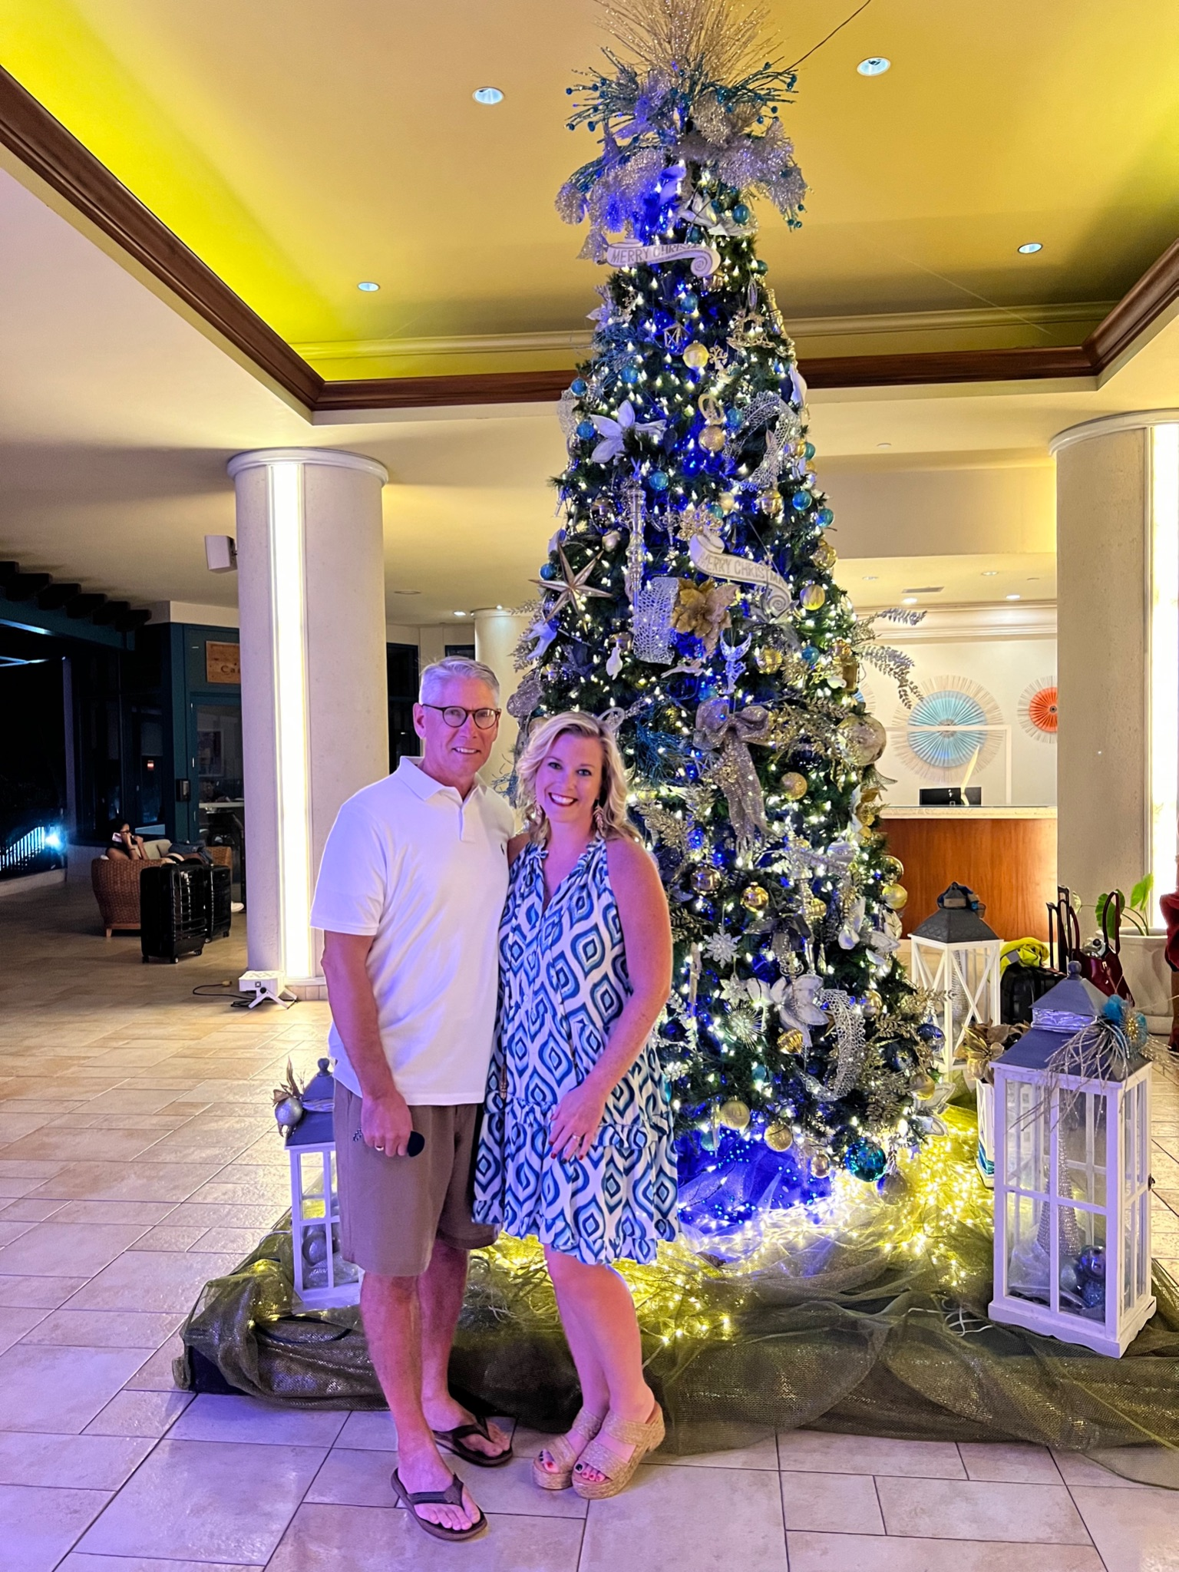
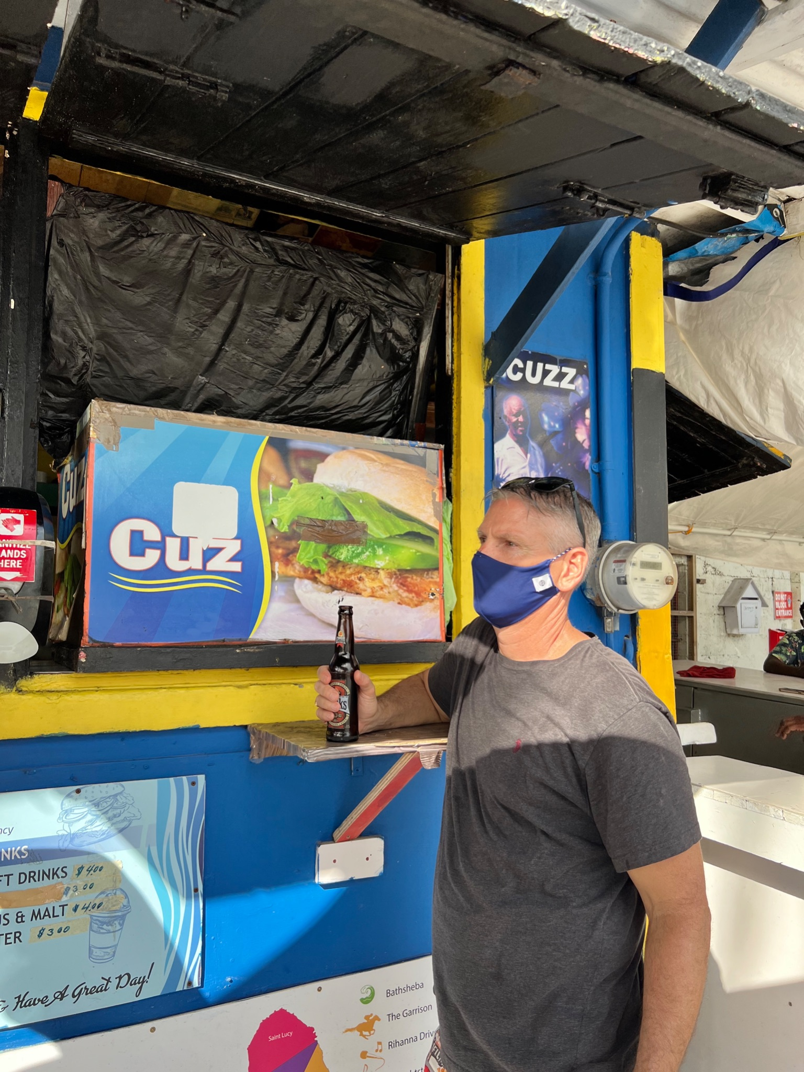


Slide 12
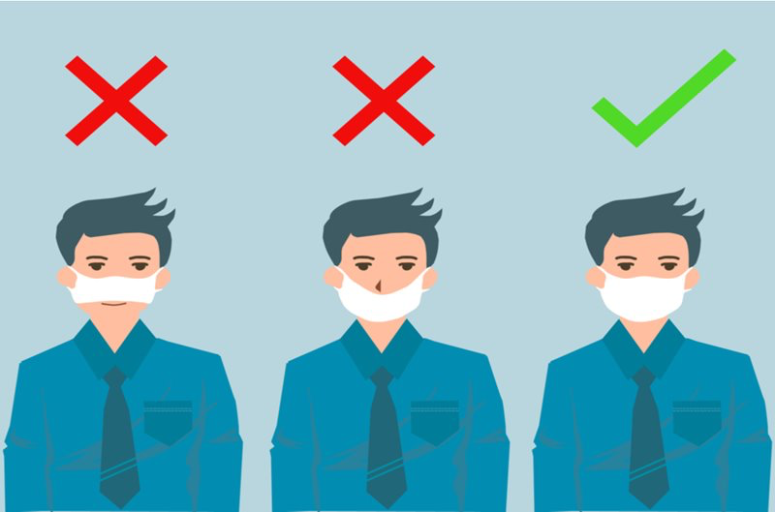
Mask wearing was serious business

Slide 13
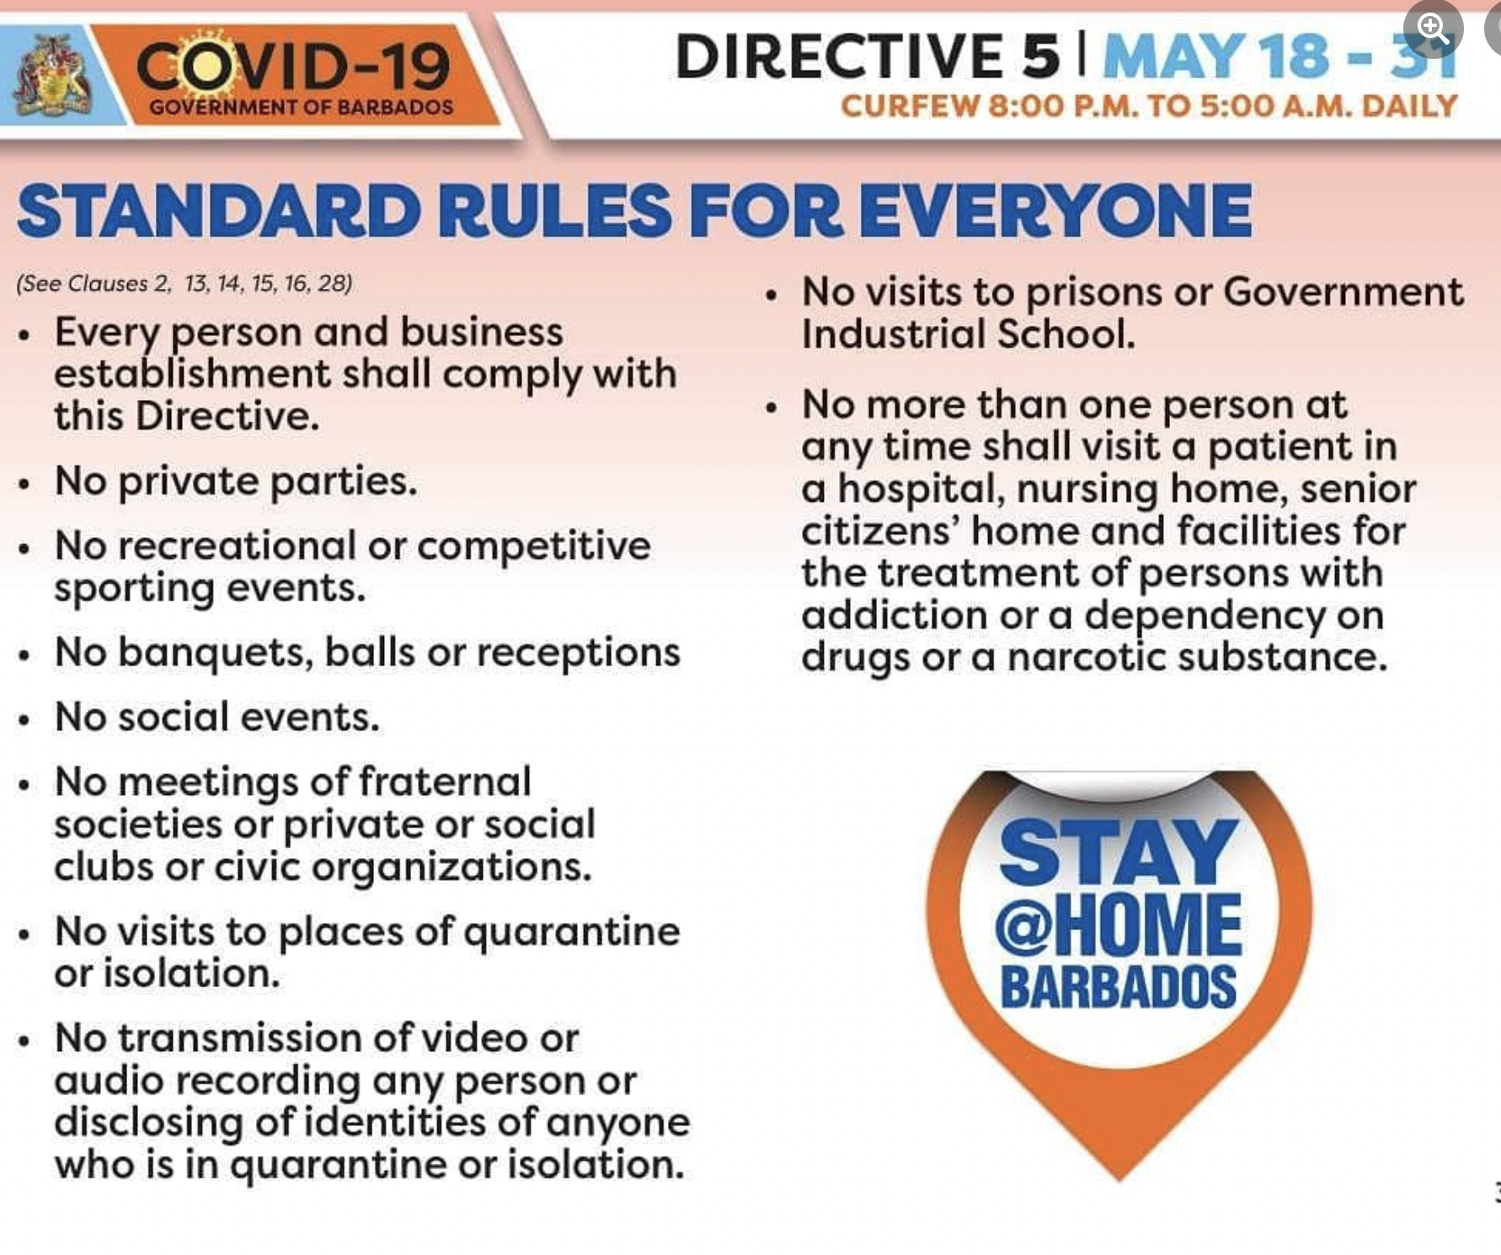

Slide 14
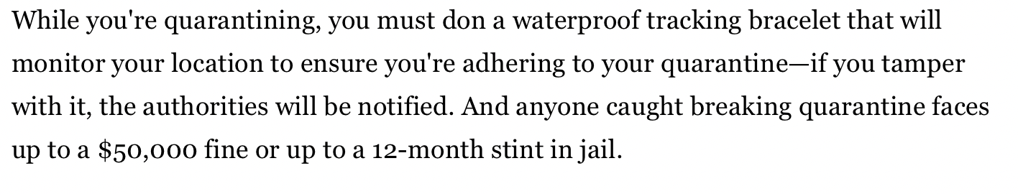
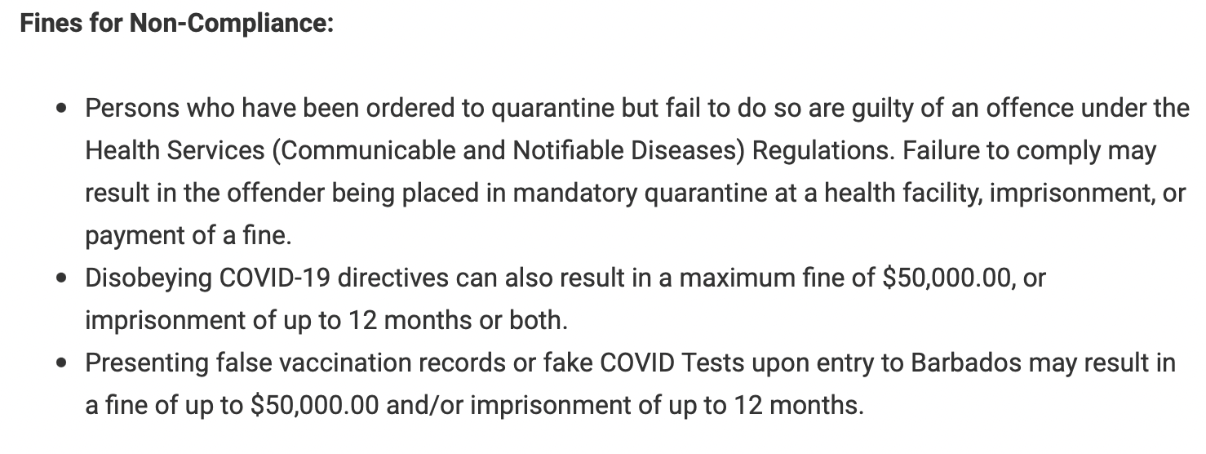

Slide 15


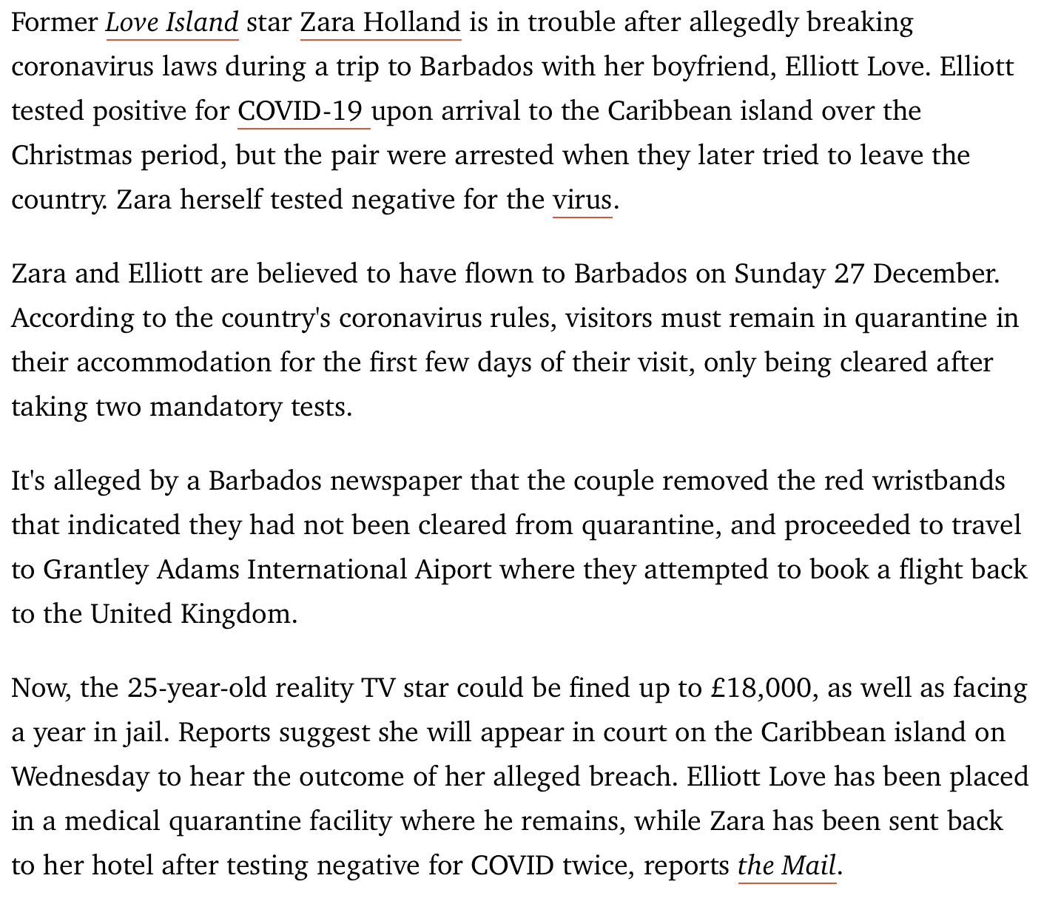

Slide 16
Isolation Facility
“We will come get you.”

Slide 17
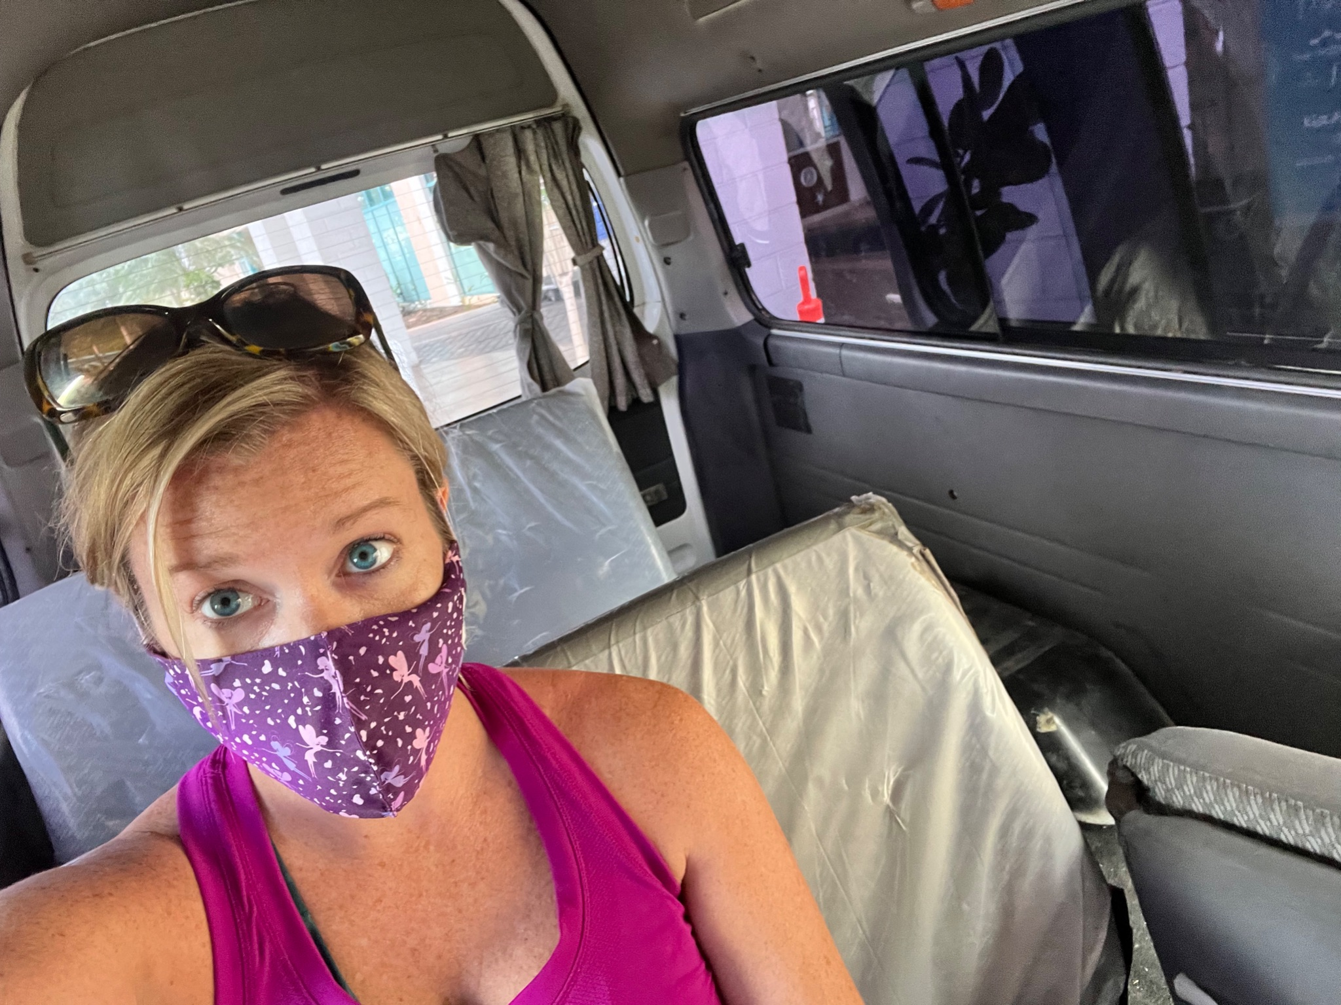
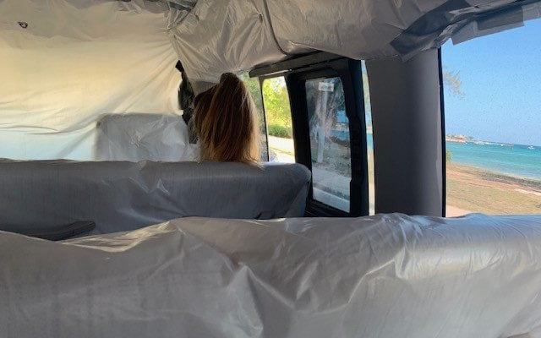

Slide 18
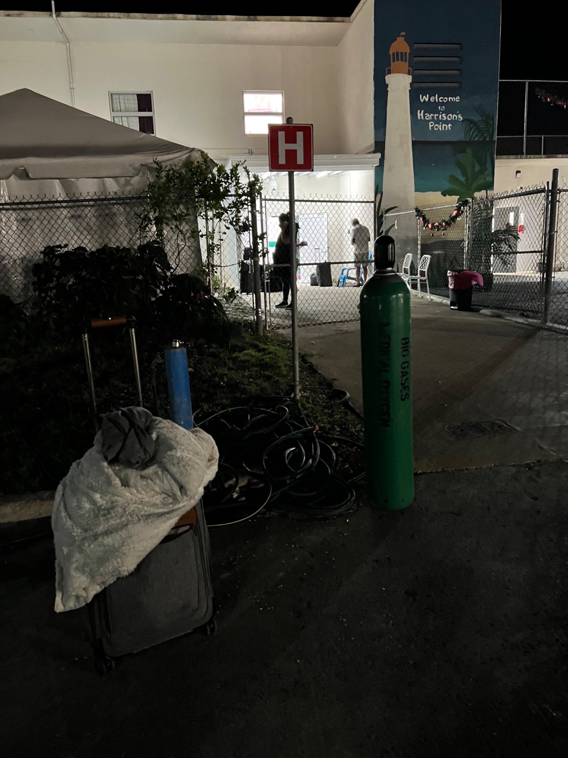

Conditions at the Isolation Facility
Notes:
https://metro.co.uk/2021/02/12/brits-describe-prison-camp-conditions-at-barbados-covid-facility-14069497/

Slide 19
Economic Lessons Learned
COVID has taken a toll on economies throughout the world. How they choose to recoup lost revenue differs.
  Welcome Stamp Visa
Public vs. Private Goods/Services
Cost-Benefit Analysis
Price Gouging/Price Discrimination?
Cost of 1st Vacation vs. Cost of Isolation Stay

Slide 20

Burning Question: Is COVID Isolation of Tourists an Economy Booster?

Slide 21
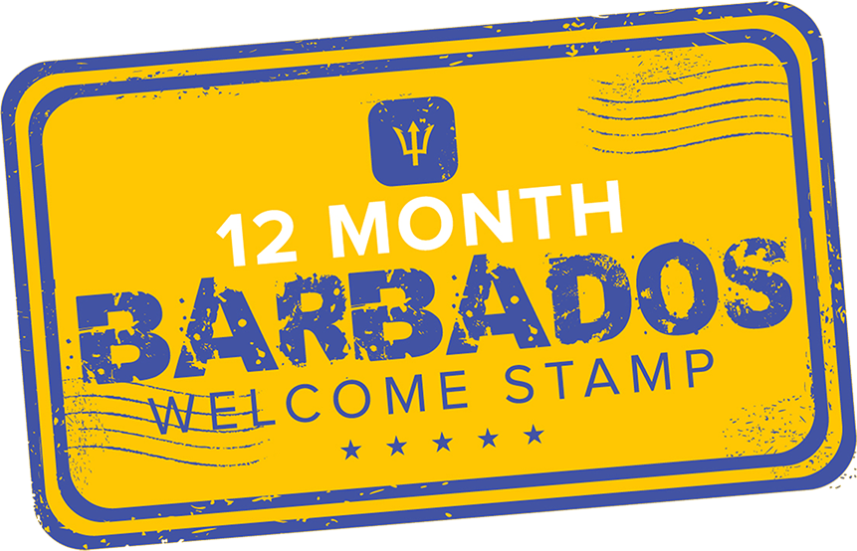

Slide 22
Public (Isolation) Facility vs. Private Isolation Hotel
Public
-No charge
-8-10 day stay, depending on condition
-3 meals per day, no charge
Private
-Pay for a hotel that is qualified to accept COVID positive isolation patients
-Find the hotel and have them follow up with doctor
-All other expenses my responsibility

Slide 23
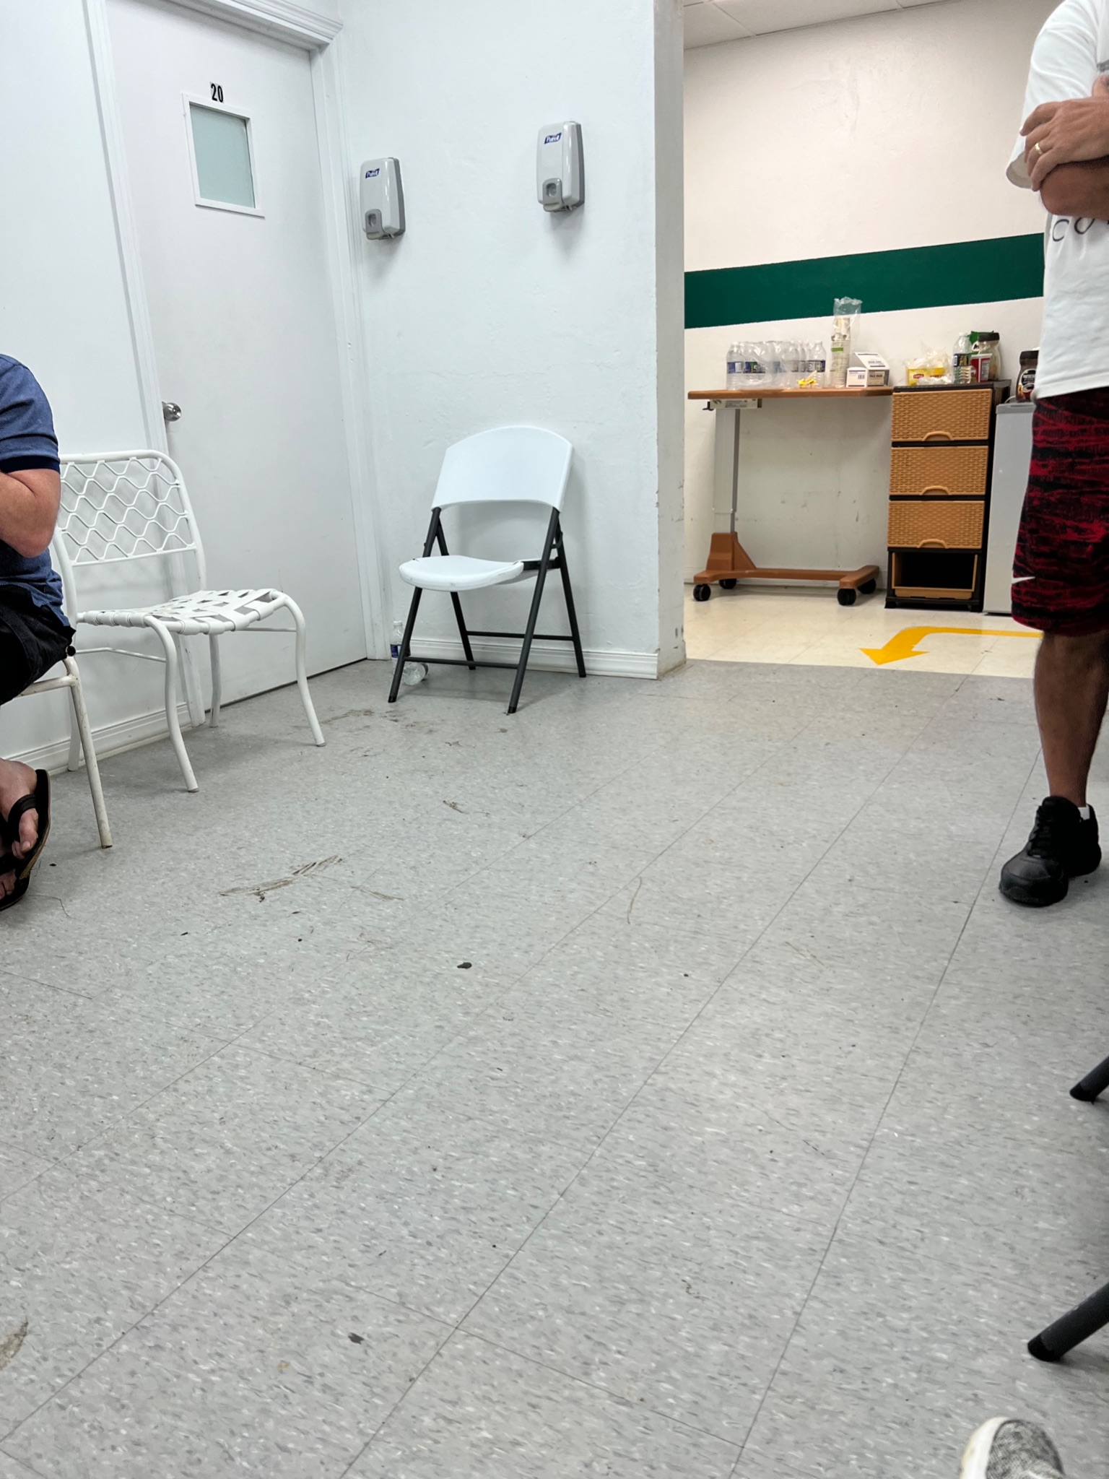
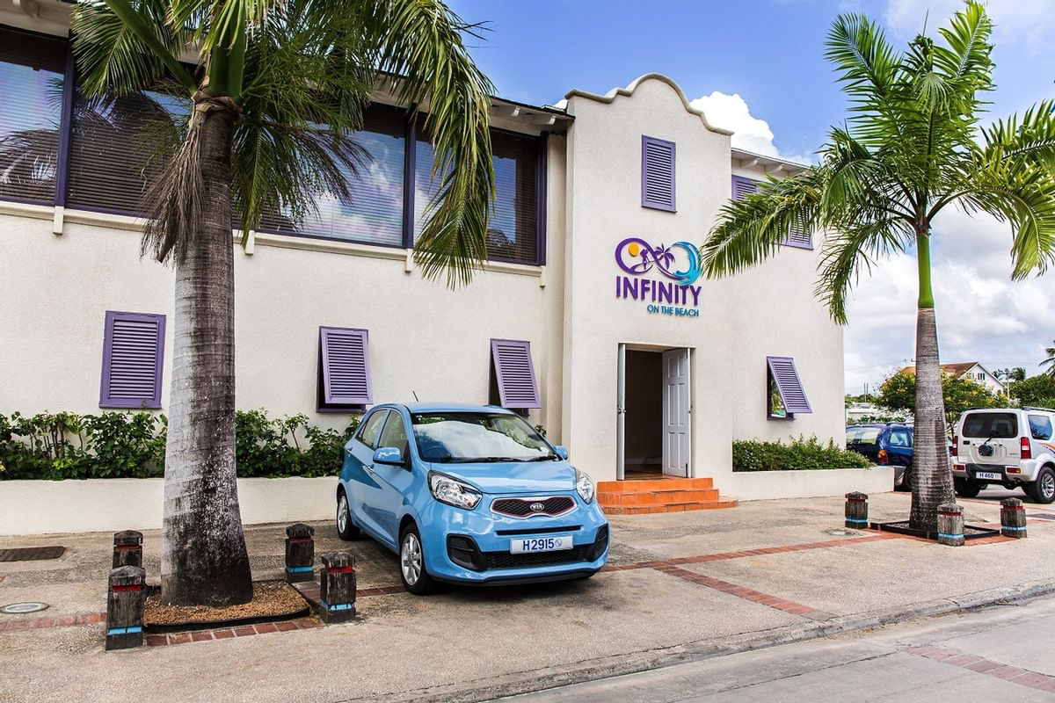
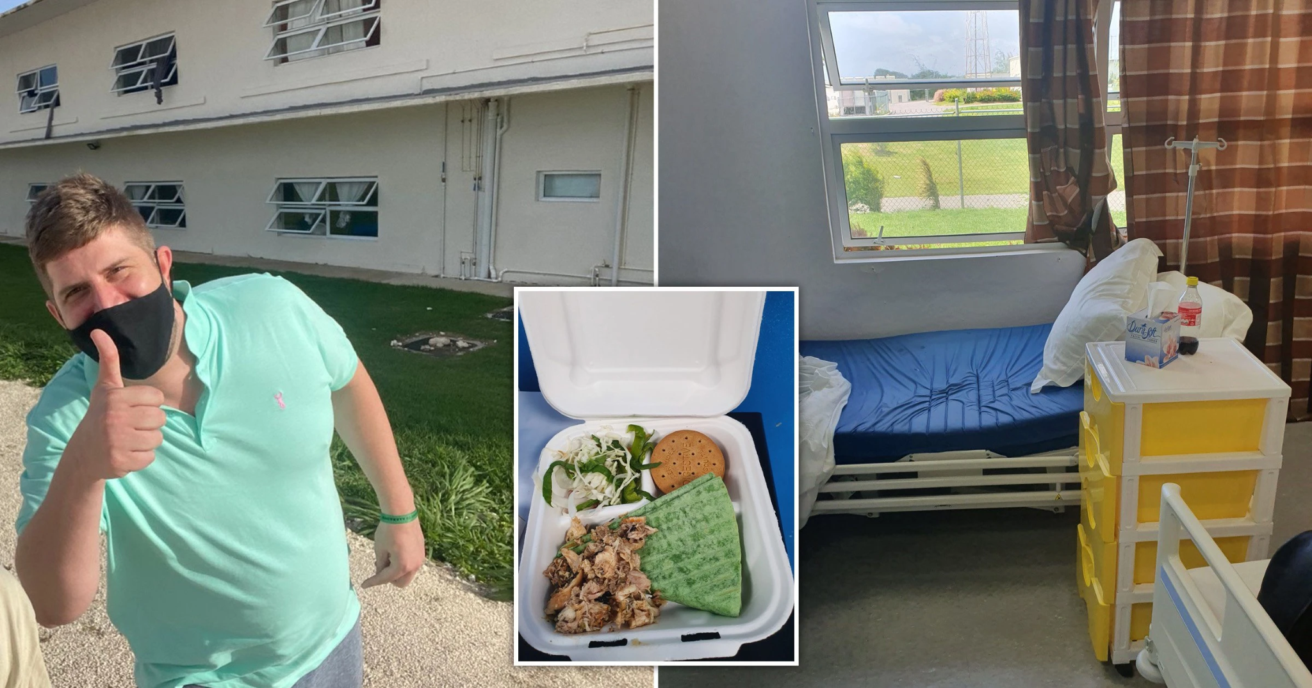

Slide 24
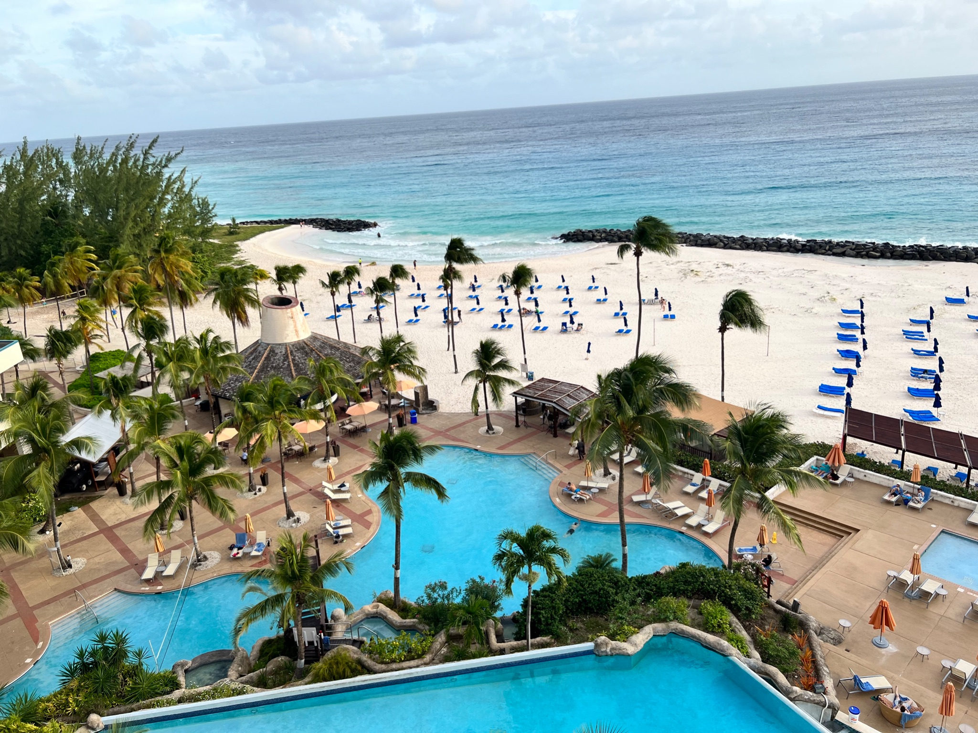
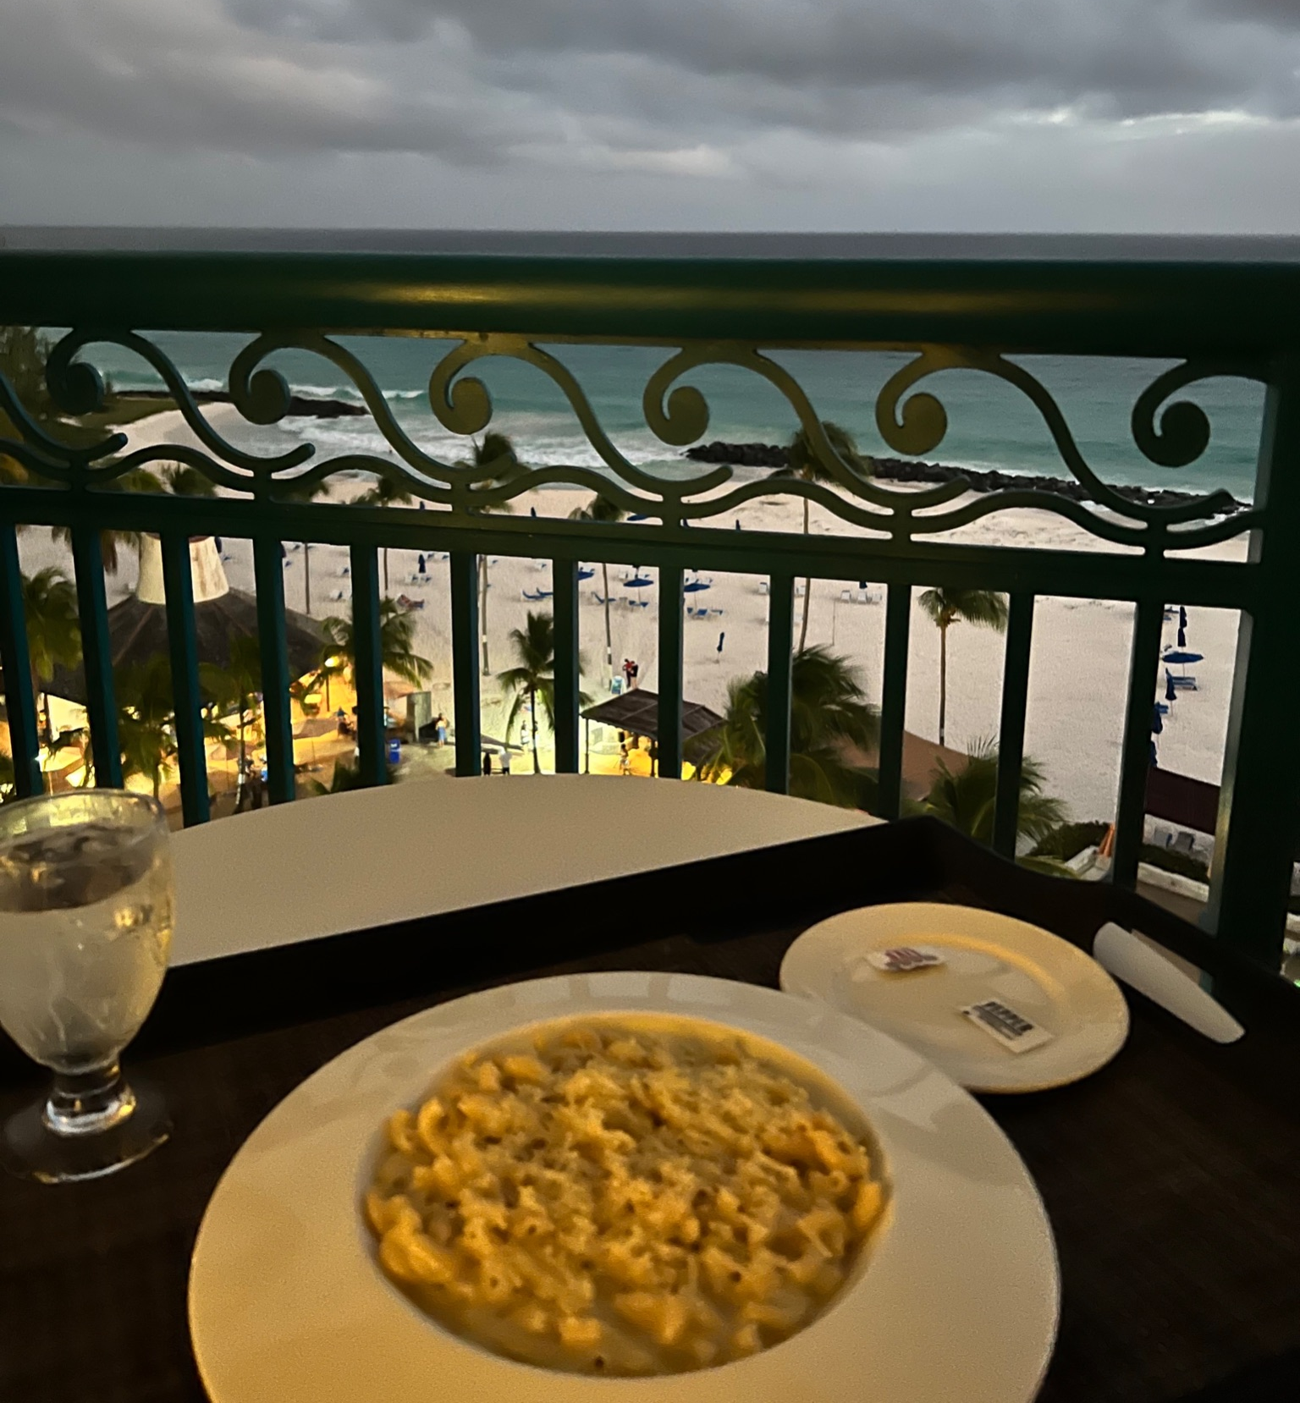
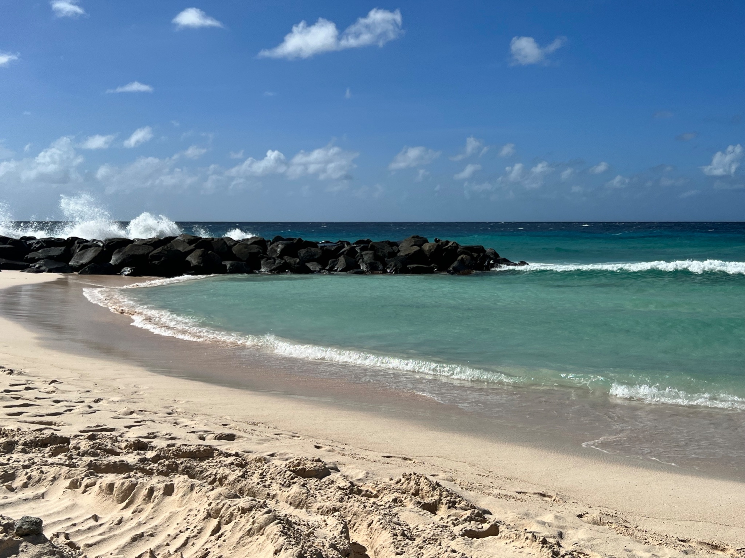
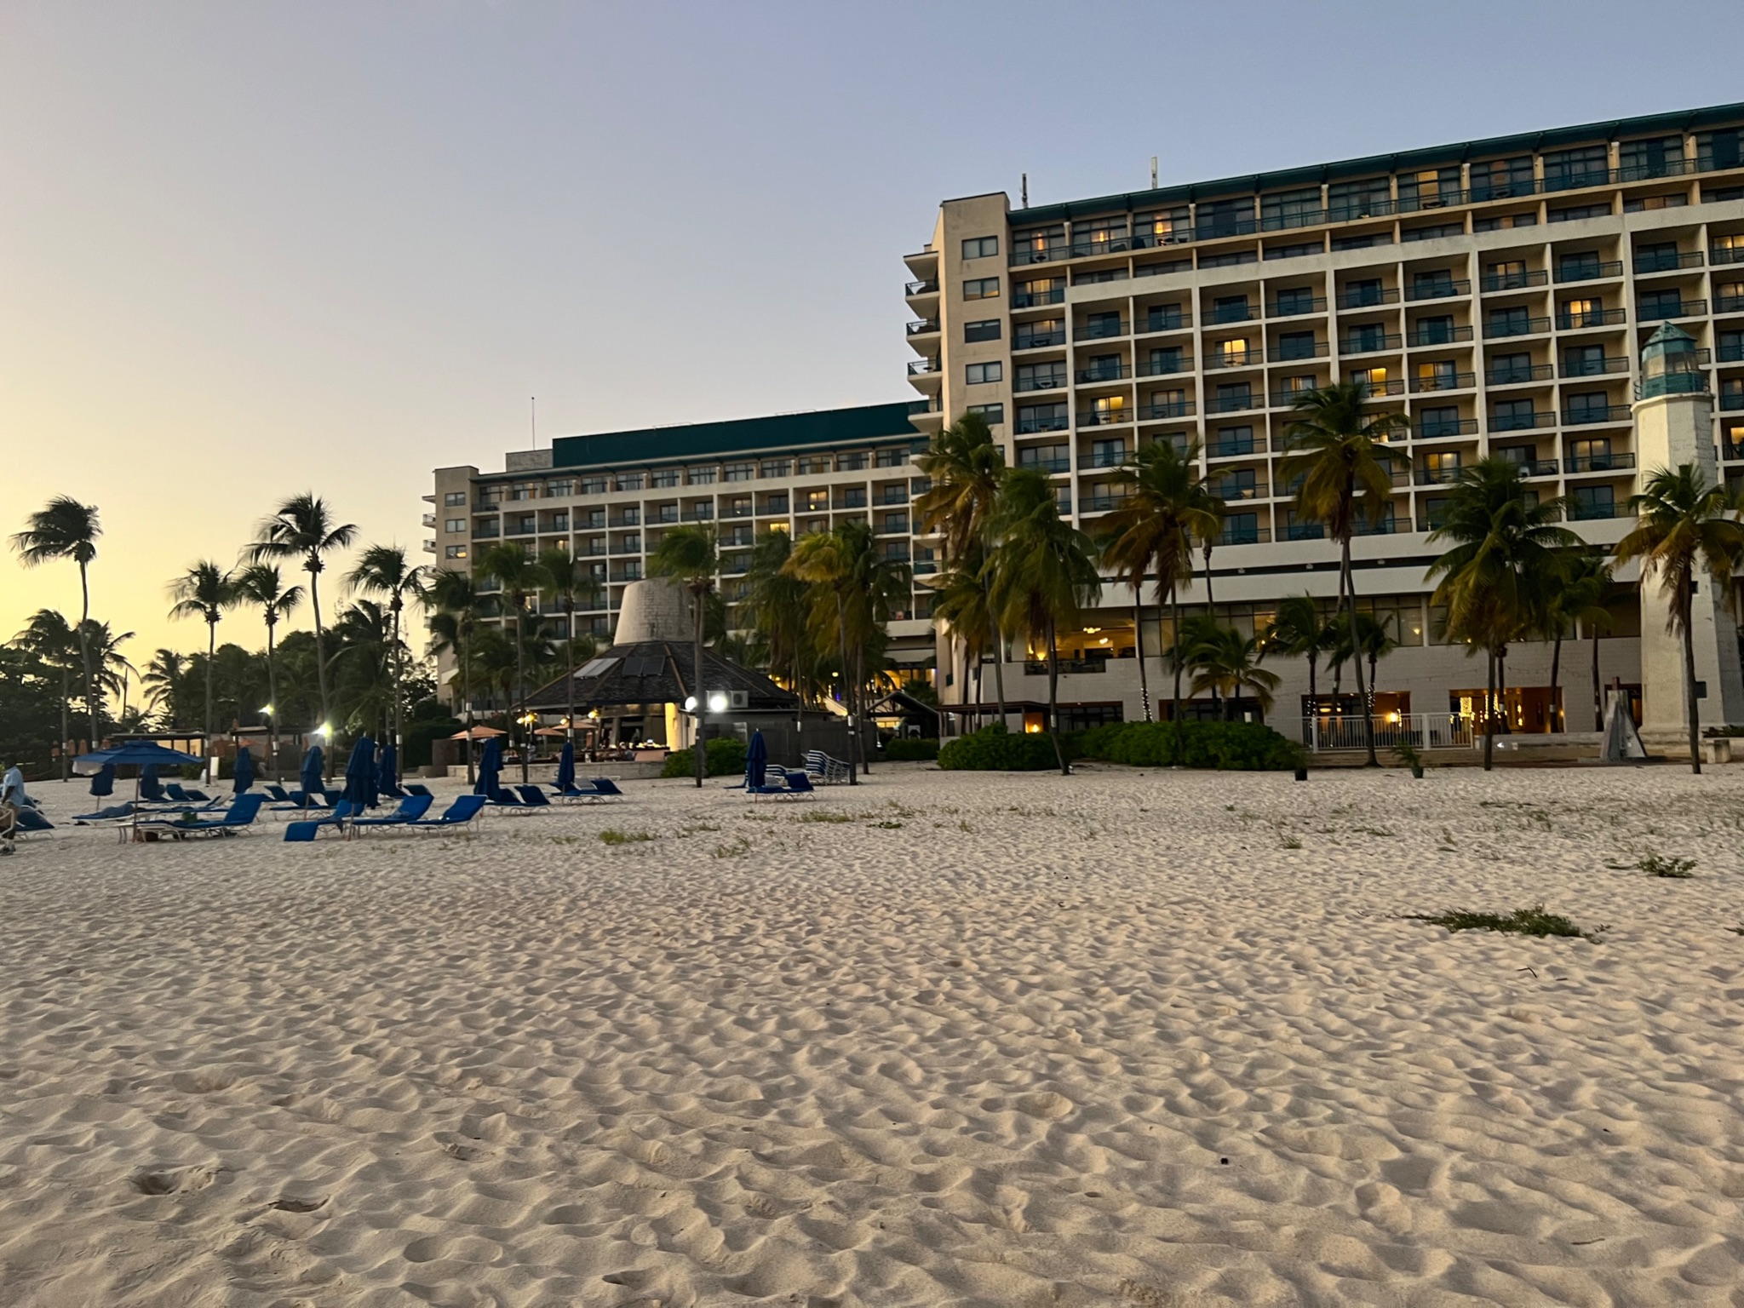

Slide 25
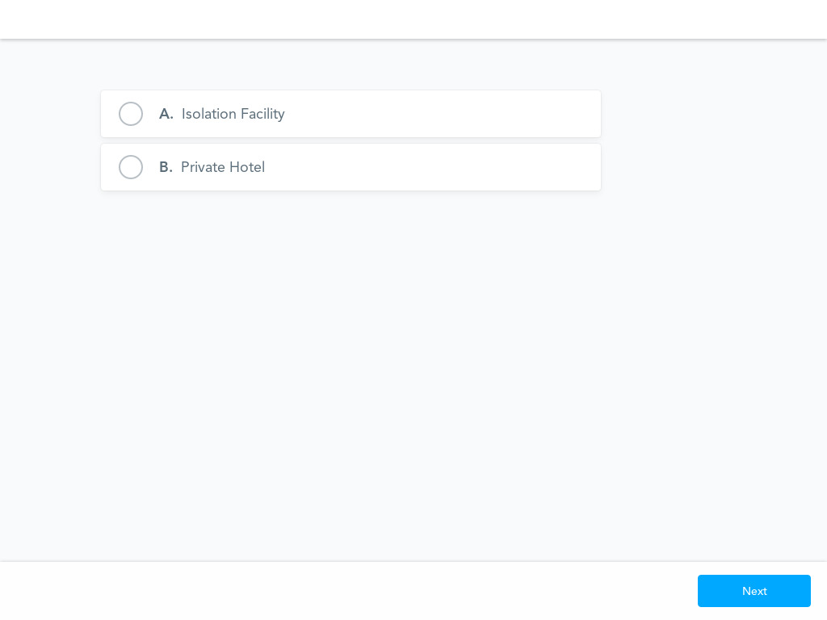
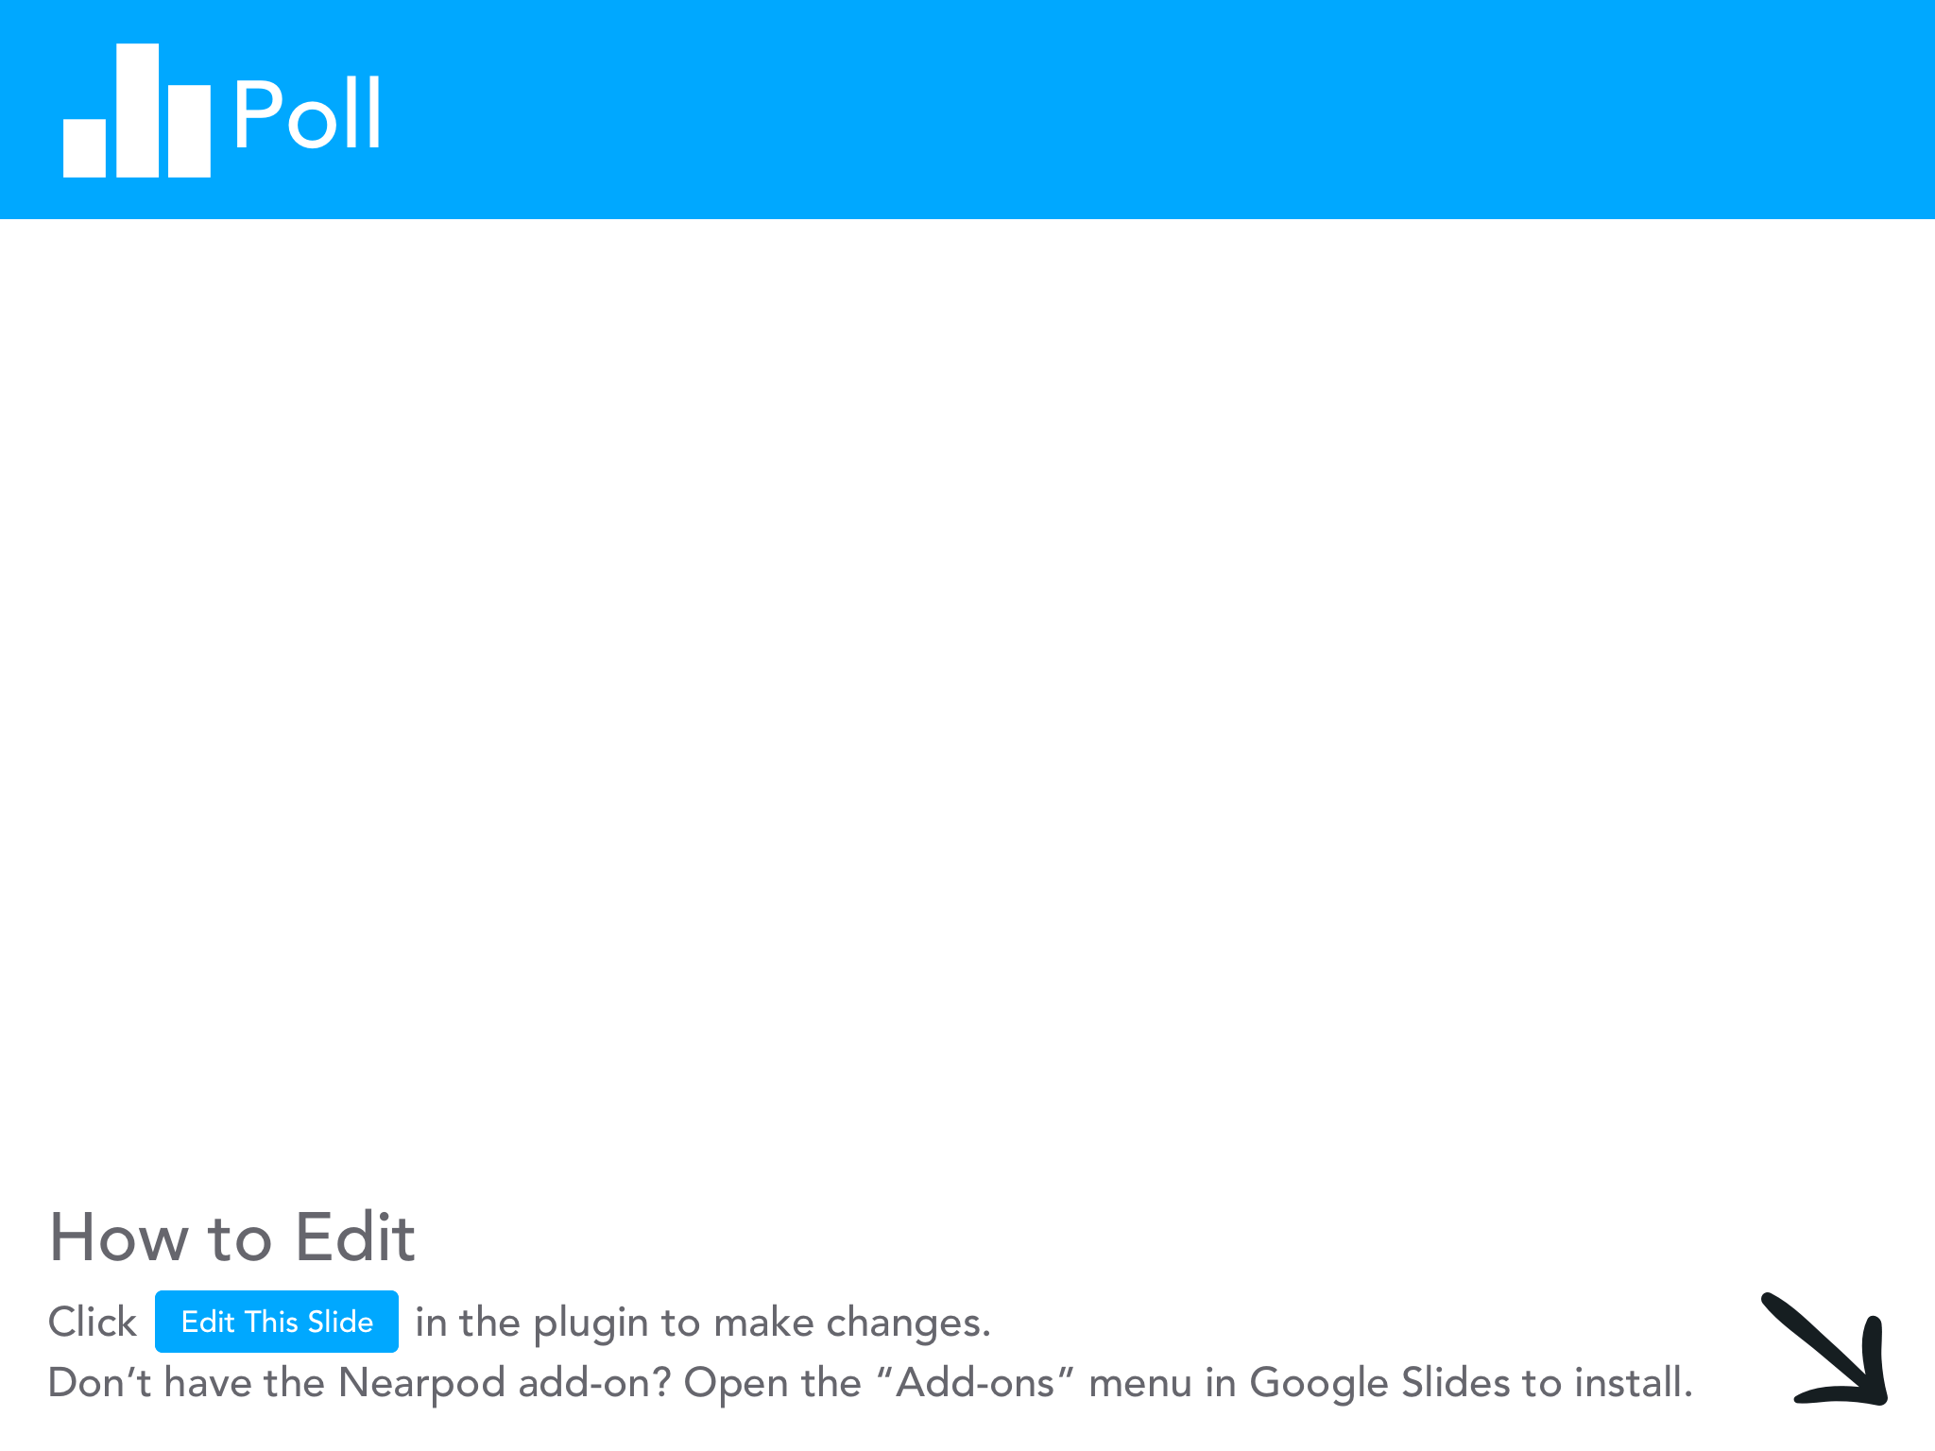

Slide 26
Cost - Benefit Analysis
Public Isolation Facility
vs.
Private Hotel Isolation

Slide 27
Public vs. Private Doctor
Public
-”Free” of course!
-Released after mandatory 14 day isolation
Private
-$200 per visit
-mandatory 2 visits
-$50/test Rapid COVID Antigen test
-Isolation time dependent upon patient. Anywhere from 10-14 days.

Slide 28
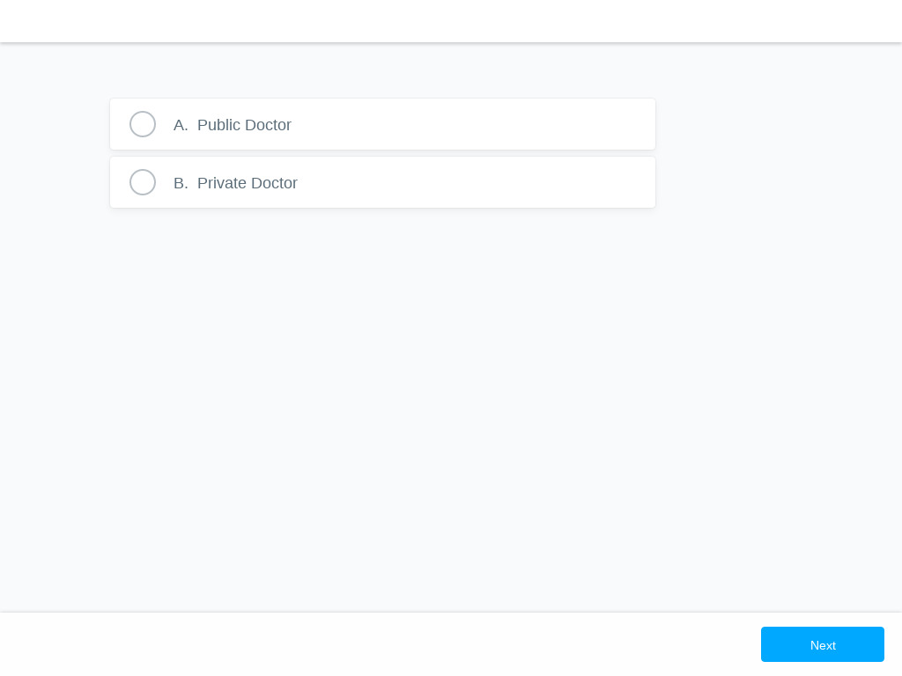

Slide 29
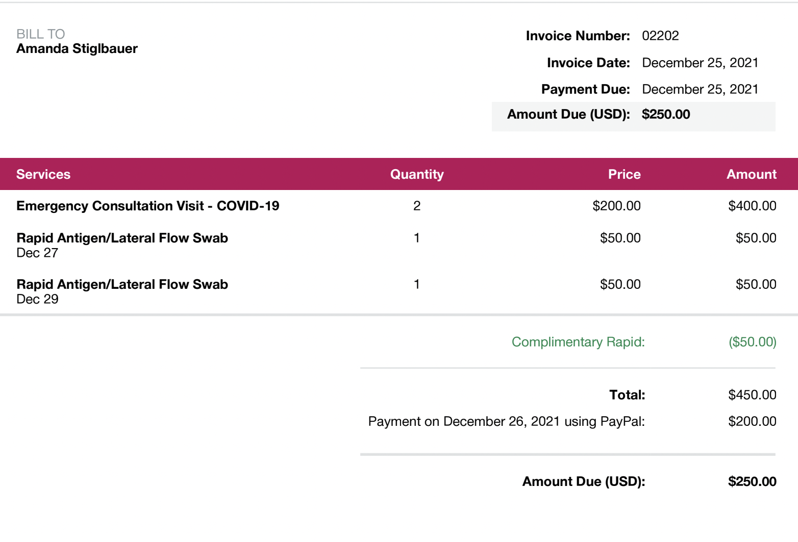

Slide 30
Price Gouging or Price Discrimination?
You decide!

Slide 31
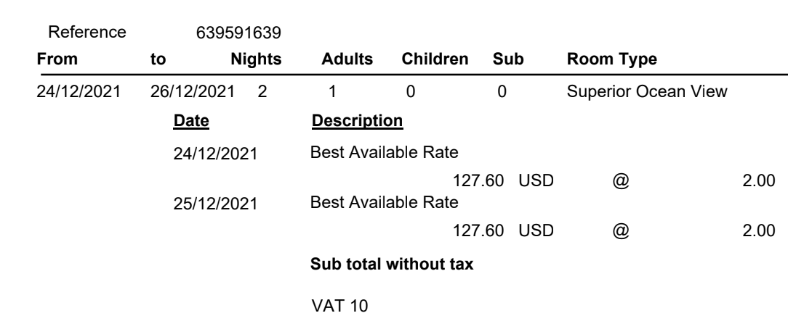
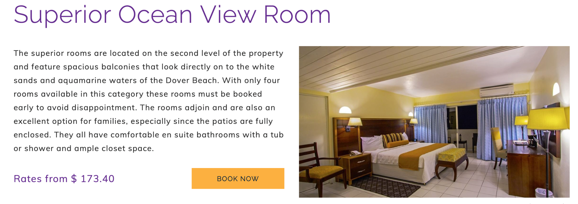
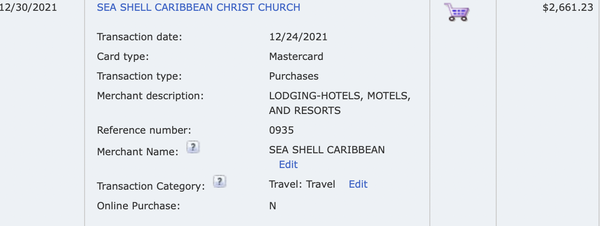
$380/night 7 nights

Slide 32
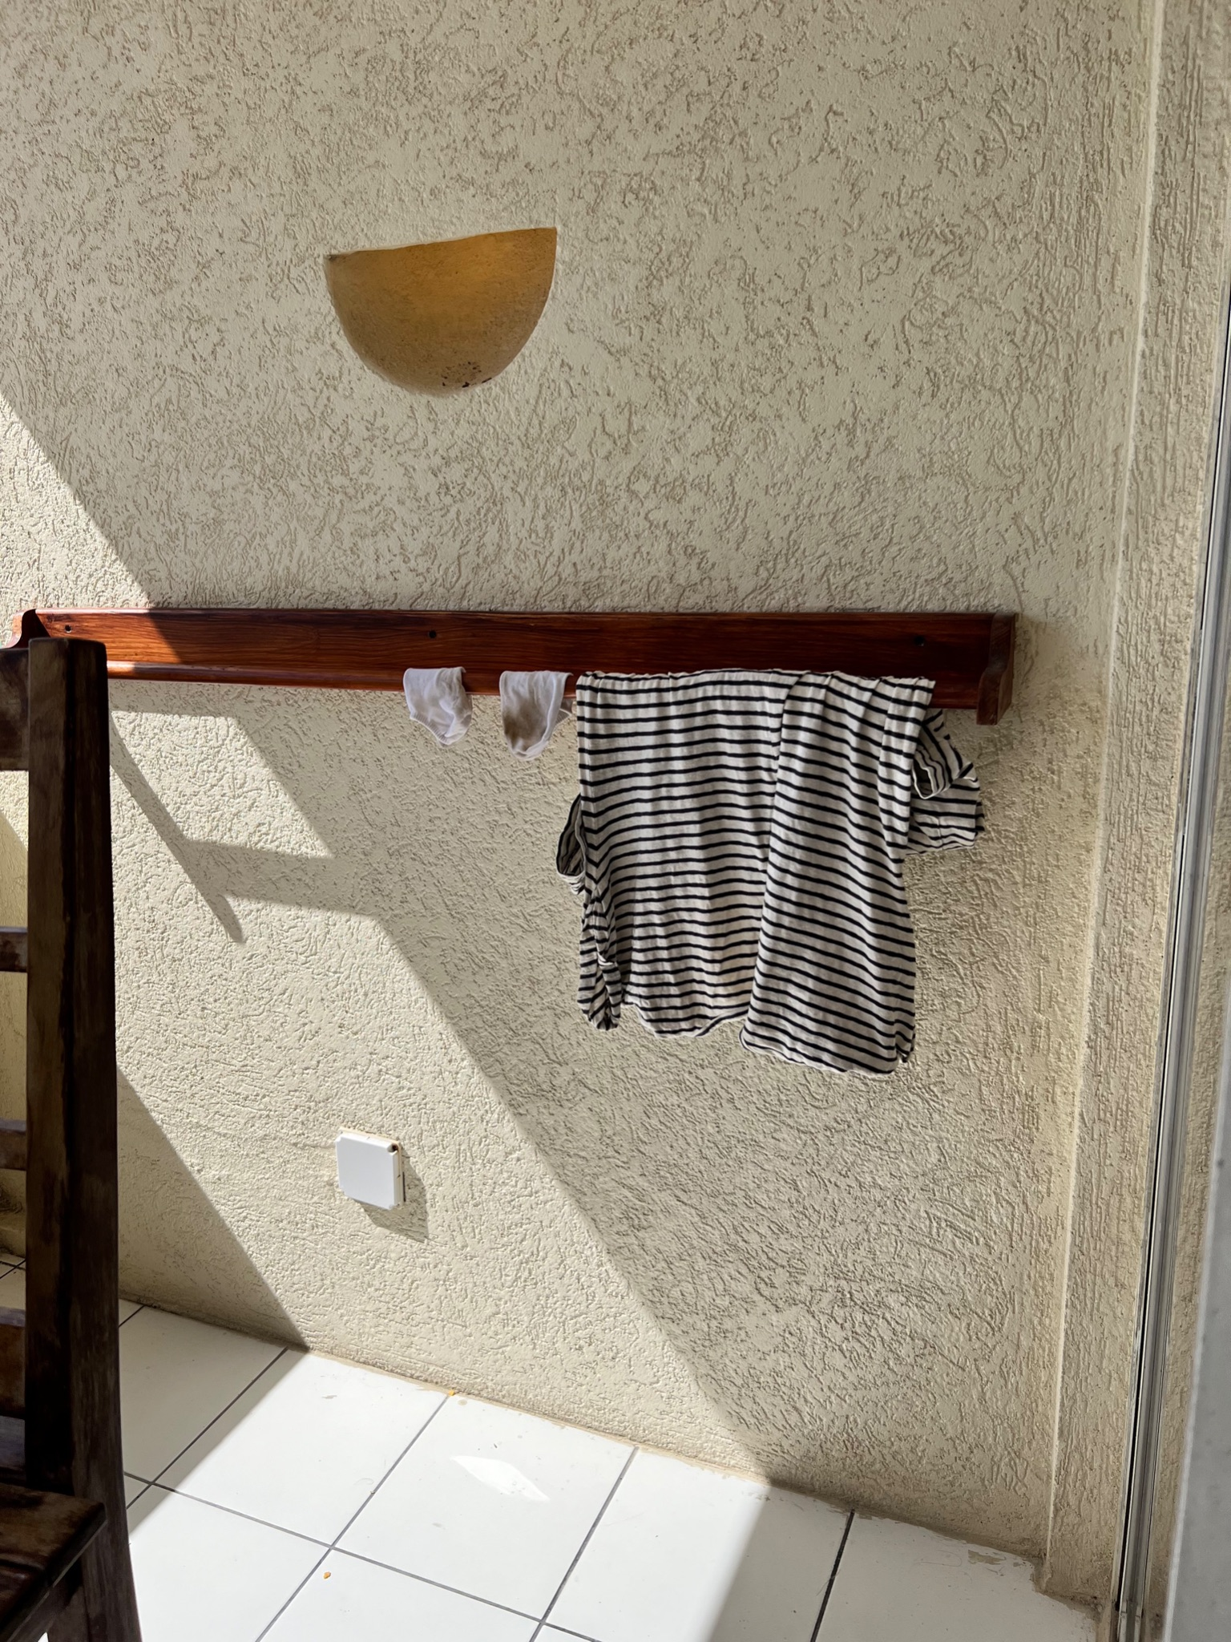
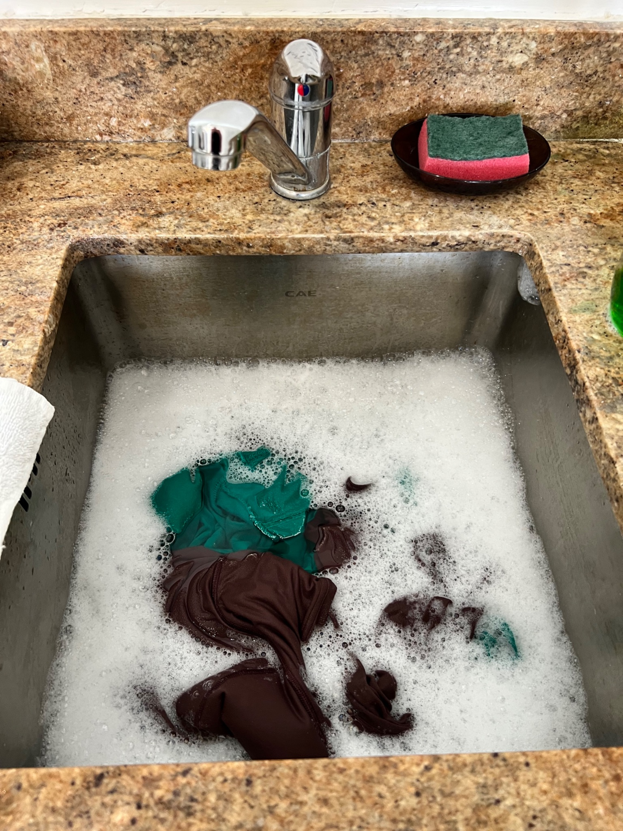

Slide 33
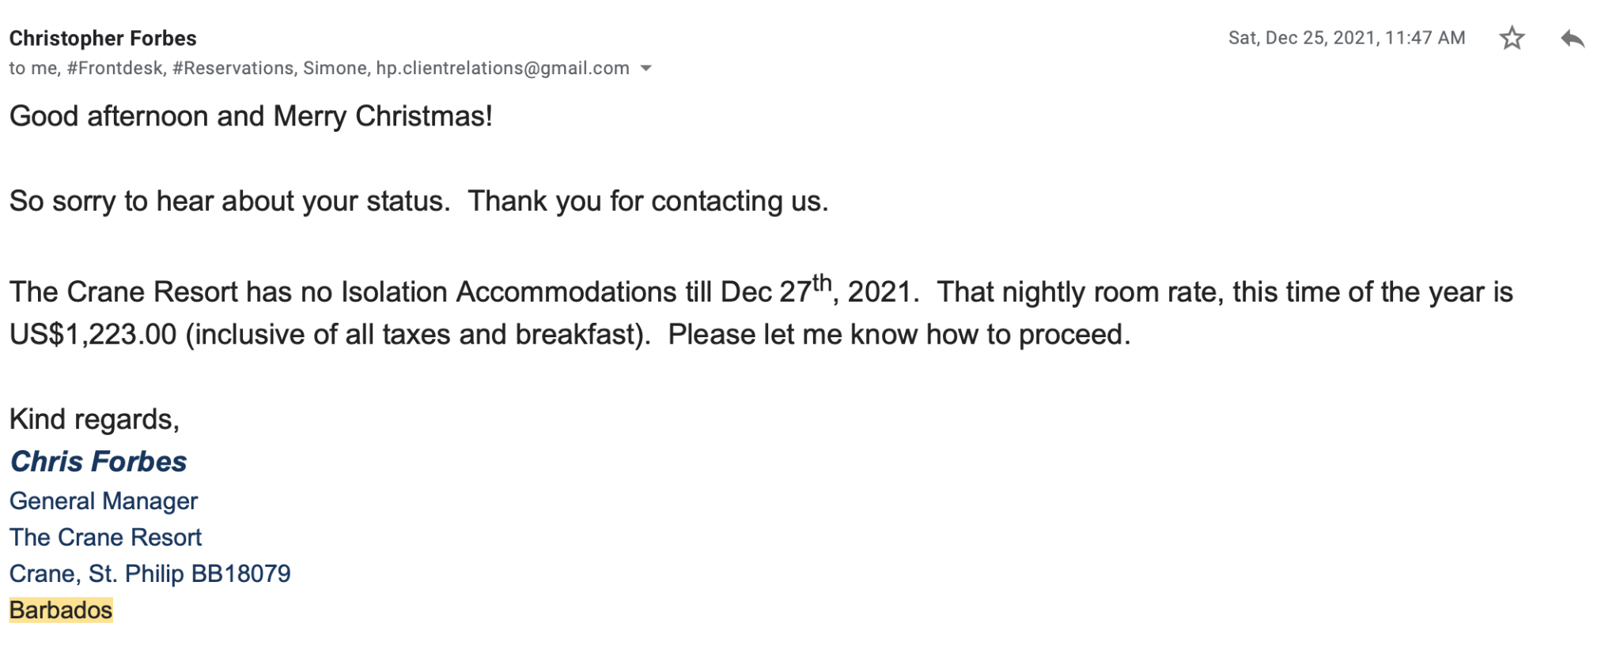


Slide 34
So how did I get off the island?

Slide 35
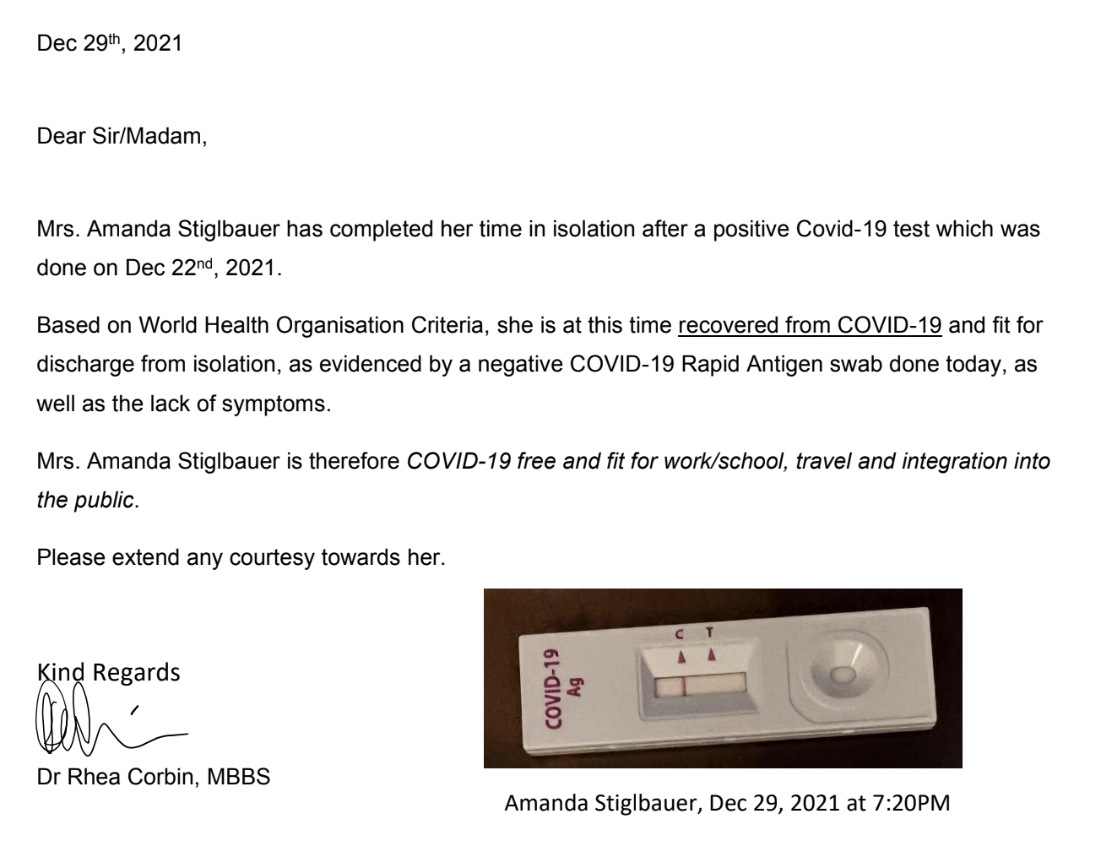

Slide 36
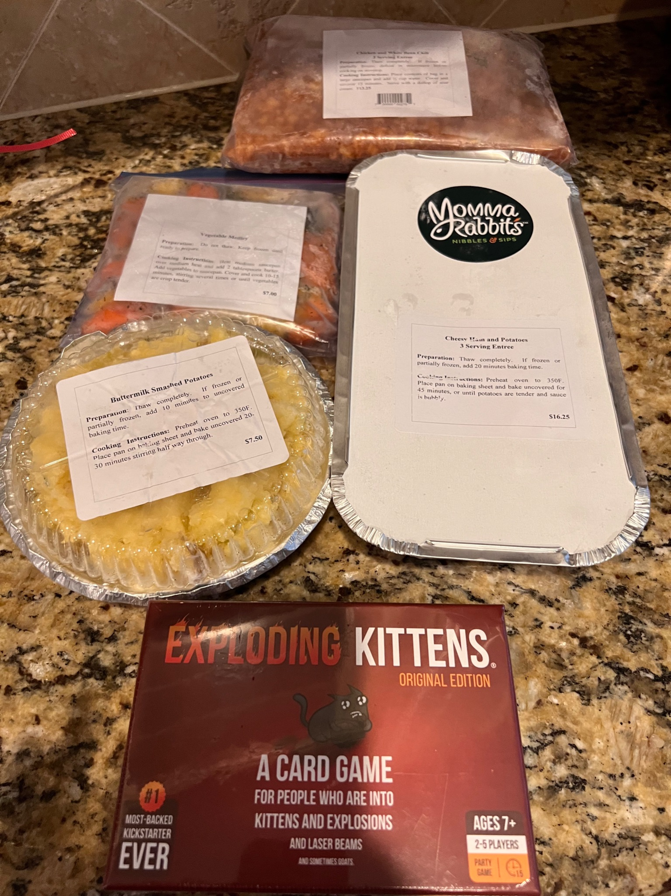
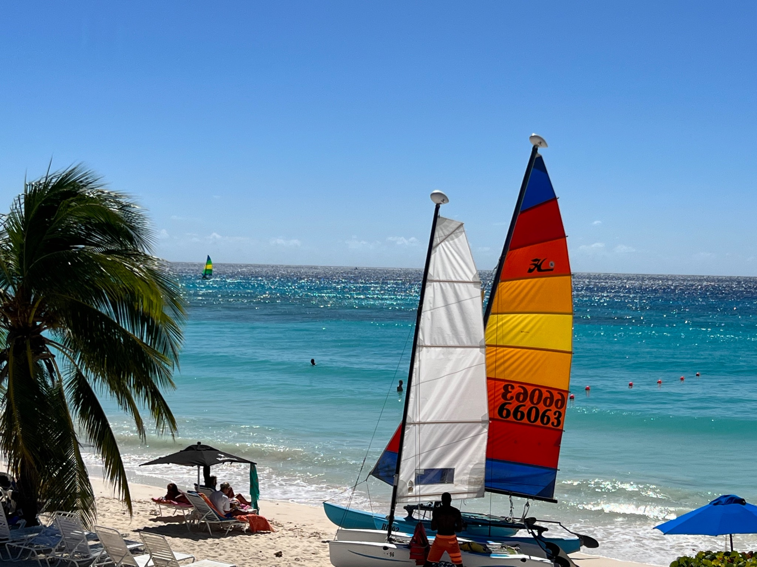
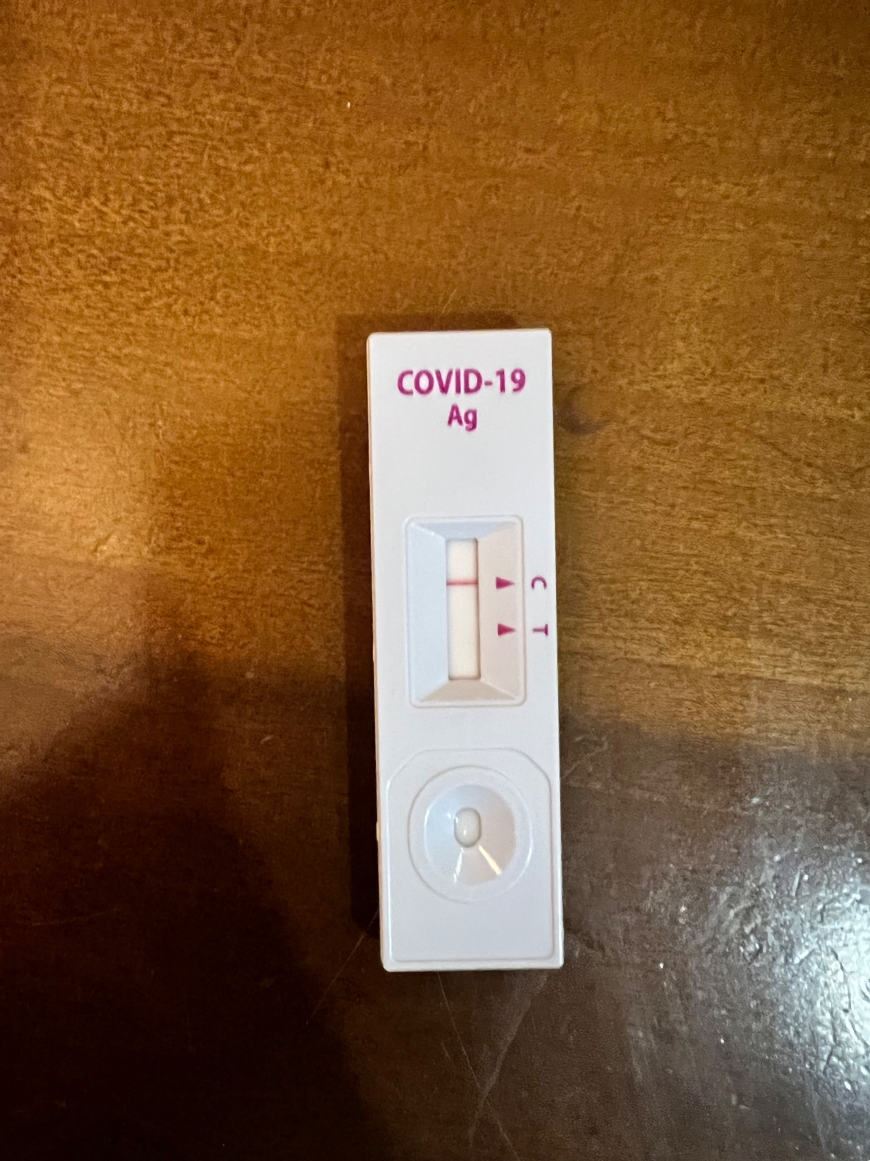
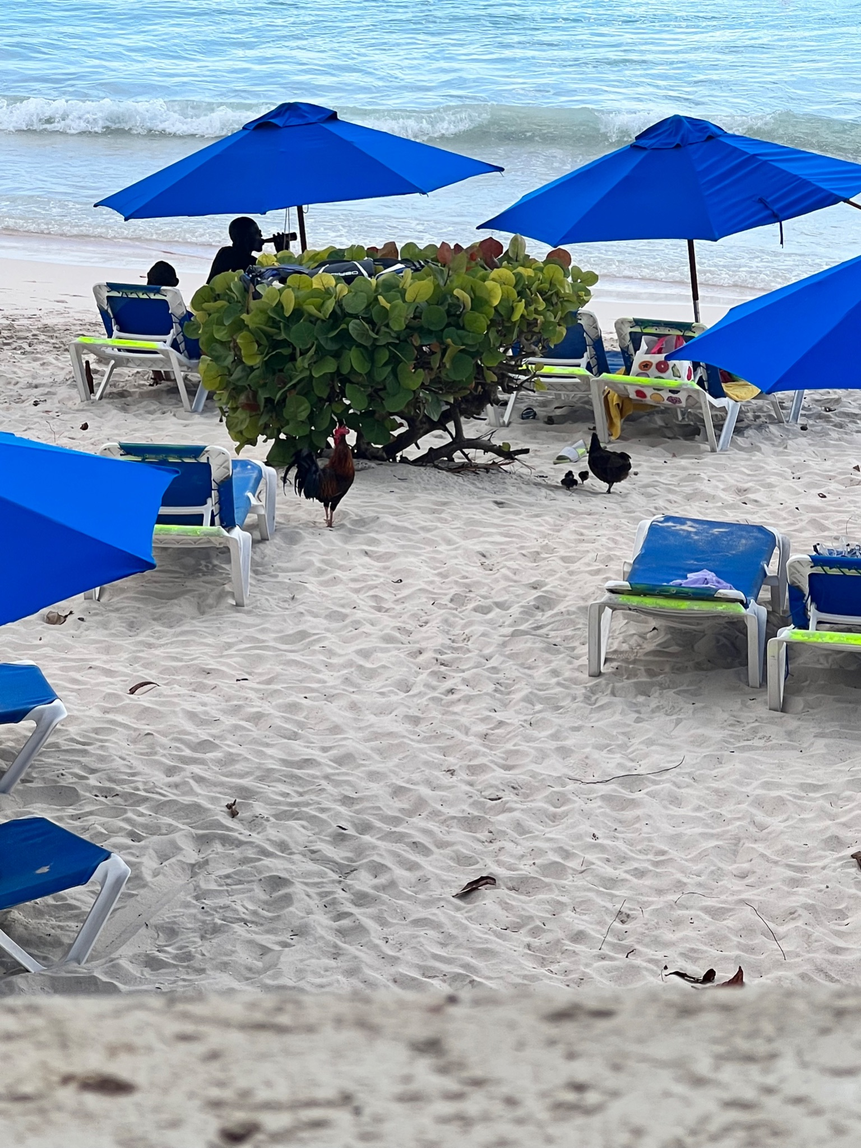
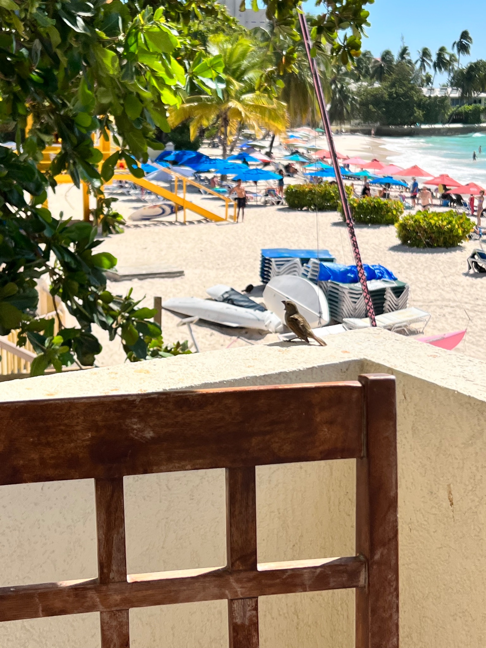

Slide 37
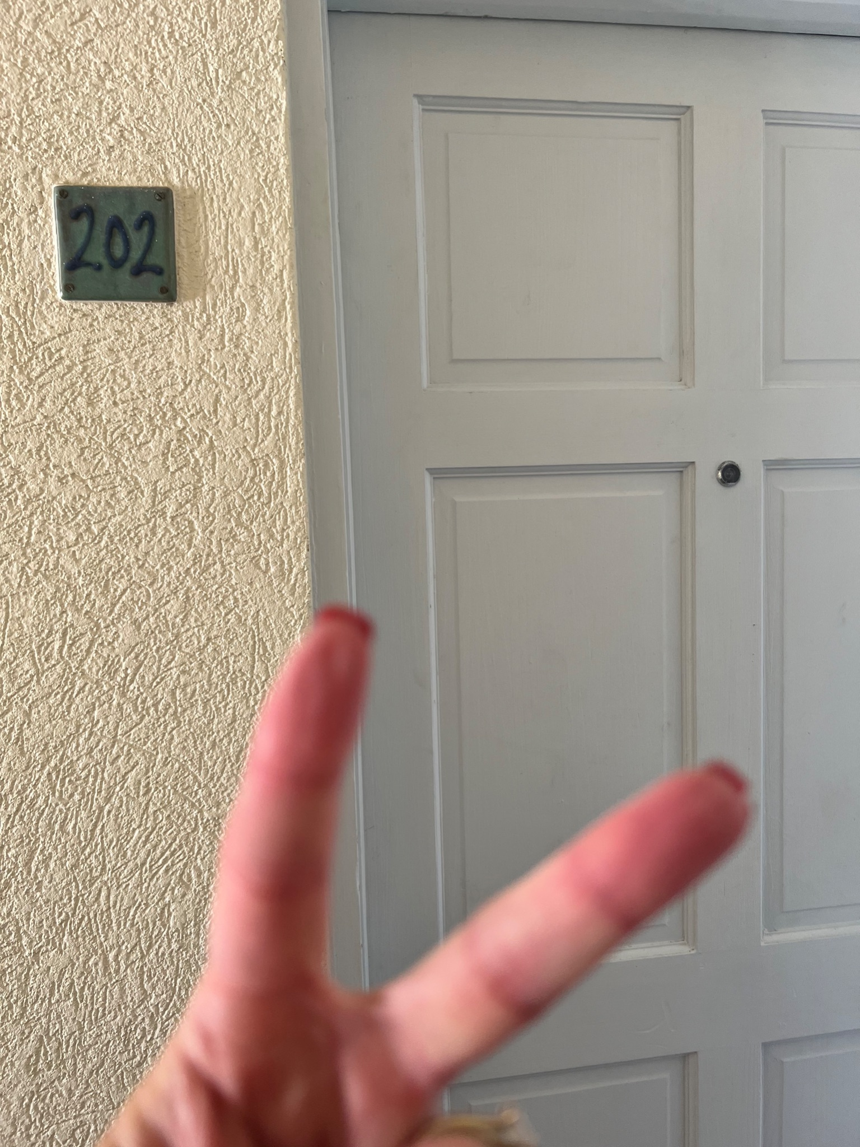

Slide 38
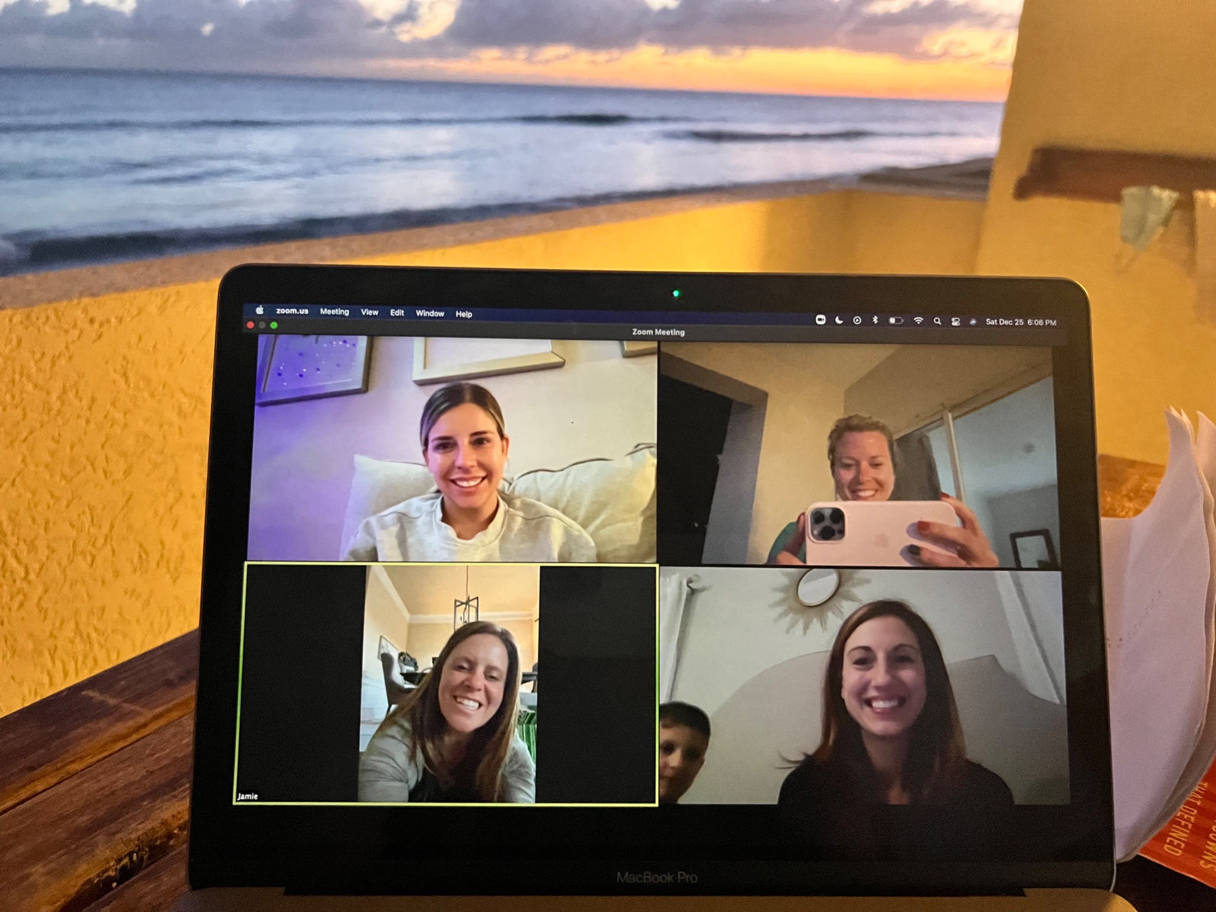

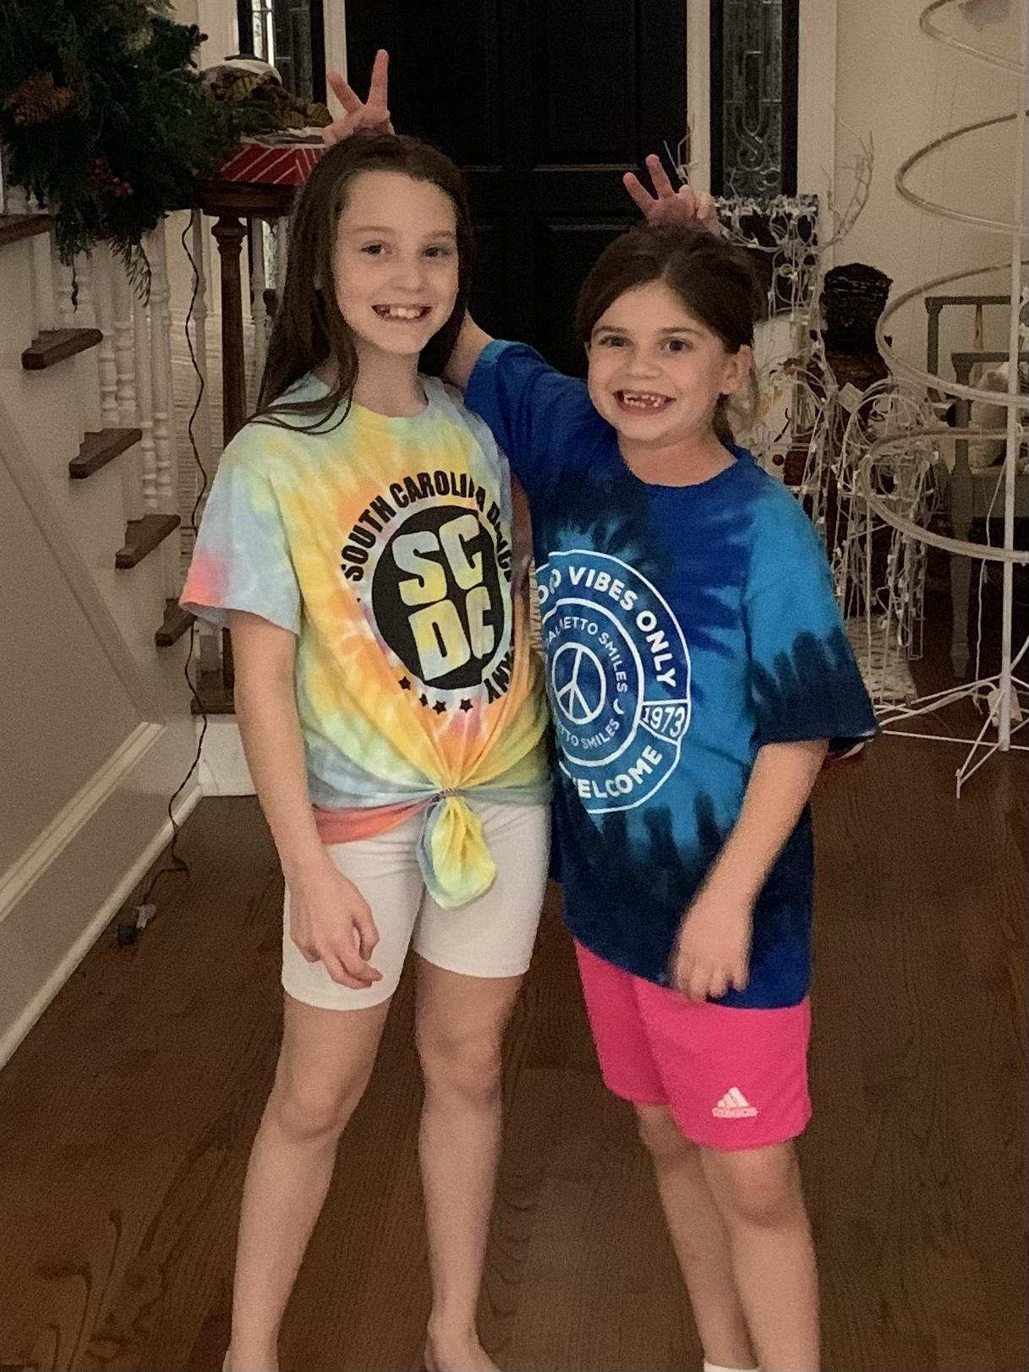
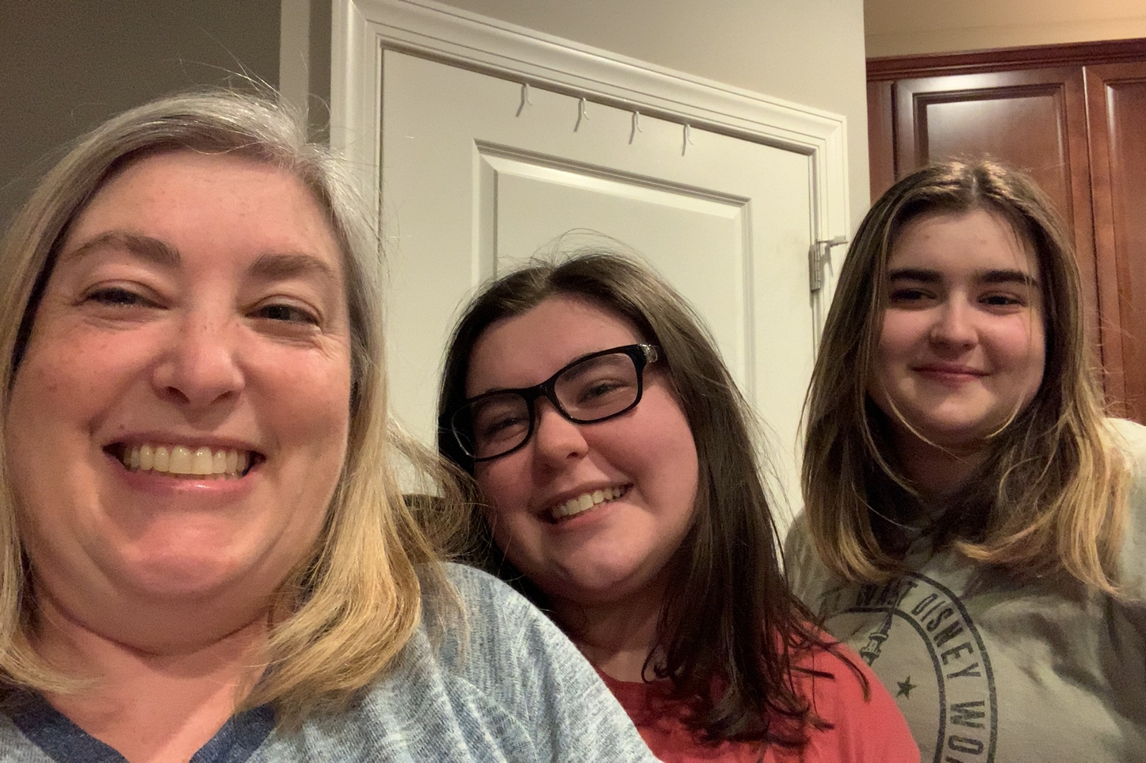


Slide 39
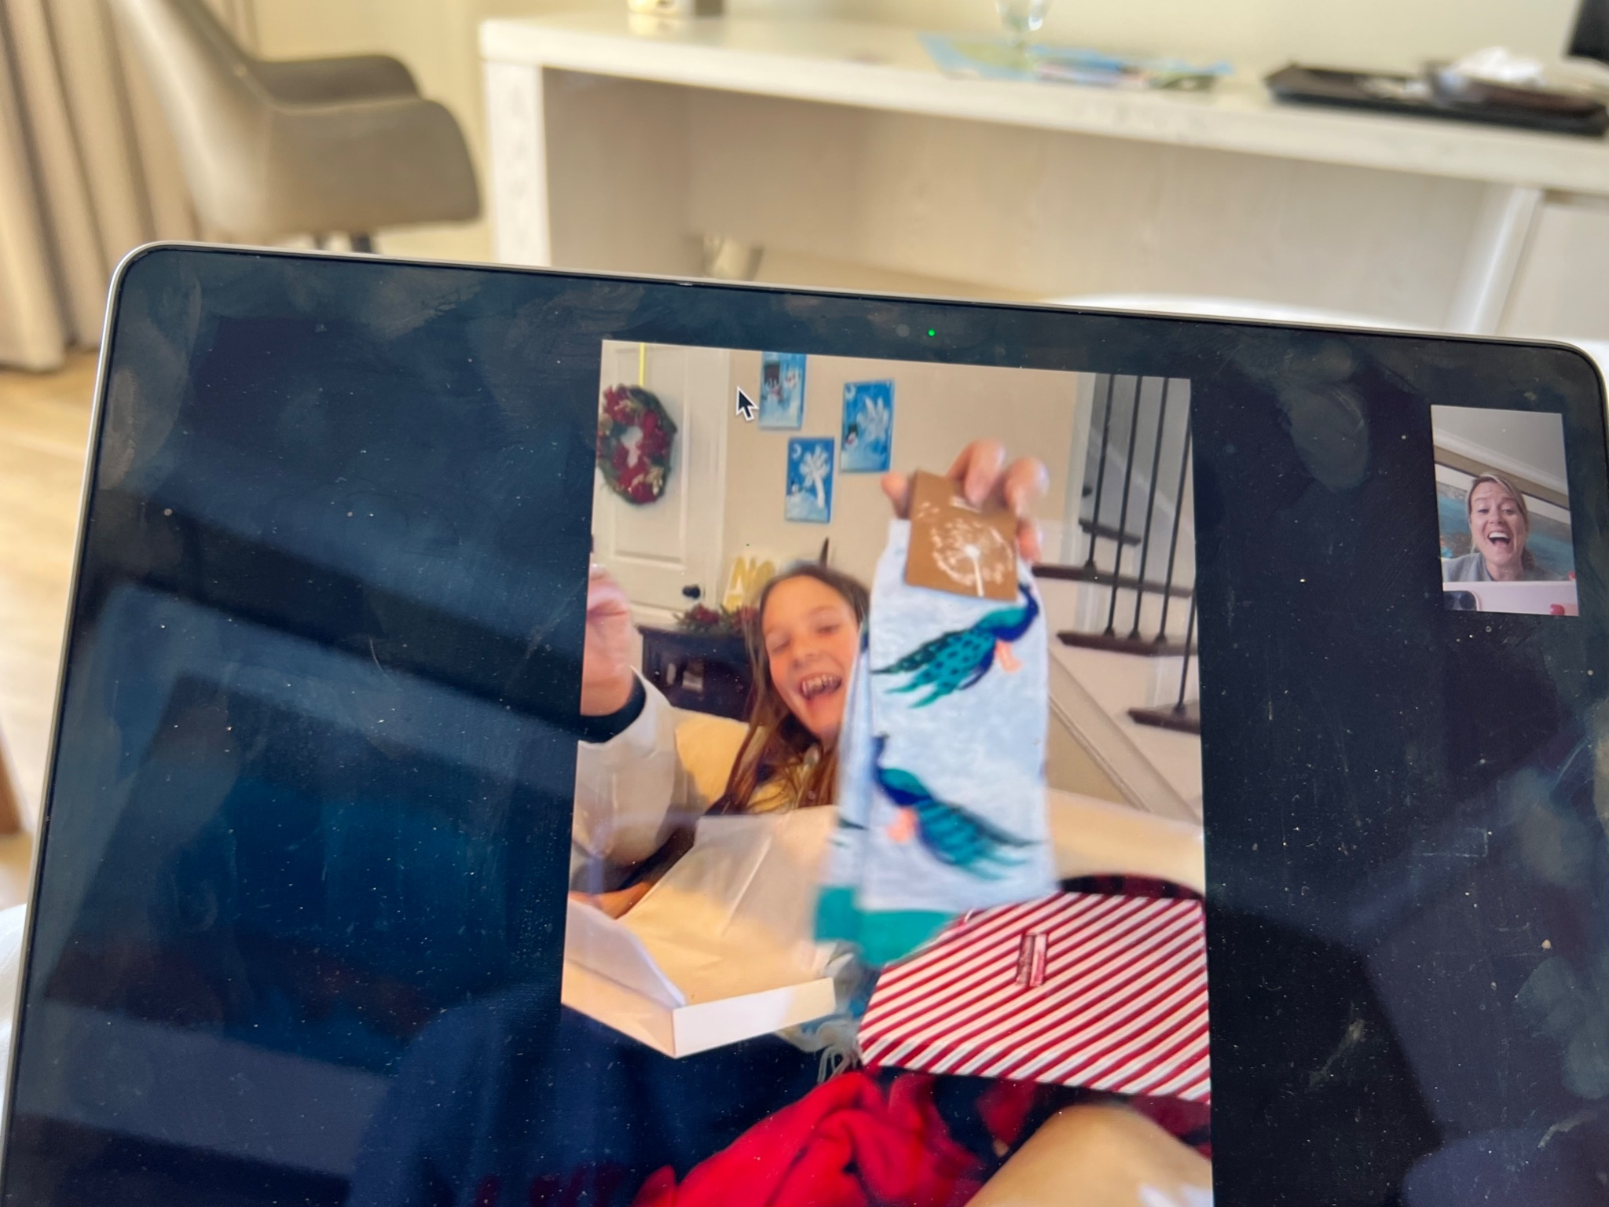


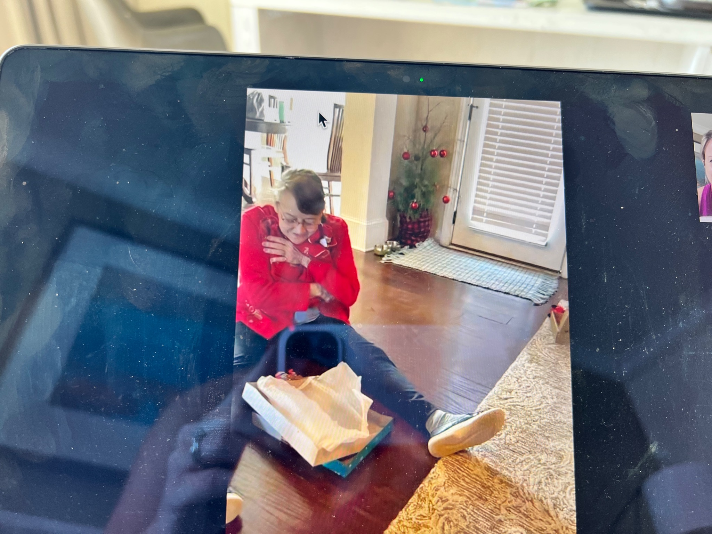
It came at a cost….

Slide 40
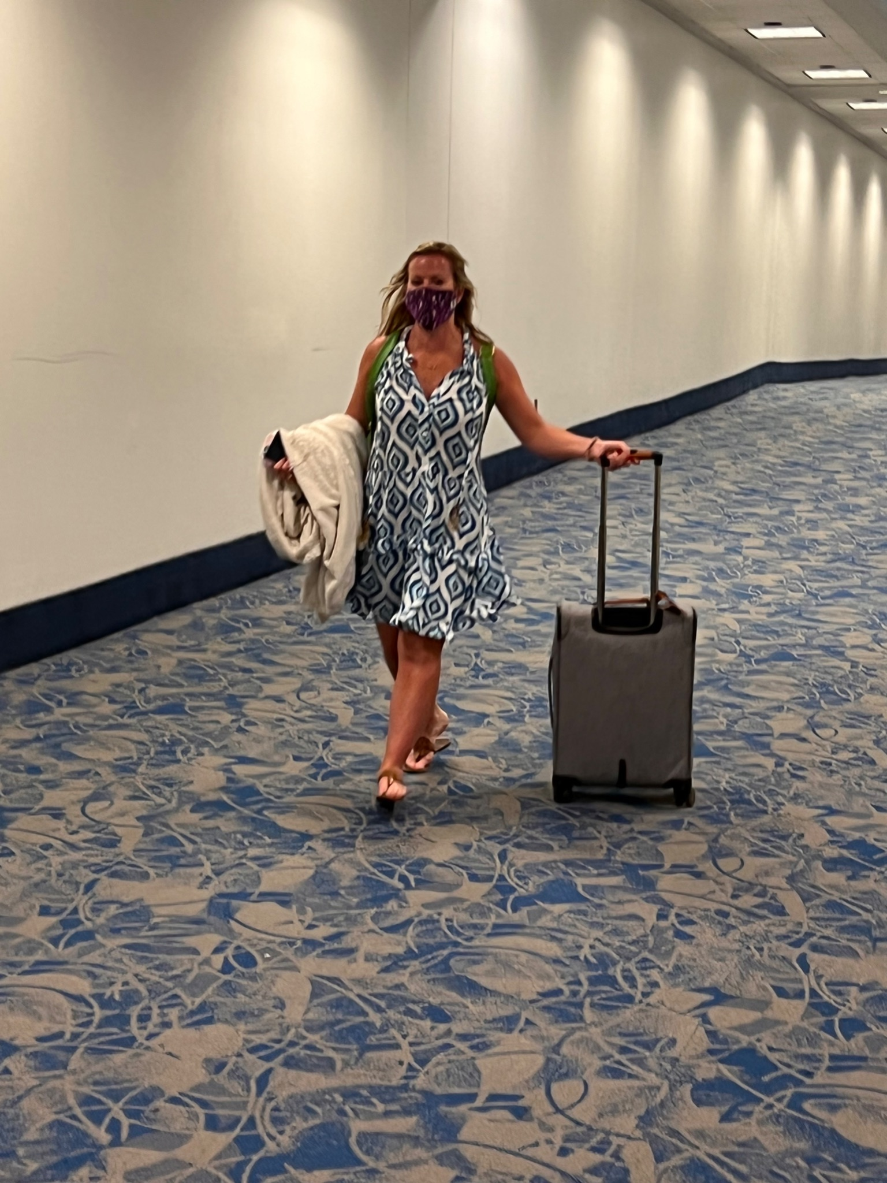
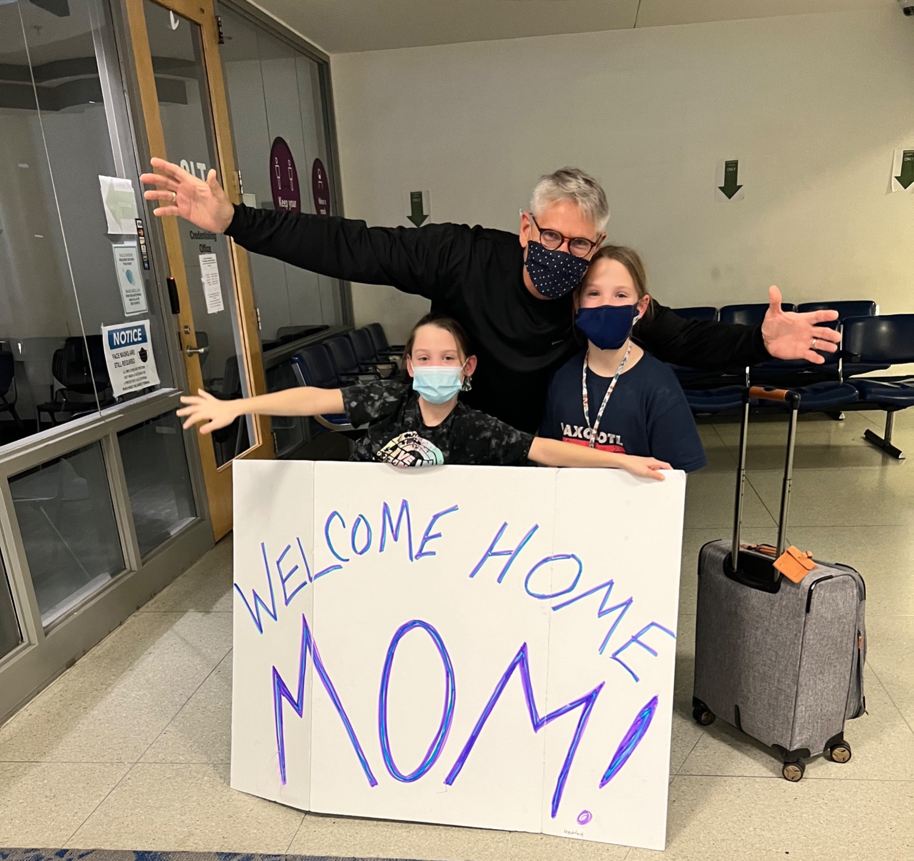

Slide 41
COVID Isolation Abroad: Economic Lessons from Barbados
Presented by Amanda Stiglbauer
January 18, 2022
astiglbauer@richland2.org

Slide 42

CEE Affiliates
https://www.councilforeconed.org/resources/local-affiliates/

