Slide 1





Black History Month: Children’s Chapter Books Featuring Young Entrepreneurs
Lynne Farrell Stover
JMU Center for Economic Education
stoverlf@jmu.edu

Slide 2
EconEdLink Membership
You can now access CEE’s professional development webinars directly on EconEdLink.org! To receive these new professional development benefits, become an EconEdLink member. As a member, you will now be able to:
Automatically receive a professional development certificate via e-mail within 24 hours after viewing any webinar for a minimum of 45 minutes
Register for upcoming webinars with a simple one-click process
Easily download presentations, lesson plan materials and activities for each webinar
Search and view all webinars at your convenience
Save webinars to your EconEdLink dashboard for easy access to the event
You may access our new Professional Development page here

Slide 3
Professional Development Certificate
To earn your professional development certificate for this webinar, you must:
Watch a minimum of 45-minutes and you will automatically receive a professional development certificate via e-mail within 24 hours.
Accessing resources:
You can now easily download presentations, lesson plan materials, and activities for each webinar from EconEdLink.org/professional-development/

Slide 4
Agenda
This session features:
Review of basic economic concepts
Discussion of the use of children’s books to teach in the content areas
Featured books’ lesson plans and activities
Links to support materials
Q & A session
The following economic and personal finance concepts are covered:
Money
Choices (Costs and Benefits)
Business Plan
Human Capital
Profit
Startup Costs
Producers and Consumers

Slide 5
Objectives
Teachers will be able to:
Review basic economic concepts
Explore chapter books that feature young entrepreneurs and learn how to identify the economic concepts found in them.
Learn how to use book content to teach age appropriate lessons and activities based on the featured concepts.

Slide 6
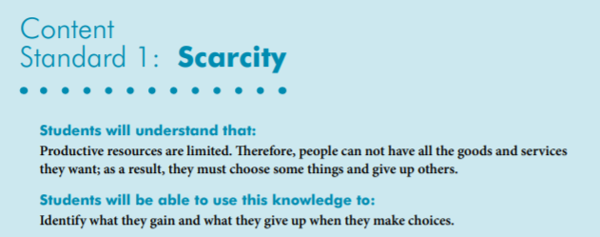

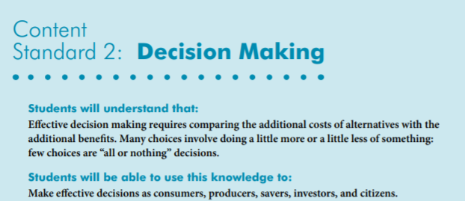
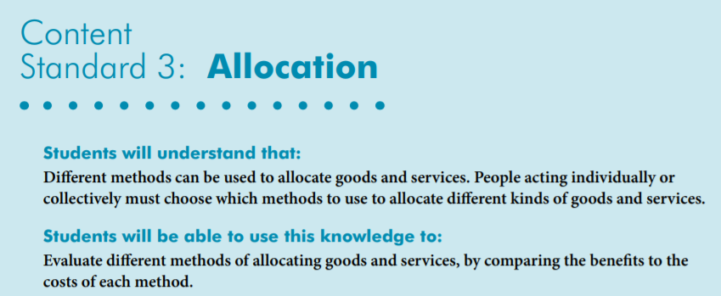
National Standards
https://www.councilforeconed.org/wp-content/uploads/2012/03/voluntary-national-content-standards-2010.pdf

Slide 7
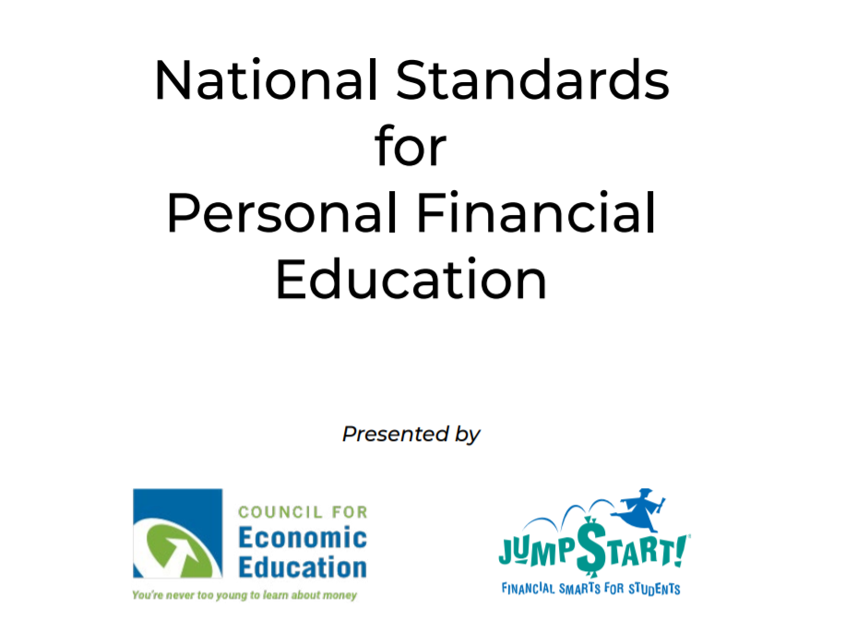
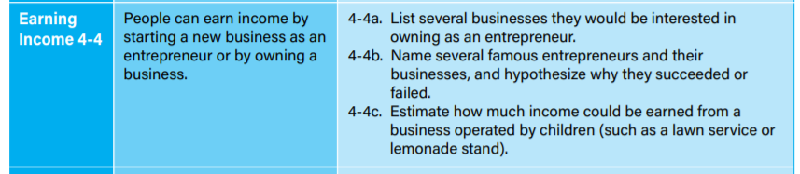

Slide 8

Virginia HISTORY & SOCIAL SCIENCE Standards of Learning
Economics
1.7 The student will explain the difference between goods and services and describe how people are consumers and producers of goods and services.
2.8 The student will describe natural resources (water, soil, wood, and coal), human resources (people at work), and capital resources (machines, tools, and buildings)
2.10 The student will explain that scarcity (limited resources) requires people to make choices about producing and consuming goods and services.
3.8 The student will demonstrate an understanding of different cultures and the natural, human, and capital resources they used in the production of goods and services.
3.9 The student will recognize that because people and regions cannot produce everything they want, they specialize in what they do best and trade for the rest.
CE.12 The student will apply social science skills to understand the United States economy by
c) describing the types of business organizations and the role of entrepreneurship;
Economics/Personal Finance
EPF.2 The student will demonstrate knowledge of the role of producers and consumers in a market economy by
c) identifying the role of entrepreneurs;
Civics
1.10 The student will apply the traits of a good citizen by
a) focusing on fair play, exhibiting good sportsmanship, helping others, and treating others with respect.

Slide 9

Using Children’s Literature to Teach in the Content Areas
It is to be noted that by using children’s picture books to teach in the content areas, we are providing students with engaging background information that encourages them to relate to concepts, improve vocabulary, and promote reading and writing skills.
Children’s literature offers many interdisciplinary possibilities including those of economics and personal finance.

Slide 10
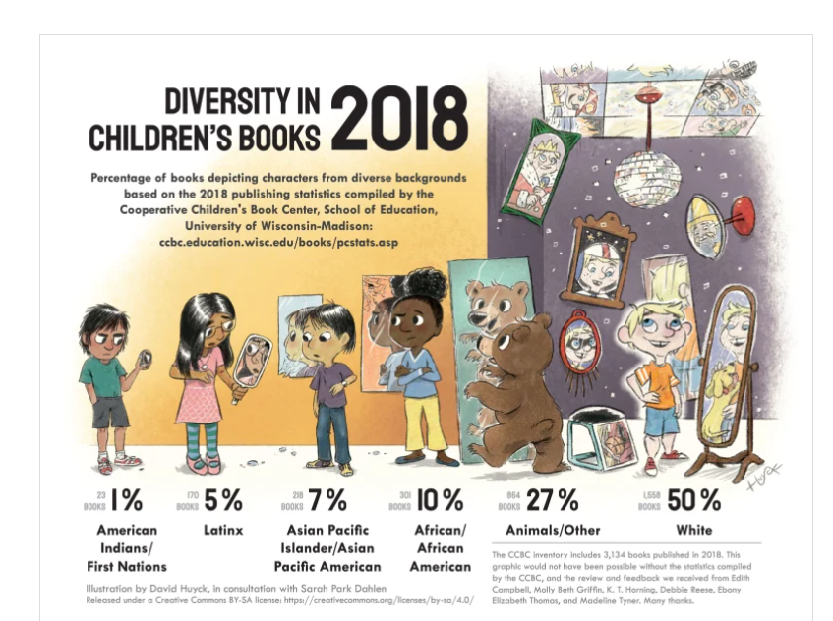

Slide 11
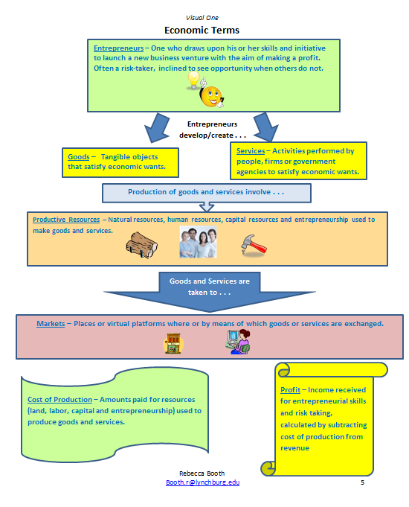

Slide 12

The Toothpaste Millionaire
Publisher: Houghton Mifflin
Copyright Date: 2006 (1972)
Reading Level: 5.0
Interest Level: 3-6

Slide 13
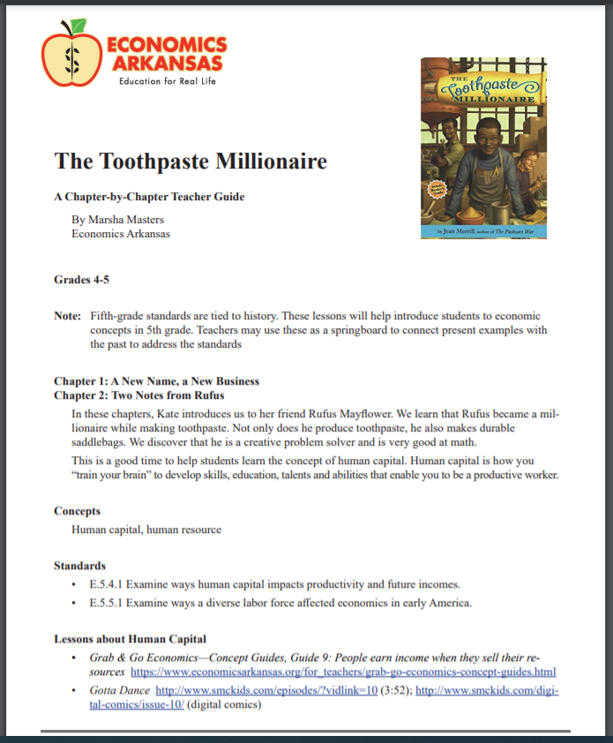

Slide 14


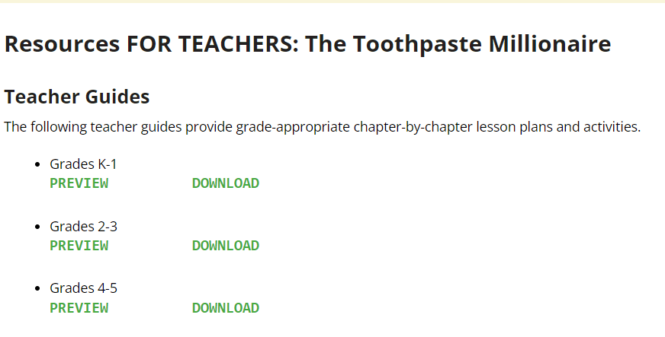
https://www.economicsarkansas.org/for_teachers/literacy-series/the-toothpaste-millionaire-for-teachers.html

Slide 15
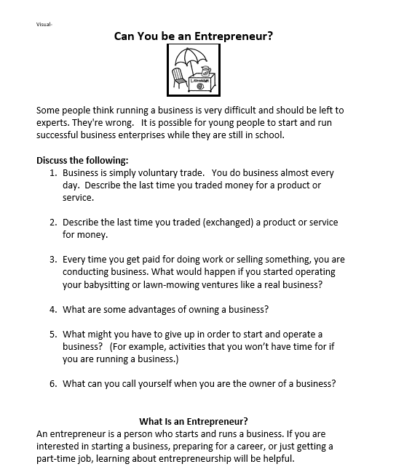
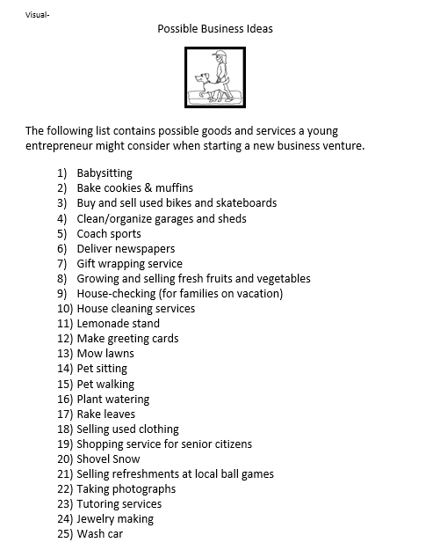
Business Plan

Slide 16
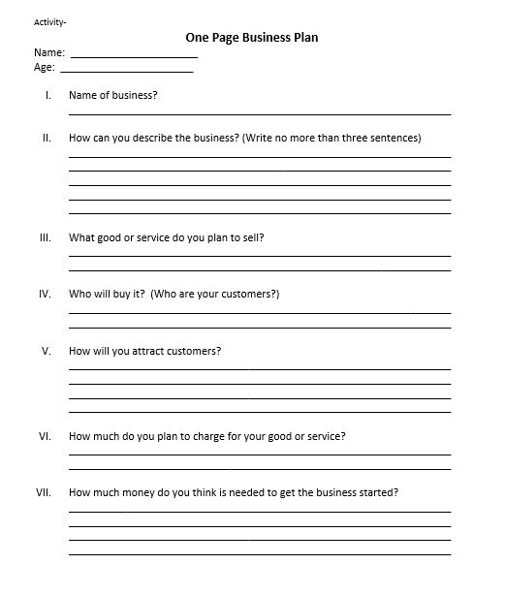


Slide 17
Danny Dollar is a kid with a plan. He is out to become a millionaire and conquer the world. Unfortunately for him, the neighborhood bullies have other plans for Danny, like public humiliation. But when the last person in the world he would have expected enters his life, something happens that he never could have imagined. Along the way in this fun story, Danny is teaching kids about finance, banking, investing and entrepreneurship.
Publisher: Big Head Books
Copyright Date: 2009
Interest Level: 1-4

Slide 18


https://nieonline.com/tbtimes/downloads/supplements/Danny_Dollar_Serial_Story.pdf
The 111 page book is online!

Slide 19
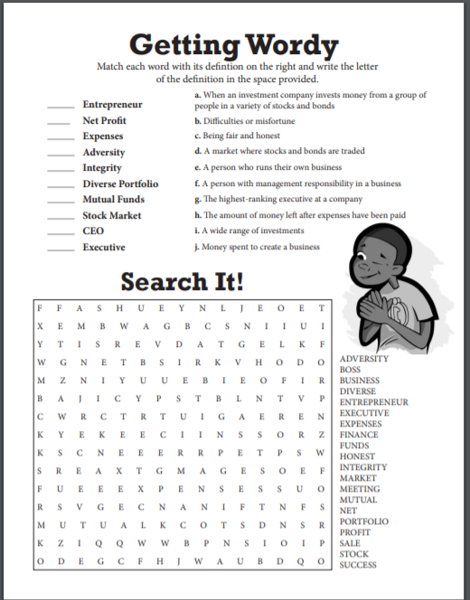

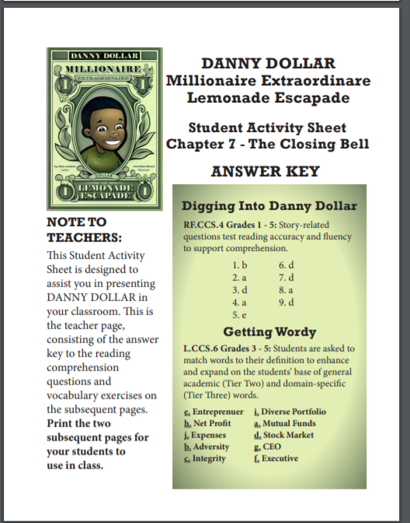
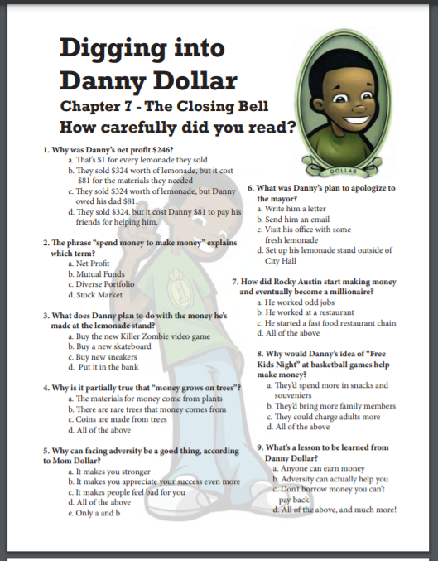
https://nieonline.com/tbtimes/downloads/supplements/DannyDollar_TG_activities.pdf
Sixteen Page Educator’s Guide

Slide 20
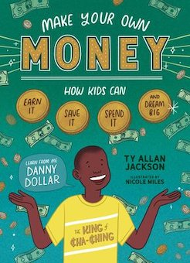
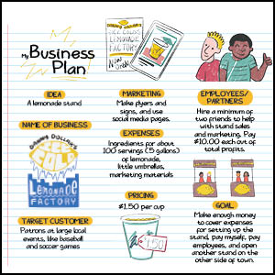
Make Your Own Money: How Kids Can Earn It, Save It, Spend It, and
Dream Big, with Danny Dollar, the King of Cha-Ching
This fun and practical guide to financial literacy and entrepreneurship inspires kids to dream big and teaches them to make, save, and spend wisely, one penny at a time.
Publisher: Storey Books
Copyright Date: 2021
Reading Level: 4.0
Interest Level: 4-7

Slide 21

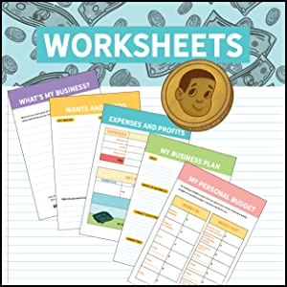
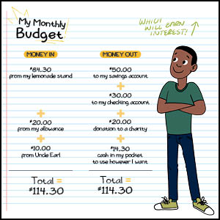

Slide 22
Cleo Edison Oliver: Playground Millionaire
Story Synopsis: Fifth-grader Cleo Edison Oliver is full of money-making ideas, and her fifth-grade Passion Project is no different, but things get more complicated when she has to keep her business running, be a good listener when her best friend needs her, and deal with the bully teasing her about being adopted at the same time.
Publisher: Scholastic
Copyright Date: 2016
Reading Level: 4.1
Interest Level: 3-6

Slide 23
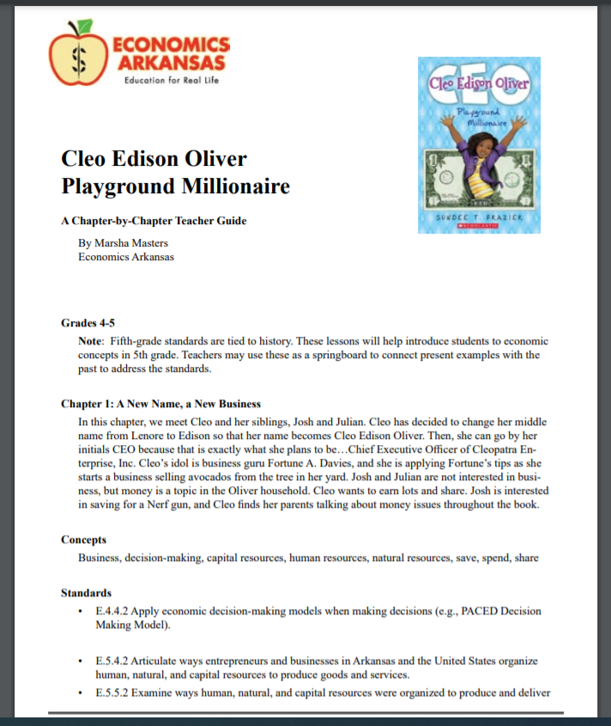
16-page Teacher Guide

Slide 24
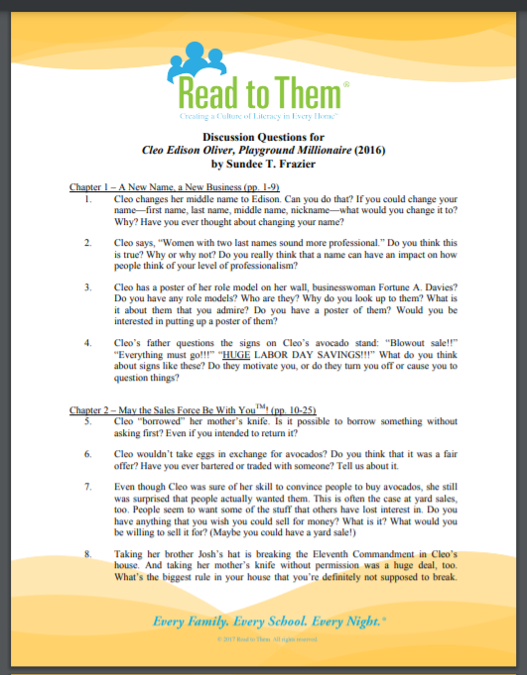
https://www.pcsb.org/site/handlers/filedownload.ashx?moduleinstanceid=65548&dataid=114704&FileName=8-RTT-Cleo-Discussion.pdf

Slide 25


J.D. and the Great Barber Battle
Story Synopsis: J.D. has a big problem--it's the night before the start of third grade and his mom has just given him his first and worst home haircut. However, he's a genius with the clippers and styles his own hair. His work makes him the talk of the town and brings him enough hair business to open a barbershop from his bedroom. But when Henry Jr., the owner of the only official local barbershop, realizes he's losing clients to J.D., he tries to shut him down for good.
Publisher: Penguin
Copyright Date: 2021
Reading Level: 3.0
Interest Level: 1-4

Slide 26
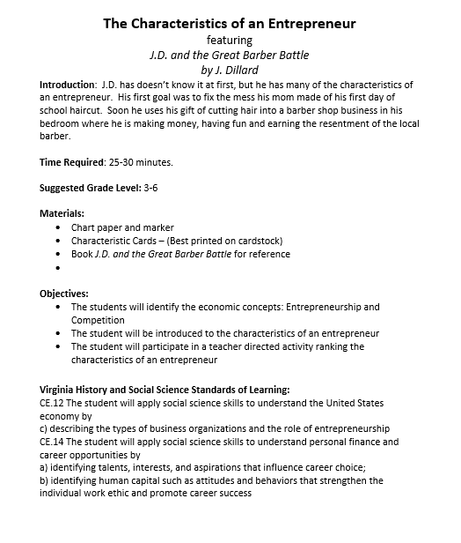

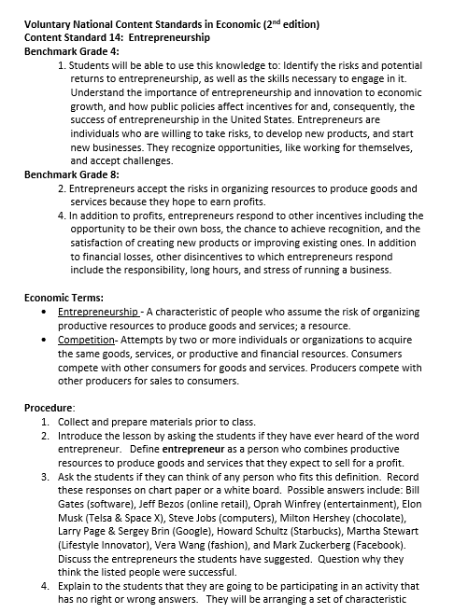
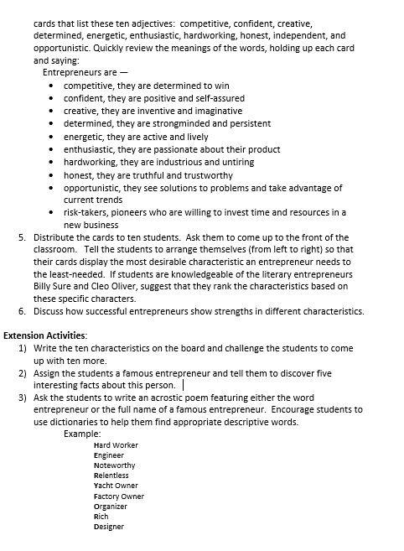
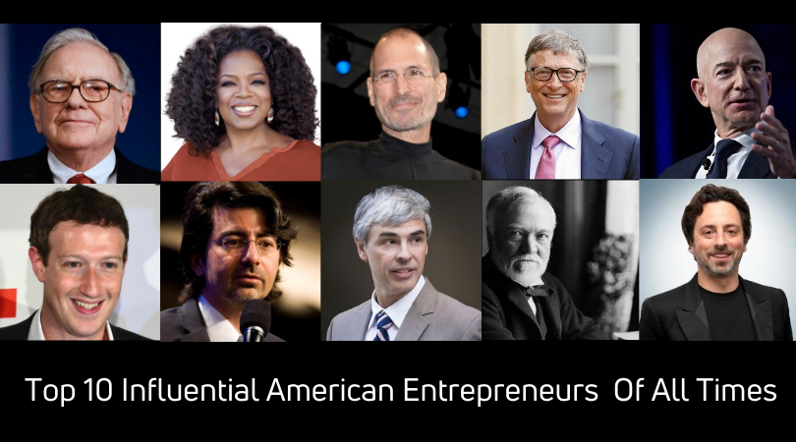
Lesson Plan
The Characteristics of an Entrepreneur

Slide 27

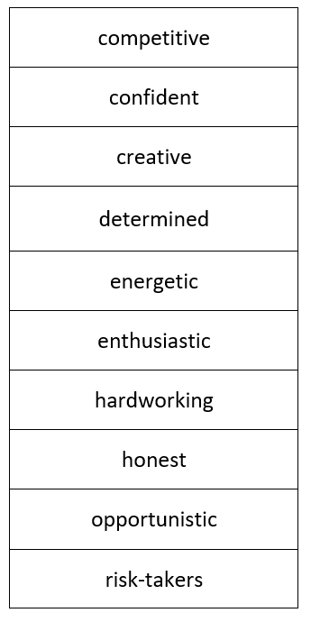
Entrepreneurs are —
competitive, they are determined to win
confident, they are positive and self-assured
creative, they are inventive and imaginative
determined, they are strongminded and persistent
energetic, they are active and lively
enthusiastic, they are passionate about their product
hardworking, they are industrious and untiring
honest, they are truthful and trustworthy
opportunistic, they see solutions to problems and take advantage of current trends
risk-takers, pioneers who are willing to invest time and resources in a new business

Slide 28
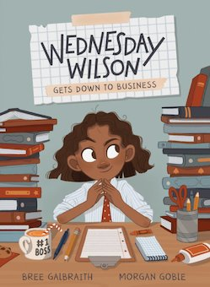
Wednesday Wilson Gets Down to Business
Story Synopsis: The most important thing to know about Wednesday Wilson is that she's an entrepreneur. She and her best friend, Charlie (Wednesday's future Vice President of Operations), with some help from her little brother, Mister, have made a list of potential businesses. But before they get to move forward on one, there's an unfortunate incident in class with the Emmas (whose last initials happen to spell M.E.A.N.) involving a piece of kale. Maybe this is just the opportunity Wednesday and her friends needed to come up with a brilliant business idea that will save the day and make them millionaires.
Publisher: Kids Can Press
Copyright Date: 2021
Reading Level: 3.0
Interest Level: 1-4

Slide 29
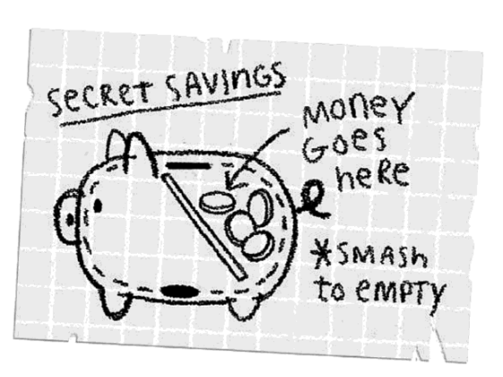
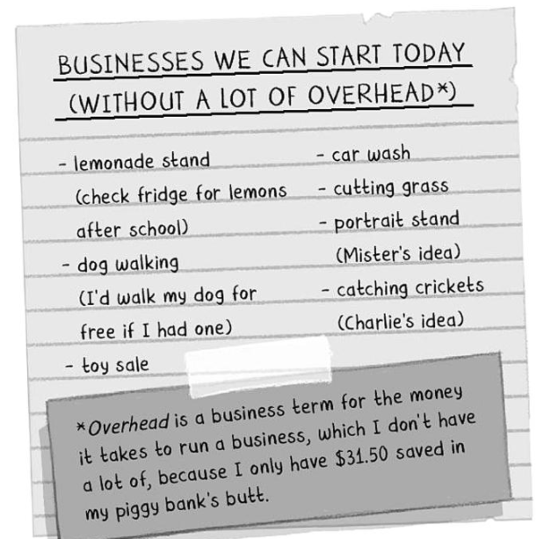
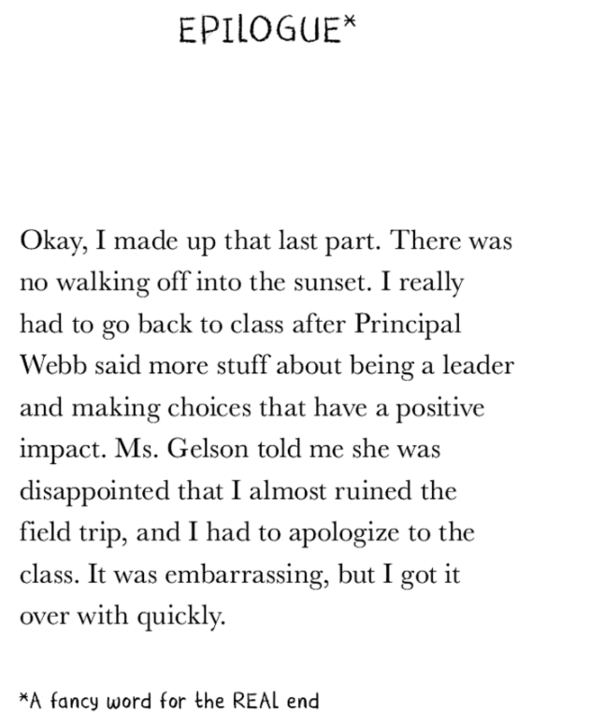
Book Features

Slide 30
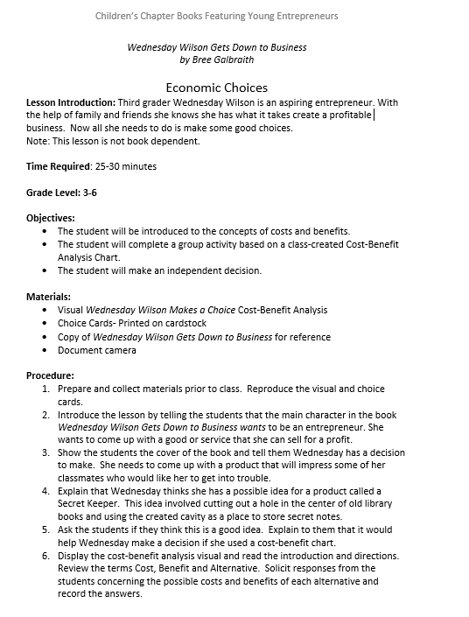
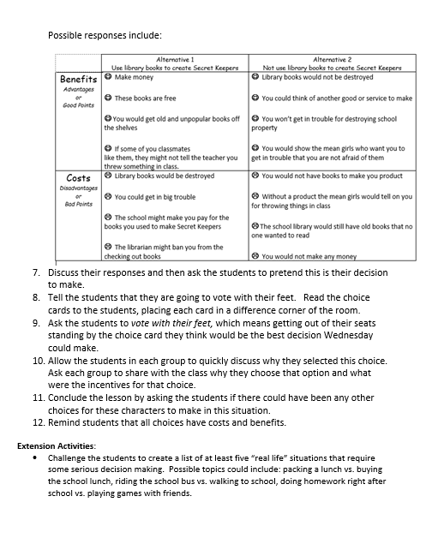
Lesson Plan

Slide 31
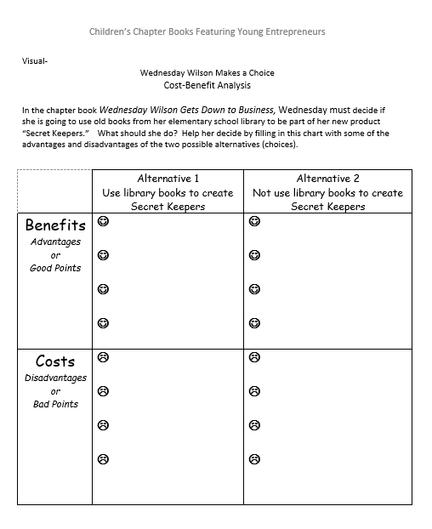

Slide 32
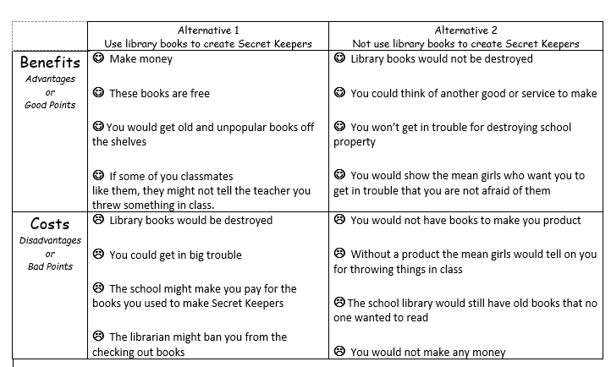
Possible Responses

Slide 33
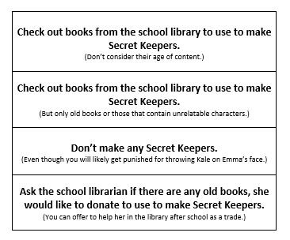

Vote with Your Feet

Slide 34
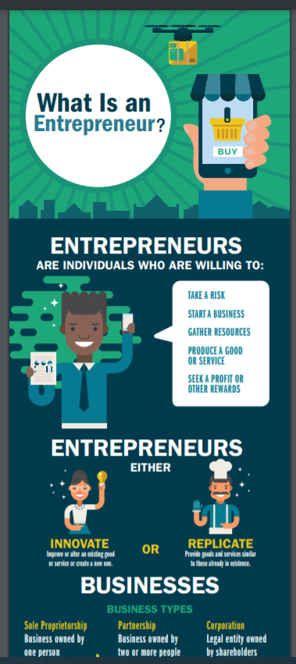
Teaching Entrepreneurship
Extension and Enrichment Activities
(Plus some cool online resources)
https://www.atlantafed.org/education/classroom-economist/infographics/what-is-an-entrepreneur/full-view

Slide 35
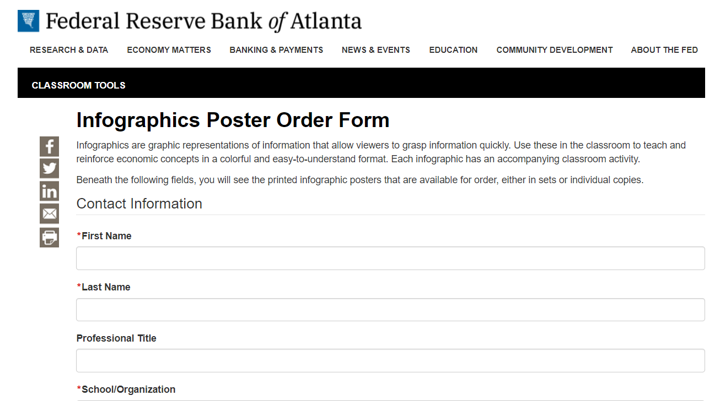
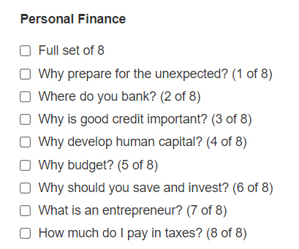
https://www.atlantafed.org/forms/education/infographics-order.aspx

Slide 36

16-page booklet from the Dallas FED
https://www.dallasfed.org/~/media/documents/educate/everyday/entrepreneurs.pdf

Slide 37
Lesson Extension
Ask the students to write an acrostic poem featuring either the word entrepreneur or the full name of a famous entrepreneur. Encourage students to use dictionaries to help them find appropriate descriptive words.
            Example:
            Hard Worker
            Engineer
            Noteworthy
            Relentless
            Yacht Owner
            Factory Owner
            Organizer
            Rich
            Designer

Slide 38
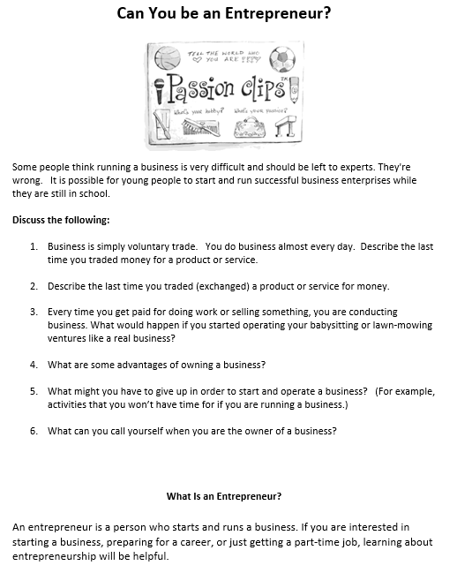

Slide 39
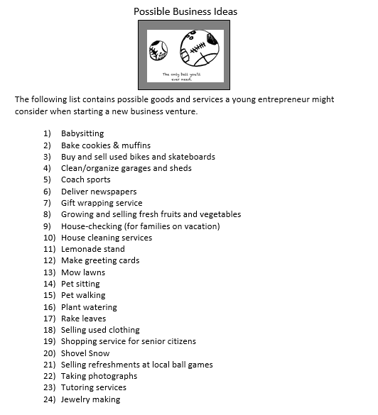

Slide 40
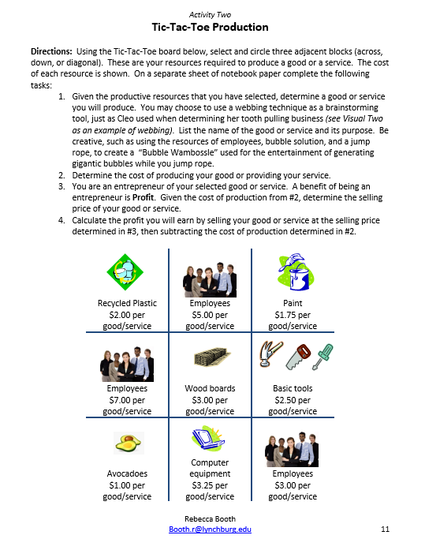

Slide 41
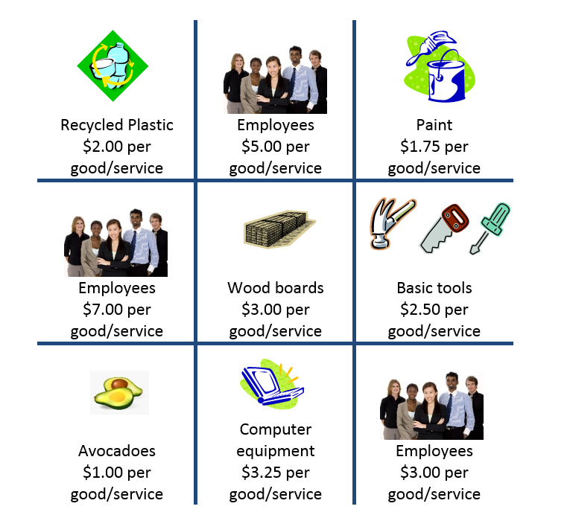

Slide 42
If You Recognize an Opportunity
(Entrepreneur Song)
(Tune: If You Are Happy And You Know It, Clap Your Hands)
If you recognize an opportunity, (clap, clap)
If you recognize an opportunity, (clap, clap)
you could start a business.
you could start a business.
You could start a business of your own. (clap, clap)
You would then be called an entrepreneur. (clap, clap)
You would then be called an entrepreneur. (clap, clap)
By using your human capital,
and taking on a risk,
you are now called an entrepreneur. (clap, clap)
Work really hard and watch your cost. (clap, clap)
Work really hard and watch your cost. (clap, clap)
By increasing your revenue,
and keeping your cost low,
you could earn a reward of profit. (clap, clap)
Rebecca Booth, Center for Economic Education at Lynchburg College, 2011.

Slide 43
Ranking: Arrange (from left to right) to display the most desirable characteristic an entrepreneur needs to the least-needed.
opportunistic
confident
creative
honest
competitive
energetic
enthusiastic
determined
risk-taker
hardworking

Slide 44

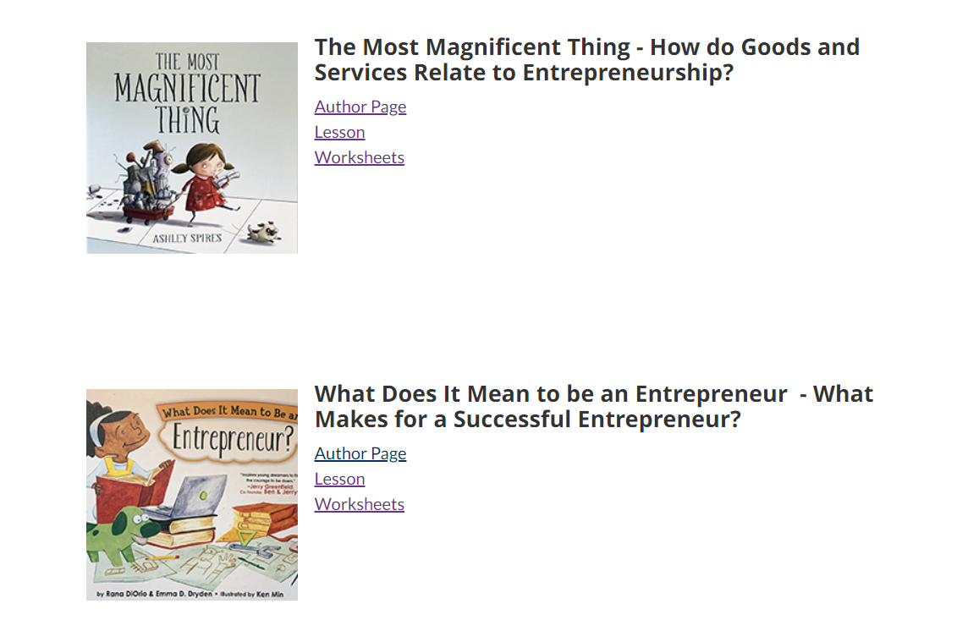
2020-2021 READING IS AN INVESTMENT
https://www.vermonttreasurer.gov/content/2020-2021-reading-investment

Slide 45
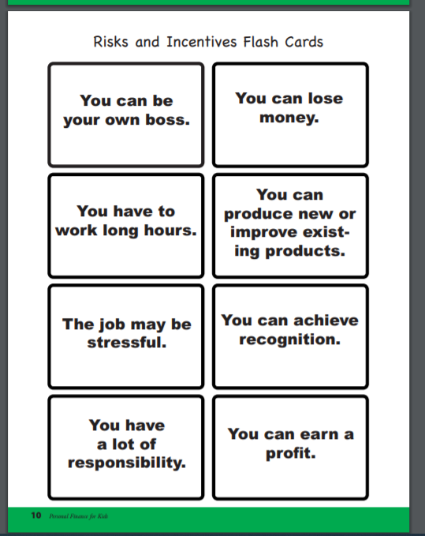
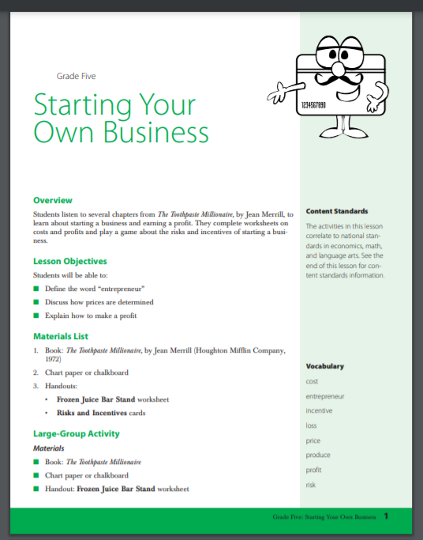
https://www.texasbankers.com/docs/toothpaste_millionaire.pdf

Slide 46
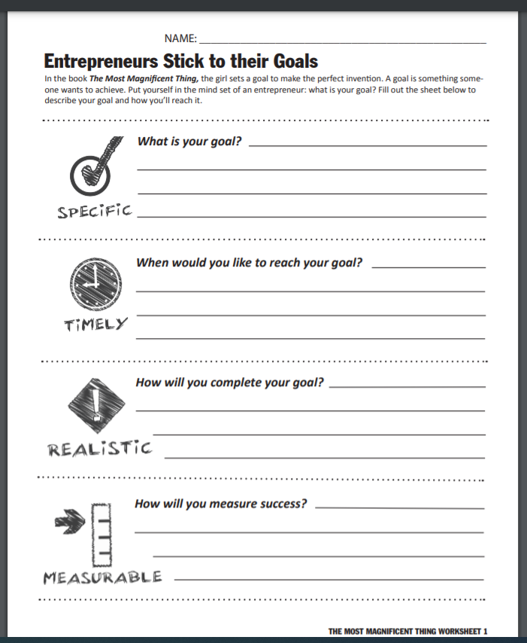
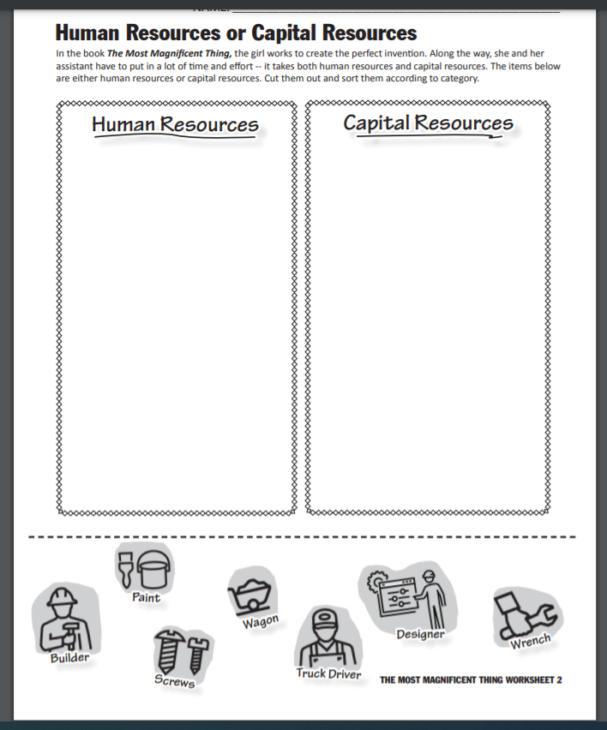

Slide 47
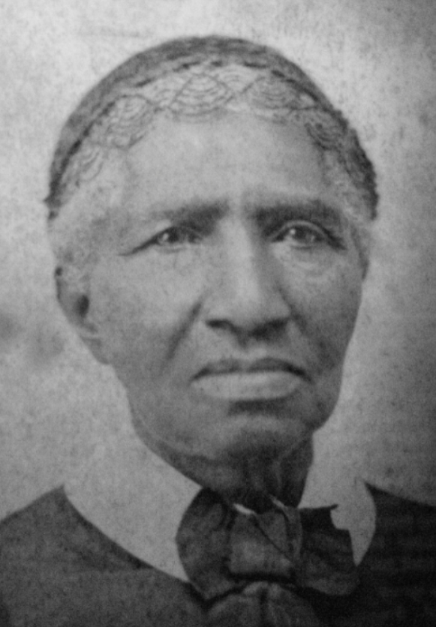
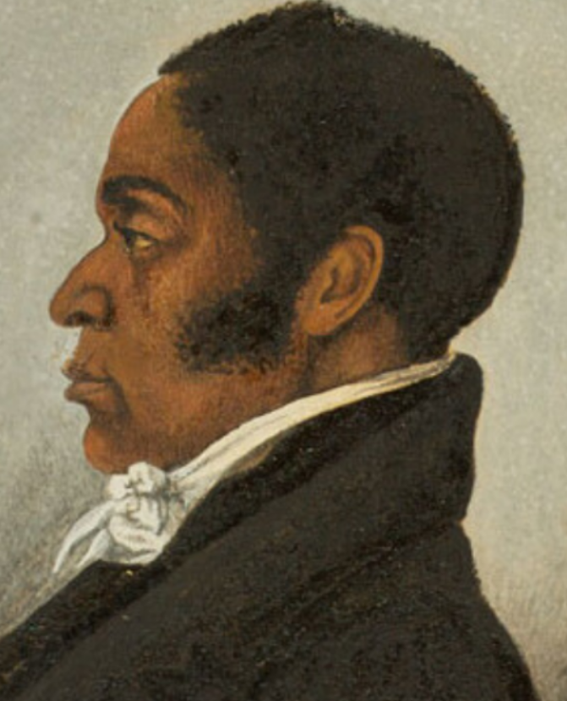
Notable Companies Founded by Black Entrepreneurs
https://stacker.com/stories/3825/notable-companies-founded-black-entrepreneurs
Clara Brown: Laundry tycoon and gold mine investor James Forten: Sailmaker and Abolitionist

Slide 48

Bonus Books
Celebrated in February, Black History Month began as a way of remembering the achievements and history of African Americas. It honors all Black people from all periods of U.S. history, from the enslaved people first brought over from Africa in the early 17th century to African Americans living in the United States today.

Slide 49







Lessons and Activities
https://youreconomicsuccess.org/blackhistory/

Slide 50
Assessment Questions
Points to Ponder:
What are some of the cost and benefits of using chapter books to teach entrepreneurship during Black History Month?
Do you think children’s literature is becoming more diverse? Why or why not?
Do you think today’s extremely successful entrepreneurs are good role models for our young learners? Why or why not?
How difficult is it to modify a classroom activity to an online lesson? (Asking for a friend.)

Slide 51
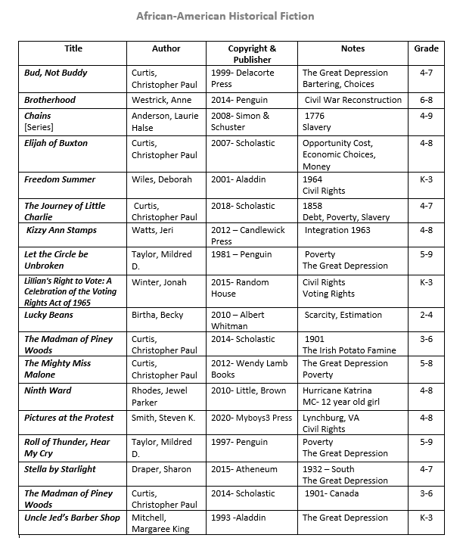





Slide 52

CEE Affiliates
https://www.councilforeconed.org/resources/local-affiliates/

Slide 53




Thank You to Our Sponsors!

