Slide 1


WELCOME
Housekeeping Items
Please use the chat function to ask questions or to notify moderator of issues
Session will be recorded and emailed to participants following the webinar
Attendance certificates can be accessed following webinar
The webinar will begin shortly

Slide 2
AP Econ Unit 3: National Income and Price Determination
Equilibrium and Changes in the Aggregate Demand-Aggregate Supply Model
Curriculum Written By: Steven Cullison
Live Webinar: January 31, 2022

Slide 3

Instructor Bio
Steven Cullison teaches AP Economics and Philosophy at Edina High School in Minnesota. He is a past winner of the Minnesota Secondary Economics Teacher of the Year Award (2019) and has coached teams to state championships in the Economic Challenge and finalists/winners in the Minnesota Federal Reserve Essay Contest. Steven holds master’s (Teaching) and professional (Educational Leadership) degrees from The University of St. Thomas, and a bachelor’s degree in psychology from The University of Minnesota. He is licensed in social studies, school administration, and special education. Steven also serves as a racial equity trainer for his district.

Slide 4
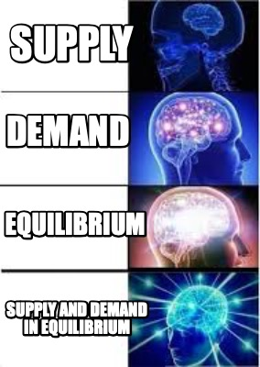
Webinar Objectives
To prepare educators to teach about equilibrium in the aggregate demand/aggregate supply model in an engaging and effective manner.

Slide 5
Agenda
Instruction on equilibrium in the AD-AS Model in the short-run and long-run
Areas where students struggle
Resources
Lessons
Questions

Slide 6

Learning Goals
To be able to:
Interpret graphs combining aggregate demand and aggregate supply
Explain the forces pushing an economy toward a long-run equilibrium
Notes:
I believe that it is best practice to explicitly state learning goals or objectives at the outset of a lesson. This is on the screen as my students enter.

Slide 7
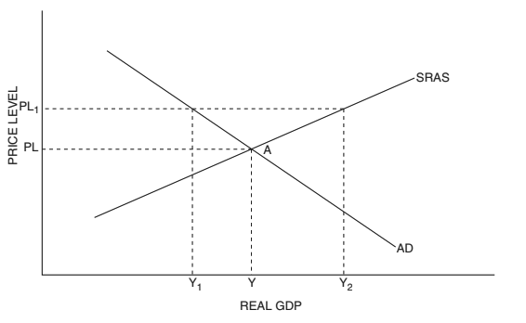
Aggregate
Demand (AD)
The amount of real output (GDP) that buyers collectively wish to purchase at each possible price level.
Notes:
A few weeks ago some of you may have joined us when we learned about aggregate demand. Take all of the demand curves for every individual good or service provided in a domestic economy, everything that every consumer, business, or the government buys, and add them all up. That’s aggregate demand.
In this model, sometimes called the Aggregate Demand/Aggregate Supply Model or simply the Macroeconomic Model, the X-axis is Real Gross Domestic Product, or GDP. This is a measure of total output or production in the economy. On the Y axis is we have price level. As you move up on the graph, prices are rising, what we call inflation.
Aggregate demand is downward sloping because, at lower price levels, when things are cheaper, people will want to buy more stuff.
By the way, the graphs used in most of this presentation are adapted from those provided in the Council on Economic Education’s Advanced Placement Macroeconomics Book, 4th Edition.

Slide 8
Aggregate
Supply (AS)
The total supply of all goods in the economy,
Notes:
Last week we had a session on aggregate supply. Add up all of the individual supply curves for every good and service built and provided in a domestic economy, every haircut offered or airplane built, and you have short-run aggregate supply. It’s upward sloping because, when offered a higher price level firms are willing, all else held equal, to make more stuff.
Aggregate demand and supply, in isolation, provide answers to “if-then statements. If the price level is Y, then firms will be wiling to produce Y amount of output. But what IS the price level? What amount of goods and services will actually be produced? To answer that, we need both aggregate supply and aggregate demand.

Slide 9
Notes:
Let’s get these crazy kids together. We’re now taking into consideration everything that people in an economy are willing to purchase (and this includes, again, not just consumers. The government, firms, and people outside of the country) and everything thay firms are willing to produce.
By combining these we can determine what output will actually be in an economy, measured in dollars (or whatever currency.)

Slide 10
Notes:
And we can also find the actual price level in the economy. From the perspective of consumers, this would be the general cost of things. From the perspective of firms, an overall indicator of what they can charge for goods and services.

Slide 11
Notes:
It’s neat an all that equilibrium is where the lines cross, x marks the spot and all. But why? Why, for instance, wouldn’t producers decide to charge more?

Slide 12
Notes:
Consider price level 1. At this price level, which is higher than equilibrium, firms are willing to produce a larger amount of stuff, output level Y2. The problem is that, at this high price level, people aren’t willing to buy nearly that amount of stuff. The quantity of domestically produced goods and services demanded at that price level is only Y1.

Slide 13
SURPLUS
Notes:
So you’ve got a surplus. If firms are actually producing this amount, then it’s going unsold. Inventory will build up. In response to warehouses of unsold goods, and empty seats on planes, businesses will lower their prices. Not because it’s convenient for economics students to have equilibrium where the lines cross, but because it’s in their own best interest.
Likewise, at any price level below equilibrium, the public wants to buy more stuff than will be produced. Firms will benefit by raising prices and producing more.

Slide 14
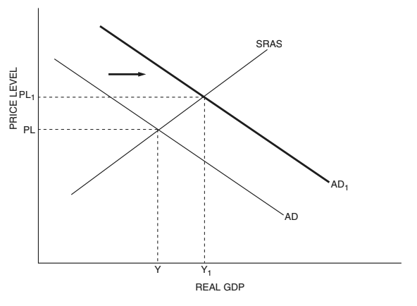
Notes:
Changes in aggregate demand or supply, then, lead to changes in output and price level. A new equilibrium. An increase in aggregate demand, say because a pandemic ends and people decide to see more movies and dine in more restaurants, would be expected to lead to more output (and jobs), which is great. But it would also be expected to lead to inflation, a higher price level, which sometimes isn’t so great.
A full list of causes of shifts of aggregate demand was covered in our session three weeks ago.

Slide 15




1
Notes:
Let’s say there’s an increase in aggregate supply. Maybe the personal computer is invented, leading to improvements in productivity. This would lead to more output (and jobs) and prices, all else held equal, would fall. Economies LOVE technological breakthroughs.
A full list of causes of shifts of aggregate supply was covered in our session last week.
Anyway, so this model allows us to estimate the impact of changes in the economy. If the government is considering raising or lowering taxes, or passing stricter environmental regulations on businesses, or entering into a trade war, we can predict what will happen to inflation, output, and the level of employment.
By the time I’ve introduced equilibrium in my classes, students will have already studied the things that can shift AD or AS, so they’re ready to start pushing these curves around to find the results.

Slide 16
Notes:
Thus far, when I’ve spoken about equilibrium, what I’ve meant is short-run equilibrium. What does that even mean? The short-run, in macroeconomics, is the time period in which resource prices have not responded to changes in the overall economy. In the short-run, the prices for goods and services may rise, for example, without any change in wages firms must pay workers.
Let’s reconsider the situation depicted above, in which aggregate demand increased, leading to more production, and higher prices. In order to produce more, firms are going to need to hire more workers, and buy more of every resource. In the long run, the increase in demand for labor and other factors of production will lead to higher prices of resources, and thus higher costs for producers. What do you suppose happens when it gets more expensive to make things?

Slide 17
2
Y2
Notes:
I’ll tell you what happens, firms are less willing to produce at any given price level. Attendees of my session last week will know that resource prices are a determinate of aggregate supply. So SRAS shifts left, automatically, in the long-run in response to an increase in aggregate demand.
Notice what has happened. We’re back where we started, in terms of real GDP, and thus where we started, job-wise. All that’s happened is some inflation.
This automatic shift is assumed to happen in the long-run in absence of any other changes in the economy.
The theory is, then, that, in the long-run, we always end up at the same level of output.

Slide 18
2
Y2
Notes:
We’ll call this long-run level of output our long-run equilibrium. A vertical line drawn at this level is our long-run aggregate supply curve. In the long-run it is held that firms will produce this amount of output, regardless of price level.

Slide 19
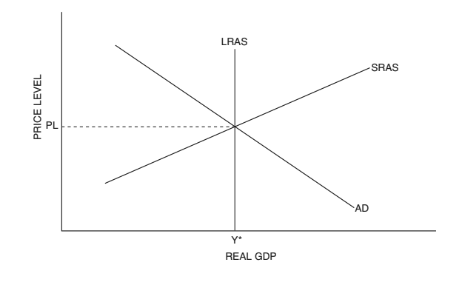
Long-Run Macroeconomic Equilibrium
Notes:
There. That’s a bit easier on the eyes.

Slide 20
Y1
Notes:
By the way, it works in the other direction too. If aggregate demand were to fall, maybe due to lower consumer confidence, then output would, in the short-run, fall to Y2. With it, hiring would fall, what we call unemployment. Demand for resources in general would fall. In the long-run, the prices for those resources would get cheaper. For example, unemployed workers, left with little bargaining power, would accept lower wages. You probably can guess what happens to aggregate supply when resource prices fall.

Slide 21
2
Y1
,Y2
Notes:
It shifts to the right as firms are willing to produce more, at any given price level, when it’s cheaper to do so. Bringing us back to long-run equilibrium.

Slide 22
FULL EMPLOYMENT
2
Y1
,Y2
Notes:
LRAS, by the way, is also called the full-employment line. The full story of that is beyond the purview of this lesson. But the long-run macroeconomic equilibrium is believed to fall at a level of hiring consistent with full employment. Anything short of this might be described as a recession.

Slide 23
1
PL1
Y1
Notes:
You may be wondering about the long-run implications of aggregate supply shifts. They’re a little different in that, depending on who you ask, and today you’re listening to me, they don’t automatically lead to changes in AD. Imagine this situation. SRAS has shifted left. Maybe there have been disruptions to supply chains. In the short-run, firms produce less and hire fewer people. Price levels rise.
When AD shifted, in the long run, there was an automatic, opposite shift in aggregate supply. You, and students, might expect something similar here, but it’s not the same. Students may suggest that AD will shift right. Just, you know, because. We have to get back to the long-run equilibrium. Don’t we?
But let’s dig deeper. Prices have risen and people have lost their jobs. Are we really expecting them to respond by shopping? There’s no real-world reason for AD to increase in this circumstance. Instead, there are two possibilities.

Slide 24
1
,
2
PL1
PL2
Y1
,Y2
Notes:
First, maybe the decrease in SRAS was due to a temporary cause. The supply chain disruption works itself out and SRAS shifts back to the right. Huzzah! Problem solved. Or, perhaps, at the lower level of production, there are some idle resources, leading to cost savings for producers, and this causes SRAS to shift back to the right. Neither of these are inevitable, however.

Slide 25
1
LRAS2
PL1
Y1
Notes:
Or the problem is permanent. Then LRAS itself moves and we have a new normal.
So you can see, we’re kind of cheating when we say that an economy always returns to the long-run equilibrium. When it doesn’t, we just redefine what the long-run equilibrium is.

Slide 26
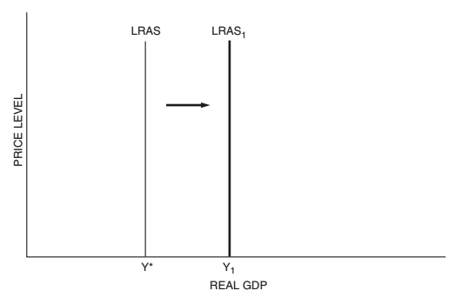
Notes:
When LRAS shifts right, we call that economic growth, and I believe that’s going to be it’s own, separate, presentation down the road.

Slide 27
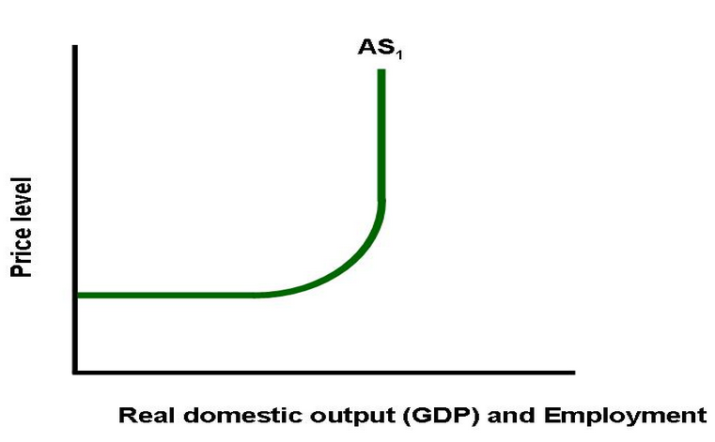
The Kinked Aggregate Supply Curve
Notes:
One more thing: those of you who attended my last session will know that short-run aggregate supply can also be depicted with a more complicated, bent, shape. AP won’t require students to draw this, or to interpret this graph, but it may make reference to it in a multiple choice question. A shift in aggregate demand, in this model, may behave differently than one in the simpler model of AS we’ve used thus far.

Slide 28
The Kinked Aggregate Supply Curve
AD1
AD2
Notes:
Consider this shift. Though aggregate demand increased, leading to higher output and more jobs, there is no inflation. Over the horizontal region of the short-run aggregate supply curve, there are believed to be idle resources. Firms, then, can increase their production without facing higher per-unit costs. For example, when we’re at this low level of employment, in a recession, there are a lot of unemployed people. Producers can increase hiring without workers gaining any leverage to negotiate higher wages.

Slide 29
The Kinked Aggregate Supply Curve
AD1
AD2
Notes:
In this intermediate range, shifts in aggregate demand have the expected effects on output and inflation. This is believed to be the range in which the real-life economy spends the most time, thus the comfort with using a simple upward sloping supply curve. It’s like we just zoomed in on this complex model so that the horizontal range at the left, and vertical range, at the right, were out of frame - still in existence, but irrelevant, out of sight and mind.

Slide 30
The Kinked Aggregate Supply Curve
AD2
AD1
Notes:
The other phenomenon we can see when depicting changes in equilibrium involve shifts in aggregate demand over the vertical range of short-run aggregate supply. Here an increase in demand leads only to inflation. This would be the result of people increased their desire, ability, and willingness to pay for things but producers were incapable of increasing production. Perhaps the factories are already operating 24 hours a day. Everyone in the workforce has a job and everyone who is willing is already working overtime. Offer a company more money and they can’t produce any more - but they can certainly charge more.

Slide 31
The Kinked Aggregate Supply Curve
LRAS
Notes:
In this model, full employment, the long-run equilibrium, is thought to lie here, in the upward sloping portion of SRAS just before it goes vertical.

Slide 32
Where Students May Struggle
Determining which line shifts in which direction
Notes:
This comes down to being solid on your knowledge of AS and AD. Here’s one tip to share with students which will help them avoid trouble: for purposes of any question asked in an AP course, a single event can only shift AS or AD in the short-run, never both. Students frequently go down rabbit holes of cause and effect in which they imagine future effects of an event and move both lines, perhaps even more than once.

Slide 33
Where Students May Struggle
Determining which line shifts in which direction
Long-run equilibrium
Notes:
AS will, in the long-run, respond to shifts in AD. That AD doesn’t, in a similar fashion, respond to AS shifts to get us back to equilibrium can be confusing at first. All I can suggest is to provide reminders and time for discussion around this.

Slide 34
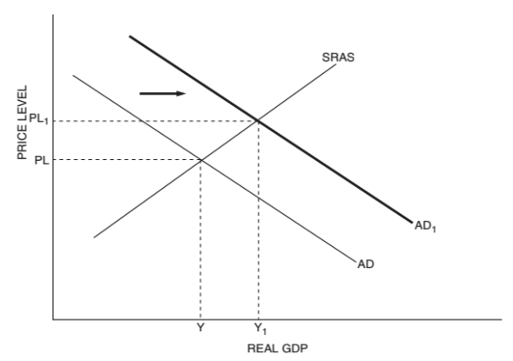
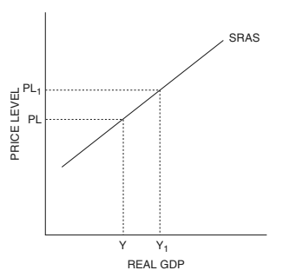
Where Students May Struggle
Determining which line shifts in which direction
Long-run equilibrium
A shift in one curve is a movement along the other
Notes:
Consider this increase in AD. This leads to a new equilibrium at a higher price level, and higher level of output, as the new AD crosses the short-run aggregate supply curve up and to the right. When we studied movements along curves we didn’t necessarily talk about WHY, for instance, the price level may have risen. Now is the time to communicate that a shift in one curve is the cause of a movement along the other.

Slide 35
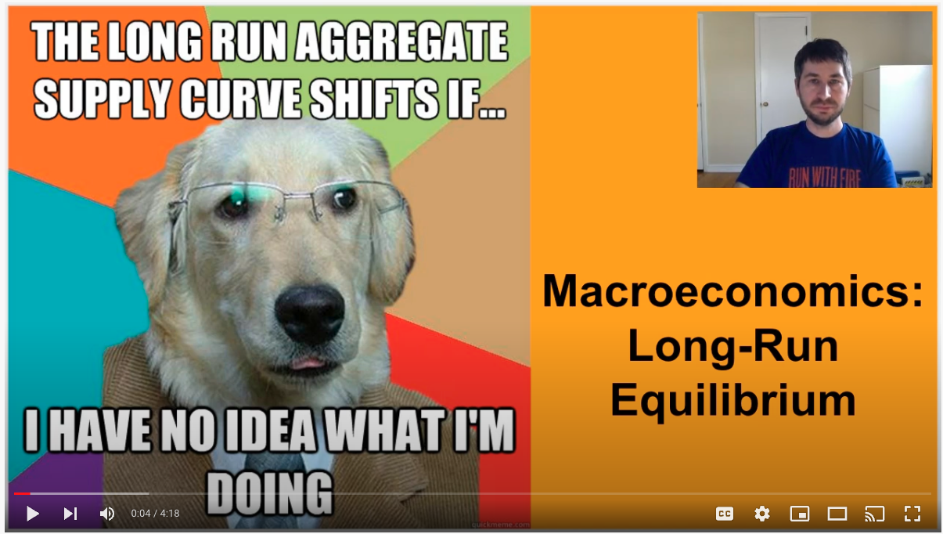
Ways to Teach This:
Lecture/Screencast/Textbook
Notes:
There are a great many topics in economics which I like to introduce through simulations and games. There are some things, and equilibrium in the macroeconomic model may be one of them, where some direct instruction can be valuable. Each of these traditional methods of instruction has its strengths and weaknesses, which is why I at least try to offer all three. One way or another, before we start on practice and review, you have to get the information out there somehow.

Slide 36
Ways to Teach This:
Lecture/Screencast/Textbook
Practice problems
Notes:
Once students have been introduced to aggregate the content, it’s time to practice. Practice problems are a vital part of instruction in an AP class. They not only provide practice with the content, but also practice understanding College Board’s writing style, which can sometimes be a bit confusing for students. Additionally, of course, they provide useful information for an instructor regarding ongoing areas of need for students.

Slide 37


Notes:
If you’ve attended some of the earlier webinars in this series, you’ve already heard about the usefulness of AP Classroom. You will have access to it once your district registers you as an instructor of AP Macroeconomics with them.

Slide 38
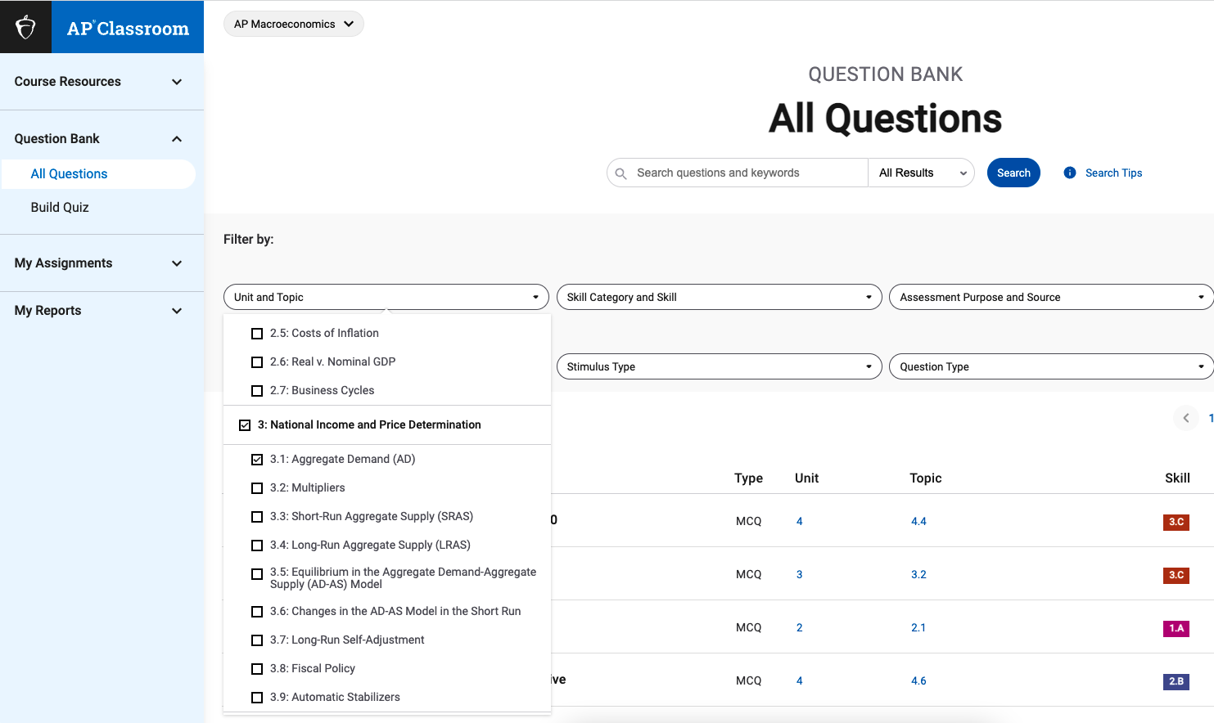
Notes:
In it you can specify a topic and type of question and get questions of identical style and difficulty to those which students will encounter on the AP test. If students are going to take the AP test, then they will need a login for this site anyway, so you can assign the questions to students directly through this system. It’s a good way to proceed, because AP doesn’t want you posting the questions elsewhere.

Slide 39
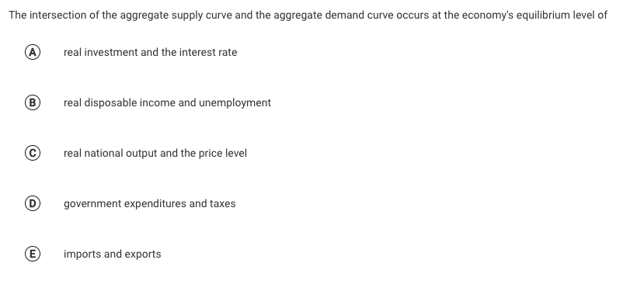
Notes:
Here’s an example question from AP Classroom.

Slide 40
Notes:
Here’s an example question from AP Classroom.

Slide 41

Ways to Teach This: Equilibrium in the AS/AD Model
Lecture/Screencast/Textbook
Practice problems
Worksheets
Notes:
The Council for Economics Education’s Advanced Placement 4th Edition Macroeconomics book provides a couple of things for you. (Click on the link above.) First, in the teacher’s manual, there’s a guide to help you in a lecture on aggregate supply. This will include a review of a lot of the information from this presentation, and will also try to anticipate places where students may make mistakes. Then, in the student book, there’s a worksheet. I like to have students work in groups on these. In this way, students support each other. When one student teaches another, they both benefit. And sometimes a fellow student can explain something in a different way than the teacher does, and it just clicks. If I’m honest, I frequently don’t grade these. Instead I’ll move throughout the room, providing feedback, and then we’ll go over the assignment together.

Slide 42



Ways to Teach This: Equilibrium in the AS/AD Model
Lecture/Screencast/Textbook
Practice problems
Worksheets
Review Games
Notes:
I don’t want to repeat my previous lessons too closely, but review games like Kahoot and Blooket are excellent classroom tools. I also suggest staging small quizbowl like competitions, old school, after the model of the finals in the National Economics Challenge.

Slide 43
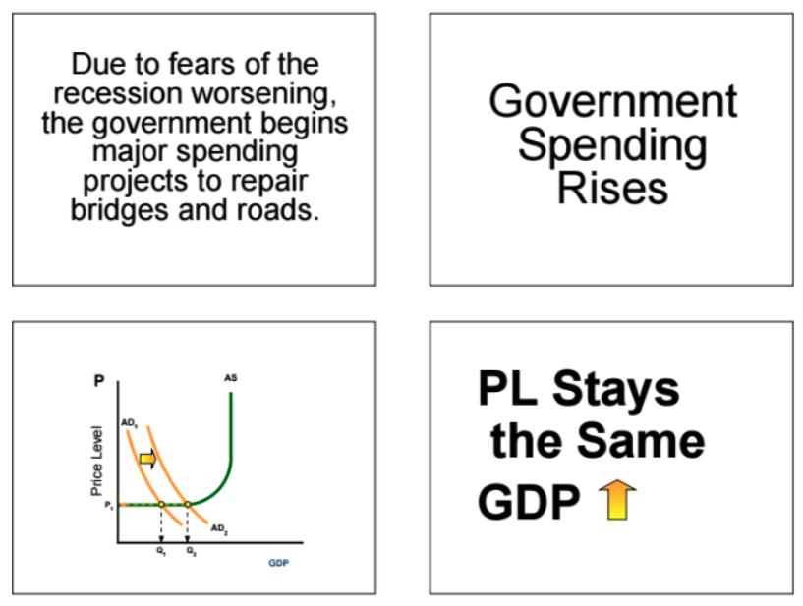
Ways to Teach This: Equilibrium in the AS/AD Model
Lecture/Screencast/Textbook
Practice problems
Worksheets
Review Games
Matching Cards

Slide 44

Ways to Teach This: Equilibrium in the AS/AD Model
Lecture/Screencast/Textbook
Practice problems
Worksheets
Review Games
Matching Cards
Watch the news

Slide 45

Questions?

Slide 46
Time Permitting: Real Life
1
PL1
AD1
Y1
Notes:
So I said that a single event only shifts one curve in AP Macroeconomics. Well, that’s one of our simplifications. The pandemic, if viewed as a single event, has changed everything. Last week we talked about the shift left of aggregate supply due to a variety of things, including supply chain troubles, producer nervousness, and people leaving the workforce. Prior to that we learned that aggregate demand has increased due to strong consumer confidence and strong consumer financial circumstances. Government programs, like efforts to keep interest rates low and stimulus checks have also encouraged spending.
Couple higher demand, and reduced aggregate supply, and you can expect inflation, represented as the rise from price level PL to PL1.
In 2021, real GDP has risen, but it still hasn’t return to where it was pre-pandemic. Further, employment, while much improved, still hasn’t reached its earlier level. I would assert, then, that while the economy is in a better place than many expected it to be, it still isn’t at long-run equilibrium.
But this model does help explain why things have gotten more expensive.

Slide 47
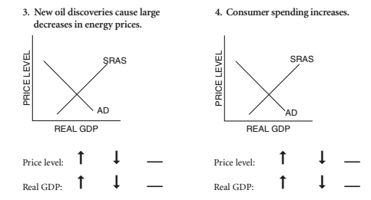
Time Permitting: Practice

Slide 48
MINNESOTA COUNCIL ON ECONOMIC EDUCATION (MCEE)
Our Vision
To equip all Minnesotans with the economic and personal financial understanding needed to succeed in today's complex economy.
Teaching Teachers, Engaging Students, and Reaching Communities
mcee.umn.edu | mcee@umn.edu | 612.625.3727
Notes:
Some upcoming webinars produced by the Minnesota council on economics education, which are open to educators world over include one titled Understanding Bitcoin, Cryptocurrency, & Blockchain Technology on February 1st and another titled Marvel Economics on February 22nd.

Slide 49
NATIONAL COUNCIL FOR ECONOMIC EDUCATION (CEE)
The Council for Economic Education’s (CEE’s) mission is to equip K-12 students with the tools and knowledge of personal finance and economics so that they can make better decisions for themselves, their families, and their communities.
We carry out our mission by providing resources and training to K-12 educators and have done so for over 70 years. Nearly two-thirds of the teachers we reach in-person are in low to moderate income schools. All resources and programs are developed by educators and delivered by our 188 affiliates across the country in every state. We reach over 50,000 teachers a year through in-person professional development and those teachers, in turn, reach approximately 5 million students throughout the country. EconEdLink, our free online educator gateway for economic and personal finance lessons and resources, attracts more than 700,000 unique visitors per year.
We also advocate for more and better education in personal finance and economics, primarily through the biennial Survey of the States.
Notes:
On February 7th I’ll lead the next session of our ongoing AP Macroeconomics series in which we’ll apply what we’ve learned today about equilbibrium in the AD-AS model to fiscal policy.

Slide 50
Thank You
Steven Cullison | steven.cullison@edinaschools.org
Notes:
Advertise upcoming sessions: Aggregate Supply on MLK Day in a week, Macroeconomic Equilibrium in which we bring AD and AS together on Monday Jan 31st, and Fiscal Policy on Feb. 7th.

