Slide 1
Macro AP Economic Series Business Cycles Presented by Kathy Pondy December 20th kathy.pondy@azecon.org

Slide 2
EconEdLink Membership
You can now access CEE’s professional development webinars directly on EconEdLink.org! To receive these new professional development benefits, become an EconEdLink member. As a member, you will now be able to:
Automatically receive a professional development certificate via e-mail within 24 hours after viewing any webinar for a minimum of 45 minutes
Register for upcoming webinars with a simple one-click process
Easily download presentations, lesson plan materials and activities for each webinar
Search and view all webinars at your convenience
Save webinars to your EconEdLink dashboard for easy access to the event
You may access our new Professional Development page here

Slide 3
Professional Development Certificate
To earn your professional development certificate for this webinar, you must:
Watch a minimum of 45-minutes and you will automatically receive a professional development certificate via e-mail within 24 hours.
Accessing resources:
You can now easily download presentations, lesson plan materials, and activities for each webinar from EconEdLink.org/professional-development/

Slide 4
Agenda
What is the Business Cycle? – 5 min
Teaching the concept of business cycle – 15 min
AP Macroeconomics framework – 5 min
Instructional idea – 10 min
Questions – 5 min

Slide 5
Objectives
Define and describe the phases of the business cycle
Graph the business cycle
Analyze economic data to determine phases of the business cycle

Slide 6
National Standards
National Content Standards in Economics – Content Standard 15: Economic Growth
Students will understand that economic growth is a sustained rise in a nation’s production of goods and services
Students will analyze real GDP for several periods in history

Slide 7
State Standards
Arizona Economic Standards
Students will use economic data to analyze the health of a national economy

Slide 8
Join Nearpod Presentation
Arizona Economic Standards
Students will use economic data to analyze the health of a national economy

Slide 9
Assessment Questions
What are the four phases of an economy’s cycle of expansions and contractions?
TBREA
How can real economic growth be measured?
When the economy experiences an expansion what is happening to Real GDP and unemployment?

Slide 10
What is the Business Cycle?
Change is the only thing that is constant. ~ Heraclitus
Every nation’s economy fluctuates between periods of expansion and contraction
These changes are caused by levels of employment, productivity, and the total demand and supply of the nation’s goods and services

Slide 11
What is the Business Cycle?
The business cycle is a model showing these fluctuations
Economists assess the performance of the economy with an introduction to measures of economic performance and the business cycle

Slide 12
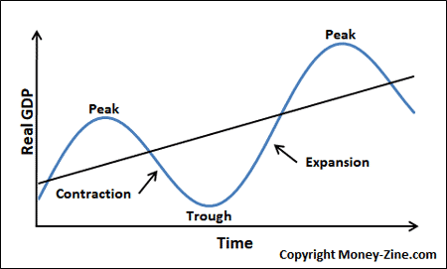
What is the Business Cycle?

Slide 13
What is the Business Cycle?
Key Vocabulary:
Business Cycle
Expansion
Contraction
Recession
Depression
Peak
Trough
Growth trend
Output gap

Slide 14
Teaching the Business Cycle
1 day of instruction following instruction on economic indicators
Practice drawing the model
Exit ticket assessment

Slide 15
Business Cycle
The business cycle model shows the fluctuations in a nation’s aggregate output and employment over time.
The solid line in the model shows the growth trend of a nation’s economy

Slide 16
Business Cycle
The trend line represents continually growth over time
At this point the nation’s resources are fully utilized – full employment

Slide 17
Business Cycle
The blue line shown represents the actual cycles of economic output
Students need to be able to
Identify them on the graph
Understand what causes them
Analyze what is indicates about the current health of the economy

Slide 18
Business Cycle
Expansion
Peak
Contraction
Trough

Slide 19
Expansion
During an expansionary period, output – Real GDP – is increasing and unemployment is falling.

Slide 20
Expansion
Eventually the output growth will slow down
The peak of the model represents the highest production point in that cycle

Slide 21
Expansion
Important to know:
As unemployment rises, but still falls below the trend line, an output gap occurs
Not necessarily considered economic growth, may simply be recovery

Slide 22
Contraction
During a contractionary period, output – Real GDP – is falling and unemployment is rising

Slide 23
Contraction
Eventually the fall in output will ease and real GDP will begin to increase
The of trough represents the lowest production point in that cycle

Slide 24
Contraction
Important to know:
-Unemployment is rising during expansions, GDP is falling
-If the contractionary period last for more than 2 consecutive quarters, it is considered a recession

Slide 25
Output Gaps
In the short-run output gaps are the difference between actual output and the growth trend
Can be positive or negative
Policymakers use the gap to make policy decisions

Slide 26
Discussion Questions
1) Why does unemployment rise during the recession phase of the business cycle?
2) What is the difference between a recession and a depression?
3) If a country is producing beyond its production possibilities curve, what phase of the business cycle is it most likely experiencing?

Slide 27
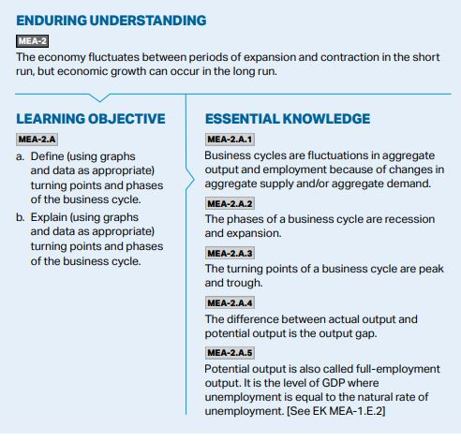
Where it fits in an AP Macroeconomics course
Unit 2 12 – 17% of test score
Business Cycles is one day in the 9 – 12-day unit
Suggested skill – Principles and Models
Essential Knowledge

Slide 28
AP Macroeconomics
When teaching this course, keep in mind that quantitative analysis in economics involves interpretation and application

Slide 29
Instructional Ideas
“Ask the Expert” Assign
Assign small groups to research the three economic indicators addressed in this unit: the unemployment rate, the inflation rate, and GDP
Students should find current data so that they are prepared to explain the status of their indicator to their classmates
Once students have become experts on their given indicator, have groups rotate through each expert station to learn about the indicators they have not yet mastered

Slide 30
Business Cycles through the Decades

Slide 31
References
https://www.khanacademy.org/economics-finance-domain/ap-macroeconomics/economic-iondicators-and-the-business-cycle/business-cycles/a/lesson-summary-business-cycles
https://courses.lumenlearning.com/wmopen-macroeconomics/chapter/business-cycles/
https://www.investopedia.com/terms/o/outputgap.asp

Slide 32
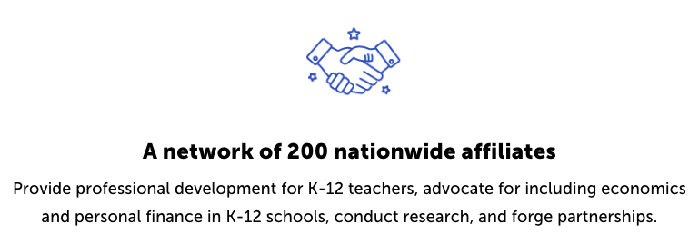
CEE Affiliates
https://www.councilforeconed.org/resources/local-affiliates/

Slide 33
Thank You to Our Sponsors!

