Slide 1
Your Personal Finance for Teachers:
Protecting Your Assets and Using Debt Strategically
Teachers Can Be Financially Fit, Too Tawni Hunt Ferrarini, PhD Lindenwood University tferrarini@lindenwood.edu Tawni.org

Slide 2
EconEdLink Membership
You can now access CEE’s professional development webinars directly on EconEdLink.org! To receive these new professional development benefits, become an EconEdLink member. As a member, you will now be able to:
Automatically receive a professional development certificate via e-mail within 24 hours after viewing any webinar for a minimum of 45 minutes
Register for upcoming webinars with a simple one-click process
Easily download presentations, lesson plan materials and activities for each webinar
Search and view all webinars at your convenience
Save webinars to your EconEdLink dashboard for easy access to the event
You may access our new Professional Development page here

Slide 3
Professional Development Certificate
Earn your professional development certificate for this webinar:
Watch a minimum of 45-minutes, and a professional development certificate will automatically be e-mailed to you within 24 hours.
Access resources:
Download presentations, lesson plan materials, and activities for each webinar at EconEdLink.org/professional-development/

Slide 4
Full Disclosure.
I am not a financial advisor. This presentation connects you to educational resources designed by teachers for teachers. It is research based on and driven by economic reasoning.

Slide 5
Discussion Starter
From a financial perspective, which concerns you most?

Slide 6
A Little Background
Teachers Can Be Financially Fit: Economist’s Advice for Educators
Written by four teachers for teachers (Mark Schug, Bill Wood, Scott Niederjohn and Tawni Ferrarini)
This 14-chapter book customized personal finance for teachers and includes case studies and 911s.
The book can be ordered from Springer (the publisher, it offers bulk order discounts) or Amazon.
This site overs financial tools and curriculum links for teachers. www.financiallyfitteachers.com

Slide 7
Agenda
Welcome to “Your Personal Finance: Protecting Your Assets and Using your Debt Strategically”
Review key financial objectives
Link the current asset and debt decisions to the future
Complete a family finance case study
Identify useful resources
Review – once over lightly

Slide 8
Objectives
Relate to national and regional standards
Define assets, credit, debt and debt-to-income ratio customized for teachers
Link today’s spending and saving to future financial frontiers
Explore strategies to live comfortably and securely in light of current events
Leverage available resources
Take action and be a good steward of your finances

Slide 9
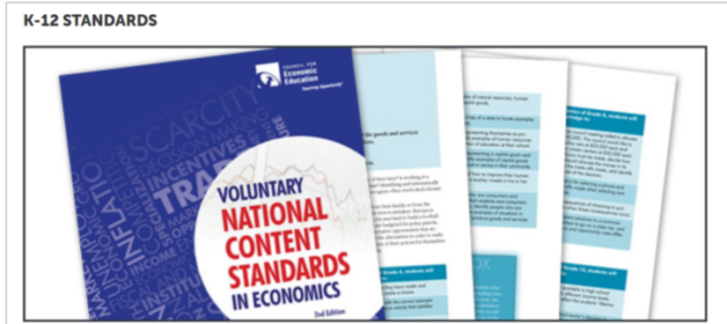
National Standards
3. Allocation & 12. Interest Rates
5. Financial Investing

Slide 10
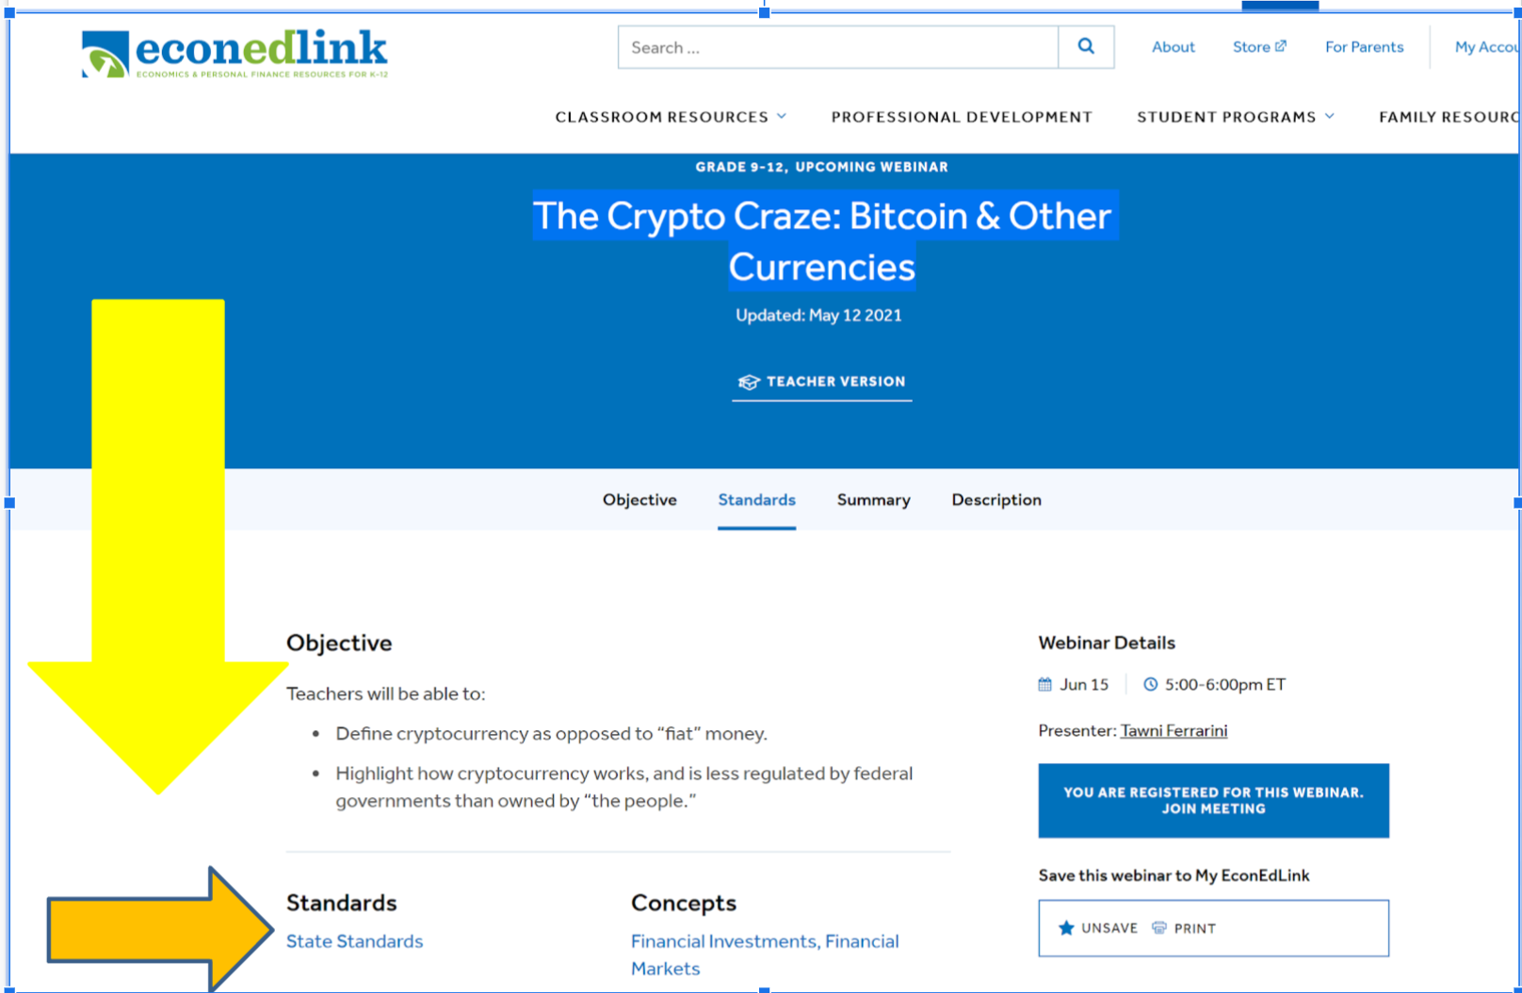
Customize the Resources based on Standards
Find your list of corresponding regional standards with your favorite browser.

Slide 11
Teacher’s Financial Challenges
Name two asset and/or debt challenges unique to teachers.

Slide 12
Drag your dot to indicate whether you agree or disagree:
Agree
Disagree
RESPOND: I could “retire” comfortably at the end of this year if offered 50% of one year’s pay as severance OR leave with minimal stress if laid off.

Slide 13
Realities
Every profession faces periods of unemployment.
Every living person retires.

Slide 14
Plan!
Devise a plan for your working career.
Create one that leads to a life of financial security and comfort.

Slide 15
Assets
Major source of income: active teaching income…
Do you know your labor market?
What is the median pay?
How many teacher jobs were there in 2020?
What is the projected change?

Slide 16
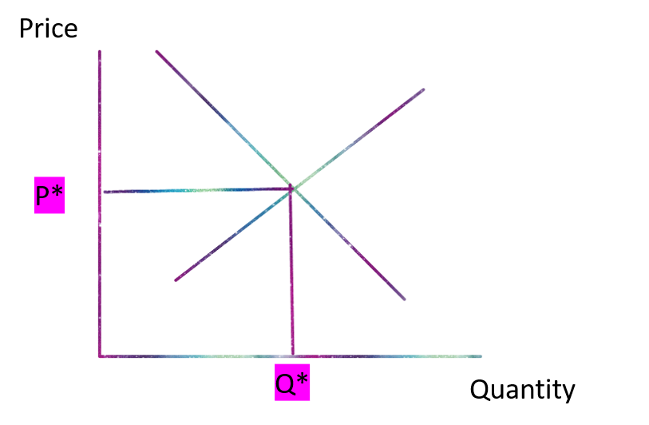
BLS-OOH
Market for _______________ teachers
Pick an occupation
Identify the median pay or annually salary for 2020
Identify the total number of jobs, 2020
Median pay per year
Total number of jobs

Slide 17
BLS-OOH
Market for ???
Market for _______________
2. Median pay
Median pay per year
3. Total number o jobs, 20YY
Total number of jobs

Slide 18
ASSETS AND INCOME
Decode that paycheck
DEBT
Active Income: You provide time, skills, expertise for wages, salaries and more.

Slide 19
ASSETS AND INCOME
Decode that paycheck
Savings
Investments
House and commercial property
Retirement income
Pension, Social Security (if eligible)
More
DEBT
Passive income: you do NOT do something personally to earn the income; By other means...
DIVERSIFY!

Slide 20
ASSETS AND INCOME
Decode that paycheck
Diversify your investment portfolio (Doing so helps manage downside risk)
DEBT
Financing through credit cards and debt

Slide 21
ASSETS AND INCOME
Decode that paycheck
Investment portfolio diversification
DEBT
Financing through credit cards and debt
DEBT TO INCOME RATIO CALCULATOR

Slide 22
Framing the Task
Different people with varying incomes spend, use debt, save and invest for different reasons.

Slide 23
Framing the Task
Different people spend, use debt, save and invest for different reasons.
These reasons are connected to financing short-term purchases (vacation, entertainment room, and more), preparing for large purchases (such as higher education, autos, and homes), and more.

Slide 24
Framing the Task
Different people spend, use, debt, save and invest for different reasons.
These reasons are connected to financing short-term purchases (vacation, entertainment room, and more), preparing for large purchases (such as higher education, autos, and homes), and more.
BALANCE THE TWO -- INCOME VS DEBT and DEBT vs INCOME -- over a lifetime!

Slide 25
FOCUS
Choose comfortable and secure financial living as a key goal.

Slide 26
FOCUS
Choose comfortable and secure financial living as a key goal.
Use the present to build a future income stream based on research.

Slide 27
FOCUS
Choose comfortable and secure financial living as a key goal.
Use the present to build a future income stream based on research.
ASSETS vary in value, and different types of DEBT represent different commitments to pay.

Slide 28
Financial Investing
Financial investment involves the purchase of financial assets with income (wages, salaries, interest income, dividend income and more).
The intent is to increase income in the future or build wealth over time.

Slide 29
Financial Investing
Financial investment involves the purchase of financial assets with income (wages, salaries, interest income, dividend income and more).
Investors choose to use their income to purchase among stocks, bonds, savings and various other financial instruments.
Each has different risks and expected rates of return.

Slide 30
Financial Debt
Represents commitmentsto pay overtime in exchange for getting something now.
Borrow an amount - the principal.
Make a promise to pay over time.
Pay a price for money now versus saving for the future and financing yourself.
Pay interest.

Slide 31
Debt:
Commitments to Pay With or Without Interest
“Good Debt”
Amounts borrowed when the rate of return is greater than the cost of borrowing (interest) .
That is, the expected benefits are greater than the costs.
“Bad Debt”
Amounts borrowed when the rate of return is LESS than the cost of borrowing (interest) .
That is the expected benefits are LESS than the costs.

Slide 32
Good or Bad Debt?
Which of the following increases the net worth or has future value for the teacher… making $40,000 with a student loan of $20,000 at a rate of 3.5% over 10 years?
.

Slide 33
Debt:
Commitments to Pay With or Without Interest
“Good Debt”
“Bad Debt”

Slide 34
Knowing Your DTI…
Debt-To-Income Ratio.
Shed the bad debt and manage the good debt.
Reduce the DTI.
Expand your future financing options and lower your rates of interest.

Slide 35
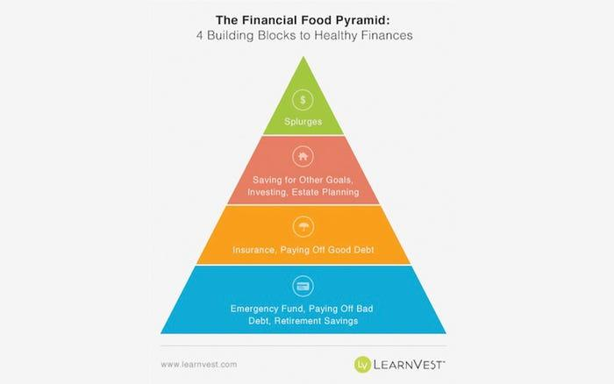
Emergency Fund, Paying off bad debt, leveraging retirement savings
https://www.fool.com/investing/general/2014/08/17/the-pyramid-approach-to-retirement-planning.aspx

Slide 36
Insurance and Paying off good debt
https://www.businessinsider.com/personal-finance/pyramid-financial-security-2014-4

Slide 37
Saving for other goals, investing, estate planning
https://www.businessinsider.com/personal-finance/pyramid-financial-security-2014-4

Slide 38
Splurge
https://www.businessinsider.com/personal-finance/pyramid-financial-security-2014-4

Slide 39
Independence
INDEPENDENT OF WHERE YOU ARE...
PLAN!
MODIFY YOUR CHOICES -- THE MOST VALUABLE ASSET YOU HAVE!

Slide 40
Important disclosures
No one knows the future.
Always know your DTI and manage it to live securely and comfortably.
This much is certain: A high DTI limits your options during recessions and expansions!

Slide 41
Take Inventory
Step back:
Inventory your financial assets, insurance, and income streams.
Financial assets include a wide variety of financial instruments including bank deposits, stocks, bonds, and mutual funds.
Identify all income streams - earned income, passive income, dividends, interest, and more.

Slide 42
Take Inventory
List all your debt.
Separate the good from the bad.
Manage each with emphasis on getting rid of the bad.

Slide 43
Evaluate: DTI
What the debt? A new teacher pays $1500 a month for a mortgage and another $100 a month for an auto loan, $200 in student loans, and $200 a month in other debts, determine the monthly payments.

Slide 44
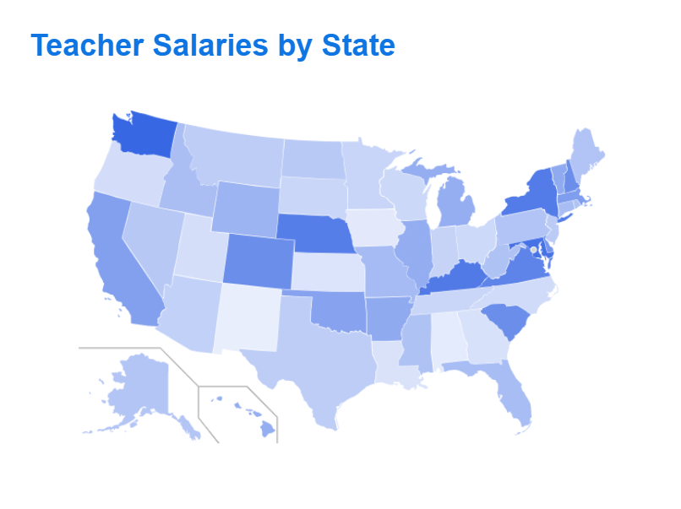
Evaluate: DTI (Answers)
What the debt? A new teacher pays $1500 a month for a mortgage and another $100 a month for an auto loan, $200 in student loans, and $200 a month in other debts, determine the monthly payments.
Answer: $2000 (=$1500+$100+$200+$200)
Research monthly salaries for teachers around the U.S. at https://www.ziprecruiter.com/Salaries/Teacher-Salary-per-Month

Slide 45
DTI: 2
This new teacher nets $44,000 a year in a high demand school district. What is the monthly salary?

Slide 46
DTI: 2 (Answers)
This new teacher nets $44,000 a year in a high demand school district. What is the monthly salary?
Answer: (Above $3600 = $44,000/12)

Slide 47
DTI: 3
A teacher with a monthly income of $3600 and $2000 in total debt has a DTI of:

Slide 48
DTI: 3 (Answers)
A teacher with a monthly income of $3600 and $2000 in total debt has a DTI of:
Answer: 18 ($3600/$2000)
This teacher will manage debt payments quite easily, is attractive to creditors, and is likely to get relatively low rates of interest IF financing a home, car, additional education, and such are strategic.

Slide 49
DTI: Learn More

Slide 50
Evaluate and Plan
Evaluate your income (active and passive).
Consider your debt.
Determine your DTI.
Devise a plan to move forward (with some help from your friends).

Slide 51
References
EconEdLink.org
Financial Fitness for Life, Grades 9-12
Teachers Can Be Financially Fit, Too

Slide 52
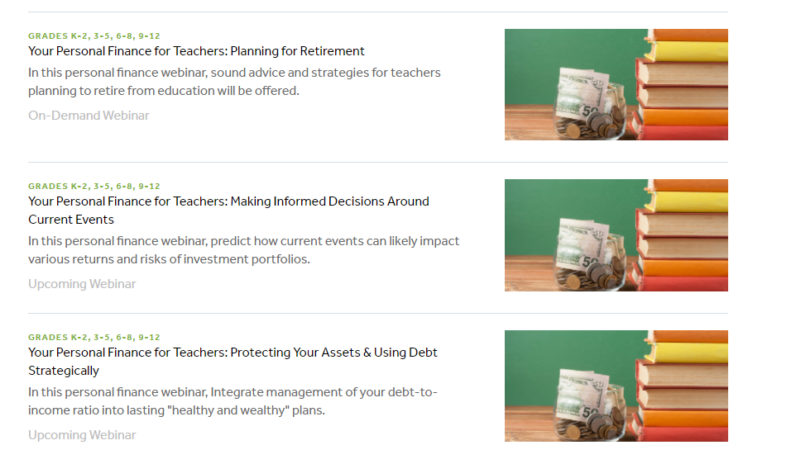
STAY CONNECTED: ON-DEMAND

Slide 53
Questions?

Slide 54
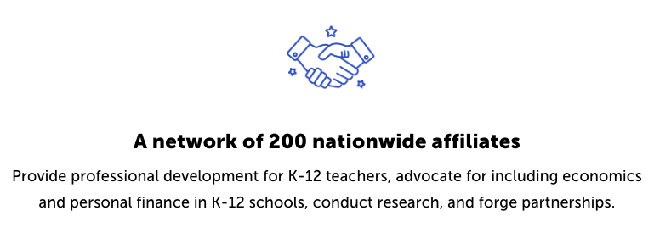
CEE Affiliates
https://www.councilforeconed.org/resources/local-affiliates/

Slide 55
Thank You to Our Sponsors!

