Slide 1
CALCULATING To Create a budget: Using the Percentage Allocation Method to Create a Basic Spending and Savings Plan

Slide 2
Can a family comfortably live on a household income of $62,843.00 per year?

Slide 3
It Depends!

Slide 4
Budget
A budget is a spending-and-savings plan, based on estimated income and expenses for an individual or an organization, covering a specific time period.
Individual households need budgets in order to ensure that their financial future is secure.
Some financial experts recommend that when creating a budget, families adhere to certain percentages to best allocate their income.

Slide 5
Carlos and Sofia's Budget
Carlos and Sofia live in Maine and have a household income of $62,843.00 per year, or $5,236.92 per month.
They are interested in creating a monthly budget and would like to know how much they can afford to spend and save.
After doing much research, Carlos & Sofia have decided to create their budget by using the percentage allocation method.

Slide 6
Carlos and Sofia's Budget
The method we will use to calculate each expense category will be multiplying monthly income ( I ) by the percentage allocated to each expense category expressed as a decimal (p).
This will equal the total dollar amount budgeted (AB) for each expense.
This calculation can also be expressed by the formula:

Slide 7
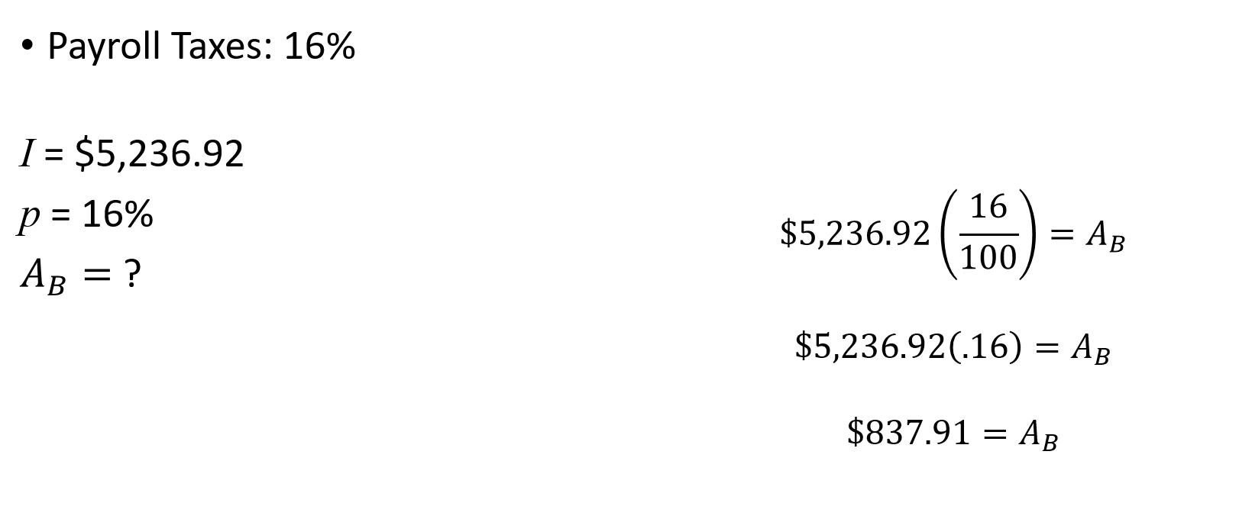
Carlos and Sofia's Budget

Slide 8
Carlos and Sofia's Budget

Slide 9
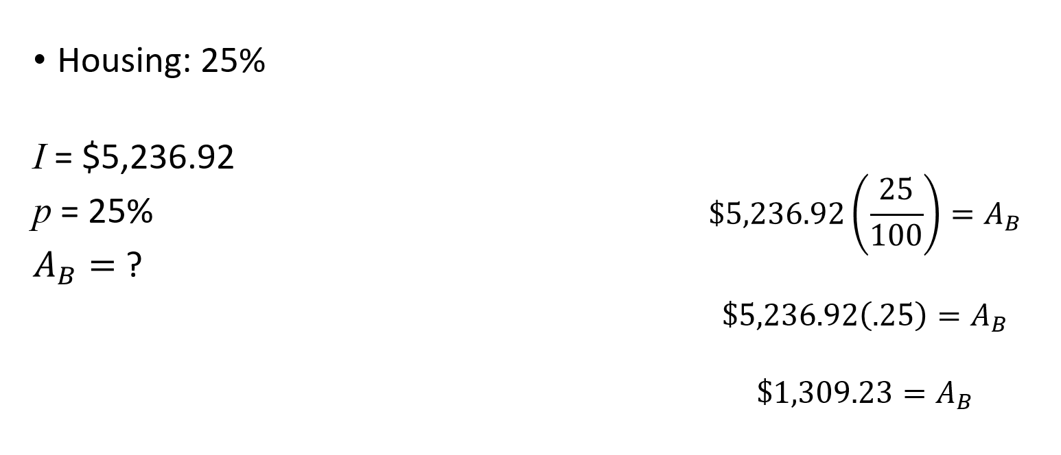
Carlos and Sofia's Budget

Slide 10
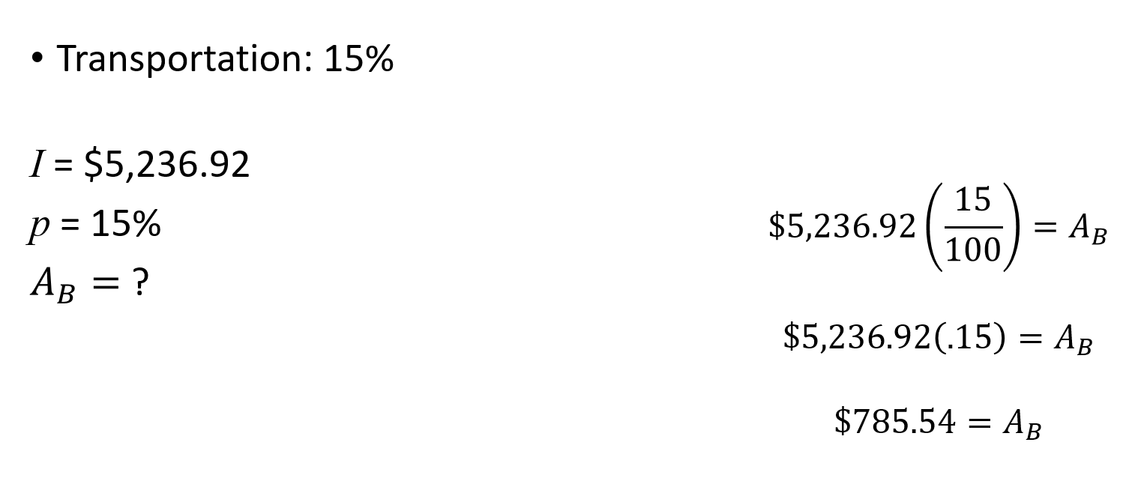
Carlos and Sofia's Budget

Slide 11
Carlos and Sofia's Budget

Slide 12
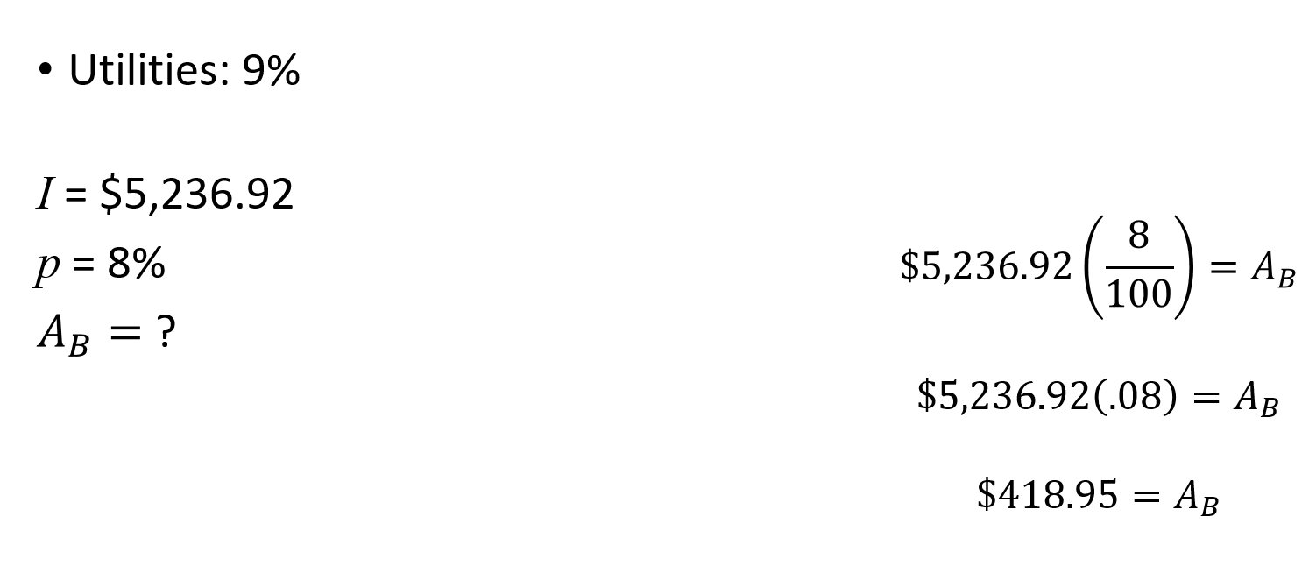
Carlos and Sofia's Budget

Slide 13
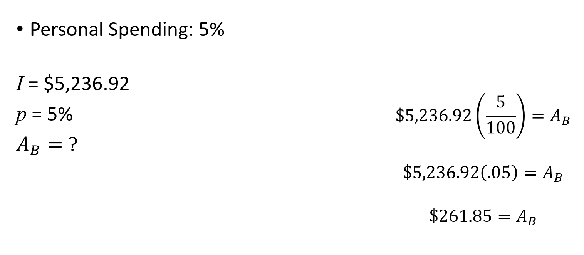
Carlos and Sofia's Budget

Slide 14
Carlos and Sofia's Budget: Checkpoint
In order for the budget to be feasible for Carlos and Sofia, the budget must balance.
Total Monthly Income: $5,236.92
Total Monthly Budgeted Savings & Expenses: $5,236.92

Slide 15
Occupation Based Budget
Open a web-browser and navigate to: https://www.bls.gov/k12/students/careers/career-exploration.htm
Read the list of occupational areas given and select a job in an area that most interests you. For example, if you are interested in learning more about careers where you help your community, click on Helping your community and then select one of the specific job titles listed, such as Social Worker or Firefighter.
Once you select an occupation, you will be brought to the United States Bureau of Labor Statistics’ Occupational Outlook Handbook entry for that profession. In the summary section, find the yearly median pay for the profession. Use this number to calculate monthly income (I).

