Slide 1
Scarcity Presented by Joshua Frost, Brooklyn Technical High School 10/04/2021 jfrost@schools.nyc.gov

Slide 2
EconEdLink Membership
You can now access CEE’s professional development webinars directly on EconEdLink.org! To receive these new professional development benefits, become an EconEdLink member. As a member, you will now be able to:
Automatically receive a professional development certificate via e-mail within 24 hours after viewing any webinar for a minimum of 45 minutes
Register for upcoming webinars with a simple one-click process
Easily download presentations, lesson plan materials and activities for each webinar
Search and view all webinars at your convenience
Save webinars to your EconEdLink dashboard for easy access to the event
You may access our new Professional Development page here

Slide 3
Professional Development Certificate
To earn your professional development certificate for this webinar, you must:
Watch a minimum of 45-minutes and you will automatically receive a professional development certificate via e-mail within 24 hours.
Accessing resources:
You can now easily download presentations, lesson plan materials, and activities for each webinar from EconEdLink.org/professional-development/

Slide 4
Agenda
Scarcity Defined
Council for Economic Education Resource Overview
Crash Course Economics
Scarcity Defined as social, political, or economic issue
Catan as classroom resource to teach Unit 1 concepts such as scarcity, PPC, Invisible Hand, opportunity costs, tradeoff, trade, and supply and demand
Catan Extension: Guns, Germs and Steel reading on the Māori and Morori

Slide 5
National Standards
https://www.councilforeconed.org/wp-content/uploads/2012/03/voluntary-national-content-standards-2010.pdf
Content Standard 16: Role of Government and Market Failure: There is an economic role for government in a market economy whenever the benefits of a government policy outweigh its costs. Governments often provide for national defense, address environmental concerns, define and protect property rights, and attempt to make markets more competitive. Most government policies also have direct or indirect effects on people’s incomes.
Content Standard 17: Government Failure: Costs of government policies sometimes exceed benefits. This may occur because of incentives facing voters, government officials, and government employees, because of actions by special interest groups that can impose costs on the general public, or because social goals other than economic efficiency are being pursued.

Slide 6
National Standards
Content Standard 9: Students will understand that: Competition among sellers usually lowers costs and prices, encourages producers to produce what consumers are willing and able to buy. Competition among buyers increases prices and allocates goods and services to those people who are willing and able to pay the most for them.
Content Standard 10: Institutions evolve and are created to help individuals and groups accomplish their goals. Banks, labor unions, markets, corporations, legal systems, and not-for-profit organizations are examples of important institutions. A different kind of institution, clearly defined and enforced property rights, is essential to a market economy.
Content Standard 15: Investment in factories, machinery, new technology, and in the health, education, and training of people stimulates economic growth and can raise future standards of living.

Slide 7
State Standards
NY State Standards http://www.nysed.gov/curriculum-instruction
The study of economics requires an understanding of major economic concepts and systems, the principles of economic decision making, and the interdependence of economies and economic systems throughout the world. Students:
analyze the effectiveness of varying ways societies, nations, and regions of the world attempt to satisfy their basic needs and wants by utilizing scarce resources
define and apply basic economic concepts such as scarcity, supply/demand, opportunity costs, production, resources, money and banking, economic growth, markets, costs, competition, and world economic systems
understand the nature of scarcity and how nations of the world make choices which involve economic and social costs and benefits
describe the ideals, principles, structure, practices, accomplishments, and problems related to the United States economic system
understand the roles in the economic system of consumers, producers, workers, investors, and voters.

Slide 8
Assessment Questions
What is a scarce resource?
What is scarcity?
How do environmental factors play a role in resource allocation?
What are opportunity costs and how do society’s determine which resources are essential to their success?
What role does trade play in determining how to distribute and allocate scarce resources?
What is comparative advantage, and how do societies organize around resources and trade?

Slide 9
Scarcity
Scarcity is one of the key concepts of economics. It means that the demand for a good or service is greater than the availability of the good or service. Therefore, scarcity can limit the choices available to the consumers who ultimately make up the economy.

Slide 10
Scarcity
Scarcity exists because we have limited resources and unlimited wants. No society has ever had enough resources to produce all the good and services its members wanted.
Scarcity requires people to make choices. If we use scarce resources for one purpose, we cannot use the for another.

Slide 11
Scarcity
Opportunity Cost is the forgone benefit of the next best alternative when resources are used for one purpose rather than another. Because of scarcity every decision has an opportunity cost.
Economic costs take account of the opportunity costs of doing one thing over another.

Slide 12
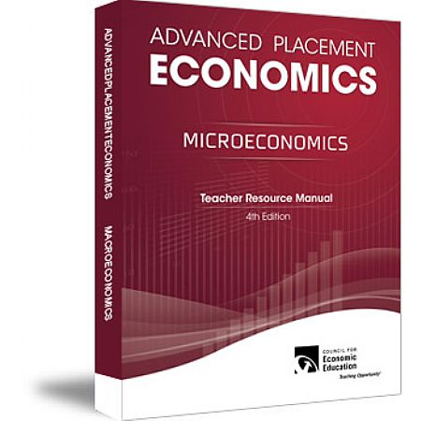
Council for Economic Education Workbooks

Slide 13
Advance Placement Economics 4th Edition
Activity 1.1
Activity 1.2
Visual 1.1
…Available on the CEE store

Slide 14
Macroeconomics
Do You Think Like an Economist?
Circle T for true or F for false in the statements that follow.
T F 1. Because it is desirable, sunshine is scarce.
T F 2. Because it is limited, polio is scarce.
T F 3. Because water covers three-fourths of the earth’s surface and is renewable, it cannot be
considered scarce.
T F 4. The main cost of going to college is tuition, room, and board.
T F 5. If mass transportation fares are raised, almost everyone will take the trains anyway.
T F 6. You get what you pay for.
T F 7. If someone makes an economic gain, someone else loses.
T F 8. If one nation produces everything better than another nation, there is no economic
reason for these two nations to trade.
T F 9. A nonregulated monopoly tends to charge the highest possible price.
T F 10. A business owner’s decision to show more care for consumers is a decision to accept
lower levels of profits

Slide 15
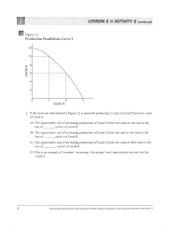

Slide 16
Ways of thinking Like Economists… Council of Economic Education Resources, Visual 1.1

Slide 17
Scarcity Council of Economic Education Resources
Scarcity Video:
https://vimeo.com/331311542
Opportunity Costs:
https://vimeo.com/307566929
Scarcity Kahoot Game:
https://create.kahoot.it/share/scarcity-video-and-quiz/26c5b457-7444-4594-9ff9-4514c14b1a0a

Slide 18
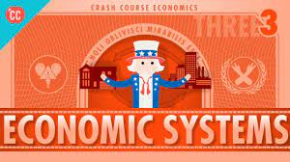
Crash Course Economics
Intro to Economics: Crash Course Econ #1 - YouTube
4:25-6:45

Slide 19
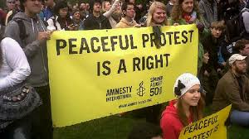
Scarcity defined as a political, economic, or social issue.

Slide 20
Scarcity as an economics issue
Taxation, resource allocation, development, and economic philosophy are examples of discussion points.
Global
National
State
Local/Municipal

Slide 21
Scarcity as a political issue
Representation, party affiliation, sustainability, infrastructure, interpretations of law are possible topics for discussion.
Global
National
State
Local/Municipal

Slide 22
Scarcity as a social issue
Possible topics for discussion: equity, social justice, protest movements, entrenched societal systemic institutions, immigration policy…
Global
National
State
Local/Municipal

Slide 23
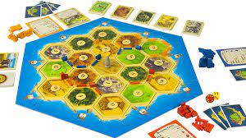
Catan

Slide 24
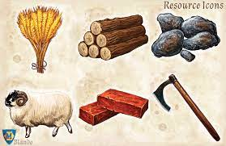
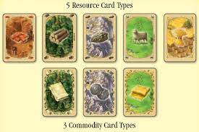
Catan Resources

Slide 25
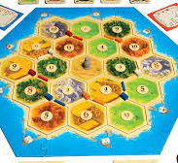
Catan: The Board

Slide 26
Catan Extensions: Guns, Germs and Steel
by Jared Diamond
https://www.amazon.com/Natural-Experiments-History-Jared-Diamond/dp/0674060199
Focus: How geography molded societies on Polynesian islands pages 53-66

Slide 27
Catan Extensions: Guns, Germs and Steel
“Contributing to these differences among Polynesian societies were at least six sets of environmental variables among Polynesian islands: island climate, geological type, marine resources, area, terrain fragmentation, and isolation. Let's examine the ranges of these factors, before considering their specific consequences for Polynesian societies.”
-Jeremy Diamond, Guns, Germs and Steel- page 58

Slide 28
Discussion Questions for Guns, Germs, and Steel Reading
CHAPTER 2: A Natural Experiment of History from Guns, Germs and Steel by Jared Diamond
1. Why does Diamond call the development of Polynesian societies a “natural experiment of history?”
2. Why did the Maori and the Moriori evolve differently?
3. How does the fact that the Maori defeated the Moriori support Diamond’s argument on the importance of environmental factors in history?
4. What are the six environmental factors that Diamond isolates in his discussion of Polynesian societies?

Slide 29
Discussion Questions for Guns, Germs and Steel Reading
5. How did population density affect economies, social complexity and political organization?
6. Which of the six factors do you consider most important? Explain your reasoning.
7. Evaluate Diamond’s arguments. Are they convincing or not? Explain where you agree or disagree with Diamond’s views.

Slide 30
CEE Affiliates
https://www.councilforeconed.org/resources/local-affiliates/

Slide 31
Thank You to Our Sponsors!

