Slide 1
The Economics of Incarceration
Presented by Theodore Opderbeck 12/14/2021 opderbeckt@waldwickschools.org

Slide 2
EconEdLink Membership
You can now access CEE’s professional development webinars directly on EconEdLink.org! To receive these new professional development benefits, become an EconEdLink member. As a member, you will now be able to:
Automatically receive a professional development certificate via e-mail within 24 hours after viewing any webinar for a minimum of 45 minutes
Register for upcoming webinars with a simple one-click process
Easily download presentations, lesson plan materials and activities for each webinar
Search and view all webinars at your convenience
Save webinars to your EconEdLink dashboard for easy access to the event
You may access our new Professional Development page here

Slide 3
Professional Development Certificate
To earn your professional development certificate for this webinar, you must:
Watch a minimum of 45-minutes and you will automatically receive a professional development certificate via e-mail within 24 hours.
Accessing resources:
You can now easily download presentations, lesson plan materials, and activities for each webinar from EconEdLink.org/professional-development/

Slide 4
Agenda
Discuss how economic decisions have shaped our national incarceration/corrections policy
Examine U.S. incarceration statistics and compare to other nations.
Explore alternative incarceration models that rely more on human capital development and rehabilitation.
Introduce dynamic learning activities, lesson plans, and digital resources to reinforce content.

Slide 5
Objectives
To analyze the current state of incarceration in the U.S. using statistics and quantitative data.
To explore how economic concepts shape our corrections system.
To discuss how economic and racial inequality contribute to corrections dysfunction.
To investigate alternative systems that encourage human capital development.
To introduce dynamic learning activities and project ideas to engage students.

Slide 6
National Standards
Council for Econ Ed Standard 3: Allocation
Different methods can be used to allocate goods and services. People acting individually or collectively must choose which methods to use to allocate different kinds of goods and services.
.https://www.councilforeconed.org/wp-content/uploads/2012/03/voluntary-national-content-standards-2010.pdf

Slide 7
National Standards
Council for Econ Ed Standard 17: Government Failure
Costs of government policies sometimes exceed benefits. This may occur because of incentives facing voters, government officials, and government employees, because of actions by special interest groups that can impose costs on the general public, or because social goals other than economic efficiency are being pursued.
https://www.councilforeconed.org/wp-content/uploads/2012/03/voluntary-national-content-standards-2010.pdf

Slide 8
State Standards
12.G5 PUBLIC POLICY: All levels of government—local, state, and federal—are involved in shaping public policy and responding to public policy issues, all of which influence our lives beyond what appears in the Constitution. Engaged citizens understand how to find, monitor, evaluate, and respond to information on public policy issues.
http://www.nysed.gov/common/nysed/files/programs/curriculum-instruction/ss-framework-9-12.pdf

Slide 9
Question of the Day
Which U.S. state has the highest number of people in prison?
California
Florida
New York
Texas
https://worldpopulationreview.com/state-rankings/prison-population-by-state

Slide 10
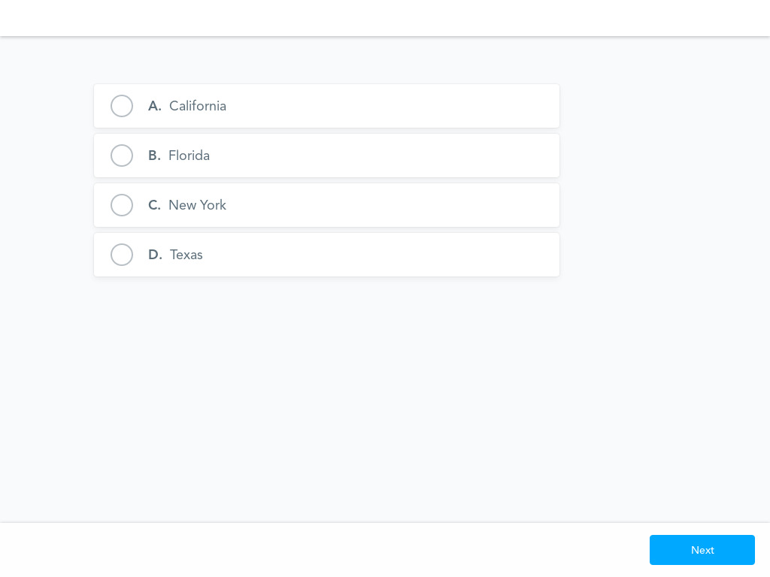

Slide 11
Economics and Cross Curricular Applications
Political Science
Law/ Criminal Justice
Sociology
Scarcity
Comparative Economic Systems
Resource Allocation Models
Fiscal Policy

Slide 12
Important Concepts
Incarceration
Decarceration
Mass Incarceration
Recidivism

Slide 13
Philosophies of Punishment
Retribution: revenge enacted due to a wrong/criminal act “Just Desserts”
Deterrence: discouraging others from committing a crime by making an example of criminals
Incapacitation: removing dangerous offenders from society
Rehabilitation: working to help offenders re-enter society and actively contribute

Slide 14
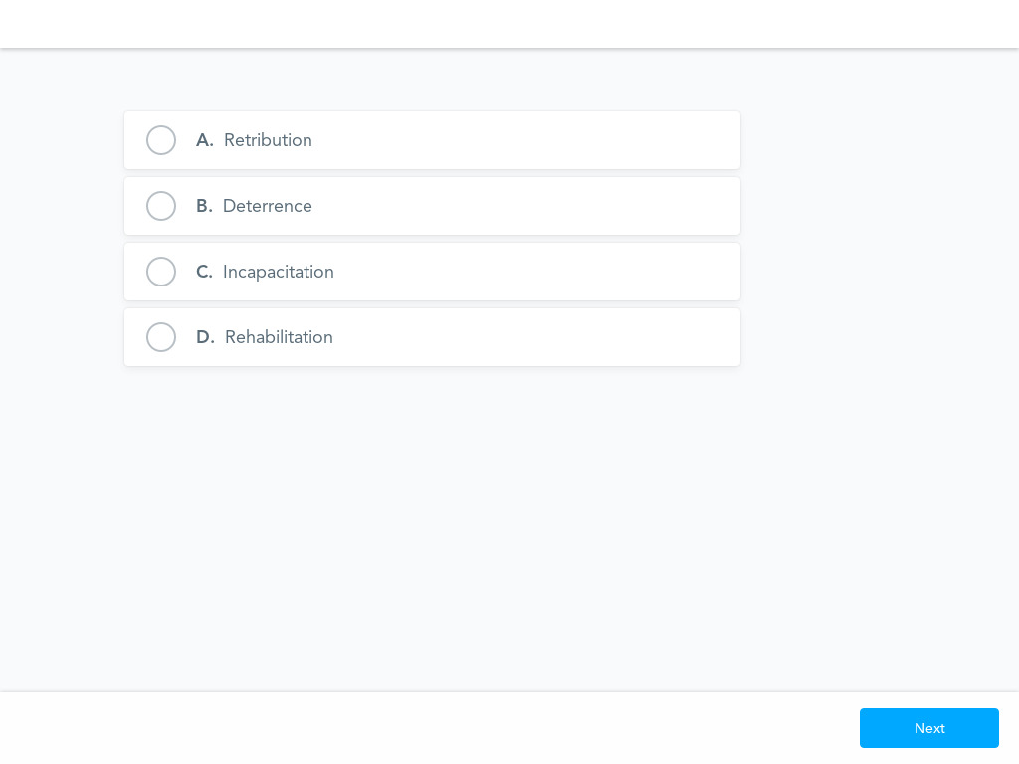

Slide 15
General Trends
700% increase in the U.S. prison population from early 1970’s to 2009
Even as the violent crime rate has decreased dramatically, the prison population has increased
7% decline in recent years
Five states have decreased their prison population by more than 30% (Alaska, Connecticut, New Jersey, New York, Vermont)
If current pace of decarceration holds, it will take 72 years to halve the U.S. prison population
1.8 million Americans are currently incarcerated

Slide 16
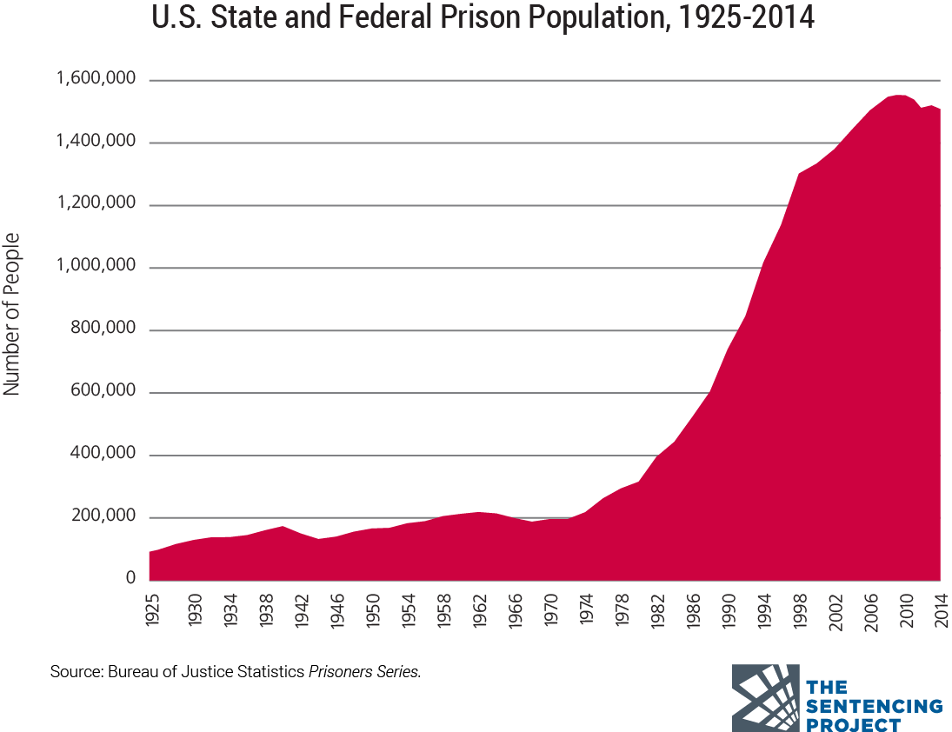

Slide 17
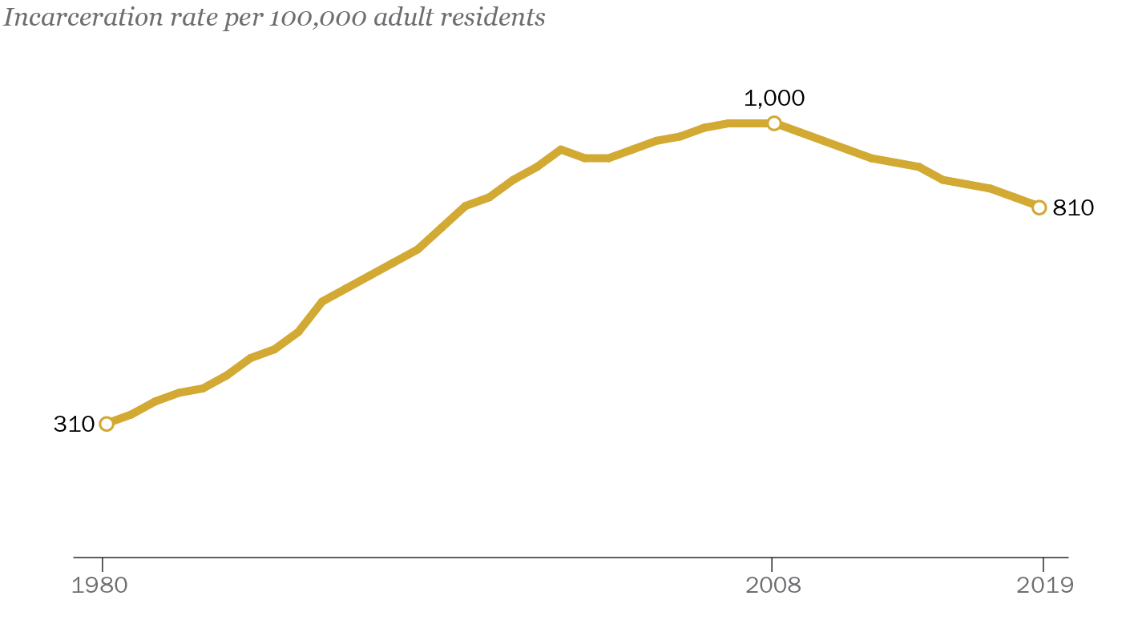

Slide 18
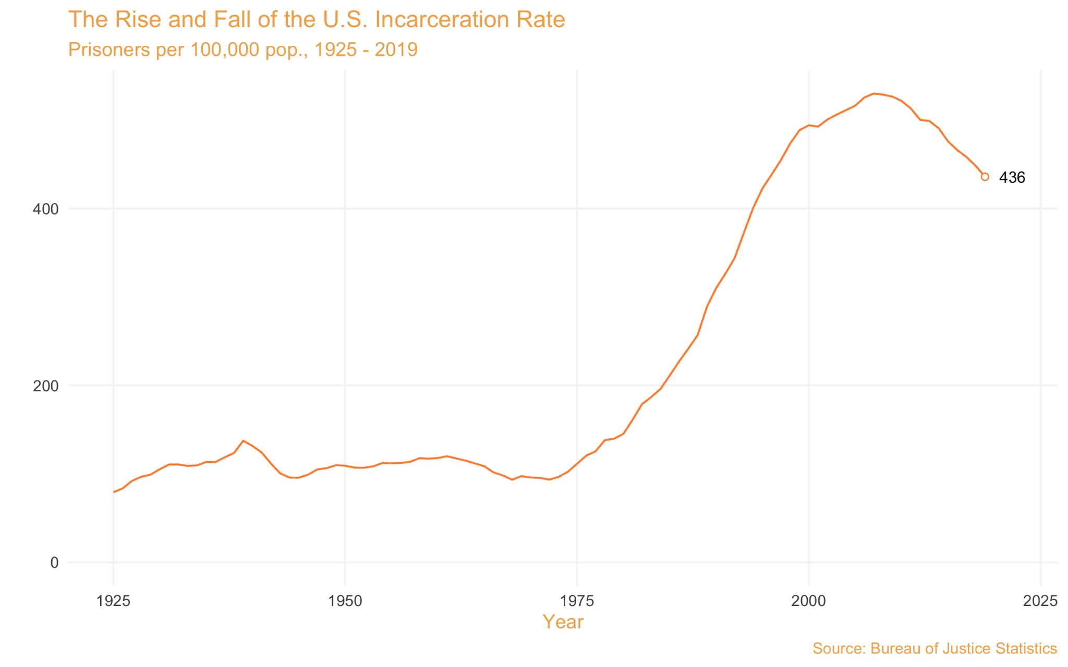

Slide 19
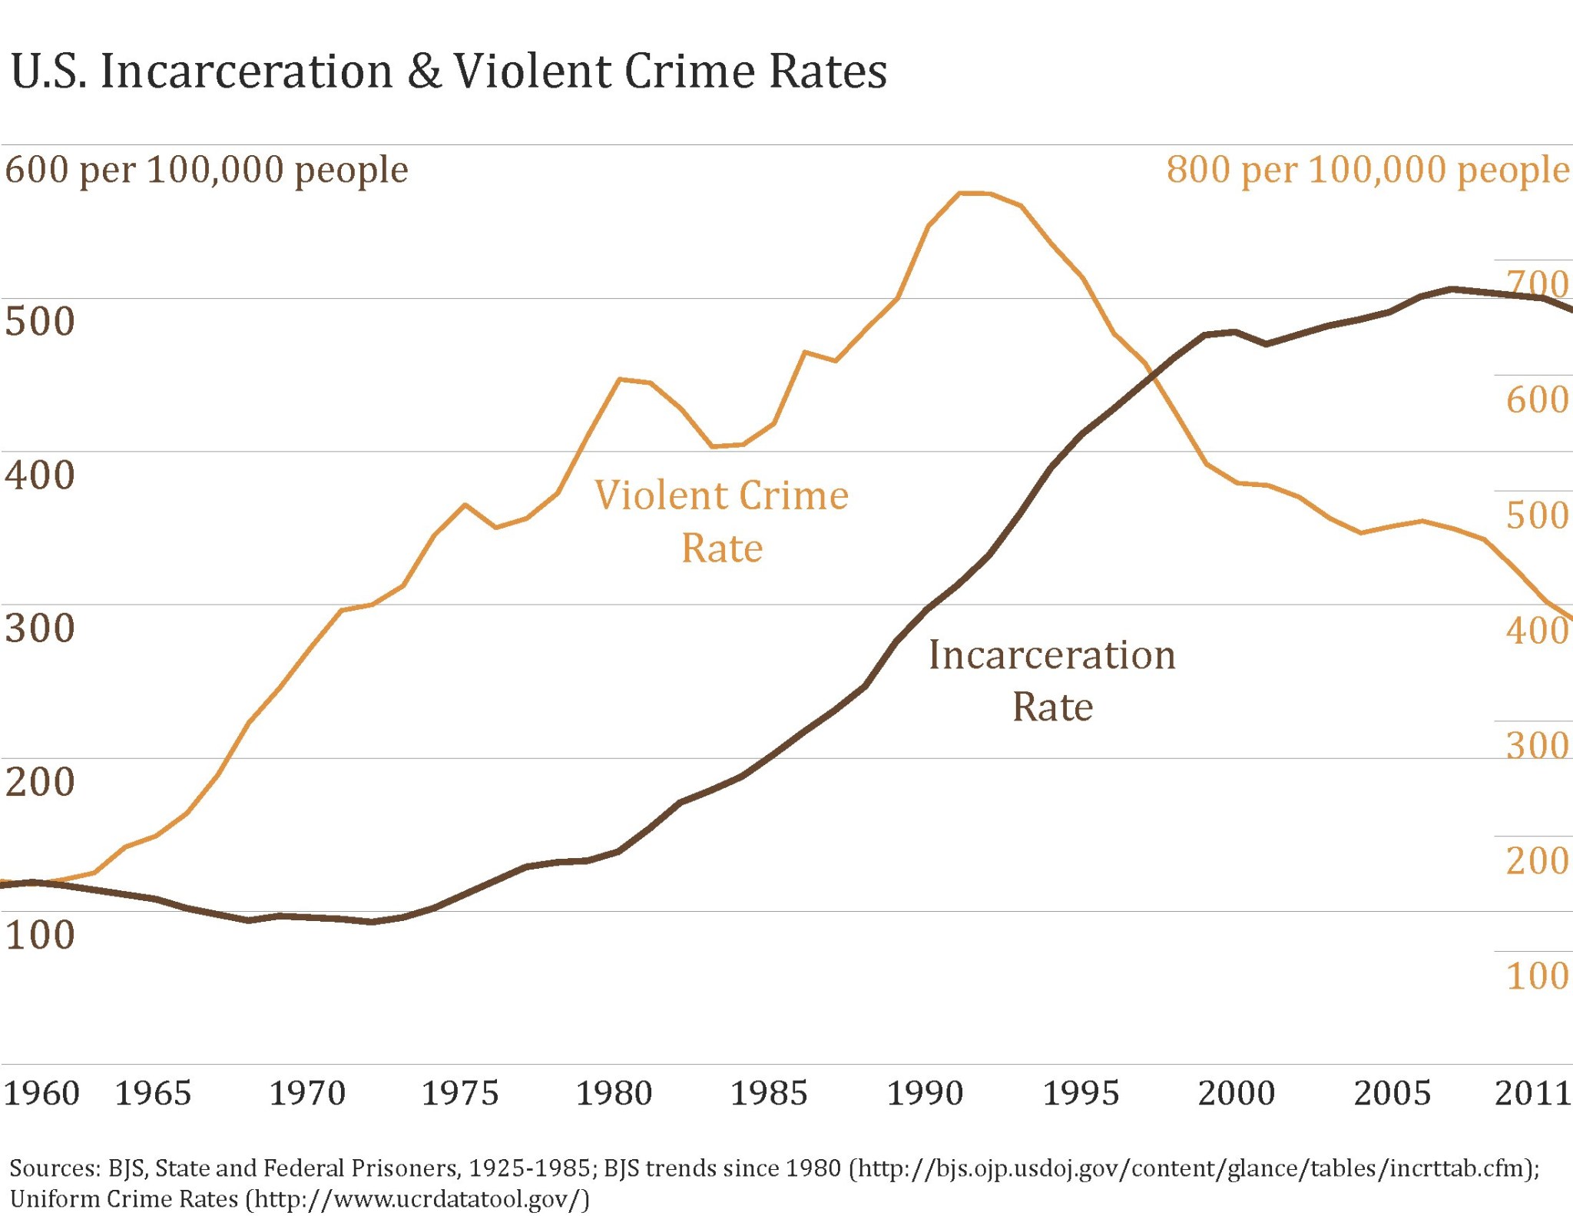

Slide 20
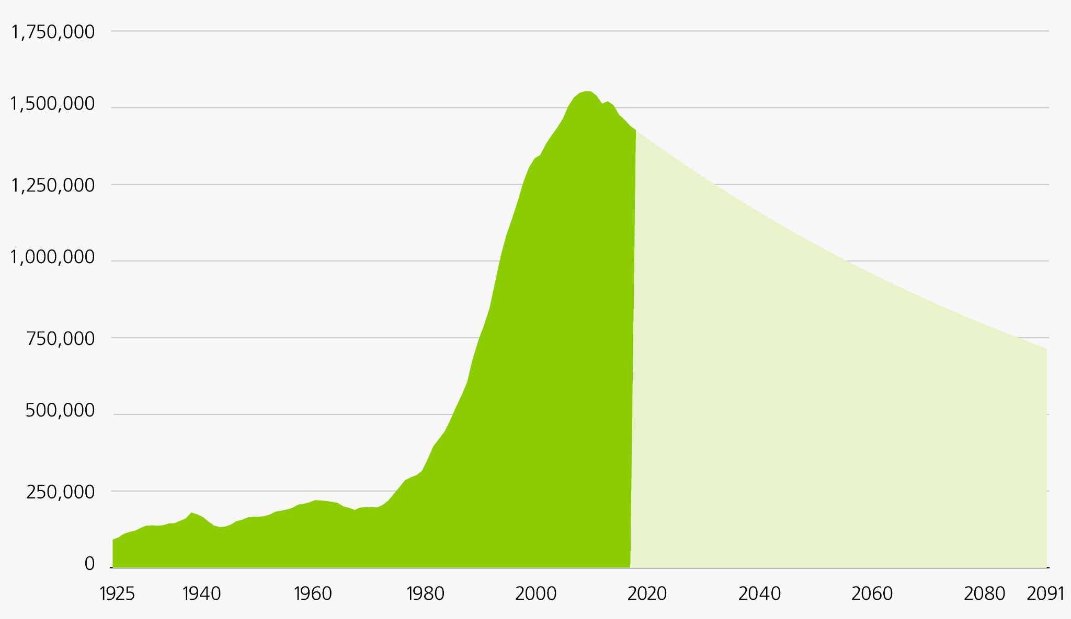

Slide 22
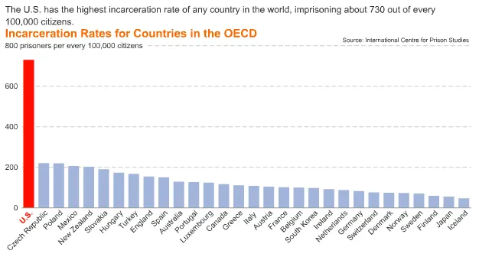

Slide 23
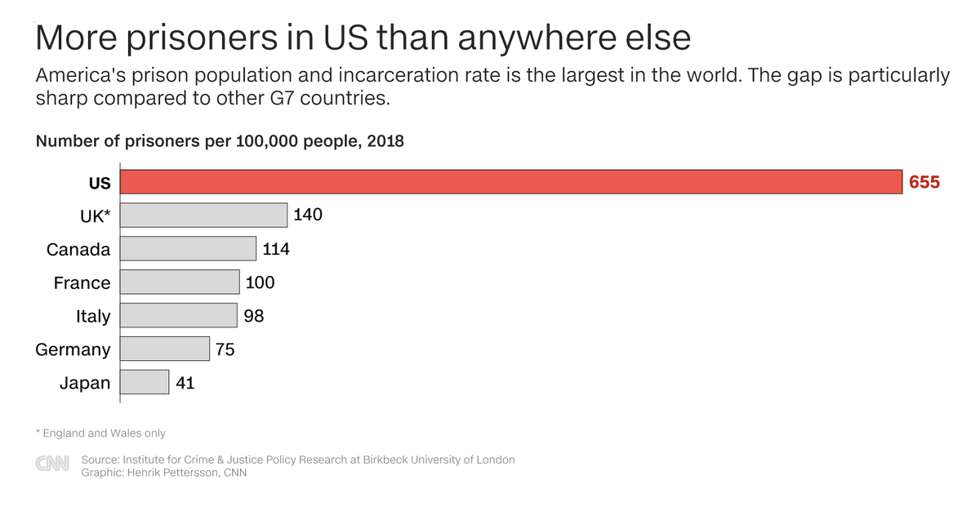

Slide 24
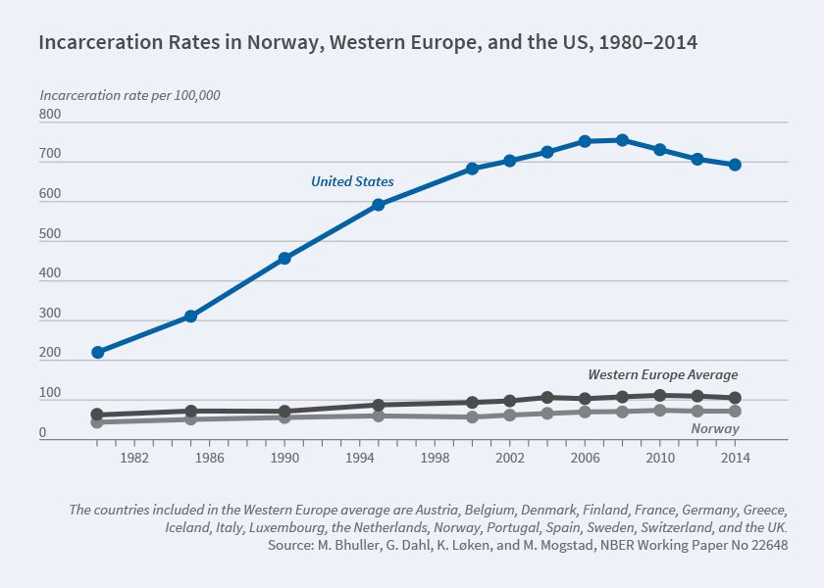

Slide 25
Why did the U.S. prison population skyrocket from the 1980’s to 2000’s?
Tougher sentencing on drug offenses
Stricter Policing
Better tracking and databases
Longer, mandatory sentencing
Ex: “Three Strikes Laws”

Slide 29
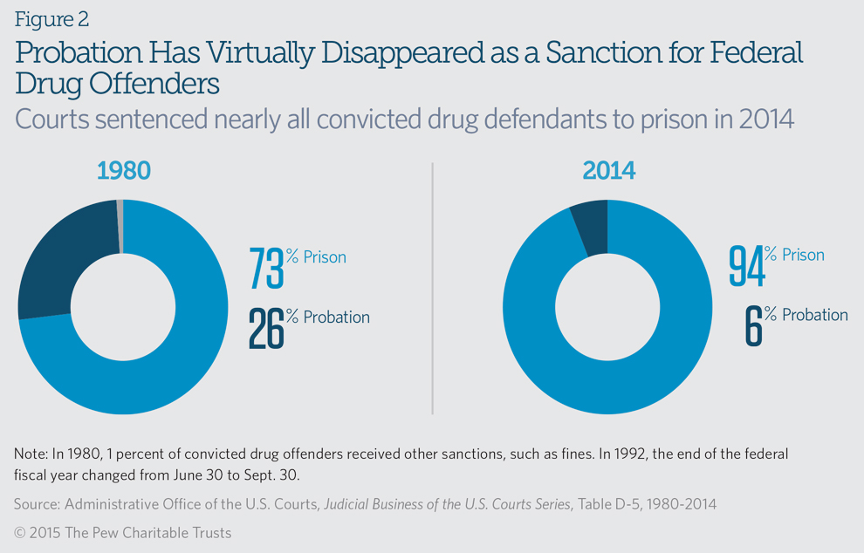

Slide 31
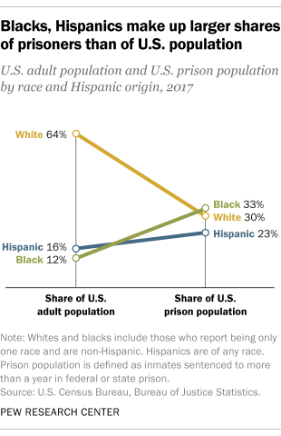
Prison Demographics by Race

Slide 32
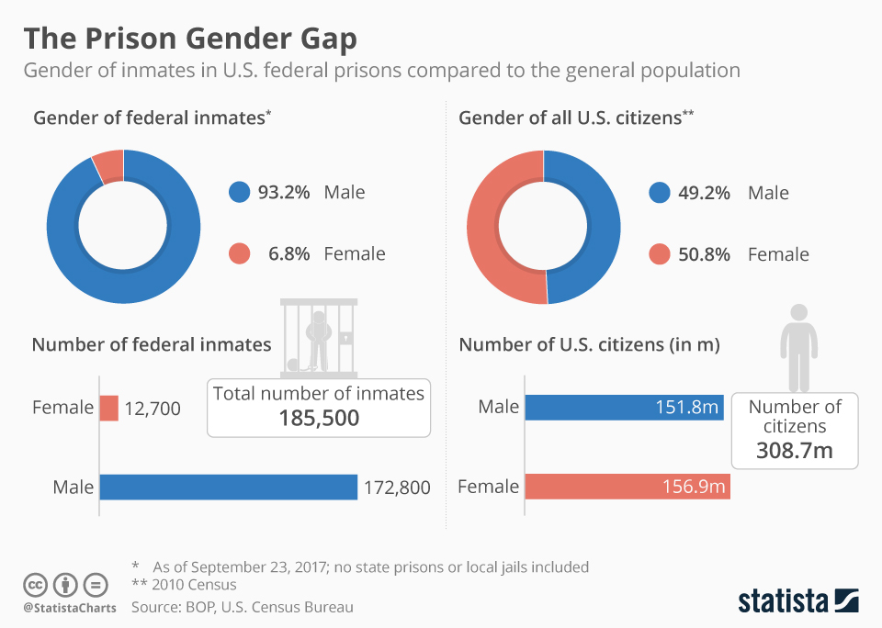
Prison Demographics by Gender

Slide 33
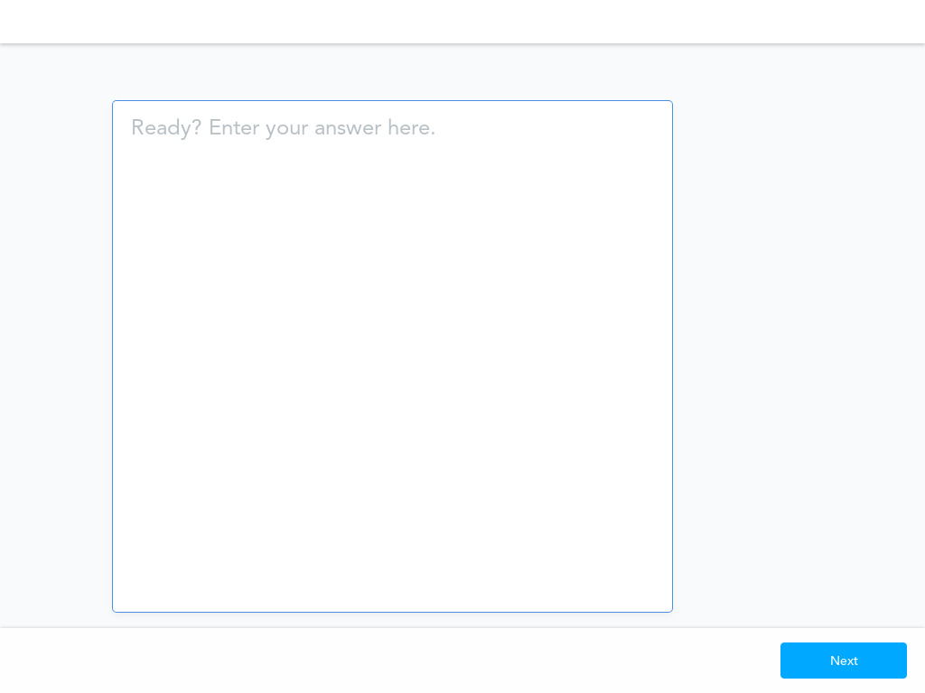

Slide 35
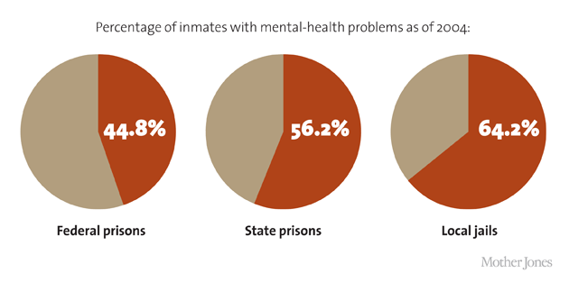

Slide 36
Summary of Prison Population in the U.S.
Large percentage of drug offenders
Mostly male
Disproportionately black and hispanic
Large percentage with mental illness
https://www.pbs.org/wgbh/frontline/film/prison-state/

Slide 37
The Economic Cost of Incarceration
Average annual total cost = $80 billion
Sample state costs per year:
Alabama - $14,780
New York - $69,640
Average state cost - $35,000
New Report by Bureau of Justice Statistics = $181 billion per year
Factoring in court costs, policing, and costs to families supporting those in jail
Cost of incarceration rose over 300% from the 1980’s to 2015

Slide 38
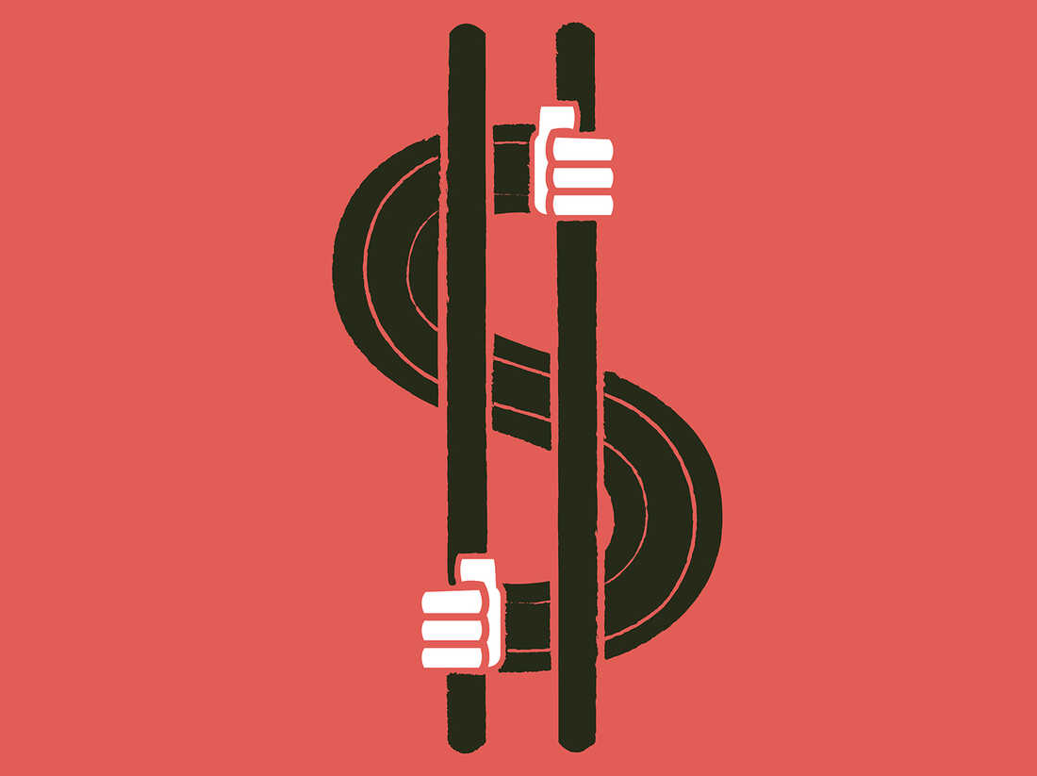
The Economic Cost of Incarceration
Majority of spending (68%) consists of personnel costs - salaries, overtime, and benefits
About 10% of prison spending is on health care
Approximately 17% of spending is for facility maintenance

Slide 39
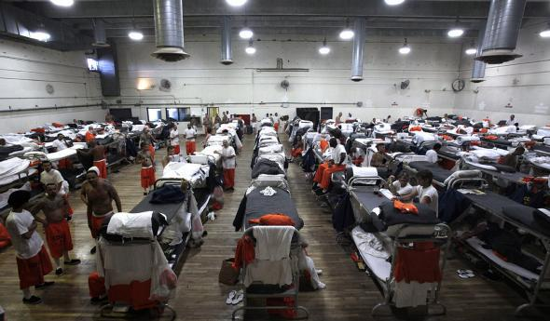
Prison Overcrowding
Since 1970, the prison population expanded 700%
Ten states are operating above 100% capacity
Majority of states are currently at 75% capacity
Overcrowding = increased violence, lack of adequate health care (ex: COVID), reduced educational/vocational opportunities

Slide 40
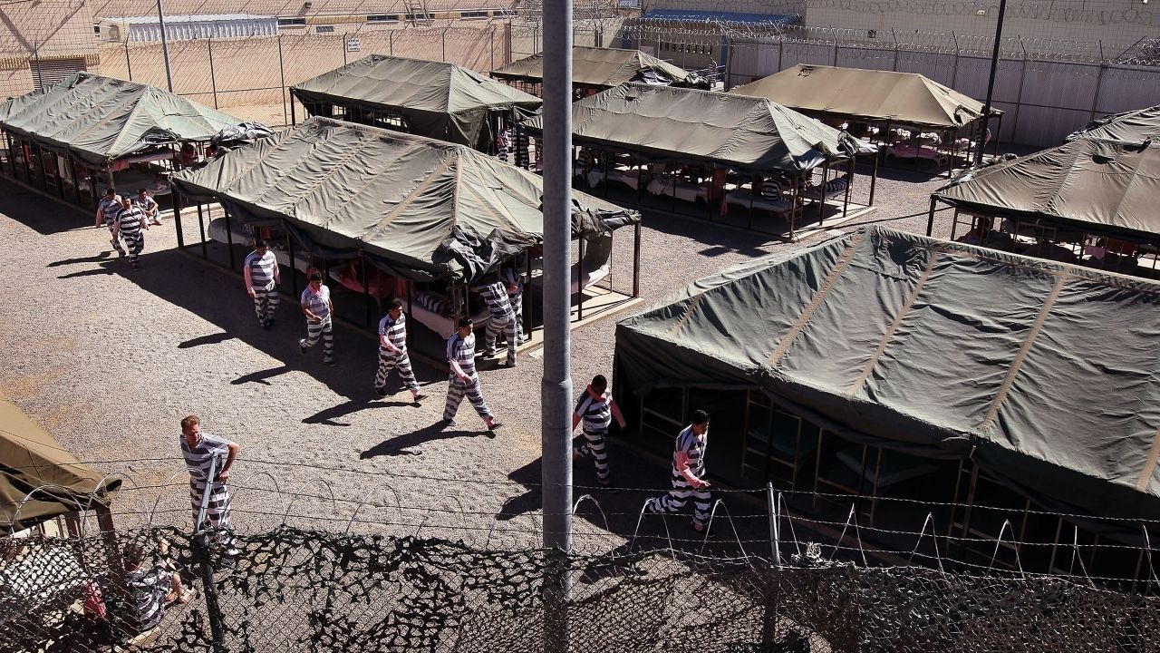
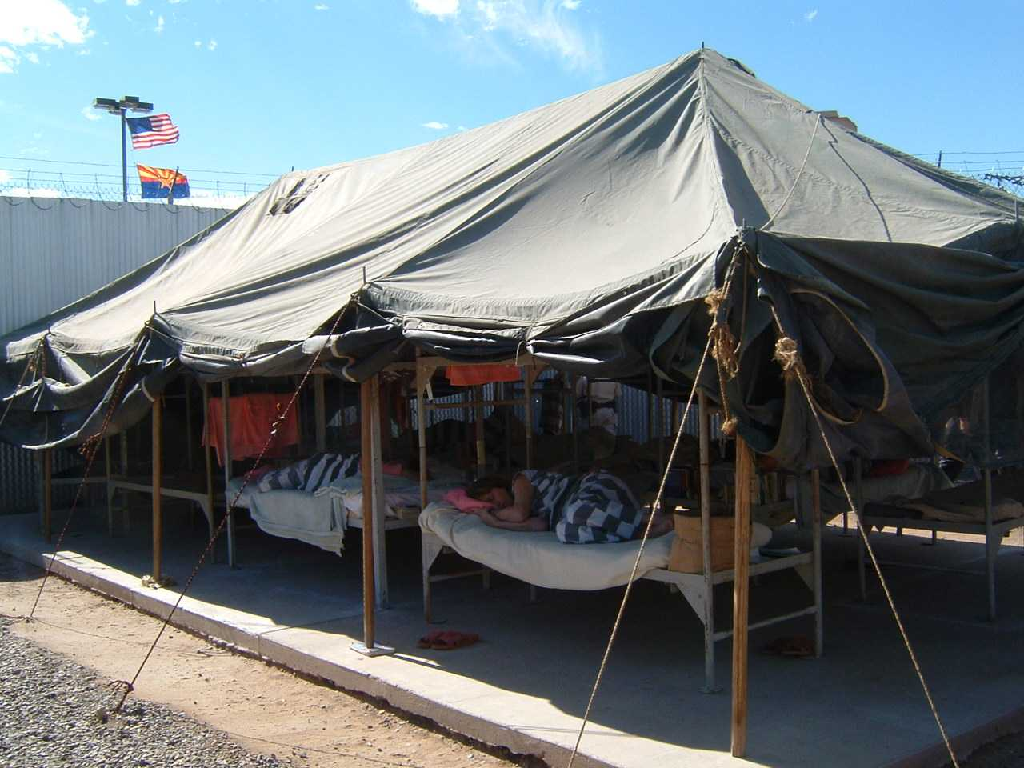

Slide 41
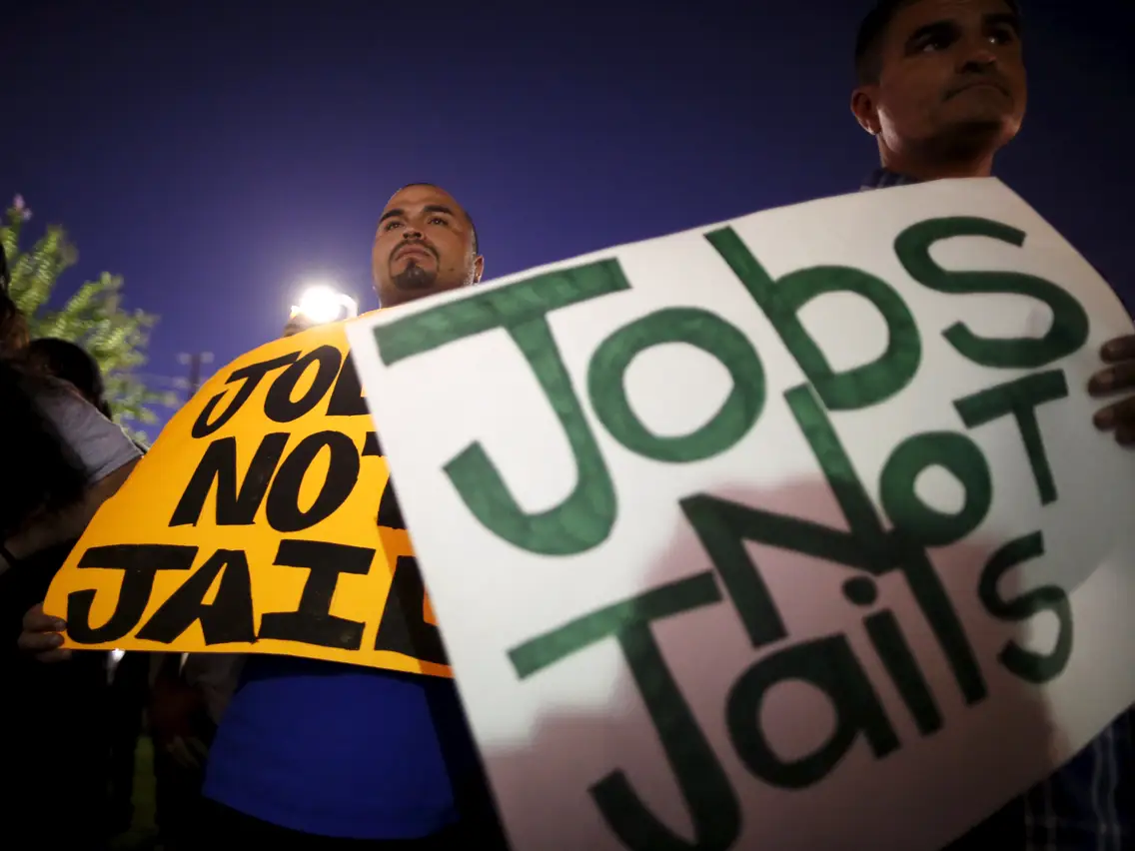
Employment and Prison
Average daily wage of incarcerated people: 86 cents
Unemployment rate of formerly incarcerated people: 27%
Average lost wages over lifetime due to being incarcerated: $500,000

Slide 42
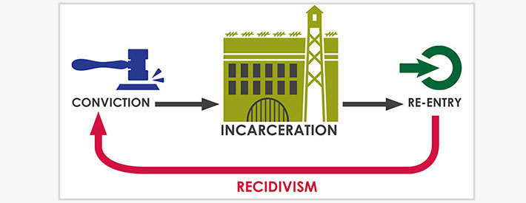
Recidivism Rates
National recidivism rate:
44% after one year of release
68% after three years of release
77% after five years of release
State recidivism statistics: https://worldpopulationreview.com/state-rankings/recidivism-rates-by-state

Slide 44
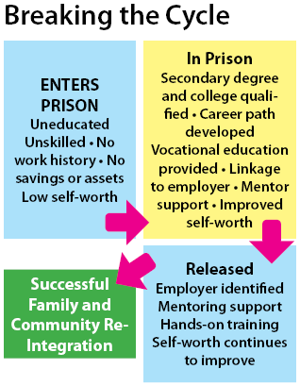

Slide 45
Recidivism Rates
Why are recidivism rates higher in the U.S.?
Repeat drug offenders
Focus on retribution/incapacitation; not enough resources utilized for rehabilitation programs
Minimal funding on reentry programs
https://www.pbs.org/newshour/economy/the-u-s-spends-billions-to-lock-people-up-but-very-little-to-help-them-once-theyre-released

Slide 46
International Recidivism Rates: A Comparative Study
Recidivism two years after release:
Norway: 20%
Canada: 35%
China: 8%
Germany 40%
Ireland: 55%
Denmark: 29%

Slide 47
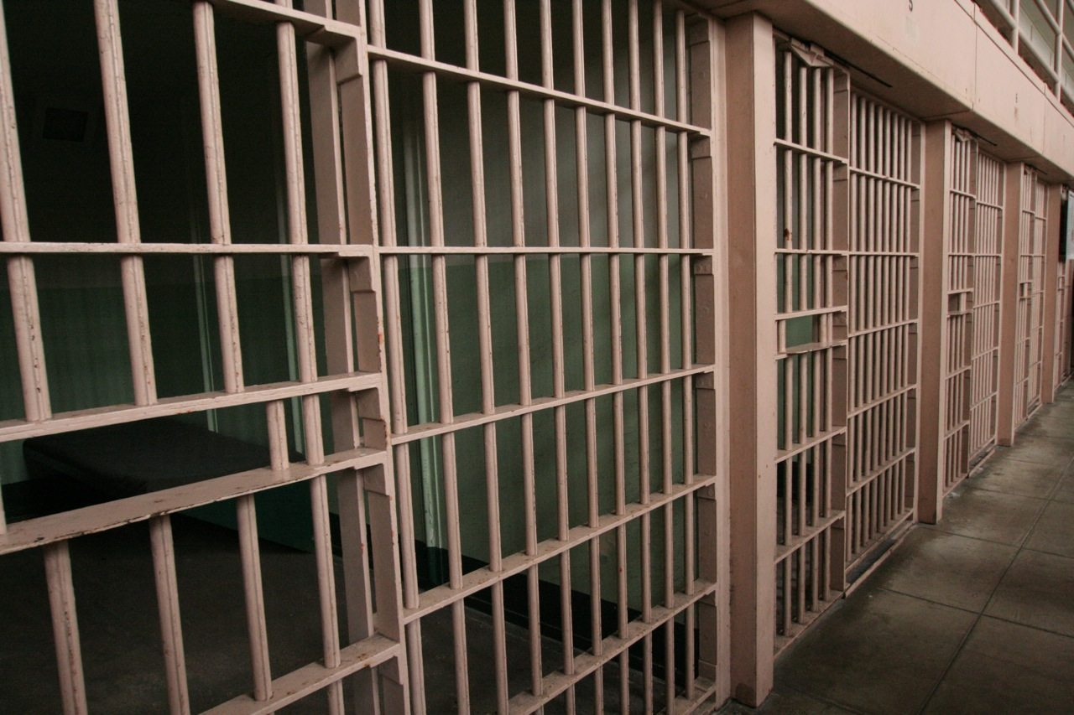
Reducing the Costs of Incarceration
Major paradigm shift towards rehabilitative philosophy
Educational attainment
Vocational training
Therapeutic programs while in prison
Long run approach - upfront costs could be high but overall costs could decrease

Slide 48
Would Rehabilitative Programs Cost Too Much?
https://www.apa.org/monitor/julaug03/rehab
https://www.nber.org/reporter/2020number1/benefits-rehabilitative-incarceration

Slide 51
Rehabilitation Approaches
Post Secondary Educational Opportunities:
https://www.vera.org/publications/investing-in-futures-education-in-prison
Job Training Apprenticeships: https://www.brookings.edu/research/a-better-path-forward-for-criminal-justice-training-and-employment-for-correctional-populations/

Slide 52
Rehabilitation Approaches
Post Secondary Educational Opportunities:
https://www.vera.org/publications/investing-in-futures-education-in-prison
Job Training Apprenticeships: https://www.brookings.edu/research/a-better-path-forward-for-criminal-justice-training-and-employment-for-correctional-populations/

Slide 53
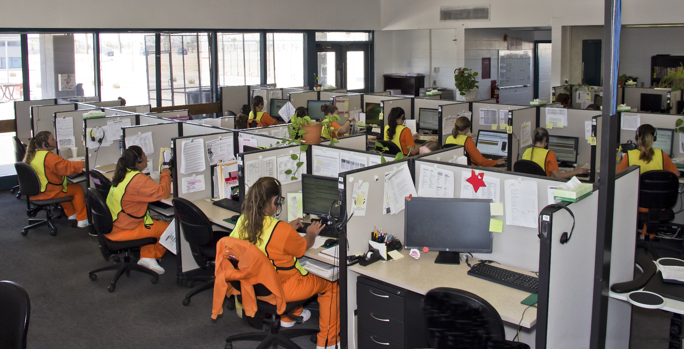
Examples of Rehabilitation Approaches
Prison to Workplace: https://www.prisonfellowship.org/2016/07/prison-work-program-works/
https://www.wbur.org/hereandnow/2017/05/24/jails-to-jobs-program-new-york

Slide 54
Examples of Rehabilitation Approaches
Prison Arts/ Gardening Programs:
https://www.rta-arts.org/
Horticultural Therapeutic Programs: https://www.htinstitute.org/blog/horticultural-therapy-as-rehabilitative-reform-in-the-american-prison-system/

Slide 55
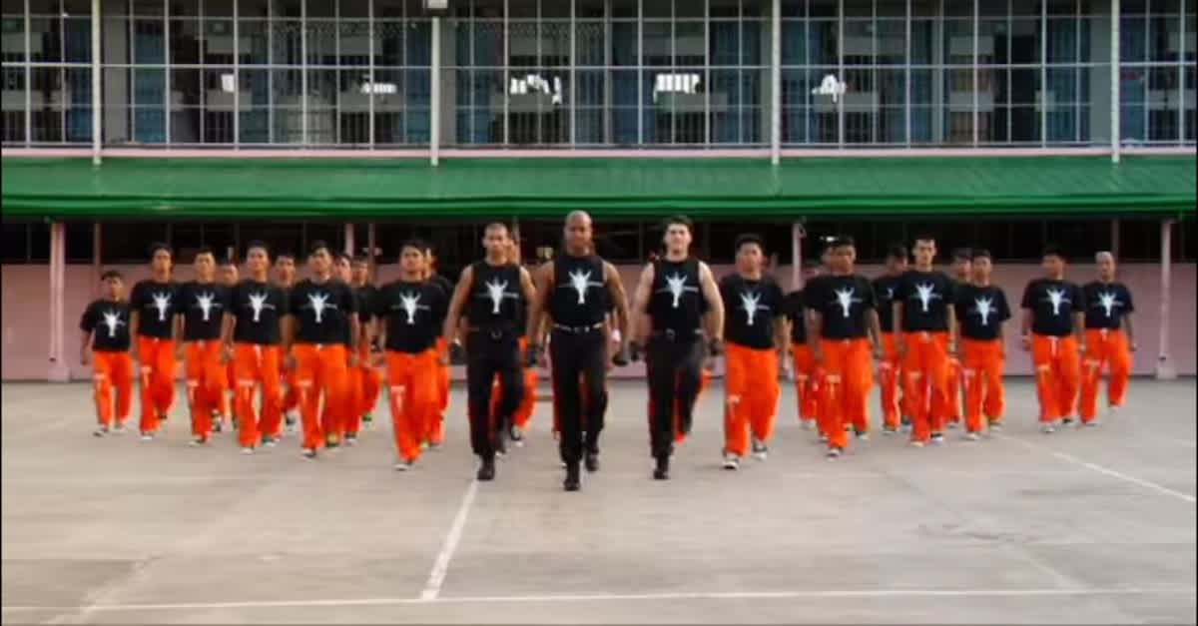

Slide 56
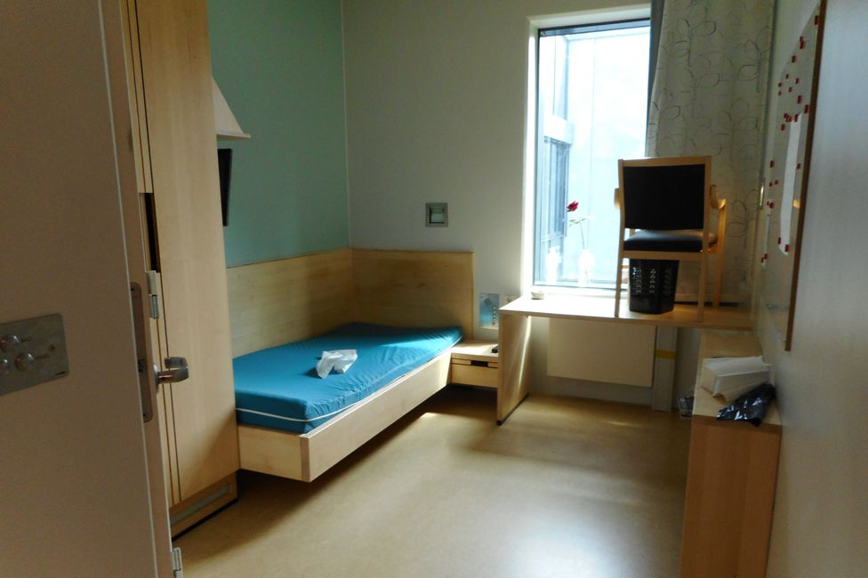
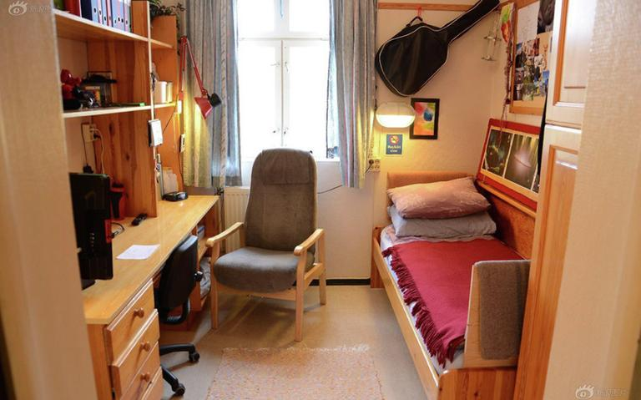

Slide 58
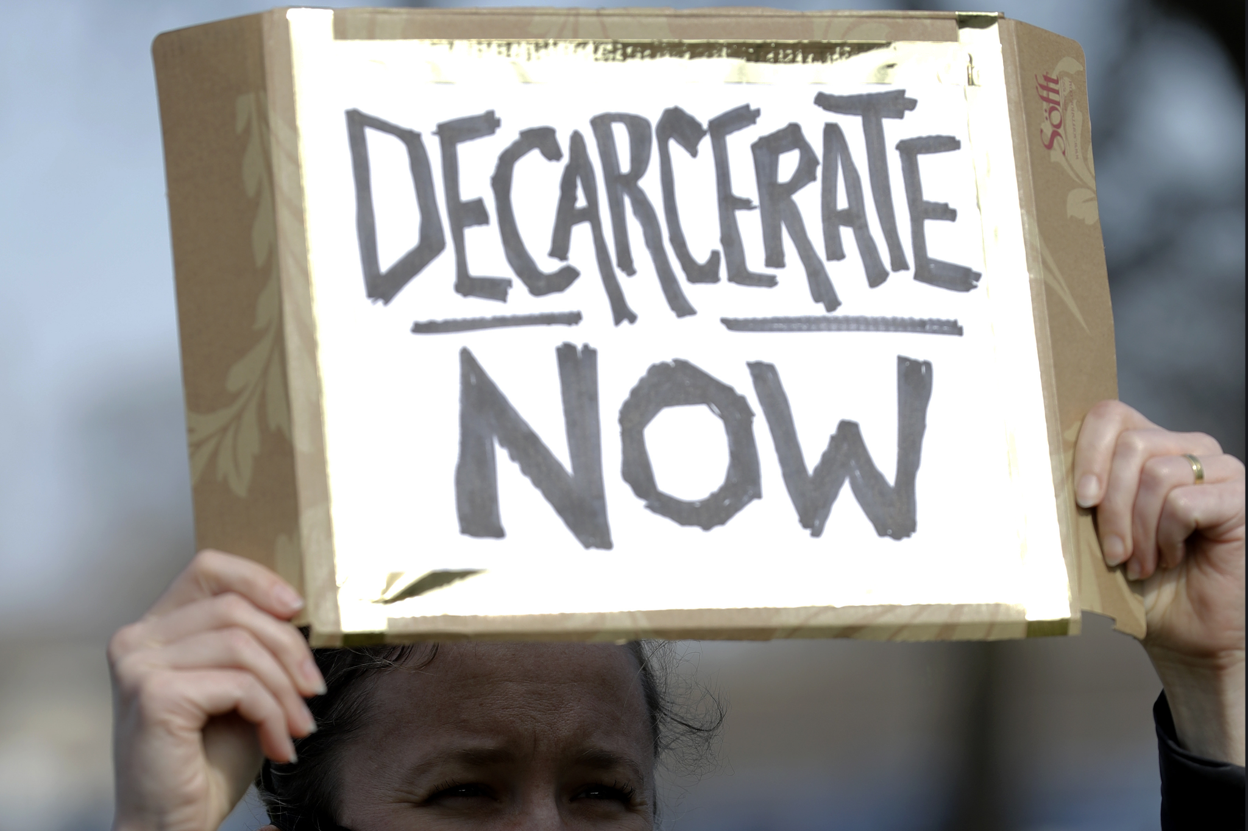
Decarceration Efforts
https://www.sentencingproject.org/publications/decarceration-strategies-5-states-achieved-substantial-prison-population-reductions/
https://www.reuters.com/investigates/special-report/usa-jails-release/

Slide 59
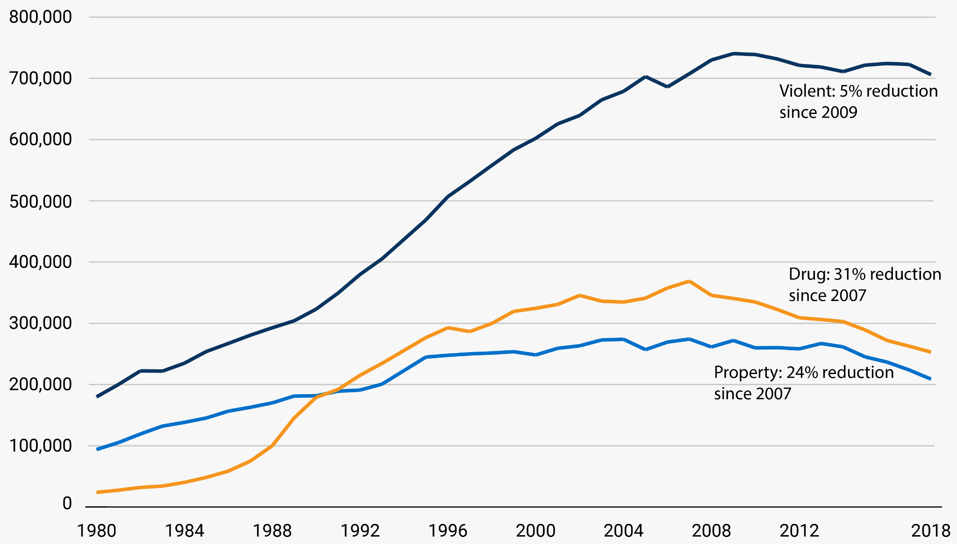

Slide 60
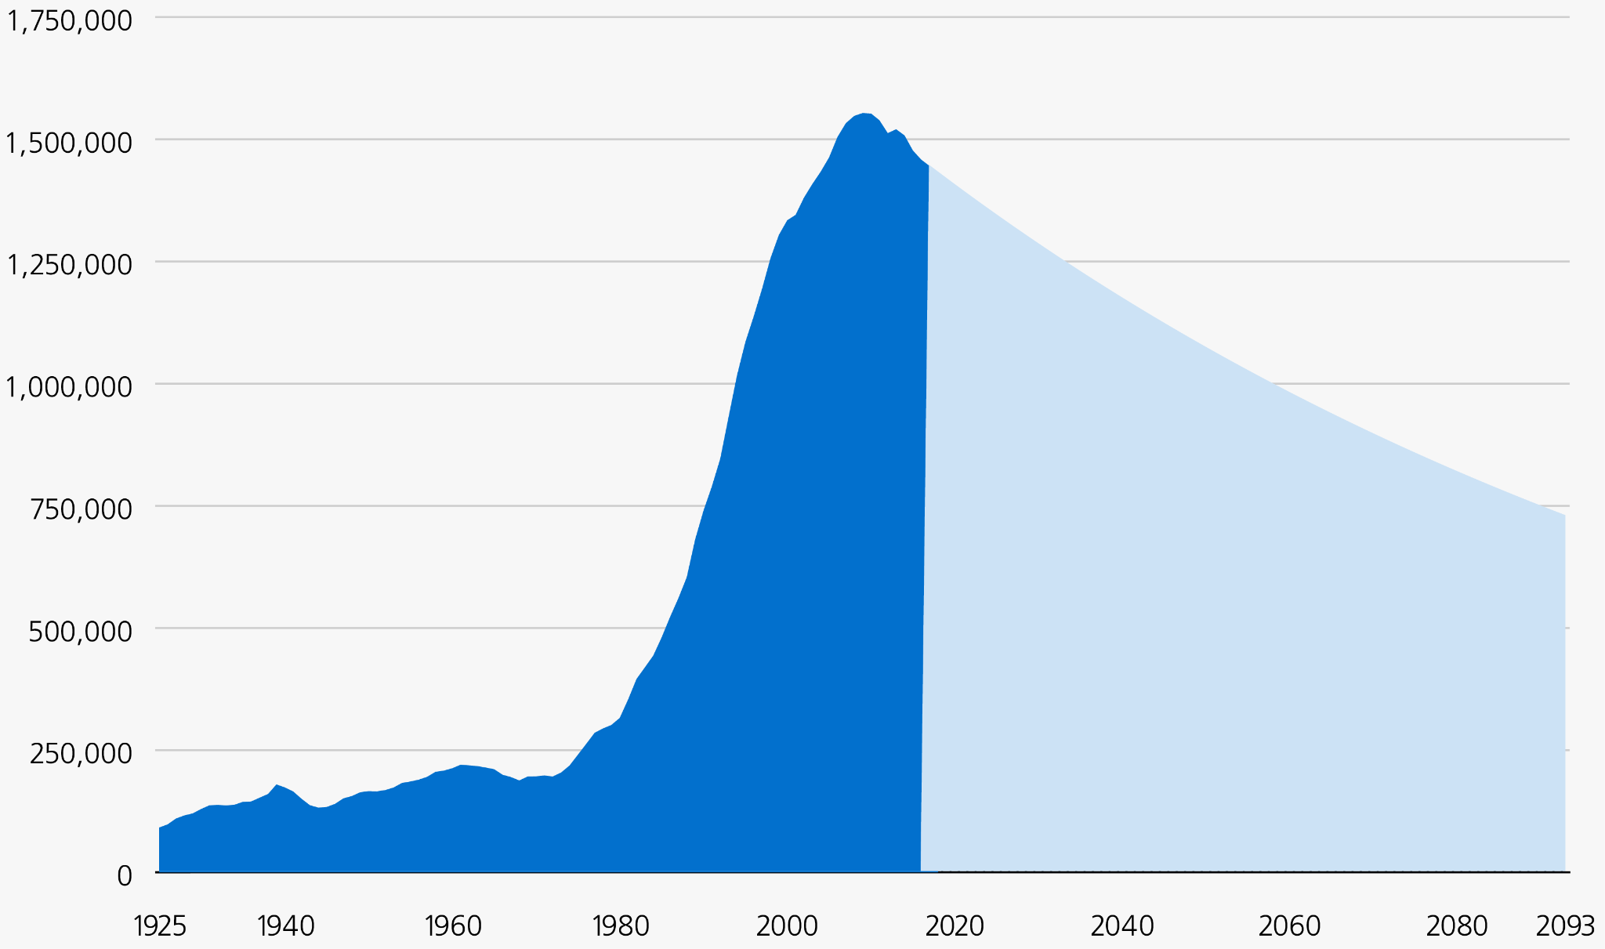

Slide 61
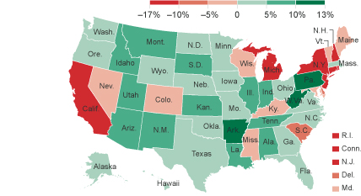

Slide 62
Student Learning Activities
Prisons/Jails History Nearpod: https://docs.google.com/presentation/d/1xLWXsaMFua0VeDg7oqSh2c5UBOgDtTxYJsjB483FQno/edit#slide=id.p3

Slide 63
Student Learning Activities
Cost/Benefits Analysis: Is Rehabilitation Worth the Investment?
Students research the current economic costs of incarceration.
Compile graphs, data tables, maps, visuals, and text on slides
Students research studies that have been conducted on the costs and benefits of enacting rehabilitation- focused programs and present on slides.
Students provide an informed opinion on whether the U.S. should shift to a more rehabilitative model?

Slide 64
Student Learning Activities
Cost/Benefits Analysis: Is Rehabilitation Worth the Investment?
Alternative Presentation Modes:
Create a short documentary
Stage a town hall meeting
Mock Congressional Hearing
Stage a talk show
Invite professionals into the class!

Slide 65
Student Learning Activities
PBS Documentary “Prison State”: Reflection Paper
Criminal Procedure Reflection Paper: Prison State
Directions: During the next two days we will be watching the PBS documentary: Prison State.
You will write a 3-5 paragraph reflection on the video. Take notes as we watch together. Here’s what I would like you to include:
-Relevant statistics regarding incarceration rates, etc.
-Challenges the prison system is facing including any failures you notice.
-Trace the story of any one of the people the video portrays and describe their circumstances and how the system has failed them.
-Highlight any reforms or changes that have either happened or should happen.
-Any overall reactions/ personal reflections.

Slide 66
Student Learning Activities
International Prison Systems: Comparative Analysis
https://docs.google.com/presentation/d/1FKokw10BBRtI4gqc8H6_WigpVijZOCmwDH0sRzMnDfc/edit?usp=sharing

Slide 67
Student Learning Activities
Incarceration Nation: Google Form
https://docs.google.com/forms/d/1qA5qYgj5SJisVphMhxyzIUwk0z6a6PiEL05mHre9cOQ/edit

Slide 68
Student Learning Activities
Design a Prison: Visual Representation
https://docs.google.com/document/d/1v-2WVJnqKcsTT74TQ0IhcnonBRRvNNRBXtWkWWPT9rc/edit?usp=sharing
Google Sketchup: https://www.sketchup.com/
Minecraft
Draw a physical blueprint

Slide 69
Formative Assessment Options
Socrative: b.socrative.com Room Name: Opderbeck
Google Forms: https://www.google.com/forms/about/
Quizlet Live: www.quizlet.com
Kahoot: www.kahoot.com
Blooket: www.blooket.com

Slide 70
References/ Resources
https://www.prisonpolicy.org/
https://www.sentencingproject.org/criminal-justice-facts/
https://www.bop.gov/

Slide 71
CEE Affiliates
https://www.councilforeconed.org/resources/local-affiliates/

Slide 72
Thank You to Our Sponsors!

