Slide 1


Teaching Scam Avoidance
Presented by Andrew Menfi
December 9th, 2021 amenfi3@gmail.com

Slide 2
EconEdLink Membership
You can now access CEE’s professional development webinars directly on EconEdLink.org! To receive these new professional development benefits, become an EconEdLink member. As a member, you will now be able to:
Automatically receive a professional development certificate via e-mail within 24 hours after viewing any webinar for a minimum of 45 minutes
Register for upcoming webinars with a simple one-click process
Easily download presentations, lesson plan materials, and activities for each webinar
Search and view all webinars at your convenience
Save webinars to your EconEdLink dashboard for easy access to the event
You may access our new Professional Development page here

Slide 3
Professional Development Certificate
To earn your professional development certificate for this webinar, you must:
Watch a minimum of 45-minutes and you will automatically receive a professional development certificate via e-mail within 24 hours.
Accessing resources:
You can now easily download presentations, lesson plan materials, and activities for each webinar from EconEdLink.org/professional-development/

Slide 4
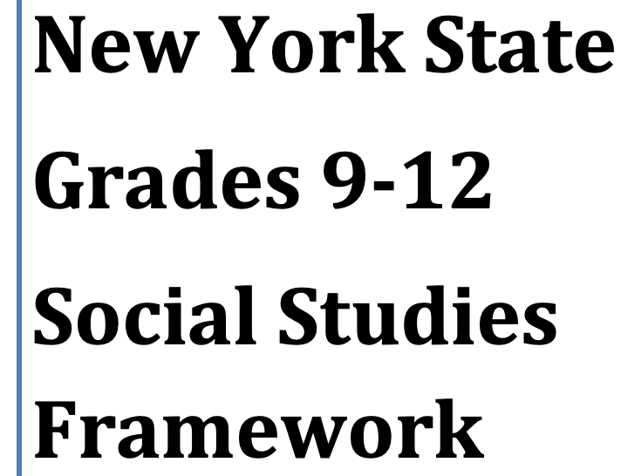


National & State Standards
National:
  STANDARDS 13
New York:
  13.E1

Slide 5
Objective
Engaging and useable lessons/materials on common financial scams and how to avoid them.

Slide 6


Why?
$50-$100 Billion lost to scams/ fraud in 2020
1 out of 3 American adults have been victims of a scam
Young People = Easy Targets

Slide 7
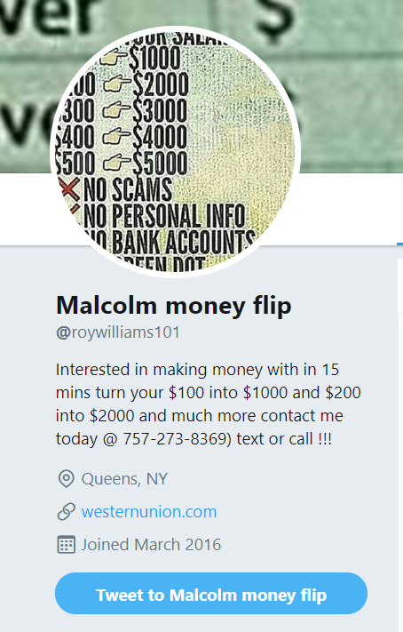
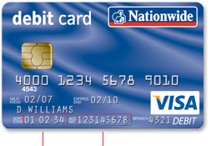


Agenda
Pyramid Scheme [Multi-Level Marketing]
Money “Flipping”
Debit Card “Cracking”
Phishing
  Phishing Activity

Slide 8
Pyramid Scheme
  [Multi-Level Marketing]
  Business that profits by recruiting Salespeople

Slide 9




Pyramid Scheme
  Examples

Slide 10

5 Signs of a Pyramid Scheme
  1. Required cash investments:
  2. Overestimated earnings:
  3. Overpriced & bad products:
  4. Recruiting more members:
  5. Limited Time Offers:

Slide 11


Pyramid Scheme [Activity]
  Vemma Verve Case Study

Slide 12

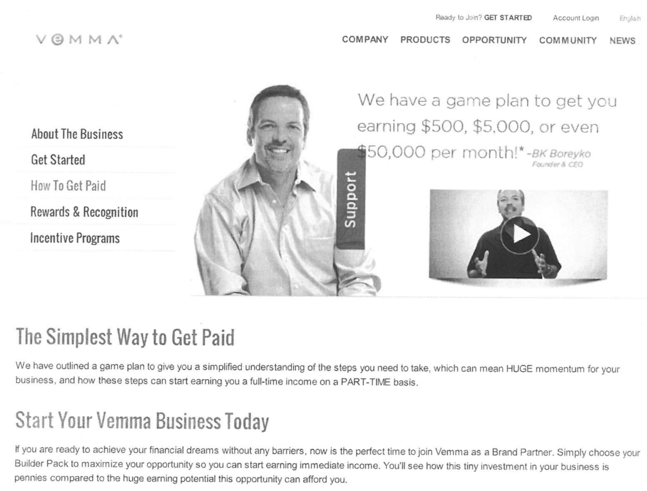
Pyramid Scheme [Activity]
  Vemma Verve Case Study

Slide 13
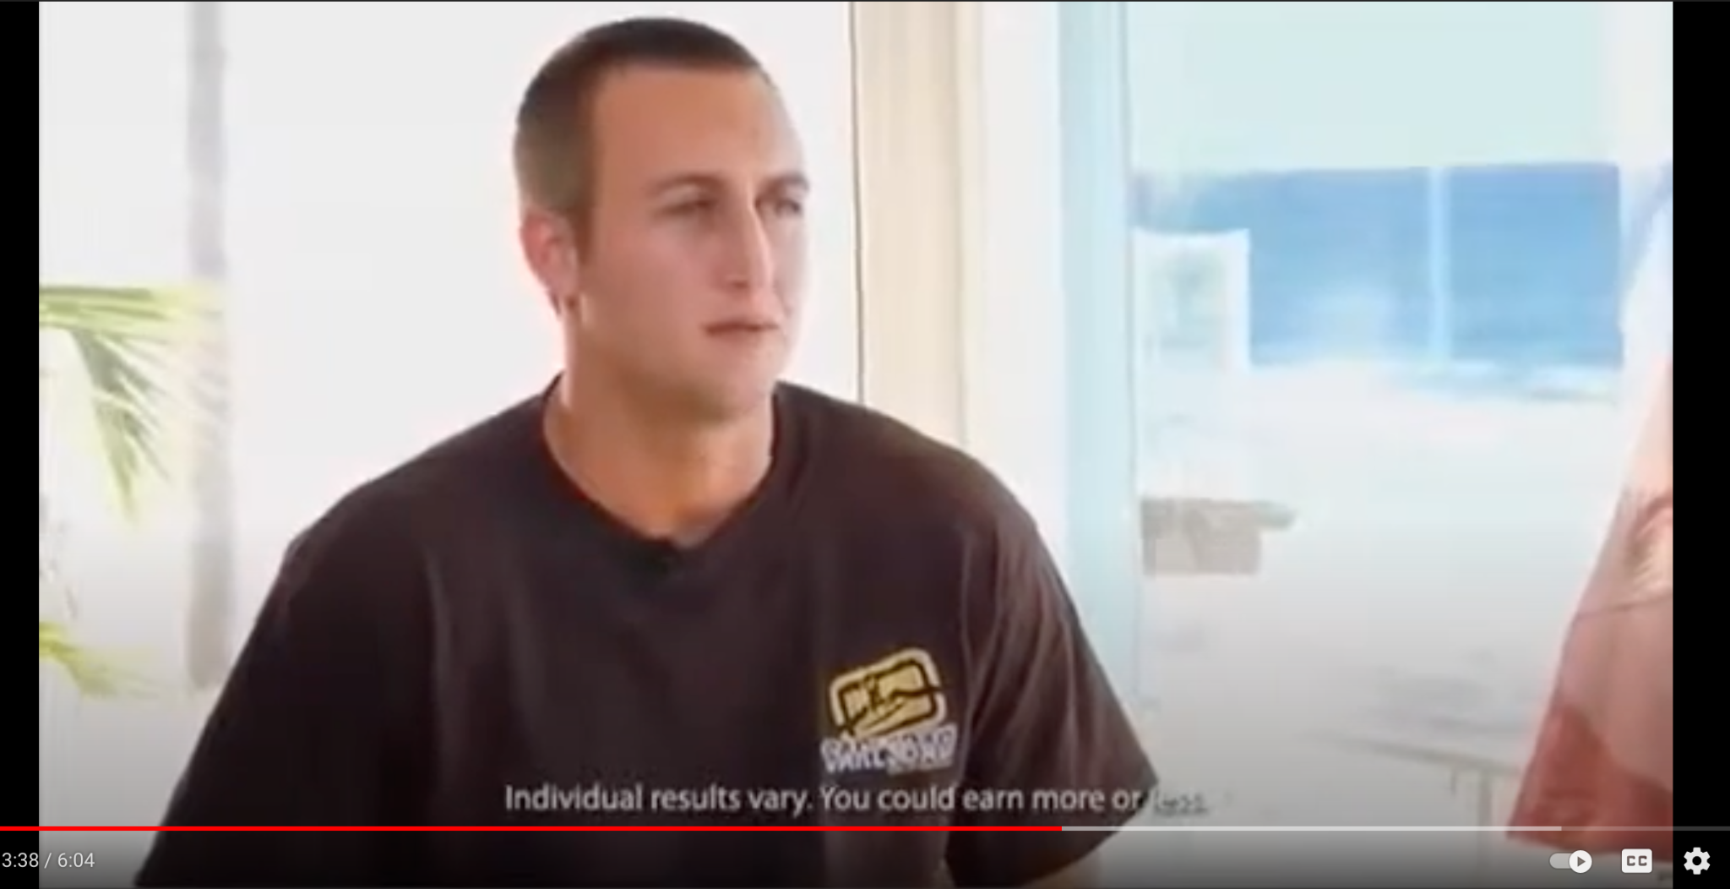
Pyramid Scheme [Activity]
  Vemma Verve Case Study

Slide 14
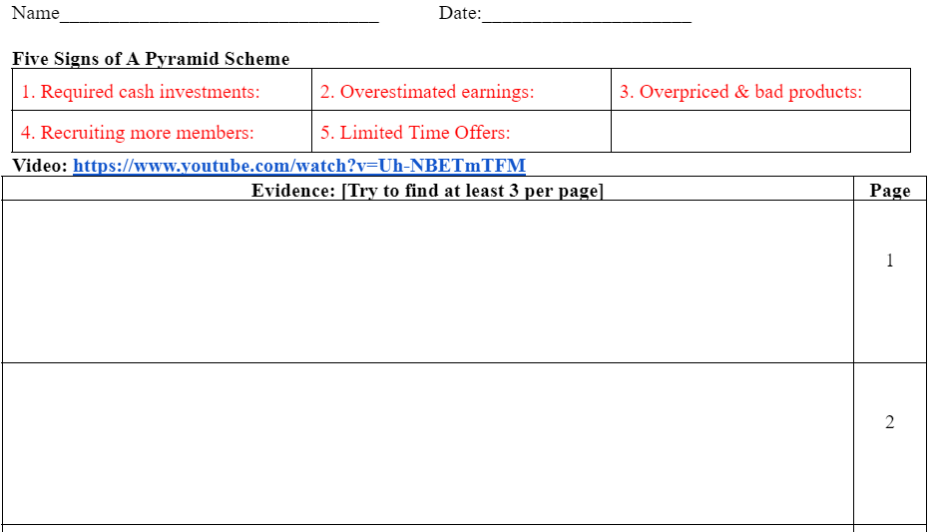
Pyramid Scheme [Activity]
  Vemma Verve Case Study

Slide 15
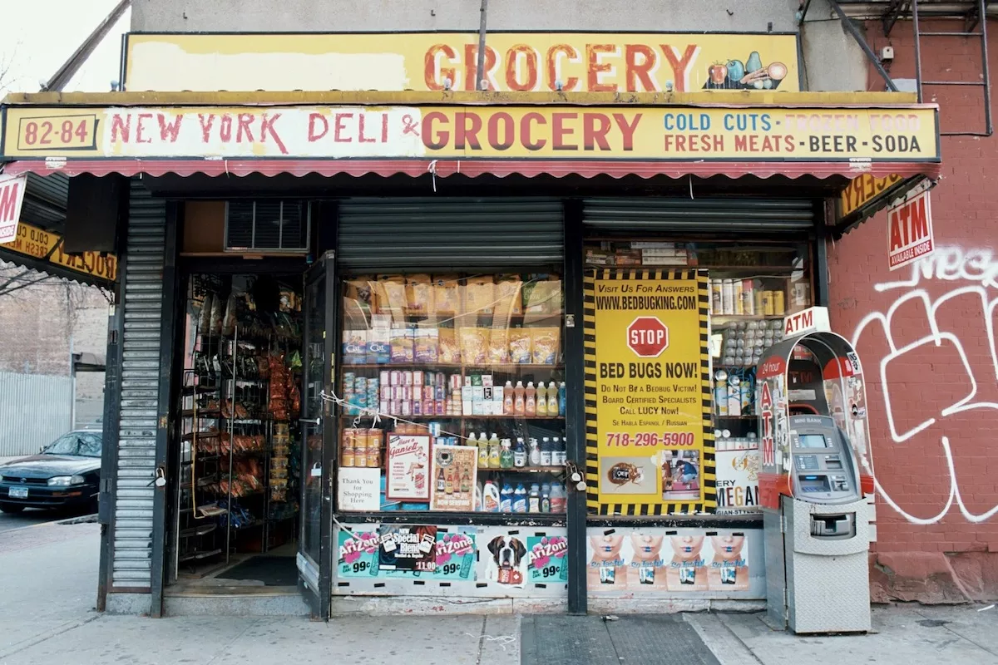
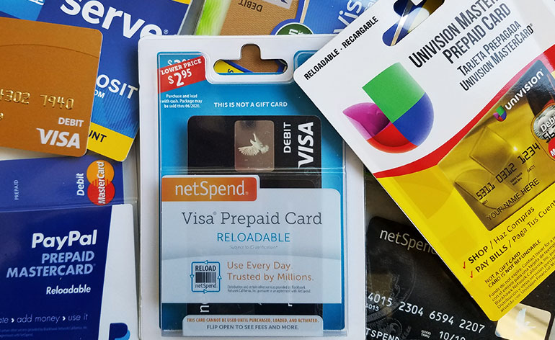
Money “Flipping”

Slide 16
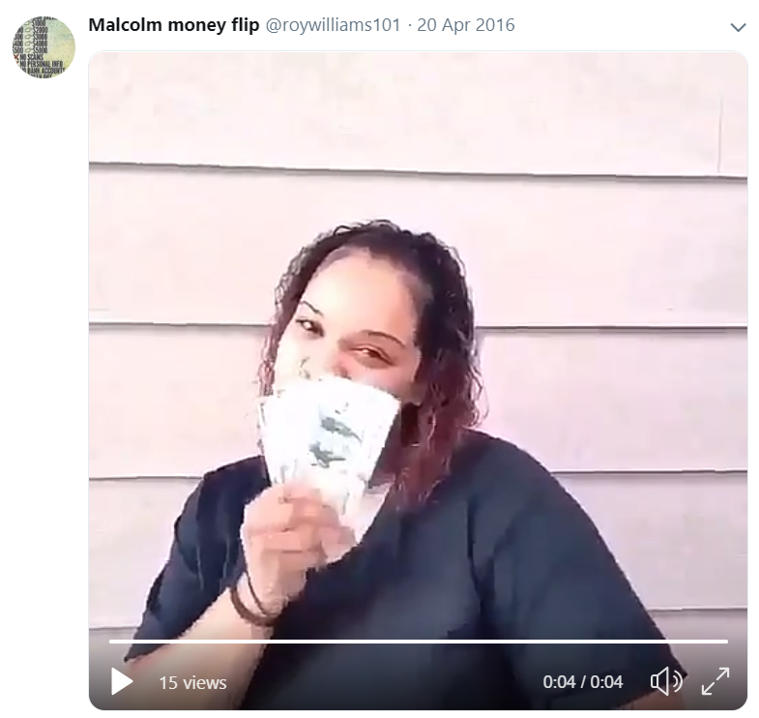

Money “Flipping” [Activity]
  Document Based Questions

Slide 17
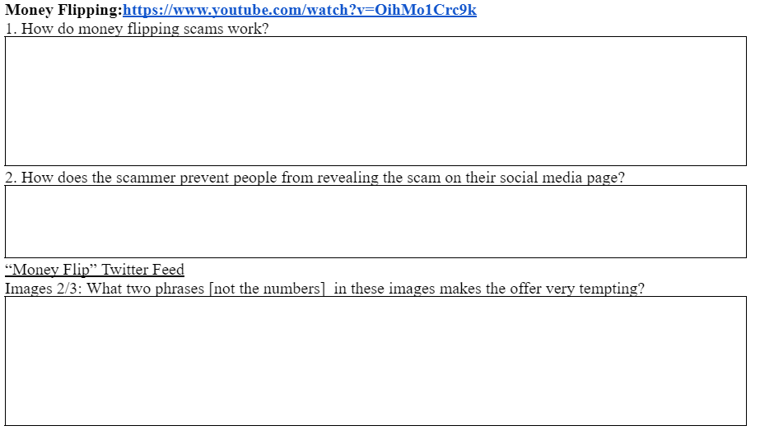
Money “Flipping” [Activity]
  Document Based Questions

Slide 18
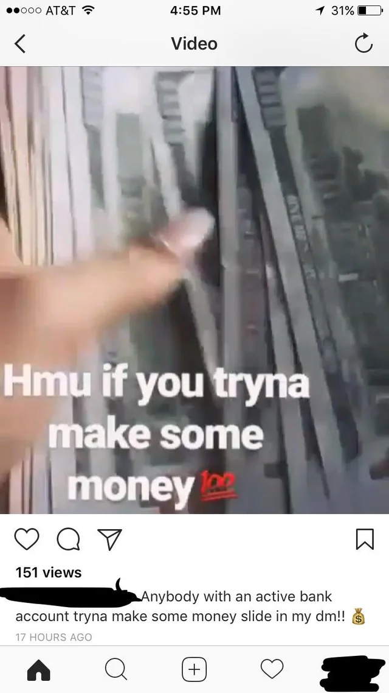
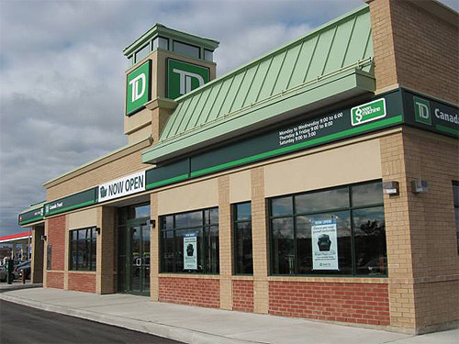
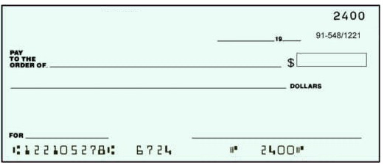
Debit Card “Cracking”

Slide 19
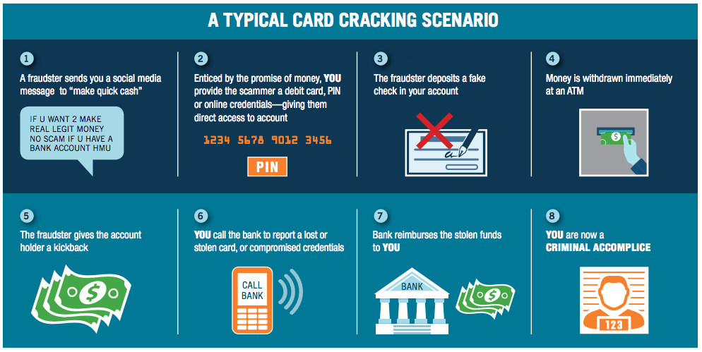
Debit Card Cracking

Slide 20
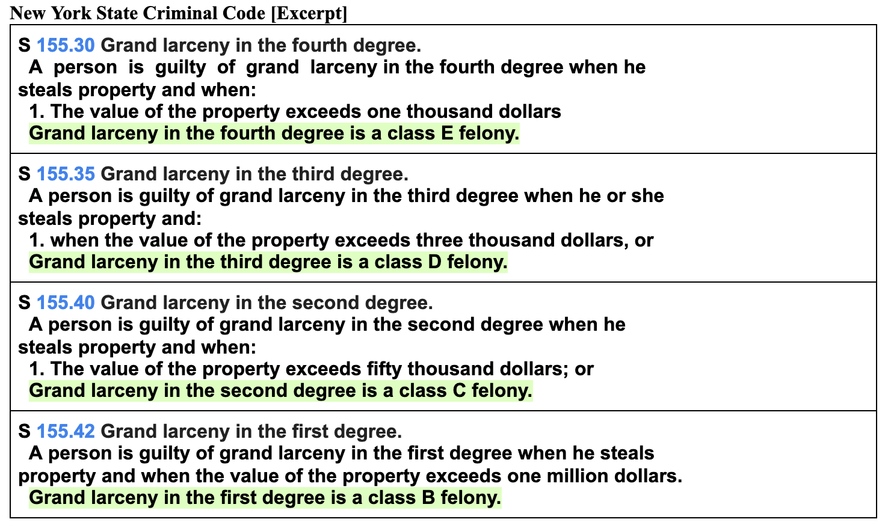
Debit Card Cracking [Activity]
  Document Based Questions

Slide 21
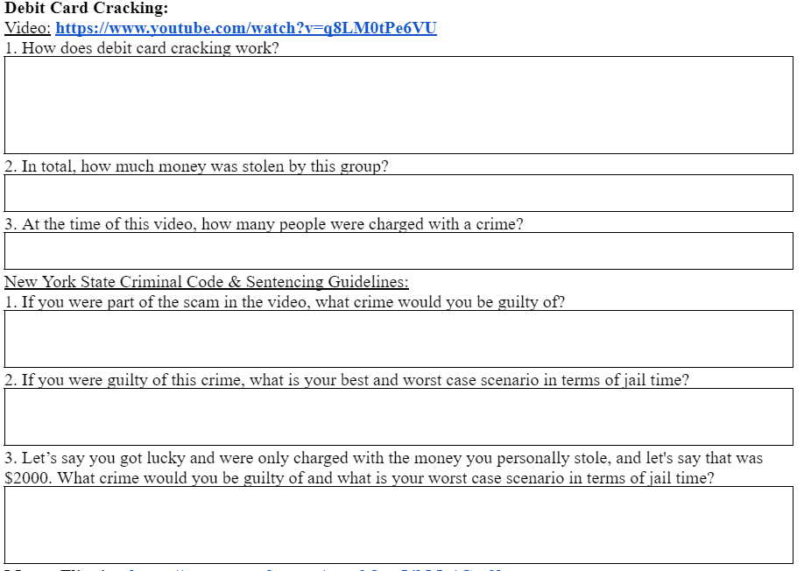
Debit Card Cracking [Activity]
  Document Based Questions

Slide 22
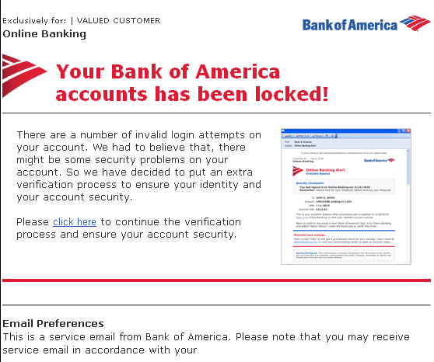
Phishing:

Slide 23
5 Signs of a Phishing Attack
1. Requests Information
2. Spelling/ Grammar Mistakes
3. Sense of Urgency
4
4. Unfamiliar Greeting
3
5. Strange URL
5
https://www.bankofamerica.com/
VS
https://Hapenstance/search?q=long+url&rlz=1C5GCEM_enUS922US922&oq=long+url&aqs=chrome..69i57j0i512l9.3544j0j4&sourceid=chrome&ie=UTF-8
1
2

Slide 24

Phishing [Activity]
  Real Or Phish?

Slide 25
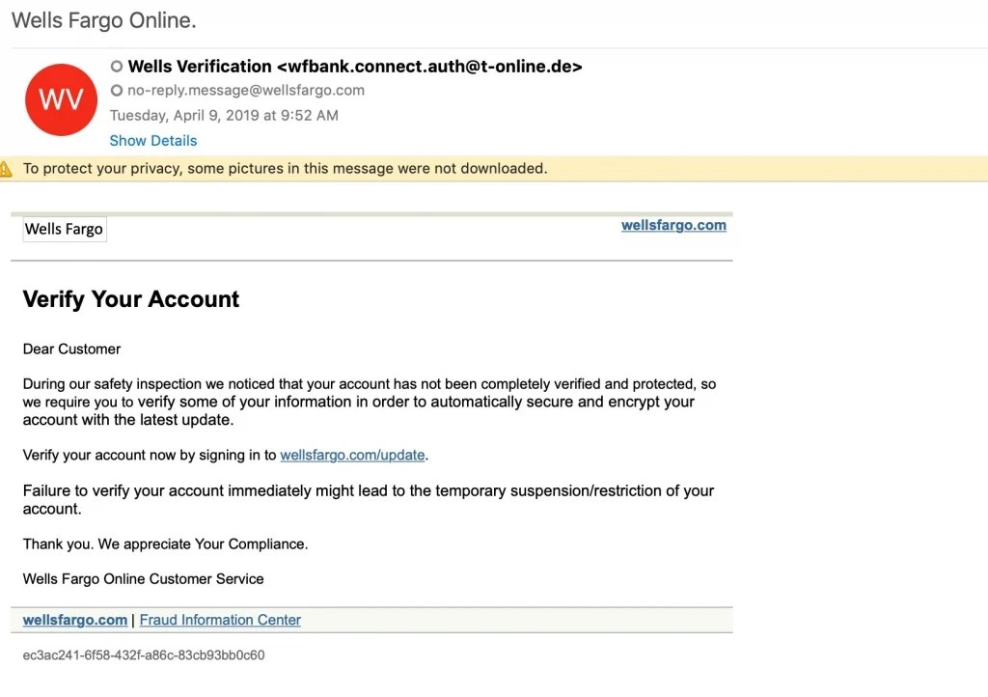
1

Slide 26
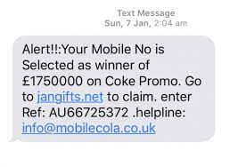
2

Slide 27
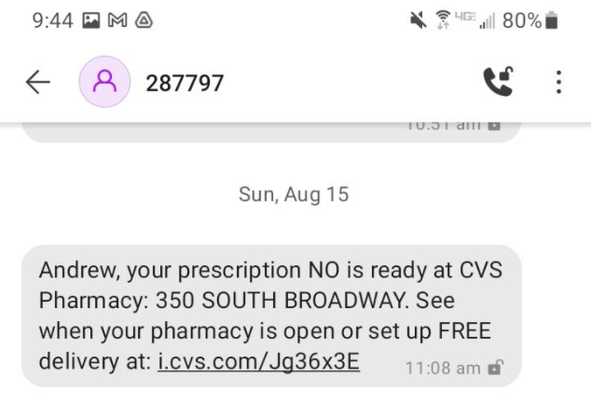
3

Slide 28
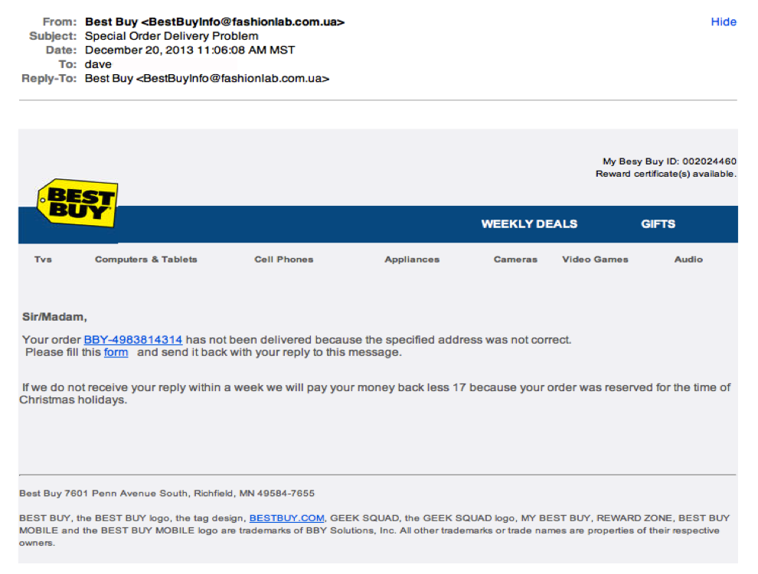
4

Slide 29
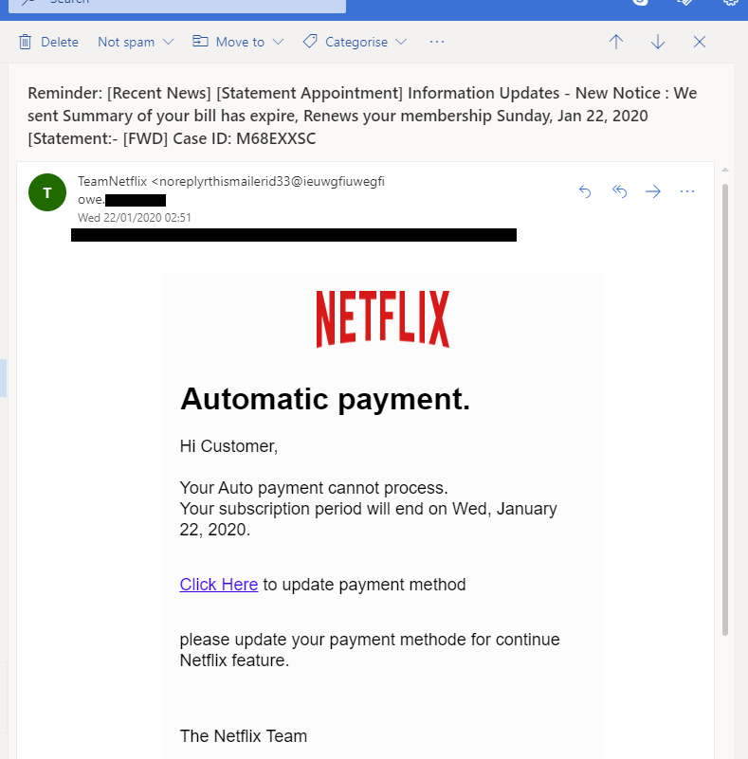
5

Slide 30
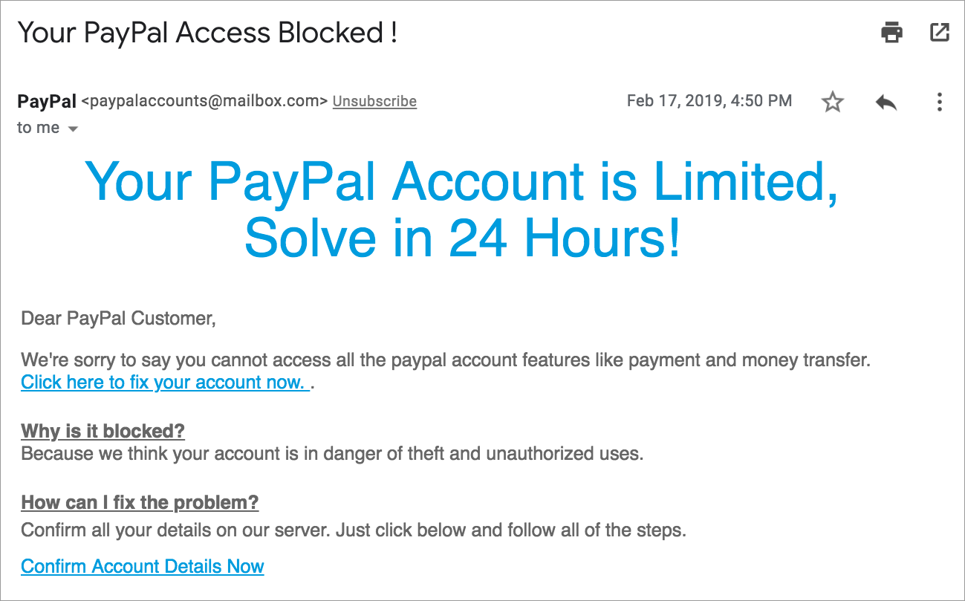
6

Slide 31
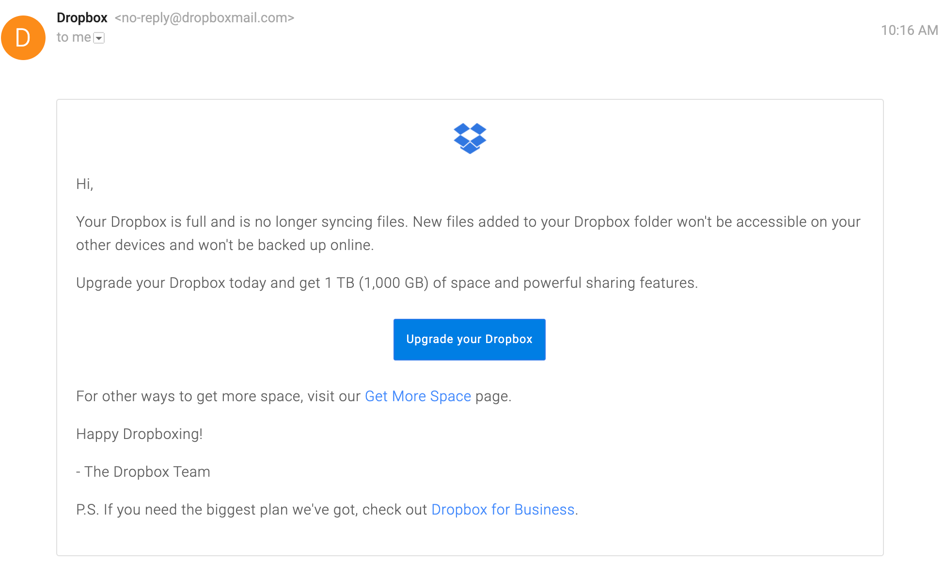
7

Slide 32
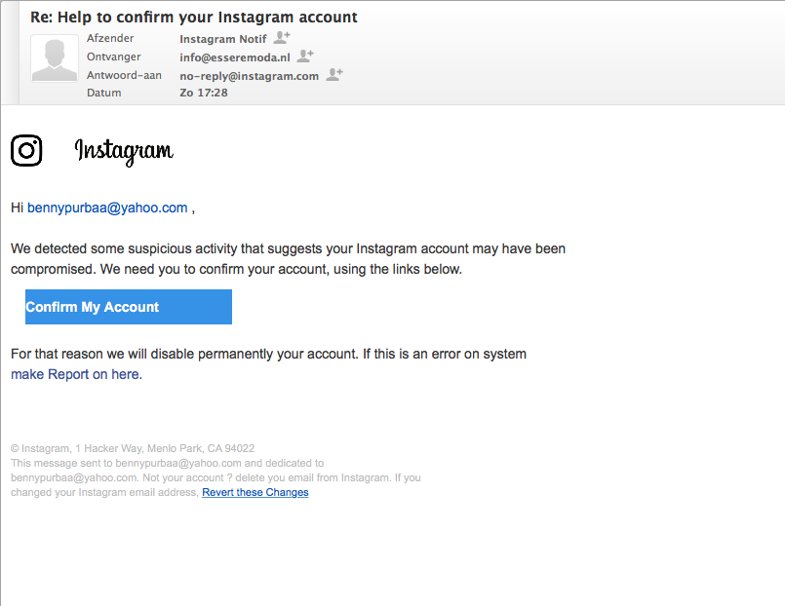
8

Slide 33
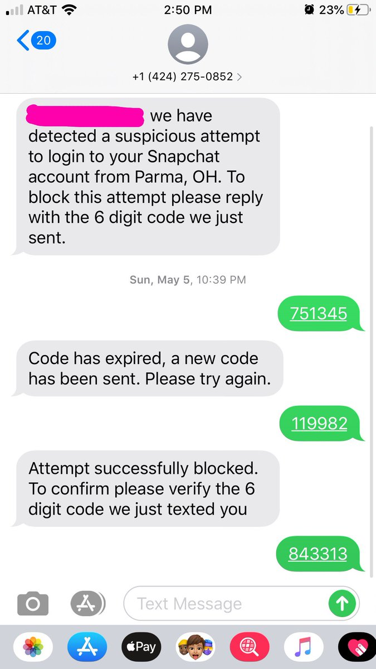
9

Slide 34
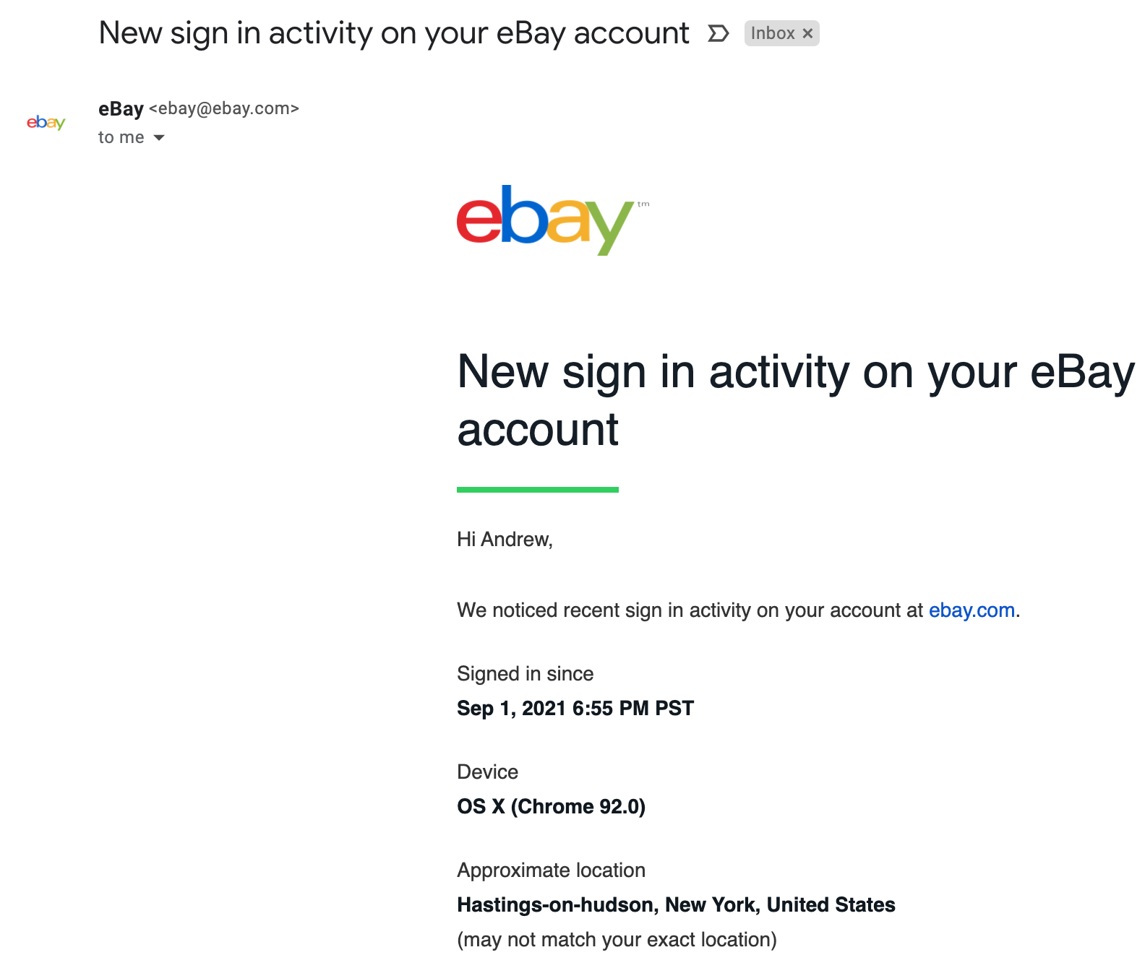

10

Slide 35
How Did You Do?

Slide 36
1
PHISHING

Slide 37
2
PHISHING

Slide 38
3
REAL

Slide 39
4
PHISHING

Slide 40
5
PHISHING

Slide 41
6
PHISHING

Slide 42
7
REAL

Slide 43
8
PHISHING

Slide 44
9
PHISHING

Slide 45
10
REAL

Slide 46
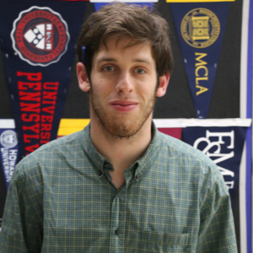
Contact & Questions?
Andrew Menfi
Social Studies Teacher
New Visions Charter High School
for Advanced Math & Science
amenfi3@gmail.com
Thanks For Your Time!
Notes:
What can I add? Sharecropping Farming
Which do we do? Price, Barter System, Business Reg

Slide 47

CEE Affiliates
https://www.councilforeconed.org/resources/local-affiliates/

Slide 48




Thank You to Our Sponsors!

Slide 49



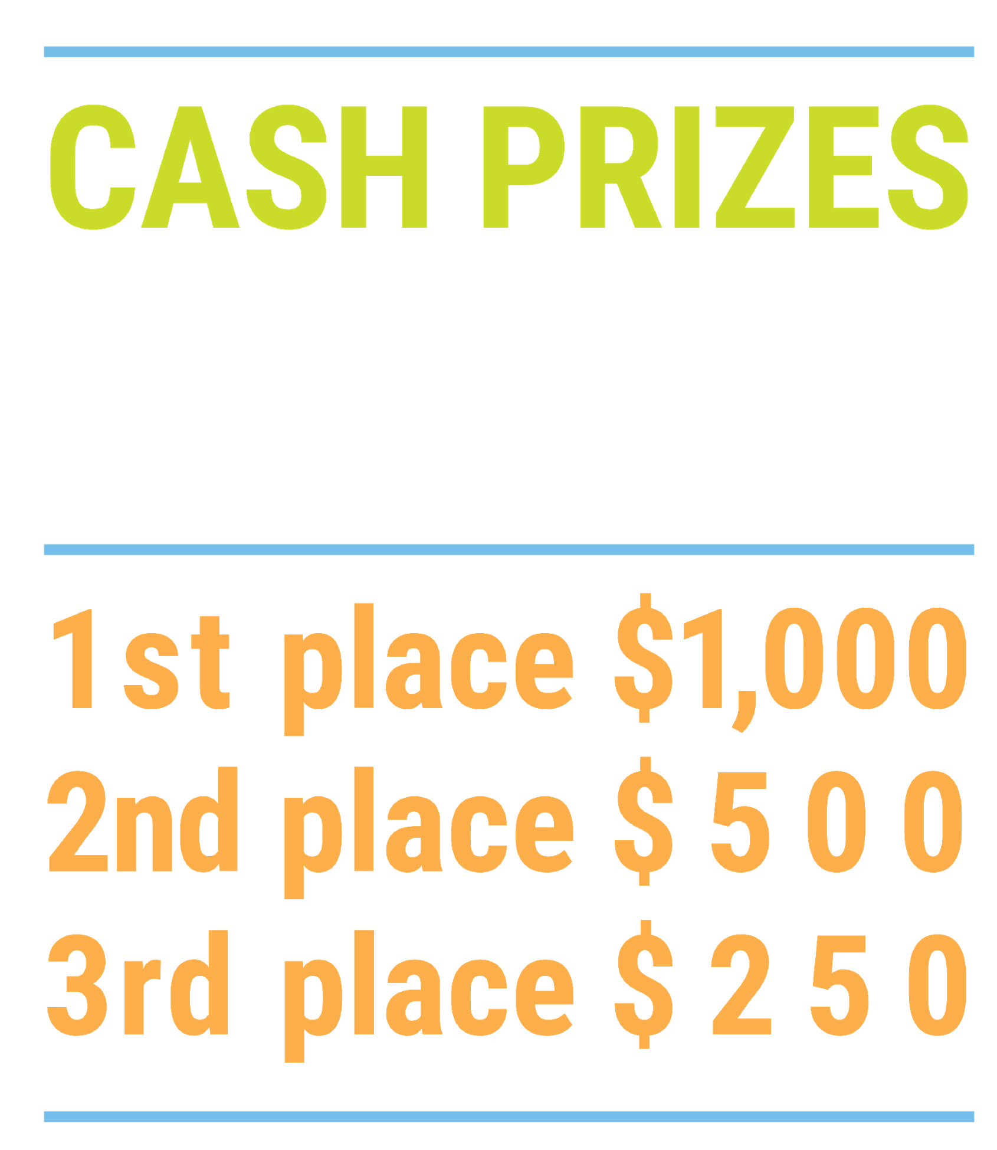

We’ve gone Virtual!
Teach Economics?
Your students may have what it takes to compete in the nation’s only high school economics competition!
Why Play?
• Fun team learning experience
• Great for college applications
• No other challenge like this
• Online participation makes access easy
• Chance for cash prizes
How it Works
Teams register
Teachers enroll team(s) of 3- 4 high school students from the same school. Multiple teams allowed.
Teams compete within their state
Compete to win your state competition for a
chance to advance to the National Semi-Finals.
National Semi-Finals: May 3-20, 2021
Teams answer multiple-choice questions on macroeconomics, microeconomics, and international & current events.
National Finals: May 22-24, 2021
Teams analyze an economic issue and present their solution. Top teams engage in the Finals Quiz Bowl where they face-off answering questions to claim the National Title.
Two divisions based on experience level
David Ricardo for first-time competitors who have taken no more than one economics course.
Adam Smith for returning competitors, AP, International Baccalaureate, and honors students.
Register Today at NationalEconomicsChallenge.org

Slide 50



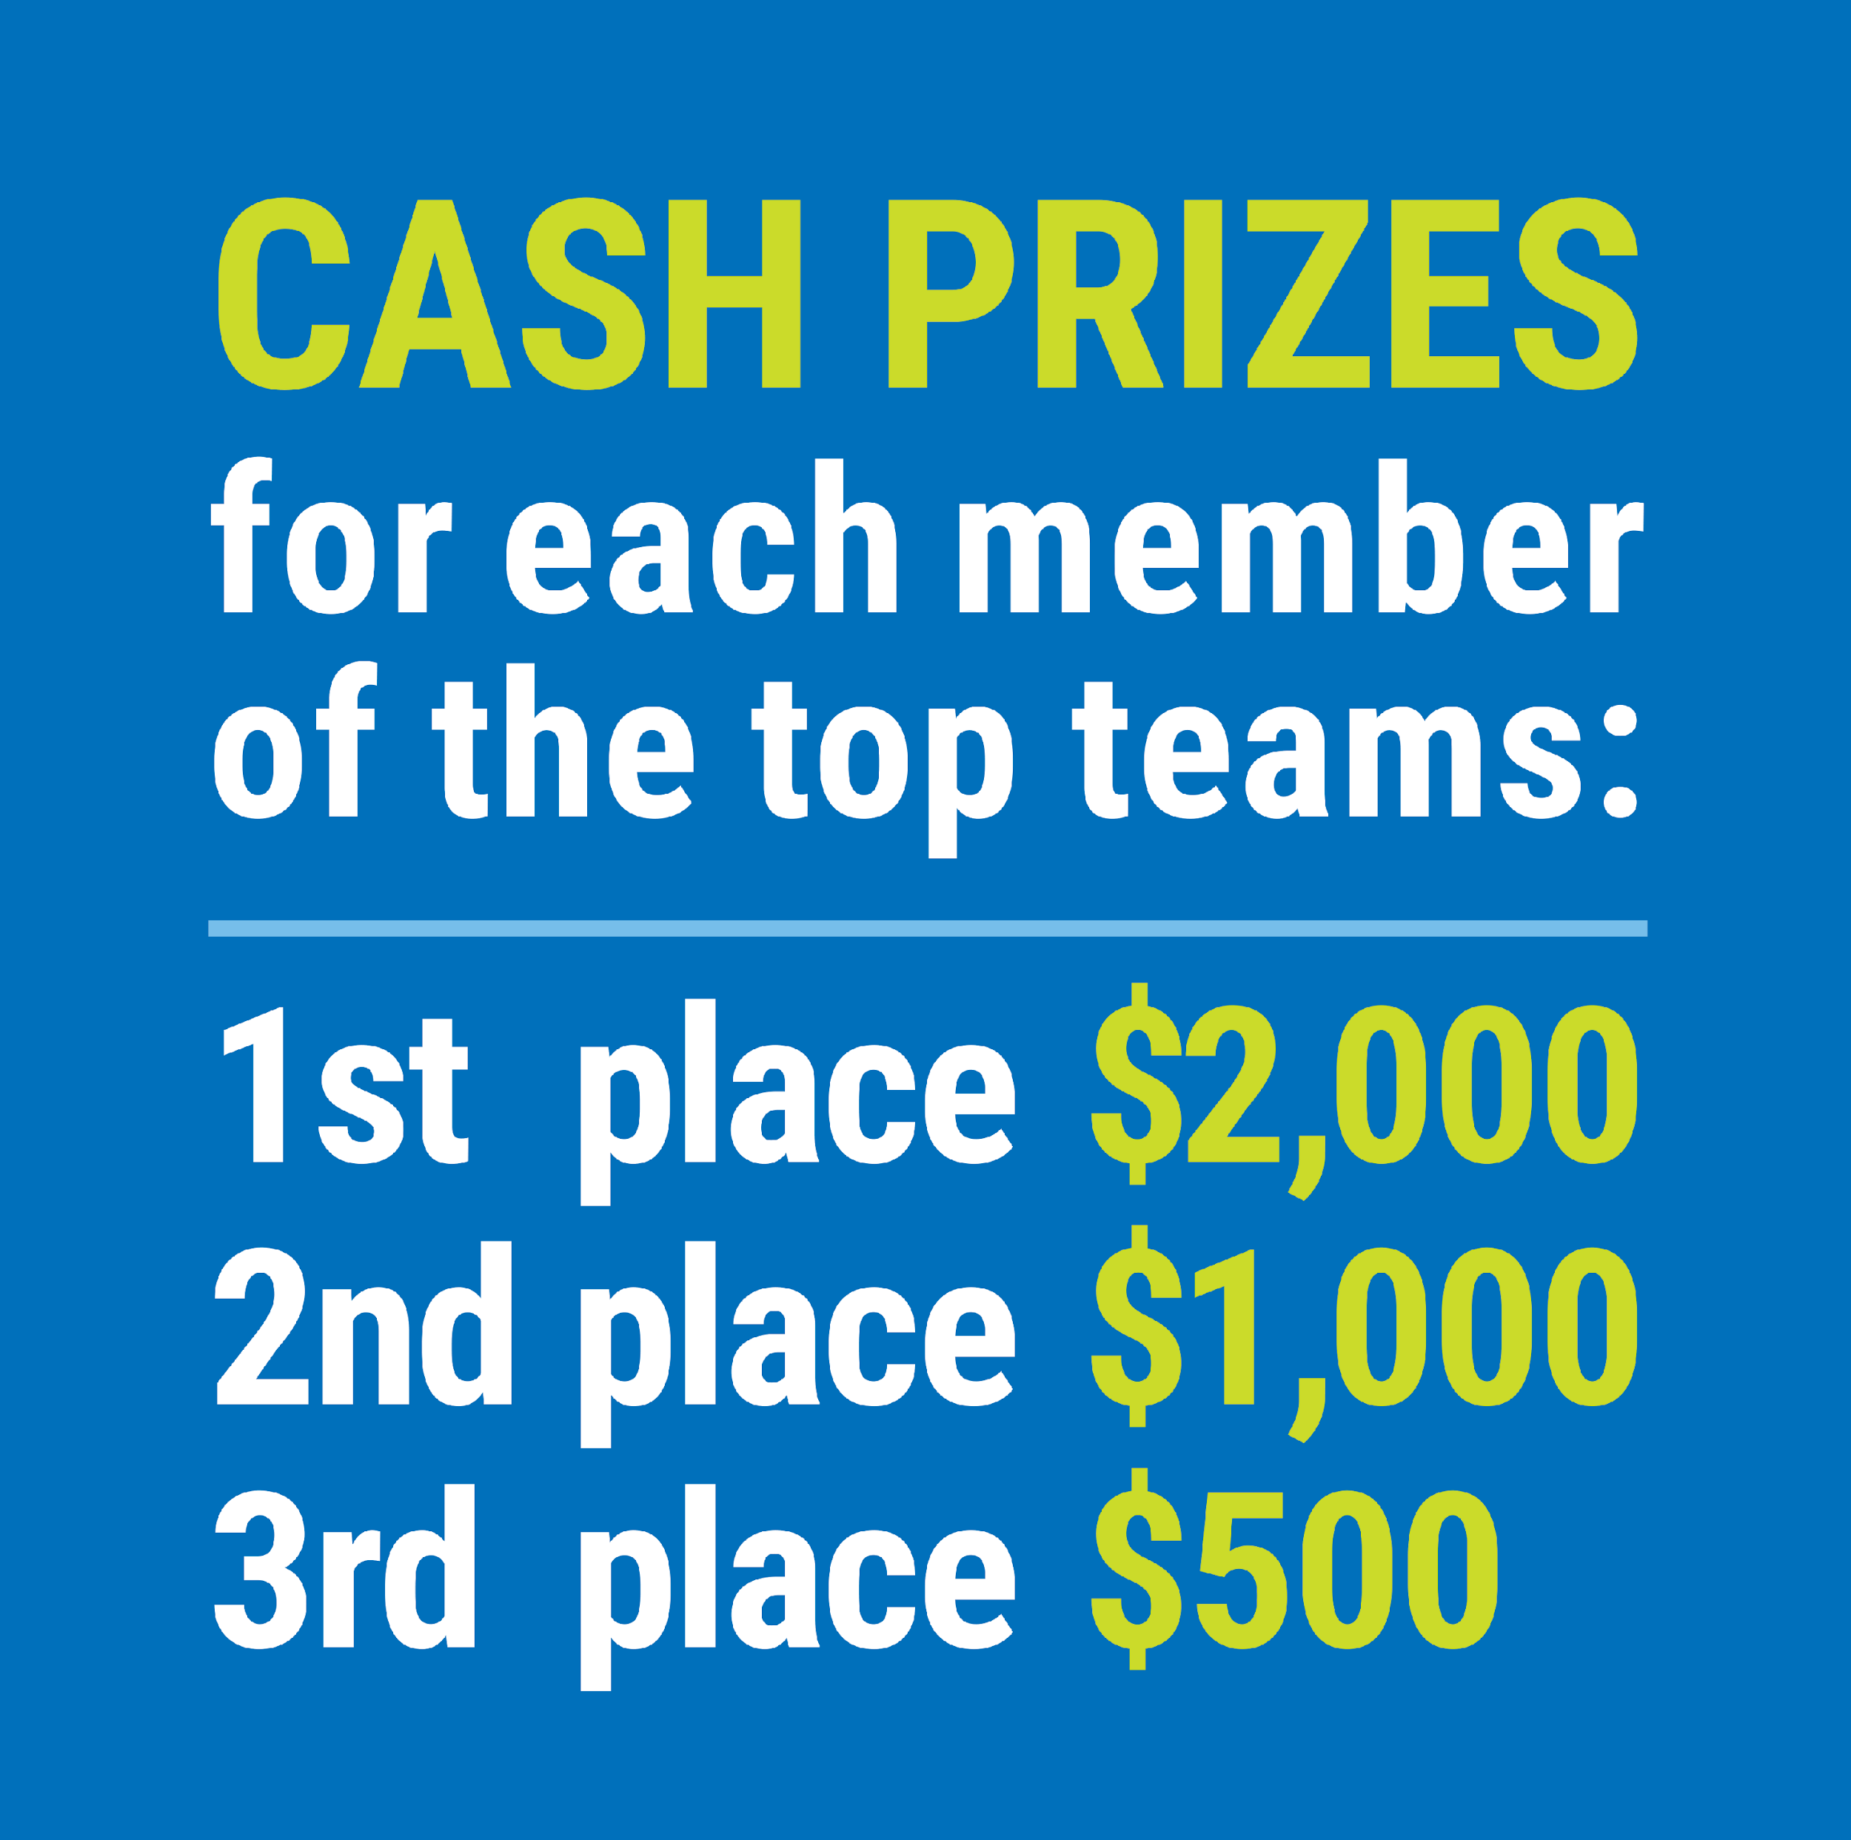

FIND YOUR LOCAL COMPETITION
AND REGISTER TODAY!
The National Personal Finance Challenge is a competition that provides high school students with an exciting and motivating opportunity to build, apply, and demonstrate their knowledge of money management.
Through online exams and a personal finance simulation, teams showcase their expertise in earning income, buying goods and services, saving, using credit, investing, as well as protecting and insuring.
Teams of up to four students, with one teacher/coach, can qualify to represent their state at the National Personal Finance Challenge by winning their local competition.
NATIONALS
Semi-Finals: First round elimination via online multiple-choice questions.
Finals: Case study round virtually co-hosted by the Cleveland Fed on June 3.
personalfinancechallenge.org

Slide 51
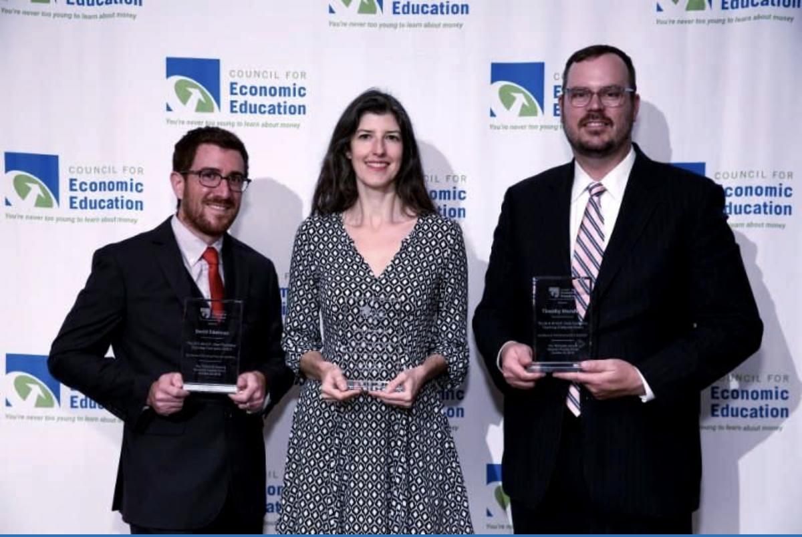
The 2021 Sloan Teaching Champion Award
Winners receive:
A cash award of $5,000
A cash award of $2,500 for their school to support economic education
Recognition at our annual Visionary Awards convening.
This award promotes economic education by honoring three outstanding teachers who incorporate exemplary teaching techniques that improve their students’ economic understanding in and out of the classroom.
This award is open to New York metropolitan area high school teachers of all subjects, not just teachers of economics. Applicants must demonstrate how they integrate economics into their teaching.
Sound like you or someone you know?
Applicants must teach in one of the
Twelve New York state counties (New York, Kings, Bronx, Richmond, Queens, Nassau, Suffolk, Westchester, Putnam, Rockland, Orange and Dutchess)
Eight New Jersey counties (Bergen, Passaic, Essex, Hudson, Middlesex, Union, Morris, Monmouth), or the
Two Connecticut counties (Fairfield and New Haven)
Application will be launched on Friday February 19th 2021
You can access the application here.
CONTACT
Please feel free to e-mail us at rrivera@councilforeconed.org
with any questions you have.

