Slide 1







Giving Thanks for New Picture Books: Dreamers Who Give, Build, and Grow
Lynne Farrell Stover
JMU Center for Economic Education
stoverlf@jmu.edu

Slide 2
EconEdLink Membership
You can now access CEE’s professional development webinars directly on EconEdLink.org! To receive these new professional development benefits, become an EconEdLink member. As a member, you will now be able to:
Automatically receive a professional development certificate via e-mail within 24 hours after viewing any webinar for a minimum of 45 minutes
Register for upcoming webinars with a simple one-click process
Easily download presentations, lesson plan materials and activities for each webinar
Search and view all webinars at your convenience
Save webinars to your EconEdLink dashboard for easy access to the event
You may access our new Professional Development page here

Slide 3
Professional Development Certificate
To earn your professional development certificate for this webinar, you must:
Watch a minimum of 45-minutes and you will automatically receive a professional development certificate via e-mail within 24 hours.
Accessing resources:
You can now easily download presentations, lesson plan materials, and activities for each webinar from EconEdLink.org/professional-development/

Slide 4

Agenda
This session features:
Review of basic economic concepts
Discussion of the use of children’s books to teach in the content areas
Featured books’ lesson plans and activities
Links to support materials
Q & A session
The following economic concepts are covered:
Opportunity Cost
Productive Resources
Money
Choices
Human Capital
Specialization

Slide 5
Objectives
Teachers will be able to:
Review basic economic concepts
Explore new picture books (copyrights 2017-2021) and learn how to identify the economic concepts found in them.
Learn how to use book content to teach age appropriate lessons and activities based on the featured concepts.

Slide 6
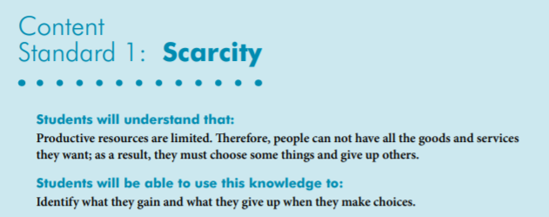

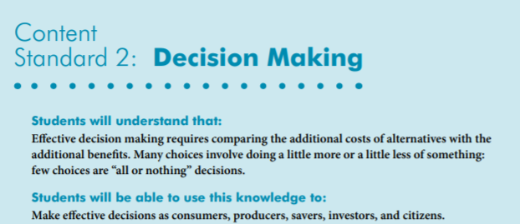
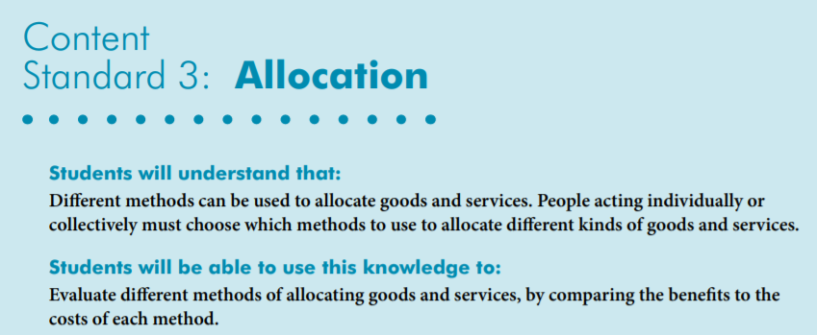
National Standards
https://www.councilforeconed.org/wp-content/uploads/2012/03/voluntary-national-content-standards-2010.pdf

Slide 7

Virginia HISTORY & SOCIAL SCIENCE Standards of Learning
Economics
K.8 The student will match simple descriptions of work that people do with the names of those jobs.
1.7 The student will explain the difference between goods and services and describe how people are consumers and producers of goods and services.
2.4 The student will describe how the contributions of selected individuals changed the
lives of Americans, with emphasis on: d) George Washington Carver
2.8 The student will describe natural resources (water, soil, wood, and coal), human resources (people at work), and capital resources (machines, tools, and buildings)
2.10 The student will explain that scarcity (limited resources) requires people to make choices about producing and consuming goods and services.
3.8 The student will demonstrate an understanding of different cultures and the natural, human, and capital resources they used in the production of goods and services.
3.9 The student will recognize that because people and regions cannot produce everything they want, they specialize in what they do best and trade for the rest.
Civics
1.10 The student will apply the traits of a good citizen by
a) focusing on fair play, exhibiting good sportsmanship, helping others, and treating others with respect.

Slide 8
Featured Economic Concepts
Choice- An act of selecting or making a decision when faced with two or more alternatives.
Human Capital Intangible assets possessed by individuals, including knowledge, talent, skills, health, and values. (Also known as human resources)
Money – any generally accepted medium of exchange
Opportunity Cost - the real cost of a choice. It is the next best alternative that is given up—the lost opportunity
Productive Resources- things used in the production of goods and services including: Natural Resources (gifts of nature that are present without human intervention), Human Resources (the quantity and quality of human effort directed toward producing goods and services) and Capital Resources (manmade resources such tools, buildings, and vehicles used in production).
Scarcity – the condition of limited resources-- because resources are limited, people must make choices.
Wants - A desire that can be satisfied by consuming or using a good or service.
Wage- payments for labor services that are directly tied to time worked or pieces produced.

Slide 9

Using Children’s Literature to Teach Content
It is to be noted that by using children’s picture books to teach in the content areas, we are providing students with engaging background information that encourages them to relate to concepts, improve vocabulary, and promote reading and writing skills.
Children’s literature offers many interdisciplinary possibilities including those of economics and personal finance.

Slide 10
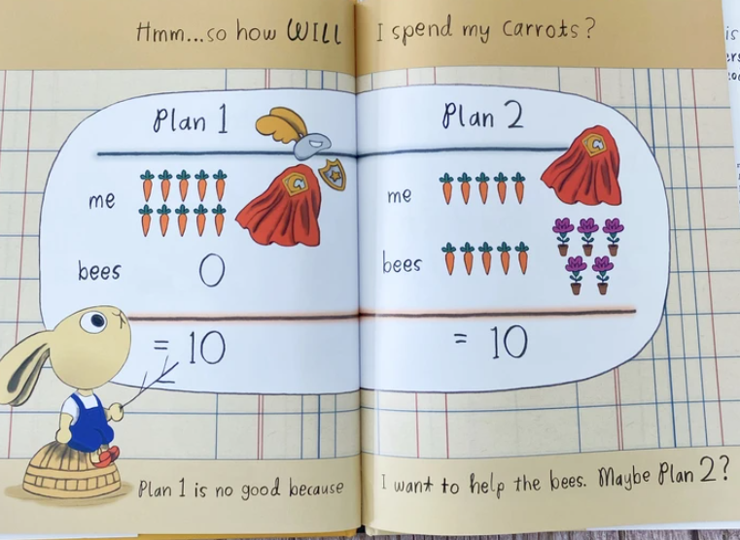
Give It!
Goods & Services
Charity-Fiction
Publisher: Penguin
Copyright Date: 2020
Reading Level: 2.0
Interest Level: PK-2

Slide 11
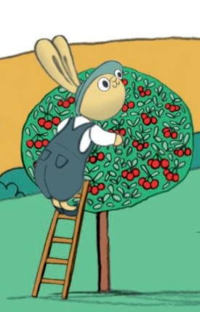
Give It!
Story Synopsis: When Chummy’s grandmother gives him ten carrots for his birthday, he has to make some decisions. He definitely wants to help others, but he is not sure of the best way to do so. With some sensible discussion, informative graph making, and charitable consideration, he makes a choice that will have an impact on others and the environment.

Slide 12
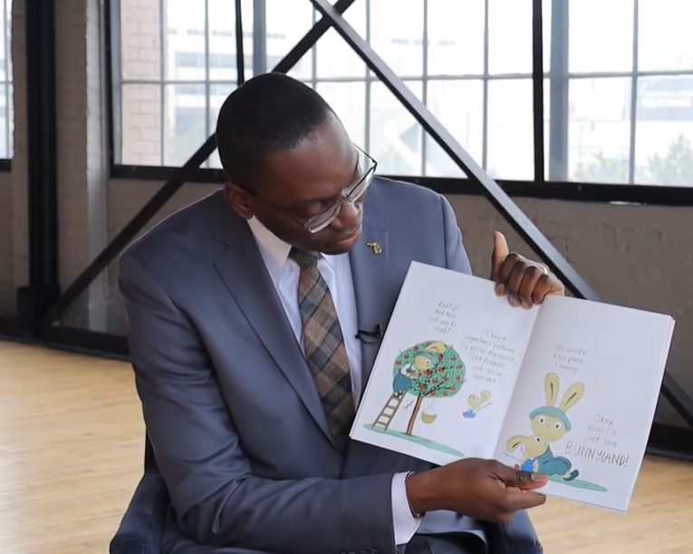

Give It!
https://www.youtube.com/watch?v=lCuBSL-njsM
(3:35 Reading Time)

Slide 13
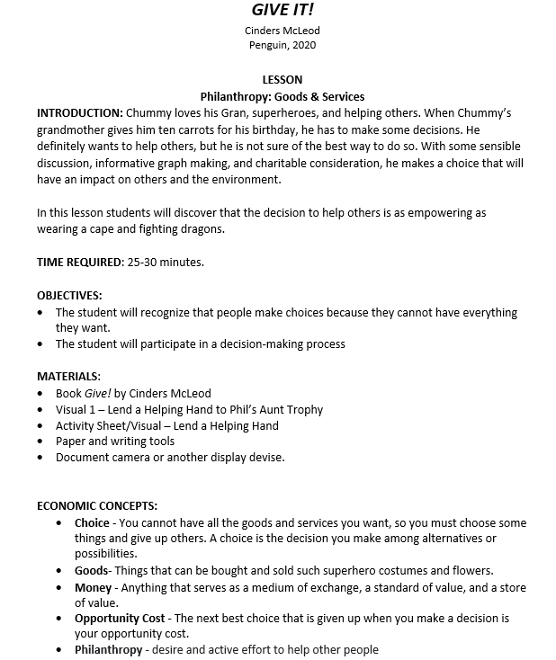
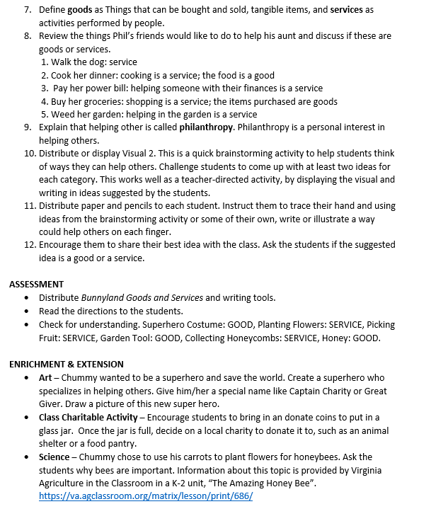
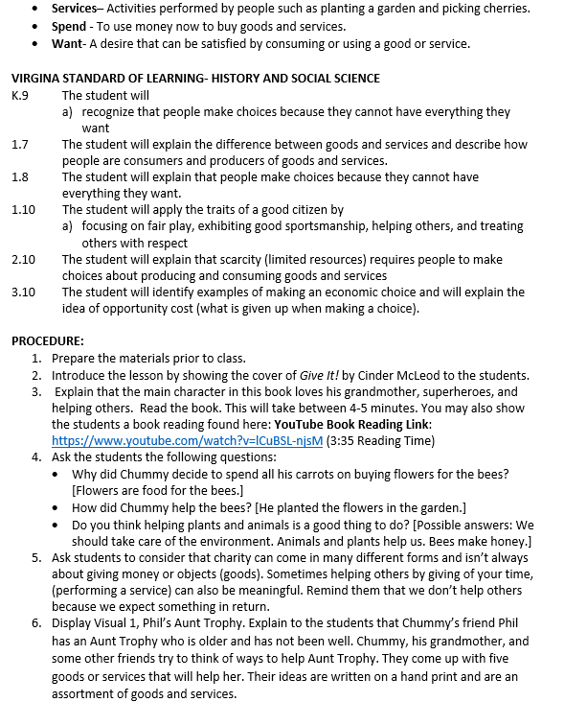
Lesson Plan

Slide 14
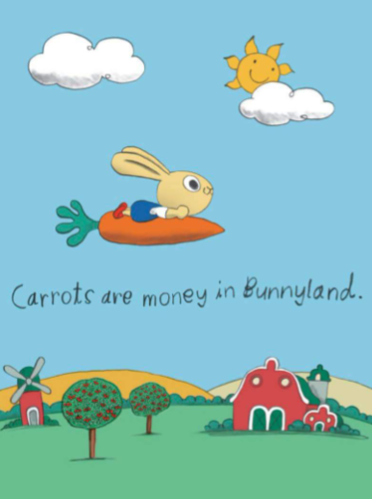
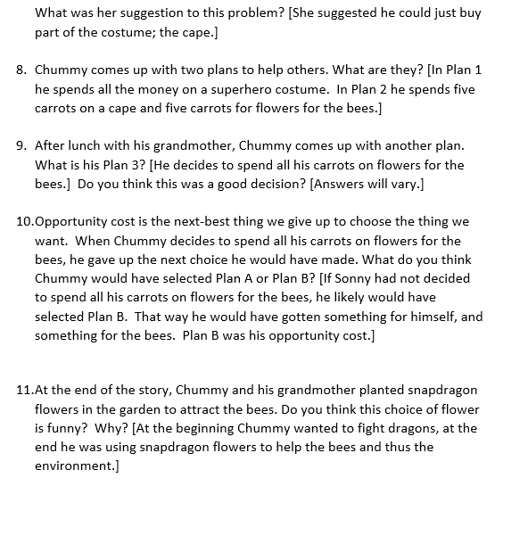
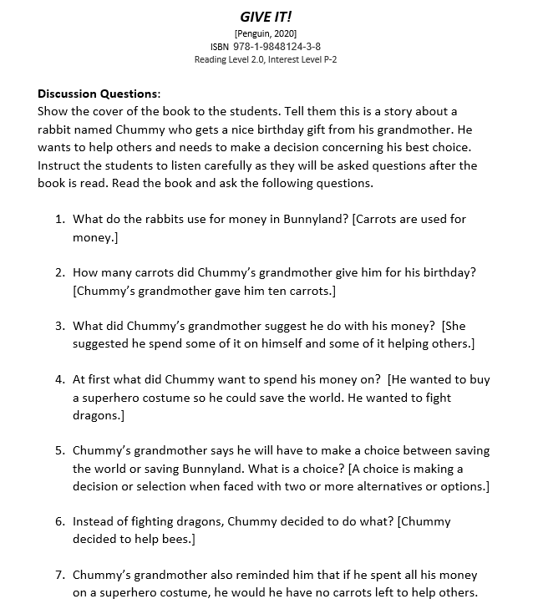
Discussion Questions

Slide 15



Visual

Slide 16
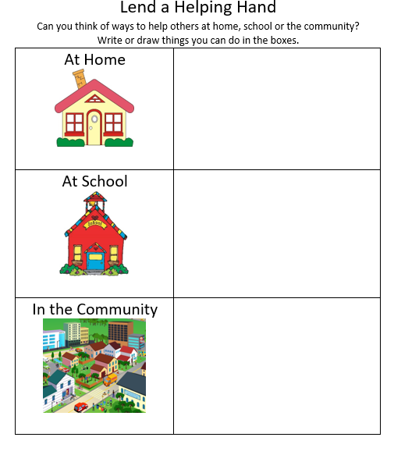

Activity Sheet

Slide 17
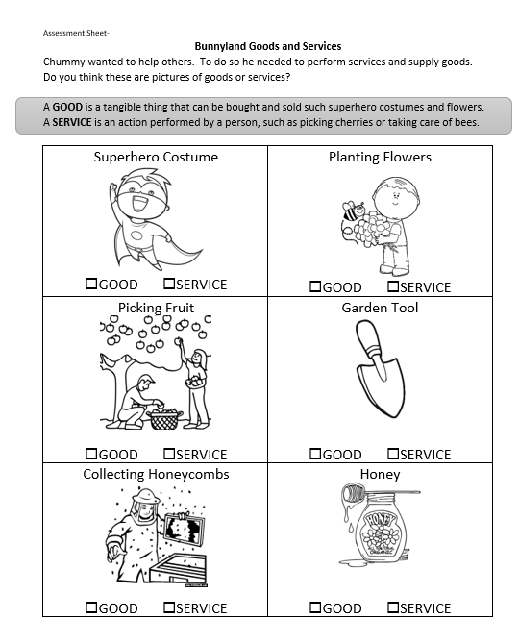

Assessment

Slide 18

Note: This title is featured in the Bunnyland series.
http://youreconomicsuccess.org/kidlit/

Slide 19
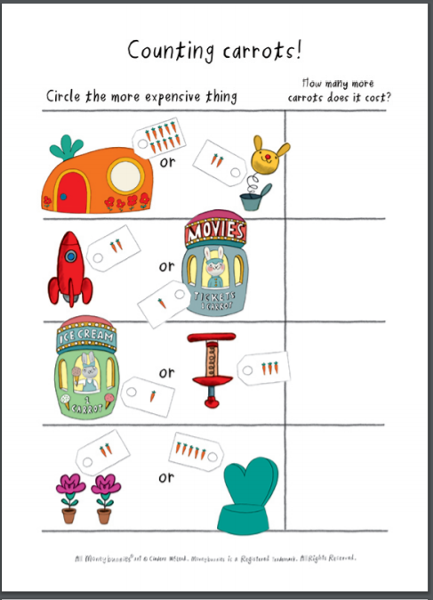
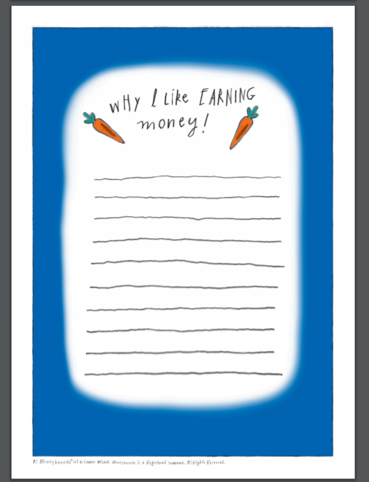
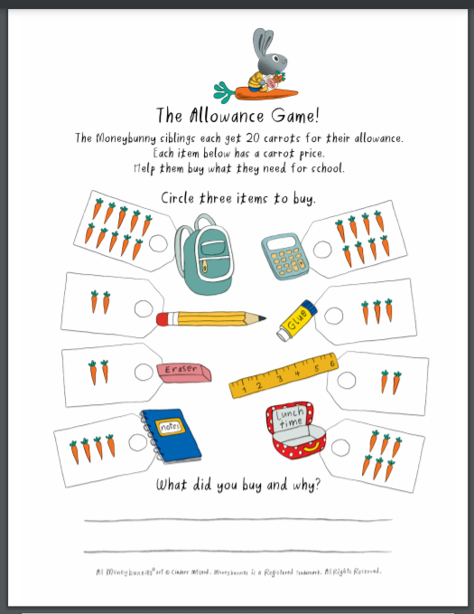
Activity Sheets
https://storage.googleapis.com/classroom-portal-production/uploads/2021/04/9c78f1c0-monneybunny-activities.pdf
Math Writing Decision-Making

Slide 20
What is Given from the Heart
Reading Level: 3.3
Interest Level: P-2
Publisher: Random House
Copyright Date: 2019
https://www.youtube.com/watch?v=eE7C4etCqh0

Slide 21
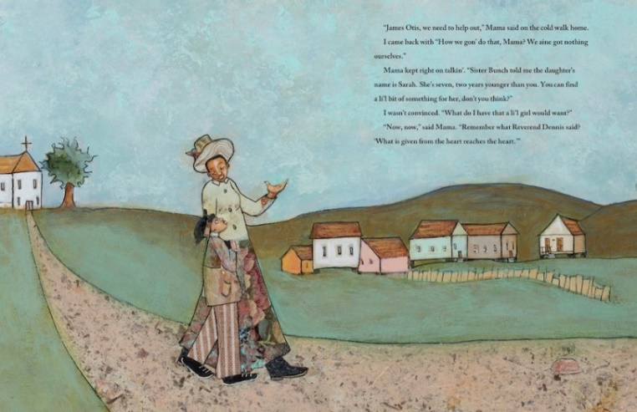
What is Given From the Heart
Story Synopsis: Times are hard for nine-year-old James Otis. He and his mother are living in a dilapidated house after losing their farm due to the death of his father. Things get worse when there is a flood, and the dog runs away. Despite their own poverty, James Otis and his mother problem solve how to help the Temples, a family who has lost everything in a fire. Using a treasured tablecloth for the material to sew a new apron and writing a book featuring seven-year-old Sarah Temple as the main character, the mother and son duo give gifts from their hearts.

Slide 22
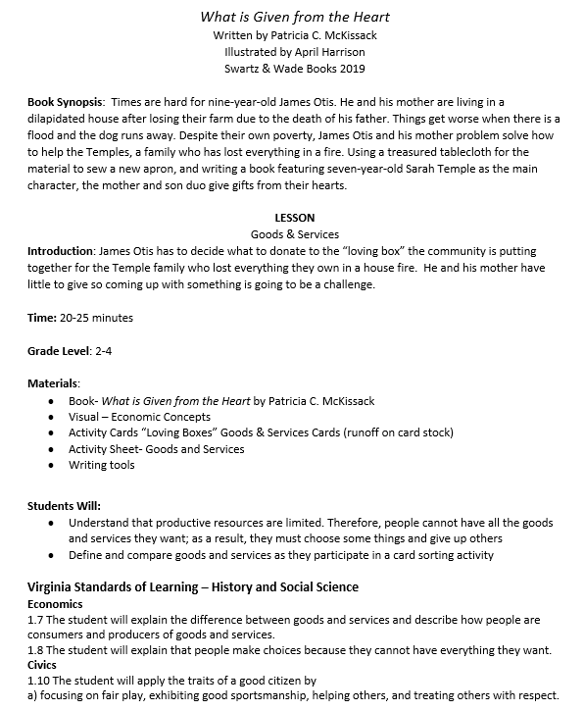
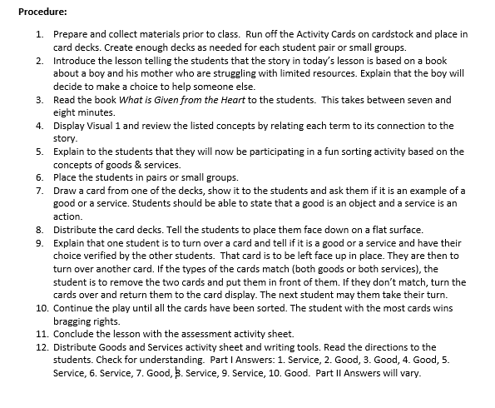
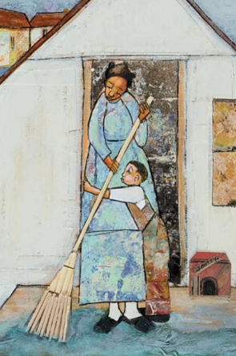
Lesson Plan

Slide 23
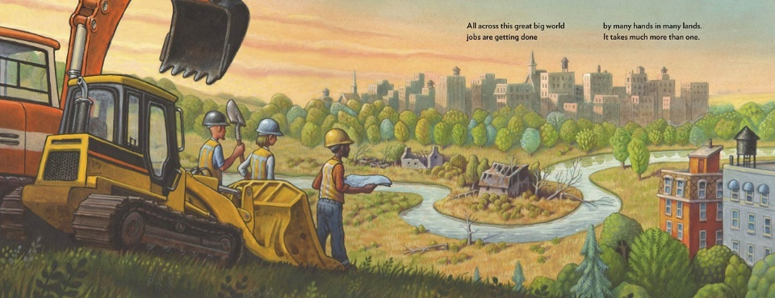
Someone Builds the Dream
Specialization
Copyright Date: 2021
Reading Level: 2.0
Interest Level: K-3
Stories in Rhyme

Slide 24
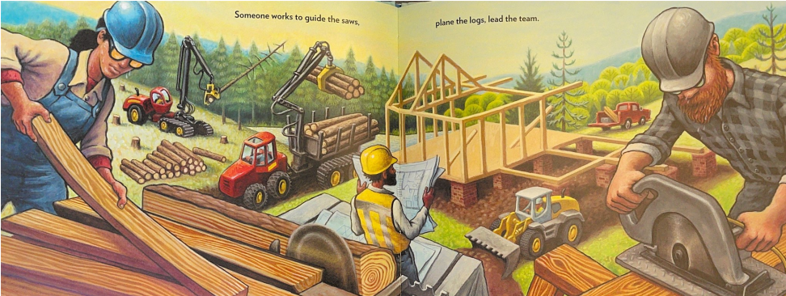

Someone Builds the Dream
Story Synopsis: Architects, engineers, scientist, authors and illustrators develop the ideas. However, it’s the construction workers, carpenters, electricians and printing press operators who make these ideas a reality.

Slide 25
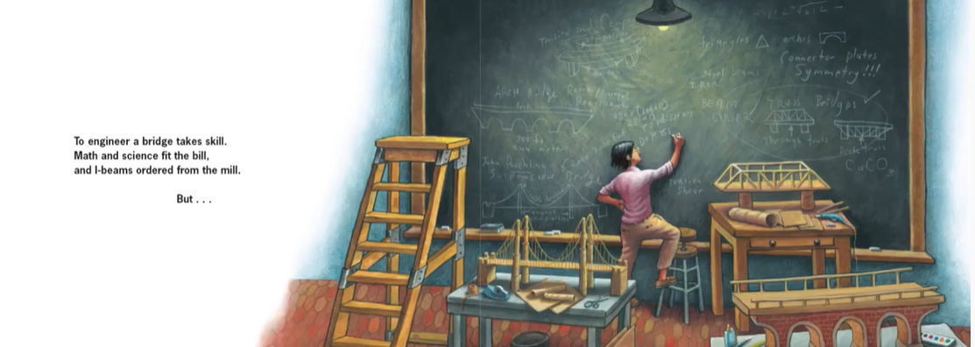
Someone Builds the Dream
https://www.youtube.com/watch?app=desktop&v=H5rcpgEiiuo
Reading Time (3:12)

Slide 26
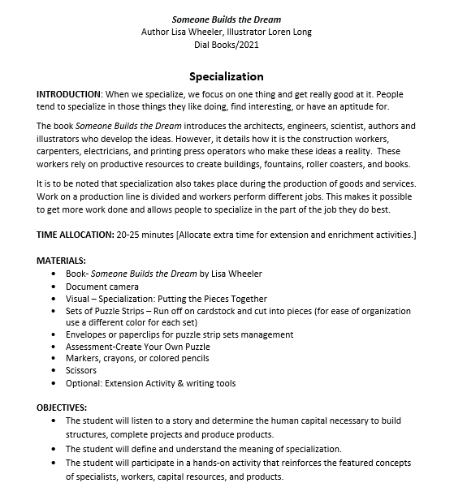
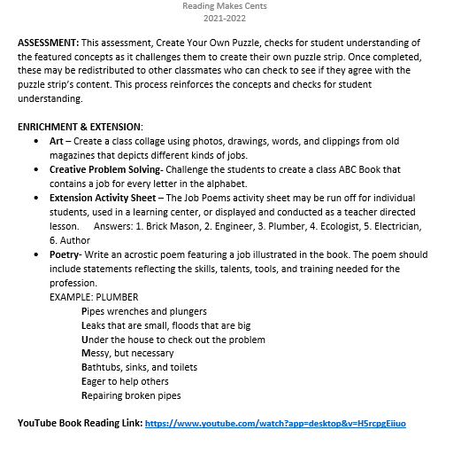
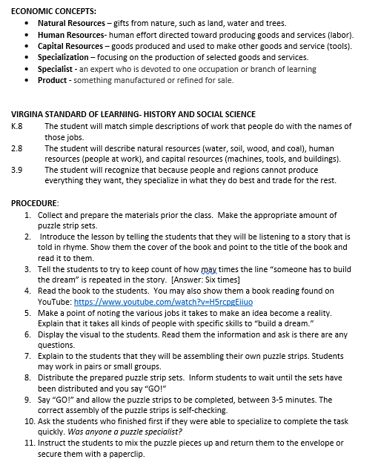

Lesson Plan

Slide 27
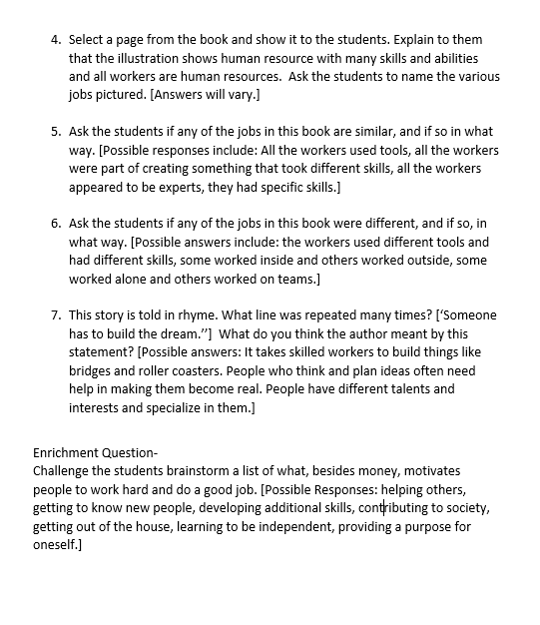
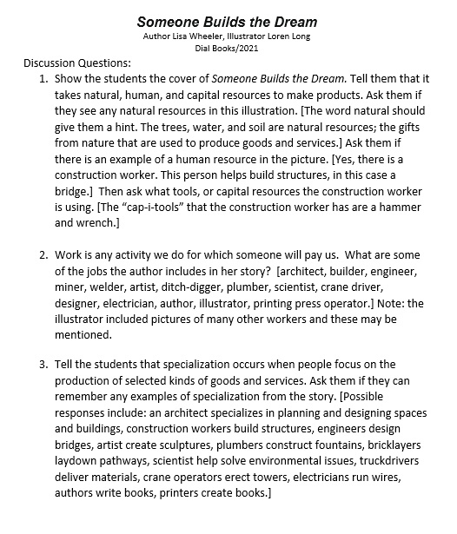

Discussion Questions

Slide 28
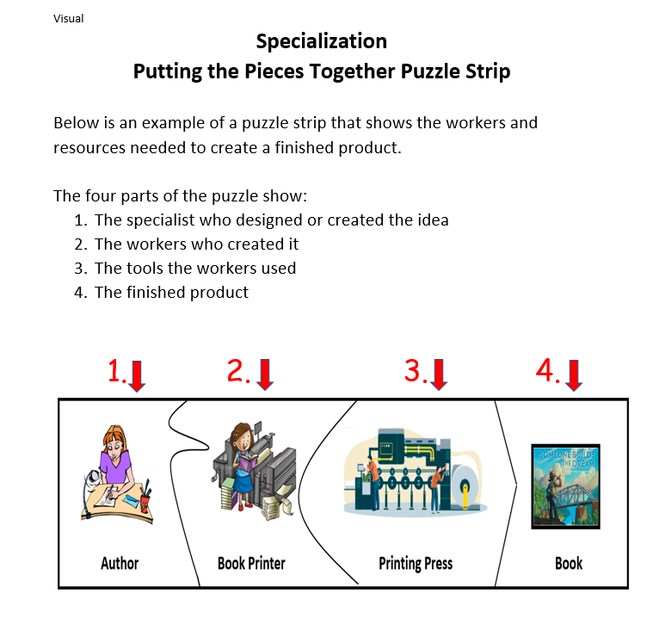
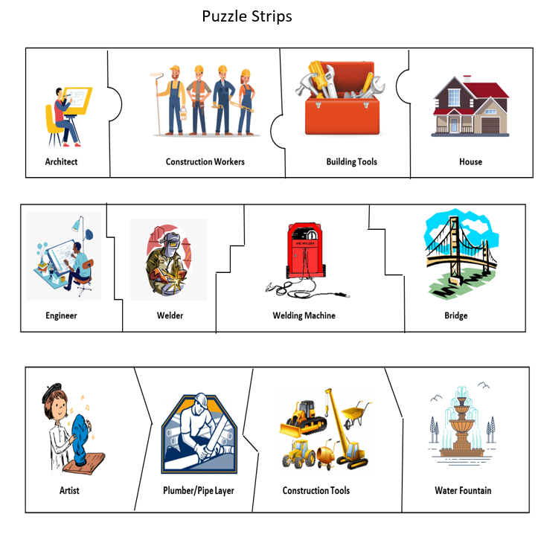

Slide 29
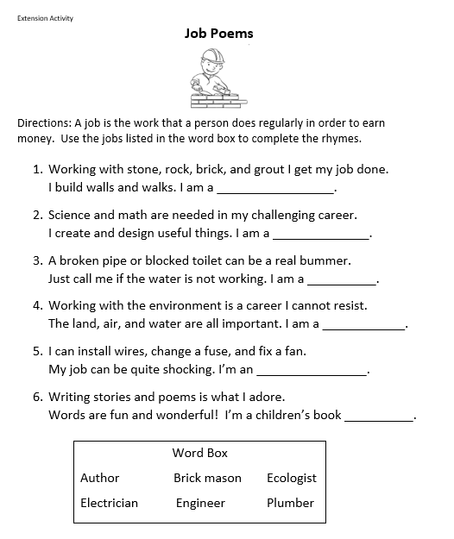

Extension Activity

Slide 30


Resources provided by publisher
https://penguinclassroom.com/books/someone-builds-the-dream/

Slide 31
FRY BREAD
Productive Resources
Publisher: Roaring Brook Press
Copyright Date: 2019
Reading Level: 2.0
Interest Level: P-2
Realistic Fiction

Slide 32

Story Synopsis: A portrayal of a modern Native American family, told in lively and powerful verse, The book uses fry bread as a metaphor for love, sharing, and honoring the old while embracing the new.

Slide 33
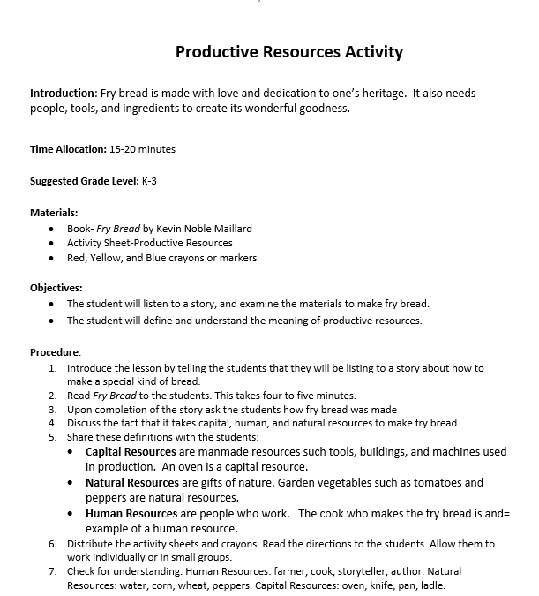
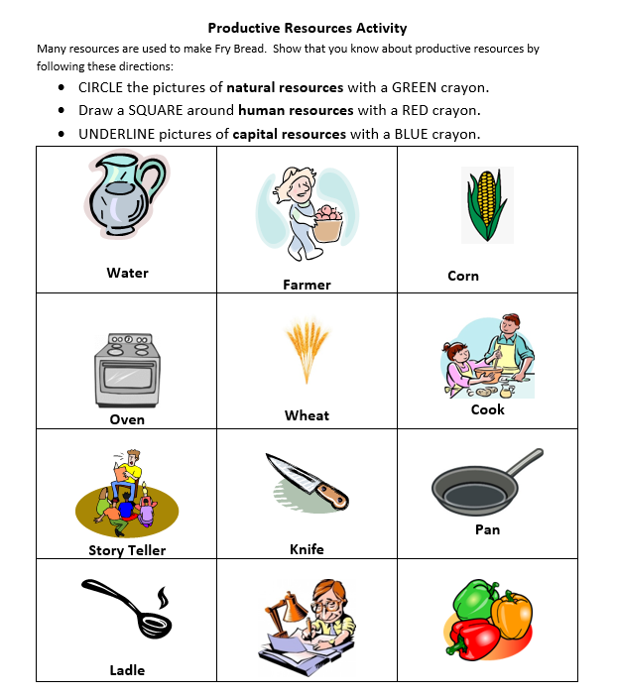

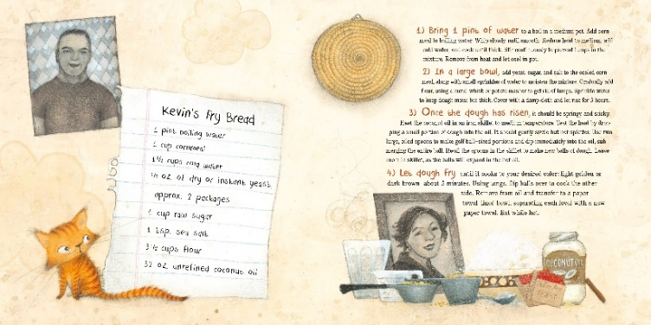
Productive Resources Lesson

Slide 34

Book’s End Pages
America's 573 recognized tribes.

Slide 35
The Secret Garden of
~George Washington Carver~
Scarcity/Limited Resources
Publisher: HarperCollins
Copyright Date: 2020
Reading Level: 4.5
Interest Level: K-3
Picture Book Biography

Slide 36

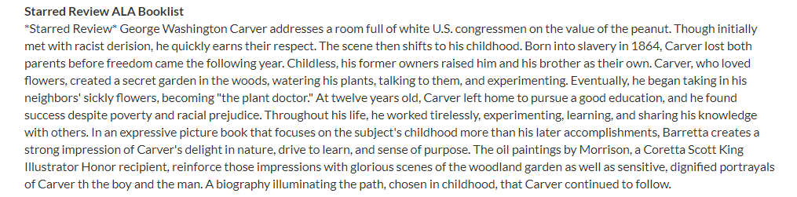
Story Synopsis: Focusing on the early life of George Washington Carver, rather than his accomplishments as an adult, this biography features the struggles and prejudices he faced on his journey to become a prominent scientist and respected educator.

Slide 37
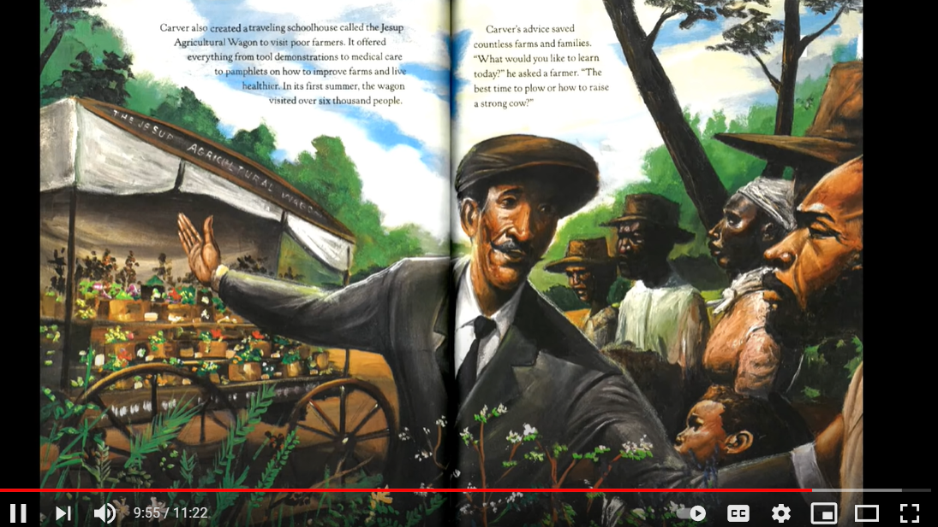
The Secret Garden of George Washington Carver
https://www.youtube.com/watch?v=28vSGkGNtkA

Slide 38
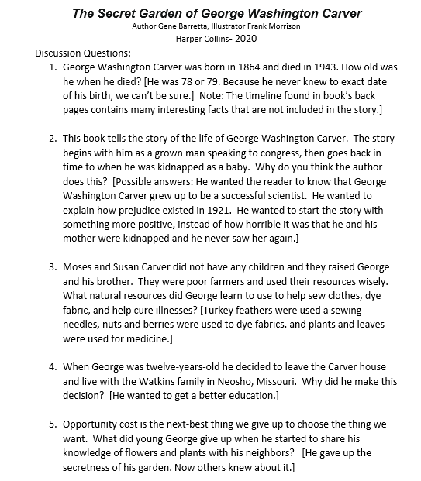
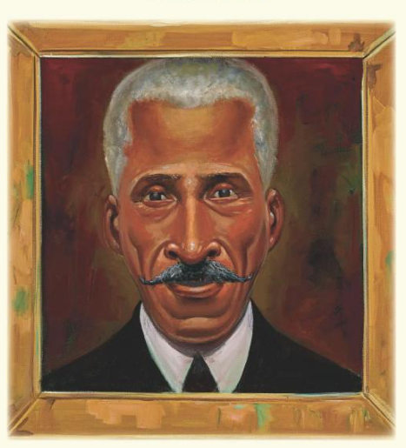
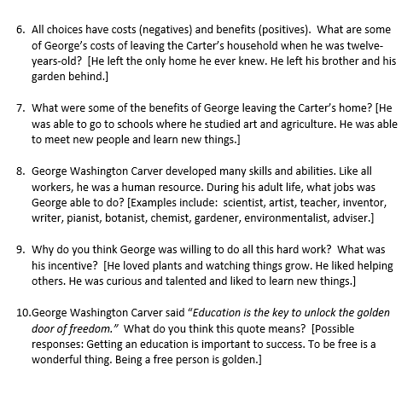
Discussion Questions

Slide 39
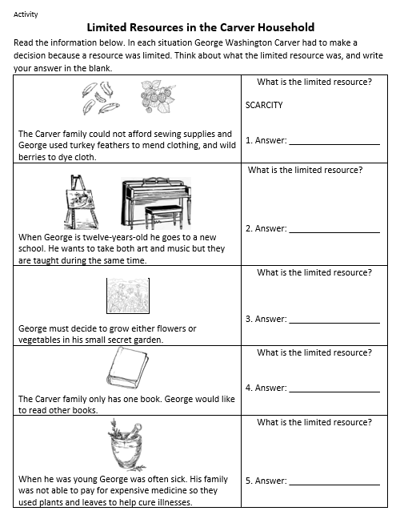
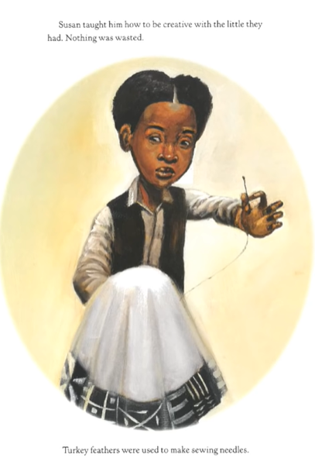
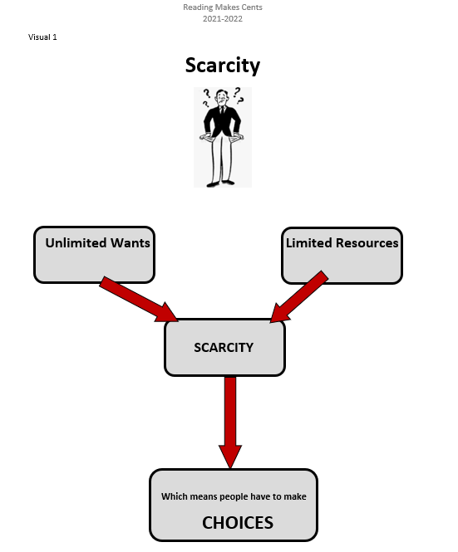
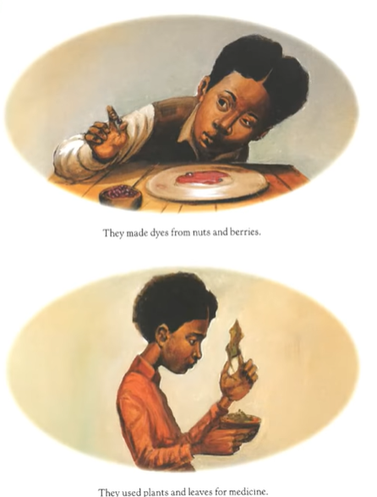

Slide 40
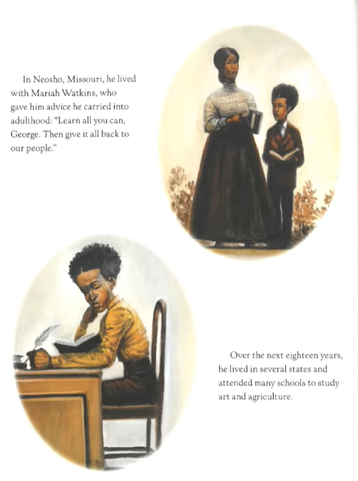
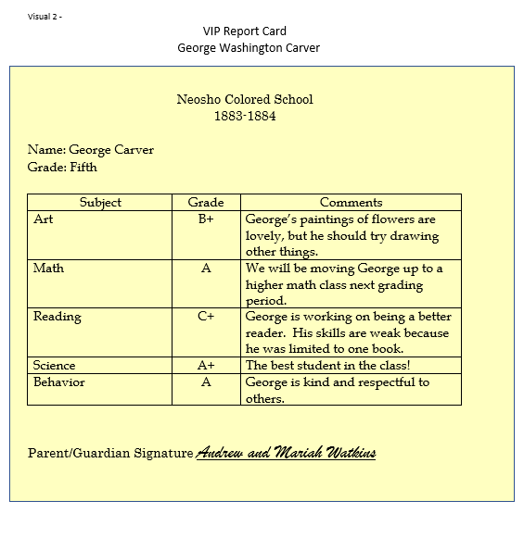
Enrichment Activity

Slide 41
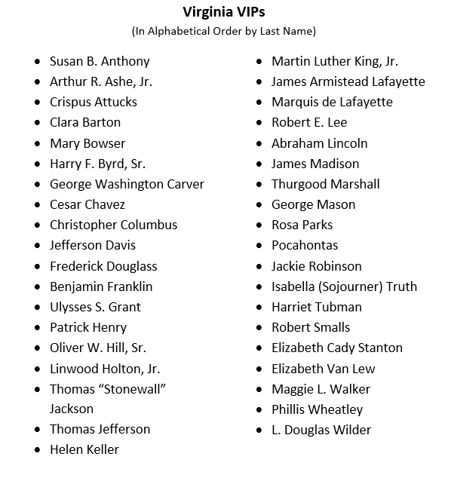

Creative Writing/Research – Instruct the students to create a report card that would reflect the personality, challenges and accomplishments of historic figures featured in the SOLs. Display Visual 2, George Washington Carver’s Report Card, and review the content with the class. Post a list of the provided Virginia VIP names, allow students to select one, and distribute the VIP Report Card activity sheet. Provide research materials such as encyclopedias and biographies. Encourage students to share their work and/or display the completed report cards on a bulletin board titled “VIP Report Cards.”

Slide 42


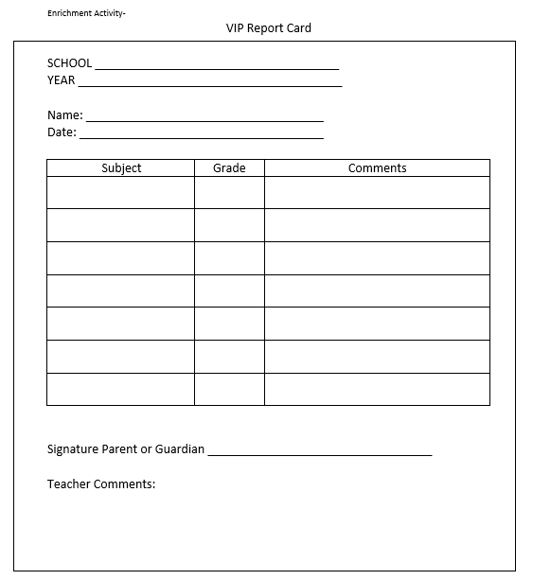




Slide 43
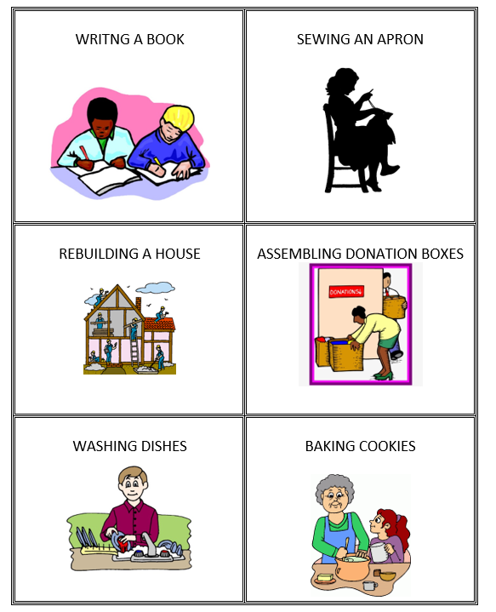
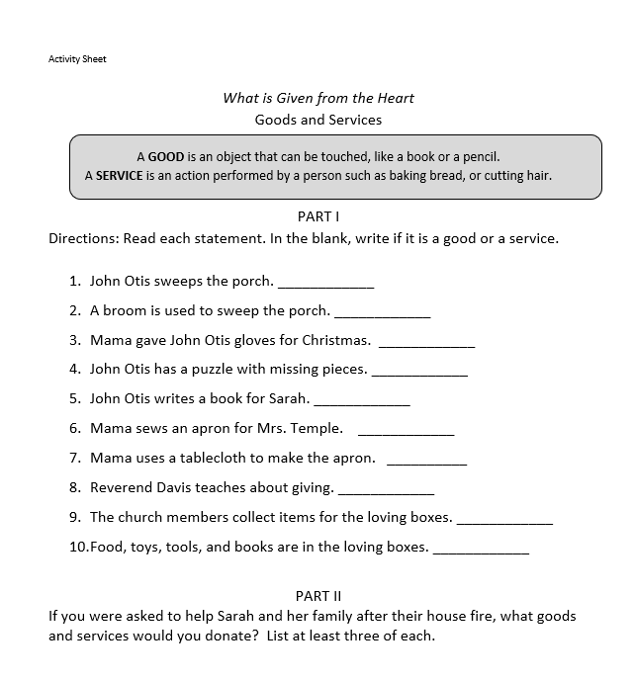

Activity Sheets & Cards

Slide 44




Assessment

Slide 45


Keeping the City Going
Story Synopsis:. New York City is experiencing a pandemic and once busy streets are mostly empty. Thankfully there are still those doing their necessary jobs. These are the essential workers keeping us safe and healthy. They make sure our mail is delivered and the grocery stores’ shelves are stocked.
Publisher: Atheneum
Copyright Date: 2021
Reading Level: 2.0
Interest Level: PK-2
Starred Review ALA Booklist
Starred Review for Kirkus Reviews
Starred Review for Publishers Weekly

Slide 46


Featuring the concepts of…
Allocation of limited resources
Capital resources
Human capital
Interdependence
Scarcity
Specialization
https://www.youtube.com/watch?v=qkv52VAFbBk

Slide 47


Essential Worker Activity Cards & Job List

Slide 48
Assessment Questions
What are the benefits of using children’s literature to teach economics and personal finance?
Is using a children’s book more difficult with online instruction?
How can picture books be used with older students?
The book The Secret Garden of George Washington Carver includes references to slavery and segregation. Would this require sensitivity of instruction in multi-cultural classrooms?
Do you know of any new titles that can be added to the bibliography?

Slide 49


New Picture Books featuring Strong Economic Content

Slide 50
Links Included in this Session
Virginia Standards of Learning | https://www.doe.virginia.gov/testing/index.shtml
National Content Standards in Economics | https://www.councilforeconed.org/wp-content/uploads/2012/03/voluntary-national-content-standards-2010.pdf
Keeping the City Going | https://www.youtube.com/watch?v=qkv52VAFbBk
Give It! Reading | https://www.youtube.com/watch?v=lCuBSL-njsM
Bunnyland Publisher Activity Sheets | https://storage.googleapis.com/classroom-portal-production/uploads/2021/04/9c78f1c0-monneybunny-activities.pdf
The Secret Garden of George Washington Carver | https://www.youtube.com/watch?v=28vSGkGNtkA
Someone Builds the Dream | https://www.youtube.com/watch?app=desktop&v=H5rcpgEiiuo
What is Given from the Heart | https://www.youtube.com/watch?v=eE7C4etCqh0

Slide 51
Comments?
Questions?
Concerns?

Slide 52

CEE Affiliates
https://www.councilforeconed.org/resources/local-affiliates/

Slide 53




Thank You to Our Sponsors!

