Slide 1
The Psychology of Consumer Pricing Presented by Matthew Gherman Edward R. Murrow High School 11/9/21 mgherman@schools.nyc.gov

Slide 2
EconEdLink Membership
You can now access CEE’s professional development webinars directly on EconEdLink.org! To receive these new professional development benefits, become an EconEdLink member. As a member, you will now be able to:
Automatically receive a professional development certificate via e-mail within 24 hours after viewing any webinar for a minimum of 45 minutes
Register for upcoming webinars with a simple one-click process
Easily download presentations, lesson plan materials and activities for each webinar
Search and view all webinars at your convenience
Save webinars to your EconEdLink dashboard for easy access to the event
You may access our new Professional Development page here

Slide 3
Professional Development Certificate
To earn your professional development certificate for this webinar, you must:
Watch a minimum of 45-minutes and you will automatically receive a professional development certificate via e-mail within 24 hours.
Accessing resources:
You can now easily download presentations, lesson plan materials, and activities for each webinar from EconEdLink.org/professional-development/

Slide 4
Agenda
Briefly explain the creation of market price
Demonstrate how businesses use market price and input costs as a basis for pricing
Examine different psychological pricing strategies and their effectiveness

Slide 5
Objectives
Give teachers definitions and examples of psychological pricing
Provide activities for students to apply the concepts creatively

Slide 6
National Standards
7.1 Market prices are determined through the buying and selling decisions made by buyers and sellers.
7.2 The term ‘relative price’ refers to the price of one good or service compared to the prices of other goods and services. Relative prices are the basic measures of the relative scarcity of products when prices are set by market forces (supply and demand).
8.1 Demand for a product changes when there is a change in consumers’ incomes, preferences, the prices of related products, or in the number of consumers in a market.
8.2. Supply of a product changes when there are changes in either the prices of the productive resources used to make the product, the technology used to make the product, the profit opportunities available to producers from selling other products, or the number of sellers in a market.
8.3. Changes in supply or demand cause relative prices to change; in turn, buyers and sellers adjust their purchase and sales decisions.

Slide 7
State Standards
12.E2a Given that the resources of individuals (and societies) are limited, decisions as to what goods and services will be produced and to whom to sell one’s resources are driven by numerous factors, including a desire to derive the maximum benefit from and thus the most efficient allocation of those resources.
12.E2b The choices of buyers and sellers in the marketplace determine supply and demand, market prices, allocation of scarce resources, and the goods and services that are produced. In a perfect world, consumers influence product availability and price through their purchasing. Product market supply and demand determine product availability and pricing.
12.E2c Businesses choose what to supply in the product market, based on product market prices, available technology, and prices of factors of production. The prices of those factors are determined based on supply and demand in the factor market. The supply and demand of each factor market is directly related to employment. Debates surround various ways to minimize unemployment (frictional, structural, cyclical).

Slide 8
Opening Discussion
Motivation : What is the average price of a slice of pizza in Brooklyn?

Slide 9
What Does Price Do?
The amount of money a seller is willing and able to accept in exchange for a product at a given time and under certain circumstances
The amount the consumer is willing and able to pay in exchange for a good or service
Price allocates goods and services among those who are willing and able to buy them
Price allocates financial resources (sales revenue) among producers according to how well they satisfy customers’ needs
Price helps customers allocate their own financial resources among various want-satisfying products

Slide 10
How are Prices Created?

Slide 11
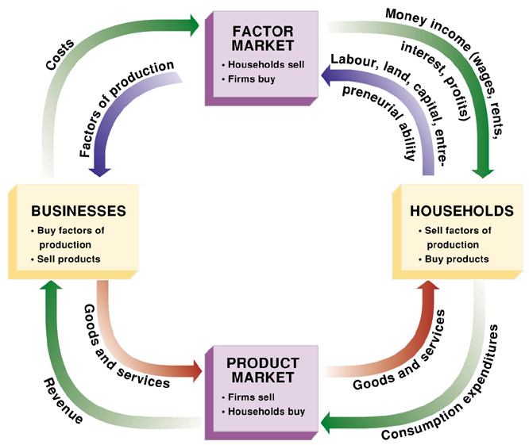
Circular Flow Model
Free exchange between consumers (households) and businesses

Slide 12
Quick Overview: Supply and Demand
Supply – Ability and Willingness of Businesses to sell goods/services
The quantity of a product that producers are willing to sell at each of various prices
Quantity supplied by producers increases as the price increases
Price = profit
Break Even is when Total Revenue = Input Costs
Demand – Ability and Willingness of Consumers to buy goods/services
The quantity of a product that buyers are willing to purchase at each of various prices
Quantity demanded increases as the price decreases
Equilibrium
The price at which quantity supplied = quantity demanded. Acceptable to both businesses and consumers.

Slide 13
How Is Price Created?

Slide 14
Business Input Costs
1) raw materials
2) major equipment
3) accessory equipment -- equipment for production/office activities
4) component parts -- becomes part of a larger product
5) process material -- end part of finished product (example -- food preservatives)
6) supply (examples -- paper, pencils, oils, and cleaning agents_
7) business services -- services that help the business function (examples -- financial, legal, online, janitorial, marketing, research and development)
8) taxes, loans, rent, insurance

Slide 15
Costs, Revenue, Profits:
https://www.economicsonline.co.uk/Business_economics/Costs.html

Slide 17
Cost Base Pricing
Prices based on factors of production/input costs
Class discussion: what are input costs/factors of production?
variable -- changes month-to-month
fixed -- constant/ month-to-month
Total Revenue = quantity sold x price
Break even analysis: with your current price, how many units will you have to sell, so your total revenue breaks even with your factors of production costs?
Total revenue is greater than input costs = profit (“in the black,” “Black Friday”)

Slide 18
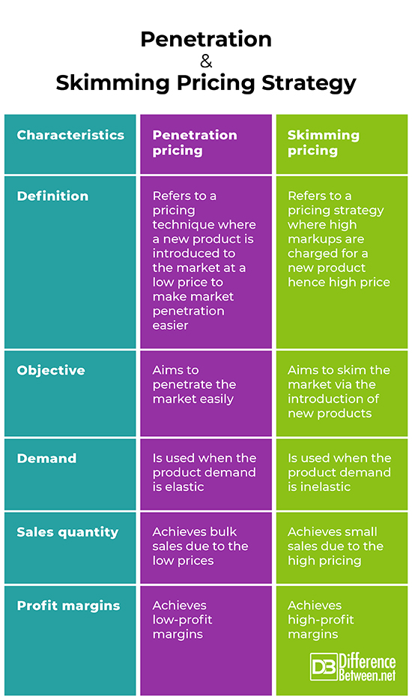

Slide 19
New Market Pricing

Slide 20
New Market Pricing

Slide 21
Psychological Pricing

Slide 23
Odd- Number Pricing:
Consumers respond more positively to odd numbers ($4.99) than even ($5.00)
Approximately… 60% of prices in advertising material ended in the digit 9, …30% ended in the digit 5, …7% ended in the digit 0 and the remaining seven digits combined accounted for only slightly over 3% of prices evaluated

Slide 24
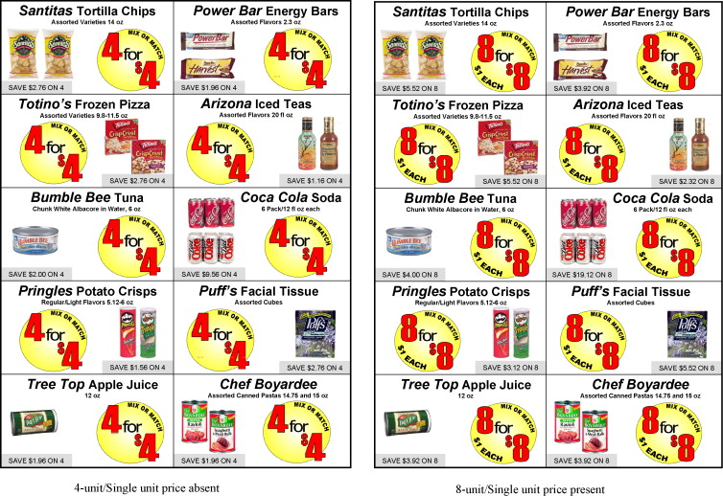
Multiple-Unit Pricing:
Single price for two or more items prices

Slide 25
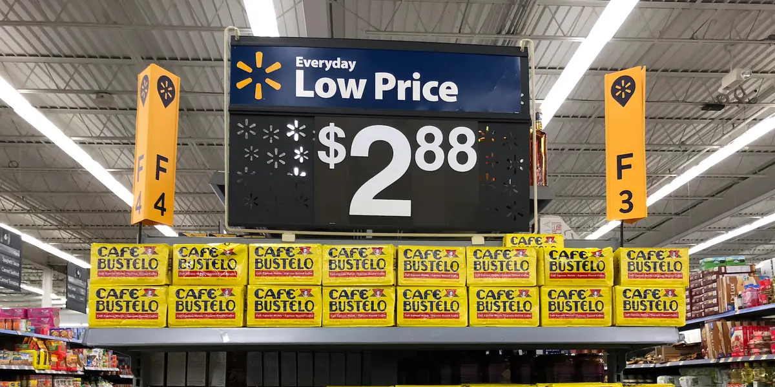
Everyday Low Prices
Prices that are not discounted but are kept consistently low, and so lower than the competitors' prices

Slide 26
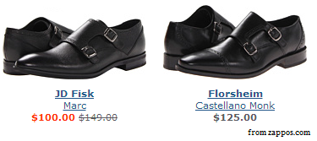
Reference Pricing
Placing items next to more expensive items to suggest a sale: external (store is suggesting to person) and internal (person knows the average value of the item)

Slide 27
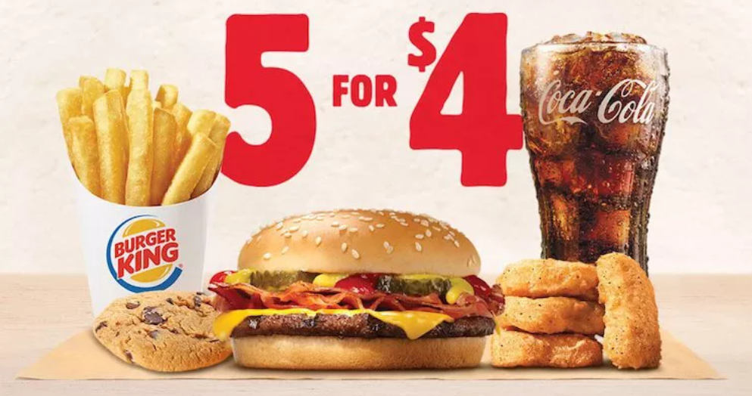
Bundle Pricing
Complementary products packaged together for a combined, lower than individual, price

Slide 28
Product-Line Pricing
establishing and adjusting the prices of multiple products within a product line.

Slide 29
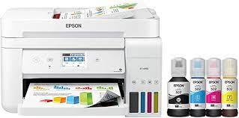
Captive Pricing
Main product is low (cameras) but complementary products are expensive (film, batteries)

Slide 30
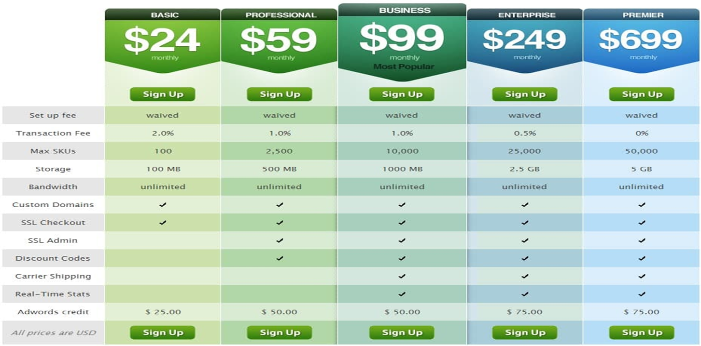
Premium Pricing
Pricing the highest-quality or most versatile products higher than other models in the product line.

Slide 31
Price Lining
the strategy of selling goods only at certain predetermined prices
Perry Ellis Tommy Hilfiger Alfani
$44 $44 $44

Slide 32
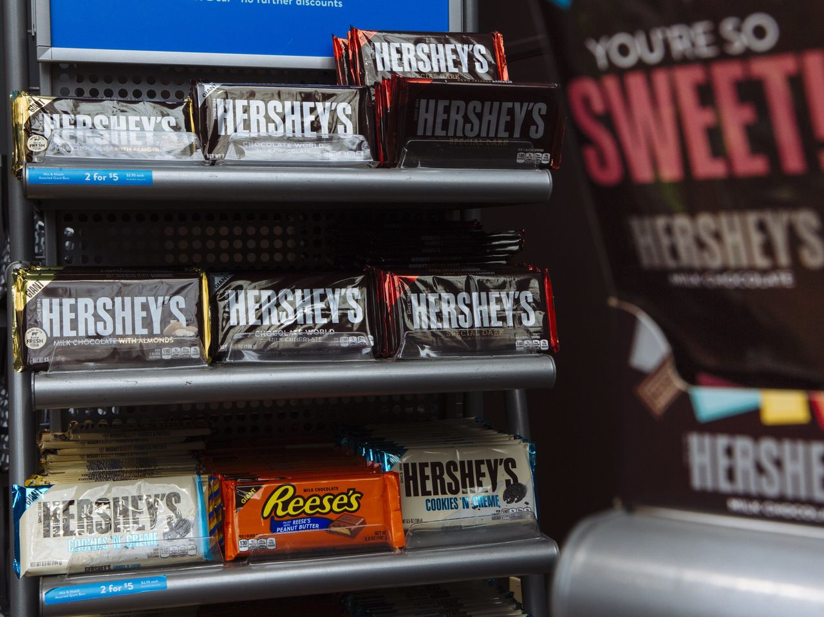
Customary Pricing
Prices kept by tradition (e.g., candy bars and chewing gum)

Slide 33
Differential Pricing
charging different prices to different buyers for the same quality and quantity of a product.

Slide 34
Secondary- Market Pricing
Primary market -- main group of buyers receive one price
Secondary market -- secondary group of buyers receive different price

Slide 35
Promotional Pricing
occasionally reducing the "price leaders" and having "special event pricing" and "comparison discounting"

Slide 36
Periodic Pricing
Temporary reduction of prices on based on a pattern (e.g., seasonal sales/discounts)

Slide 37
Negotiating Price
Final price between buyers and sellers

Slide 38
Assessment Questions

Slide 39
Assessment #1
https://www.moneycrashers.com/negotiation-techniques-to-score-a-great-deal/
What advice did you think was the best to know from a consumer perspective? Business perspective?

Slide 40
Assessment #2
See the Psychological Pricing Activity Sheet

Slide 41
Assessment #3
https://www.veeqo.com/us/blog/psychological-pricing-strategy
How are the pricing strategies we used today applied to the business world of e-commerce?
If you oversaw e-commerce of a company, how would you apply the concepts?

Slide 42
Assessment #4
https://www.minderest.com/blog/2019/09/30/36-tricks-implementing-psychological-pricing-techniques-your-online-store
Choose 5 of the above strategies. How would you implement them? Explain.

Slide 43
Assessment #5
Price Penetrating vs. Price Skimming
http://www.differencebetween.net/business/difference-between-penetration-and-skimming-pricing-strategy/
What is the theory for each?
What are the business arguments for each?
If you were opening up a new store front business (such as a pizzeria) and you had the ability to choose one, which would you choose? Explain.

Slide 44
References
https://www.minderest.com/blog/2019/09/30/36-tricks-implementing-psychological-pricing-techniques-your-online-store
https://www.veeqo.com/us/blog/psychological-pricing-strategy

Slide 45
CEE Affiliates
https://www.councilforeconed.org/resources/local-affiliates/

Slide 46
Thank You to Our Sponsors!

