Slide 1


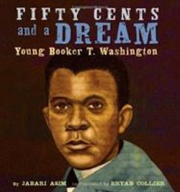

Money Movers:
Engaging Economics for K- 3
Economics and Children’s Literature
John Kruggel
kruggejb@jmu.edu
Lynne Stover
stoverlf@jmu.edu
James Madison University
Center for Economic Education

Slide 2
EconEdLink Membership
You can now access CEE’s professional development webinars directly on EconEdLink.org! To receive these new professional development benefits, become an EconEdLink member. As a member, you will now be able to:
Automatically receive a professional development certificate via e-mail within 24 hours after viewing any webinar for a minimum of 45 minutes
Register for upcoming webinars with a simple one-click process
Easily download presentations, lesson plan materials and activities for each webinar
Search and view all webinars at your convenience
Save webinars to your EconEdLink dashboard for easy access to the event
You may access our new Professional Development page here

Slide 3
Professional Development Certificate
To earn your professional development certificate for this webinar, you must:
Watch a minimum of 45-minutes and you will automatically receive a professional development certificate via e-mail within 24 hours.
Accessing resources:
You can now easily download presentations, lesson plan materials, and activities for each webinar from EconEdLink.org/professional-development/

Slide 4
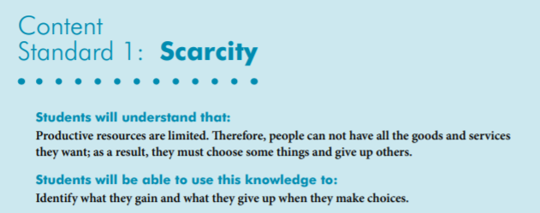

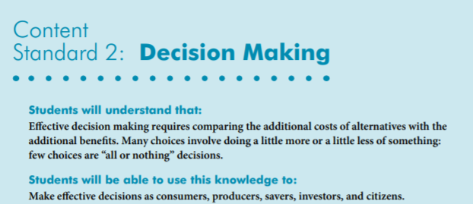
National Standards
https://www.councilforeconed.org/wp-content/uploads/2012/03/voluntary-national-content-standards-2010.pdf

Slide 5

State Standards
Virginia HISTORY & SOCIAL SCIENCE Standards of Learning
K.8 The student will match simple descriptions of work that people do with the names of those jobs.
1.7 The student will explain the difference between goods and services and describe how people are
consumers and producers of goods and services.
2.8 The student will describe natural resources (water, soil, wood, and coal), human resources (people at work), and capital resources (machines, tools, and buildings).
3.8 The student will demonstrate an understanding of different cultures and the natural, human, and capital resources they used in the production of goods and services.
3.9 The student will recognize that because people and regions cannot produce everything they want, they specialize in what they do best and trade for the rest.
VS.10 The student will demonstrate an understanding of Virginia government, geography, and economics by
b) describing the major products and industries important to Virginia’s economy;

Slide 6
Ella Earns Her Own Money
Word Count: 570
Reading Level: 2.3
Interest Level: K-3
Publisher: Lerner
Copyright Date: 2014
https://www.youtube.com/watch?v=gZ9j3DZtMok
[Reading Time 4:42]

Slide 7
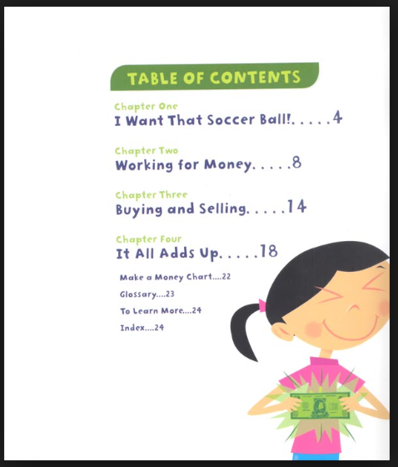
Ella Earns Her Own Money
Ella really wants a soccer ball, but doesn't have enough to buy one, so she decides to earn her own money. She cleans the car for her mom, gives the neighbor's dog a bath and sells bracelets to her friends to earn cash. Will she have enough money to buy the ball in the end?

Slide 8
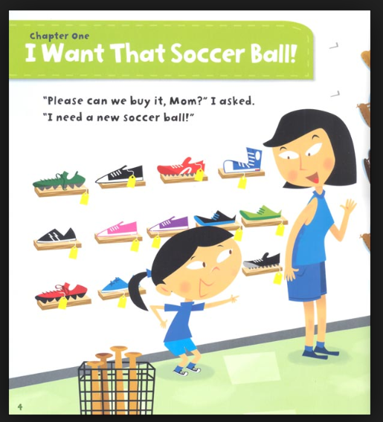
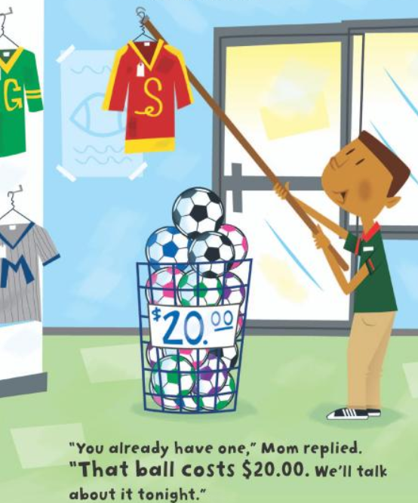
Ella Earns Her Own Money

Slide 9
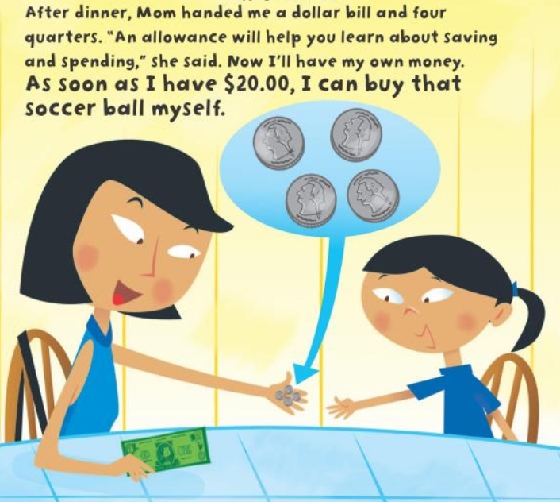
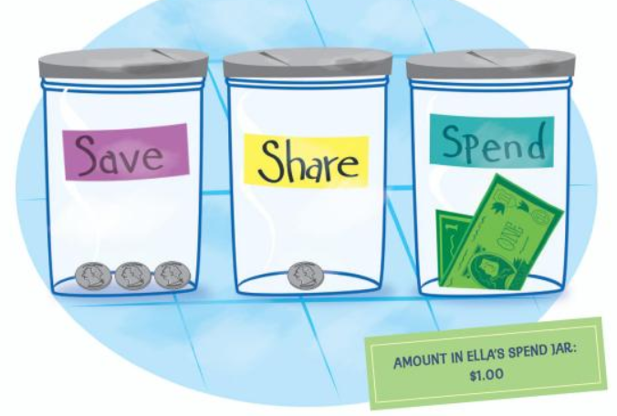
Thoughtful Saving

Slide 10
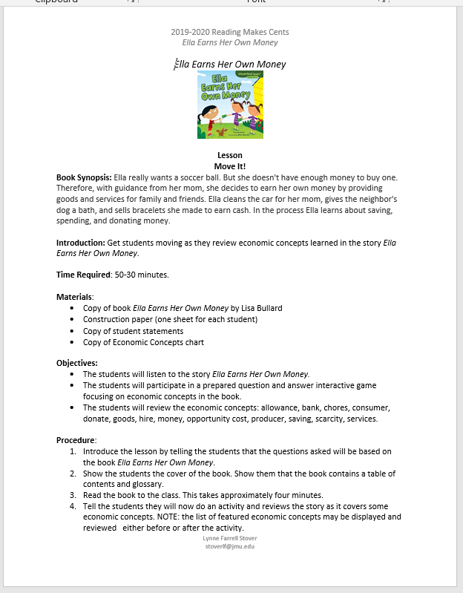
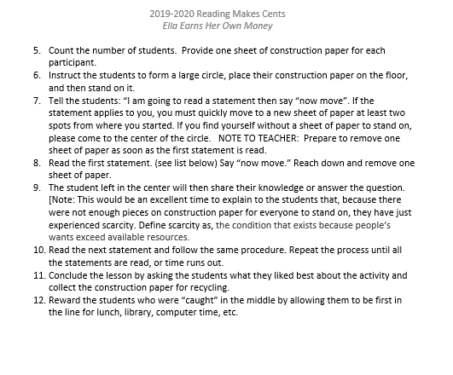
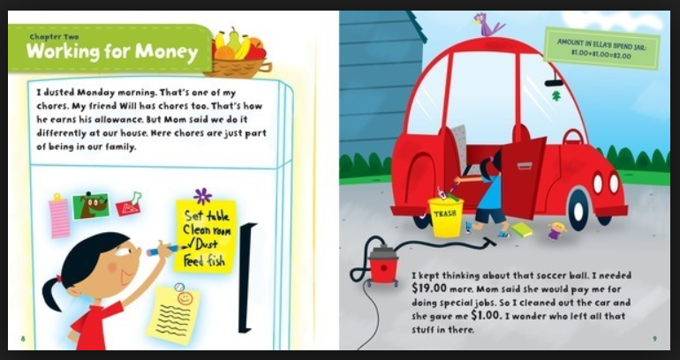
Lesson #1 – Move It!

Slide 11
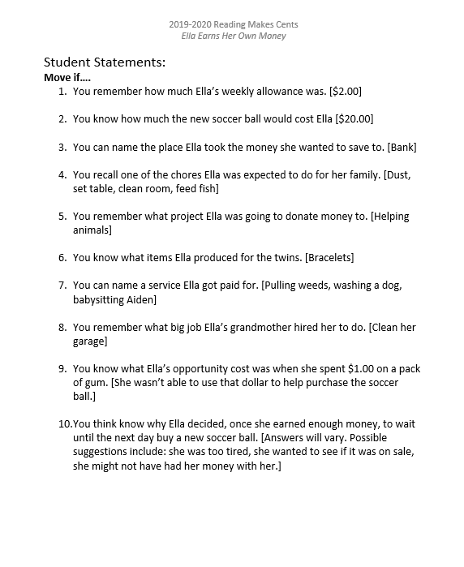
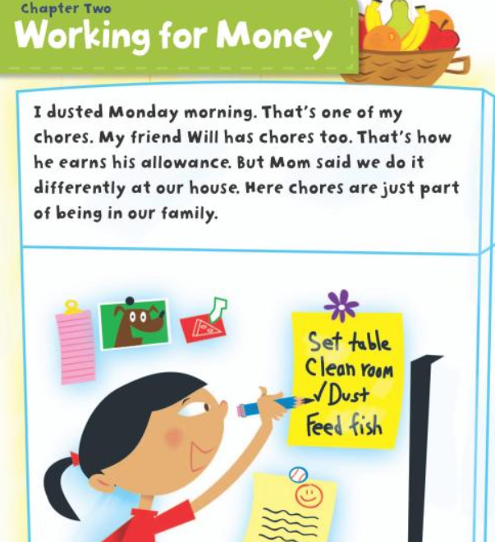


Slide 12
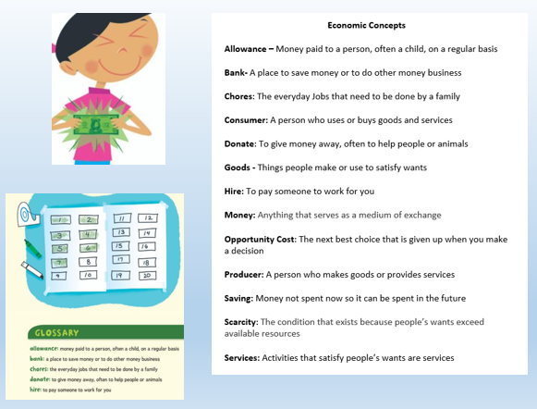

Slide 13
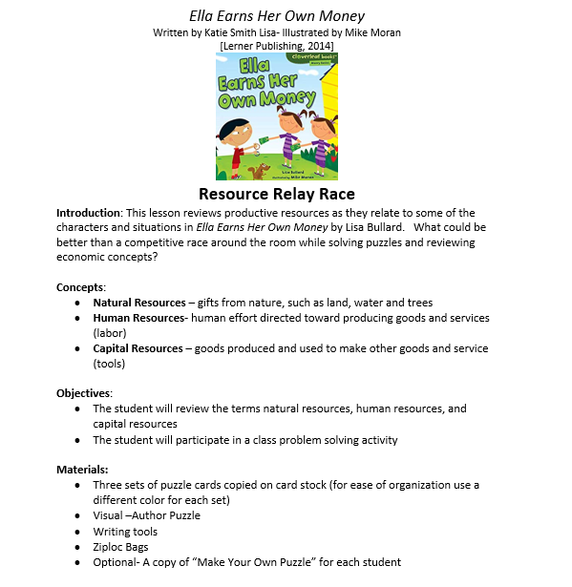

Lesson #2 – Resource Relay Race

Slide 14
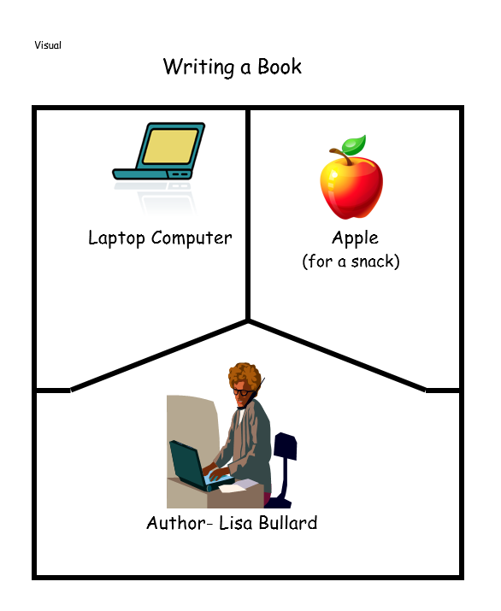
Puzzle Activity
Display the Author Puzzle Sheet and review its contents. This works well if you have two versions of the puzzle; one as a whole sheet and the other cut up in the three puzzle pieces.

Slide 15
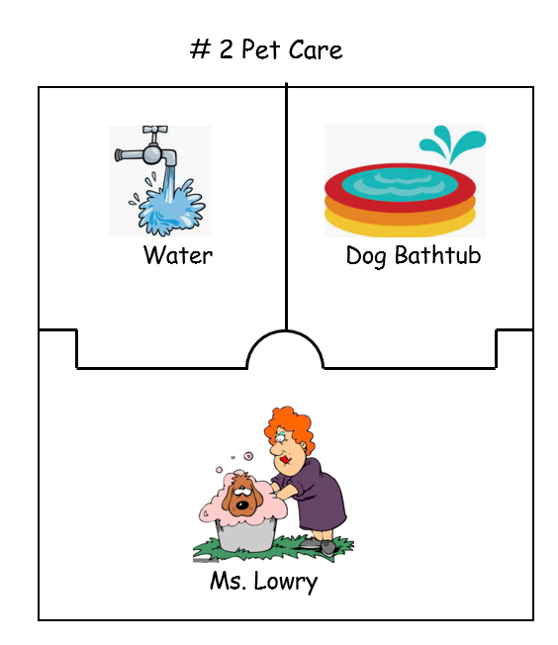
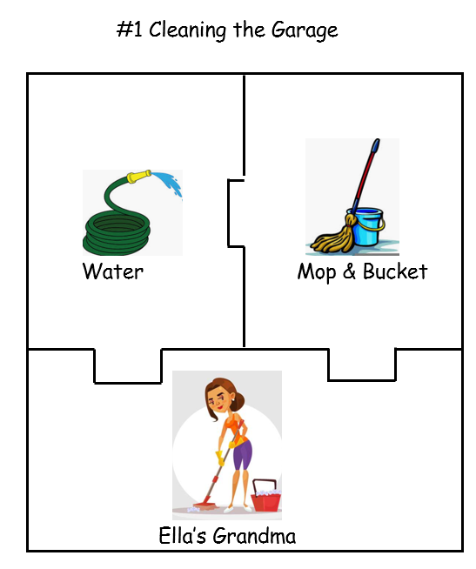
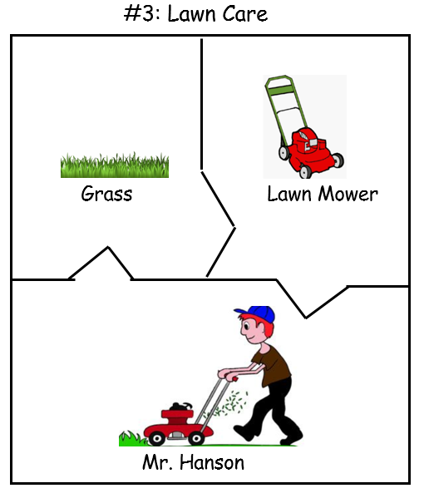
Completed Puzzles

Slide 16
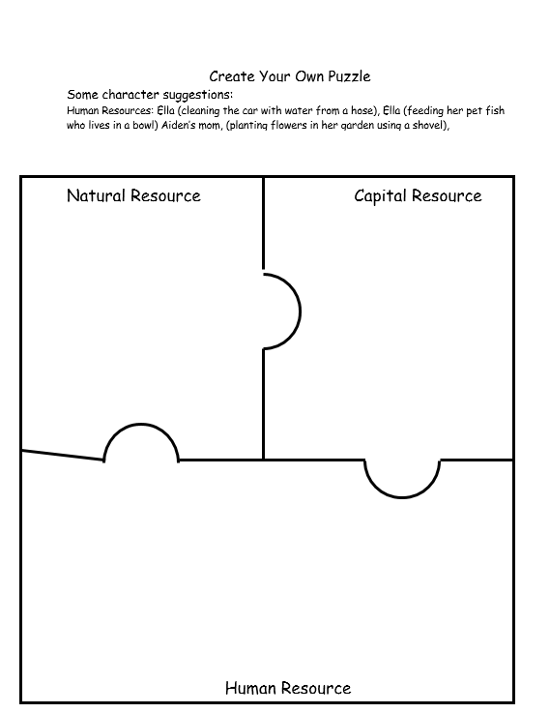

Ella Earns Her Own Money
Extension Activity: Students may create their own puzzle using the “Create Your Own Puzzle” activity sheet.

Slide 17

Monster Musical Chairs
Publisher: HarperCollins
Copyright: 2020
Reading Level: 2.0
Interest Level: P-2
https://www.youtube.com/watch?v=S-xzPD69C30
[Reading Time 3:25]

Slide 18
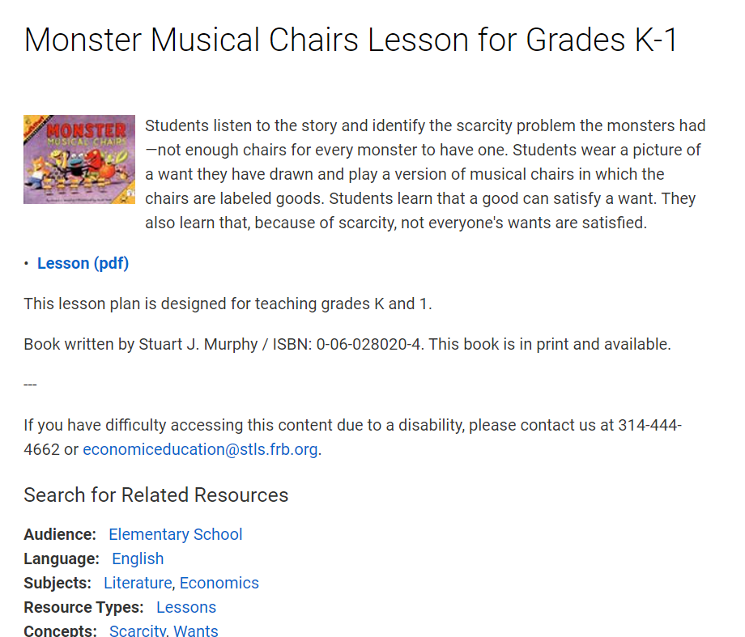
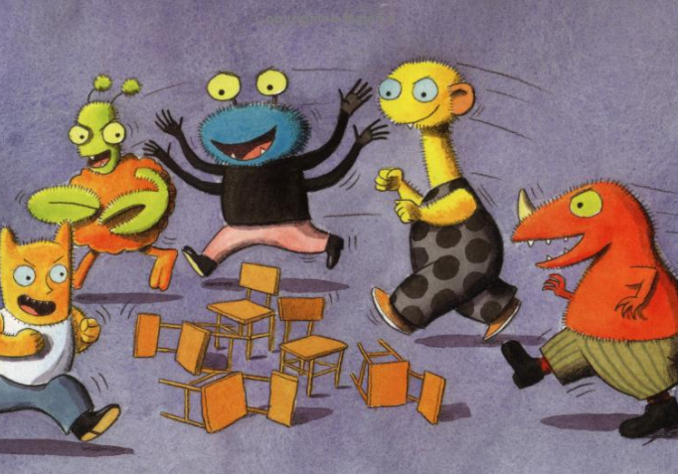
https://www.stlouisfed.org/education/monster-musical-chairs

Slide 19
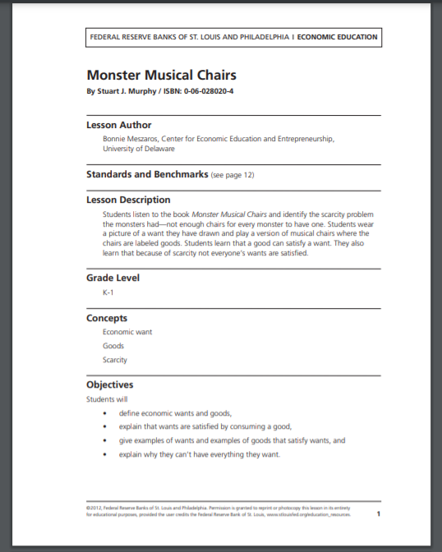
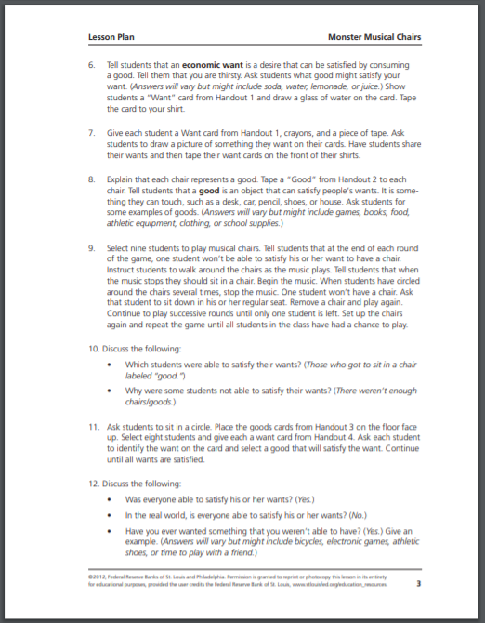
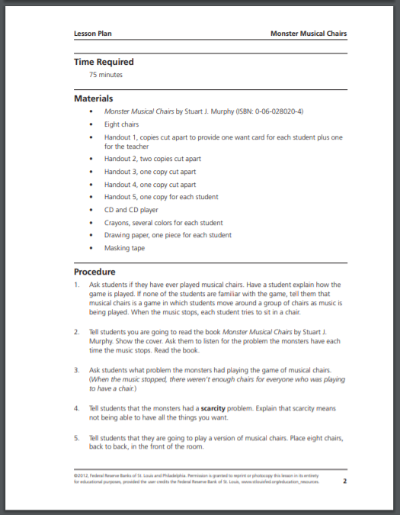
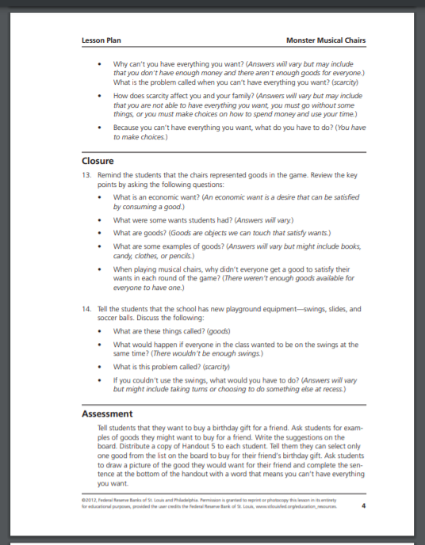

https://www.stlouisfed.org/~/media/Education/Lessons/pdf/Monster-Musical-Chairs.pdf?la=en

Slide 20
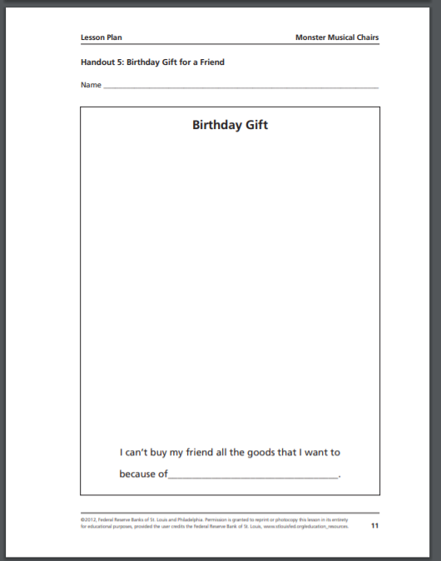
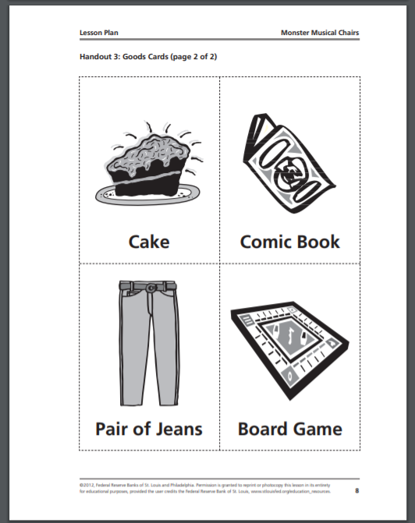
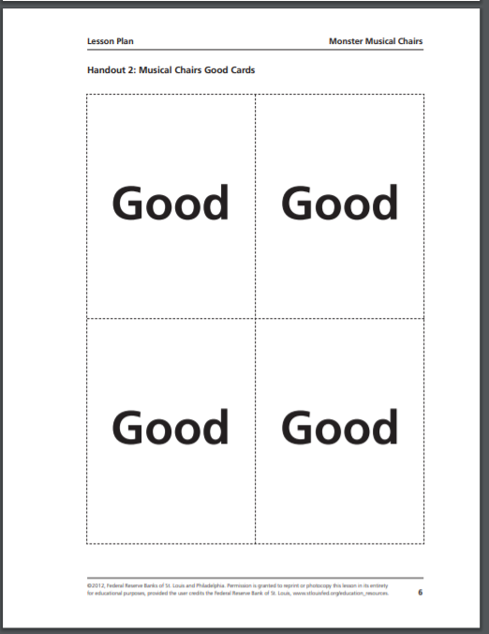

Monster Musical Chairs

Slide 21
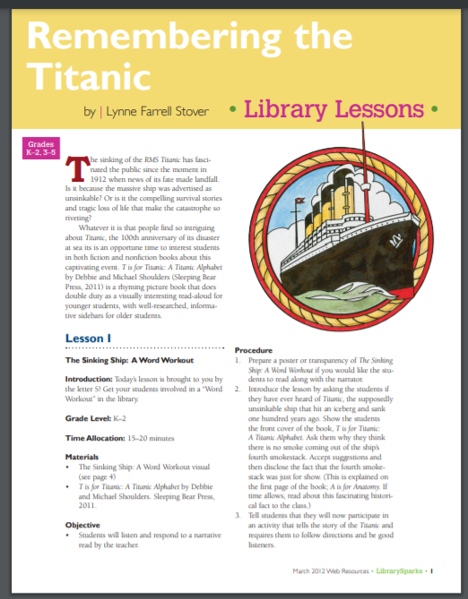
T is for Titanic: A Titanic Alphabet
Publisher: Sleeping Bear Press
Copyright: 2011
Reading Level: 7.4
Interest Level: 2-5
https://www.librarysparks.com/wp-content/uploads/2016/06/lsp_mar12_ll_titanic.pdf

Slide 22
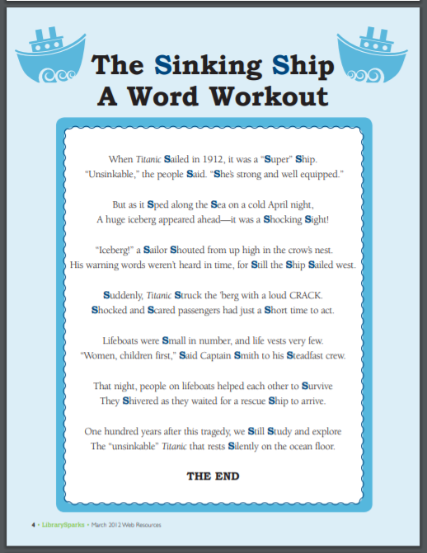

Slide 23
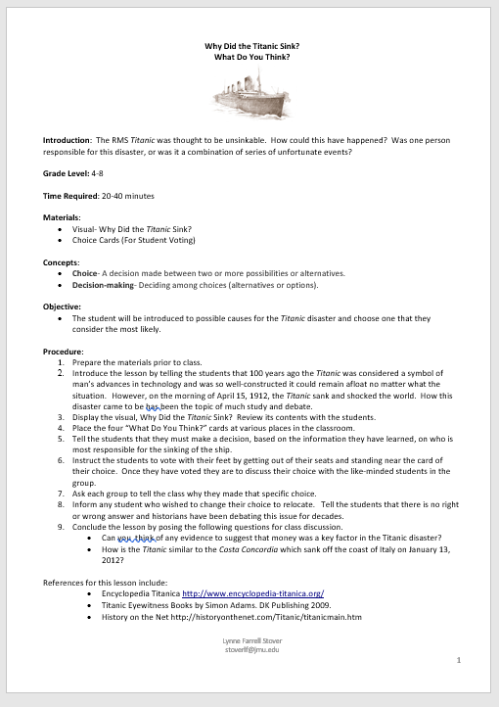
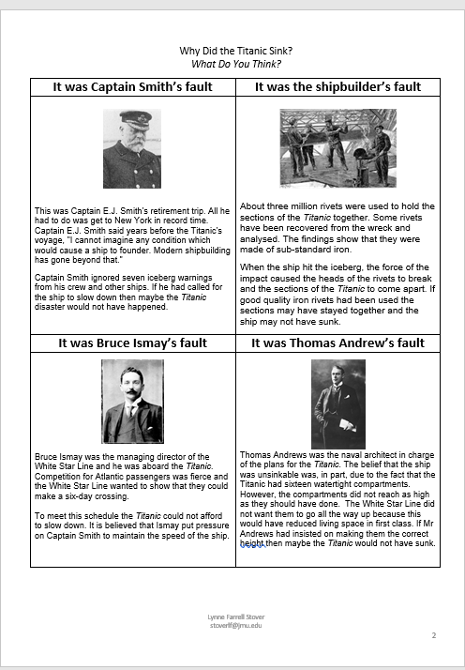
For Older Students

Slide 24
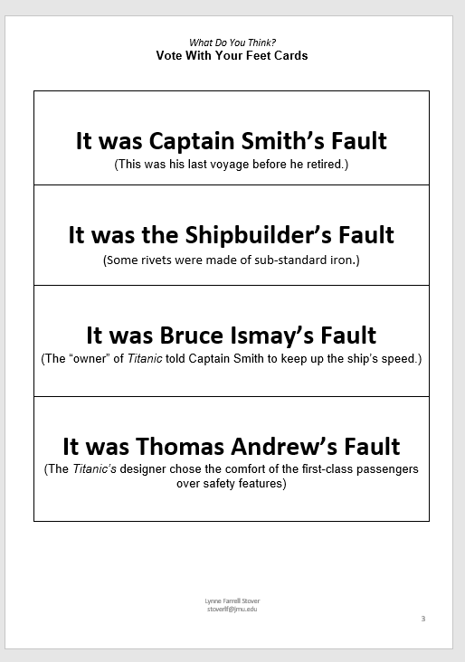


Slide 25
Fifty Cents and a Dream:
Young Booker T. Washington
Publisher: Little Brown & Co.
Copyright Date: 2012
Reading Level: 4.9
Interest Level: K-3

Slide 26
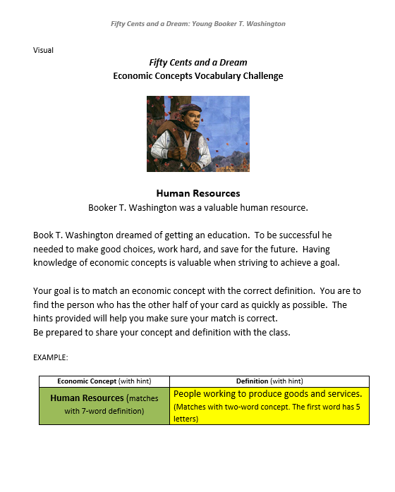
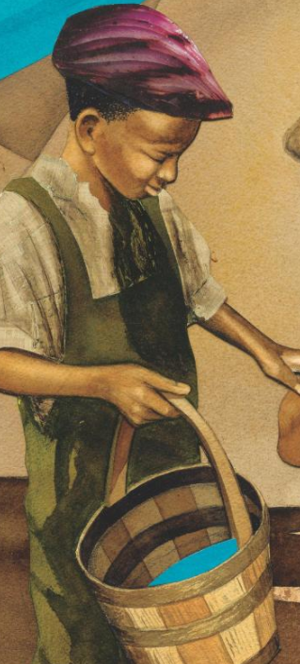
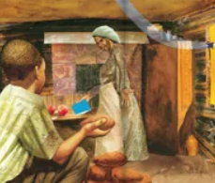

Slide 27
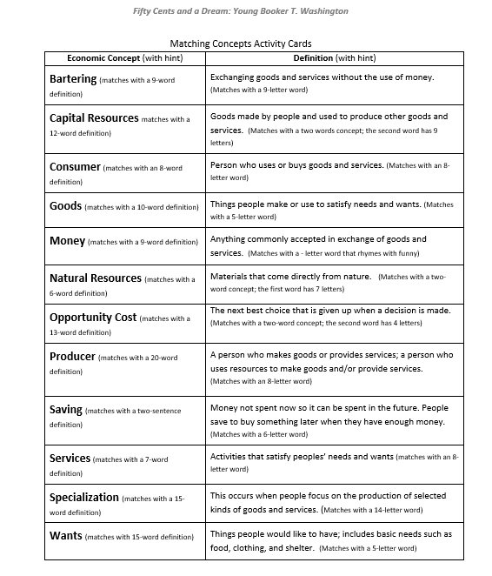
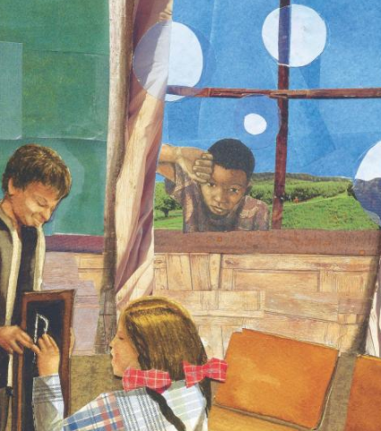

Slide 28
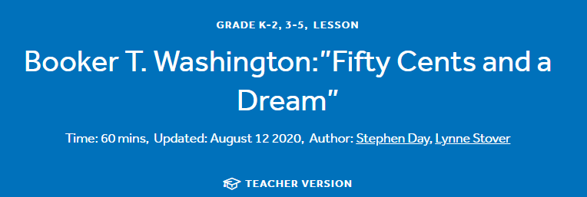
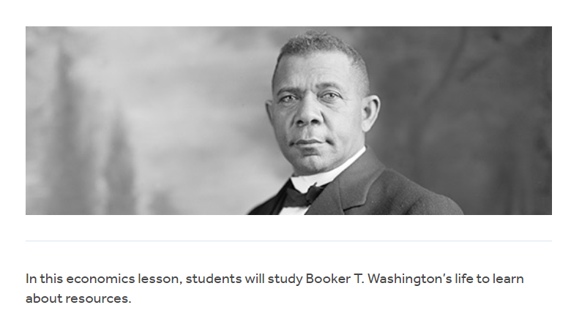
https://www.econedlink.org/resources/booker-t-washingtonfifty-cents-and-a-dream/

Slide 29




Thank You to Our Sponsors!

Slide 30

https://bit.ly/CEEConference2021

