Slide 1
Money Movers:
Engaging Economics for K-3
Vote with Your Feet,
Get Out of Your Seat
JMU Center for Economic Education
September 21, 2021
Lynne Stover
stoverlf@jmu.edu
John Kruggel
kruggejb@jmu.edu

Slide 2

CEE Affiliates
https://www.councilforeconed.org/resources/local-affiliates/

Slide 3
EconEdLink Membership
You can now access CEE’s professional development webinars directly on EconEdLink.org! To receive these new professional development benefits, become an EconEdLink member. As a member, you will now be able to:
Automatically receive a professional development certificate via e-mail within 24 hours after viewing any webinar for a minimum of 45 minutes
Register for upcoming webinars with a simple one-click process
Easily download presentations, lesson plan materials and activities for each webinar
Search and view all webinars at your convenience
Save webinars to your EconEdLink dashboard for easy access to the event
You may access our new Professional Development page here

Slide 4
Professional Development Certificate
To earn your professional development certificate for this webinar, you must:
Watch a minimum of 45-minutes and you will automatically receive a professional development certificate via e-mail within 24 hours.
Accessing resources:
You can now easily download presentations, lesson plan materials, and activities for each webinar from EconEdLink.org/professional-development/

Slide 5
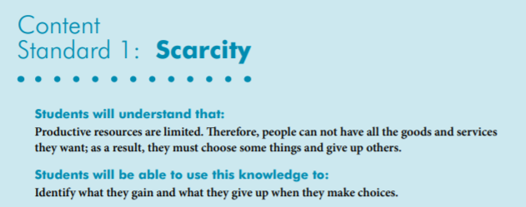

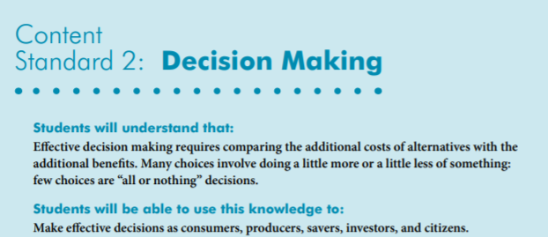
National Standards
https://www.councilforeconed.org/wp-content/uploads/2012/03/voluntary-national-content-standards-2010.pdf

Slide 6

State Standards
VIRGINIA HISTORY & SOCIAL SCIENCE STANDARDS OF LEARNING
K.8 The student will match simple descriptions of work that people do with the names of those jobs.
1.7 The student will explain the difference between goods and services and describe how people are
consumers and producers of goods and services.
2.8 The student will describe natural resources (water, soil, wood, and coal), human resources (people at work), and capital resources (machines, tools, and buildings).
3.8 The student will demonstrate an understanding of different cultures and the natural, human, and capital resources they used in the production of goods and services.
3.9 The student will recognize that because people and regions cannot produce everything they want, they specialize in what they do best and trade for the rest.
VS.10 The student will demonstrate an understanding of Virginia government, geography, and economics by
b) describing the major products and industries important to Virginia’s economy

Slide 7

Interactive learning is not a new concept…
“ Tell me and I forget.
Teach me and I remember.
Involve me and I learn.”
-Benjamin Franklin

Slide 8
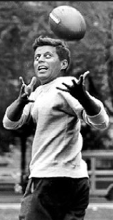
GET THE STUDENTS MOVING!
“Physical fitness is not only one of the most important keys to a healthy body, it is the basis of dynamic and creative intellectual activity.”
-John F. Kennedy

Slide 9

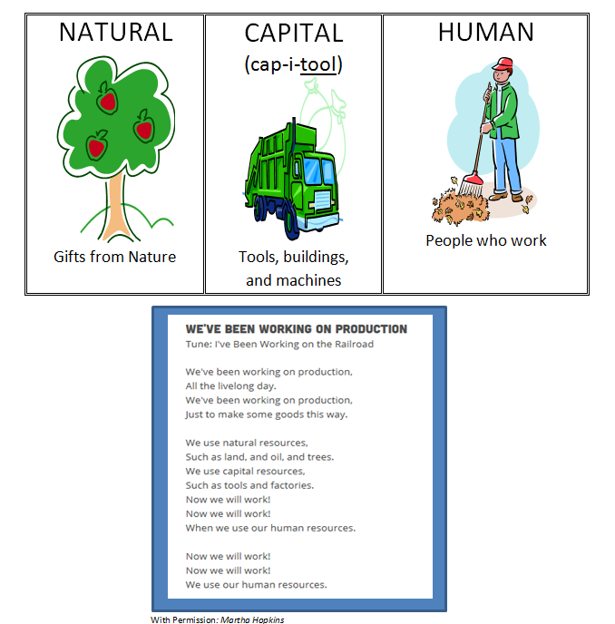
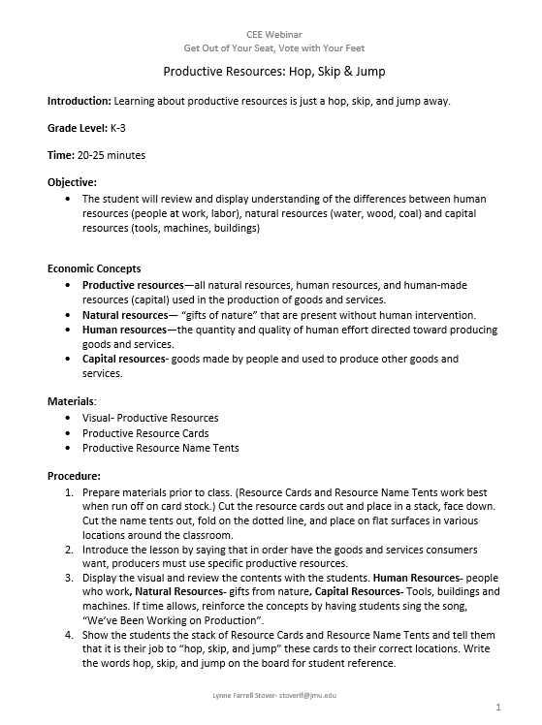
Productive Resources: Hop, Skip & Jump

Slide 10
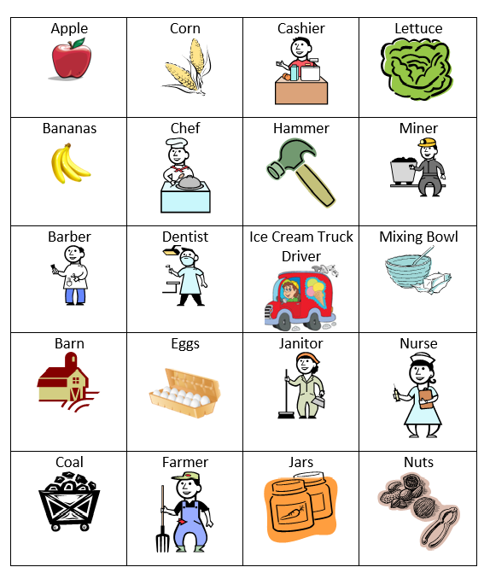
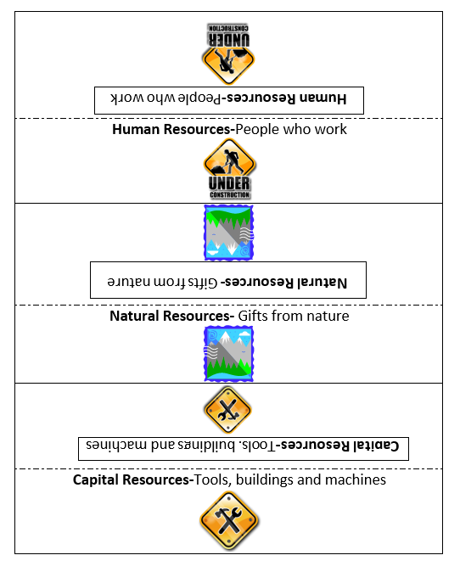
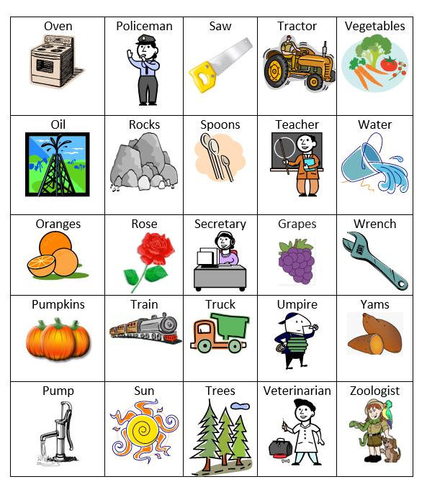


Activity Cards

Slide 11
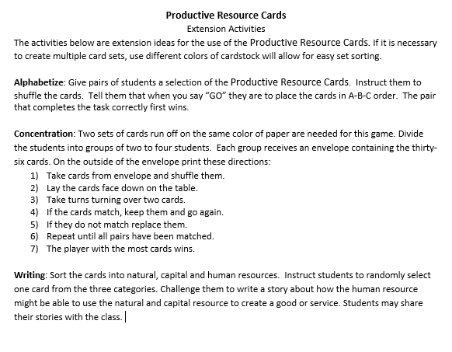


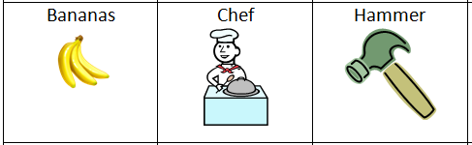
Extension Activities

Slide 12
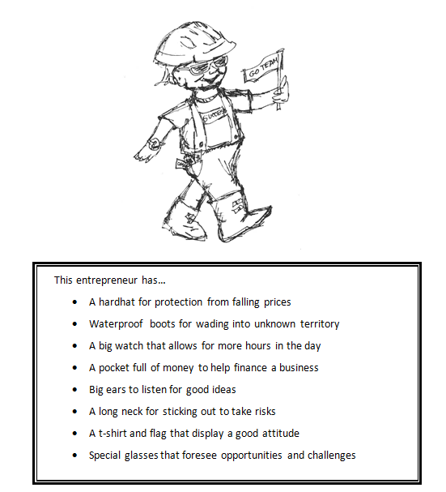
What it takes to be an Entrepreneur

Slide 13
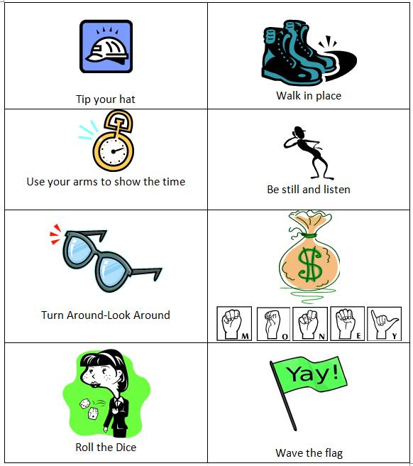

Entrepreneur Activity Cards

Slide 14
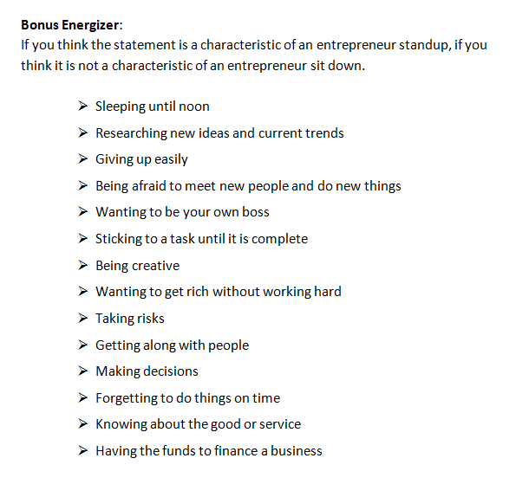

Entrepreneur Activity

Slide 15
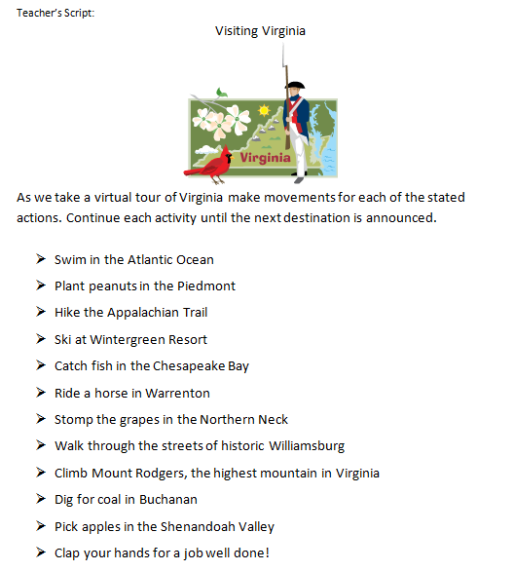

Touring the States

Slide 16
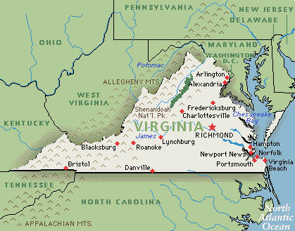




Extension Activities
Extension Activities:
Provide a state map and challenge students locate the areas listed in the activity.
Review the natural resources referenced in the script. Ask the students what human resources and capital resources are needed to get these products to market.
Encourage students to add their own ideas to the listed activities.

Slide 17
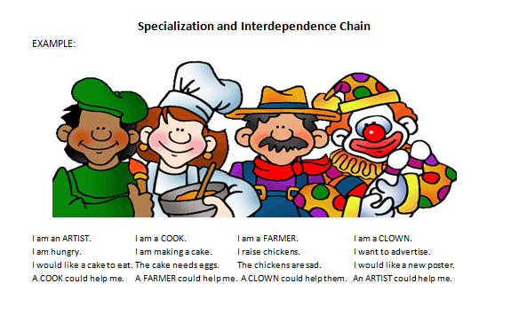
Specialization and Interdependence Chain

Slide 18
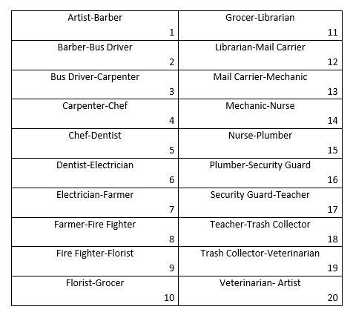
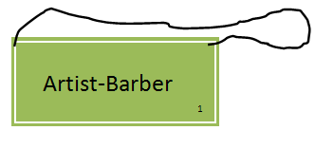
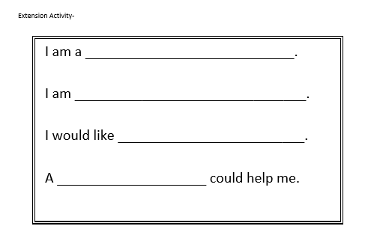
Students take on a job and create a class chain...

Slide 19
Teaching About Choices
Economics is all about making choices.
We need to make choices because we have limited resources and unlimited wants.
This is called scarcity.
Teaching students about being intentional decision makers has been shown to have significant impacts on their financial futures.

Slide 20
How do we Teach Children About Choices?
So, HOW can we teach them to be intentional decision makers?
The PACED Model helps walk students through the process necessary for them to become intentional decision-makers.

Slide 21

PACED Model
The PACED Model helps walk students through the process necessary for them to become intentional decision-makers.
Identify a Problem
Brainstorm Alternatives to the problem
Use Criteria to judge the alternatives
Evaluate the solution
Decide

Slide 22
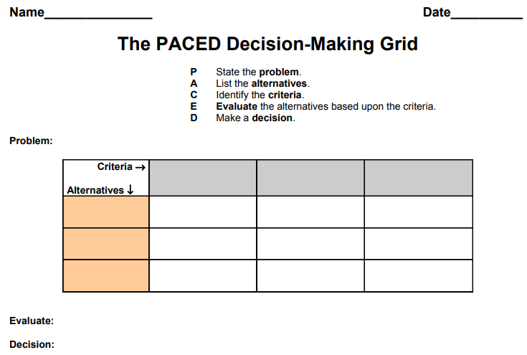

Slide 23
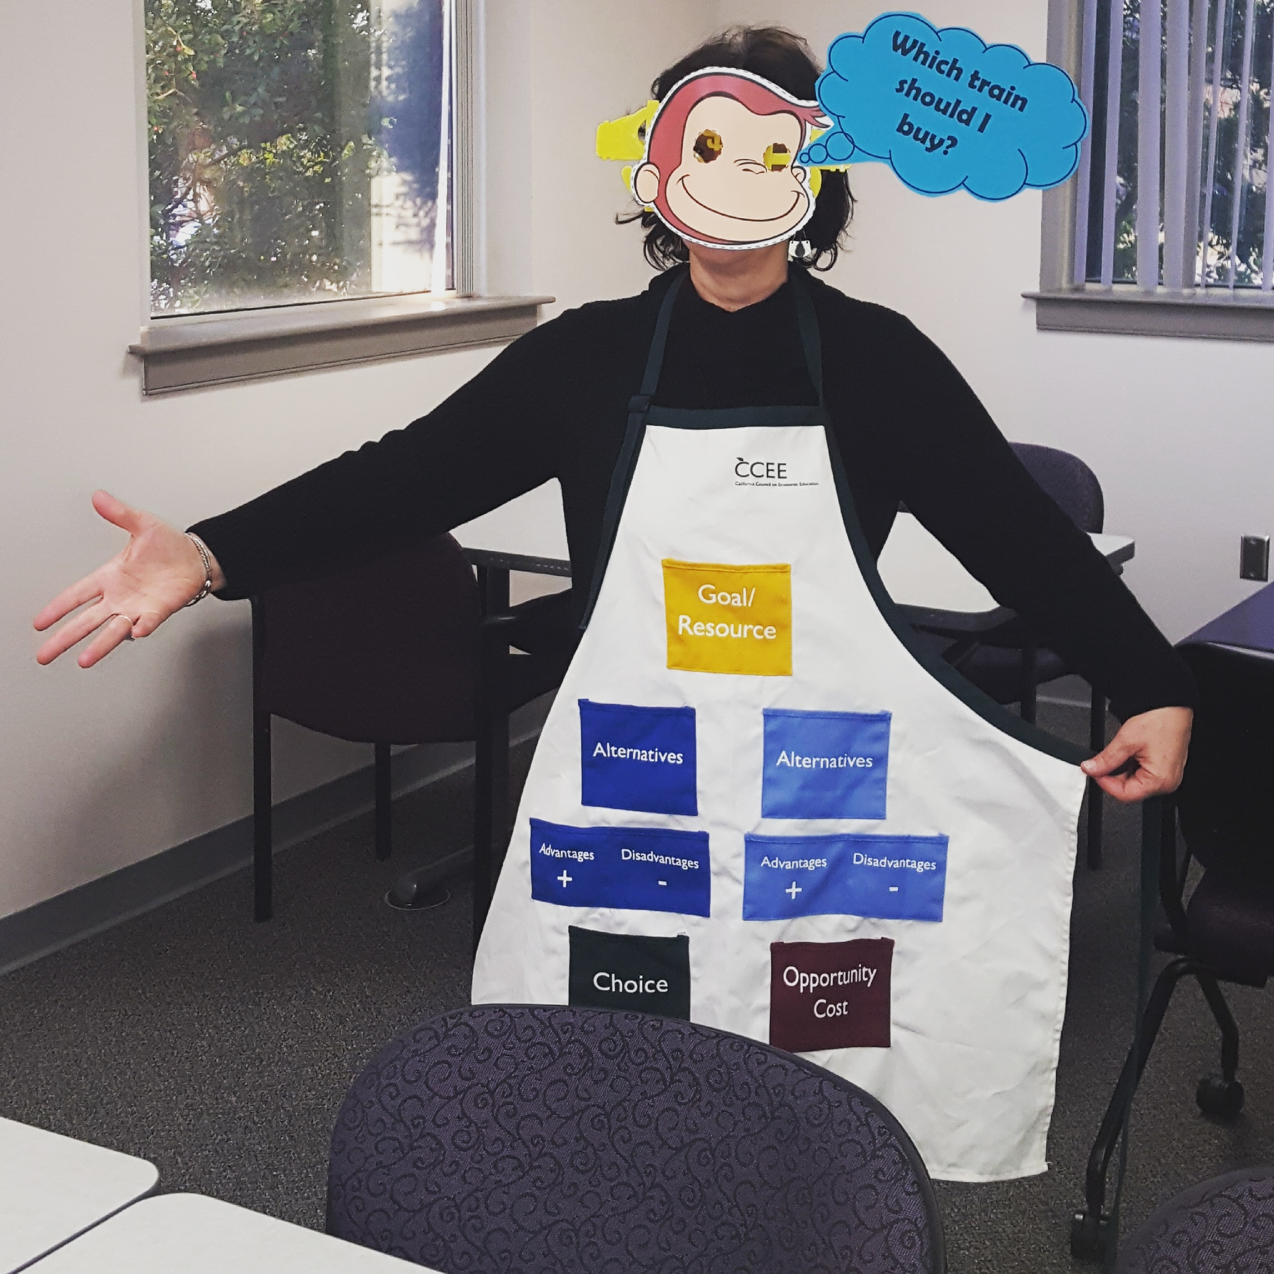
Alternative to Graphic Organizer/Matrix
A decision-making apron is a more hands on version of the typical PACED matrix.
The apron allows students to get up and engage with the matrix.
The Arkansas Council on Economic Education has a great lesson that includes an image you can use to make one.

Slide 24
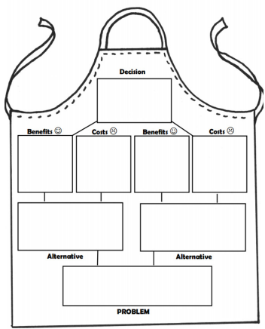

Slide 25
Another Alternative for the PACED Model
Here’s another iteration you can use if you want to get everyone moving.
This adaptation of the PACED Model involves posting the different steps around your room and having students place post-it notes under each sign…

Slide 26
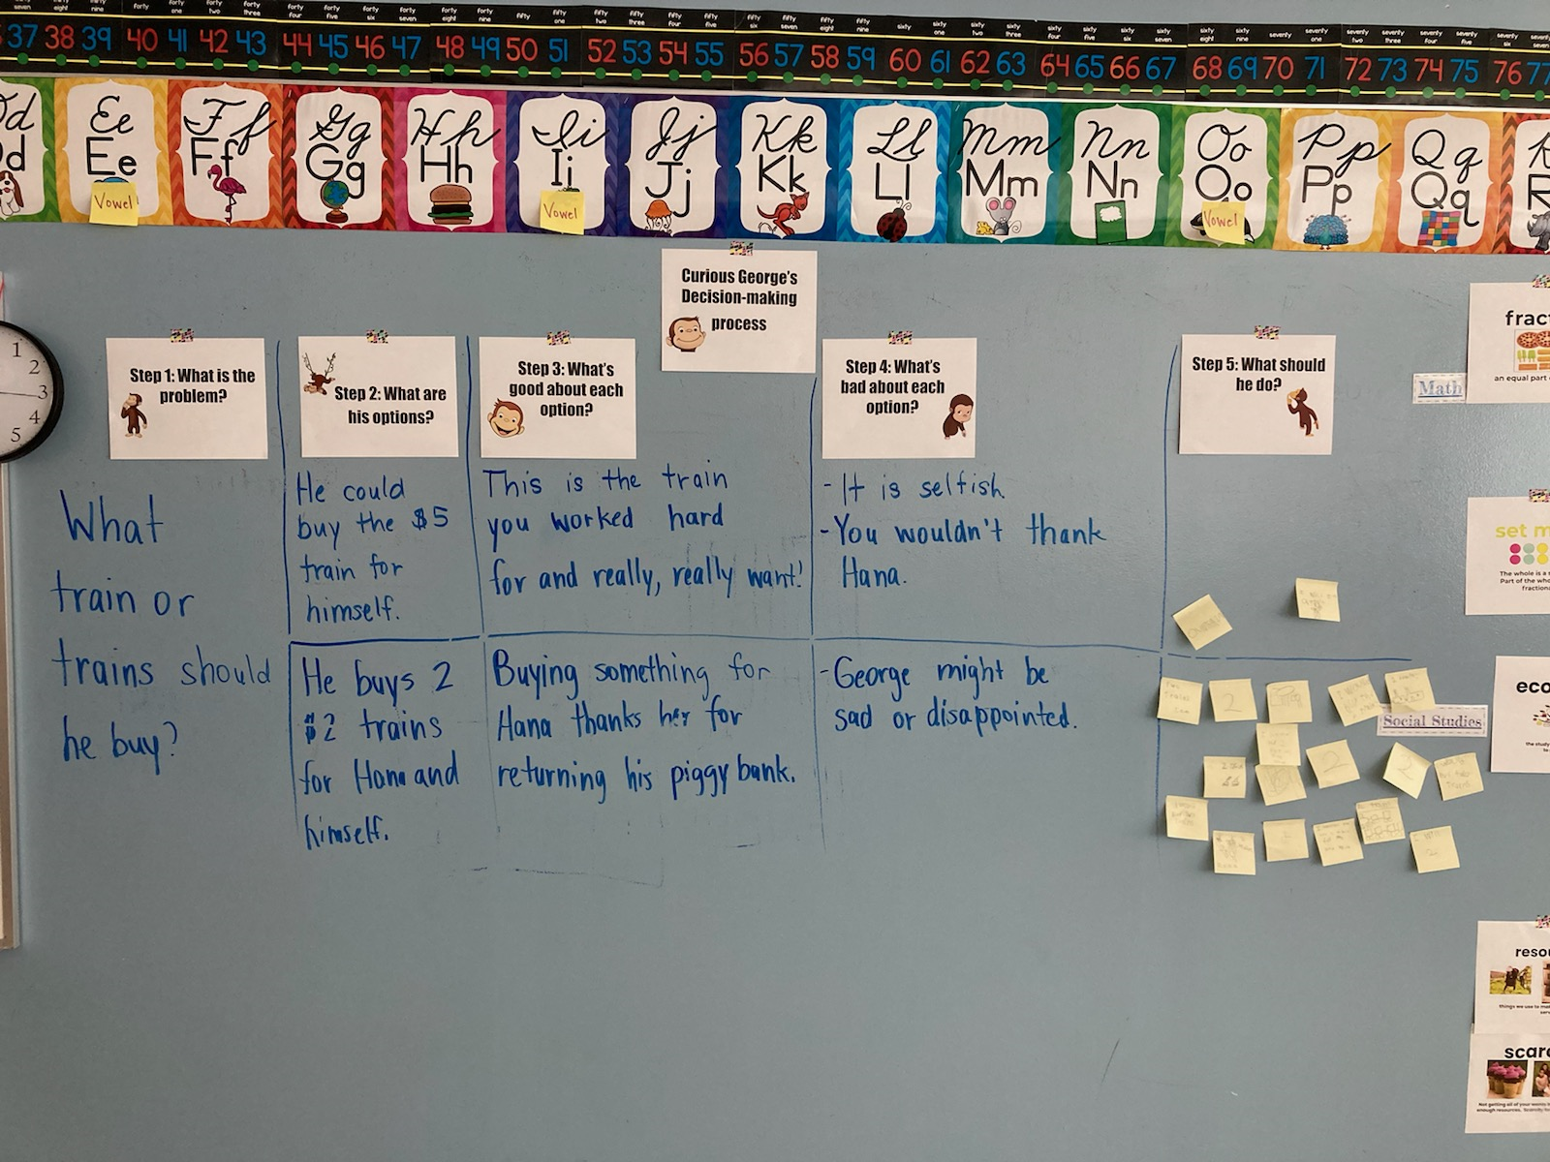

Slide 27
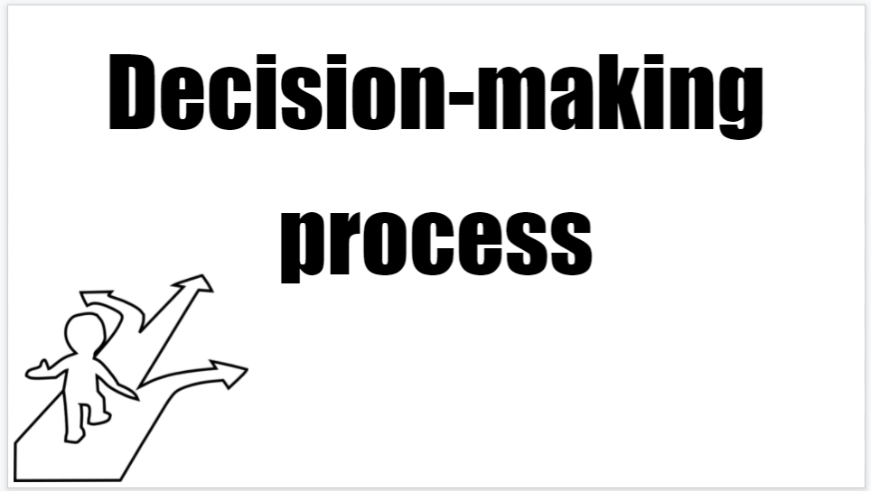
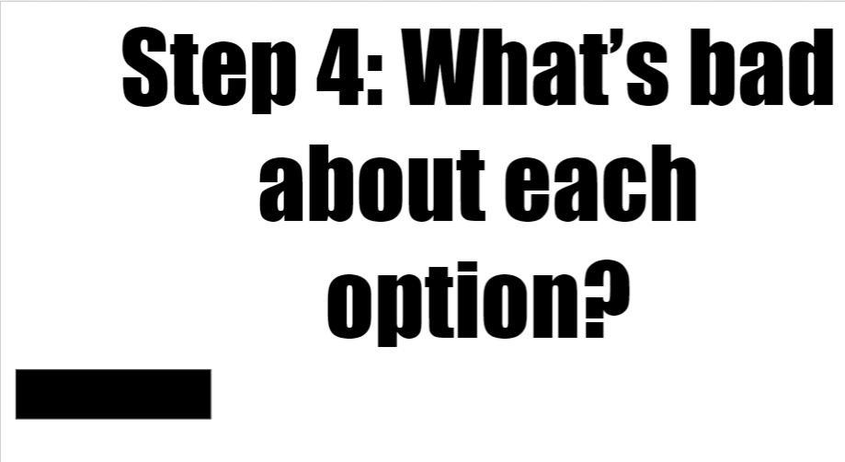

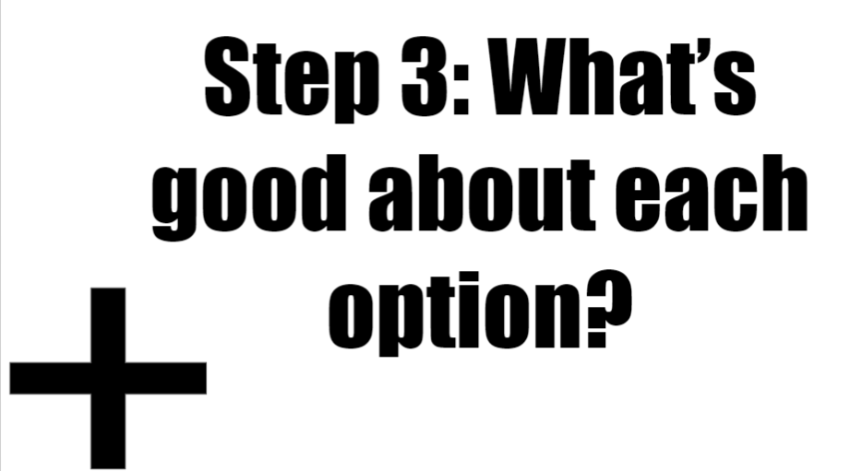
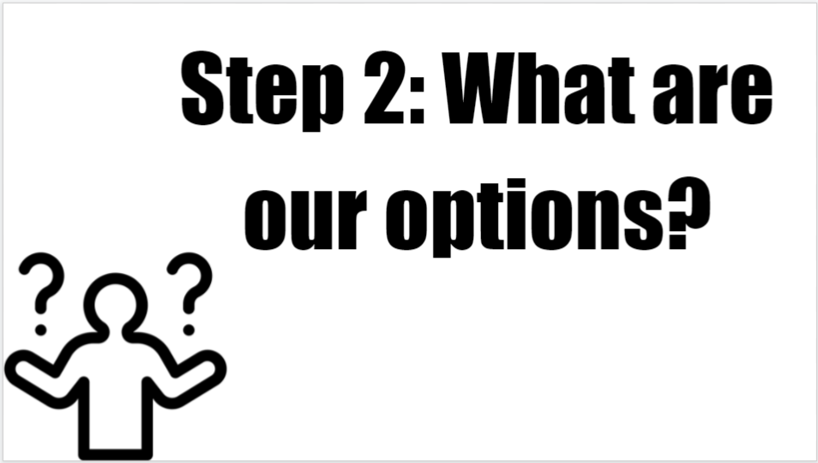
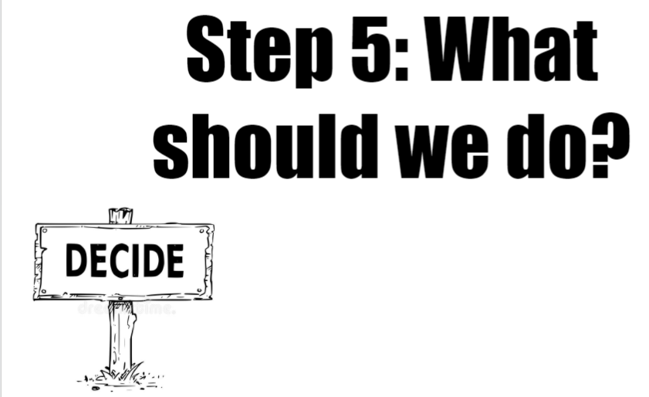

Slide 28
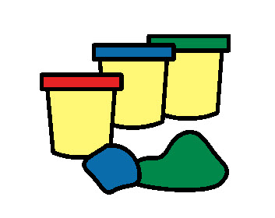
You can access the signs here
Recipe for clay you can use for the next activity here

Slide 29
Trading with Clay!
Playful Economics Lesson 6: Trade: Getting the Things We Want
People trade to satisfy their wants, trade allows us to gain more than possible if we tried to make everything ourselves. (specialization)
Voluntary trade is a positive-sum event. When trade is voluntary, both parties expect to benefit.
Trade without money is called barter. In order for barter to work, both parties must want the same thing.

Slide 30
Procedure
Give students some modeling clay.
Tell them they have 5 minutes to make a good.
After they have finished making their goods (5-10 minutes), give them 5 minutes to think of ways to advertise their good.
After everyone has advertised their good, ask if there’s a good ANOTHER student produced that they want.
Give them 5 minutes to trade their good with a classmate.
Stress that students DO NOT have to trade if they don’t want to.

Slide 31
Trading Activity Wrap-Up
How many of you traded items?
  Why did you trade?
  Were you forced to trade?
  Did you end up better off after you traded?
Is there anything that could have made your trade easier?
  Money?
  Did you make something other kids might like?
    What happens to businesses if they make something consumers don’t want?
  Did you advertise it well enough?
Did any of you want something that you didn’t get?
Did any of you trade multiple times?

Slide 32
Possible Record Sheet
Here’s a sheet you can use with the activity.
Have students answer question 1 BEFORE they advertise their goods with each other.
Have students answer question 2 AFTER they advertise their goods with each other, but BEFORE they trade.
Have students answer question 3 AFTER they are free to trade.

Slide 33
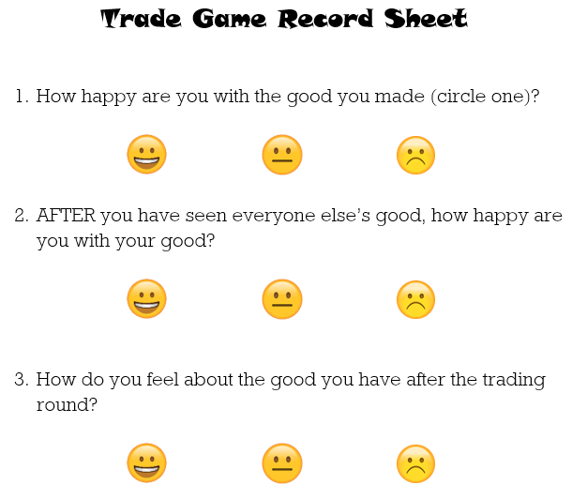

Slide 34

Assessment Questions
Things to think about...
What are the benefits of getting students activity involved in lesson content?
Would it be possible to do these activities using online instruction?
Can you think of other methods to get students moving?
Could these activities be used with older students?

Slide 35
References
(Links Included in this Webinar)
Playdough recipe | https://www.thebestideasforkids.com/playdough-recipe/
Virginia Standards of Learning | https://www.doe.virginia.gov/testing/index.shtml
National Content Standards in Economics | https://www.councilforeconed.org/wp-content/uploads/2012/03/voluntary-national-content-standards-2010.pdf

Slide 36


Comments?
Questions?
Suggestions?

Slide 37




Thank You to Our Sponsors!

Slide 38

https://bit.ly/CEEConference2021

