Slide 1
Teaching Fiscal Policy in the COVID Era:
Fiscal Stimulus vs. National Debt
Presented by Bill Bosshardt
March 11, 2021 wbosshar@fau.edu

Slide 2
EconEdLink Membership
You can now access CEE’s professional development webinars directly on EconEdLink.org! To receive these new professional development benefits, become an EconEdLink member. As a member, you will now be able to:
Automatically receive a professional development certificate via e-mail within 24 hours after viewing any webinar for a minimum of 45 minutes
Register for upcoming webinars with a simple one-click process
Easily download presentations, lesson plan materials and activities for each webinar
Search and view all webinars at your convenience
Save webinars to your EconEdLink dashboard for easy access to the event
You may access our new Professional Development page here

Slide 3
Professional Development Certificate
To earn your professional development certificate for this webinar, you must:
Watch a minimum of 45-minutes and you will automatically receive a professional development certificate via e-mail within 24 hours.
Accessing resources:
You can now easily download presentations, lesson plan materials, and activities for each webinar from EconEdLink.org/professional-development/

Slide 4
Weighing the benefits and costs of a stimulus

Slide 5
Concepts to Know:
Debt vs. Deficit
Federal budget deficit – measured typically over the course of one year, a deficit occurs when the federal government’s outlays (payments) are larger than its receipts (funds paid to government).
  Implication: The U.S. must borrow to fund the deficit. The United States Treasury borrows the funds by selling U.S. Treasury Bills, Notes and Bonds. The Treasury must pay interest on these securities.
National debt – is the total amount owed by the United States government due to the accumulation of deficits over many years.
  Implication: Budget deficits increase the debt as more is owed. Budget surpluses decrease the debt as funds are repaid.

Slide 6
Concepts to Know:
Interest Rate
Interest rate – is the amount a borrower pays to the lender for a loan. The interest rate is expressed as a percentage of the amount owed.

Slide 7
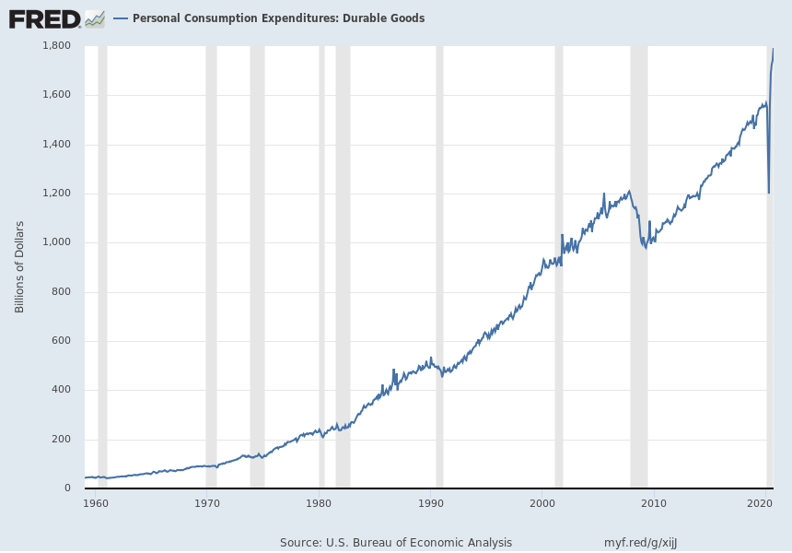
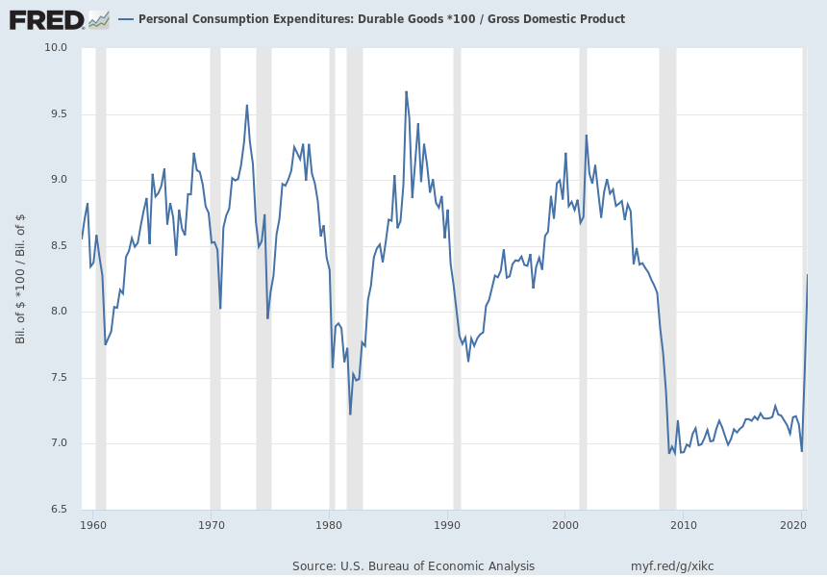
Concepts to Know:
As Percentage of GDP
Personal Consumption Expenditures Since 1960
Personal Consumption Expenditures
as a Percentage of GDP Since 1960

Slide 8
Concepts to Know:
Consumption
Personal Consumption
Expenditures (Durables) Since 1960
Personal Consumption Expenditures as a Percentage of GDP Since 1960
Will generally increase because of:
  Inflation (when expressed in dollars)
  Growth in the economy
Looking at this graph does not tell very much.
Is not sensitive to inflation.
By dividing by GDP, the statistic shows how big something is relative to the economy size.

Slide 9
Event to Know:
CARES Act
Enacted March 27, 2020
Included (only parts of the entire law):
  Cash payment to individuals
  Federal Pandemic Unemployment Compensation increases unemployment payments
  Paycheck Protection Program for small businesses to take loans that may be forgiven if the business retains its employees
  Help for large businesses like the airlines
  Aid for state and local governments
  Aid to hospitals

Slide 10
Policy Goals
What are the immediate benefits of an expansionary fiscal policy or fiscal stimulus during a recession like the COVID-19 recession?
How large or important are these benefits?
What are the long-run costs of an expansionary fiscal policy or fiscal stimulus during a recession like the COVID-19 recession?
How large or important are these costs?
Is a fiscal stimulus a useful tool to counteract the effects of the current Covid-19 recession?

Slide 11
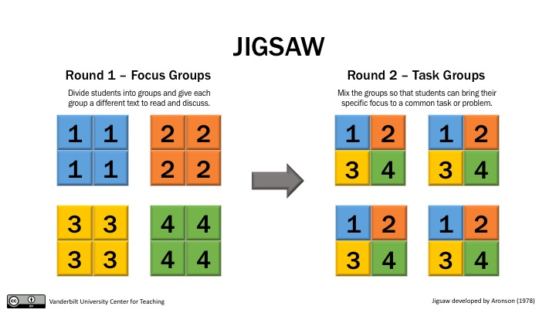
Focus Groups and Task Groups

Slide 12
Focus Groups and Task Groups
Name | Focus Group | Task Group
Elsie | 1 | A
Jay | 1 | B
Niamh | 2 | A
Cora | 2 | B
Kimberley | 3 | A
Esther | 3 | B
Gemma | 4 | A
Demi | 4 | B
Irqa | 5 | A
Dorothy | 5 | B
Ray | 6 | A
Marie | 6 | B

Slide 13
We’ll Go Through Focus Group Data and Questions
Short version (two graphs)
Long version (three graphs)

Slide 14
Focus Group Questions
Does the economy currently need more stimulus?
Are households and businesses stressed and in need of help?
Based on historical levels, are high interest rates currently a concern?
Based on current and historical measures, are interest payments currently a concern to the overall federal budget?
Did the CARES Act expense have a big impact on the national debt?
Does a one-time intervention such as the CARES Act have a continued effect on the long-term deficit or debt?

Slide 15
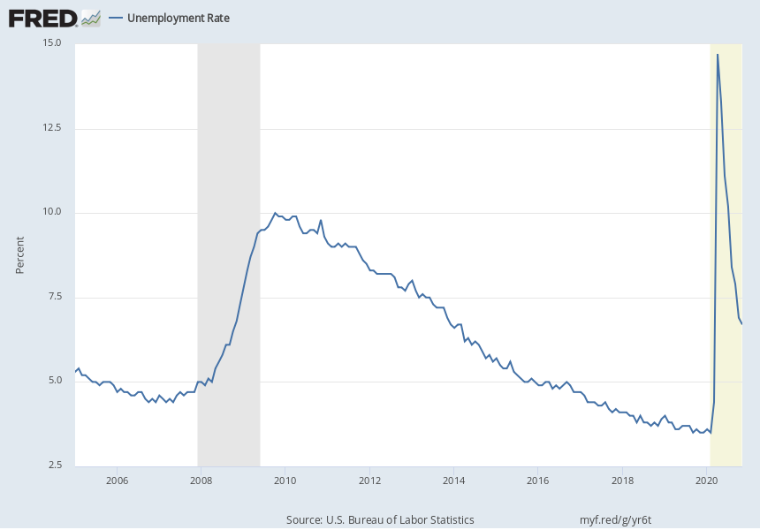
• How does the increase in unemployment compare to the Great Recession of 2008?
• How quickly has unemployment recovered compared to the Great Recession of 2008?
• Has unemployment completely recovered since the beginning of the pandemic?
“Does the economy currently need more stimulus?”

Slide 16
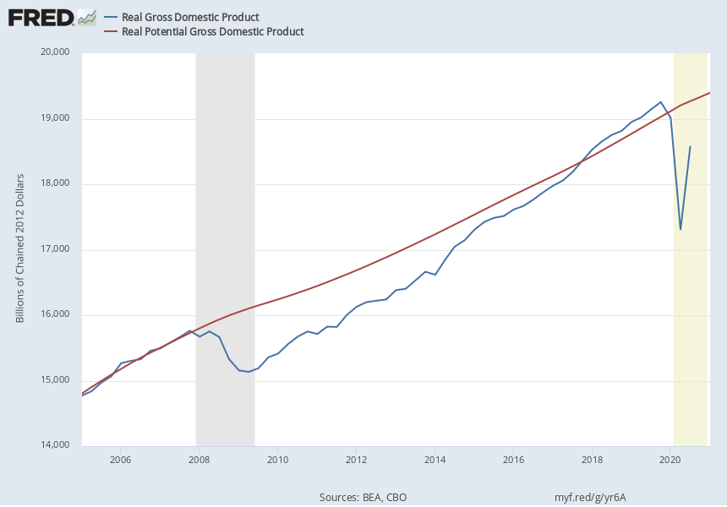
• Is the size of the economy as measured by real GDP above or below real potential GDP (real potential GDP is an estimate of the capacity of the economy)?
• How quickly has real GDP recovered compared to the Great Recession of 2008?
“Does the economy currently need more stimulus?”

Slide 17
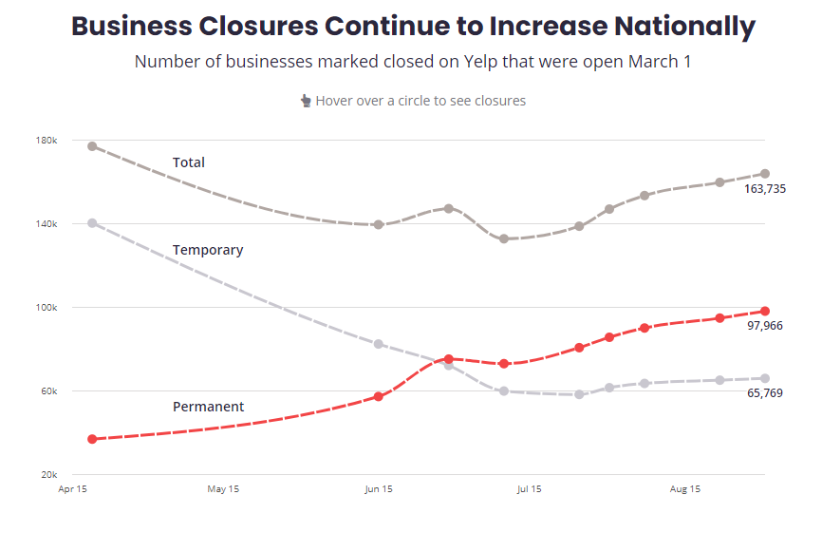
• How are business closures measured in this graph?
What kind of businesses are generally on Yelp?
• What is the trend in the total number of businesses that are closed?
• What is the trend in the total number of businesses that are permanently closed?
“Are households and businesses stressed and in need of help?”

Slide 18
• Are symptoms of anxiety disorder or depressive disorder higher or lower than before the pandemic?
• Have the symptoms increased or decreased since April when the recent surveys began?
“Are households and businesses stressed and in need of help?”
Time Period Label | Value in %
Pre Pandemic Comparison | 11.0
Apr 23 - May 5 | 35.9
May 7 - May 12 | 34.4
May 14 - May 19 | 33.9
May 21 - May 26 | 34.3
May 28 - June 2 | 35.5
June 4 - June 9 | 36.1
June 11 - June 16 | 36
June 18 - June 23 | 36.1
June 25 - June 30 | 37.8
July 2 - July 7 | 39
July 9 - July 14 | 40.3
July 16 - July 21 | 40.9
Aug 19 - Aug 31 | 36.4
Sep 2 - Sep 14 | 36.2
Sep 16 - Sep 28 | 37.2
Sep 30 - Oct 12 | 37.5
Oct 14 – Oct 26 | 37.8
Oct 28 – Nov 9 | 41.4
Nov 11 – Nov 23 | 42.6
Feb 3 – Feb 15 | 39.2

Slide 19
• How does the federal government borrow funds?
• What might happen to interest rates if federal government borrowing increases?
• What is meant by crowding out?
• Because businesses borrow funds to fund expansions and improvements what will happened to economic growth if interest rates rise significantly?
• How can you tell if crowding out is a problem?
“Based on historical levels, are high interest rates currently a concern?”
Crowding out article:
* Paragraph one: Government borrows to pay for deficit, pays interest.
* Paragraph two: As government borrows, interest rates rise.
* Paragraph three: As interest rates rise, businesses may borrow less and therefore invest less in their businesses, slowing growth.

Slide 20
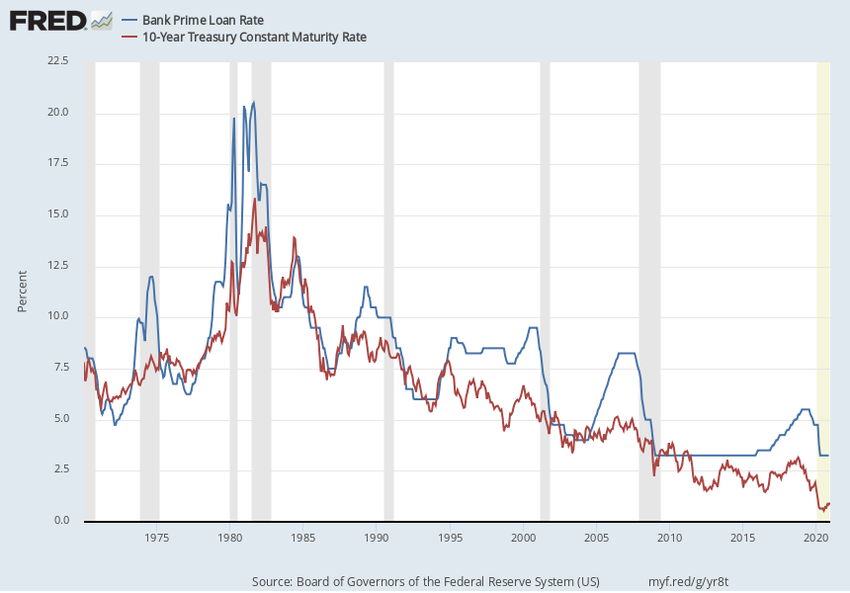
• Have interest rates (measured in the graph by the interest rates for businesses and federal government) increased or decreased over the last 40 years? Over the last 20 years?
• Would you describe current interest rates as relatively high or relatively low?
Based on historical levels, are high interest rates currently a concern?

Slide 21
• Is interest a large portion of the federal government’s budget?
• Did total spending increase from 2019 to 2020? Why?
“Based on current and historical measures, are interest payments currently a concern to the overall federal budget?”
 | 2019 ($ Trillion) | 2019 (% of GDP) | 2020 ($ Trillion)
Revenue | 3.5 | 16.3% | 3.4
Total Spending | 4.4 | 21.0% | 6.6
Mandatory Spending | 2.7 | 12.9% | 4.6
Discretionary Spending | 1.3 | 6.3% | 1.7
Interest | 0.4 | 1.8% | 0.3
Deficit | 1.0 | 4.6% | 3.3

Slide 22
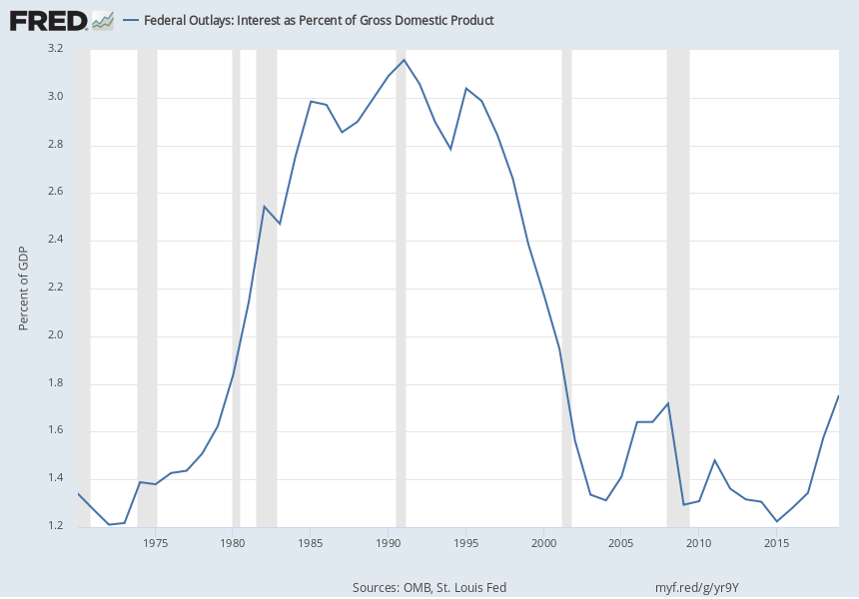
• Historically speaking, is the total amount of interest paid on the national debt as a percentage of GDP high or low?
• What is the trend for the total amount of interest paid on the national debt recently?
“Based on current and historical measures, are interest payments currently a concern to the overall federal budget?”

Slide 23
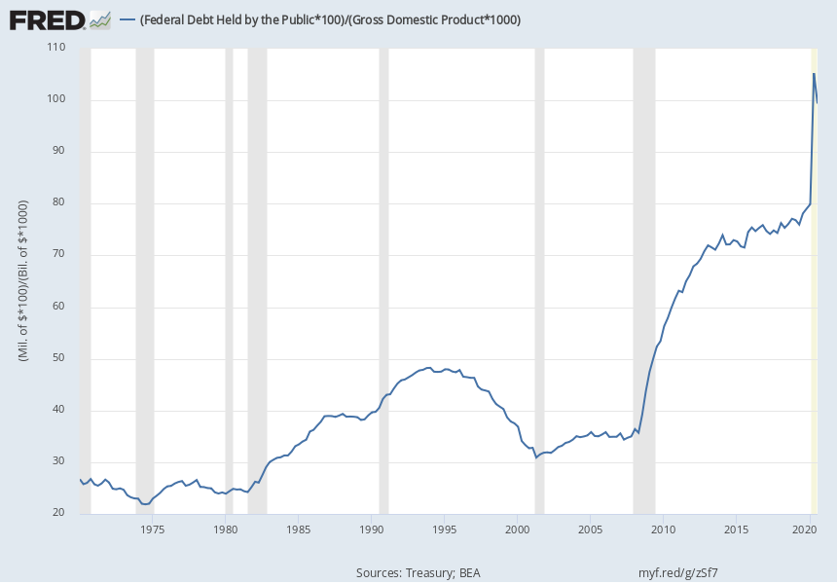
• During the Great Recession 2008 and the current recession, what has happened to the national debt?
• Why did the national debt decrease in the late 1990s?
• Why did the national debt as a percentage of GDP decrease in the last measurement (what happened to GDP)?
“Did the CARES Act expense have a big impact on the national debt?”

Slide 24
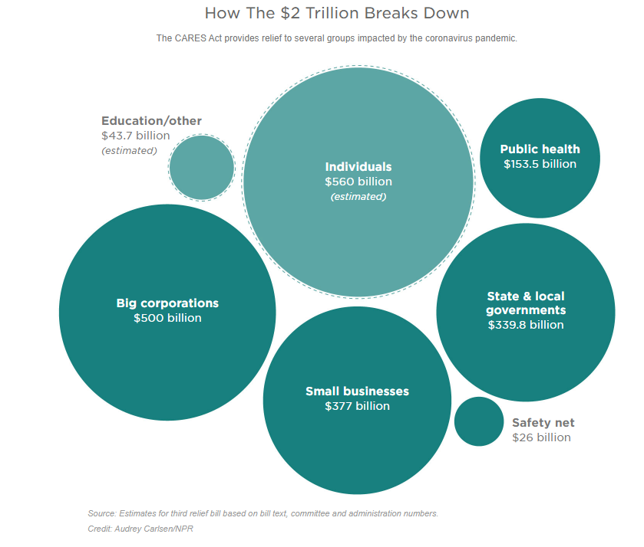
What are some of the components of the CARES Act? (You can go to the NPR article for more details than provided by the graphic.)
• Who is helped by the CARES Act?
“Did the CARES Act expense have a big impact on the national debt?”

Slide 25
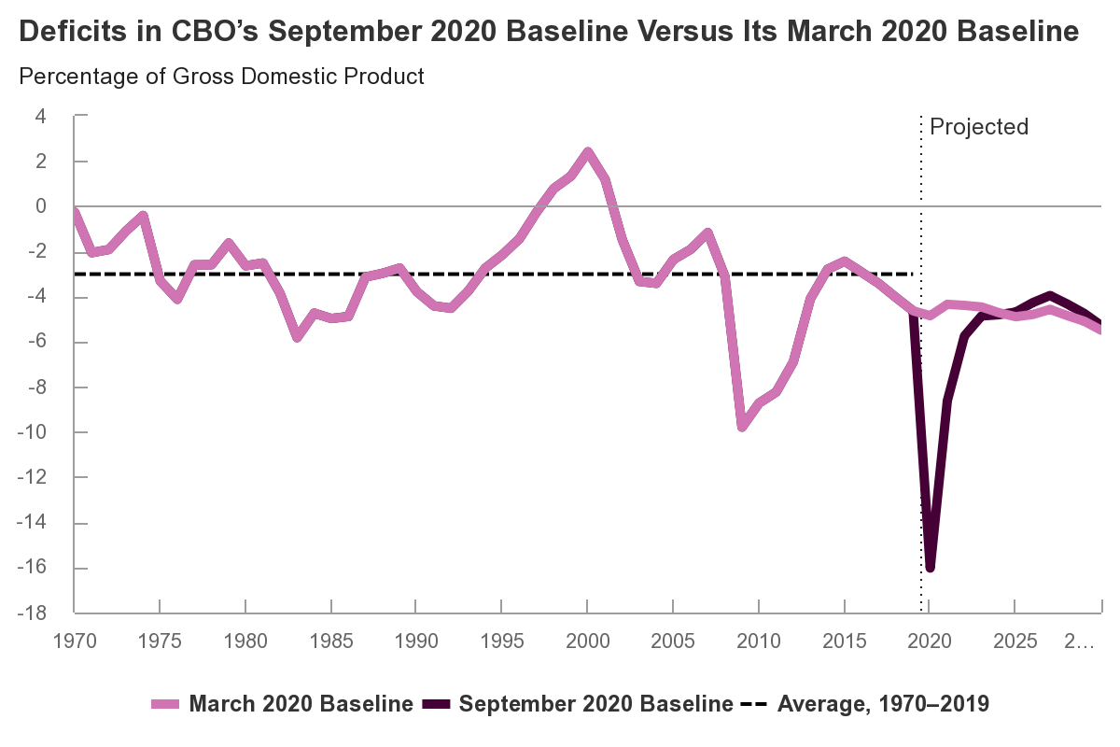
• Based on the projected deficits by the CBO, will the CARES Act stimulus have continued impacts on the deficit?
“Does a one-time intervention such as the CARES Act have a continued effect on the long-term deficit or debt?”

Slide 26
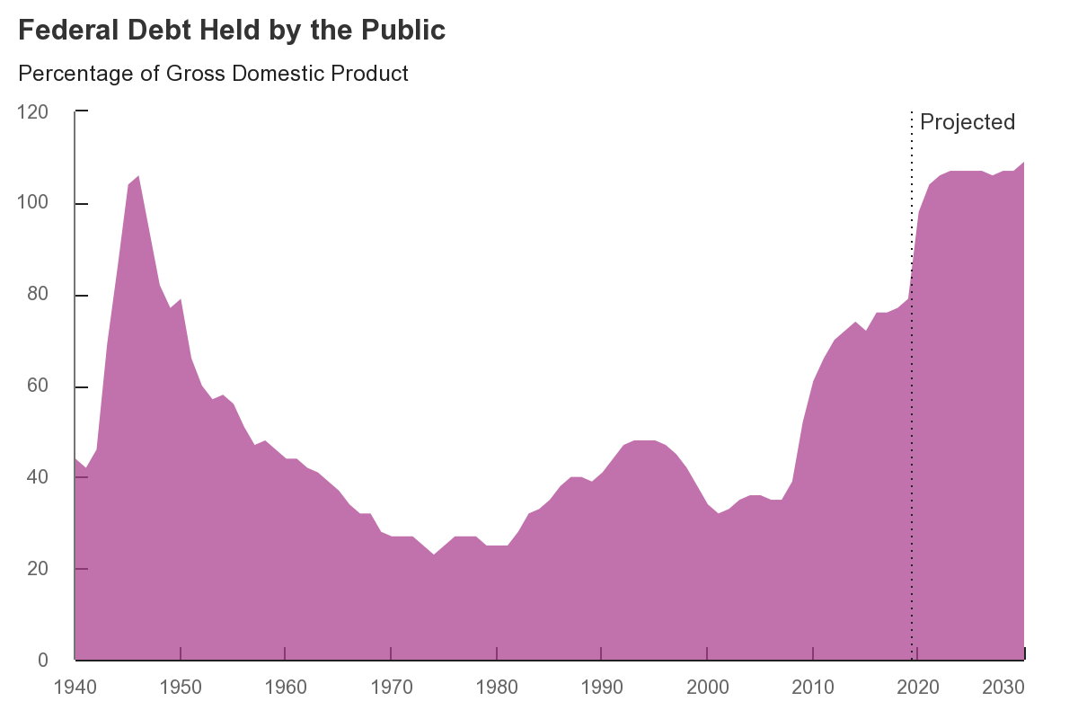
• Based on the projected debt by the CBO, will the CARES Act stimulus have continued impacts on the debt?
“Does a one-time intervention such as the CARES Act have a continued effect on the long-term deficit or debt?”

Slide 27
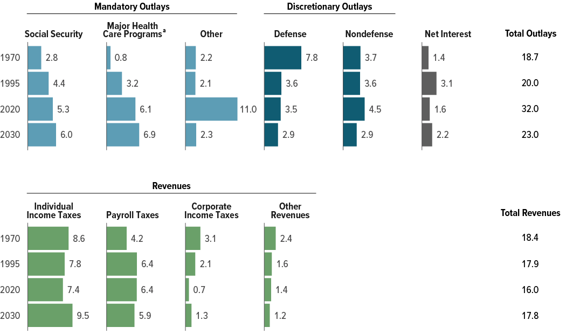
Based on the projected debt by the CBO, will the CARES Act stimulus have continued impacts on the debt? Identify the impact of the CARES Act in the figures
•The United States is projected to have increasing long-term deficits. What spending programs are increasing over time? Why do you think these are projected to increase?
•The United States is projected to have increasing long-term deficits. What sources of revenue have been trending downward over time? Why do you think these have been decreasing?
“Does a one-time intervention such as the CARES Act have a continued effect on the long-term deficit or debt?”
CBO’s Baseline Projections of Outlays and Revenues, Compared With Actual Values 25 and 50 Years Ago (Percentage of Gross Domestic Product)…

Slide 28
Final Question for Task Group
First, each member of the task group will relay the main question posed to their focus group and discuss the focus group’s consensus.
Second, after six focus questions have been discussed, the task group should discuss the final question:
After weighing the immediate benefits of a stimulus against stimulus’ long-term costs, is a fiscal stimulus a useful tool to counteract the effects of the current Covid-19 recession?

Slide 29
Stimulus?
Benefits
Moves economy towards potential GDP faster, leading to a quicker recovery of economic growth
Reduces unemployment
Helps reduce stress on households
Helps small and large businesses recover
Helps local and state governments provide services
Costs
Increases national debt
Increases interest paid in future by federal government
May hinder business borrowing for investment if interest rates rise

Slide 30
Questions to ask about the long-term costs of a stimulus on the debt…
Do interest rates rise significantly to high levels because of the stimulus?
Are interest payments historically large relative to GDP?
What contributes to a rise in costs leading to a larger national debt?
  One-time money stimulus programs
  Ongoing programs
Can taxes be raised in the future to reduce the debt?

Slide 31
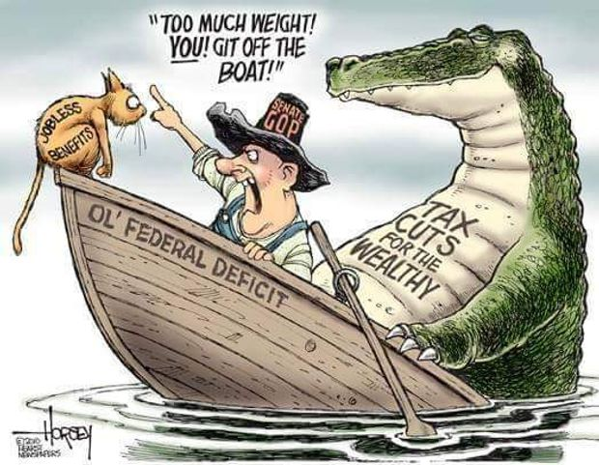
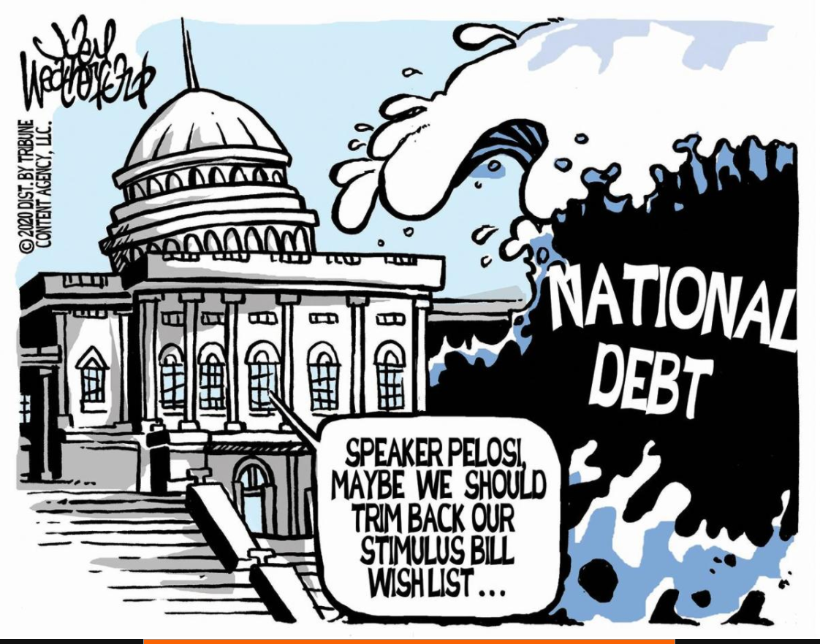
The Debate…
https://www.marketwatch.com/story/ted-cruz-is-asked-why-national-debt-is-paramount-to-republicans-only-when-a-democrat-is-in-the-white-house-11603831170
https://www.usnews.com/cartoons/deficit-and-budget-cartoons

Slide 32
What do kids think?
Though these lesson lean toward the idea that temporarily increased spending is not a large danger, kids may focus on future issues, that will likely affect their generation, as an increased worry…

Slide 33

CEE Affiliates
https://www.councilforeconed.org/resources/local-affiliates/

Slide 34




Thank You to Our Sponsors!

Slide 35





We’ve gone Virtual!
Teach Economics?
Your students may have what it takes to compete in the nation’s only high school economics competition!
Why Play?
• Fun team learning experience
• Great for college applications
• No other challenge like this
• Online participation makes access easy
• Chance for cash prizes
How it Works
Teams register
Teachers enroll team(s) of 3- 4 high school students from the same school. Multiple teams allowed.
Teams compete within their state
Compete to win your state competition for a
chance to advance to the National Semi-Finals.
National Semi-Finals: May 3-20, 2021
Teams answer multiple-choice questions on macroeconomics, microeconomics, and international & current events.
National Finals: May 22-24, 2021
Teams analyze an economic issue and present their solution. Top teams engage in the Finals Quiz Bowl where they face-off answering questions to claim the National Title.
Two divisions based on experience level
David Ricardo for first-time competitors who have taken no more than one economics course.
Adam Smith for returning competitors, AP, International Baccalaureate, and honors students.
Register Today at NationalEconomicsChallenge.org

Slide 36





FIND YOUR LOCAL COMPETITION
AND REGISTER TODAY!
The National Personal Finance Challenge is a competition that provides high school students with an exciting and motivating opportunity to build, apply, and demonstrate their knowledge of money management.
Through online exams and a personal finance simulation, teams showcase their expertise in earning income, buying goods and services, saving, using credit, investing, as well as protecting and insuring.
Teams of up to four students, with one teacher/coach, can qualify to represent their state at the National Personal Finance Challenge by winning their local competition.
NATIONALS
Semi-Finals: First round elimination via online multiple-choice questions.
Finals: Case study round virtually co-hosted by the Cleveland Fed on June 3.
personalfinancechallenge.org

Slide 37

The 2021 Sloan Teaching Champion Award
Winners receive:
A cash award of $5,000
A cash award of $2,500 for their school to support economic education
Recognition at our annual Visionary Awards convening.
This award promotes economic education by honoring three outstanding teachers who incorporate exemplary teaching techniques that improve their students’ economic understanding in and out of the classroom.
This award is open to New York metropolitan area high school teachers of all subjects, not just teachers of economics. Applicants must demonstrate how they integrate economics into their teaching.
Sound like you or someone you know?
Applicants must teach in one of the
Twelve New York state counties (New York, Kings, Bronx, Richmond, Queens, Nassau, Suffolk, Westchester, Putnam, Rockland, Orange and Dutchess)
Eight New Jersey counties (Bergen, Passaic, Essex, Hudson, Middlesex, Union, Morris, Monmouth), or the
Two Connecticut counties (Fairfield and New Haven)
Application will be launched on Friday February 19th 2021
You can access the application here.
CONTACT
Please feel free to e-mail us at rrivera@councilforeconed.org
with any questions you have.

