Slide 1
Basic Economic Concepts in AP Macroeconomics: Equilibrium, Disequilibrium, and Changes in Equilibrium
Presented by Theodore Opderbeck 11/15/21 opderbeckt@waldwickschools.org

Slide 2
EconEdLink Membership
You can now access CEE’s professional development webinars directly on EconEdLink.org! To receive these new professional development benefits, become an EconEdLink member. As a member, you will now be able to:
Automatically receive a professional development certificate via e-mail within 24 hours after viewing any webinar for a minimum of 45 minutes
Register for upcoming webinars with a simple one-click process
Easily download presentations, lesson plan materials and activities for each webinar
Search and view all webinars at your convenience
Save webinars to your EconEdLink dashboard for easy access to the event
You may access our new Professional Development page here

Slide 3
Professional Development Certificate
To earn your professional development certificate for this webinar, you must:
Watch a minimum of 45-minutes and you will automatically receive a professional development certificate via e-mail within 24 hours.
Accessing resources:
You can now easily download presentations, lesson plan materials, and activities for each webinar from EconEdLink.org/professional-development/

Slide 4
Agenda
Discuss the concepts of equilibrium, disequilibrium, and changes in equilibrium as they relate to the AP Macroeconomics Curriculum.
Explore formative and summative assessment options and EdTech resources to maximize student understanding.
Introduce dynamic learning activities and lesson plans to reinforce content.

Slide 5
Objectives
To analyze how equilibrium and disequilibrium are achieved within markets.
To examine how various determinant factors change supply and demand and affect prices and quantity in markets.
To investigate resources to construct digital formative and summative assessments to reinforce learning and prepare for the AP test.
To apply the concepts covered in the webinar to real world national and international examples.
To introduce dynamic learning activities and project ideas to engage students.

Slide 6
National Standards
Standard 7: Markets and Prices. A market exists when buyers and sellers interact. This interaction determines market prices and thereby allocates scarce goods and services.
Standard 8: The Role of Prices. Prices send signals and provide incentives to buyers and sellers. When supply or demand changes, market prices adjust, affecting incentives.
https://www.councilforeconed.org/wp-content/uploads/2012/03/voluntary-national-content-standards-2010.pdf

Slide 7
State Standards
NYS Social Studies 12. E2 INDIVIDUALS AND BUSINESSES IN THE PRODUCT AND FACTOR MARKETS: Free enterprise is a pillar of the United States economy and is based on the principle that individuals and businesses are free to make their own economic choices as they participate in these markets. Individuals buy the goods and services that they desire from businesses in the product markets, and they contribute to producing these goods and services by supplying the resources that they own to businesses in the factor markets.
http://www.nysed.gov/common/nysed/files/programs/curriculum-instruction/ss-framework-9-12.pdf

Slide 8
Question of the Day
Which individual cell phone has had the highest sales in 2021?
Apple iPhone 12
Apple iPhone 11
Samsung Galaxy A12
Xiaomi Redmi 9

Slide 9
Question of the Day
In what year was the first cell phone commercially available? (Motorola DynaTak 8000X)
1991
1983
1977
1995
Notes:
$3,9995 in 1983/ $9,000 adjusted for inflation

Slide 10
Economics and Cross Curricular Applications
Mathematics (Graphing, quantitative analysis)
Current events
Politics/sociology
Supply, Demand, and Markets
Equilibrium, Disequilibrium, Shortages, Surpluses
Determinants of and changes to supply and demand

Slide 11
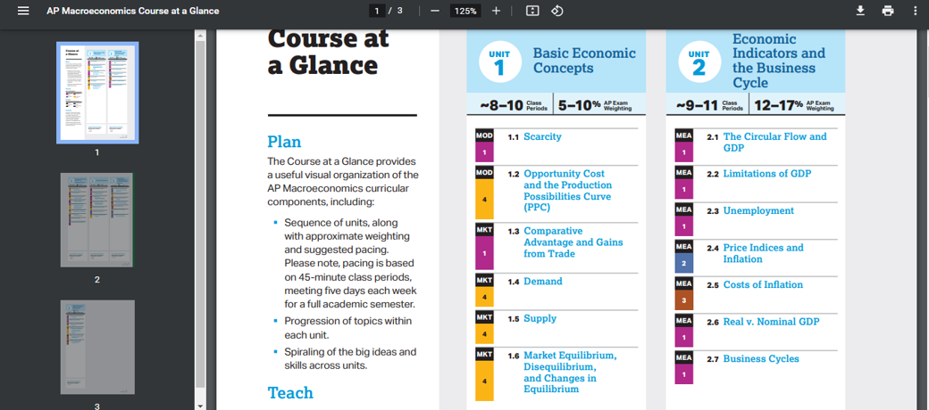
AP Economics Curriculum

Slide 12
AP Economics College Board Curriculum Resources
https://apcentral.collegeboard.org/courses/ap-macroeconomics/course
https://apstudents.collegeboard.org/courses/ap-macroeconomics/free-response-questions-by-year
https://myap.collegeboard.org/login

Slide 13
Other Informational Resources
Khan Academy: https://www.khanacademy.org/economics-finance-domain/ap-macroeconomics/basic-economics-concepts-macro/market-equilibrium-disequilibrium-and-changes-in-equilibrium/a/lesson-summary-market-equilibrium-disequilibrium-and-changes-in-equilibrium
Mr. Clifford’s AP Econ YouTube: https://www.youtube.com/watch?v=V0tIOqU7m-c

Slide 15
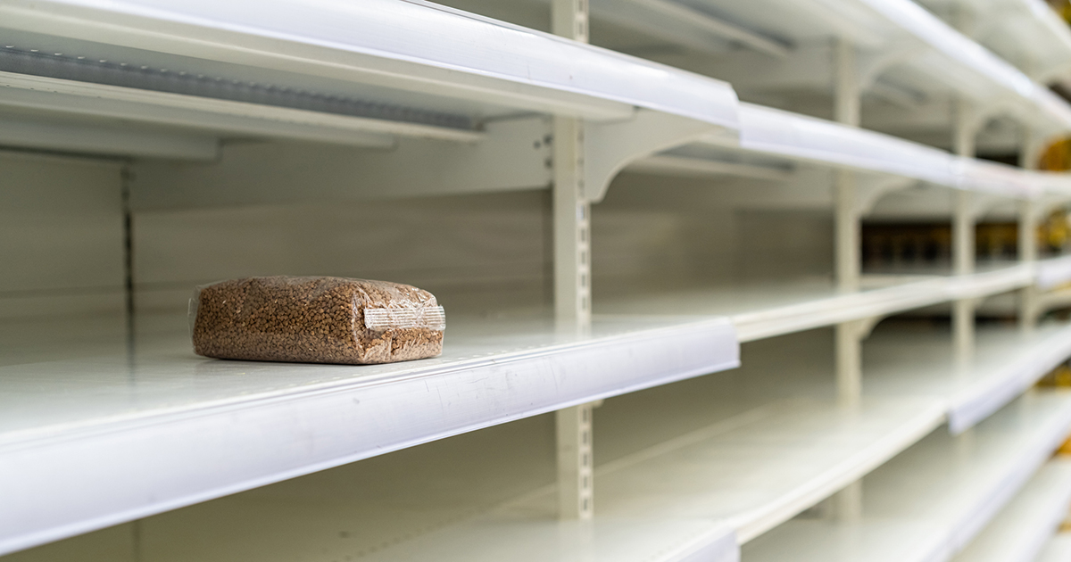
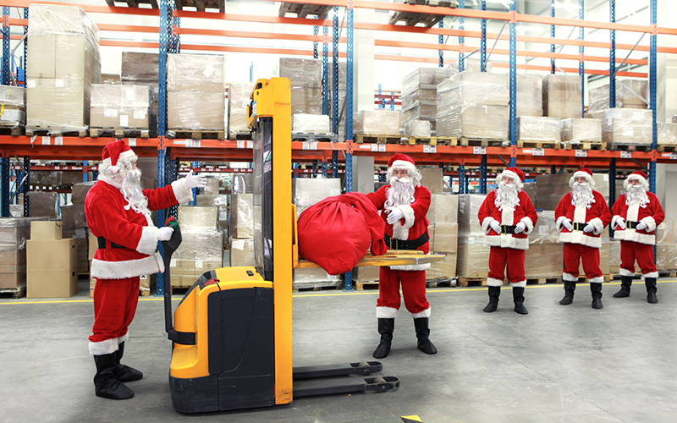

Slide 17
Important Concepts
Equilibrium
Disequilibrium
Changes in Equilibrium
Determinants/Changes in Supply and Demand

Slide 18
DEMAND / SUPPLY FOR PIZZAS
PRICE | QUANTITY DEMANDED | QUANTITY SUPPLIED
$8 | 100 | 20
10 | 80 | 40
12 | 60 | 60
14 | 40 | 80
16 | 20 | 100

Slide 19
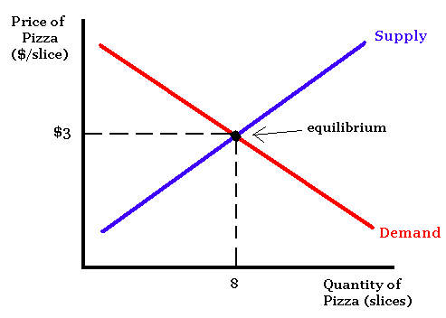
Market Equilibrium
$12
60

Slide 20
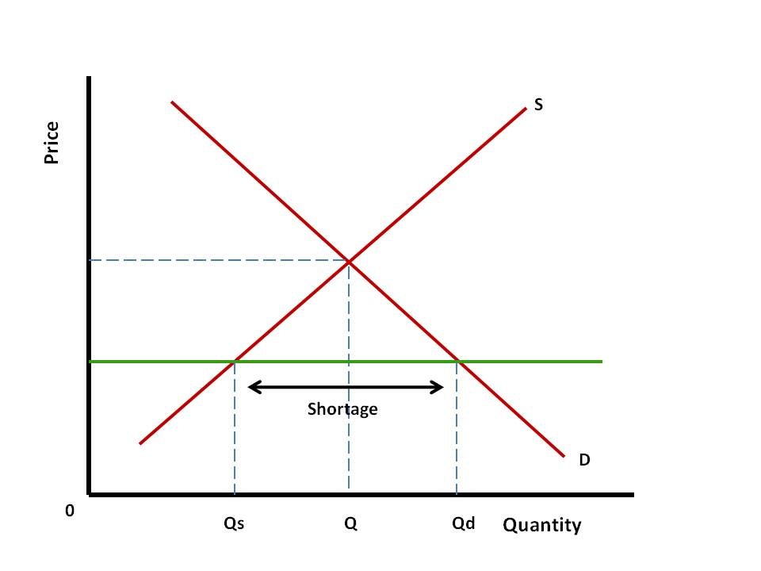
Disequilibrium = Price Below Equilibrium

Slide 21
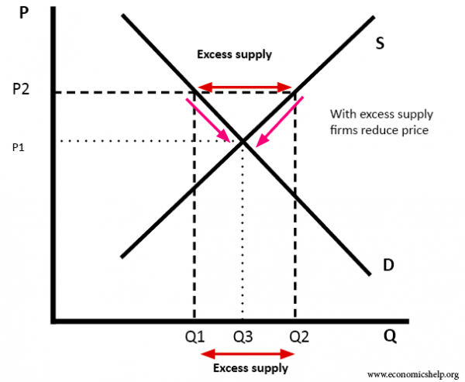
Disequilibrium = Price Above Equilibrium

Slide 22
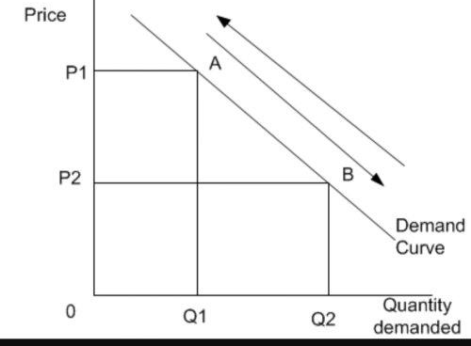
Change in Quantity Demanded

Slide 23
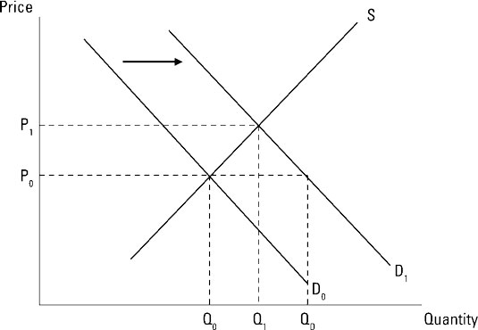
Increase in Demand
Price Increases
Quantity Increases

Slide 24
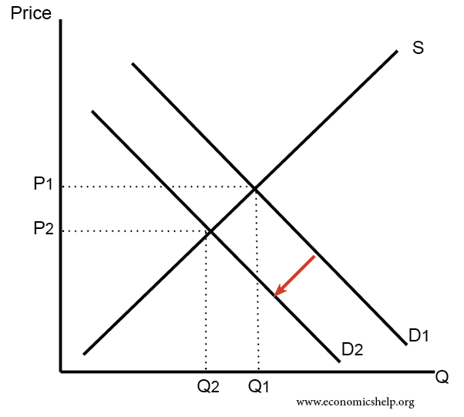
Decrease in Demand
Price Decreases
Quantity Decreases

Slide 25
Factors that Cause a Shift in Demand (Increase or Decrease)
Consumer Preferences - trends, fads
Advertising/ Marketing
Population Level
Generally, increases in population lead to increases in overall demand

Slide 26
Famous Commercials Leading to Increased Demand
Nike Air Jordan: https://www.youtube.com/watch?v=3NxF3ipUEHE
Apple vs. PC: https://www.youtube.com/watch?v=0eEG5LVXdKo&t=124s

Slide 27
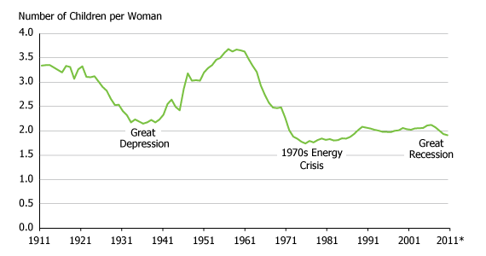

Slide 28
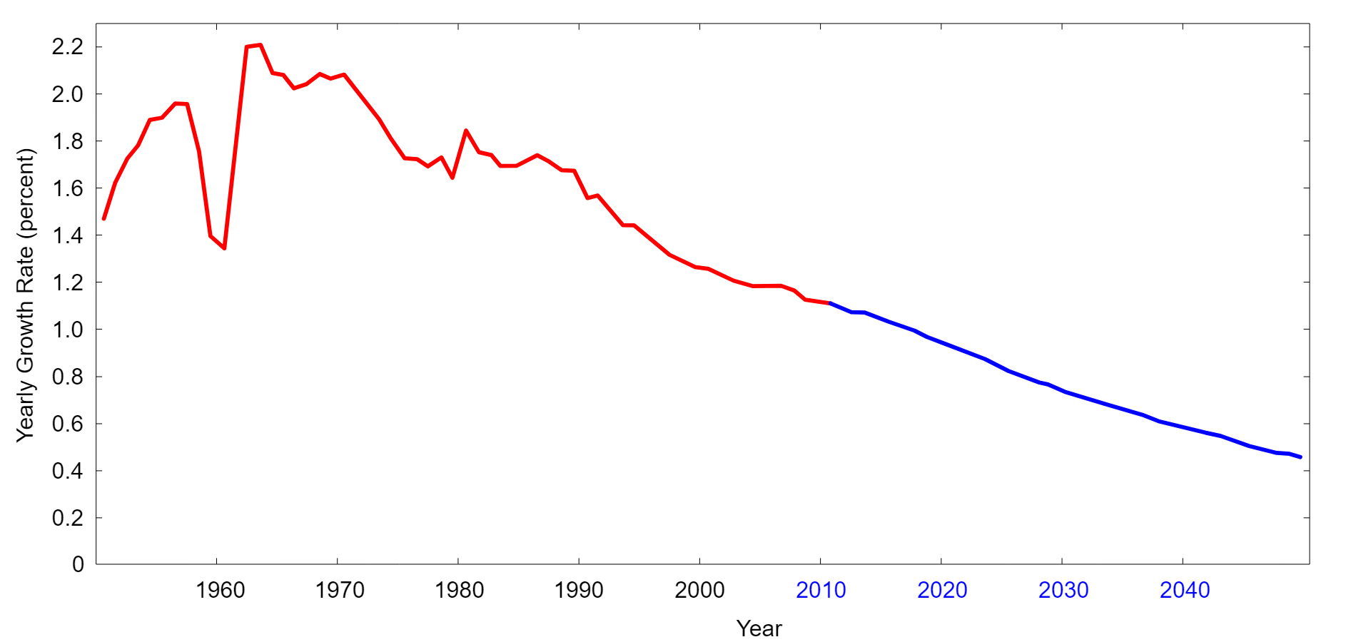

Slide 29
Factors that Cause a Shift in Demand (Increase or Decrease), Cont’d
Prices of Related Goods:
Complementary goods - goods that are bought and used together.
Assume that pancakes and maple syrup are complementary goods. If the price of pancakes increases, the quantity demanded for pancakes decreases; therefore, the demand for syrup (pancake’s complement) decreases.
Substitute goods - goods that are used in place of one another.
Assume that pizza and hamburgers are substitute goods. If the price of pizza increases the quantity demanded for pizza decreases; therefore the demand for hamburgers (pizza’s substitute) increases.

Slide 30
Factors that Cause a Shift in Demand (Increase or Decrease), Cont’d
Income Level
Normal Good: income increases, demand increases; income decreases, demand decreases
Examples:
Inferior Good: income increases, demand decreases; income decreases, demand increases
Examples:

Slide 31
Factors that Cause a Shift in Demand (Increase or Decrease), Cont’d
Future Price Change Expectations:
Price is expected to increase in future = increase in demand in the near term
Price is expected to decrease in future = decrease in demand in the near term

Slide 32
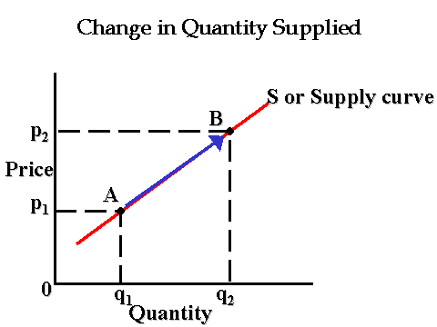

Slide 33
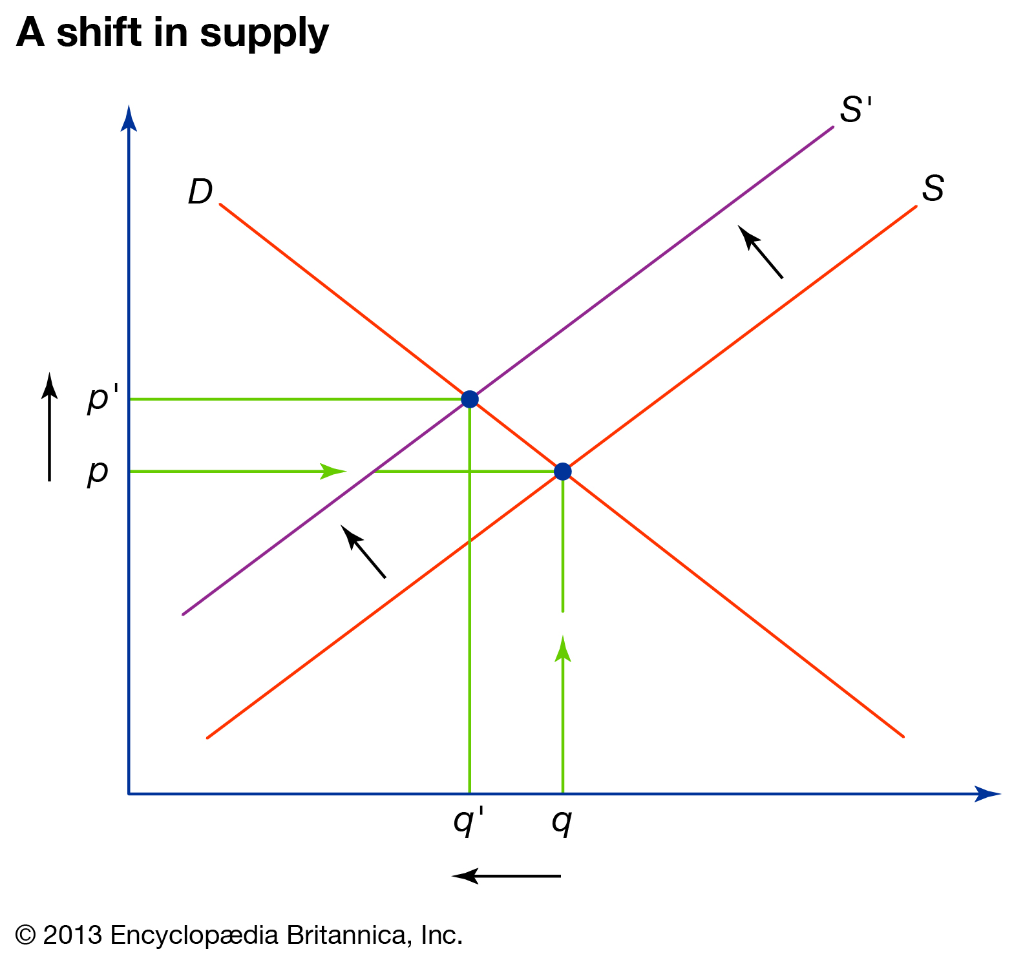
Decrease in Supply
Price Increases
Quantity Decrease

Slide 34
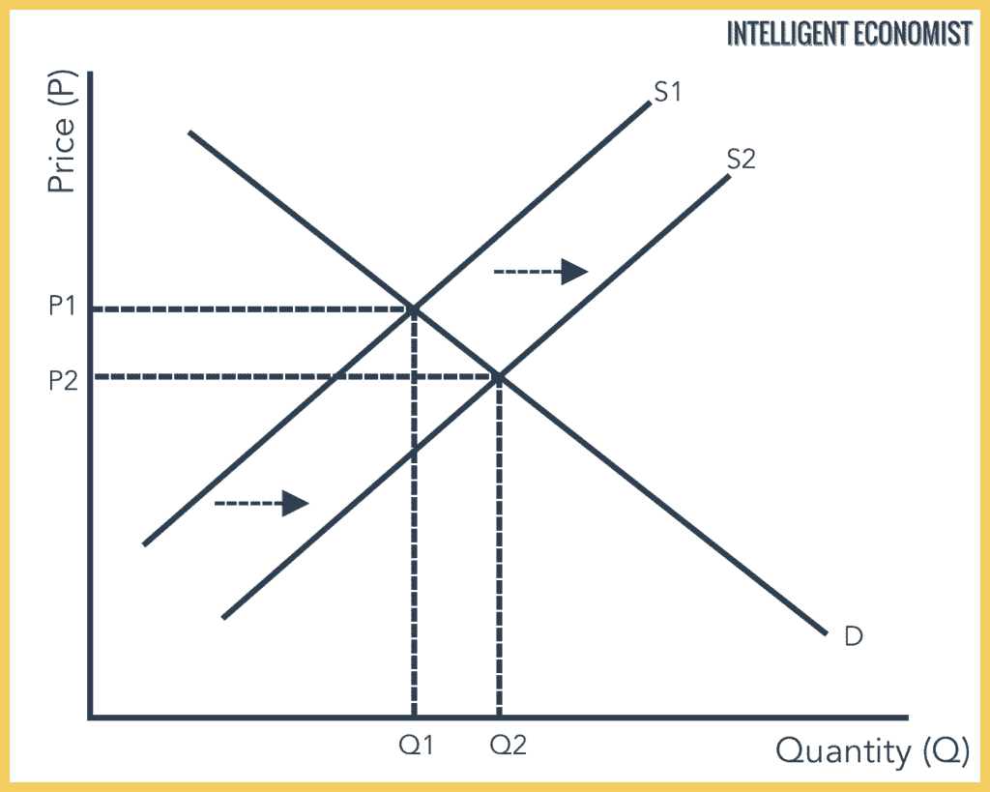
Increase in Supply
Price Decreases
Quantity Increases

Slide 35
Factors that Cause a Shift in Supply (Increase or Decrease)
Changes in the price of inputs/ resources used in production
Input price increase - decrease in supply
Input price decrease - increase in supply
Changes in the number of competitors in the market
Increase in competition - increase in supply
Decrease in competition - decrease in supply
Changes in technology/ productivity
Increase in tech/productivity - increase in supply

Slide 36
What factors have caused increases in productivity in the last few decades?
Rapid increases in tech/ internet/ e-commerce
Globalization
https://docs.google.com/document/d/1prOmvw7uFyLAhwOderS6tKAwSoCz-9rDjRGU_W9aU3U/edit?usp=sharing

Slide 37
What factors are causing supply chain issues?
https://docs.google.com/document/d/13lqKOdFingKqZd6-nkci84-Ak8t86YHKfDWz_sPiEVM/edit?usp=sharing

Slide 38
Simultaneous Shifts in Supply and Demand
CHANGE | CHANGE IN Q | CHANGE IN P
Demand Increases (Shifts Right) | Quantity Increases | Price Increases
Demand Decreases (Shifts Left) | Quantity Decreases | Price Decreases
Supply Increases (Shifts Right) | Quantity Increases | Price Decreases
Supply Decreases (Shifts Left) | Quantity Decreases | Price Increases

Slide 39
Increase in Demand
Price Increases
Quantity Increases

Slide 40
Decrease in Demand
Price Decreases
Quantity Decreases

Slide 41
Increase in Supply
Price Decreases
Quantity Increases

Slide 42
Decrease in Supply
Price Increases
Quantity Decrease

Slide 43
Simultaneous Shifts in Supply and Demand
CHANGE | CHANGE IN Q | CHANGE IN P
Demand Increases (Shifts Right)/ Supply Increases (Shifts Right) | Quantity Increases | Price Indeterminate
Demand Decreases (Shifts Left)/ Supply Decreases (Shifts Left) | Quantity Decreases | Price Indeterminate

Slide 44
Simultaneous Shifts in Supply and Demand
CHANGE | CHANGE IN Q | CHANGE IN P
Demand Increases (Shifts Right)/ Supply Decreases (Shifts Left) | Quantity Indeterminate | Price Increases
Demand Decreases (Shifts Left)/ Supply Increases (Shifts Right) | Quantity Indeterminate | Price Decreases

Slide 45
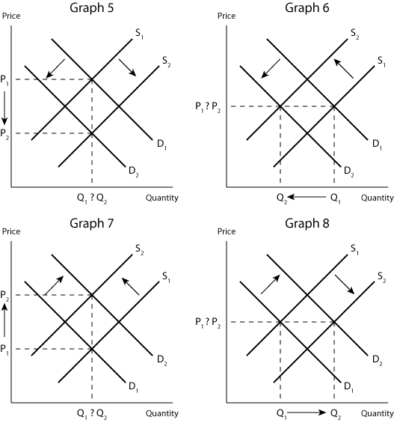

Slide 46
Sample Lesson Plan
Introductory Set: Use a Google Form, Google Classroom Poll, or Poll Everywhere to poll students on recent shopping experiences. Have them reflect on the price they paid, what they expected to pay, if there were any evidences of surpluses or shortages. Also, were there any substitute goods or complementary goods, was the purchase contingent on income levels, what the competition, etc. See here for example: https://docs.google.com/forms/d/1zmse5Urlsfd_by7iurOpNxN94QmAAnpVPJ5sd0goil4/edit

Slide 47
Sample Lesson Plan
Learning Activity:
Review or introduce supply, demand, and equilibrium.
Choose a product market and use it as an illustration. You might bring in the product to display or consume.
Creative Option: Simulate a market in your classroom for a product (ex: sell lollipops - teacher is the supplier, students have fake money. Construct a supply/demand schedule and graph. Establish equilibrium, then raise or lower price and discuss surpluses, shortages and how markets self-correct.

Slide 48
Sample Lesson Plan
Learning Activity:
Determinants of Demand:
Review the various factors that can potentially shift the demand and/or supply curve
For each determinant, use a quick activity to reinforce learning. NOTE: all of the following short activities can be used, not used, or modified. After each activity, be sure to have students draw supply and demand graphs and show how demand or supply change and the new equilibrium price and quantity.

Slide 49
Sample Lesson Plan
Learning Activity:
Determinants of Supply and Demand:
Advertising: Show some vintage ads and have students rank in a poll. Have students come up with examples of successful advertising campaigns they can remember. Ask students how businesses successfully market in today’s world.
Consumer Preferences: Provide examples of fads and past trends. Think/Pair/Share: what are the biggest fads and trends currently? How much staying power do they hold?

Slide 50
Sample Lesson Plan
Learning Activity:
Determinants of Supply and Demand:
Population: Show population growth graphs. Have students predict overall demand based on population trends? Discuss: should immigration be encouraged due to the fact that the U.S. is facing slowing population growth?

Slide 51
Sample Lesson Plan
Learning Activity:
Determinants of Supply and Demand:
Prices of Related Products: copy small images of various products that are related as substitutes or complements. Have students blindly choose up to four images from an envelope. Students mingle around and try to find examples of complementary goods and substitute goods within the class
Draw graphs based on examples to show what happens when prices change for substitutes and complements.

Slide 52
Sample Lesson Plan
Learning Activity:
Determinants of Supply and Demand:
Normal and Inferior Goods: Use a Google Form to have students evaluate if they believe goods are normal or inferior and hold a discussion. Example here:

Slide 53
Sample Lesson Plan
Learning Activity:
Determinants of Supply
Changes in price of inputs/ factors of production:
Think/Pair/Share or predetermined examples - have students brainstorm examples of any product. Then discuss what factors of production are involved and how a change in price in those factors would either increase or decrease supply.
Teacher can also assign each student a product and have them think of the above and share

Slide 54
Sample Lesson Plan
Learning Activity:
Determinants of Supply
Increase or decrease in competition
Provide an example of a product market to each student. (ex: fast food, clothing, cell phone service, sneakers, coffee, etc.) Have them compile a list of all the competitors within the market. Determine which markets have the most supply and which have the least and how price is affected.
Teacher can also hang copies on wall of various markets and students do this as a “gallery walk”

Slide 55
Sample Lesson Plan
Reinforcement of Learning:
Provide students with plenty of graphing examples so they can get used to drawing and correctly labeling the graphs
Examples Here:
https://docs.google.com/document/d/1L0r3ACzXywD4l_OqoyxXS4mC3gK7m09Gz11ziqn5Mhg/edit?usp=sharing

Slide 56
Sample Lesson Plan
Reinforcement of Learning/ Formative Assessment
Provide students with plenty of multiple choice/reasoning questions.
Digital Formative Assessment Options:
Socrative: socrative.com
Google Forms
Kahoot: https://kahoot.com/
Blooket
R

Slide 57
Sample Lesson Plan
Reinforcement of Learning/ Formative Assessment
Sample Multiple Choice Question:
Assume that the price of leather used to produce shoes increases. As a result, there is ______________ in the supply of shoes and the supply curve of shoes ________________.
a. an increase; shifts rightward
b. an increase; shifts leftward
c. a decrease; shifts rightward
d. a decrease; shifts leftward
e. cannot be determined; cannot be determined
R

Slide 58
Sample Lesson Plan
Reinforcement of Learning/ Formative Assessment
Sample Multiple Choice Question:
11. If there is a simultaneous increase in supply and decrease in demand, the price will necessarily __________________ and the quantity will _________________.
a. increase; increase
b. decrease; decrease
c. decrease; cannot be determined
d. cannot be determined; decrease
e. cannot be determined; increase

Slide 59
Sample Lesson Plan
Reinforcement of Learning/ Formative Assessment
Sample Multiple Choice Question:
11. Which of the following statements is correct?
i. a surplus puts downward pressure on the price of a good
ii. a shortage puts upward pressure on the price of a good
iii. there are no shortages or surpluses at equilibrium
a. i and ii only
b. i and iii only
c. ii and iii only
d. i, ii, and iii
e. iii only

Slide 60
Sample Lesson Plan
Reinforcement of Learning/ Formative Assessment
Sample Multiple Choice Question:
16. Assume that incomes rise and restaurant meals are a normal good. Additionally, there is an increase in food shipping costs due to supply chain issues. The price of restaurant meals will ______________ and the equilibrium quantity of restaurant meals will ___________________.
a. increase; increase
b. decrease; decrease
c. increase; decrease
d. decrease; increase
e. increase; cannot be determined

Slide 61
Sample Lesson Plan
Reinforcement of Learning/ Formative Assessment
Provide students with plenty of multiple choice/reasoning questions.
BLOOKET! - So much fun!!
www.blooket.com
R

Slide 62
Sample Lesson Plan
Application/ Homework/ Extension
Find contemporary articles dealing with changes in supply and demand in markets and how they affect economic current events. Do circle discussions/ Socratic seminars/ Discussion quiz
Examples: Housing; energy; supply chain issues; college education
One of my recent assignments: https://docs.google.com/document/d/1ZYCglZTE__G0B1xGHiT_8GvwLQU0lbJ0hCsZg_s6qko/edit?usp=sharing
R

Slide 63
Sample Lesson Plan
Application/ Homework/ Extension
Find contemporary articles dealing with changes in supply and demand in markets and how they affect economic current events. Do circle discussions/ Socratic seminars/ Discussion quiz
Another Example: https://docs.google.com/document/d/1ZYCglZTE__G0B1xGHiT_8GvwLQU0lbJ0hCsZg_s6qko/edit?usp=sharing

Slide 64
Sources for Prepared Articles
Newsela:
www.newsela.com
Ex: https://newsela.com/read/constitutional-right-grow-food/id/2001025042/

Slide 65
Additional Resources
Khan Academy: https://www.khanacademy.org/economics-finance-domain/ap-macroeconomics/basic-economics-concepts-macro/market-equilibrium-disequilibrium-and-changes-in-equilibrium/a/lesson-summary-market-equilibrium-disequilibrium-and-changes-in-equilibrium
Lumen Learning: https://courses.lumenlearning.com/suny-macroeconomics/chapter/reading-equilibrium-surplus-and-shortage/

Slide 66
Additional Resources
Khan Academy: Determinants of Supply/Demand - https://www.khanacademy.org/economics-finance-domain/ap-macroeconomics/basic-economics-concepts-macro/supply/a/lesson-overview-supply-and-its-determinants
https://opentextbc.ca/principlesofeconomics/chapter/3-2-shifts-in-demand-and-supply-for-goods-and-services/

Slide 67
CEE Affiliates
https://www.councilforeconed.org/resources/local-affiliates/

Slide 68
Thank You to Our Sponsors!

