Slide 1
It’s All Elementary!
Part III:
What Does Our Community
Provide for Us?
Presented by Teresa Mungai
Teresam@azecon.org
October 28, 2021

Slide 2
EconEdLink Membership
You can now access CEE’s professional development webinars directly on EconEdLink.org! To receive these new professional development benefits, become an EconEdLink member. As a member, you will now be able to:
Automatically receive a professional development certificate via e-mail within 24 hours after viewing any webinar for a minimum of 45 minutes
Register for upcoming webinars with a simple one-click process
Easily download presentations, lesson plan materials and activities for each webinar
Search and view all webinars at your convenience
Save webinars to your EconEdLink dashboard for easy access to the event
You may access our new Professional Development page here

Slide 3
Professional Development Certificate
To earn your professional development certificate for this webinar, you must:
Watch a minimum of 45-minutes and you will automatically receive a professional development certificate via e-mail within 24 hours.
Accessing resources:
You can now easily download presentations, lesson plan materials, and activities for each webinar from EconEdLink.org/professional-development/

Slide 4
Agenda
Review Economics and Personal Finance Standards
Interactive Lesson Activities
Questions

Slide 5
Objectives
Participants will review the Economics and Personal Finance standards for K-5th grade.
Participants will take part in interactive lesson activities that can be used in a K-5 classroom.

Slide 6
National Standards
Economics Standards
Standard 1: Scarcity
Standard 2: Decision Making
Standard 5: Trade
Financial Literacy Standards
Standard 1: Earning Income
Standard 2: Spending

Slide 7
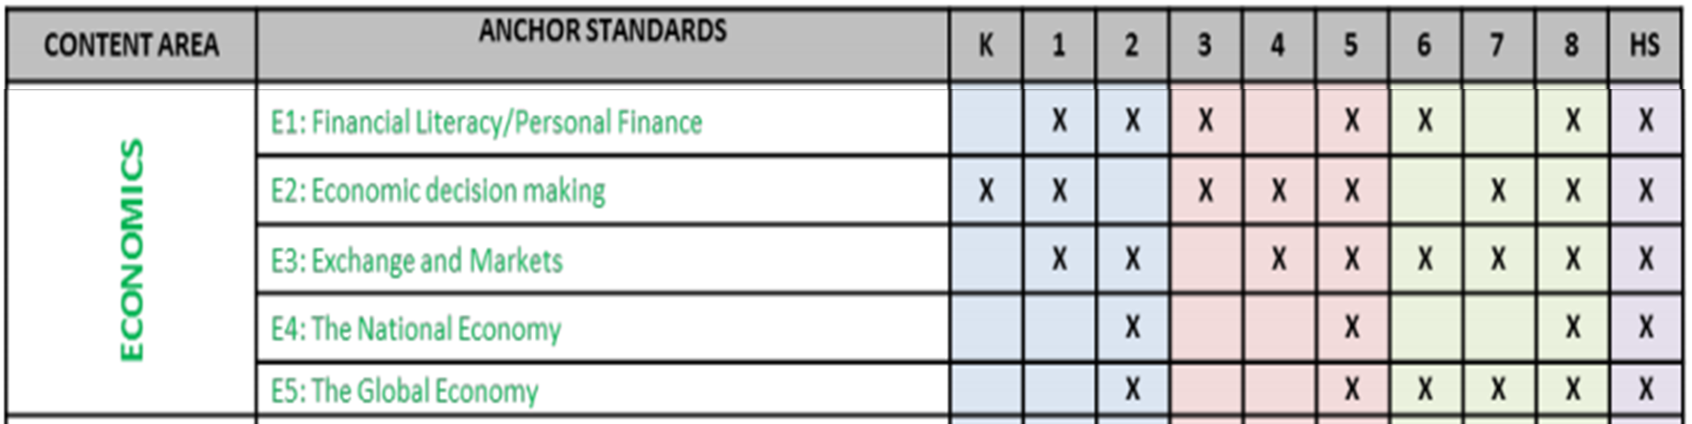
State Standards
Arizona History and Social Science Standards

Slide 8
Lesson Activities

Slide 9

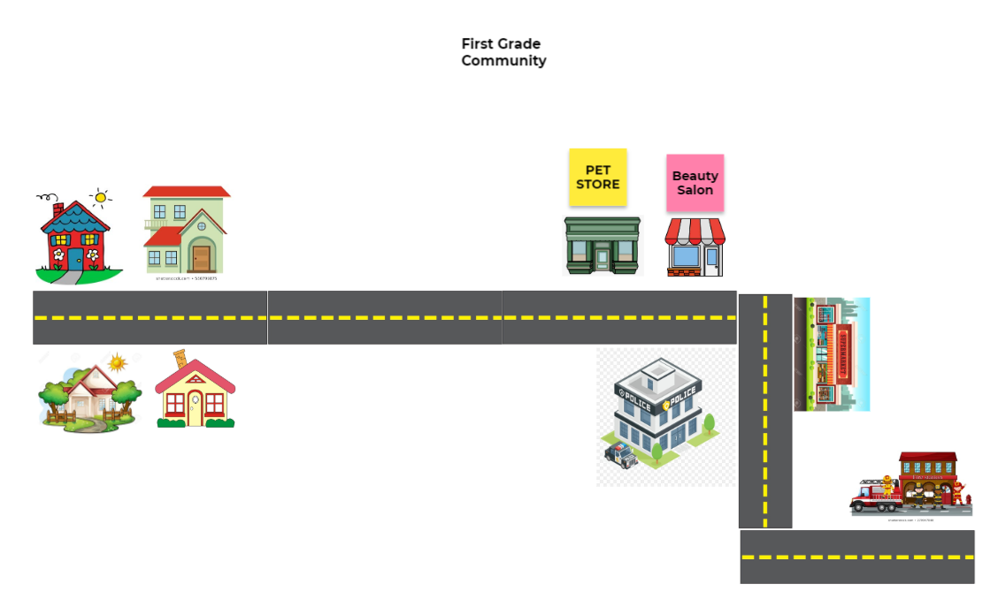
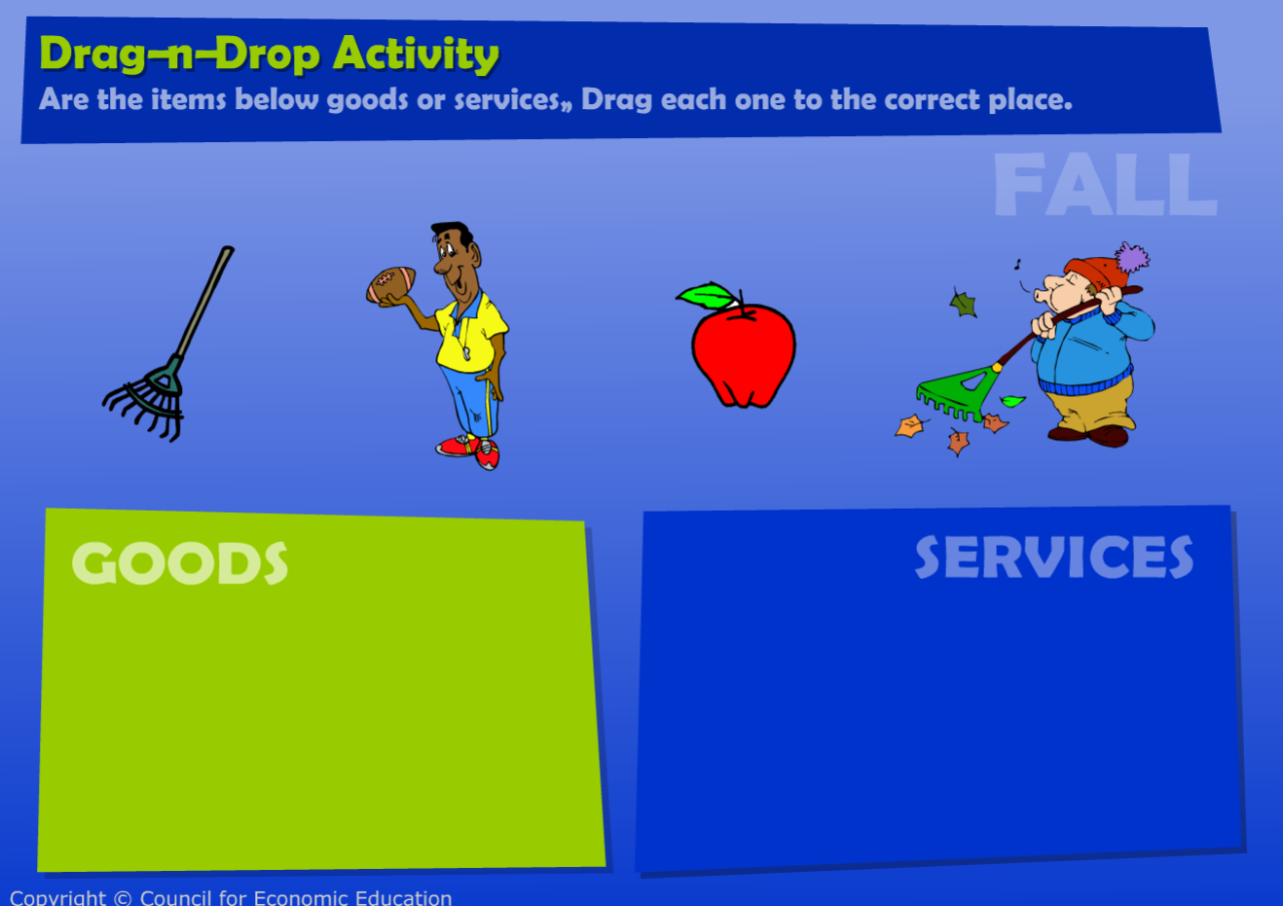
Communities: What They
Provide For US

Slide 10

PBS Kids: You, Me & Community
Together We’re the Key
Notes:
Lesson: https://www.econedlink.org/resources/communities-what-they-provide-for-us/

Slide 11
What does community mean to you?
What do you know about your community?

Slide 12
Who are some of the people in your community?
Police officers
Fire fighters
Teachers
Others?

Slide 13
What are some goods that businesses in your community provide?
What is a good?
Do you ever go shopping with your parents?
Can you think about any goods they may have bought?
Where did they buy them?
Can you name the businesses in your community that provide those goods?

Slide 14
What are some services that businesses in your community provide?
What is a service?
Have you ever had someone help you with your family car?
Can you name the businesses in your community that provide those services?

Slide 15
Can you think of places other than a business that provide services?
Do teachers provide a service?
Is a school a business?

Slide 16
Let’s watch a video about communities!
You, Me and Community Video

Slide 17
You, Me and Community
What were some businesses mentioned in the video?
Grocery store
Dry Cleaner
Music store
Bakery

Slide 18
You, Me, and Community
What were some goods provided in the video?
Groceries
Strudel. Do you know what a strudel is? What are some other things a baker could make?
Lemonade

Slide 19
You, Me, and Community
What were some services provided in the video?
Plumber fixing pipes
Construction worker making a building
Music lessons

Slide 20
The community in this video was a city.
Have you ever designed a community!?
Let’s look at some ways cities can be designed.

Slide 21

Community Building
Activity
Notes:
Jamboard: https://jamboard.google.com/d/15NQoHRyhASr8SEDfV24svQ05nX46EeFHoWd_YNqf_yc/copy

Slide 22

Cloudy with a Chance of Meatballs

Slide 23
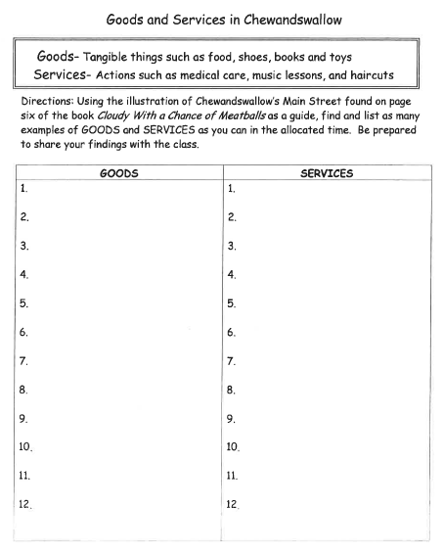
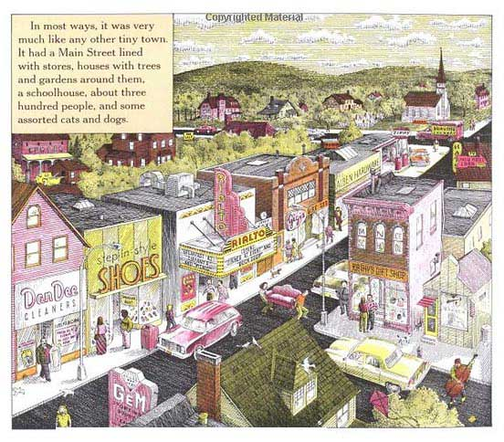
Cloudy with a Chance of Meatballs
Notes:
https://padlet.com/teresa_mungai/2ge0j07upuiuvpgf

Slide 24
Questions?

Slide 25
References
What Does Our Community Provide for Us?
  Lesson: Click Here
  Video: Click Here
  Jamboard Activity: Click Here
Cloudy with a Chance of Meatballs
  Padlet Activity: Click here

Slide 26

CEE Affiliates
https://www.councilforeconed.org/resources/local-affiliates/

Slide 27




Thank You to Our Sponsors!

