Slide 1
It’s All Elementary!
Part II:
Using Stories to Integrate Economics and Science
Presented by Teresa Mungai
Teresam@azecon.org
October 28, 2021

Slide 2
EconEdLink Membership
You can now access CEE’s professional development webinars directly on EconEdLink.org! To receive these new professional development benefits, become an EconEdLink member. As a member, you will now be able to:
Automatically receive a professional development certificate via e-mail within 24 hours after viewing any webinar for a minimum of 45 minutes
Register for upcoming webinars with a simple one-click process
Easily download presentations, lesson plan materials and activities for each webinar
Search and view all webinars at your convenience
Save webinars to your EconEdLink dashboard for easy access to the event
You may access our new Professional Development page here

Slide 3
Professional Development Certificate
To earn your professional development certificate for this webinar, you must:
Watch a minimum of 45-minutes and you will automatically receive a professional development certificate via e-mail within 24 hours.
Accessing resources:
You can now easily download presentations, lesson plan materials, and activities for each webinar from EconEdLink.org/professional-development/

Slide 4
Agenda
Review Economics and Personal Finance Standards
Interactive Lesson Activities
Questions

Slide 5
Objectives
Participants will review the Economics and Personal Finance standards for K-5th grade.
Participants will take part in interactive lesson activities that can be used in a K-5 classroom.

Slide 6
National Standards
Economics Standards
Standard 1: Scarcity
Standard 2: Decision Making
Standard 3: Allocation
Standard 4: Incentives
Standard 5: Trade
Standard 6: Specialization
Financial Literacy Standards
Standard 1: Earning Income
Standard 2: Spending
Standard 3: Saving
Standard 6: Managing Risk

Slide 7
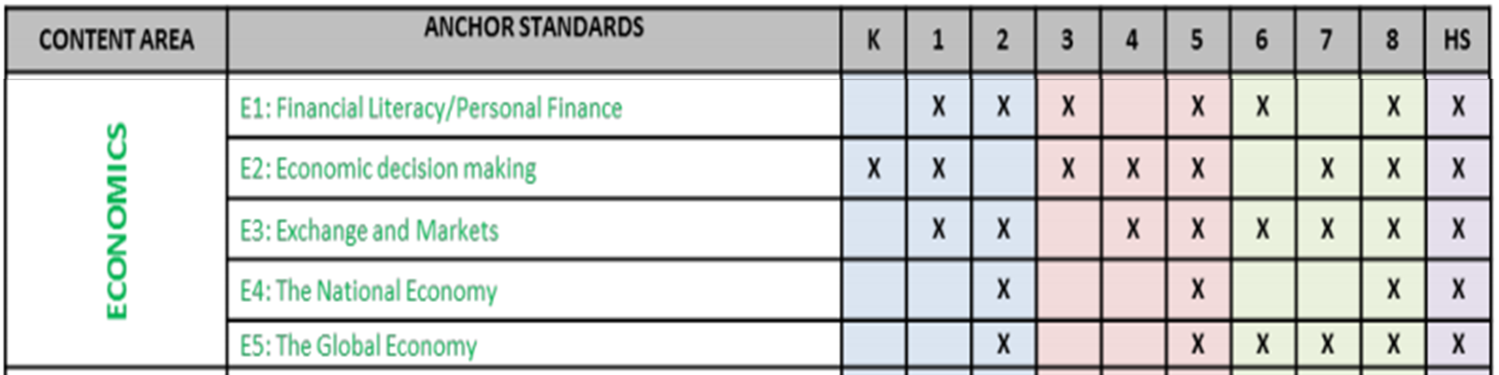
State Standards
Arizona History and Social Science Standards

Slide 8
Lesson Activities

Slide 9

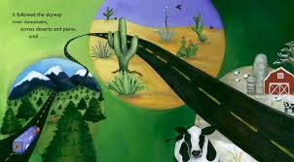

An Orange in January
Video
Lesson
Notes:
An Orange in January
Video: https://jsvjyi1hoqugkf6osbrtbfktwsb-my.sharepoint.com/:v:/g/personal/elenazee_azecon_org/Ec7oxxWyyepGmE1FOJI1MVUB04-VmX23b0INDh_wdfInKQ?e=BGNYu6
Lesson: https://www.stlouisfed.org/~/media/Education/Curriculum/pdf/Kiddynomics-Lesson-3-An-Orange-in-January.pdf

Slide 10
An Orange in January
Economics
Producers
Consumers
Trade
Opportunity Cost
Science
Weather
Seasons
Five Senses
Growth Cycles
Geography
Hemispheres

Slide 11


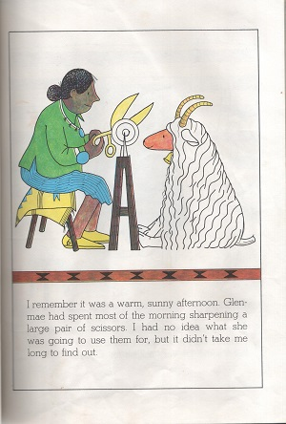
Goat in the Rug
Video Lesson
Activity
Notes:
Video: https://1drv.ms/v/s!AkHzvdsS7d5fgs9rwIkjaLFwJhN0Aw?e=ahZpI4
Lesson: https://www.stlouisfed.org/~/media/Education/Lessons/pdf/The-Goat-in-the-Rug.pdf
Padlet: https://padlet.com/teresa_mungai/o1abseg2pjk7sizv
Answers:
Natural Resources – Mohair, yucca plants, water
Human Resources – Glenmae
Capital Resources – Scissors, carding combs, buckets, spindle, large pots, loom
Intermediate Goods – Store-bought dyes yarn

Slide 12
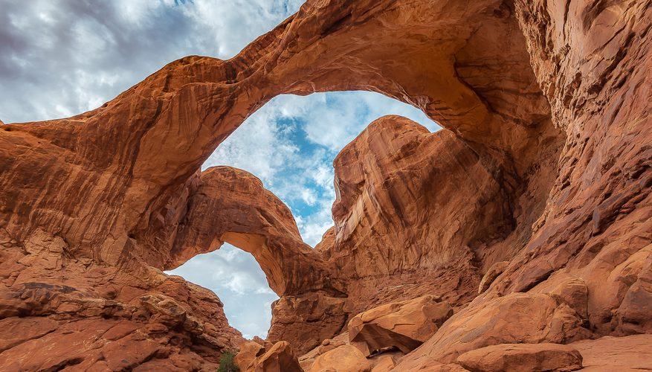
How did this happen?

Slide 13
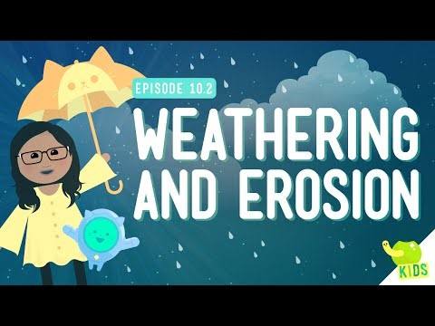

Weathering vs. Erosion
Notes:
https://www.youtube.com/watch?v=R-Iak3Wvh9c

Slide 14
Mountain Watershed Activity
Create a mountain out of your piece of paper. Tape down the edges to the table.
Activate prior knowledge: With your table partners, can you name any of the parts of the mountain you just created?

Slide 15
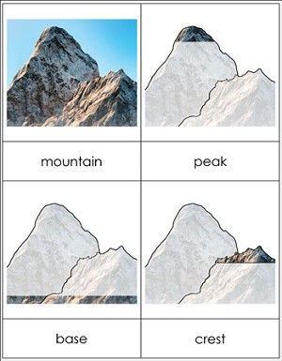
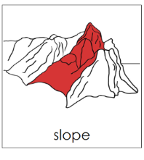
Mountain Watershed Activity
Notes:
Erosion= movement of particles due to water
Once model I made, students critically analyze their model. Where do you think a river would form from runoff. Trace on your landform the “path” of the rivers you predict. Where you have your predictions, place a large dot of ink in washable marker at the very top of the start of the “line” for the river and the peak and crest of the mountain.
WATERSHED An area of land in which precipitation collects and then flows and drains into one body of water. Also known as a drainage basin.
RUNOFF Precipitation that travels across the surface of the Earth in uncontrolled streams, rivers, drains, or sewers.
EROSION Process by which earth material is moved from one area to another by water or wind.
Sediment Materials such as rock fragments and grains that have been transported by wind, water, or glaciers.
PRECIPITATION Rain or snow.

Slide 16
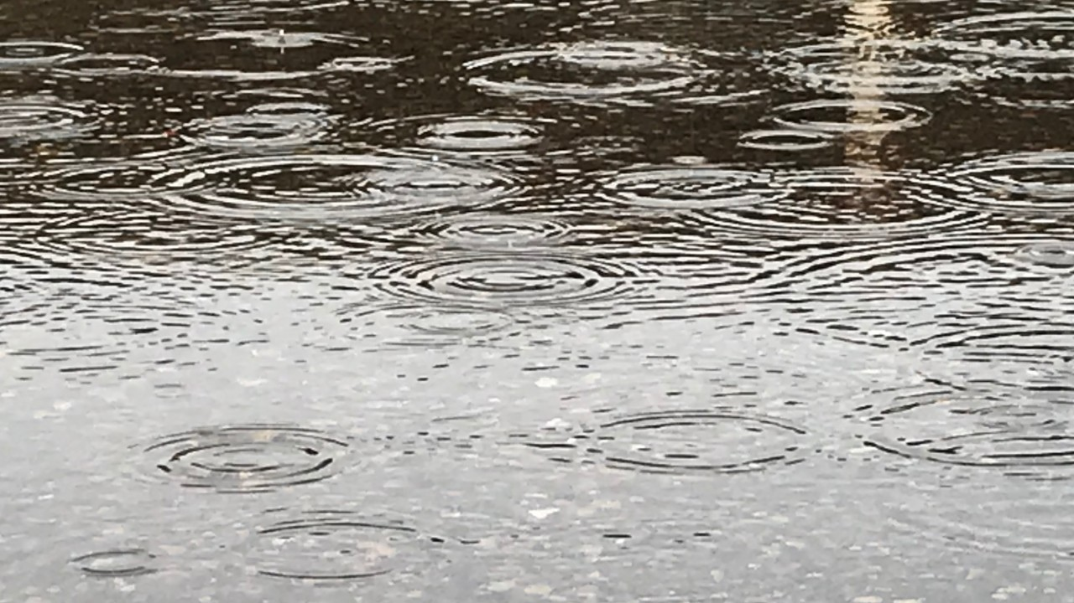
Mountain Watershed Activity
Prediction:
Use a permanent marker to draw arrows that show the direction water will flow down your mountain.
Use a washable marker (transfer ink, mark dark) on the crest and peaks of your mountain.
Make it rain!
Note your observations.

Slide 17

Mountain Watershed Activity
Notes:
Crosscutting concept prompt: Systems and system models
Have them think about the entire system.
https://www.youtube.com/watch?v=hCS0y_22XVQ

Slide 18
Mountain Watershed Activity
Let’s think about this entire system…
What would happen in this system if you increased the amount of precipitation?
Notes:
Crosscutting concept prompt: Systems and system models
Have them think about the entire system
WATERSHED An area of land in which precipitation collects and then flows and drains into one body of water. Also known as a drainage basin.
RUNOFF Precipitation that travels across the surface of the Earth in uncontrolled streams, rivers, drains, or sewers.
EROSION Process by which earth material is moved from one area to another by water or wind.
Sediment Materials such as rock fragments and grains that have been transported by wind, water, or glaciers.
PRECIPITATION Rain or snow.
.

Slide 19
Economics Extension
Where in your “mountain area” should you have farms, trails, housing etc…
Science Standards
4.E1U2.10
Define problems(s) and design solution(s) to minimize the effects of natural hazards.
Economics Standards
By applying economic reasoning, individuals seek to understand the decisions of people, groups, and societies.
4.E2.1 Examine concepts of scarcity, choice, opportunity cost, and risk.
    Key concepts include but are not limited to nomadic and sedentary societies, reasons for European exploration, triangular trade, Jamestown settlement, and the establishment of colonies
Notes:
When was vocabulary introduced?
Use vocabulary and contact AS you explain the lesson.

Slide 20
References
An Orange in January
  Video: Click Here
  Lesson: Click Here
Goat in the Rug
  Video: Click Here
  Lesson: Click Here
  Padlet Activity: https://padlet.com/teresa_mungai/o1abseg2pjk7sizv
  Weathering and Erosion video: Click Here
  Mountain Watershed Activity video: Click Here

Slide 21
Questions?
Notes:
www.myclassroomeconomy.org

Slide 22

CEE Affiliates
https://www.councilforeconed.org/resources/local-affiliates/

Slide 23




Thank You to Our Sponsors!

