Slide 1
Enhancing Economics with
Graphic Novels and Comics
Presented by
Joshua Frost, Brooklyn Technical High School
9/20/2021 jfrost@schools.nyc.gov

Slide 2
EconEdLink Membership
You can now access CEE’s professional development webinars directly on EconEdLink.org! To receive these new professional development benefits, become an EconEdLink member. As a member, you will now be able to:
Automatically receive a professional development certificate via e-mail within 24 hours after viewing any webinar for a minimum of 45 minutes
Register for upcoming webinars with a simple one-click process
Easily download presentations, lesson plan materials and activities for each webinar
Search and view all webinars at your convenience
Save webinars to your EconEdLink dashboard for easy access to the event
You may access our new Professional Development page here

Slide 3
Professional Development Certificate
To earn your professional development certificate for this webinar, you must:
Watch a minimum of 45-minutes and you will automatically receive a professional development certificate via e-mail within 24 hours.
Accessing resources:
You can now easily download presentations, lesson plan materials, and activities for each webinar from EconEdLink.org/professional-development/

Slide 4
Agenda
Introduction and overview of how comics and graphic novels enhance classroom instruction
Present Economix as an alternative or complimentary text
Enduring Understanding Graphic Novel Unit: Contains a unit overview, lessons, summative assessment project, and samples of student work
Fed Comics: An overview of the Comic Series published by the Federal Reserve
Comic Activity
Questions and Answers

Slide 5
Objectives
To create an alternative text for students to grasp complex concepts in an accessible fashion
To create classroom activities that foster discussion
To create assessments that draw on different mediums of expression
To present graphic novels and comics to further student understanding and simplify core discipline specific concepts

Slide 6
National Standards
https://www.councilforeconed.org/wp-content/uploads/2012/03/voluntary-national-content-standards-2010.pdf
Content Standard 16: Role of Government and Market Failure: There is an economic role for government in a market economy whenever the benefits of a government policy outweigh its costs. Governments often provide for national defense, address environmental concerns, define and protect property rights, and attempt to make markets more competitive. Most government policies also have direct or indirect effects on people’s incomes.
Content Standard 17: Government Failure: Costs of government policies sometimes exceed benefits. This may occur because of incentives facing voters, government officials, and government employees, because of actions by special interest groups that can impose costs on the general public, or because social goals other than economic efficiency are being pursued.

Slide 7
National Standards
Content Standard 9: Students will understand that: Competition among sellers usually lowers costs and prices, encourages producers to produce what consumers are willing and able to buy. Competition among buyers increases prices and allocates goods and services to those people who are willing and able to pay the most for them.
Content Standard 10: Institutions evolve and are created to help individuals and groups accomplish their goals. Banks, labor unions, markets, corporations, legal systems, and not-for-profit organizations are examples of important institutions. A different kind of institution, clearly defined and enforced property rights, is essential to a market economy.
Content Standard 15: Investment in factories, machinery, new technology, and in the health, education, and training of people stimulates economic growth and can raise future standards of living.

Slide 8
State Standards
NY State Standards http://www.nysed.gov/curriculum-instruction
The study of economics requires an understanding of major economic concepts and systems, the principles of economic decision making, and the interdependence of economies and economic systems throughout the world. Students:
analyze the effectiveness of varying ways societies, nations, and regions of the world attempt to satisfy their basic needs and wants by utilizing scarce resources
define and apply basic economic concepts such as scarcity, supply/demand, opportunity costs, production, resources, money and banking, economic growth, markets, costs, competition, and world economic systems
understand the nature of scarcity and how nations of the world make choices which involve economic and social costs and benefits
describe the ideals, principles, structure, practices, accomplishments, and problems related to the United States economic system
understand the roles in the economic system of consumers, producers, workers, investors, and voters.

Slide 9
Assessment Questions
1. What are Enduring Understandings?
2. How do we use Enduring Understandings as a discipline to ensure students learn material as part of their lifelong scholarship?
3. How do comics and graphic novels provide a visual storytelling narrative that is more interactive than other mediums of written expression?
4. How can we use comics to explain complex discipline specific concepts? (Fed Comics)
5. What role does storytelling have in creating understanding of challenging material?

Slide 10



Why Comics?

Slide 11
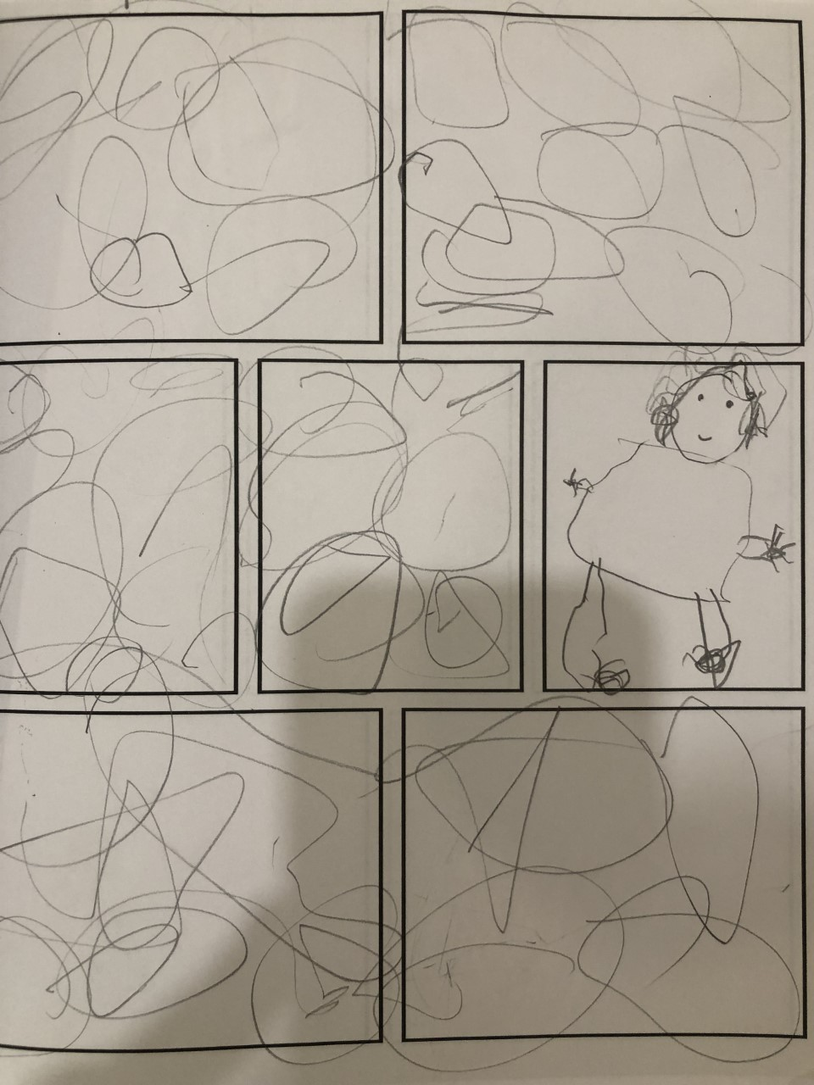

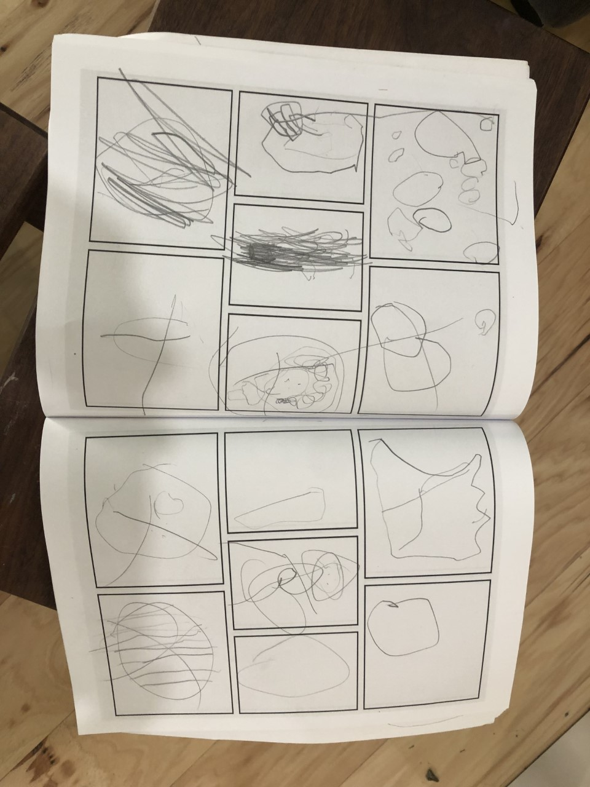
Why Comics?

Slide 12
Why Comics?
1. Gene Yang, author of American Born Chinese, speaks about how students learn from Comics.
https://www.youtube.com/watch?v=Oz4JqAJbxj0
4:45-6:00
2. Scott McCloud, author of Understanding Comics, explains how the reader visually interacts with comics and how the development of comics is rooted in narrative story telling from the past.
https://www.youtube.com/watch?v=fXYckRgsdjI
7:45-10:20

Slide 13
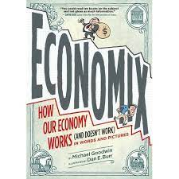
Economix
Alternative or Complimentary Text for Economics or AP Economics Courses

Slide 14
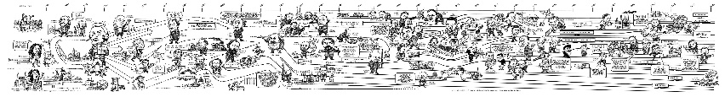
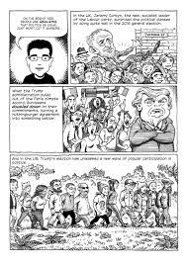
Economix Overview

Slide 15
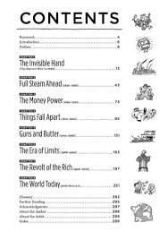
Table of Contents

Slide 16
Economix Unit
Economix Book Talk Discussions:
Preliminary weekly book talk assignment:
Economix Chapter 8 Assignment:
1. Read Chapter 8: The World Today: pages 251-291
2. Create five questions based on chapter 8 content.
3. Cite three images/quotes from their assigned text that they believe encapsulates the main theme from that chapter. (Example: Page 32: Left Panel)
4. What is the theme of this chapter? (In a sentence)
5. Write a paragraph about the theme of this chapter. (Provide evidence from the text)

Slide 17
Socratic Seminar
Purpose:
Socratic Seminars promote thinking, meaning-making, and the ability to debate, use evidence and build on one another’s thinking. When well designed and implemented, the seminar provides an active role for every student, engages students in complex thinking about rich content and teaches students discussion skills.
Materials:
• Provocative question for discussion, chosen beforehand
• Associated text(s)

Slide 18
Socratic Seminar
Procedure:
1. Select a significant piece of text or collection of short texts related to the current focus of study. This may be an excerpt from a book or an article from a magazine, journal, or newspaper. It might also be a poem, short story, or personal memoir. The text needs to be rich with possibilities for diverse points of view.
2. Develop an open-ended, provocative question as the starting point for the seminar discussion. The question should be worded to elicit differing perspectives and complex thinking. Students may also generate questions to discuss.
3. Students prepare for the seminar by reading the chosen piece of text in an active manner that helps them build background knowledge for participation in the discussion. The completion of the pre-seminar task is the student’s “ticket” to participate in the seminar. The pre-seminar task could easily incorporate work on reading strategies. For example, students might be asked to read the article in advance and to text-code by underlining important information, putting question marks by segments they wonder about and exclamation points next to parts that surprise them.
4. Once the seminar begins, all students should be involved and should make sure others in the group are drawn into the discussion

Slide 19
5. Begin the discussion with the open-ended question designed to provoke inquiry and diverse perspectives. The teacher may pose follow-up questions.
6. The discussion proceeds until you call time. At that time, the group debriefs their process; if using a Fishbowl (see Fishbowl entry and variations that follow), the outer circle members give their feedback sheets to the inner group students.
7. Protocol norms: Students… Respect other students. (Exhibit open-mindedness and value others’ contributions.) • Are active listeners. (Build on one another’s ideas by referring to them.) • Stay focused on the topic. • Make specific references to the text. (Use examples from the text to explain their points.)

Slide 20
Example #1 of student work from Chapter 8 Assignment
Discussion Questions
Based on the information that the author provided about 9/11 and the United States subsequent involvement in Iraq, to what extent is it fair to say that the United States has contributed greatly to the crisis in the Middle East?
The author discusses how social media mobilized people around the “Occupy Wall Street” Movement. Do you think that this year’s many social justice movements were helped or harmed by social media?
Were Obama’s economic plans successful?
The author says that the economic and social state of 2011 is somewhat of a “blast from the past.” What historical era do you think 2020 can be compared to, economically or socially?

Slide 21
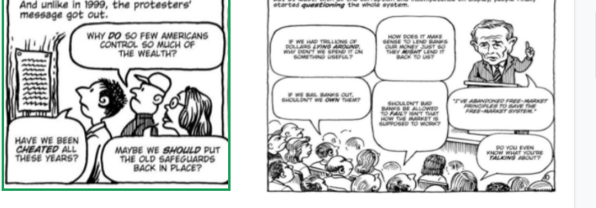
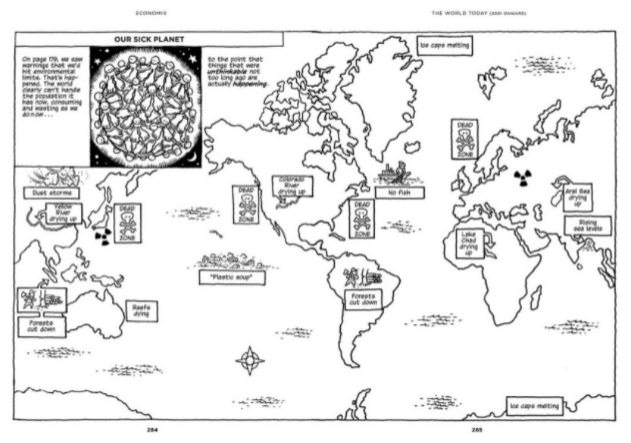
Example #1 of Student Work from Chapter 8 Assignment

Slide 22
Example #1 of student work from Chapter 8 Assignment
Chapter 8 Theme
One theme present in this chapter is American people and leaders finding solutions to complex as nuanced social and economic problems.

Slide 23
Example #1 of Student Work from Chapter 8 Assignment
Throughout this chapter, the author explores both global and American economic and social conflicts of 2001 to the present day and presents ways that people and leaders from various countries have made attempts to solve these problems. For example, on page 252, he explains how President George W. Bush increased the United States presence in Iraq and maximized the military budget in response to the tragic events of September 11th. Later, on pages 260 and 268, he discusses the economic crash of 2008 and the steps that newly elected President Barack Obama took to bring jobs back and improve the economy. In addition, he mentions the protesting and political organizing carried out by workers and ordinary people in response to what they viewed as exploitation from corporations. Finally, towards the end of the book, he discusses the many problems our current world faces, such as climate change, and offers solutions focusing on democracy, critical thinking, and much more. As shown by these examples, the author uses this chapter to stress the many economic problems and solutions that we have and will encounter.

Slide 24
Enduring Understandings Project
Enduring Understandings:
1. Are statements summarizing important ideas and core processes that are central to a discipline and have lasting value beyond the classroom.
2. Articulate what people should “revisit” over the course of their lifetimes in relationship to the content area.
3. Frame the big ideas that give meaning and lasting importance to content
4. provide a conceptual foundation for studying the content area and • are deliberately framed as declarative sentences
Sample Enduring Understandings:
1. There is a relationship between the consumption and conservation of natural resources.
2. Scientific and technological developments affect people’s lives, the environment and transform societies.
3. Governments balance the rights of individuals with the common good.
4. Topography, climate, and natural resources of a region influence the culture, economy, and lifestyles of its inhabitants.
5. Topography, climate, and natural resources of a region influence the culture, economy, and lifestyles of its inhabitants.

Slide 25
Enduring Understandings Project
Students will create an original five panel graphic representation that tells the story of your student generated enduring understanding.
Project Components:
1. Each group will be assigned one of eight chapters from Economix.
2. Historical Events List:
Each group will make a list of what they consider the five most important events that occurred in their assigned chapter. Each event listed should be cited from the text. (Example: Adam Smith published The Wealth of Nations. Page 7: upper left panel) the list will be typed and submitted on an 8.5 by 11 sheet of paper that will also include their thematic list.
Group Grade 10%. Each student will individually submit this work.

Slide 26
Enduring Understandings Project
3. Thematic List:
Each group will create a list of what they consider the five most significant themes of their group’s assigned chapter. Each theme should be cited from the text. (The Post World War 2 nation existed in a perpetual war time economy. Page 44: upper right panel) the list will be typed and submitted on an 8.5 by 11 sheet of paper that also will include their historical events list.
Group Grade 10%. Each student will individually submit this work.
4. Each group should create an original Enduring Understanding statement that captures the lasting importance of the content of their assigned chapter. The statement will be drafted and revised before it becomes the basis of their poster. (This statement will be typed and submitted with both the thematic and historical events lists.)
Group Grade 10%. Each student will individually submit this work.

Slide 27
Enduring Understandings Project
5. Each student will create a poster that contains their Enduring Understanding and a five panel graphic representation of original artwork that tells the story of their Enduring Understanding. All posters should have artwork that is not directly taken from the text.
Individual grade 70%. Each student will individually submit this work.

Slide 28


Slide 29


Slide 30
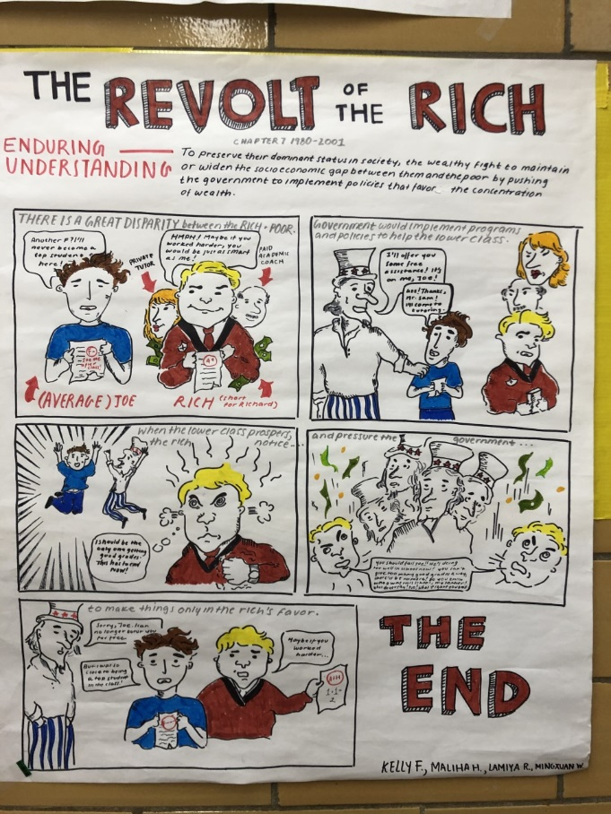
Student Work, Example 1: Enduring Understanding Project

Slide 31
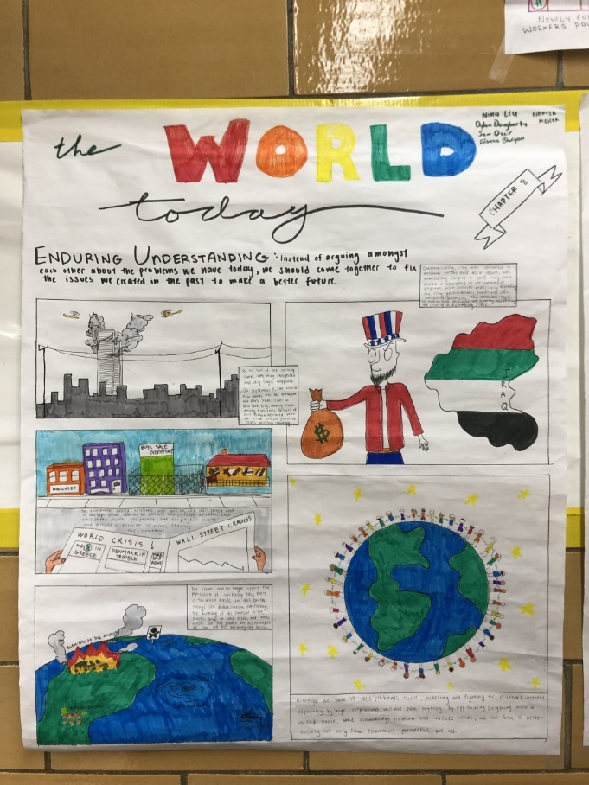
Student Work, Example 2: Enduring Understanding Project

Slide 32
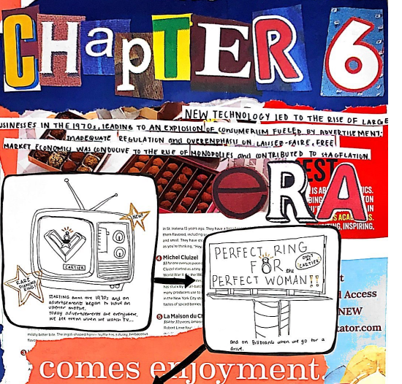
Student Work, Example 3: Enduring Understanding Project

Slide 33
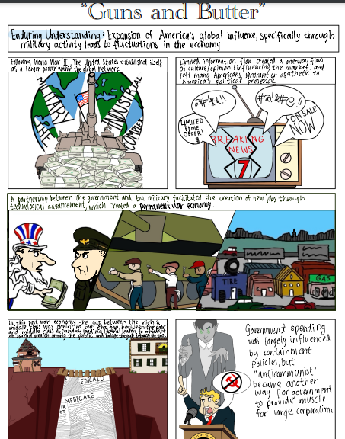
Student Work, Example 4: Enduring Understanding Project

Slide 34
Student Work: Example 4 : Enduring Understanding Project: Process
Enduring Understanding: Expansion of America’s global influence, specifically through military activity, leads to fluctuations in the economy.
Historical Events:
The Marshall Plan (1947) sends billions of dollars to Western Europe. (page 133: third panel)
Postwar media expands, mostly due to the popularization of television (page 154: second panel)
The Cold War begins (page 136: second to last panel)
Lyndon B. Johnson elected in 1964 (page 156: top panel)
The Red Scare (page 159: last row)
Thematic List:
The United States establishes itself as a larger power within the global network. (page 133: third panel)
Limited information flow in postwar media created a one-way flow of culture and opinion (influencing the market), rendering disagreements useless and fostering political apathy. (page 154: third and fourth panels)
A partnership between the government and the military facilitated the creation of new jobs through technological advancement, therefore creating a permanent war economy. (page 151: fifth panel)
In the post war economy, while the gap between the rich and middle class was shrinking, the gap between the poor and middle class expanded, leading liberal leaders to attempt to spread wealth among the public. (page 147: fourth panel and page 156: top panel)
Government spending was largely influenced by containment policies. (page 159: bottom panel)

Slide 35
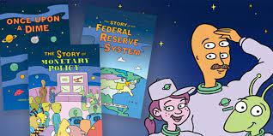
New York Fed's Educational Comic Book Series
https://www.youtube.com/watch?v=d0mD8P_A1Lo

Slide 36
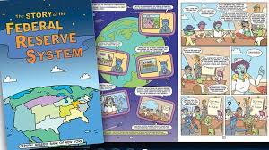
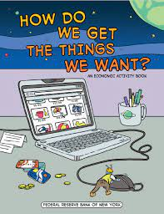

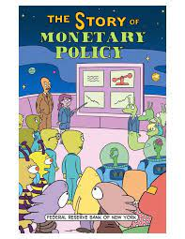
Federal Reserve Educational Comics
https://www.newyorkfed.org/outreach-and-education/comic-books

Slide 37

Let’s Make a Comic
https://www.youtube.com/watch?v=ufOXBuGhVWg

Slide 38
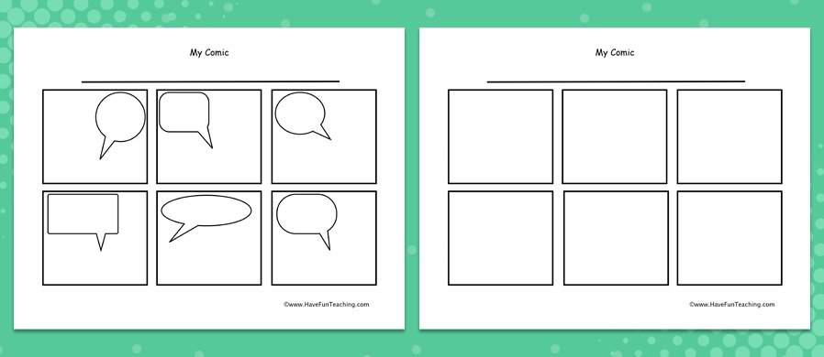
Let’s Make a Comic

Slide 39



New York City Comics

Slide 40
References
1. Federal Reserve Education Comics
https://www.newyorkfed.org/outreach-and-education/comic-books
2. Michael Goodwin, Economix
https://economixcomix.com/
3. Scott McCloud, Understanding Comics
http://scottmccloud.com/
4. Gene Yang, American Born Chinese
https://geneyang.com/

Slide 41
References
5. John Lewis March
https://www.penguinrandomhouse.com/series/1MA/march
6. Expeditionary Learning: Socratic Seminar
file:///C:/Users/jfros/Downloads/socratic_seminar_protocol_el_012612%20(4).pdf
7. Enduring Understandings
https://www.mresc-learning.org/wp-content/uploads/2016/05/Essential-Question-and-Enduring-Understanding-Tutorial.pdf

Slide 42

CEE Affiliates
https://www.councilforeconed.org/resources/local-affiliates/

Slide 43




Thank You to Our Sponsors!

Slide 44
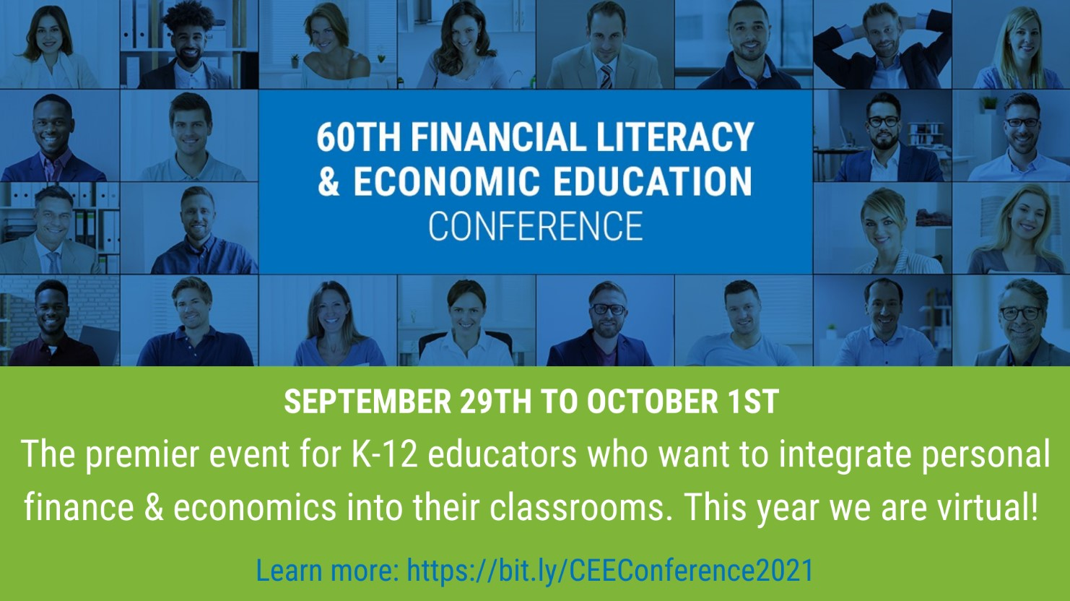
https://bit.ly/CEEConference2021

