Slide 1
Money Movers:
Engaging Economics for K-3
Using Manipulatives and Puzzles to Teach Primary Economic Concepts
John Kruggel
Associate Director for Program
JMU Center for Economic Education
9/14/21 kruggejb@jmu.edu

Slide 2
EconEdLink Membership
You can now access CEE’s professional development webinars directly on EconEdLink.org! To receive these new professional development benefits, become an EconEdLink member. As a member, you will now be able to:
Automatically receive a professional development certificate via e-mail within 24 hours after viewing any webinar for a minimum of 45 minutes
Register for upcoming webinars with a simple one-click process
Easily download presentations, lesson plan materials and activities for each webinar
Search and view all webinars at your convenience
Save webinars to your EconEdLink dashboard for easy access to the event
You may access our new Professional Development page here

Slide 3
Professional Development Certificate
To earn your professional development certificate for this webinar, you must:
Watch a minimum of 45-minutes and you will automatically receive a professional development certificate via e-mail within 24 hours.
Accessing resources:
You can now easily download presentations, lesson plan materials, and activities for each webinar from EconEdLink.org/professional-development/

Slide 4

CEE Affiliates
https://www.councilforeconed.org/resources/local-affiliates/

Slide 5
Agenda
15 mins: Decision-making
10 mins: Producing goods/services
15 mins: Complements and substitutes
10 mins: Productive resources
5 mins: Putting it all together
5 mins: Q&A

Slide 6
What is Economics About?
What is the one word answer you will typically get if you ask that question?
(Think about it for a few, we’re going to use a collaboration board on Nearpod to answer.)

Slide 7
How Do We Teach Children About Choices?
Economics is all about making choices.
We need to make choices because we have limited resources and unlimited wants.
Teaching students about being intentional decision makers has been shown to have significant impacts on their financial futures.

Slide 8
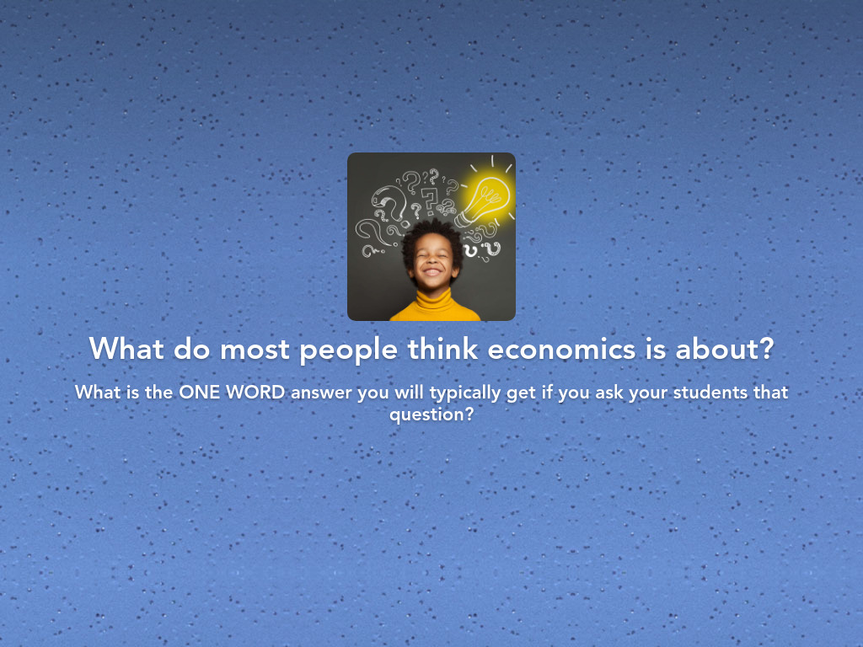
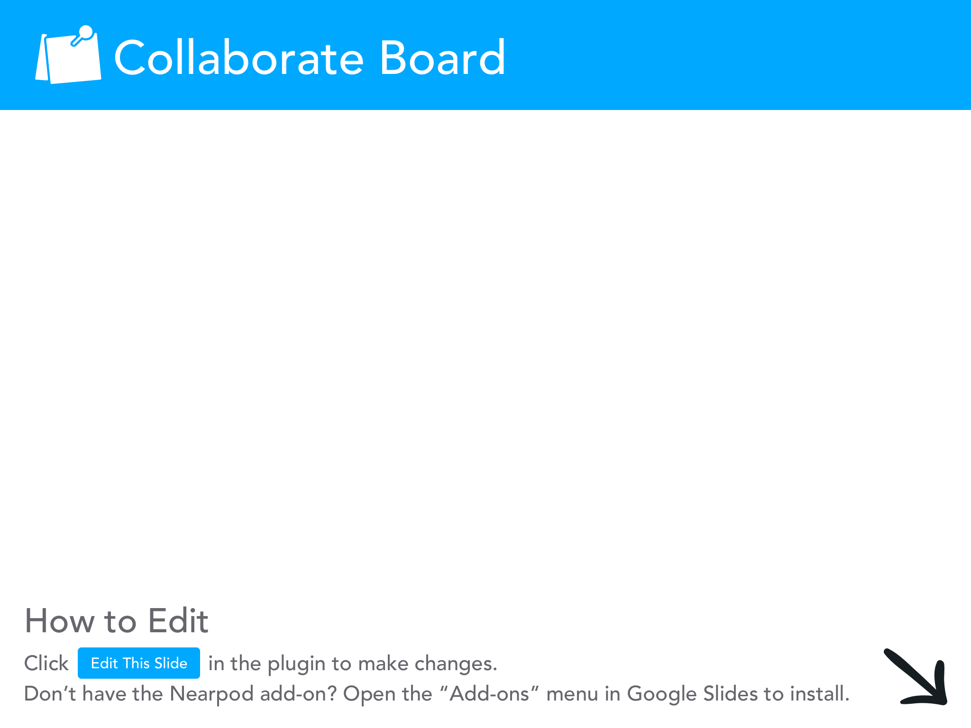

Slide 9
How Do We Teach Children About Choices?
So, HOW can we teach them to be intentional decision makers?
The PACED Model helps walk students through the process necessary for them to become intentional decision-makers.

Slide 10

PACED Model
The PACED Model helps walk students through the process necessary for them to become intentional decision-makers.
Identify a Problem
Brainstorm Alternatives to the problem
Use Criteria to judge the alternatives
Evaluate the solution
Decide

Slide 11
PACED Model Grid
Econedlink has a version of the PACED Model grid/table you can print and use with your classes.
Let’s take a look at it!

Slide 12
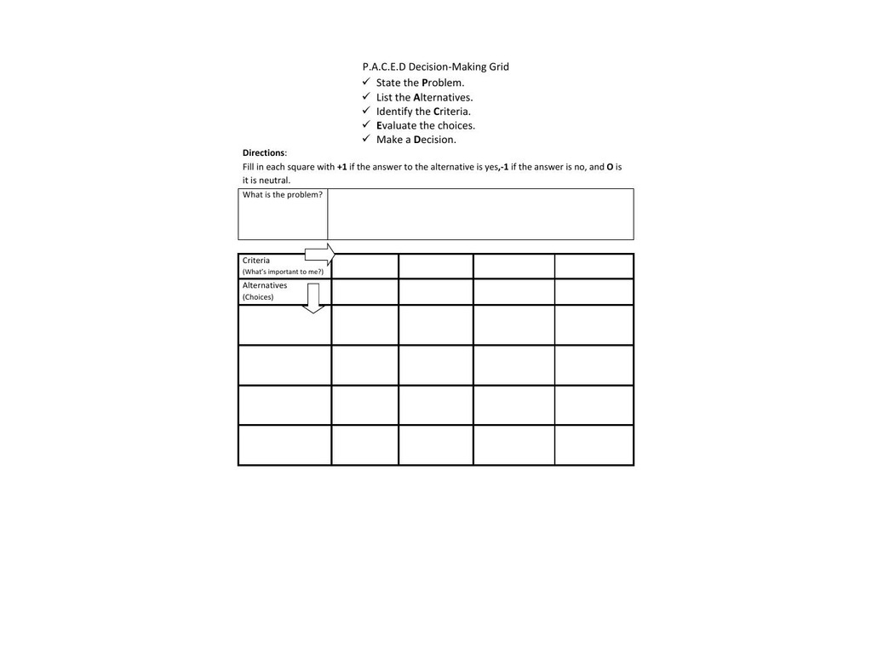
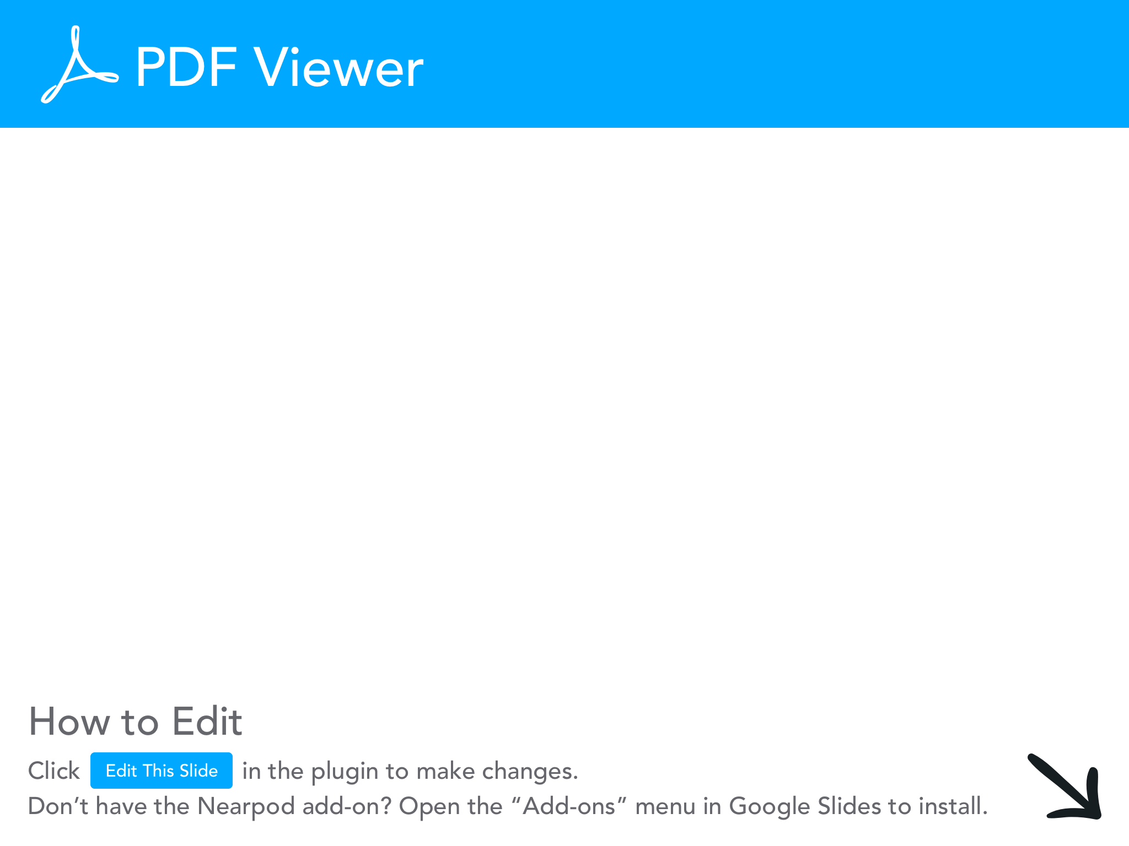

Slide 13
Example From Today
You had a problem, how should you spend your evening?
What were your alternatives?

Slide 14
Example From Today
You had a problem, how should you spend your evening?
What were your alternatives?
Grade work, eat dinner, attend this webinar.

Slide 15
Example From Today
You had a problem, how should you spend your evening?
What were your alternatives?
Grade work, eat dinner, attend this webinar.
Now you need to use criteria to evaluate your alternatives.

Slide 16
Example From Today
You had a problem, how should you spend your evening?
What were your alternatives?
Grade work, eat dinner, attend this webinar.
Now you need to use criteria to evaluate your alternatives.
Maybe you are all caught up on grading
You can eat after the webinar (or even during it).

Slide 17
Example From Today
You had a problem, how should you spend your evening?
What were your alternatives?
Grade work, eat dinner, attend this webinar.
Now you need to use criteria to evaluate your alternatives.
Maybe you are all caught up on grading
You can eat after the webinar (or even during it).
Then you had to decide.

Slide 18
Adaptation to PACED chart
Here’s a simpler version of the PACED chart to help students understand the decision-making process.
With this chart, they start by choosing two of the options given to them.
They cut out their options and place them at the top of the page.
Then they write down the good and the bad for each option.
After the have written the good and bad, they circle the winner.

Slide 19
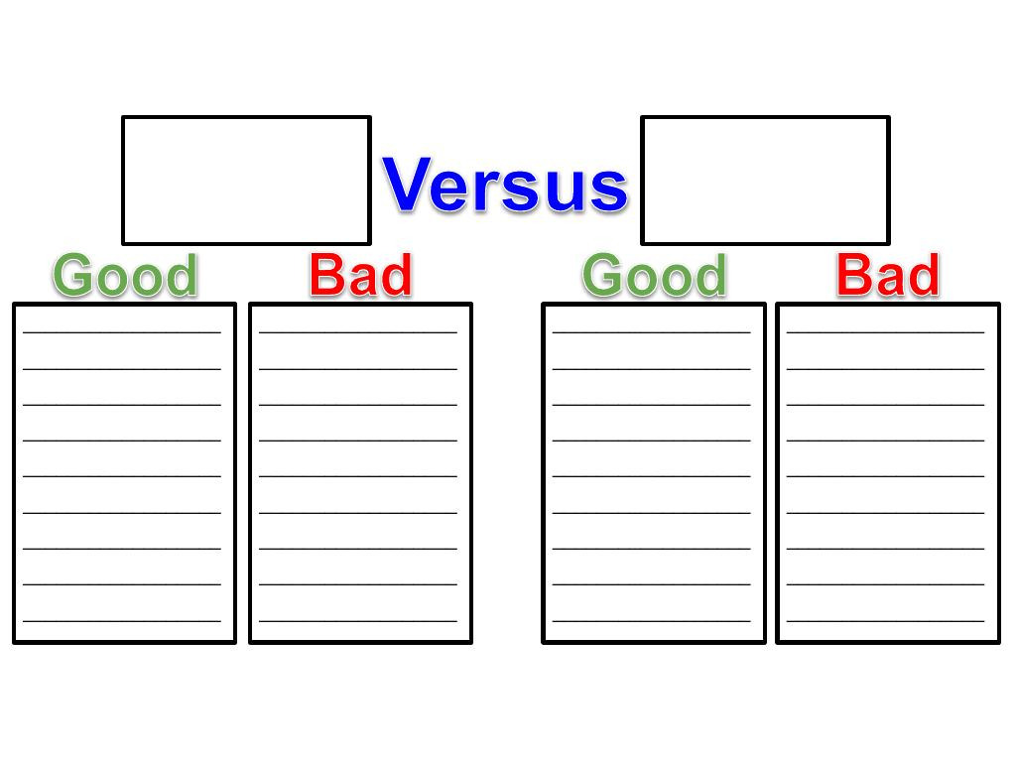

Slide 20
Goods & Services/ Producers & Consumers
A good is something we can touch that can be bought or sold.
A service is something we pay people to do for us.
We use productive resources to create goods and provide services.
A producer is someone who combines resources to make goods and provide services.
A consumer is someone who uses or buys goods and services.

Slide 21
Production Activity
Playful Economics is a curriculum that uses modeling clay to teach economic concepts.
Lesson 8 in this curriculum focuses on specialization and division of labor.
Students are divided into 2 groups of workers.
One group forms an assembly line to make burgers out of clay.
In the other, workers produce each burger out of clay individually.

Slide 22
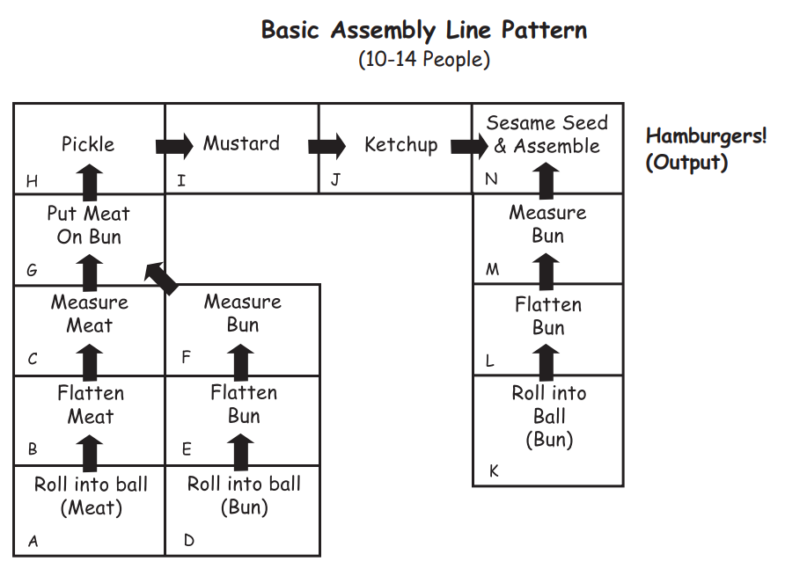

Slide 23

Process
Give each team 5 minutes to make as many hamburgers as possible.
See which side can produce more given the time constraints.

Slide 24

Wrap-Up
Discuss why producers many prefer to use assembly lines to make goods. (cheaper costs, higher output)
Ask how consumers might benefit from assembly lines as well (more goods to consume, cheaper costs typically means lower prices).

Slide 25

Extensions
My wife teaches 2nd grade. She does a similar activity to illustrate producers and consumers as well as satisfying part of her famous Americans standard (Ford).
She has her students break into 2 teams and make ice cream sundaes instead of clay burgers.
If you want something more active, get a bag of tennis balls and 2 empty buckets.

Slide 26
Extensions
Have 10 students line up in the front of the classroom. Place the tennis balls in one of the buckets, place the other bucket at the other end of the line of students. Give them 1 minute to get the balls from one bucket to the other by passing them along the line.
LEAVE the buckets where they are. Have 2 students come up and try to move all of the tennis balls in 1 minute.

Slide 27
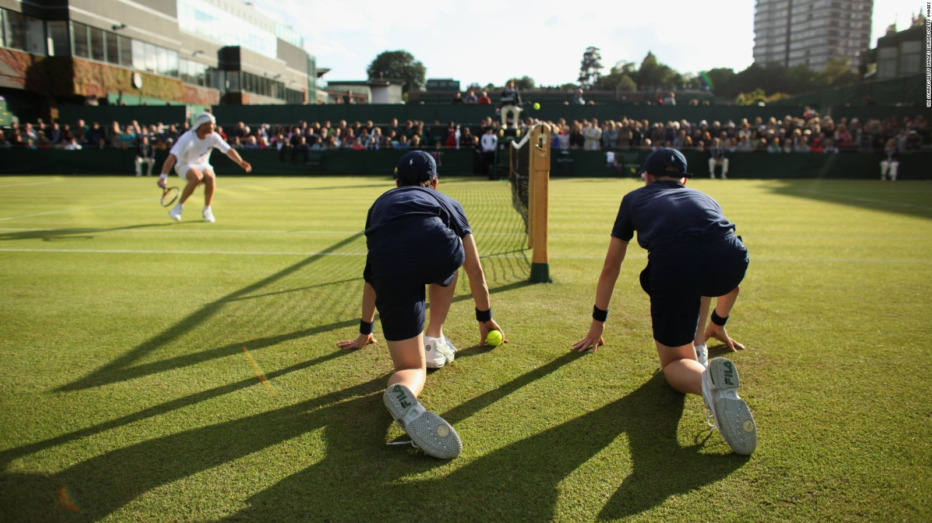

Slide 28
Complements & Substitutes
Complements are goods that are used together.
Hot dogs and hot dog buns are a good example, or hot dogs and mustard.
Substitutes are goods that can replace each other.
Coke and Pepsi are a good example, or butter and margarine.

Slide 29

Complements & Substitutes
Complements and substitutes do rely on consumer tastes and preferences in some cases.
Hot dogs and ketchup might be complementary goods for some, but will get you kicked out of some restaurants in Chicago

Slide 30
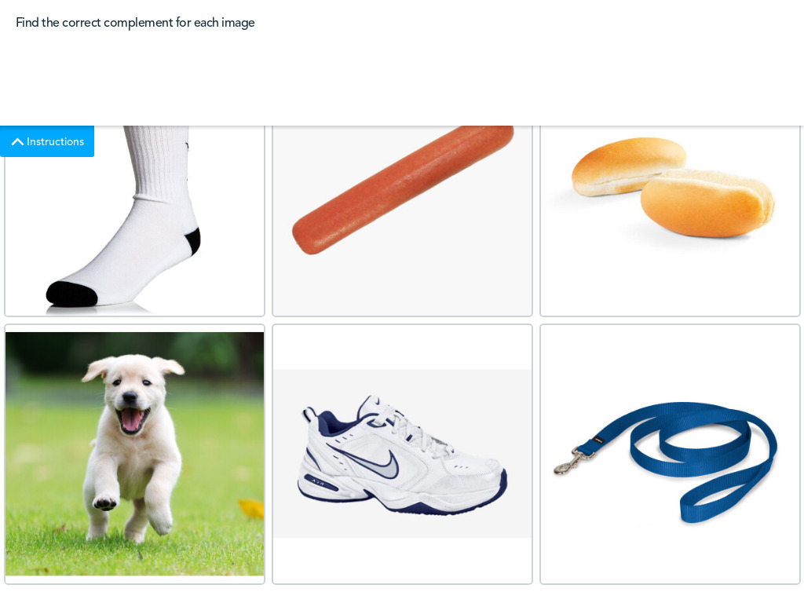
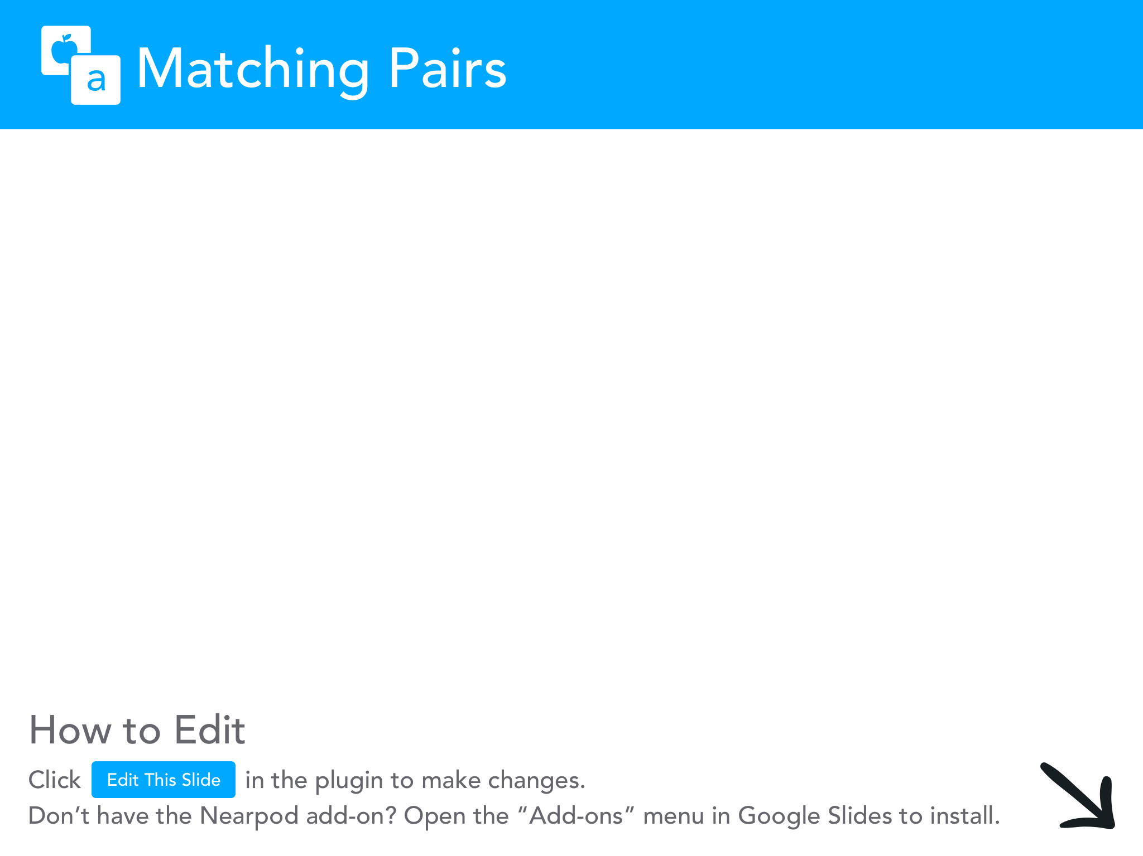

Slide 31
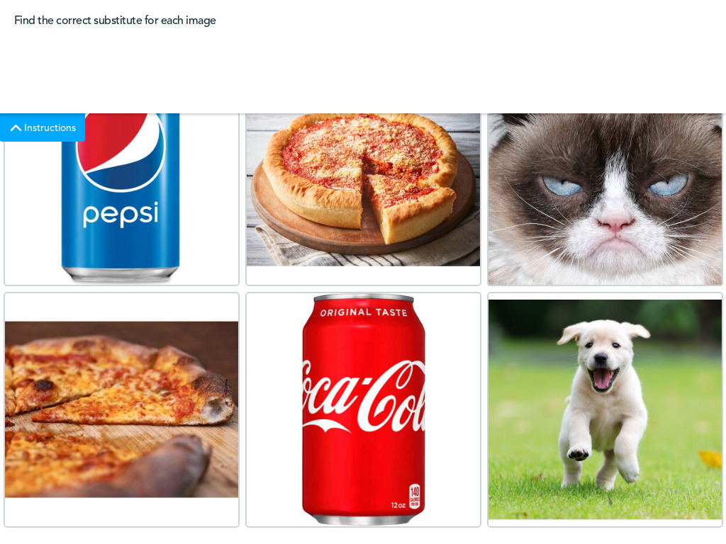

Slide 32
Check for Understanding Activity
Give students a set of cards.
Have them identify which card is the substitute and which is the complement.
Remember, tastes and preferences matter so students may not have the same answers.

Slide 33
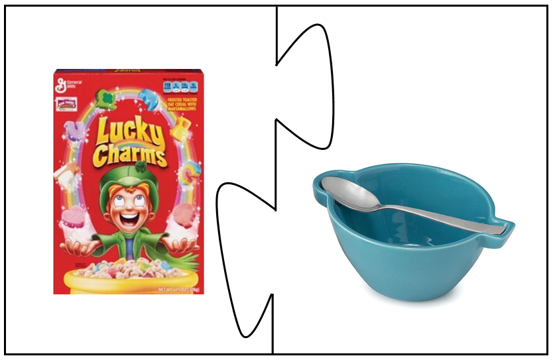
Example

Slide 34
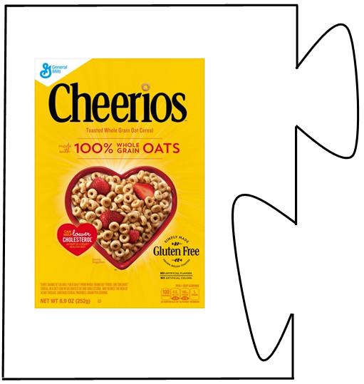
Example

Slide 35
Example

Slide 36
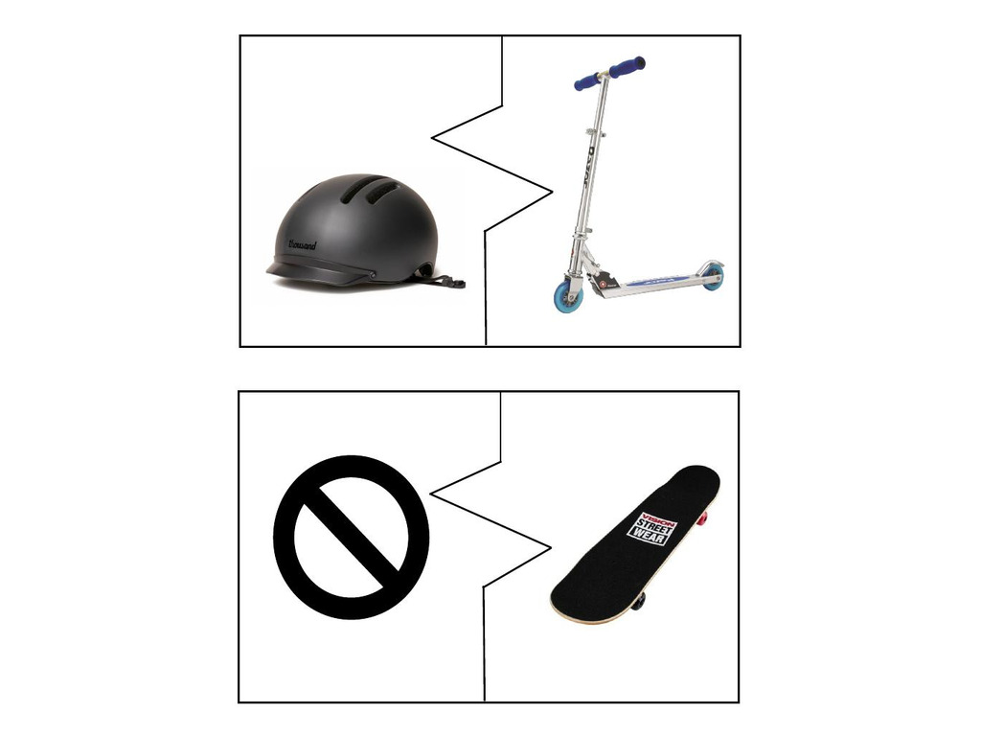

Slide 37
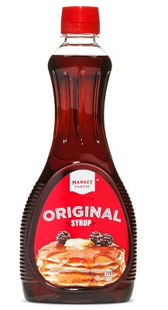

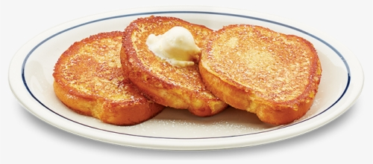
Extension
Have students share which substitute they preferred as a way to address tastes and preferences.
Example:
with
or

Slide 38
Types of Productive Resources
Natural Resources: Sometimes called “gifts of nature.” Natural resources are things found in nature we use to make goods and provide services.
--Examples: Lumber, coal, soil, cotton, etc.

Slide 39
Types of Productive Resources
Natural Resources: Sometimes called “gifts of nature.” Natural resources are things found in nature we use to make goods and provide services.
--Examples: Lumber, coal, soil, cotton, etc.
Human Resources: Sometimes called labor. Human resources are the people who work in jobs to produce goods and services.
--Examples: Lumberjacks, miners, farmers, etc.

Slide 40
Types of Productive Resources
Natural Resources: Sometimes called “gifts of nature.” Natural resources are things found in nature we use to make goods and provide services.
--Examples: Lumber, coal, soil, cotton, etc.
Human Resources: Sometimes called labor. Human resources are the people who work in jobs to produce goods and services.
--Examples: Lumberjacks, miners, farmers, etc.
Capital Resources: Goods that are produced and used to make other goods and services.
--Examples: Axes, shovels, tractors, etc.

Slide 41
Productive Resources CFU
An easy way to assess understanding of the productive resources is to give students a copy of cards with images representing the different productive resources and the sets of the names of each productive resource. (next slide)
Have students attempt to get as many matches as possible.

Slide 42
Productive Resources CFU
Students can work with small groups if you prefer. Have them match as many as they can. If they don’t get a match, they need to let the person to their left (or assign numbers if left/right is too tricky) attempt to make a match.
Run through the game a few times to reinforce the concept.

Slide 43
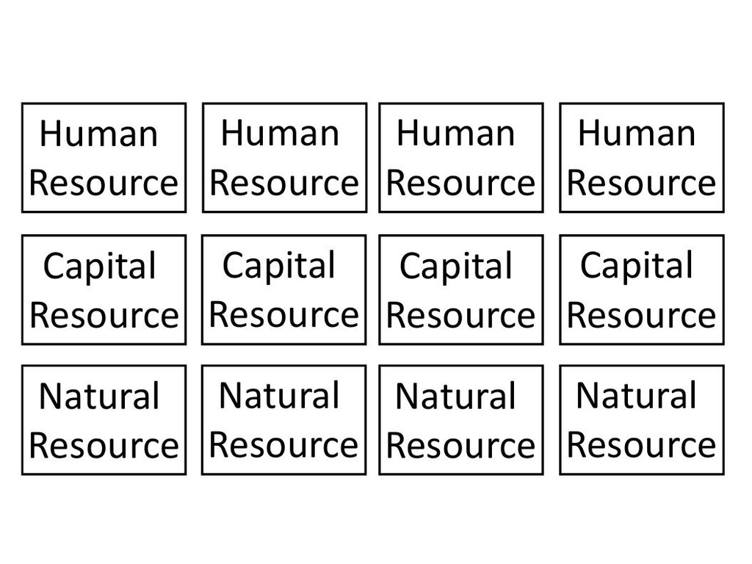

Slide 44
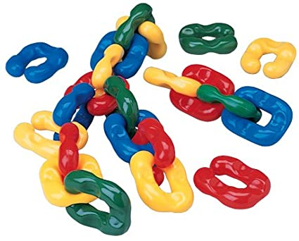
Putting It All Together
I call this activity the Econ Chain (it’s still in a beta version).
It is meant to illustrate how the economy is connected by showing the steps food takes to get from the farm to your house.
The activity is a simple puzzle that students put together.
I developed this with a local teacher who has a large ELL population.

Slide 45

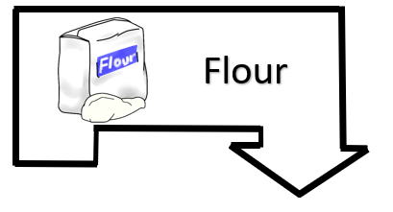
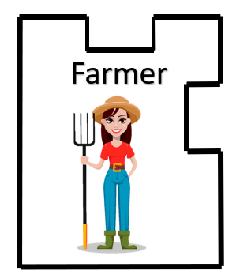



Econ Chain (first half)

Slide 46




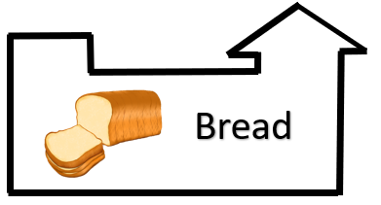
Econ Chain (last half)

Slide 47
Econ Chain (the Whole Thing)
Each piece fits together like this when printed off.

Slide 48
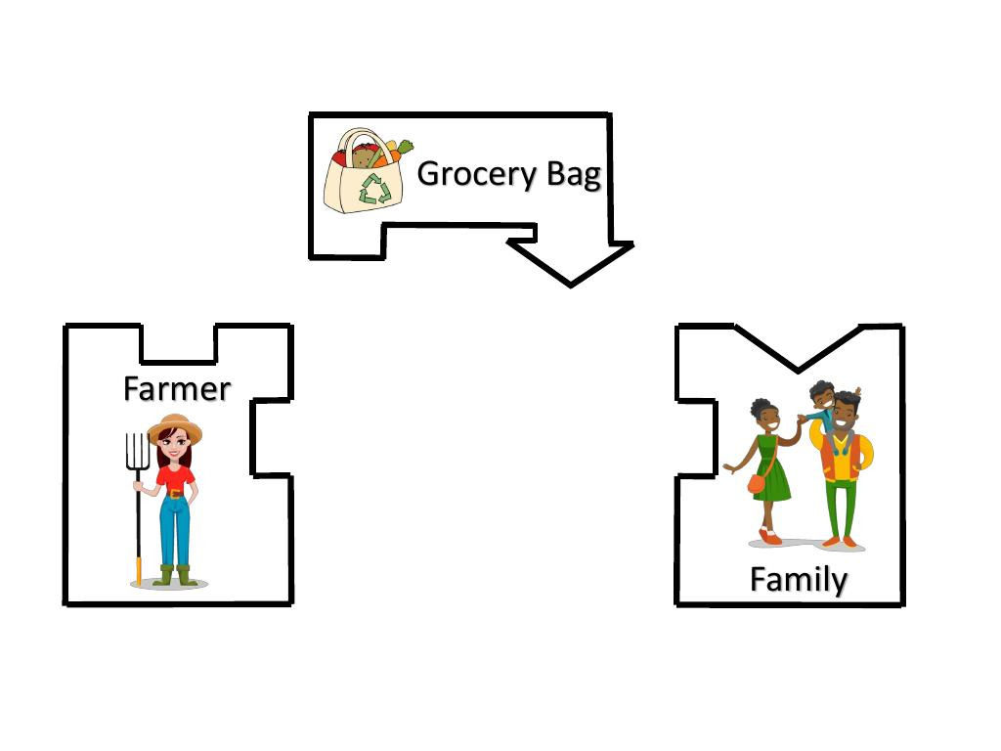

Slide 49
Assessment
After they have completed the puzzle, have students answer the following questions:
Which type of resource are the farmer and baker?
Which type of resource are the truck and mill?
Name one example of a natural resource in the econ puzzle.
Name two producers in the econ chain.
Name one consumer in the econ chain.
Are there any complements in the econ chain?
Are there any substitutes in the econ chain?

Slide 50
Additional Extensions
Please be sure to join us next week when we demonstrate how to adapt some of these lessons to get students moving around the class.
We will also cover additional activities you can use to cover your econ standards by getting kids up and moving.

Slide 51


Slide 52




Thank You to Our Sponsors!

Slide 53
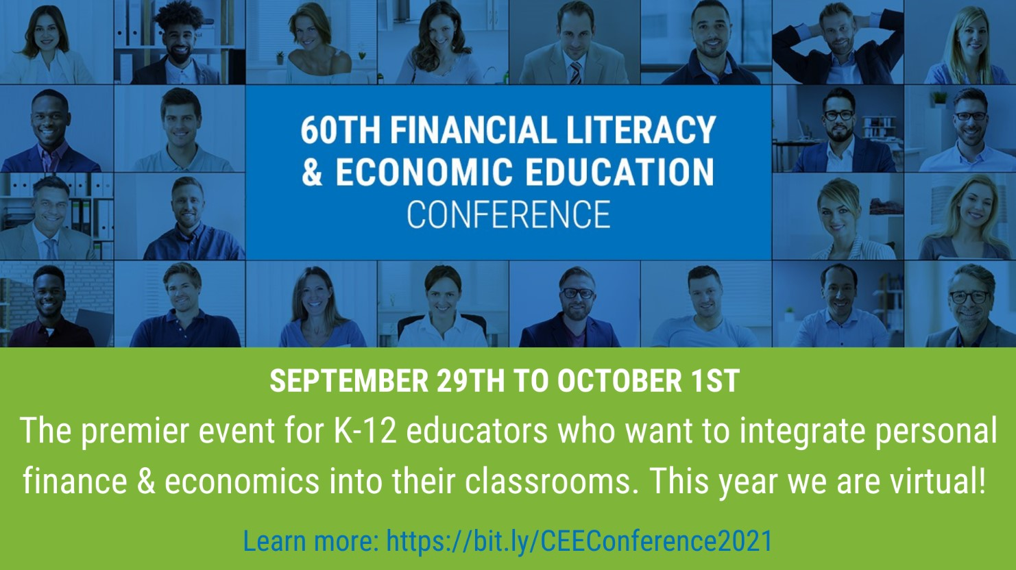
https://bit.ly/CEEConference2021

