Slide 1
The Massachusetts Council Presents:
Teaching Fiscal Policy and Equity in the COVID Era
Presented by
Dr. Margaret Brooks, MA Council Executive Director and Guest Speaker Demetriouse Russell
June 7, 2021 mbrooks@councilforeconed.org

Slide 2
EconEdLink Membership
You can now access CEE’s professional development webinars directly on EconEdLink.org! To receive these new professional development benefits, become an EconEdLink member. As a member, you will now be able to:
Automatically receive a professional development certificate via e-mail within 24 hours after viewing any webinar for a minimum of 45 minutes
Register for upcoming webinars with a simple one-click process
Easily download presentations, lesson plan materials and activities for each webinar
Search and view all webinars at your convenience
Save webinars to your EconEdLink dashboard for easy access to the event
You may access our new Professional Development page here

Slide 3
Professional Development Certificate
To earn your professional development certificate for this webinar, you must:
Watch a minimum of 45-minutes and you will automatically receive a professional development certificate via e-mail within 24 hours.
Accessing resources:
You can now easily download presentations, lesson plan materials, and activities for each webinar from EconEdLink.org/professional-development/

Slide 4
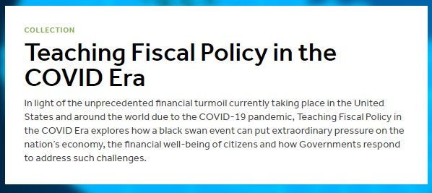

Many thanks to the Peter G. Peterson Foundation for supporting the development of EconEdLink Fiscal Policy curriculum materials!
Notes:
Teaching Fiscal Policy in the COVID Era Archives - EconEdLink

Slide 5

https://econedlink.org

Slide 6
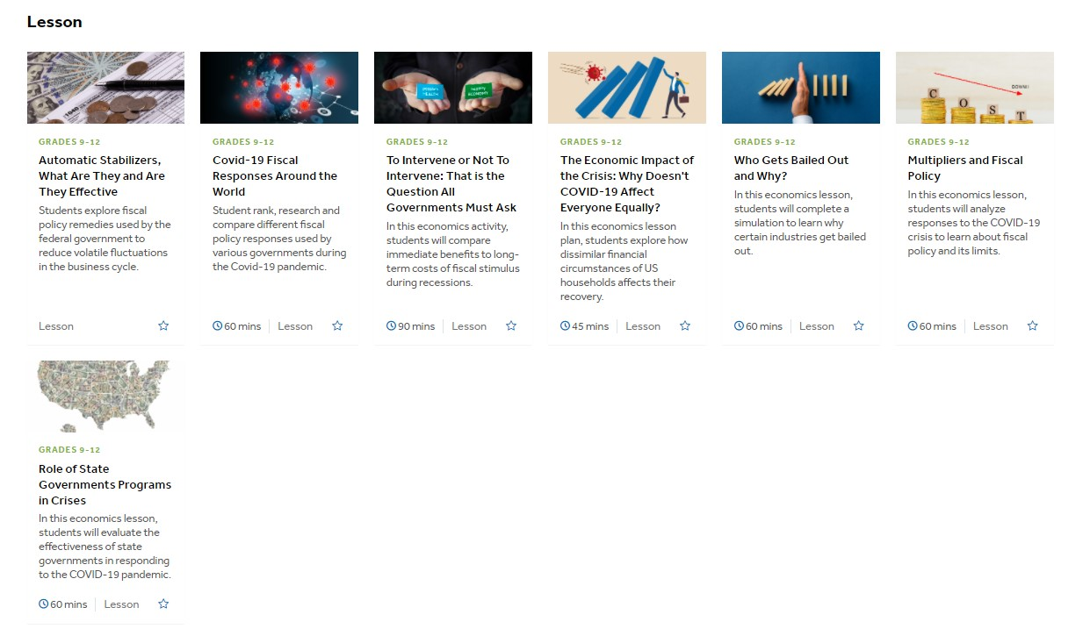
Today’s Webinar
https://www.econedlink.org/resources/collection/teaching-fiscal-policy-in-the-covid-era/
Notes:
Teaching Fiscal Policy in the COVID Era Archives - EconEdLink

Slide 7
Agenda
EconEdLink Free Classroom Curriculum Resource EconEdLink - Multipliers and Fiscal Policy
Definition of Fiscal Policy and Rationale for Implementation
Importance of Advancing Racial Equity
Effective Fiscal Policy Can Expand Opportunities for Blacks and Latinx to Build a Stronger Economy for All
https://www.econedlink.org/resources/multipliers-and-fiscal-policy/

Slide 8
Objectives
Teachers will be able to:
Define what is meant by fiscal stimulus and what short- and long-term impacts are for an economy recovering from the COVID-19 recession.
Explain how and why certain policies are developed, and their consequences.
See how fiscal policies that prioritize greater racial equity will lead to improved national economic outcomes for all.

Slide 9
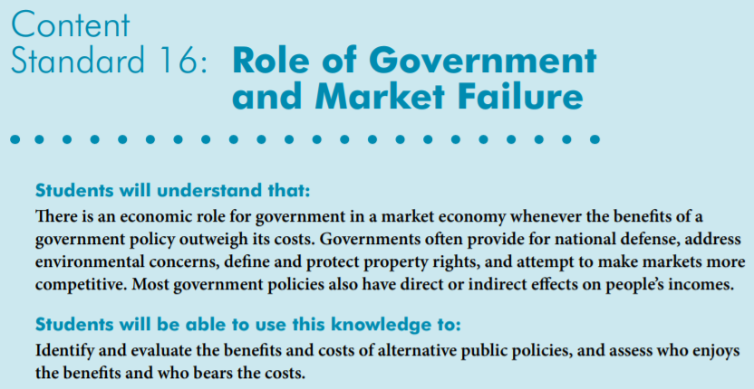
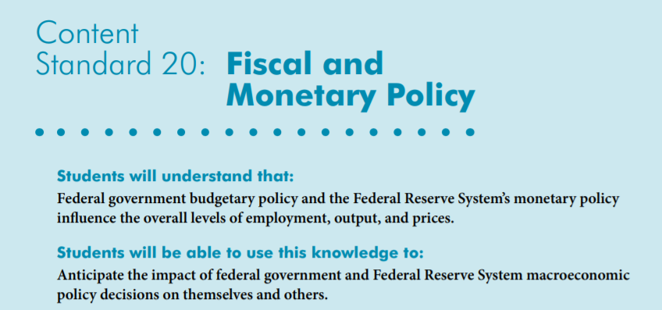
National Standards
National Standards https://www.councilforeconed.org/wp-content/uploads/2012/03/voluntary-national-content-standards-2010.pdf
Notes:
National Standards https://www.councilforeconed.org/wp-content/uploads/2012/03/voluntary-national-content-standards-2010.pdf

Slide 10
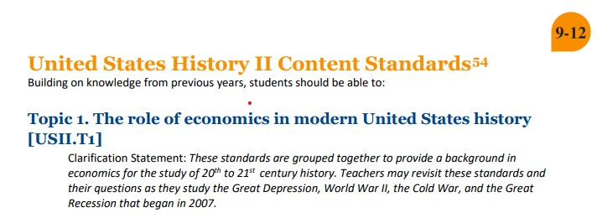
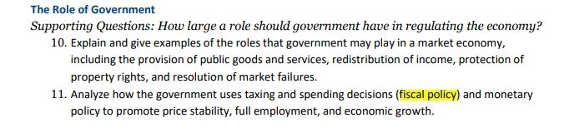

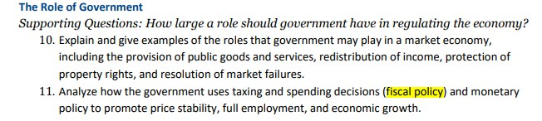
MA State Standards
Source History and Social Science Framework (mass.edu)
Notes:
MA History and Social Science Framework History and Social Science Framework (mass.edu)

Slide 11
EconEdLink - Multipliers and Fiscal Policy
Evaluate fiscal policy responses to the COVID-19 pandemic
Apply fiscal policy multipliers

Slide 12
Question:
What to do with $100?
If someone gave you $100, how much of it would you spend?
  Think about what you would spend it on
  Write your answer in the chat box [number between 0 and 100]
How does your answer compare to your classmates?
Notes:
Bell-ringer/warm-up activity to get students thinking about MPC

Slide 13
MPC and MPS
Marginal Propensity to Consume (MPC): proportion of additional income that is spent on goods and services
  If MPC = .7 then consumers would spend 70% of additional income, and save the rest
Marginal Propensity to Save (MPS): proportion of additional income that is saved
All additional income is either spent or saved, so MPC + MPS = 1

Slide 14
MPC Factors
MPC will be higher for those with
  Lower income
  Lower taxation level
  More consumer confidence
Notes:
Lower income: People with lower incomes spend a large percent of their income on necessities; saving can be considered a luxury.
Lower taxation level: High income and consumption taxes discourage spending. Therefore, tax holidays would encourage spending.
More consumer confidence: If consumers are optimistic, they feel comfortable spending. If they are uncertain or worried, they tend to save more.

Slide 15
MPC and Fiscal Policy
When the government spends money and/or cuts taxes to help us recover from a crisis, there will be a multiplying effect which is influenced by the size of the MPC.
Notes:
Essential question/thesis of the lesson

Slide 16
Fiscal Policy Review
Who: President and Congress
What: Government Spending and/or Taxes
Why: Dampen business cycle
  Macroeconomic goals are sustainable growth, stable prices and full employment
How: Changing government spending and/or taxes shifts aggregate demand
  Expansionary: increase G and/or decrease taxes → AD increase → economic growth and inflation
  Contractionary: decrease G and/or increase taxes → AD decrease → economic decline and disinflation
Notes:
Use expansionary fiscal policy to close a recessionary gap. Use contractionary fiscal policy to close an inflationary gap.

Slide 17
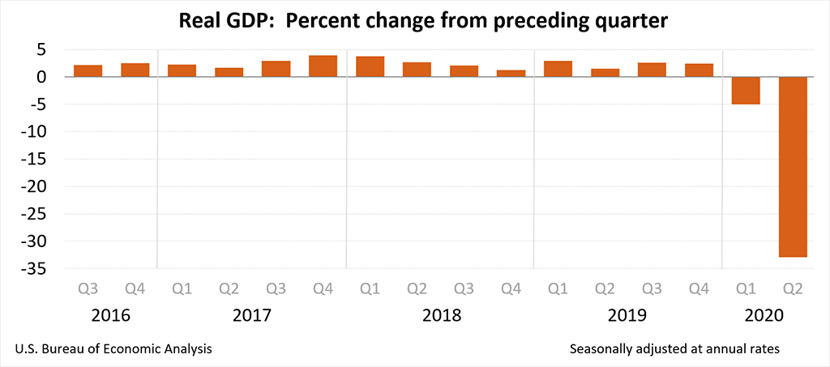
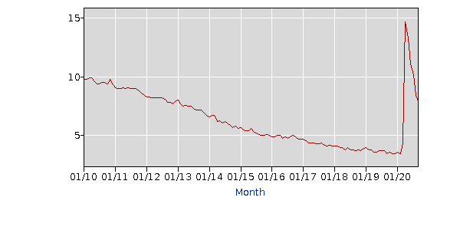
COVID-19 Economy
Economic Growth, according to BEA.gov
Unemployment, according to BLS.gov
Notes:
RGDP data: https://www.bea.gov/news/2020/gross-domestic-product-2nd-quarter-2020-advance-estimate-and-annual-update#:~:text=Real%20gross%20domestic%20product%20(GDP,real%20GDP%20decreased%205.0%20percent.
Unemployment data: https://data.bls.gov/timeseries/LNS14000000?amp%253bdata_tool=XGtable&output_view=data&include_graphs=true

Slide 18
2020 - Time for Fiscal Policy?
Economic decline and rising unemployment while inflation never got above 1%… a good time for Expansionary Fiscal Policy?
Notes:
CPI data: https://data.bls.gov/timeseries/CUSR0000SA0&output_view=pct_1mth

Slide 19
COVID-19 Fiscal Policy
Coronavirus Preparedness and Response Supplemental Appropriation - 3/6/2020
  $8.3 billion
  Treatment and vaccine research
  Testing
Families First Coronavirus Response Act - 3/18/2020
  $192 billion
  Delay tax filing deadline
  Paid leave if: sick, caring for someone sick, child care closed, etc.
Notes:
Summary of Coronavirus Preparedness and Response Supplemental Appropriation : https://www.congress.gov/bill/116th-congress/house-bill/6074
Summary of Families First Coronavirus Response Act: https://www.congress.gov/bill/116th-congress/house-bill/6201

Slide 20
COVID-19 Fiscal Policy [2]
Coronavirus Aid, Relief, and Economic Security (CARES) Act – 3/27/2020, amended 4/24/2020
  $2.5 trillion (10% GDP)
  Small business loans/grants
  Large business loans
  Stimulus checks
  Expanded unemployment
Notes:
Here’s an activity relating to the impact of fiscal policies https://econedlink.org/wp-content/uploads/2021/01/In-class-Activity-.pdf
Summary of CARES Act: https://www.congress.gov/bill/116th-congress/house-bill/748
This is a great brief article from NPR for further investigation into the CARES Act: https://www.npr.org/2020/03/26/821457551/whats-inside-the-senate-s-2-trillion-coronavirus-aid-package
Students are likely most familiar with the $300 billion spent on stimulus checks to individuals: Most individuals earning less than $75,000/year got a $1200 stimulus check. Checks tapered down for those earning between $75,000 and $99,000 per year. Children got $500 checks. Most college students did not receive a check.

Slide 21
2021- Still Time for Fiscal Policy?
March 2021 US Treasury FACT SHEET
“The current public health crisis and resulting economic crisis have devastated the health and economic well- being of millions of Americans. From big cities to small towns, Americans – particularly people of color, immigrants, and low-wage workers – are facing a deep economic crisis. More than 9.5 million workers have lost their jobs in the wake of the pandemic, with 4 million out of work for half a year or longer.”
Source: https://home.treasury.gov/system/files/136/Fact-Sheet-03-18-21.pdf
Notes:
Source: https://home.treasury.gov/system/files/136/Fact-Sheet-03-18-21.pdf

Slide 22
COVID-19 Fiscal Policy [3]
H.R.1319 - American Rescue Plan Act of 2021 provides $1,400 Economic Impact Payments for people who are eligible, $2,800 for married couples, and $1,400 for each dependent. It also increased the amount of the Child Tax Credit from $2,000 to $3,600 for children under age 6, and $3,000 for other children under age 18.
The American Rescue Plan provides $350 billion in emergency funding for state, local, territorial, and Tribal governments. These funds provide assistance to households, small businesses and nonprofits; aid to impacted industries; and support for essential workers. The funds also support investment in infrastructure, including water, sewer, and broadband services.
US Treasury source: https://home.treasury.gov/news/featured-stories/fact-sheet-the-american-rescue-plan-will-deliver-immediate-economic-relief-to-families
Notes:
US Treasury source: https://home.treasury.gov/news/featured-stories/fact-sheet-the-american-rescue-plan-will-deliver-immediate-economic-relief-to-families
Additional support Capital Projects Fund ($10 billion); Homeowner Assistance Fund $10 billion; Emergency Rental Assistance $21.6 billion; Small Business Credit Initiative $10 billion; ;

Slide 23
Limits of Fiscal Policy
Effective fiscal policy is
    Timed
    Targeted
    Temporary
Notes:
Showing the video is optional given the summaries in the following 3 slides

Slide 24
Timed
Recognition lag
  Takes time to calculate macro stats and quantify the size of the gap
Administrative lag
  Difficult for president and congress to agree, especially if different political parties
Implementation lag
  Economy does not begin to grow until people receive and spend
Notes:
Government spending is heavily debated: how much to spend, what to spend money on, who should allocate the funds (individuals, businesses, or government) etc

Slide 25
Temporary
Too much expansionary fiscal policy contributes to national debt https://www.usdebtclock.org/
Assistance should help with recovery while maintaining market incentives
Notes:
Maintaining market incentives: for example, the $600 supplemental unemployment checks caused some people to earn more on unemployment than they were earning while working. It is important for this to be temporary.

Slide 26
Targeted
Target benefits toward
  Those that are hurt most by the crisis
  Those in most financial distress
  Individuals with the largest MPC in order to have the largest impact on the economy
Notes:
Those with the largest MPC: This transitions to the next slide on multipliers.

Slide 27
Multipliers
Increasing G and/or cutting taxes increases aggregate demand in the economy. The multiplier causes further increases in aggregate demand. These cause the economy to expand
Getting money in the hands of people who will spend it (higher MPC) will result in a bigger “bang for your buck” (larger multiplier)

Slide 28
Question
How can expansionary fiscal policy stimulus generate improved outcomes for Black and Latinx communities, and for the economy as a whole?

Slide 29

Demetriouse Russell
CEO, Venn Diagram Partners

Slide 30

Context: Economic Reality
63% of Americans have been living paycheck to paycheck since COVID hit.
Around 47% of Americans have the same emergency savings as before the crisis.
Stunningly, 21% of Americans say they have no emergency savings, the lowest in the 10-year history of the Bankrate poll.

Slide 31
Context: Economic Reality

Slide 32
Context: Economic Reality
The historically low poverty rates for Blacks and Hispanics in 2019 reflect gains for race and Hispanic origin groups that have traditionally been disadvantaged compared to other groups over time.

Slide 33
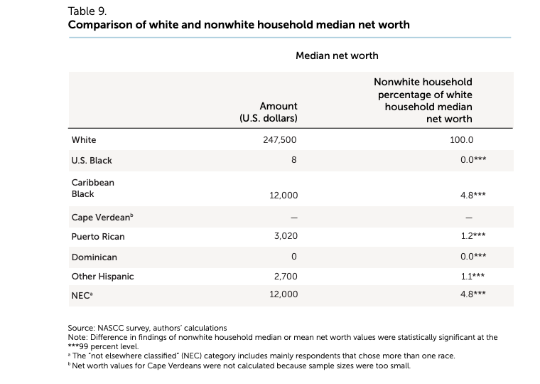
Context: Economic Reality
In Boston, White households have a median net worth of $247,500.
In the U.S., Black households have a median net worth of $8, while Dominican ones have a median net worth of $0.
Source: Federal Reserve Bank of Boston

Slide 34
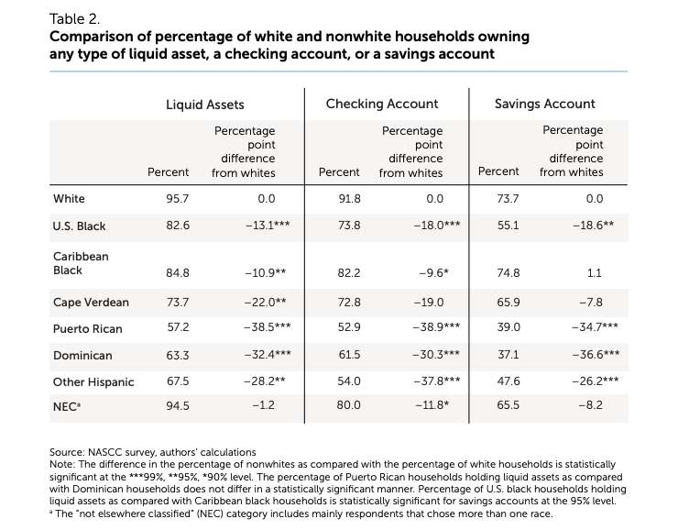
Context: Economic Reality
The typical White household in Boston is more likely than non- White households to own every type of liquid asset. For example, close to half of Puerto Ricans and a quarter of U.S. Blacks don't have either a savings or checking account, compared to only 7% of Whites.
Source: Federal Reserve Bank of Boston

Slide 35
Context: Economic Reality
A Human Rights Watch analysis of public-use microdata from the Census Bureau Household Pulse Survey shows that the pandemic’s economic fallout has had a devastating and disproportionate impact on the rights of low-income people who were already struggling. President Joe Biden’s American Rescue Plan, a $1.9 trillion coronavirus relief bill passed by the US House of Representatives on February 27, 2021, provides key investments to mitigate the growing economic hardship affecting these parts of the population. The legislation is now with the Senate, where it may be amended before it is sent back to the House for a final vote.
“Millions of people in the US are falling into preventable poverty and hunger,” said Lena Simet, senior poverty and inequality researcher at Human Rights Watch. “The measures put forth in President Biden's relief proposal are urgently needed and the government shouldn’t cut corners when so many lives and livelihoods are at risk.
.

Slide 36
How COVID-19 Affected Black and Latinx Communities
Essential workers are inherently at higher risk of being exposed to COVID-19 due to the nature of their work, and they are disproportionately representative of racial and ethnic minority groups.
This disparity contributed to COVID-19 disproportionately affecting Black and Latinx communities.

Slide 37
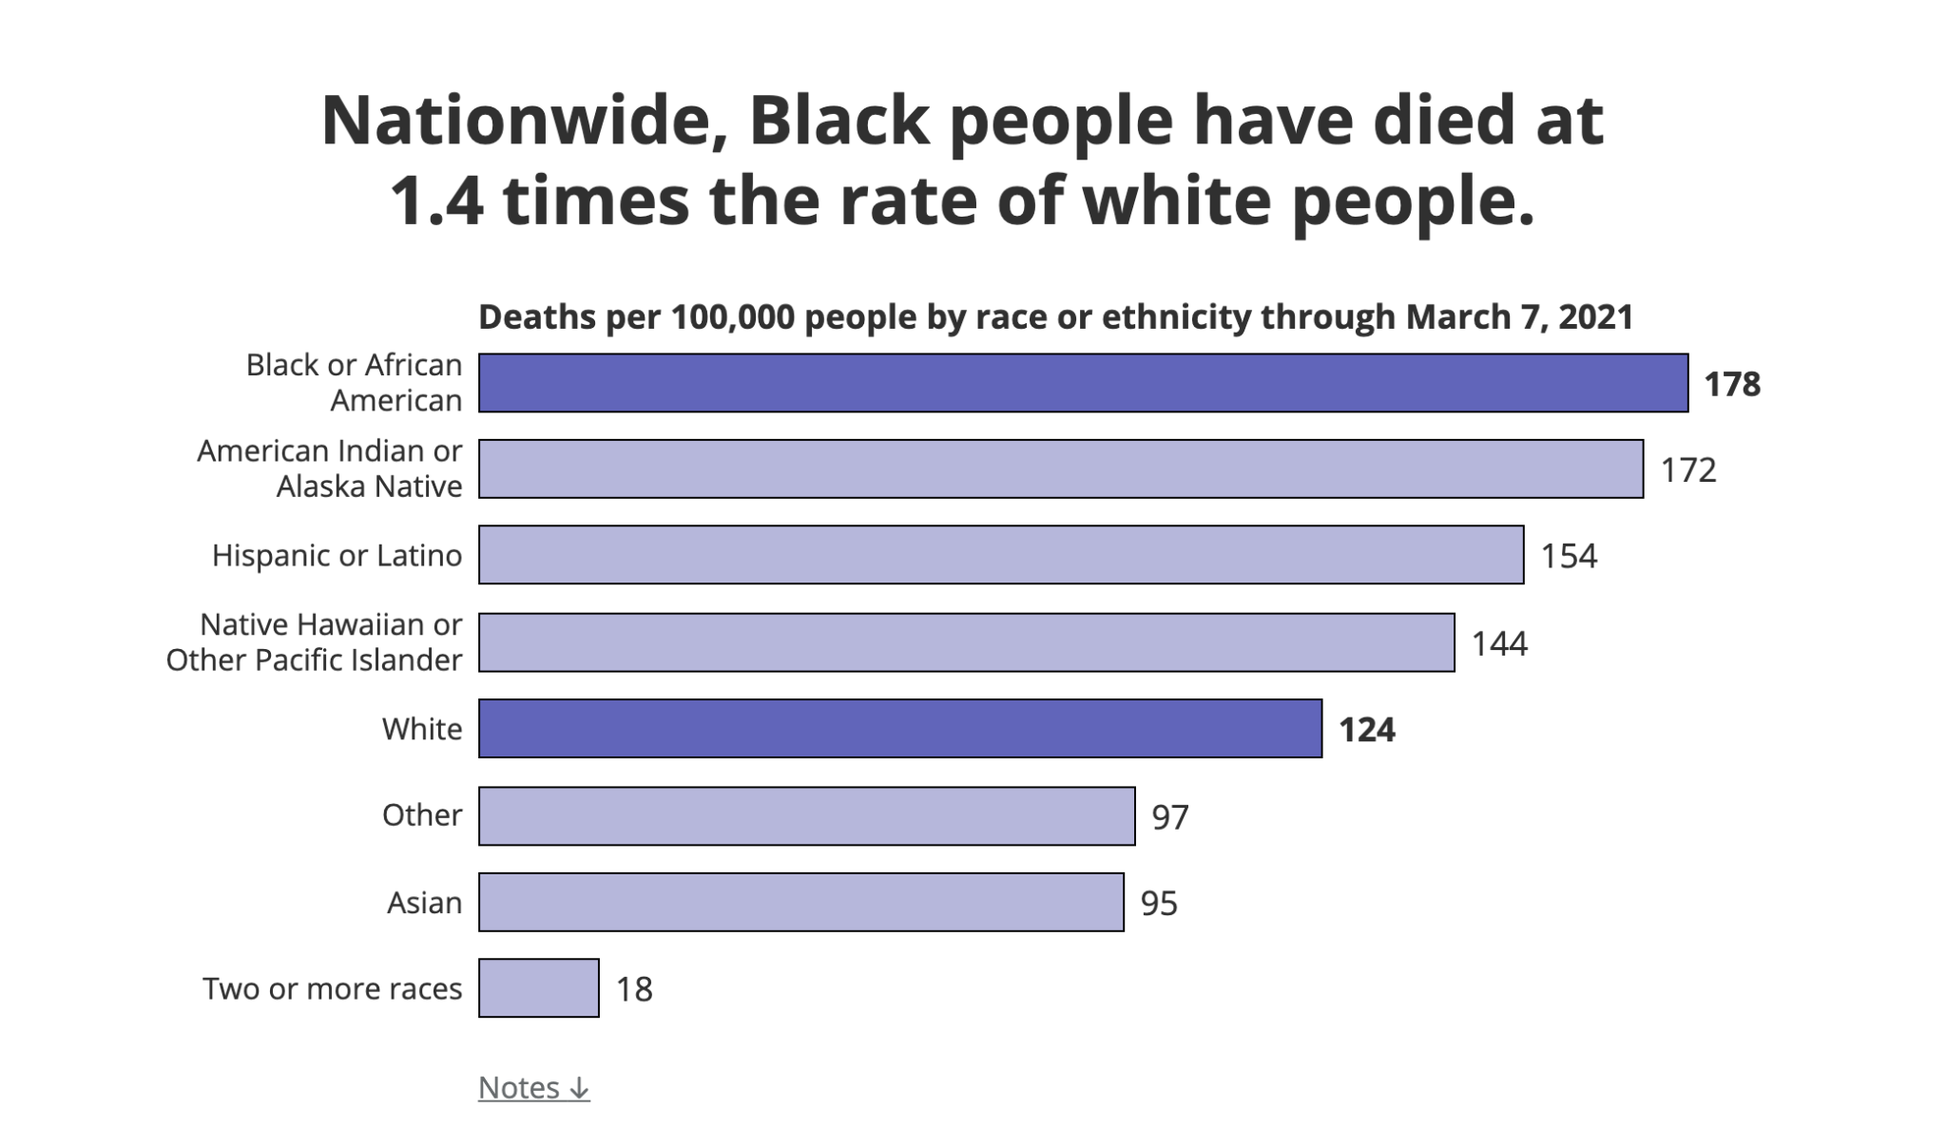
How COVID-19 Affected Black and Latinx Communities
Source: The CDC and The COVID Tracking Project

Slide 38
How COVID-19 Affected Black and Latinx Communities
Black and Latinx workers continue to lose their jobs more often, for longer periods of time, and are having more difficulty getting government support. They also have less of a financial cushion, due in large part to the racial wealth divide.

Slide 39
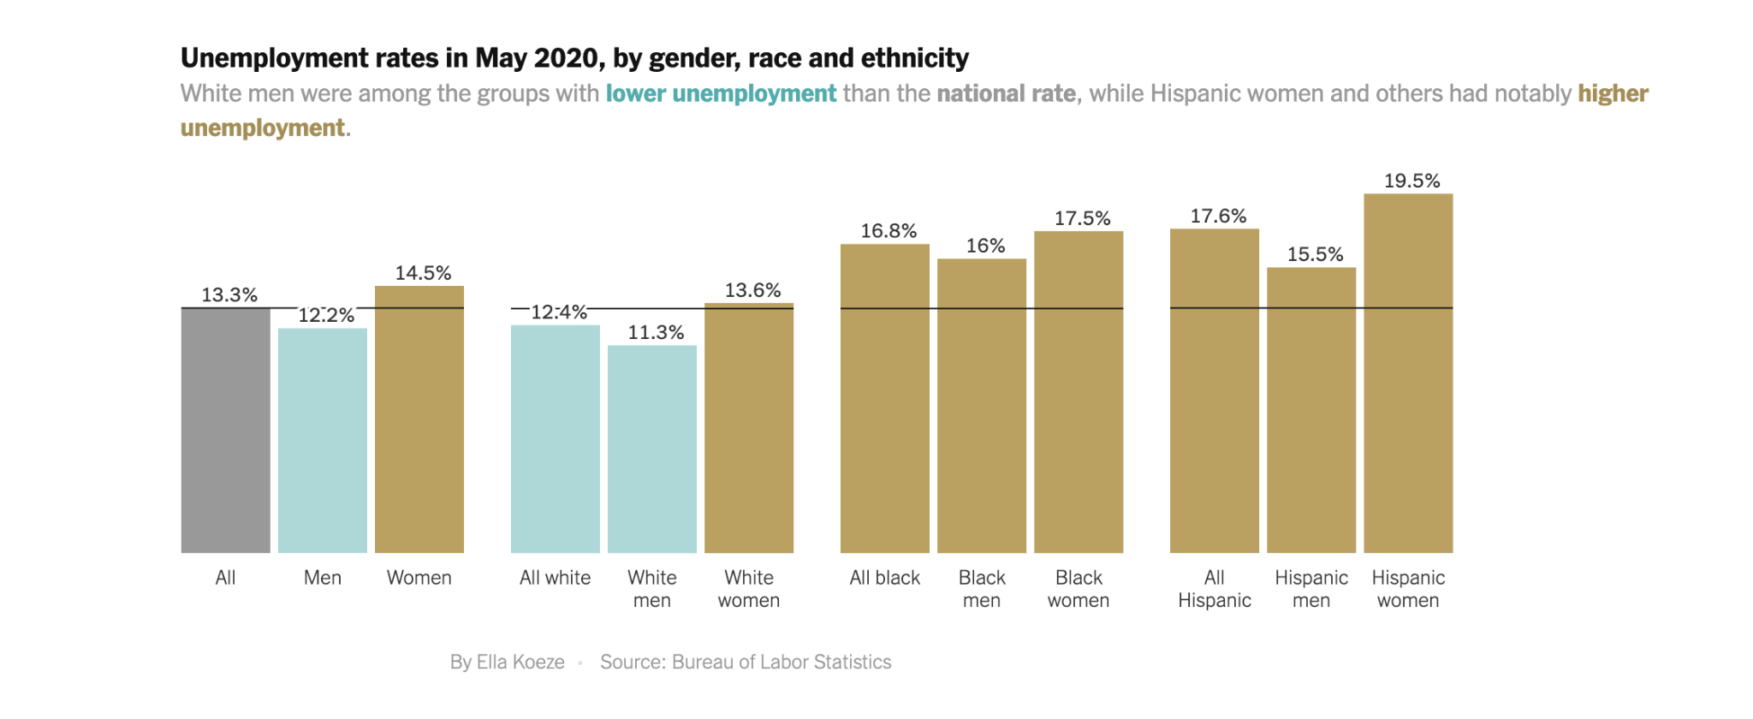
How COVID-19 Affected Black and Latinx Communities
Source: Washington Center for Equitable Growth

Slide 40
Question
How can expansionary fiscal policy combat these racial inequities?

Slide 41
Ways that COVID-19 Economic Relief Proposals Promote Racial Equity
1
Provide low-income families - with kids - with food dollars equivalent to the value of the school meals missed due to COVID-related school closures.
Ensure equitable and effective delivery of direct stimulus payments.
2
Source: The White House

Slide 42
Ways that COVID-19 Economic Relief Proposals Promote Racial Equity
3
Increase SNAP benefits to help address food insecurity.
Provide a federally-guaranteed “right to refuse employment” that will jeopardize their health. If they do so, they will still qualify for unemployment insurance.
4
4
Source: The White House
Notes:
Supplemental Nutrition Assistance Program (SNAP)

Slide 43
Ways that COVID-19 Economic Relief Proposals Promote Racial Equity
5
Provide grants and loans to women and minority-owned businesses via PPP Loan Program.
Provide housing vouchers (Section 8) to increase access to affordable housing.
6
4
Source: The White House

Slide 44
Proposed Policy: Just Future Funds
Basic income of $1,000 per month to every adult in the United States.
Basic income of $250 per month for every child in the United States.
Source: Medium
Notes:
In April of 2020, the Institute on Assets and Social Policy and Universal Income Project released the policy report Accelerating Equity and Justice: Basic Income and Generational Wealth, describing a “Just Futures Fund” policy plan that combines universal basic income with generational wealth accumulation.

Slide 45
Proposed Policy: Just Future Funds
A trust fund account for every baby born in the United States, starting with $1,000 and with an additional annual contribution of up to $2,000, based on familial wealth.
By greatly reducing the poverty rate and increasing wealth equity, we can expect to reap substantial economic gains over the long-term from the societal investment that the “Just Futures Fund” would provide.
Source: Medium
Notes:
In April of 2020, the Institute on Assets and Social Policy and Universal Income Project released the policy report Accelerating Equity and Justice: Basic Income and Generational Wealth, describing a “Just Futures Fund” policy plan that combines universal basic income with generational wealth accumulation. The report lays out the design of the policy and analyzes the expected impact on poverty rates and racial wealth equity, finding that it has a transformative positive impact on both measures.
While the financing of the policy is touched on in the report, the focus is kept at a high level, making the point that as a nation, we have an ever- growing abundance of wealth and could easily choose to fund a policy of this scale if we were to prioritize investments in our future and consider raising taxes concentrated wealth in society. In this document, we go into more depth on specific options for how the Just Futures Fund could be financed.

Slide 46
Proposed Policy: Just Future Funds
Many cities have adopted guaranteed basic income programs like: Stockton, California; St. Paul, Minnesota and Richmond, Virginia.
Source: USAToday
Notes:
In April of 2020, the Institute on Assets and Social Policy and Universal Income Project released the policy report Accelerating Equity and Justice: Basic Income and Generational Wealth, describing a “Just Futures Fund” policy plan that combines universal basic income with generational wealth accumulation. The report lays out the design of the policy and analyzes the expected impact on poverty rates and racial wealth equity, finding that it has a transformative positive impact on both measures.
While the financing of the policy is touched on in the report, the focus is kept at a high level, making the point that as a nation, we have an ever- growing abundance of wealth and could easily choose to fund a policy of this scale if we were to prioritize investments in our future and consider raising taxes concentrated wealth in society. In this document, we go into more depth on specific options for how the “Just Futures Fund” could be financed.

Slide 47
Discussion Questions
How do fiscal policies that support racial equity and social justice help build a stronger economy for all?

Slide 48
Discussion Questions
How do fiscal policies that support food, health, business and housing security help build a stronger economy for all?

Slide 49
Discussion Questions
How does public investment in infrastructure that supports small (W/MBE) business and education help build a stronger economy for all?

Slide 50
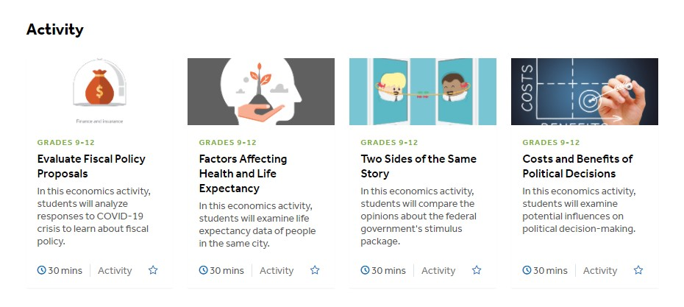
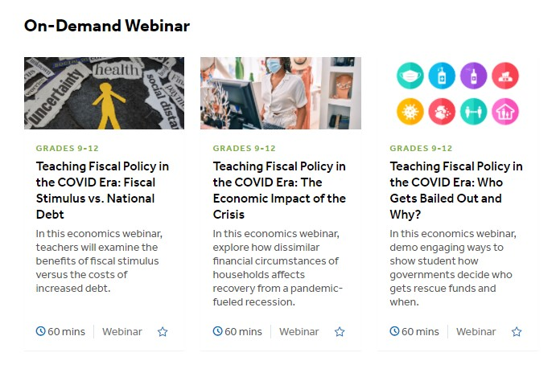
Additional EconEdLink
Fiscal Policy Resources
https://www.econedlink.org/resources/collection/teaching-fiscal-policy-in-the-covid-era/
Notes:
Teaching Fiscal Policy in the COVID Era Archives – EconEdLink

Slide 51
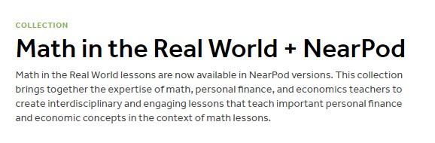


https://www.econedlink.org/resources/collection/math-in-the-real-world-nearpod/
Notes:
Math in the Real World + NearPod Archives – EconEdLink Fiscal Policy-related Lessons include Spending Multipliers, Distribution of Income and others.

Slide 52

CEE Affiliates
https://www.councilforeconed.org/resources/local-affiliates/

Slide 53

Thank You to Our Sponsor!

