Slide 1
Using Integers to Find Net Worth

Slide 2
Net Worth

Slide 3
Terms
Assets
Something of monetary value
Liabilities
Responsibilities you have to pay for something
Also called “debt”

Slide 4
Net worth of People Under 30
Marshon Lattimore (NFL Athlete) 40 million dollars (2022)
Xolo Mariduena (Actor) 2 million dollars (2022)
Chloe Kim (Olympic Snowboarder) 2.5 million dollars (2022)
Olivia Rodrigo (musician/actress) 5 million dollars (2022)
Do you think the average net worth of a person under thirty is lower or higher than Chloe Kim? Why?

Slide 5
Chloe Kim
Where do you think Chloe Kim’s money might be?
Do you think she has any “debts” or “liabilities?”
What type of “liabilities” might she have?
What type of assets do you think she would have?

Slide 6
Net Worth
The current value of a person’s assets minus liabilities.
Asset: Something of monetary value owned by an individual or an organization.
Liability: Legal responsibility to pay for damages or losses one has caused.
Notes:
Ask students: “What are some examples of Assets (something of monetary value) you or your family has?”
Help students understand that monetary value is not the same as personal value. I may love my old sneakers, but I could not sell them to anyone else for what they are worth to me!
Ask students: “What are some examples of Liabilities (a responsibility you have to pay) you or your family has?”

Slide 7
Net Worth Statement
Notes:
Here are a few assets and Liabilities

Slide 8
Net Worth Activity
Sasha’s Net Worth Statement Looks Like This.
Name: Sasha
Assets
Checking Account | 800.00
Savings Account | 1000.00
Liabilities
Credit Card | 1,800.00
Net Worth | ?

Slide 9
Sasha’s Net Worth Calculation
800 + 1,000 + -1,800 = 0
Liabilities are always a negative number because they represent monetary value owed to others.
Assets are always a positive number because they represent monetary value owned.
Sasha’s net worth is zero because her assets are equal to her liabilities.

Slide 10
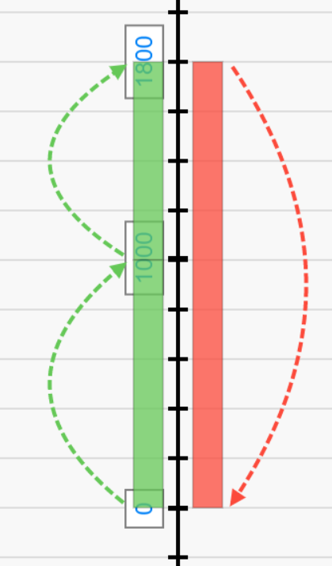
Integers, Number Sentence and Number Line
Sasha’s Net Worth can be found by computing the number sentence:
800 + 1000 + -1,800 = ?
Name: Sasha
Assets
Checking Account | 800.00
Savings Account | 1000.00
Liabilities
Credit Card | 1,800.00
Net Worth | ?

Slide 11
Net Worth Activity
Sasha took out a student loan to go to college.
How did this loan impact Sasha’s net worth?
Name: Sasha
Assets
Checking Account | 800.00
Savings Account | 1000.00
Coin Collection | ?
Liabilities
Credit Card | 1,800.00
Student Loan | ?
Net Worth

Slide 12
Sasha’s Net Worth Calculation
800 + 1,000 + 500 + -1,800 = 500
Sasha’s net worth increased from zero to $500 with the addition of more assets.

Slide 13
Net Worth Activity
Sasha was given a valuable coin collection.
Create a number sentence to find Sasha’s net worth
Name: Sasha
Assets
Checking Account | 800.00
Savings Account | 1000.00
Coin Collection | 500.00
Liabilities
Credit Card | 1,800.00
Net Worth | ?

Slide 14
Net Worth Activity
Sasha took out a student loan for college. What happens to Sasha’s net worth?
Name: Sasha
Assets
Checking Account | 800.00
Savings Account | 1000.00
Coin Collection | 500.00
Liabilities
Credit Card | 1,800.00
Student Loan | ?
Net Worth | ?

Slide 15
Group Activity
SAM LOVES SNEAKERS! ALL KINDS!
Meet Sam. He loves sneakers. Sneakers of all kinds. Use the information in this worksheet to help Sam find changes in his net worth for January, February, and March.
Notes:
Teacher asks students to read this part of the Sneaker Story.
Check for student understanding of the story by asking
What would you do in Sam’s situation?

Slide 16
Sam’s Sneaker Story Answers
 | January | February | March
Assets
Savings | 100.00 | 100.00 | 100.00
Checking |  | 100.00 | 200.00
Liabilities
Loan 1 | 200.00 | 200.00 | 100.00
Loan 2 |  |  | 180.00
Net Worth | -100.00 | 0 | 20.00
As Sam works and saves more money, his net worth is growing – even though his liabilities are also growing. While he may be able to sustain that growth for a short-time, it may become more challenging – especially if he loses his job or his boss suddenly wants all of loans his paid immediately.

Slide 17
Integers
How can we use integer number sentences to represent net worth?
Integers are a positive and negative whole numbers and zero.
Example: 5, 10, -5, -10, 0…
Non-examples: ½ , - ½ , √2, -√2,…

Slide 18
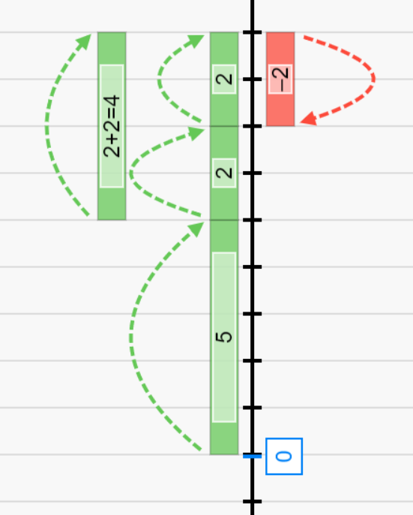
Integer Addition
Look for zero pairs:
Example: 5 + -5 = 0;
Example: 5 + 4 + - 2 = 5 + 2 + 2 + - 2 = 5 + 2 = 7
Create a vertical number line to check your answer
Write your number sentence: Example: 5 + 4 + -2 = 7

