Slide 1
Key Concepts in Microeconomics/ Energy Infrastructure
Microeconomics Summer Institute Day Two
Presented by Theodore Opderbeck
7/14/21 opderbeckt@waldwickschools.org

Slide 2
EconEdLink Membership
You can now access CEE’s professional development webinars directly on EconEdLink.org! To receive these new professional development benefits, become an EconEdLink member. As a member, you will now be able to:
Automatically receive a professional development certificate via e-mail within 24 hours after viewing any webinar for a minimum of 45 minutes
Register for upcoming webinars with a simple one-click process
Easily download presentations, lesson plan materials and activities for each webinar
Search and view all webinars at your convenience
Save webinars to your EconEdLink dashboard for easy access to the event
You may access our new Professional Development page here

Slide 3
Professional Development Certificate
To earn your professional development certificate for this webinar, you must:
Watch a minimum of 45-minutes and you will automatically receive a professional development certificate via e-mail within 24 hours.
Accessing resources:
You can now easily download presentations, lesson plan materials, and activities for each webinar from EconEdLink.org/professional-development/

Slide 4

https://bit.ly/CEEConference2021

Slide 5
60th Financial Literacy and Economic Education Conference
September 29th - October 1st, 2021
2-7 PM ET Daily
$20 discount for Summer Institute attendees
Register
https://councilforeconed2021.us2.pathable.com/
Promo Code
CEE60SI
SEE YOU THERE!!!

Slide 6
How did we do? Let us know!
Please complete our survey: https://www.surveymonkey.com/r/SummerInstitute2021

Slide 7
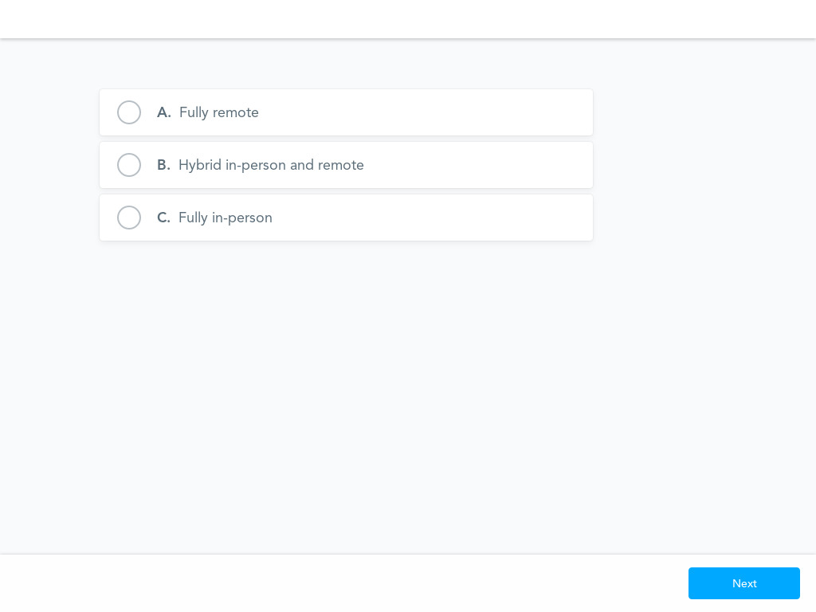
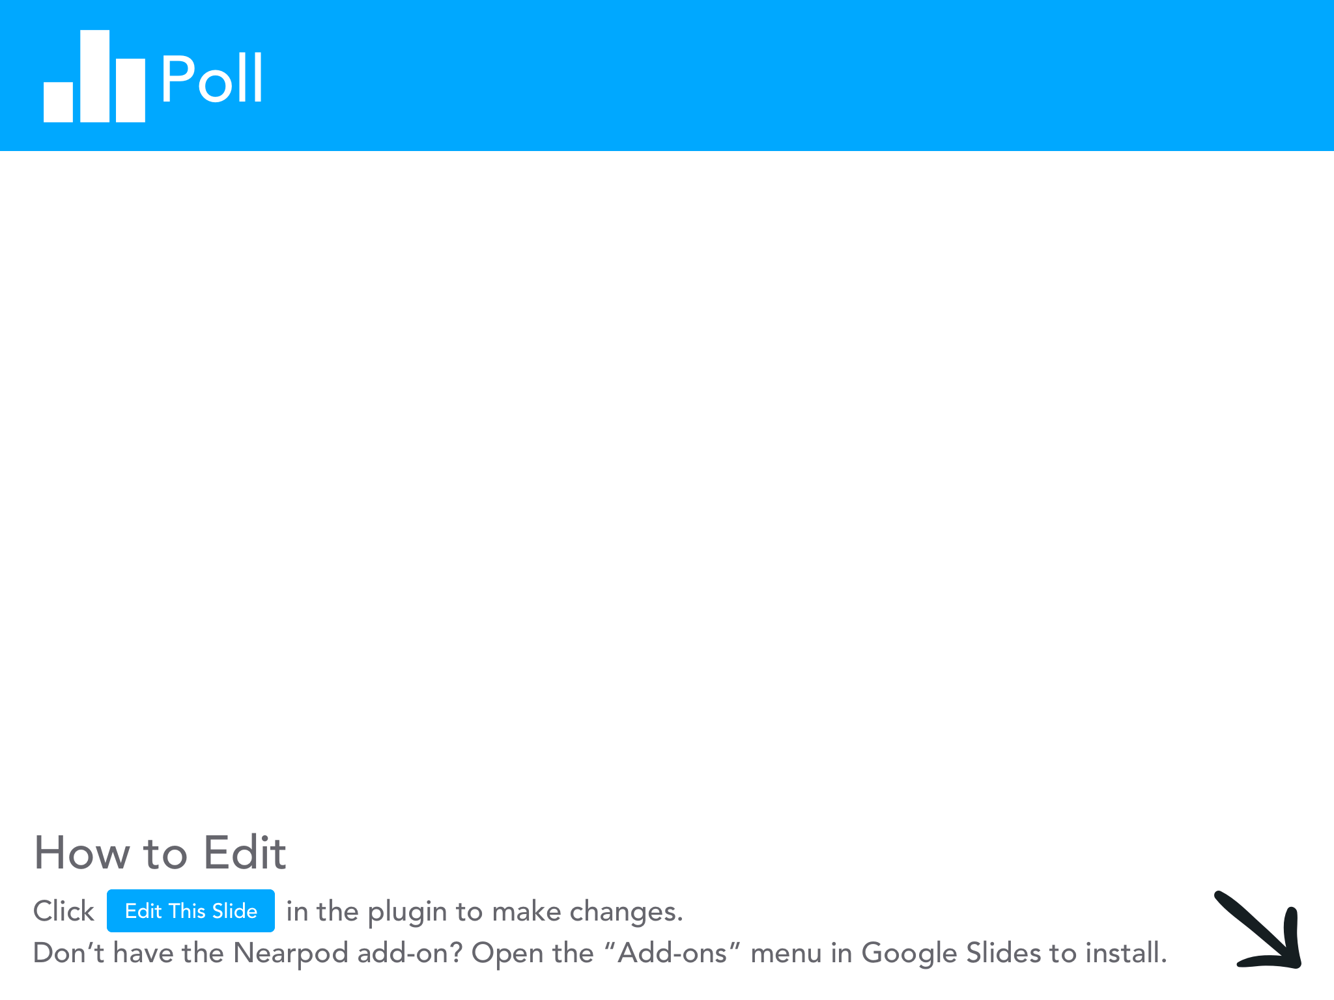

Slide 8
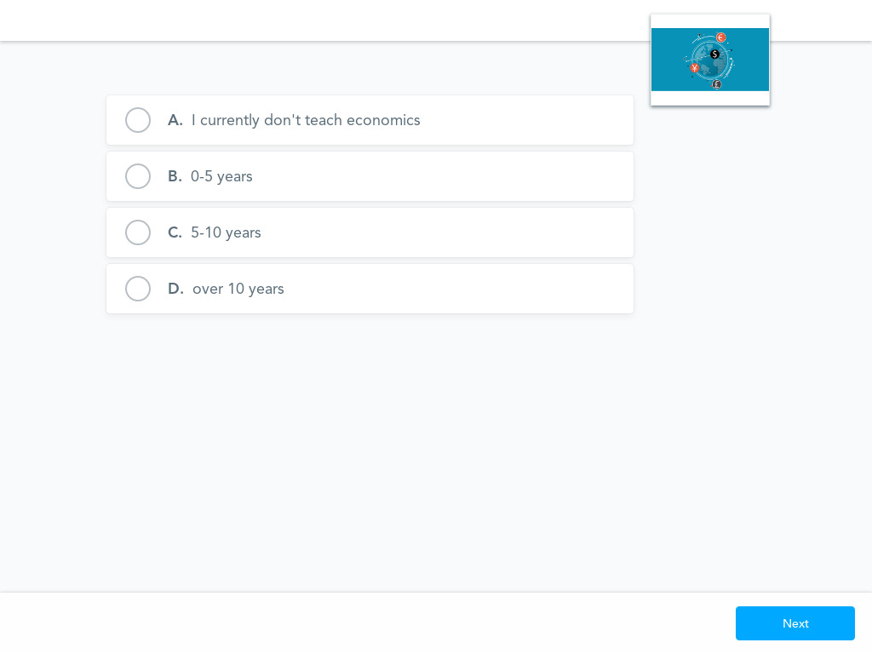

Slide 9
Objectives
To discuss how firms and households interact in a free market economy using the circular flow model
To explore the various types of business organizations and the balance between profit maximization and social responsibility.
To analyze competitive market structures and marginal analysis to determine productive efficiency.
To discuss consumer theory and utility.
To introduce dynamic learning activities and lesson plans to bring content alive for students.
To model digital formative assessment tools to use with your students in order to maximize learning.
To discuss how current energy infrastructure and renewable energy policy illustrate microeconomic concepts.

Slide 10
National Standards
NCEE Standard 2: Decision Making. Effective decision making requires comparing the additional costs of alternatives with the additional benefits. Many choices involve doing a little more or a little less of something: few choices are “all or nothing” decisions.
NCEE Standard 9: Competition and Market Structure. Competition among sellers usually lowers costs and prices, and encourages producers to produce what consumers are willing and able to buy. Competition among buyers increases prices and allocates goods and services to those people who are willing and able to pay the most for them.
https://www.councilforeconed.org/wp-content/uploads/2012/03/voluntary-national-content-standards-2010.pdf

Slide 11
State Standards
NY State Common Core Social Studies Standard 12.E2b: The choices of buyers and sellers in the marketplace determine supply and demand, market prices, allocation of scarce resources, and the goods and services that are produced. In a perfect world, consumers influence product availability and price through their purchasing
http://www.nysed.gov/curriculum-instruction

Slide 12
State Standards
NY State Common Core Social Studies Standard 12.E2c Businesses choose what to supply in the product market, based on product market prices, available technology, and prices of factors of production. The prices of those factors are determined based on supply and demand in the factor market. The supply and demand of each factor market is directly related to employment. Debates surround various ways to minimize unemployment (frictional, structural, cyclical).
http://www.nysed.gov/curriculum-instruction

Slide 13

Question of the Day
Which business firm is the top solar panel manufacturer in the U.S.?
Brookfield Renewable Partners
First Solar
Sun Power
LG Solar

Slide 14


Slide 15


Slide 16
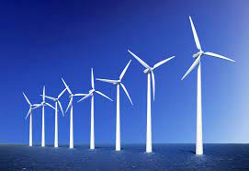
Question of the Day
Which U.S. company produces the most wind turbines?
Nordex
Goldwind
SGRE
GE Wind

Slide 17


Slide 18
Agenda: Thurs. 7/15
Circular Flow
Business Organizations/Goals
Competitive Market Structures
Business Costs and Revenue/ Marginal Analysis
Consumer Theory

Slide 19
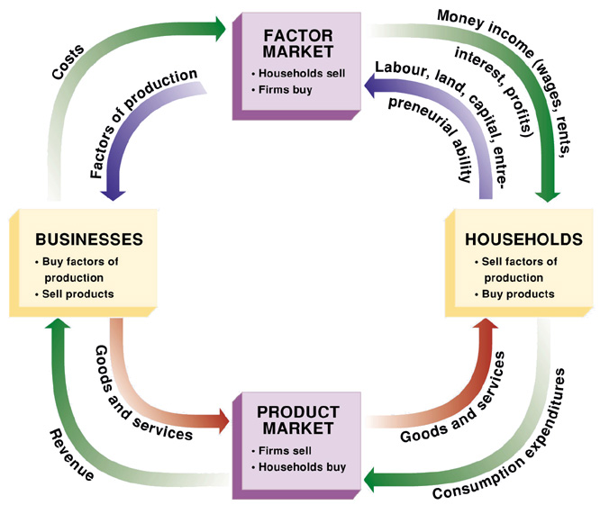
Circular Flow: Free Market
Notes:
Get kids atttention - mention iPhones

Slide 20
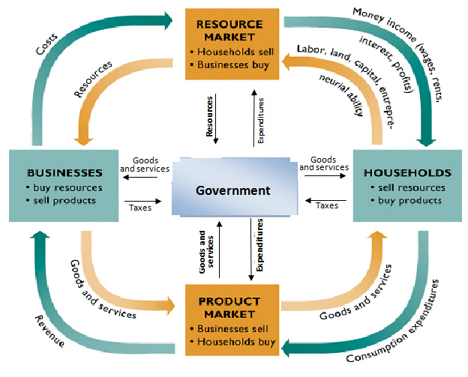
Circular Flow: Mixed Economy
Notes:
Get kids atttention - mention iPhones

Slide 21

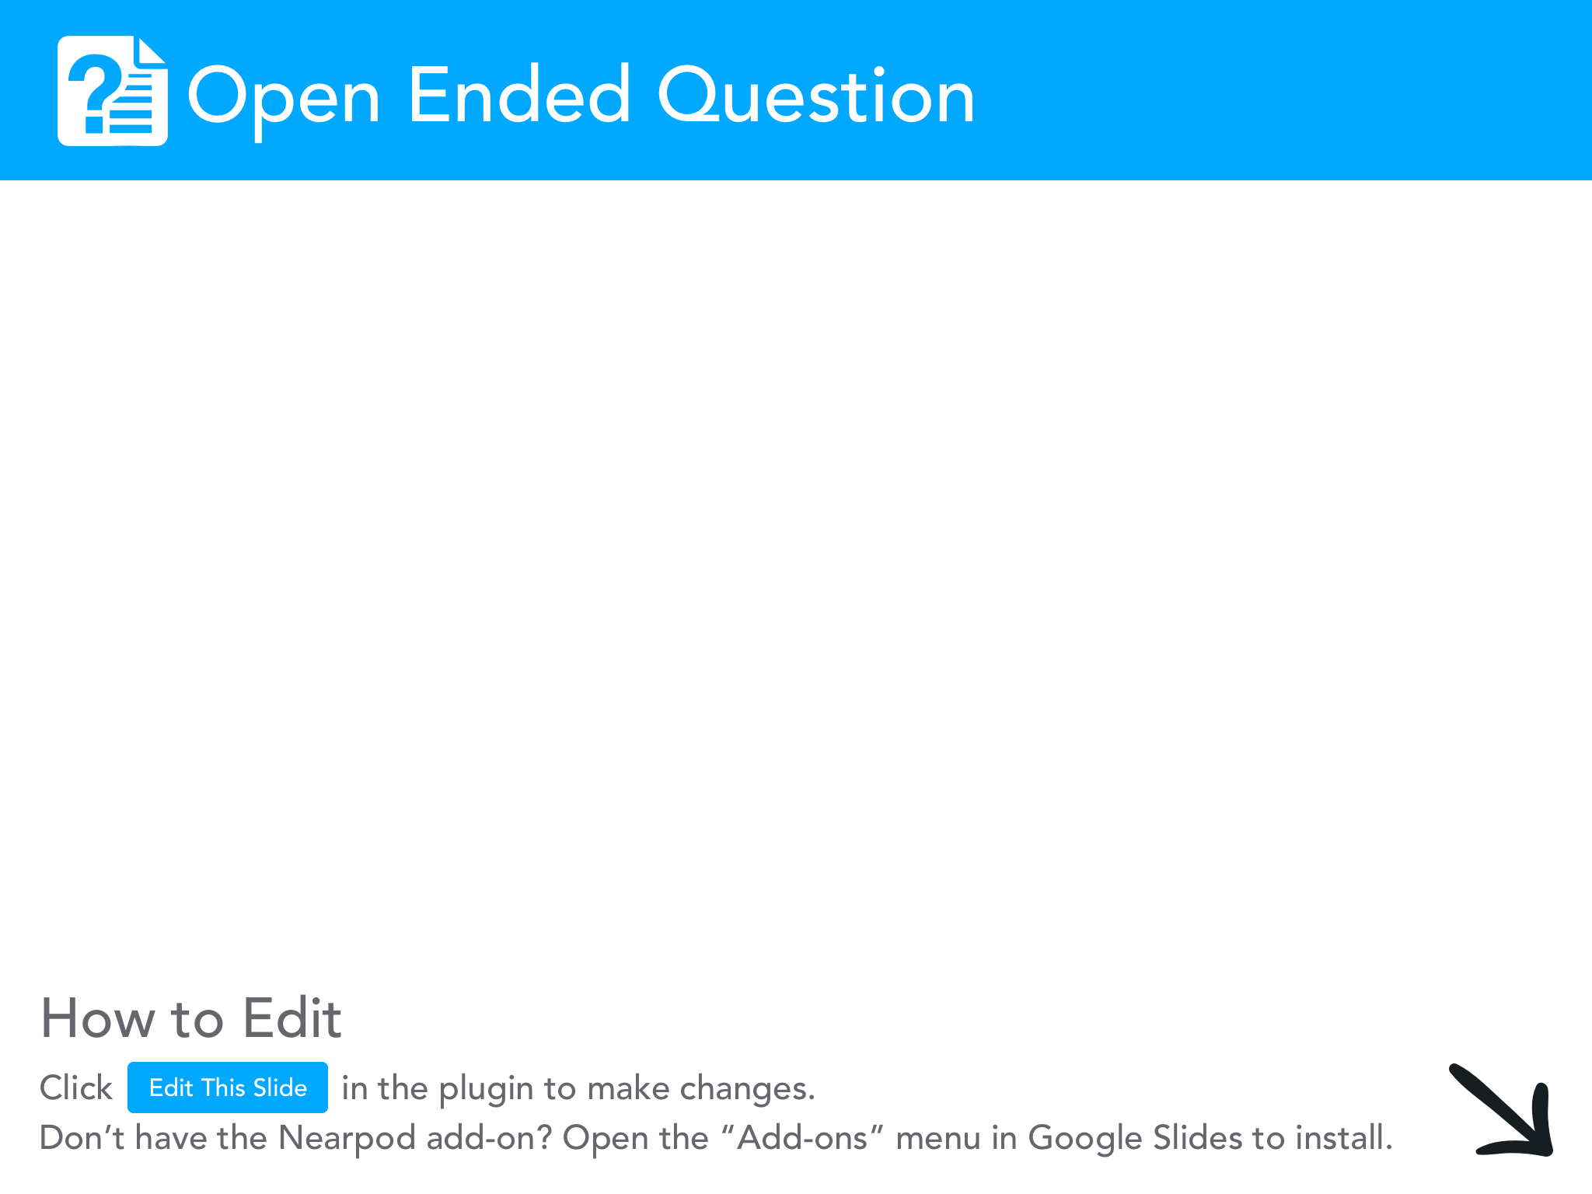

Slide 22
Lesson Plan Idea: Circular Flow Activity
Randomly choose two or three students to represent a “firm”
The rest of the class represents “households”
The firms produce and sell a product such as pretzels and purchase labor
The households produce and sell labor and purchase pretzels.
Give the firm and the students who represent households some fake money. The households purchase pretzels but in order to sell them the firm must purchase labor to deliver them to the households. The price of the pretzels and the price of the labor are determined by free market forces of supply and demand.
As long as households are purchasing money flows to firms which is used to purchase labor.
Take note of any factors that could lead to a slowdown (recession) of spending on either end and debrief.

Slide 23




Business Organizations

Slide 24
Introductory Questions
Are you a risk taker? Would you want to own your own business?
Do you like working together with others? Could you see yourself sharing responsibilities with business “partners”?
Do you think that corporations have more of a positive or negative impact on our culture?

Slide 25
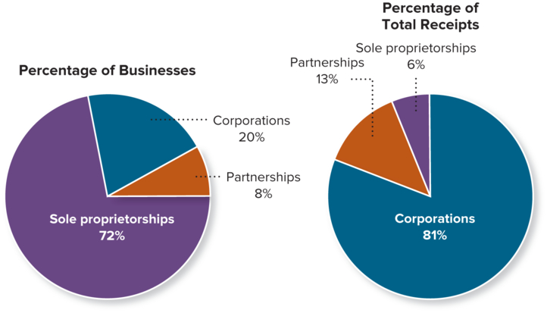
Business Organizations
Sole Proprietorship: an unincorporated business owned by a single person (72% of all U.S. businesses)
Advantages:
-Ease of start up/ few registration fees
-Simplified business ownership structure
Disadvantages:
-Unlimited personal liability/ loss
-Difficulty to raise capital/ loans

Slide 26

Entrepreneurship Activity - Shark Tank Simulation
https://drive.google.com/file/d/12lH_Wga7uTci4rv_aVGZ3AOhyaOaXq30/view?usp=sharing

Slide 27

Business Organizations
Partnership: any arrangement between two or more people to oversee business operations and share profits/liabilities (ex: general partnerships, limited liability partnerships
Advantages:
-Ease of startup, low costs
-Shared decision making
-Disadvantages:
-Shared liability for general partnerships
-Potential for conflict

Slide 28

Business Organizations
Corporation: a business entity owned by shareholders/investors (ex: publicly held, closely held)
Advantages:
-Limited liability
-Ease of raising capital
-Business security and continuity
-Disadvantages:
-Double taxation
-Difficulty to start up
-Shared profits

Slide 29
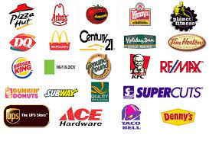
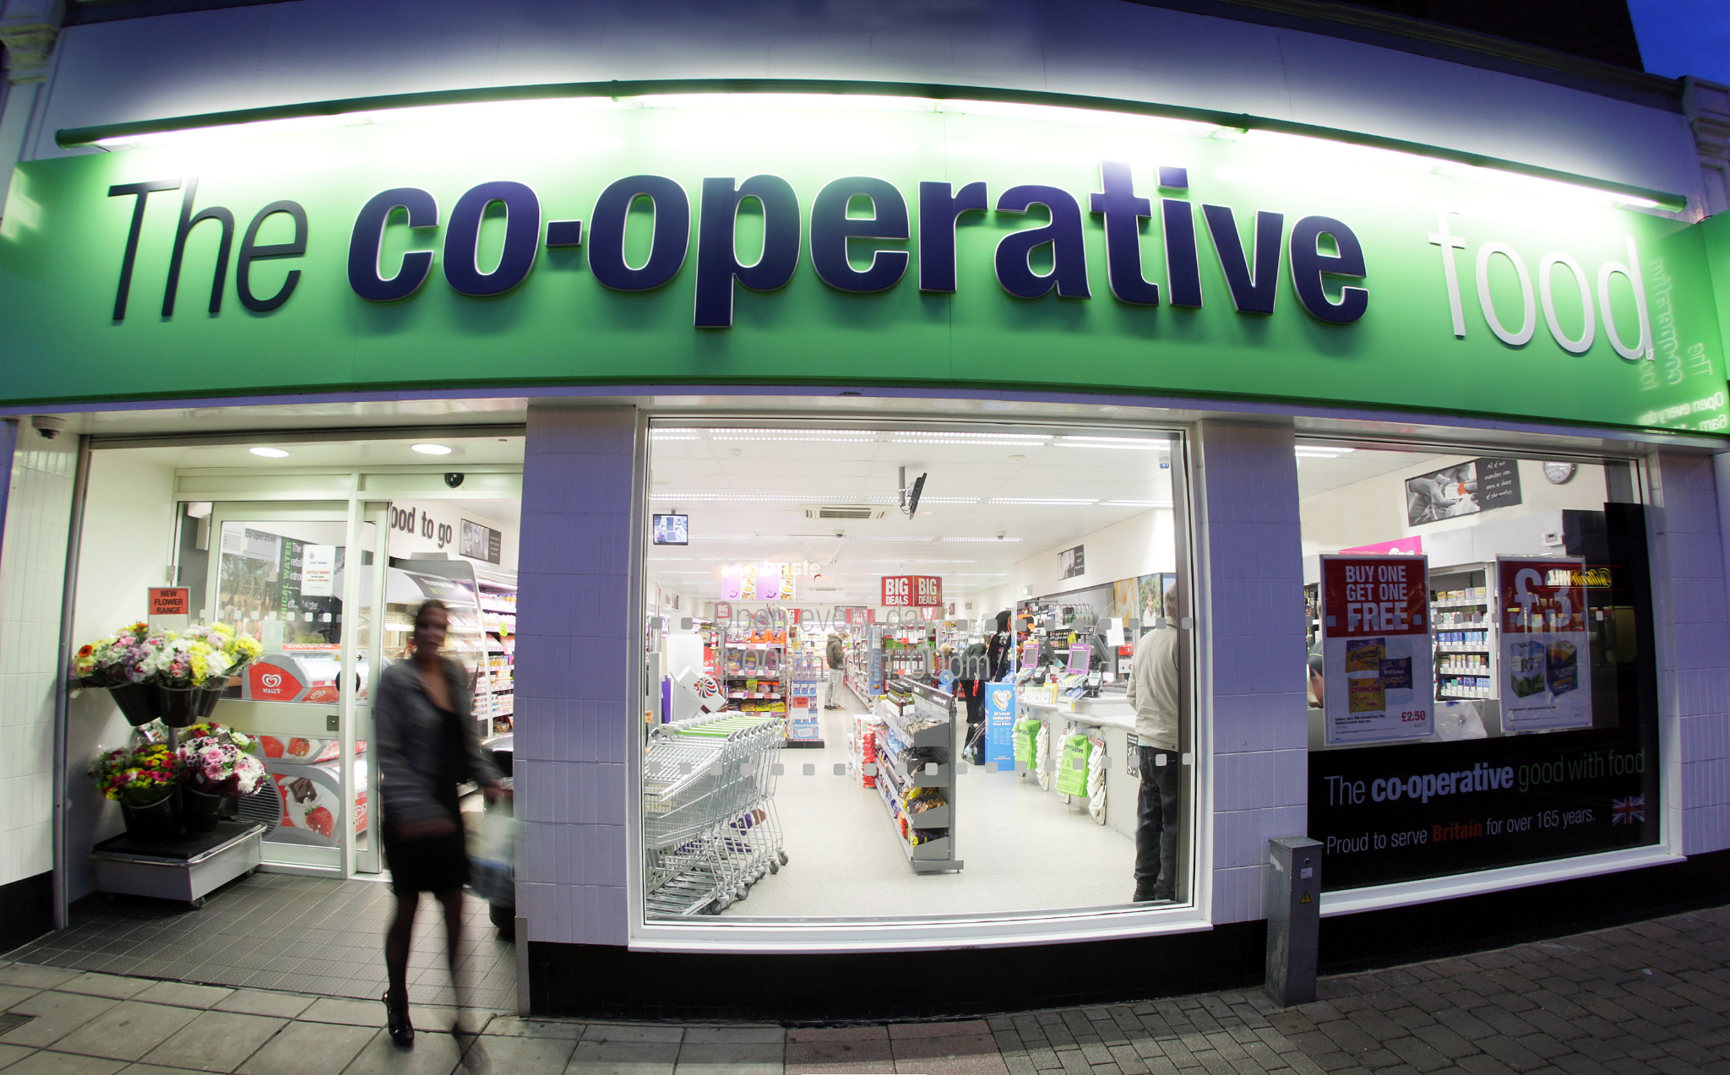

Business Organizations
Other Business Organizations
Franchises
Non-Profit Organizations
Consumer/Producer Cooperatives
Multinational Corporations

Slide 30
Learning Activity
In groups, choose one type of business organizational structure: sole proprietorship, partnership, corporation, franchise, nonprofit, or cooperative. Students will TEACH the class regarding their organization:
Creative introduction: something that gets classmates motivated to learn and intrigued with topic
TEACH the content (not a presentation): include learning activities that engage classmates
Fun, collaborative reinforcement of learning: game, simulation, etc.

Slide 31
Learning Activity
In groups, choose a local business (could be a sole proprietorship, partnership, franchise, etc). Create a video (with the business’s permission :).
In your video, interview the owner (s) regarding the risks, rewards, challenges, etc. about owning their business.
Have a day in class where you premiere the documentary films. Bring popcorn and have fun!

Slide 32
Business Organizations
Questions to Consider Regarding Renewable Energy Production:
What type(s) of business organization typically dominate the fossil fuel industry?
What type(s) of business organizations would make the most sense in the renewable energy market?
Would non-profit organizations make any sense in the green energy industry?

Slide 33
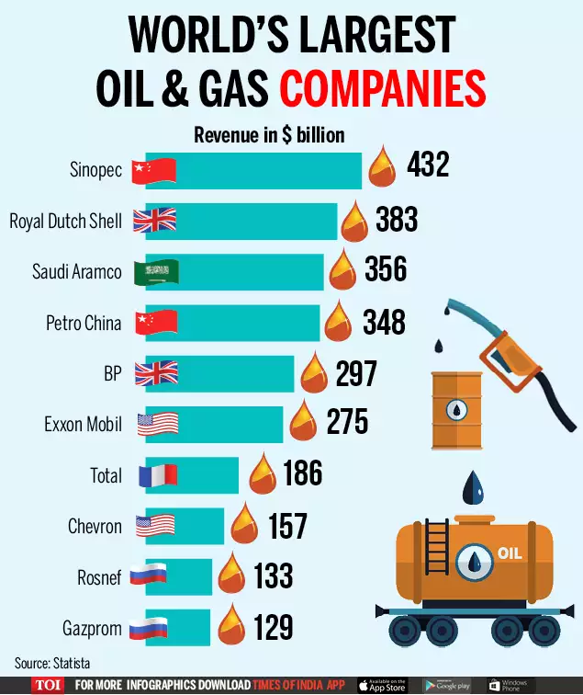

Slide 34
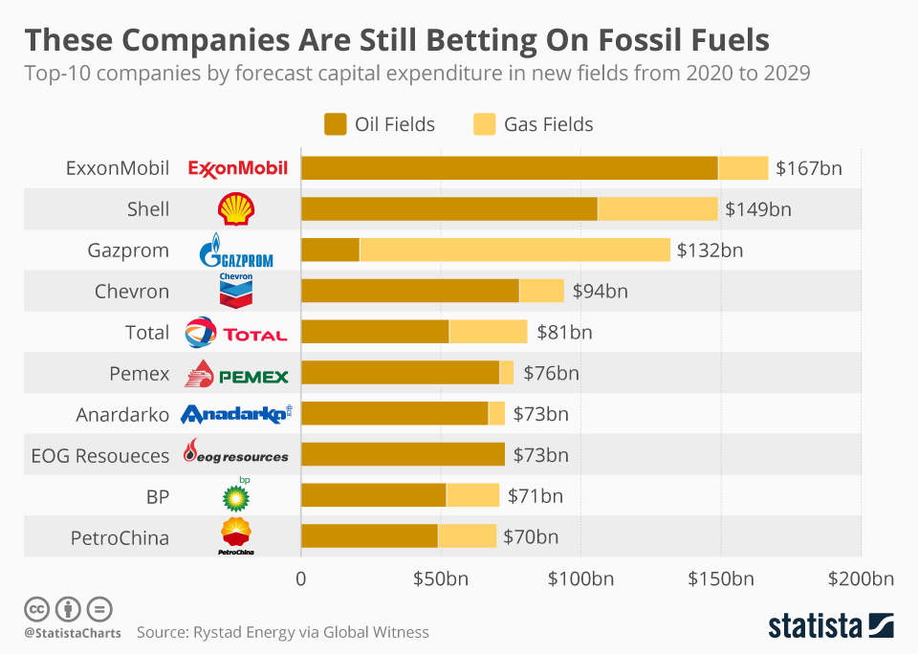

Slide 35
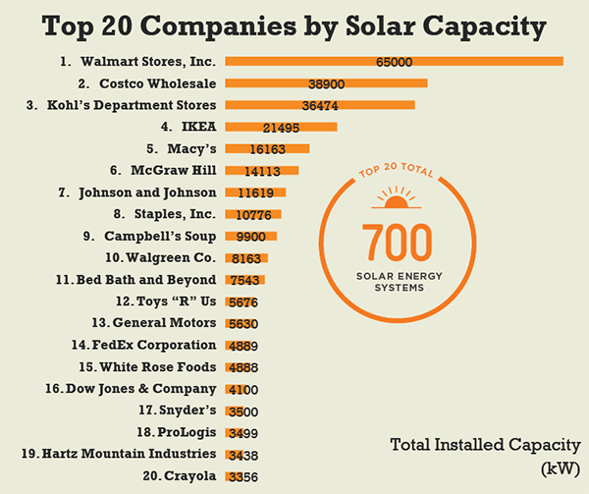

Slide 36


Business Goals
What is/are the primary goal(s) of business organizations?
-Profit maximization vs. social responsibility

Slide 37
Student Activities
Social Responsibility vs. Profit Maximization:
https://docs.google.com/document/d/1_QlzwoxtcYVX4-SmDFAqcdwg30VwrGBuMDpbYtjVbOo/edit?usp=sharing
https://docs.google.com/document/d/1yqx583RFxIwaypiLIFSQJ912MLAJ7NB8OXFuGYXVOW8/edit?usp=sharing
https://docs.google.com/document/d/1yqx583RFxIwaypiLIFSQJ912MLAJ7NB8OXFuGYXVOW8/edit?usp=sharing

Slide 38

Student Activity: Socratic Seminar
Set up a Socratic Seminar centered on the topic: Should business firms focus on profit maximization or social responsibility? How “socially responsible” should firms be?
Here is a good guideline on how to set up a Socratic Seminar: https://www.nwabr.org/sites/default/files/SocSem.pdf

Slide 39
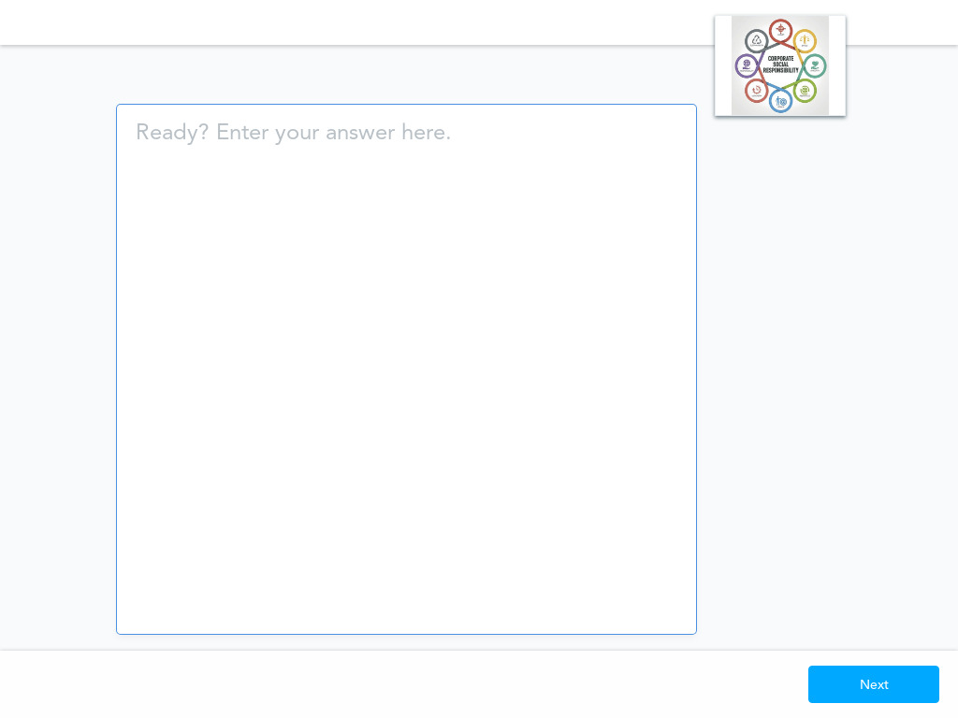

Slide 40
Digital Formative Assessment Option: Socrative
b.socrative.com
Room Name: Opderbeck

Slide 41

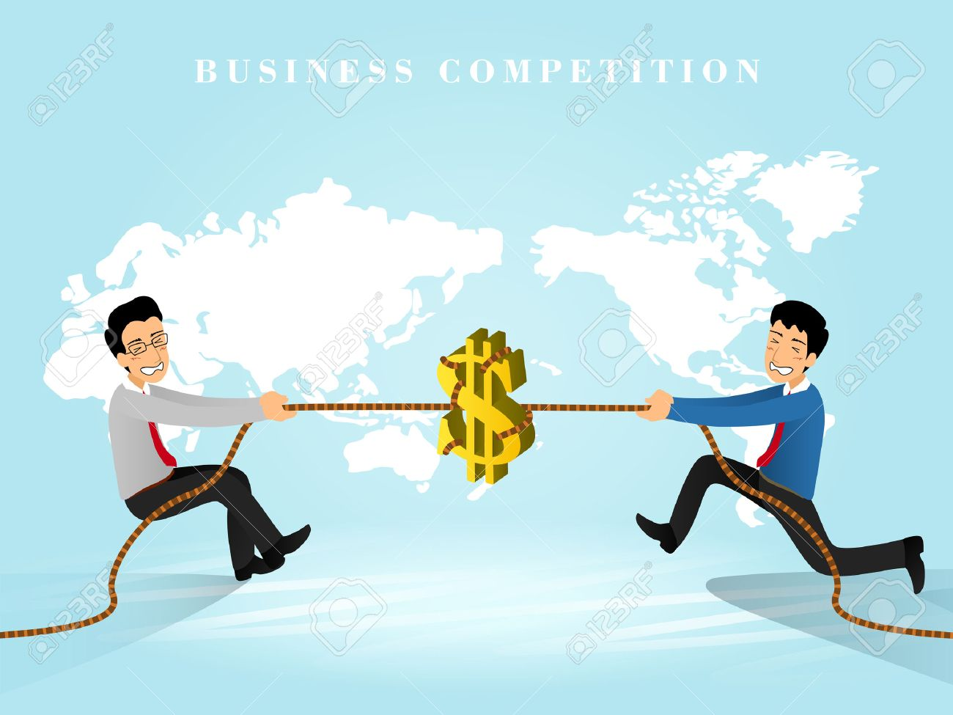

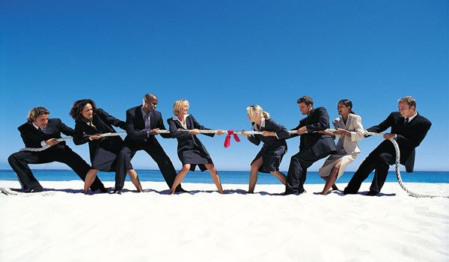
Competitive Market Structures

Slide 42
Introductory Questions
What are the benefits of competition in the business sector?
Are there any costs associated with higher levels of competition?
Is it possible that competition could encourage unfair practices or even illegal activity (case study: Enron)?

Slide 43
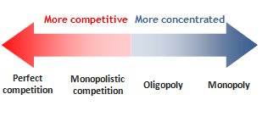
Competitive Market Structures
Perfect Competition
Monopolistic Competition
Oligopoly
Monopoly

Slide 44


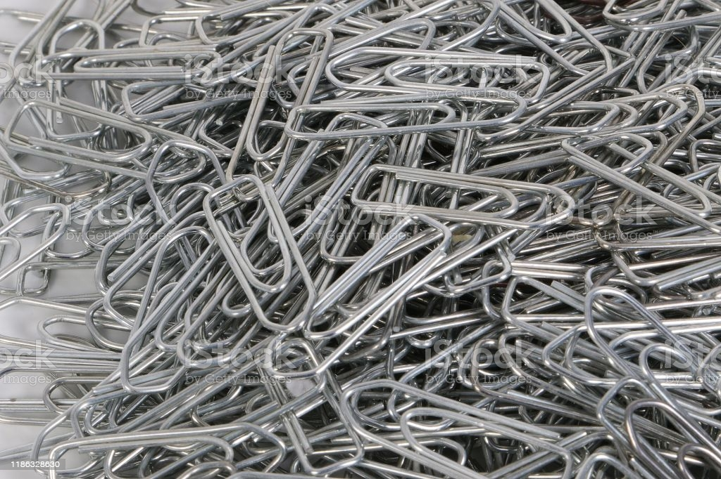
Competitive Market Structures
Perfect Competition
  Many buyers and sellers
  No barriers to enter/exit the market
  Identical products are sold
  Buyers are well informed about the products
Examples?

Slide 45
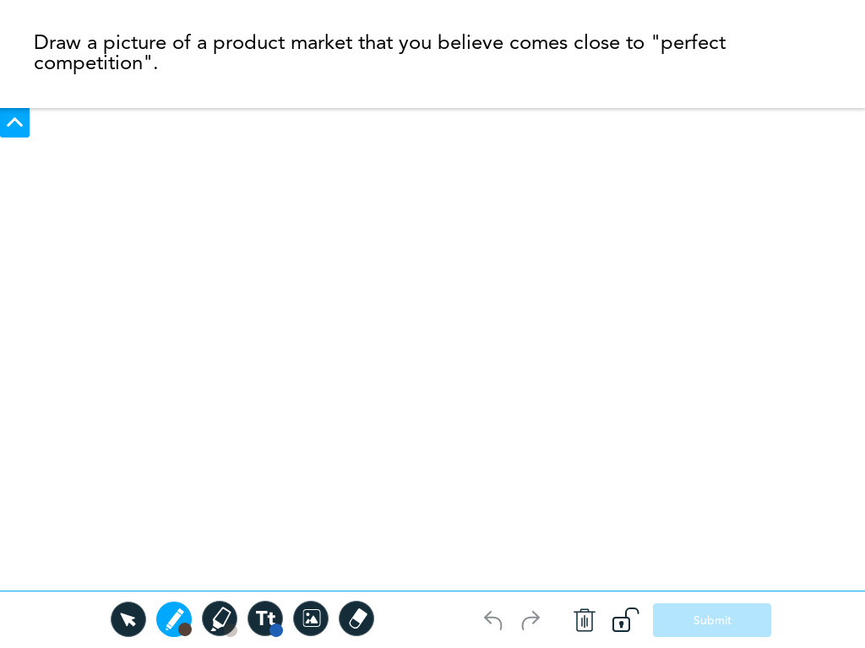
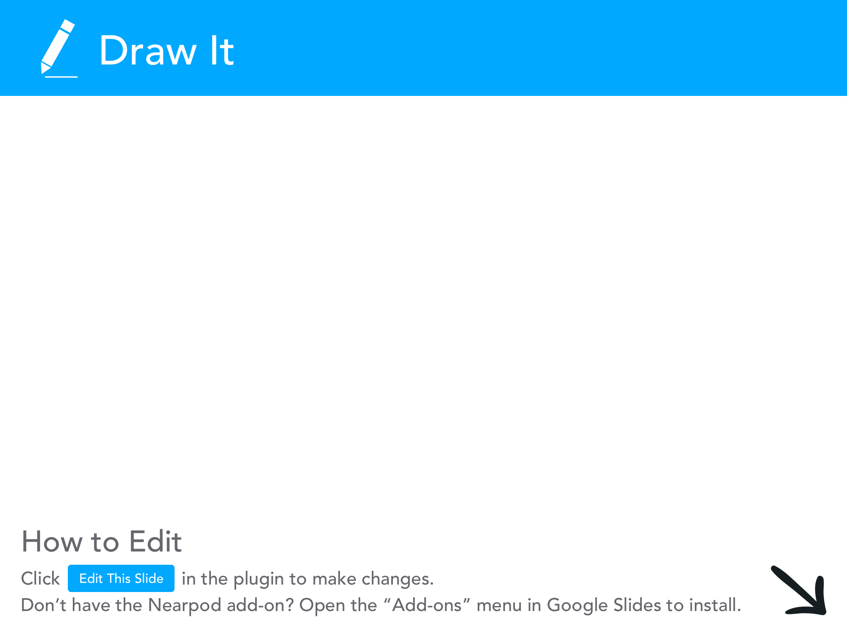

Slide 46
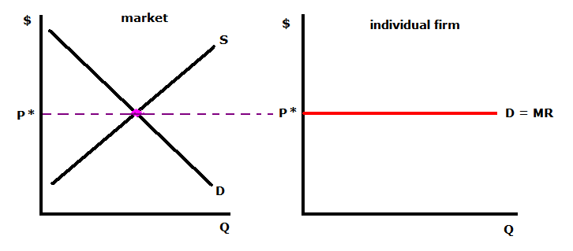
Competitive Market Structures
Perfect Competition
  Business firms are “price takers”

Slide 47

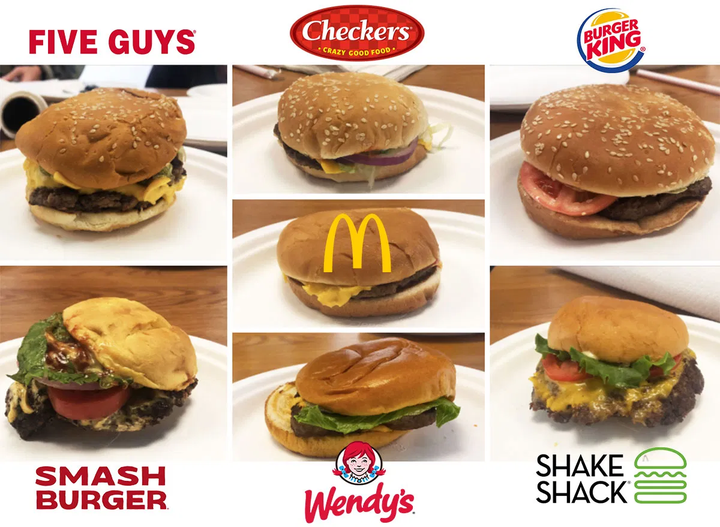

Competitive Market Structures
Monopolistic Competition
  Many buyers and sellers
  Some barriers to entry/exit
  Sellers offer similar, but differentiated products
  Buyers are well informed about the products
Examples:

Slide 49
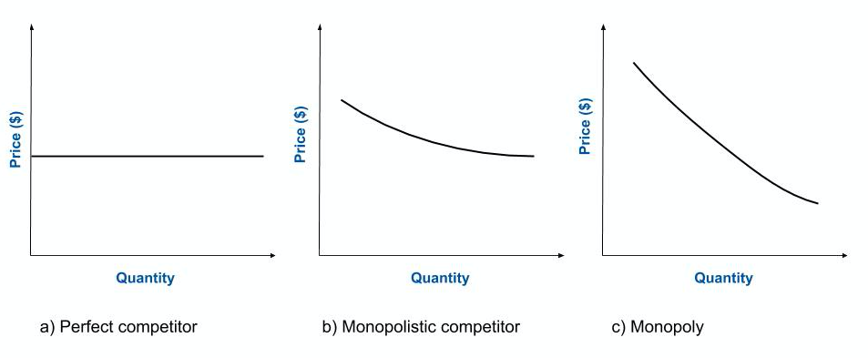
Competitive Market Structures
Monopolistic Competition: Business firms have slight pricing power based on market share

Slide 50
Learning Activity
Have students choose a product market and do an analysis of the firms that have market advantage. How have they differentiated their product to gain that advantage? Students can create a short marketing presentation as they are marketing representatives. They can bring in samples of their product vs. competitors.
Ex: Iced Tea blind “taste test”; packaging/labeling; show sales graphs, etc.

Slide 51

Competitive Market Structures
Oligopoly
  A few firms dominate the market and have large market share
  Many barriers to entry
  Firms are interdependent and have a tendency to collude
  Prices are higher
Examples:
  Slides

Slide 52
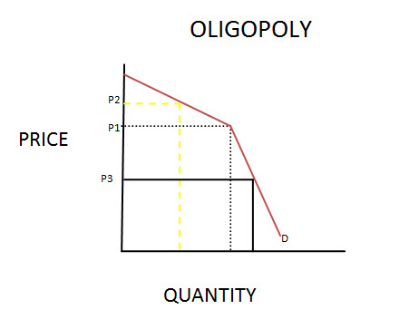

Slide 53
Competitive Market Structures
Oligopoly and “Game Theory”
  In an oligopoly, firms are likely to collude and act together
  Game Theory: a framework to study how individuals, businesses, or nations strategically interact
  Oligopoly: firms will likely take into account not only their own self interest but also the potential actions of other firms.
  An equilibrium is reached that takes into account all possible decision outcomes

Slide 54
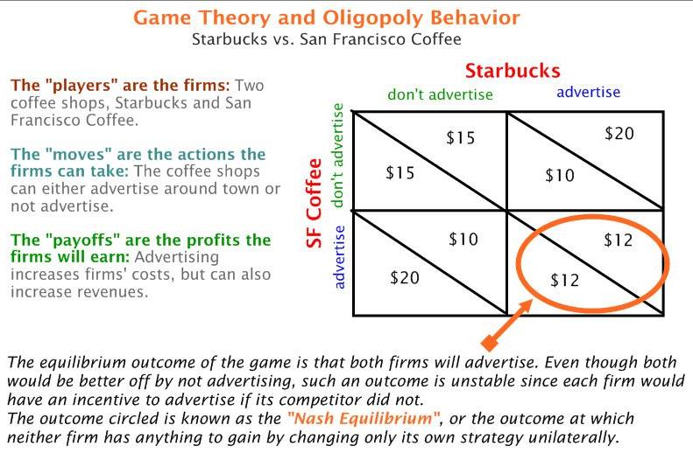

Slide 55
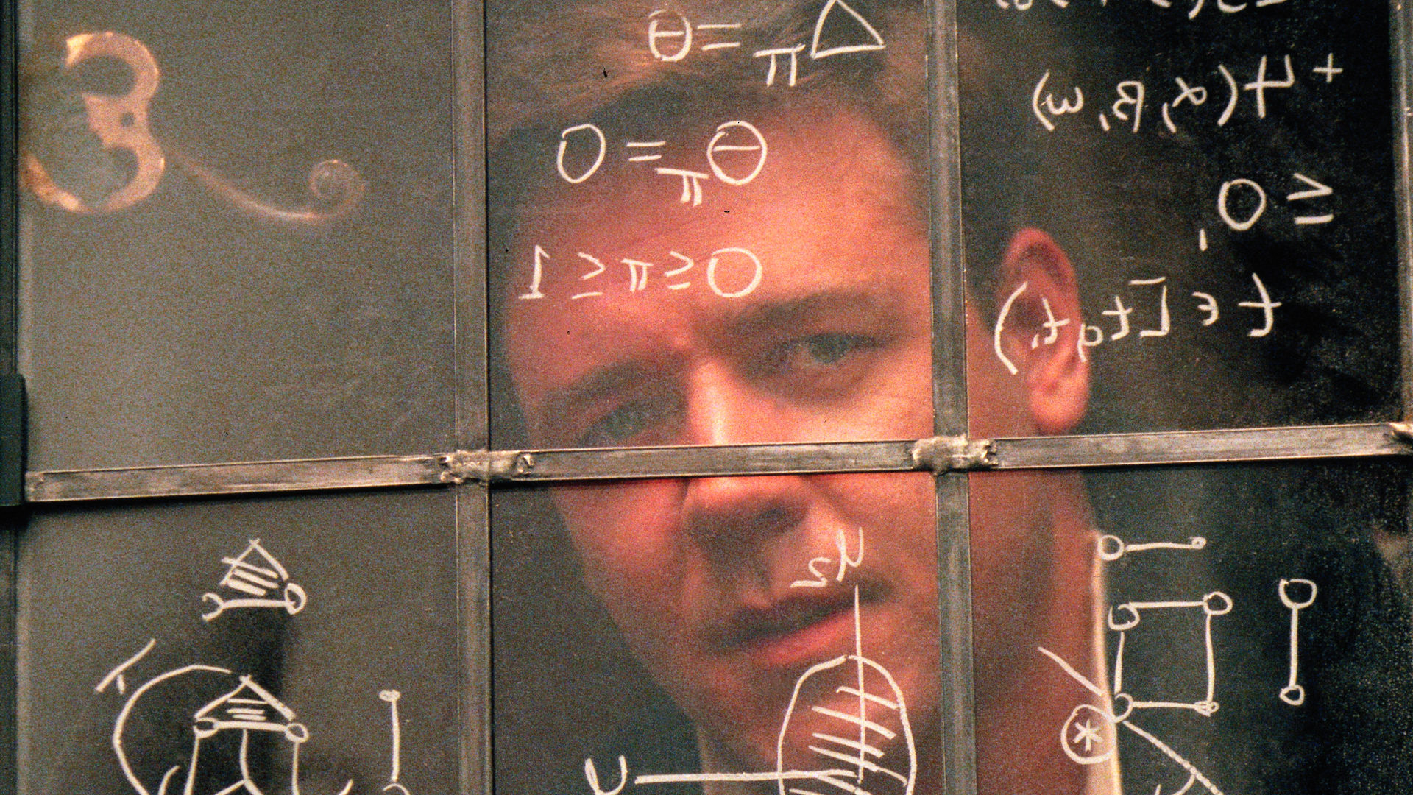
Movie Clip: A Beautiful Mind - John Nash and Game Theory
https://www.youtube.com/watch?v=LJS7Igvk6ZM&ab_channel=CringeCook

Slide 56

Competitive Market Structures
Monopoly
  One firm dominates output in a market
  Total barriers to entry
  High pricing
  Economies of scale
Types of monopoly
  Pure monopoly: controls the supply of a commodity with no close substitutes
  Natural monopoly: high start-up costs are prohibitive for other firms
  Government monopoly: a monopoly established by a government entity due to efficiency concerns

Slide 58
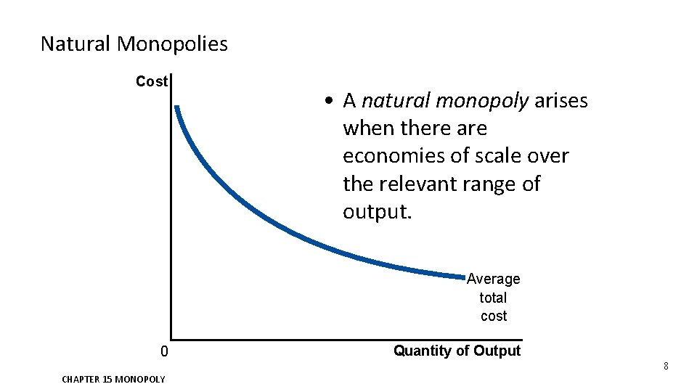
Competitive Market Structures
Monopoly and Economies of Scale

Slide 59
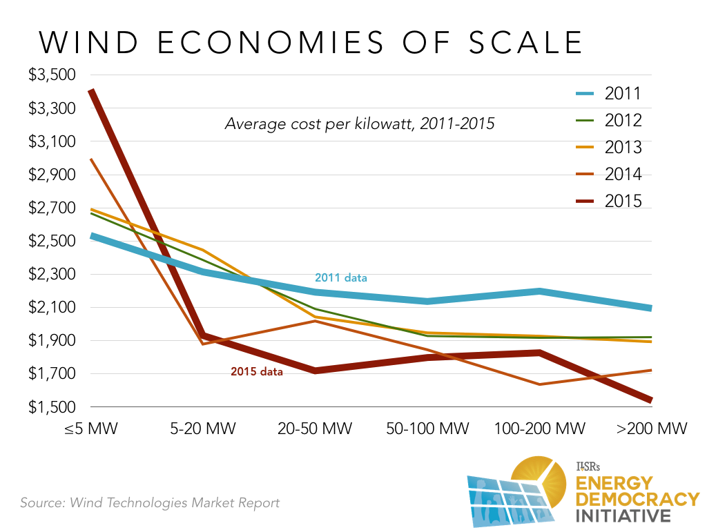

Slide 60
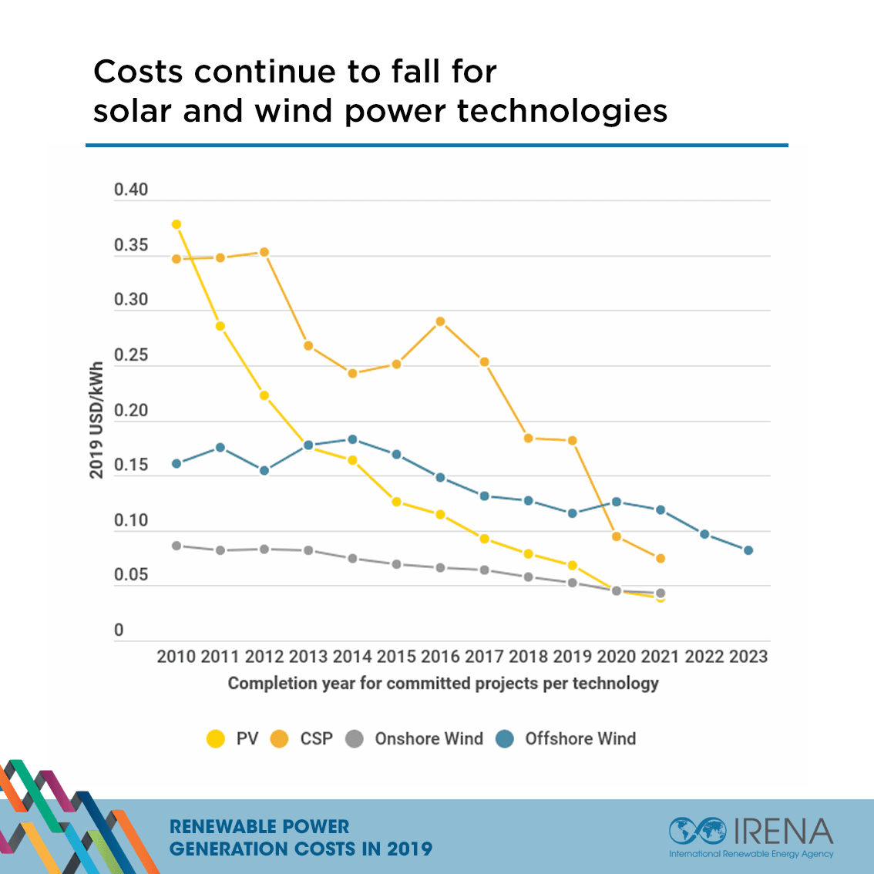

Slide 61
Competitive Market Structures
Measuring Competitive Markets
  Four Firm Concentration Ratio
    Add up the total percentage market share of the top four firms in a market.
    If the answer is more than 60%, then an oligopoly is present.
    Less than 60% is closer to monopolistic competition
    Less than = 20% perfect competition
  Example: The solar panel industry generates $1 Billion revenue annually. The top four firms combined earn $700 million.
    Four Firm ratio = 700 million / 1 Billion = 70%
    70% - oligopoly

Slide 62
Measuring Competition
https://docs.google.com/presentation/d/1Z4eyaoAf8ICtqUB6-4d5CVyUA7yLE2XBUEjHkh05dtY/edit?usp=sharing
https://docs.google.com/document/d/1h8qgrOY-EH9qZB8OznvktABsSjbiVcLAcxY2IwTbekY/edit?usp=sharing

Slide 63
Competitive Market Structures
Questions to Consider Regarding Renewable Energy Production:
What type(s) of business organization typically dominate the fossil fuel industry?
What type(s) of business organizations would make the most sense in the renewable energy market?
Would non-profit organizations make any sense in the green energy industry?

Slide 64
Student Activities
Monopolistic Competition: https://docs.google.com/document/d/1UmoQCw7UcAmhJ4l-at3j1FKwlJfU6ED9x8XUxbxntIA/edit?usp=sharing
Oligopoly and Game Theory: https://docs.google.com/document/d/1K5OyZhfwH49y9hQQXpxXLkzZKlfQLRRwHs-ClD1RyEM/edit?usp=sharing
Monopolies: https://docs.google.com/presentation/d/18OsxWrZHvsXXopGPmN6k_8CGnUta88y19ba6juspRlo/edit?usp=sharing
Use Sutori for an illustrated timeline of government regulation:
www.sutori.com

Slide 65
Articles: Renewables and Economies of Scale
https://ilsr.org/report-is-bigger-best/
https://www.renewableenergyworld.com/baseload/economy-of-scale-doing-better-than-bigger-in-renewable-energy-49807/#gref
https://ourworldindata.org/cheap-renewables-growth

Slide 66

Digital Formative Assessment Option:
Blooket.com

Slide 67
Business Costs and Revenue - Marginal Analysis
Business Costs:
Fixed Costs: stay constant regardless of the level of production. Ex:
Variable Costs: change depending on the level of production/output. Ex:
Total Costs: Fixed Costs + Variable Costs
Marginal Cost: the cost of producing one additional unit
Average Fixed Cost: Total Fixed Cost/ quantity of output
Average Variable Cost: Total Variable Cost / quantity of output
Average Total Cost: Total Cost / quantity of output

Slide 68
A Quantity of Output | B Fixed Costs | C Variable Costs | D Total Costs | E Marginal Cost | F Average Fixed Cost (B / A) | G Average Variable Cost (C / A) | H Average Total Cost (D / A)
0 | $200 | - | $200 | - | - | - | -
1 | 200 | $20 | 220 | 20 | 200 | 20 | 220
2 | 200 | 10 | 210 | 10 | 100 | 5 | 105
3 | 200 | 15 | 215 | 5 | 66.67 | 5 | 71.67
4 | 200 | 25 | 225 | 10 | 50 | 6.25 | 56.25
5 | 200 | 45 | 245 | 20 | 40 | 9 | 49
6 | 200 | 80 | 280 | 35 | 33.33 | 13.33 | 46.67

Slide 69
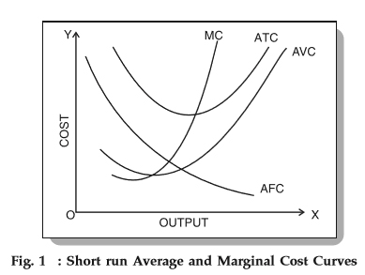
Business Costs and Revenue - Marginal Analysis

Slide 70
Business Costs and Revenue - Marginal Analysis
Business Productivity:
Marginal Production: with at least one fixed input (ex: physical capital), how much can a business produce when one more unit of another input/resource is added (ex: labor)
Total Production: how much more is the business producing given the total amount of added inputs/resources (ex: labor) with at least one other fixed input
Average Production: Total production / added input (labor)
Law of Diminishing Marginal Productivity: as long as at least one input is fixed (capital), marginal production will increase with other added inputs, reach a peak, then at some point diminish

Slide 71
Business Costs and Revenue - Marginal Analysis
Quantity (Labor) | Total Product | Marginal Product | Average Product
0 | - | - | -
1 | 4 | 4 | 4
2 | 10 | 6 | 5
3 | 20 | 10 | 6.67
4 | 35 | 15 | 8.75
5 | 40 | 5 | 8
6 | 42 | 2 | 7
7 | 38 | -6 | 5.43
Increasing Marginal Productivity = Labor Units 1 through 4
Diminishing Marginal Productivity = Labor Units 5 and 6
Negative Marginal Productivity = Labor Unit 7

Slide 72
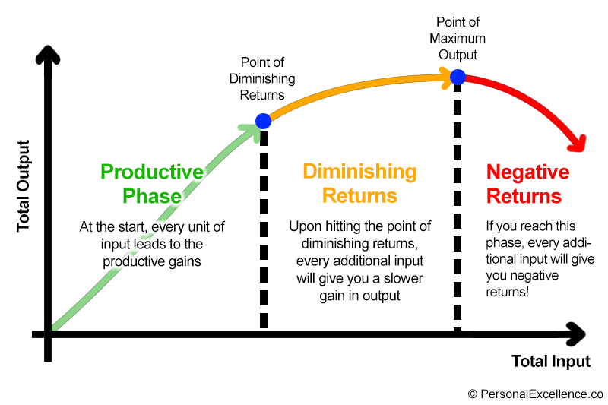

Slide 73
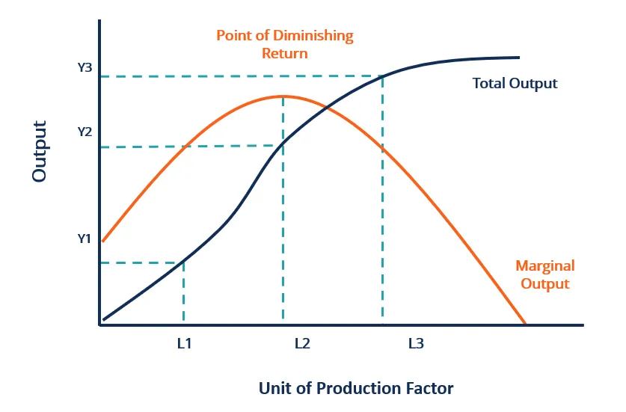
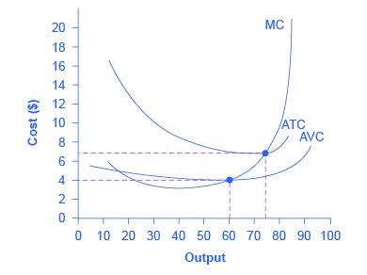
As productivity increases, costs decrease
As productivity falls, costs increase

Slide 75
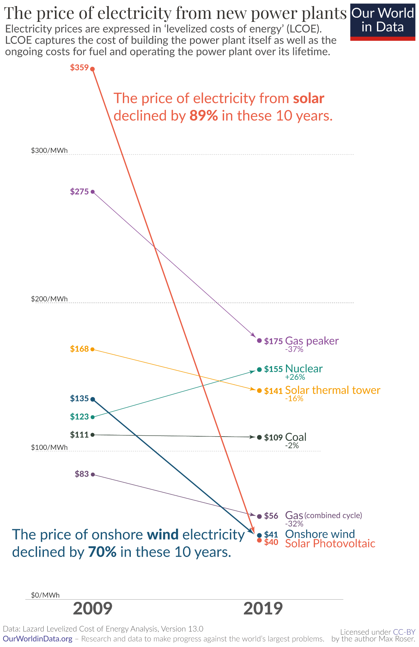

Slide 76
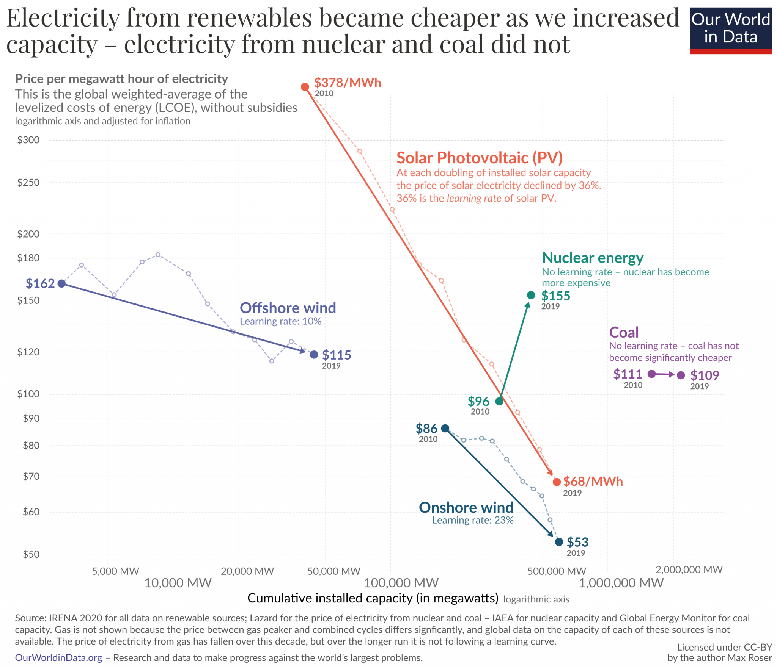

Slide 77
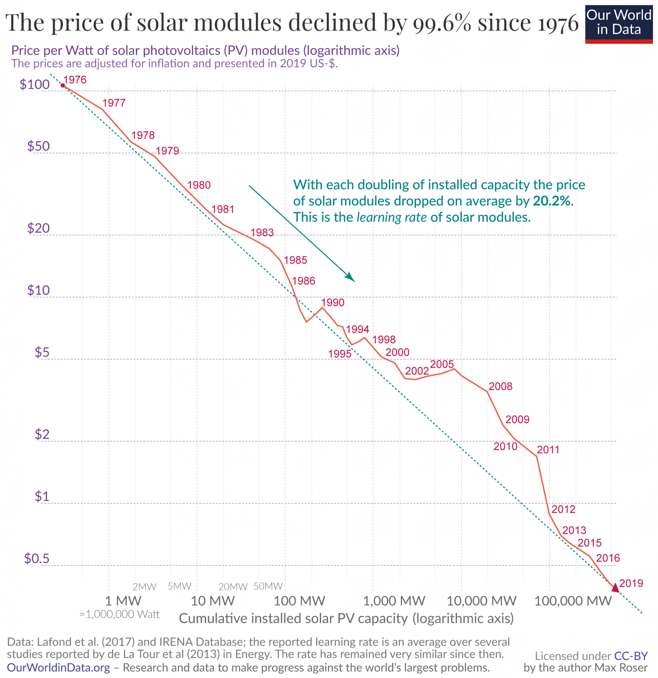

Slide 78

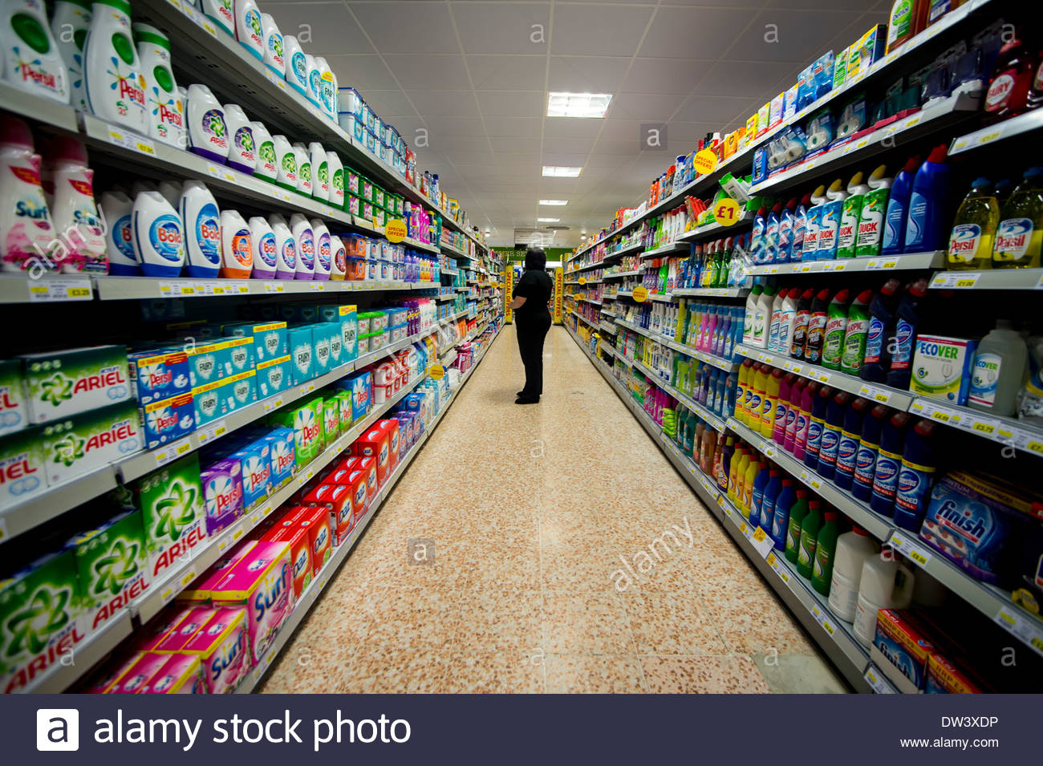

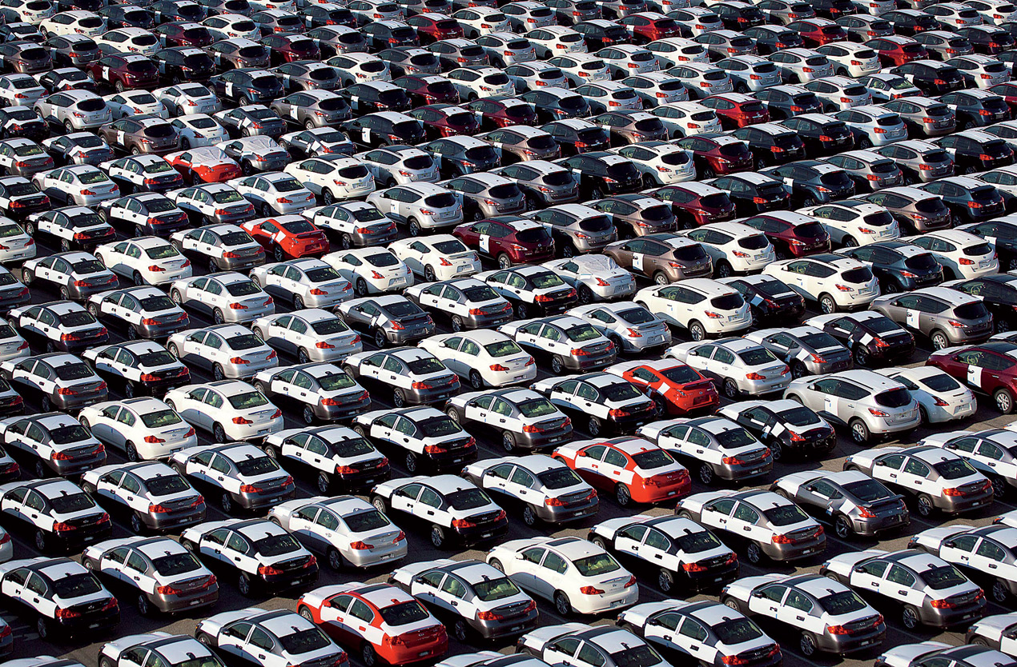
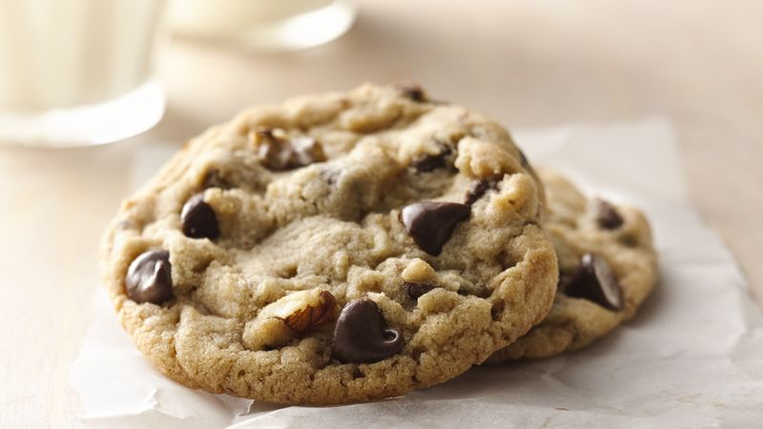
Consumer Theory

Slide 79
Consumer Theory
Consumer theory studies how individuals make choices, given restraints, such as their income and the prices of goods and services.
The decisions that consumers make about what and how much to consume shape the evolution of the overall economy. (60 - 70% of GDP)
It is assumed that consumers act in rational ways that can be observed and quantified.

Slide 80
Consumer Theory
Utility: the satisfaction one receives from consuming a good or service
Marginal utility: the satisfaction one receives from consuming one additional unit of a good or service.
Total utility: the total amount of satisfaction one receives from consuming a good or service in its entirety.
Law of Diminishing Marginal Utility: (ceteris paribus) as a person consumes more of a good or service, his/her marginal utility (satisfaction) will diminish with each unit consumed.
Examples?

Slide 81


Slide 82

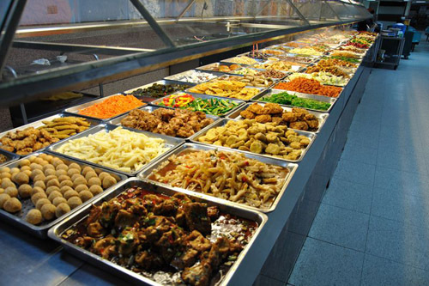

Slide 83
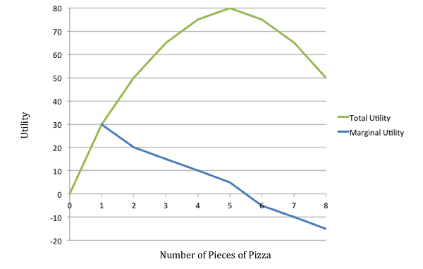
Consumer Theory

Slide 84
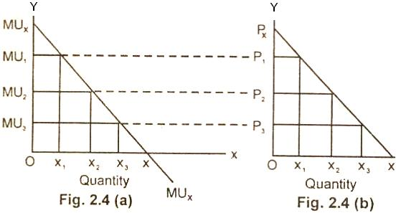

Slide 85
Budget Constraints and Indifference Curves
Budget Line: shows the combination of goods/services that can be purchased given a consumer’s budgetary constraints.
Ex: Sam’s income = $80. She wishes to purchases swimsuits and flip flops for the summer.
-Swimsuits cost $20
-Flip flops cost $10
If Sam purchases only swimsuits she can buy 4. ($80 (budget) / $20 (swimsuit cost)
If Sam purchases only flip flops she can buy 8. ($80 (budget) / $10 (flip flop cost)
There are several possible combinations of swimsuits and flip flops given her budget.
Ex: 2 swimsuits and 4 flip flops

Slide 86
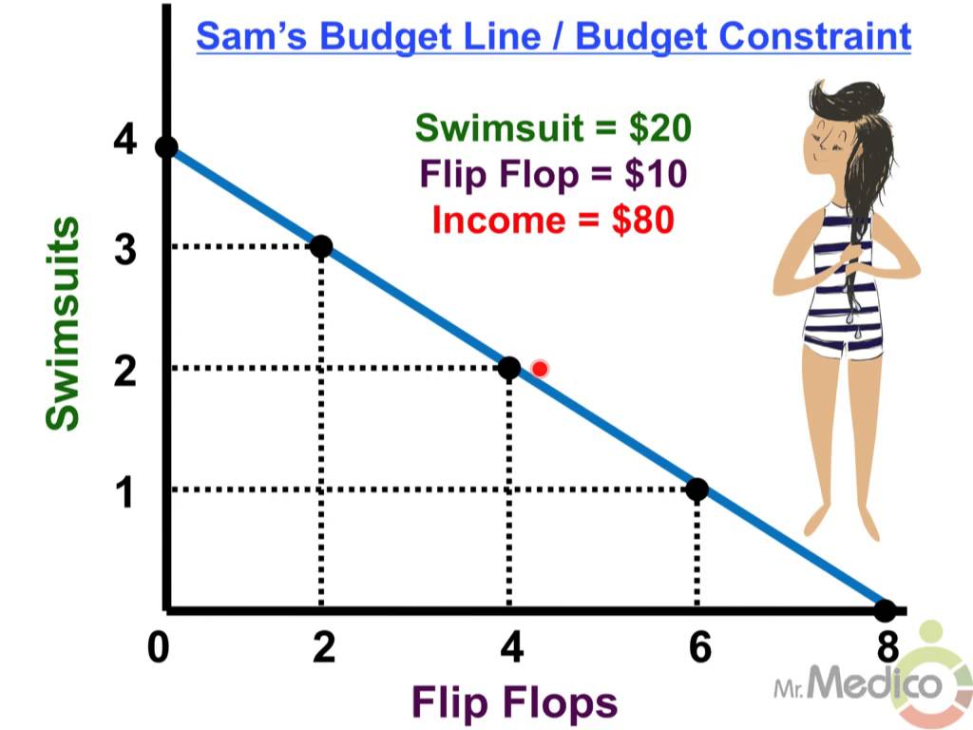

Slide 87
Indifference Curve: Shows all the combinations of two goods/services that give the consumer equal amounts of utility (satisfaction). The consumer is indifferent to the various combinations because they give equal amounts of utility.
Any of the following combinations provide 50 utils to Sam:
Swimsuits | FlipFlops
6 | 1
3 | 3
2 | 4
1 | 7

Slide 88
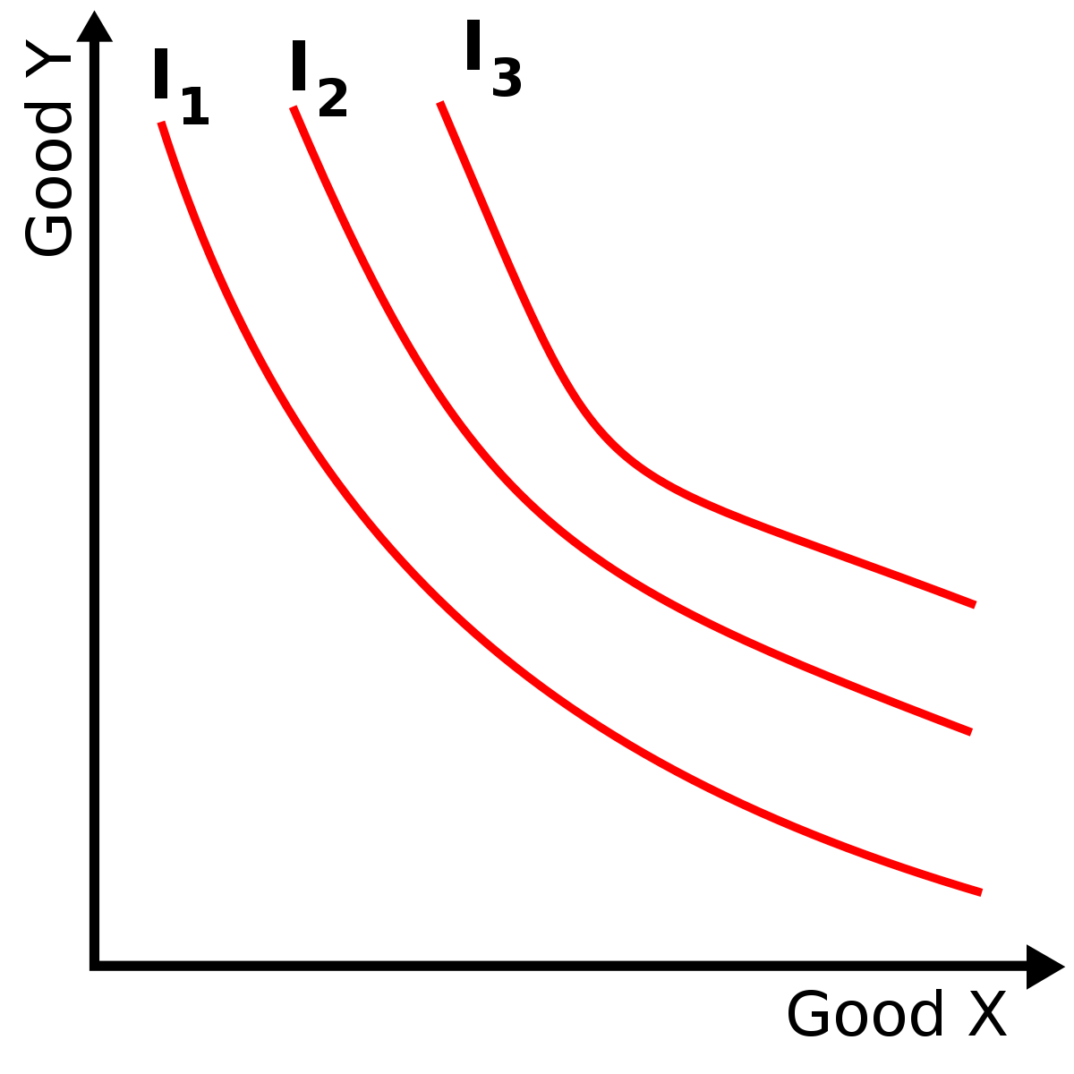

Slide 89
Consumer’s goal: to make decisions that attain the highest possible utility given the constraints of his/her budget.
The consumer will maximize his/her utility and be within his/her budget where the indifference curve is tangent to the budget line - Consumer Equilibrium

Slide 90
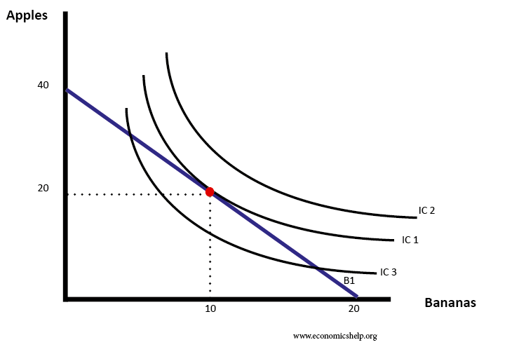

Slide 91
Consumer Theory
Have students keep a “Utility Log” where they measure their levels of satisfaction while consuming different types of goods or services. Students then construct individual utility graphs that demonstrate the Law of Diminishing Marginal Utility.
Students reflect on a decision they made between consuming two different goods or services. They calculate their budgetary constraint and construct a budget line. Students then add indifference curves and find the optimal point of consumption.

Slide 92
Digital Assessment Option:
Quizzizz.com

Slide 93


Slide 94
References
Khan Academy: https://www.khanacademy.org/economics-finance-domain/microeconomics
Mr. Clifford EconMovies: https://www.youtube.com/channel/UCCQEbqDL8i40d83Au55lYMQ
Investopedia: https://www.investopedia.com/terms

Slide 95

CEE Affiliates
https://www.councilforeconed.org/resources/local-affiliates/

Slide 96




Thank You to Our Sponsors!

