Slide 1
Macroeconomics Summer Institute Engaging Activities to Help Students See the Big Picture
Day 1: Fiscal Policy, Unemployment
and International Trade John Kruggel JMU Center for Economic Education 7/15/21
kruggejb@jmu.edu

Slide 2
EconEdLink Membership
You can now access CEE’s professional development webinars directly on EconEdLink.org! To receive these new professional development benefits, become an EconEdLink member. As a member, you will now be able to:
Automatically receive a professional development certificate via e-mail within 24 hours after viewing any webinar for a minimum of 45 minutes
Register for upcoming webinars with a simple one-click process
Easily download presentations, lesson plan materials and activities for each webinar
Search and view all webinars at your convenience
Save webinars to your EconEdLink dashboard for easy access to the event
You may access our new Professional Development page here

Slide 3
Professional Development Certificate
To earn your professional development certificate for this webinar, you must:
Watch a minimum of 45-minutes and you will automatically receive a professional development certificate via e-mail within 24 hours.
Accessing resources:
You can now easily download presentations, lesson plan materials, and activities for each webinar from EconEdLink.org/professional-development/

Slide 4
CEE Affiliates
https://www.councilforeconed.org/resources/local-affiliates/

Slide 5
https://bit.ly/CEEConference2021

Slide 6
60th Financial Literacy and Economic Education Conference
September 29th - October 1st, 2021
2-7 PM ET Daily
$20 discount for Summer Institute attendees
Register
https://councilforeconed2021.us2.pathable.com/
Promo Code
CEE60SI
SEE YOU THERE!!!

Slide 7
How did we do? Let us know! Please complete our survey: https://www.surveymonkey.com/r/SummerInstitute2021

Slide 8
Agenda
5 mins: Introduction, objectives, and standards
45 mins: Should we make that here? How comparative advantage impacts international trade.
50 mins: Circular flow and supply shocks, what happens when nations specialize and supply lines are disrupted.
50 mins: How big is too big? Looking at the stimulus packages and the role of the government in a recession.
25 mins: What is a K shaped recover? Looking at the groups hurt the most by the recession.
5 mins: Assessment questions

Slide 9
Objectives
Teachers will:
Gain access to activities they can use to bring timely macroeconomic topics to their students.
Explore how to adapt existing activities to address current events in the classroom.
Utilize additional resources they can use to integrate macroeconomic concepts into their existing curriculum.

Slide 10
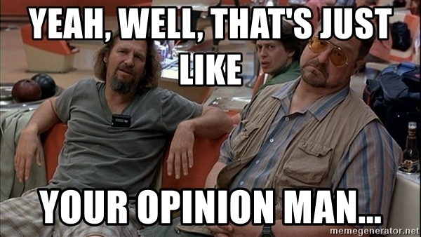

Slide 11
Macroeconomics
Macroeconomics gets a bit of a bum wrap because when we NEED macro theory to work (recessions), we NEED it to be both accurate and effective.
If macroeconomists are off even a little, people’s livelihoods are at stake.
But, that’s just my opinion man...

Slide 12
National Standards
Standard 5: Trade: Voluntary exchange occurs only when all participating parties expect to gain. This is true for trade among individuals or organizations within a nation, and among individuals or organizations in different nations.
Standard 6: Specialization: When individuals, regions, and nations specialize in what they can produce at the lowest cost and then trade with others, both production and consumption increase.
Standard 16: Role of Government and Market Failure: There is an economic role for government in a market economy whenever the benefits of a government policy outweigh its costs.
Standard 18: Economic Fluctuations: Fluctuations in a nation’s overall levels of income, employment, and prices are determined by the interaction of spending and production decisions made by all households, firms, government agencies, and others in the economy.

Slide 13
Nearpod Info
This presentation will use Nearpod to help demonstrate a number of the activities.
Nearpod has a maximum capacity of 150 participants.
We have 300 or so registrations.
We will operate on a first come, first served allocation for Nearpod.

Slide 14
Introductions
The next slide will use Nearpod to give us a chance to see where everyone is from and what you teach.
Recall, we are operating on the first come, first served method of allocating spots for Nearpod.

Slide 16
Should we make that here?
How comparative advantage impacts international trade

Slide 17
Trade
Trade is the voluntary exchange of goods and services.
Voluntary exchange occurs only when ALL participating parties expect to gain.
This holds true for trade among individuals or organizations within a nation, and among individuals or organizations in different nations.

Slide 18
Comparative Advantage and Specialization
The fundamental reason for trade is comparative advantage, which means specializing in the production of goods and services that can be produced at a lower opportunity cost than the cost a trading partner would have to pay to produce the same products.
Specialization based on comparative advantage increases the total output and consumption of the goods that are traded.

Slide 19
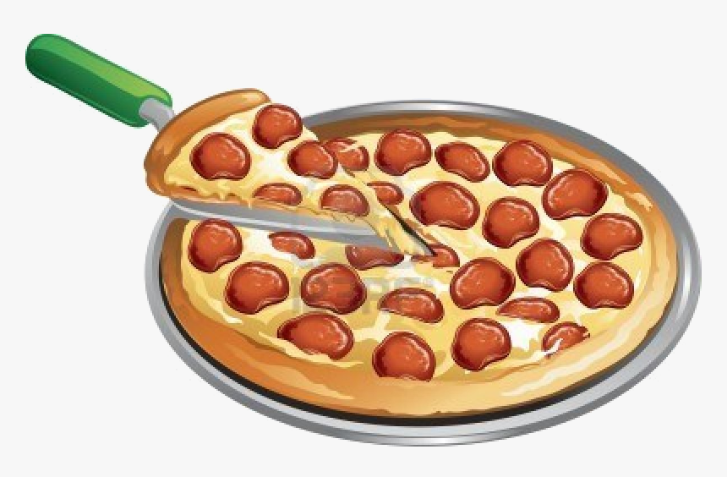
Who should do what?
Nino owns a pizza shop. He is very good at what he does.
In one hour he can make 9 pizzas or prepare 36 salads.
His business is growing and he needs to hire someone to help prepare pizzas and salads. Tony has applied for the job and seems like a reliable individual.

Slide 20
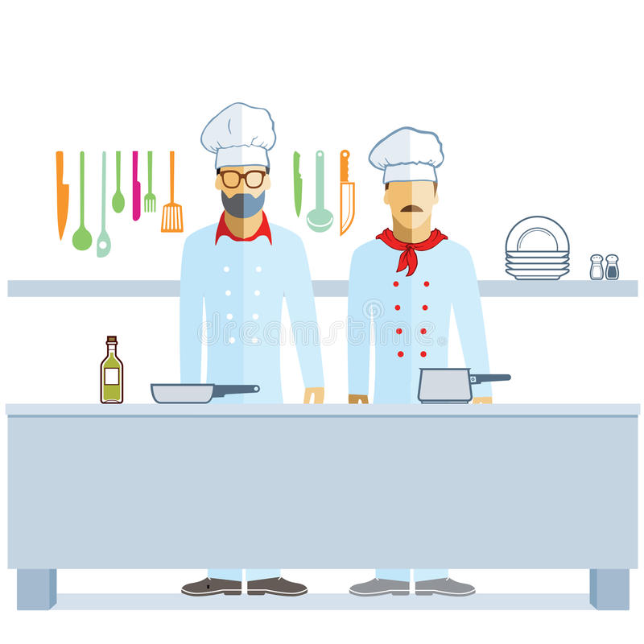
Who should do what?
In 1 hour Tony can make 6 pizzas or prepare 12 salads.
Nino plans to hire Tony. Since Nino can make more pizzas in an hour and prepare more salads in an hour than Tony, he has a dilemma.
Should he have Tony make pizzas or prepare salads?

Slide 21
Who should do what?
To answer this question, Nino should determine who can produce each good at a lower opportunity cost.
Help Nino figure that out by filling in the blanks in the following Nearpod activity.

Slide 22
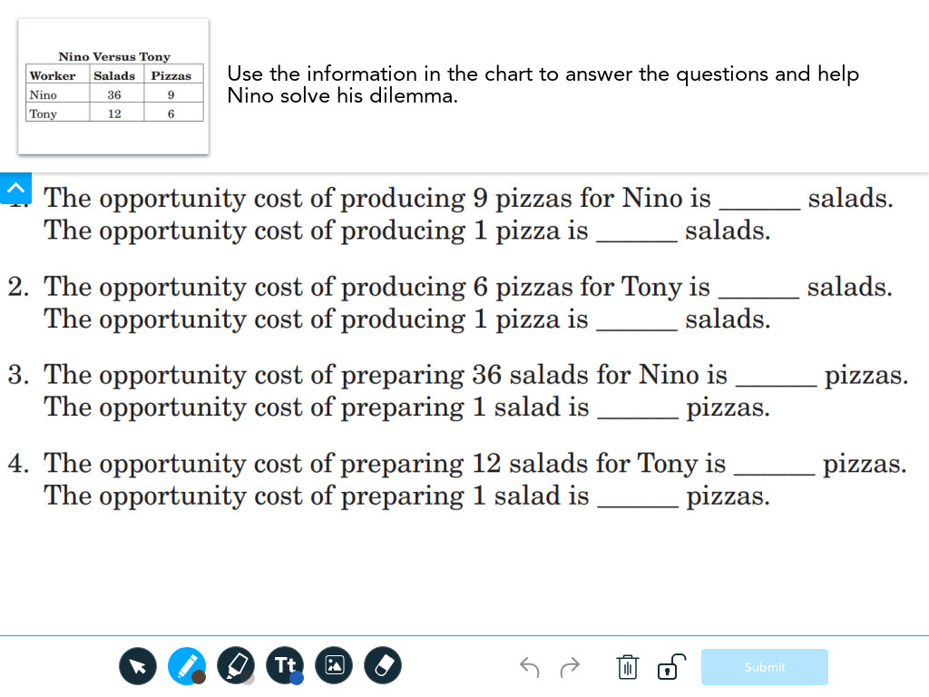
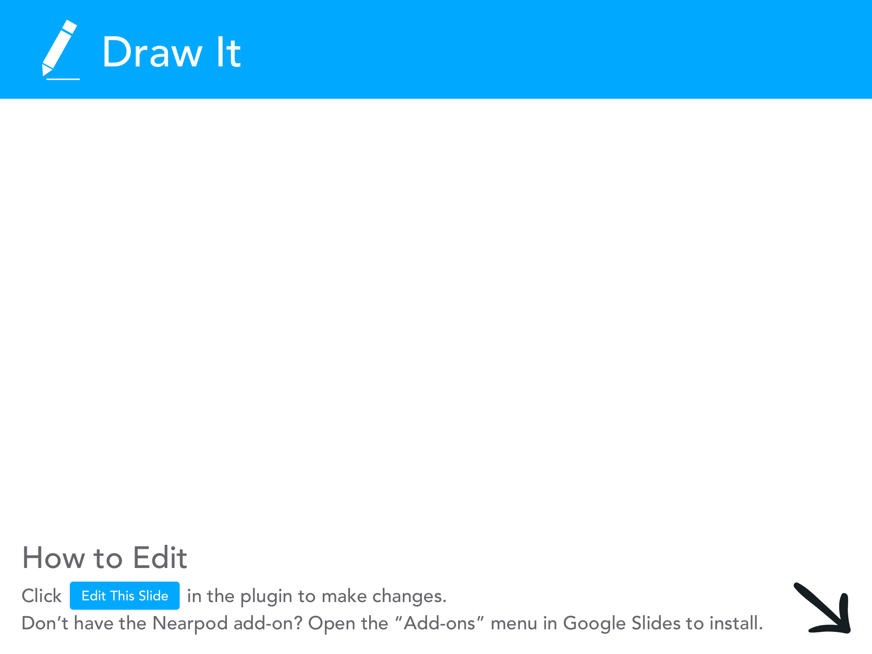

Slide 23
Answers
The opportunity cost of producing 9 pizzas for Nino is _36_ salads. The opportunity cost of producing 1 pizza is _4_ salads.
The opportunity cost of producing 6 pizzas for Tony is _12_ salads. The opportunity cost of producing 1 pizza is _2_ salads.
The opportunity cost of preparing 36 salads for Nino is _9_ pizzas. The opportunity cost of preparing 1 salad is _1/4_ pizzas.
The opportunity cost of preparing 12 salads for Tony is _6_ pizzas. The opportunity cost of preparing 1 salad is _1/2_ pizzas.

Slide 24
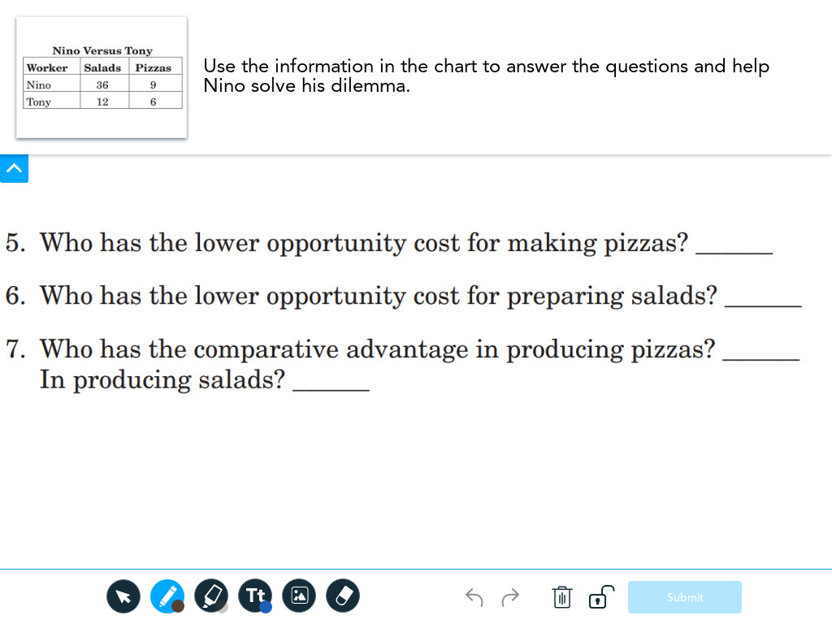

Slide 25
Answers
Who has the lower opportunity cost for making pizzas?
Tony (2 salads vs 4 salads)
Who has the lower opportunity cost for preparing salads?
Nino (¼ pizza vs ½ pizza)
Who should produce pizzas? Tony Salads? Nino

Slide 26
Visual Learners
One of the most powerful parts of this lesson is when you graph out the results.
Students are struck with the impact specializing based on comparative advantage has on the production possibilities curve/frontier.
Here’s a VERY quick refresher on the PPC.

Slide 27
Production possibilities curve/frontier
A) Inefficient production
B) Emphasis on guns
C) Emphasis on butter
D) Equal mix
X) CANNOT be produced given existing resources (increase in technology)…
there is a way to produce beyond the PPF with the existing resources through magic.

Slide 28
Tony’s Production possibilities curve/frontier
38
36
34
32
30
28
26
24
22
Salads
20
18
Tony
16
14
12
10
8
6
4
2
0
1
2
3
4
5
6
7
8
9
10
Pizzas

Slide 29
Nino’s Production possibilities curve/frontier
38
36
34
32
30
28
26
24
22
Salads
20
18
16
14
12
Nino
10
8
6
4
2
0
1
2
3
4
5
6
7
8
9
10

Slide 30
Tony & Nino’s Production possibilities curve/frontier
38
36
34
32
30
28
26
24
22
Salads
20
18
Tony
16
14
12
10
Nino
8
6
4
2
0
1
2
3
4
5
6
7
8
9
10

Slide 31
Let’s see the magic! What happens when they specialize based on comparative advantage?
38
36
34
32
30
28
26
24
22
Salads
20
18
Tony
16
14
12
10
Nino
8
6
4
2
0
1
2
3
4
5
6
7
8
9
10

Slide 32
Let’s see the magic! What happens when they specialize based on comparative advantage?
38
36
34
32
30
28
26
24
22
Salads
20
18
Tony
16
14
12
10
Nino
8
6
4
2
0
1
2
3
4
5
6
7
8
9
10

Slide 33
Make what you do best and trade for the rest!
This is true for businesses, individuals, and countries.
Specialization based on comparative advantage is one of the MOST important ideas in economics. However, the idea is very counterintuitive so many students struggle with the idea.

Slide 34
Additional Activity
Lesson 26 in the High School Economics curriculum has an additional activity on comparative where students flip cards with cell phones on one side and microwaves on the other side.
As students flip their cards it demonstrates the opportunity cost of producing more of one item over the other. Students graph out each point on the PPC as they flip cards.
The microwave and cell phone activity is very similar to the Tony and Nino one. However, the Tony and Nino activity is a better fit for virtual or hybrid learning.

Slide 35
Atlanta Fed Trade Infographic
The Atlanta Fed has a great series of infographics on a variety of topics (GDP, Entrepreneurs, Trade, Credit, etc.)
You can order a full set here
Here’s their infographic on trade:

Slide 36
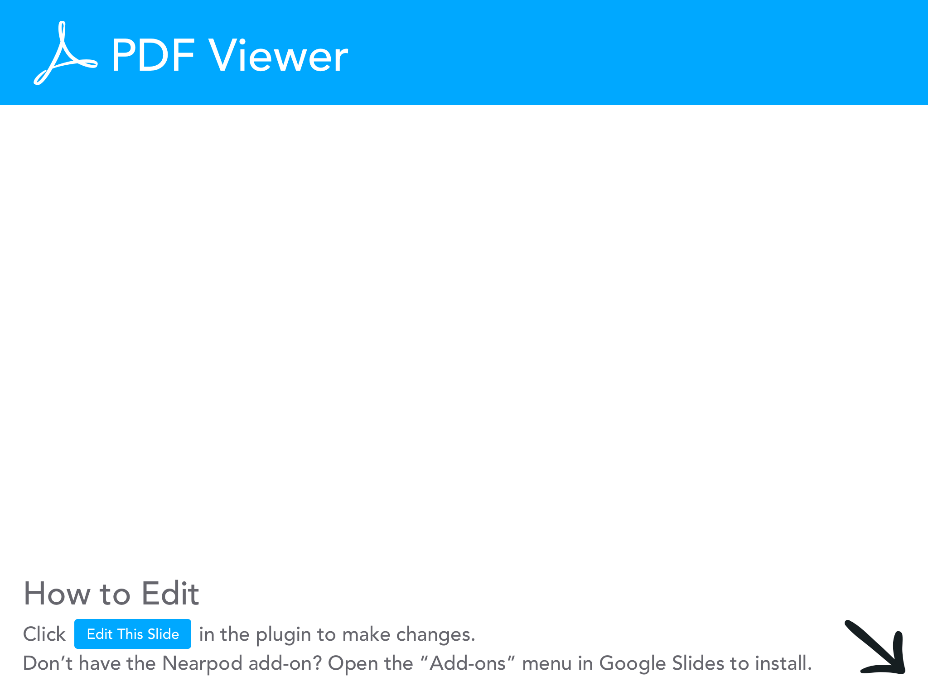

Slide 37
Bananas video clip
This video has some fun with trade and why governments sometimes don’t want to specialize based on comparative advantage.

Slide 38
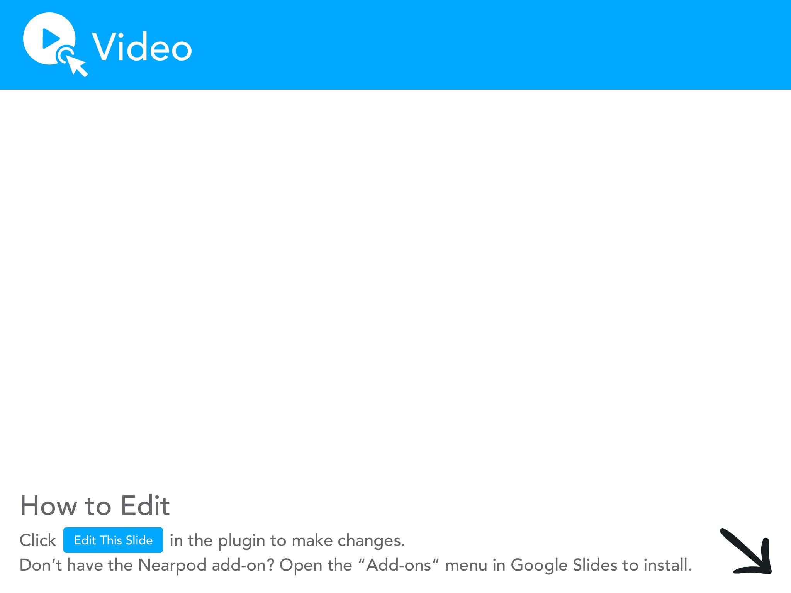

Slide 39
Specialization Extension
With Tony and Nino we saw how specialization based on comparative advantage can help increase production.
However, specialization can have drawbacks.
Here is an activity you can use to explore how specialization can be hindered.

Slide 40
Playful Economics
Playful Economics is a curriculum that uses modeling clay to teach economic concepts.
Lesson 8 in this curriculum focuses on specialization and division of labor.
Students are divided into 2 groups of workers.
One group forms an assembly line to make burgers out of clay.
In the other, workers produce each burger out of clay individually.

Slide 41
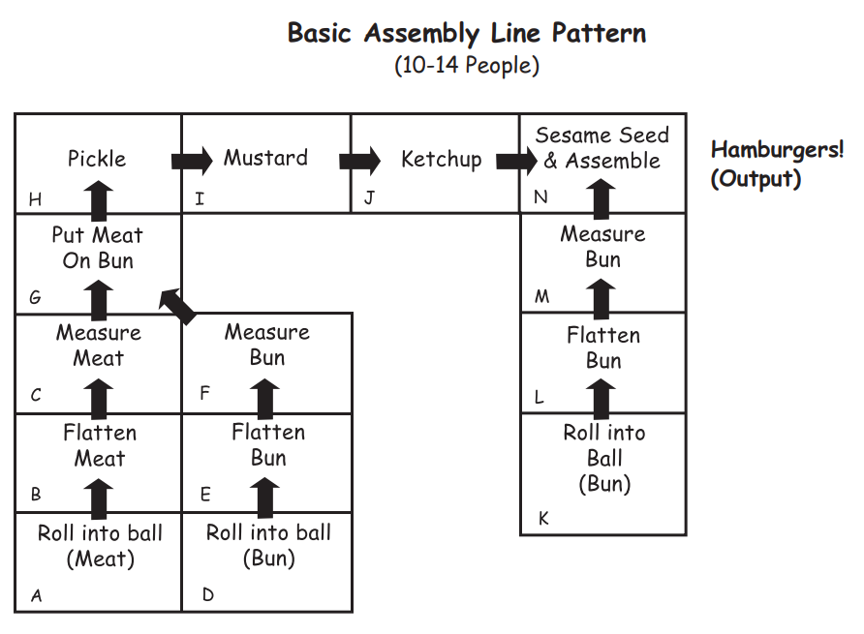

Slide 42
Wrap-Up
Give each team 5 minutes to make as many hamburgers as possible.
See which side can produce more given the time constraints.
Discuss why producers many prefer to use assembly lines to make goods. (cheaper costs, higher output)
Ask how consumers might benefit from assembly lines as well (more goods to consume, cheaper costs typically means lower prices).

Slide 43
Extensions
Break into 2 teams and make ice cream sundaes instead of clay burgers.
If you want something more active, get a bag of tennis balls and 2 empty buckets.

Slide 44
Extensions
Have 10 students line up in the front of the classroom. Place the tennis balls in one of the buckets, place the other bucket at the other end of the line of students. Give them 1 minute to get the balls from one bucket to the other by passing them along the line.
LEAVE the buckets where they are. Have 2 students come up and try to move all of the tennis balls in 1 minute.

Slide 46
Specialization
99% of the time, it works every time

Slide 47
Specialization Flaws
The Playful Economics lesson is designed for elementary students; however, my high school and university level students LOVE that activity.
Nine times out of ten the team with the assembly line can produce more hamburgers than the team with workers producing individually.
But every once and again (honestly, once a day) you get a GLORIOUS outcome, and one worker slows down the assembly line.

Slide 48
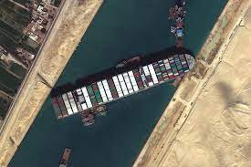
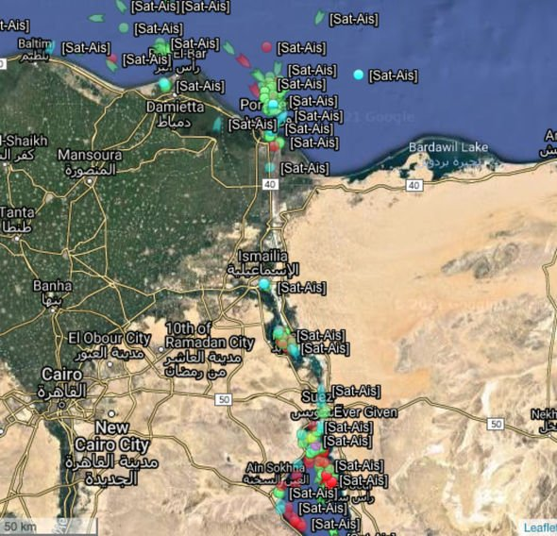
This concept applied at the macro level
Global trade was greatly disrupted by a SINGLE ship stopping traffic through the Suez Canal.
Estimated $9.5B in losses per day
Roughly 150 vessels were stuck
Choke points in trade routes can expose how trade between nations based on specialization can cause problems.

Slide 49
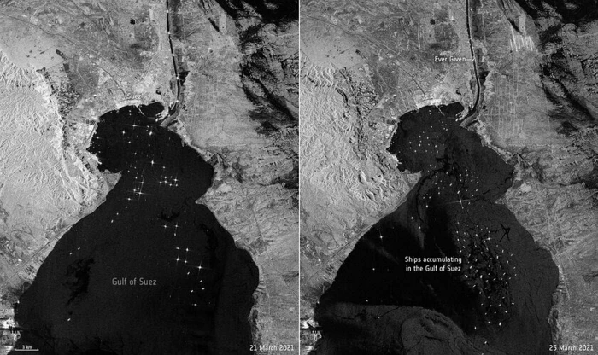
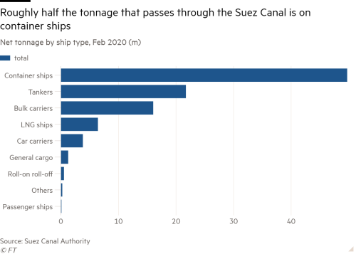

Slide 50
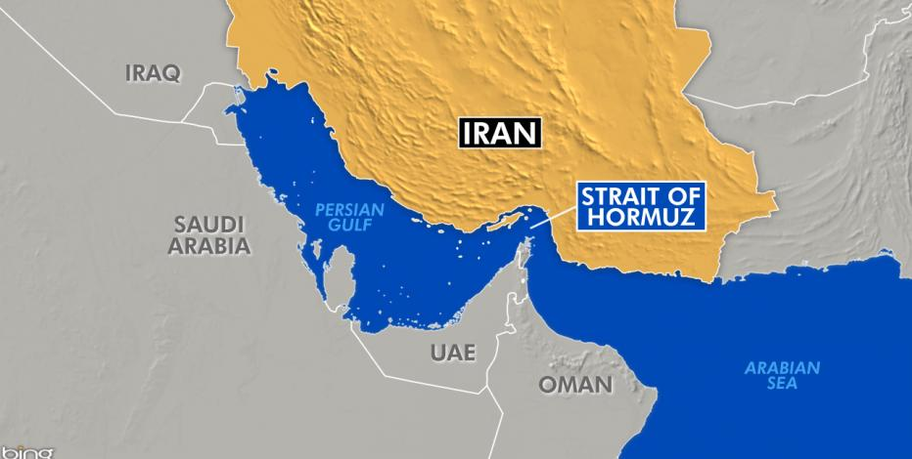
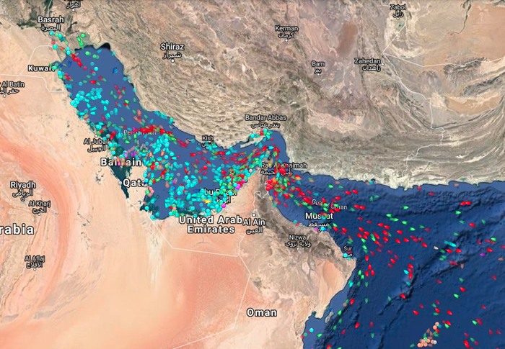
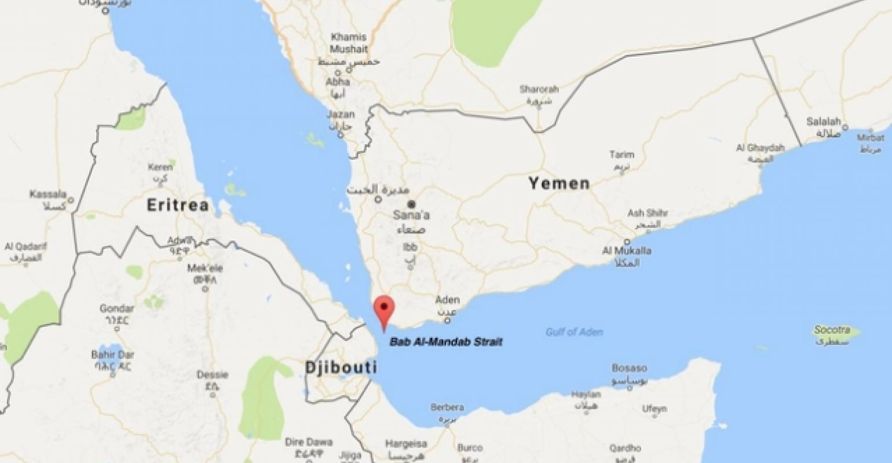
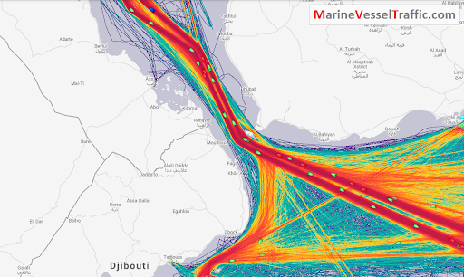
Other Choke Points

Slide 51
Trade Routes
Here’s a video you can use to illustrate how complex and pervasive international trade routes are.

Slide 52
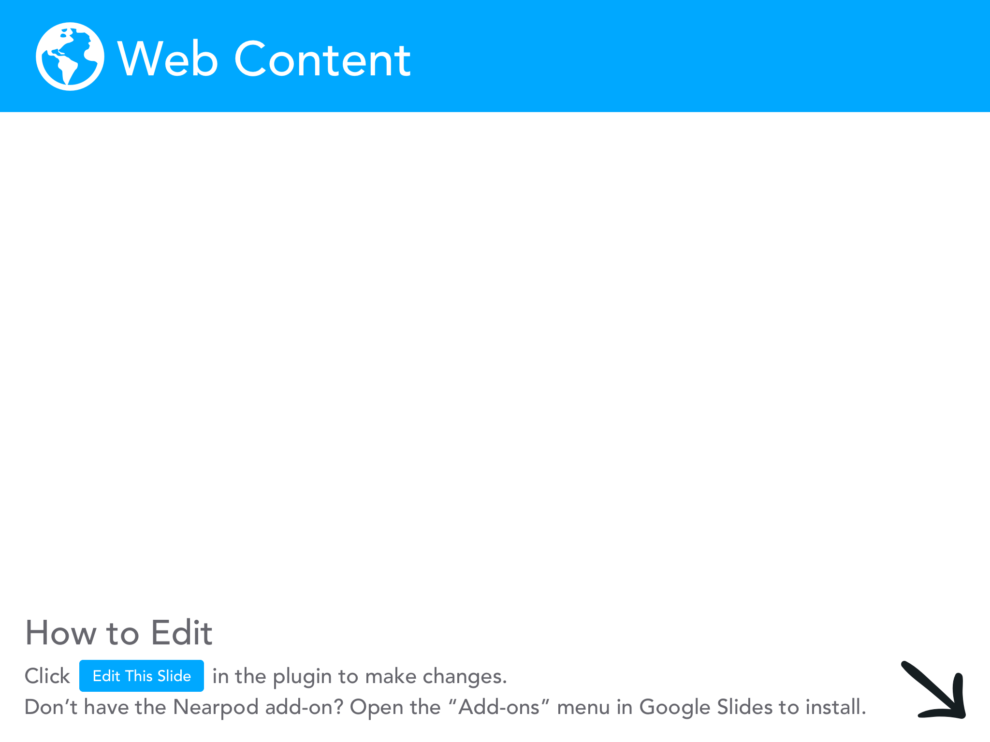

Slide 53
Circular Flows and Supply Shocks
What happens when nations specialize, and supply lines are disrupted?

Slide 54
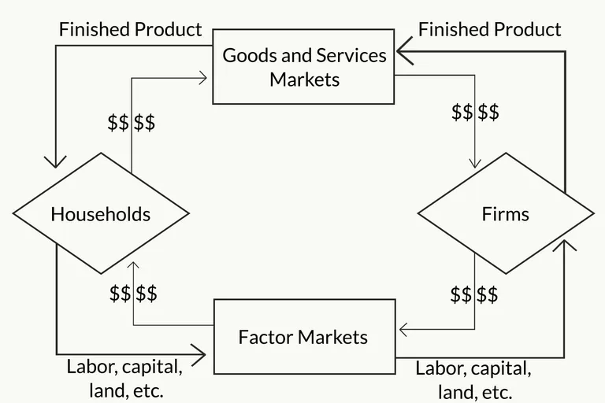
The Circular Flow Model
VERY quick refresher on the circular flow model
Product Market
Households own the factors of production (land, labor, capital) and consume goods and services.
Factor Market

Slide 55
The Circular Flow Model
Households pay firms for goods/services they need.
Product Market
Households supply labor to firms as well as land and capital.
Factor Market

Slide 56
The Circular Flow Model
Product Market
Firms produce goods by taking inputs (FOP) and turning them into outputs (finished products).
Factor Market

Slide 57
The Circular Flow Model
Firms supply goods/services they produce to households.
Product Market
Firms pay households for labor and land as well as paying back investors.
Factor Market

Slide 58
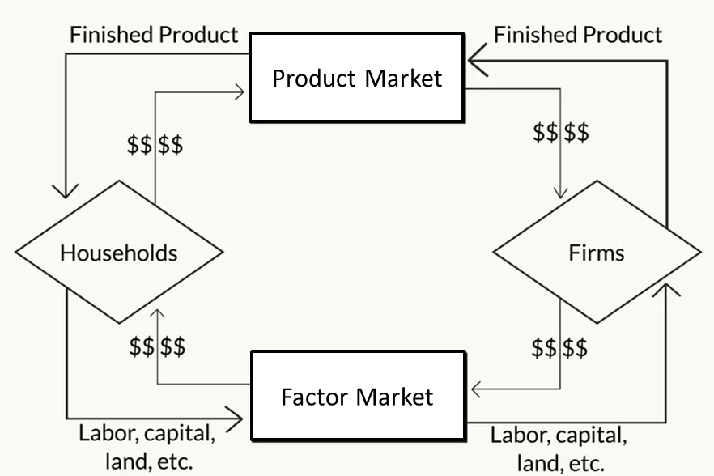
The Circular Flow Model
The product market is where finished products (goods/services) are exchanged for money.

Slide 59
The Circular Flow Model
Product Market
The factor market is where factors of production (land, labor, capital) are exchanged for money.
Factor Market

Slide 60
The Circular Flow
The Econoland activity is the BEST activity for demonstrating the circular flow model.
We are going to explore the activity as it is meant to be used, then we are going to adapt it to demonstrate what happens to interdependent economies when there are disruptions in the supply chain.

Slide 61
Econoland
In the Econoland simulation students are divided into households and businesses.
When setting up the activity, place a “Resource Market” (factor market) sign on one wall and an “Econo Market” sign on the opposite wall. Tape an “Econo Factory” sign on another wall.
You will need productive resource slips for the households (divide half of the students into households).

Slide 62
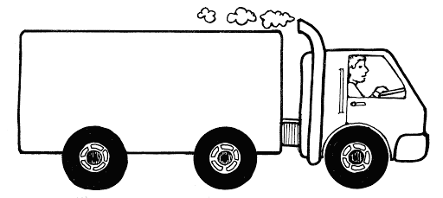
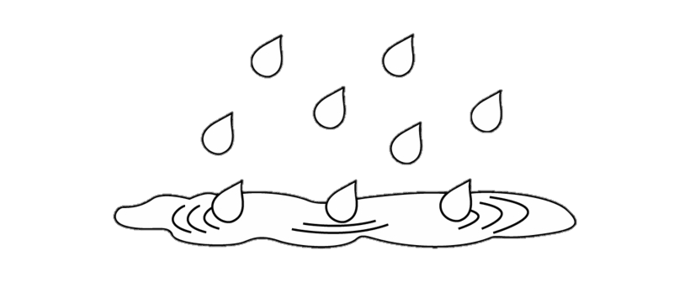
FOP Cards
Human Resources
Capital Resources
Natural Resources

Slide 63
Econoland
Each household starts with a set of resource cards (randomly assigned).
Households want to end up with Econos.
Each business starts with $20.
Businesses want to end up with as much money as possible.
Households need to sell their FOPs to businesses at the Resource (Factor) Market (sign on the wall).

Slide 64
Econoland
Businesses need to take a complete set of FOP cards (one land, one labor, one natural) to the Econo Factory to trade them for an Econo Card.
Households need to buy Econos from businesses at the Econo Market (Product Market).

Slide 65
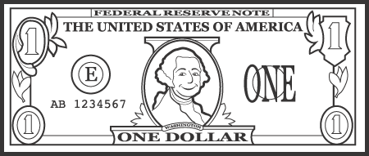
Econo and Money Cards
One Econo

Slide 66
Adapting Econoland
Simulate a global economy:
Give some households more capital resource cards than others.
Give some households more natural resource cards than others.
Give some households more labor cards than others.

Slide 67
Adapting Econoland
Simulate a shortage created by relying heavily on trade based on specialization:
Give all of the capital cards to one household.
Create a trade barrier by charging a tariff to trade with that household.
Simply remove all of the capital cards to demonstrate what happens when a producer is missing. OR, give them a small number of capital cards, when they run out give them one more every few minutes to simulate a shortage in the global economy.
(would this ever happen in the modern economy?)

Slide 68
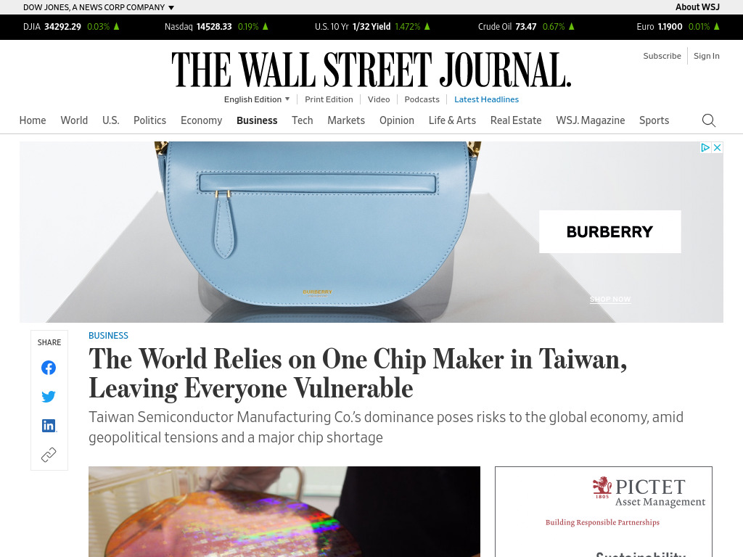

Slide 69
But WHY don’t we make chips?
Remember, make what you do best and trade for the rest.
According to Forbes:
(Semiconductor) Manufacturing on U.S. soil has eroded sharply over the last 20 years, from 37% to 12% and...it will fall to 10% by 2030. The costs of manufacturing chips are rising too high to be globally competitive: The 10-year cost of a new fab, the factory where semiconductors are produced, on U.S. soil is now 30% higher than building the same fab in Taiwan or South Korea, and up to 50% higher than China...Asia’s share of global semiconductor manufacturing will amount to 83% by 2030.

Slide 70
Government to the rescue?
The Senate has passed the CHIPS for America Act.
The House has not passed it yet.
The Act includes over $22B in federal investments for semiconductor research, design, and manufacturing.
40% tax credit for semiconductor equipment or facility costs through 2024, reduced through 2027.
So, SHOULD we make that here?

Slide 71
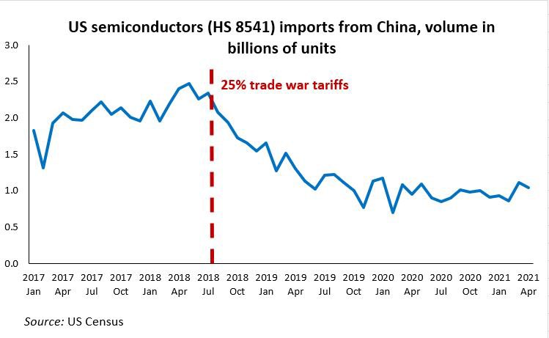
Government to the Rescue?
Of course, there could be another reason why there’s a chip shortage...

Slide 72
Government to the Rescue?
Of course, there could be another reason why there’s a chip shortage...
Jan 21, 2020 CDC confirms first case of COVID in US.

Slide 73
Government to the Rescue?
Of course, there could be another reason why there’s a chip shortage...
So, should we make them here? OR could we encourage free trade?

Slide 74
Bastiat’s Nightmare
Bastiat’s Sophisms are a GREAT read if you are looking for parables on free trade vs. protectionism.
The semiconductor situation is almost as if the government read his Sophisms and decided to do the opposite of what Bastiat suggested.
Tariffs to stymie competition AND subsidies for producers instead of using free trade to increase availability of semiconductors while maintaining/reducing costs for producers AND consumers.

Slide 75
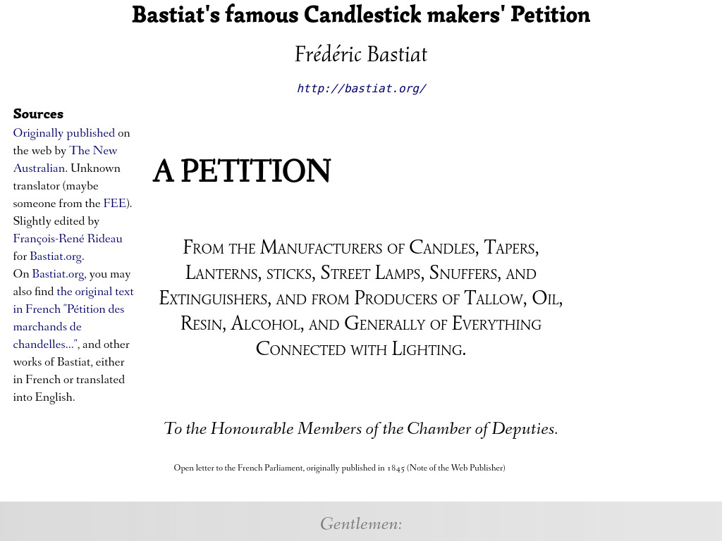

Slide 76
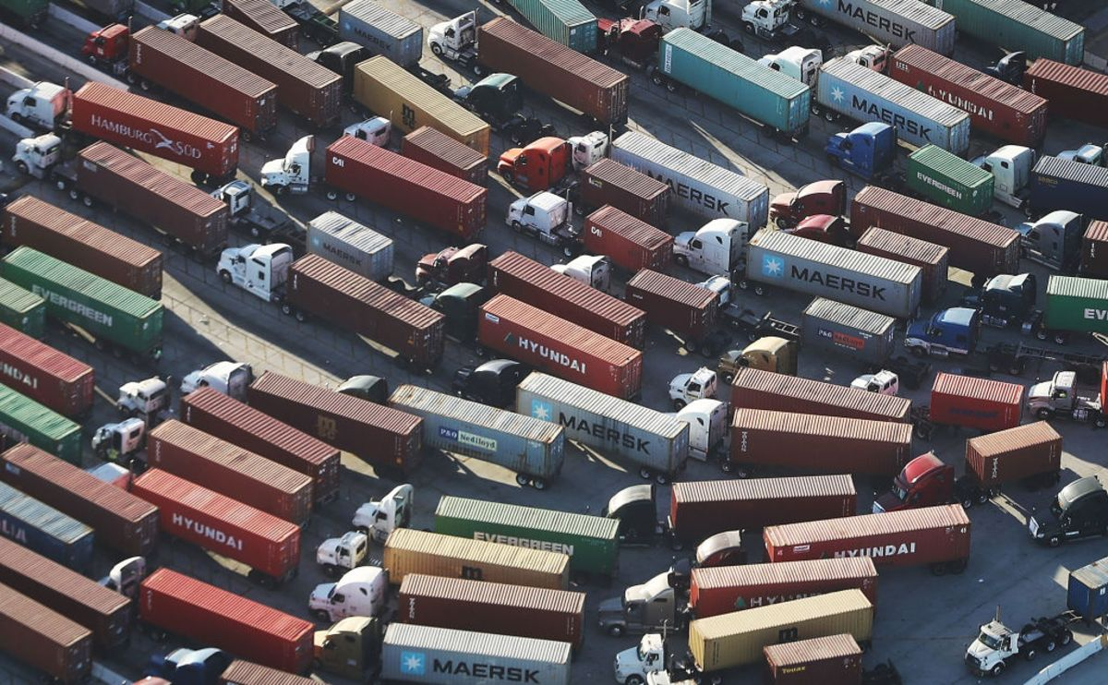
Cargo Traffic Jams
While the Suez blockage is widely known, it is NOT the only current traffic blockage involving cargo vessels.

Slide 77
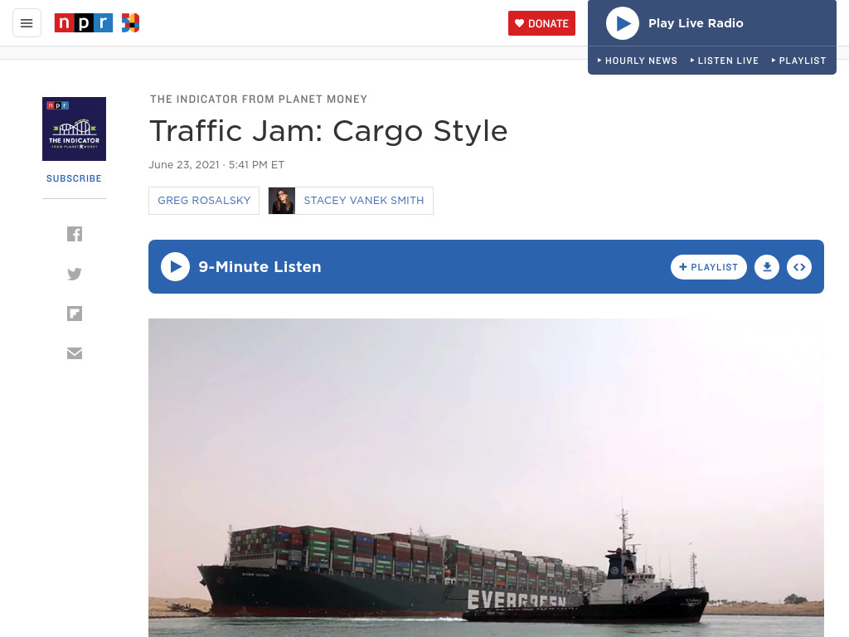

Slide 78
Cargo Ships
There’s another great clip for demonstrating how immersive global trade has become and how the shipping container has become ubiquitous to trade.

Slide 80
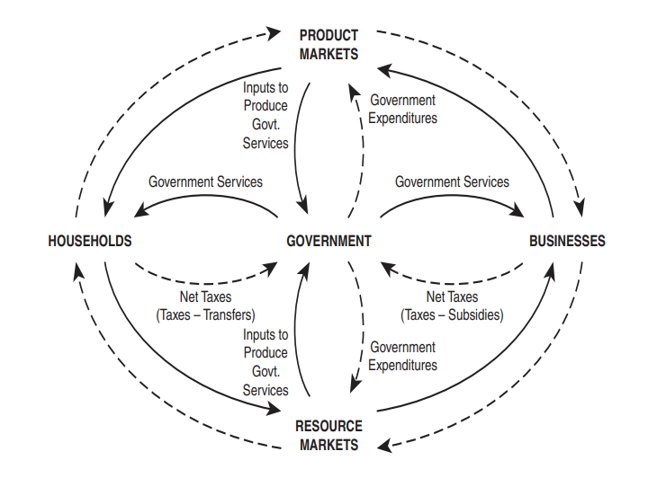
Circular Flow Model with Government
Of course the circular flow model is incomplete if you don’t include the public sector.
I add these wrinkles when I discuss fiscal policy with my students.

Slide 81
How big is too big?
Looking at the stimulus packages and the role of the government in a recession.

Slide 82
Government Spending
Fiscal policy is a strong tool for economic growth. Here are two different views on fiscal policy I used to share with my students:

Slide 83
“The first lesson of economics is scarcity: there is never enough of anything to fully satisfy all those who want it. The first lesson of politics is to disregard the first lesson of economics.”
Thomas Sowell, Basic Economics

Slide 84
“Government is like a surgeon’s scalpel: It is an intrusive tool that can be used for good or for ill. Wielded carefully and judiciously, it will facilitate the body’s remarkable ability to heal itself. In the wrong hands, or wielded overzealously with even the best of intentions, it can cause great harm.”
Charles Wheelan, Naked Economics

Slide 85
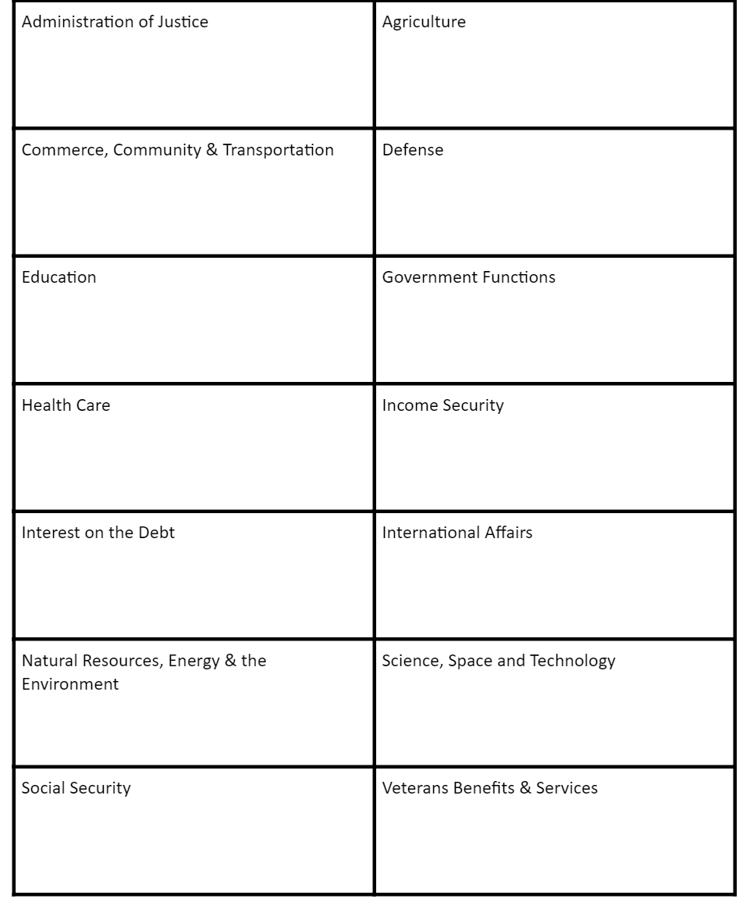
To The Penny Activity
This is a brand new activity developed by the Foundation for Teaching Economics.
In this lesson, students start by sorting 100 pennies as they think are allocated in the federal budget by stacking them in the appropriate boxes.
1 penny=1% of budget

Slide 86
Breakout Rooms
For this next activity, you will partner up in breakout rooms.
I am going to provide a link to Google Slides where you can move pennies into each category.
YOUR BREAKOUT ROOM NUMBER MATCHES THE GOOGLE SLIDE YOU SHOULD MANIPULATE.

Slide 87
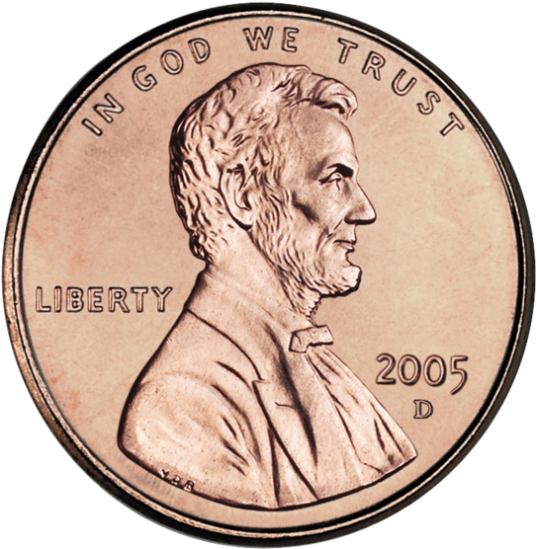
To The Penny
Administration of Justice | Commerce, Community & Transportation | Education | Health Care | Interest on the Debt | Natural Resources, Energy & The Environment | Social Security
Agriculture | Defense | Government Functions | Income Security | International Affairs | Science, Space & Technology | Veterans Benefits & Services
27
23
16
Actual Budget Allocation 2019
Notes:
If running this activity in a virtual classroom, this slide replaces Visual 2-1.

Slide 88
Debrief
How did your predictions compare to the actual 2019 budget?
What surprised you most?

Slide 89
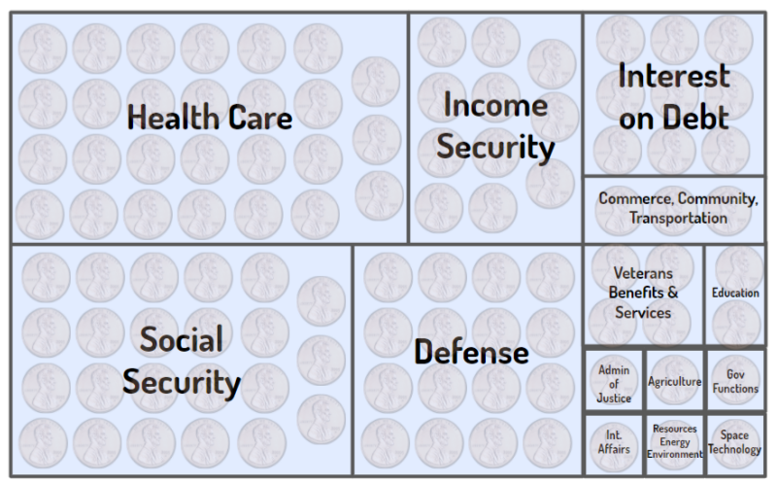
Discretionary Spending: Elected officials have the discretion to change this spending from year to year as part of the annual budget and appropriations process.
Mandatory Spending: Determined by law (prior commitments of government). Cannot be changed as part of annual budget and appropriations process.

Slide 90
Breakout Rooms
For this next activity, you will partner up in breakout rooms.
I am going to provide a link to Google Slides where you can move pennies into each category.
YOUR BREAKOUT ROOM NUMBER MATCHES THE GOOGLE SLIDE YOU SHOULD MANIPULATE.

Slide 91
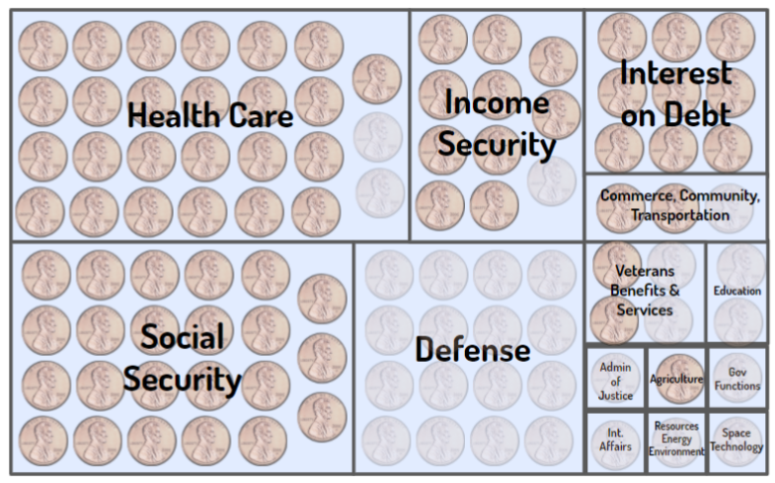
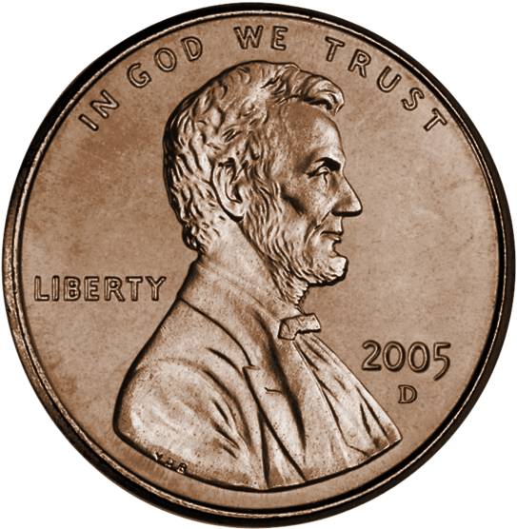
Mandatory vs Discretionary - Actual
Mandatory
Discretionary
Notes:
Allocation of the 2019 Federal Budget
If running this activity virtually, this slide replaces Visual 2-2.

Slide 92
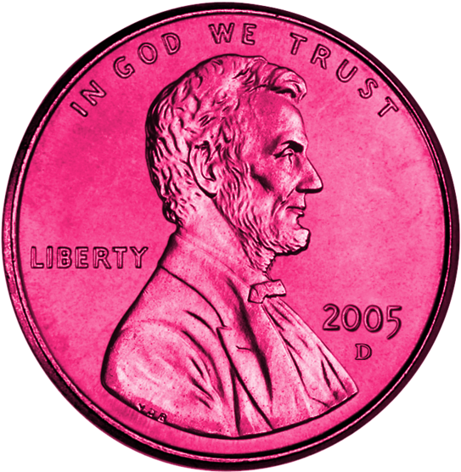
To the Penny
DIRECTIONS: Shaded pennies represent mandatory spending. The 78 pink pennies below represent money you have (tax revenue). Decide where to spend the tax revenue by placing pink pennies in the appropriate categories.. Come up with suggestions for how to deal with the uncovered pennies.
Notes:
If running this activity virtually, this slide and the team slides below replace Visual 2-2 and can be used for the ROUND 2 Procedures 13-16.
Make your own copy of the team slides below and share them so “anyone with the link” can EDIT.
Team Slides: https://docs.google.com/presentation/d/12jSexHyZdcR6jCSvZq_NO1XDlmDTfjSHNwalvjE8zPE/edit?usp=sharing
Share the link to your deck of Team Slides in the meeting chat.
As students are opening the slides explain that they will return to the same breakout room and once again, their breakout room number is also the slide number their team is assigned to work on.
Re-open the same breakout rooms so students return to work with the same team. Dismiss to breakout rooms.
Watch student progress on the shared slides. Visit breakout rooms that seem to be lagging or that ask questions.
After most teams have allocated most of their pennies, close the breakout rooms.
Display several of the team slides so they can see how other teams answered.

Slide 93
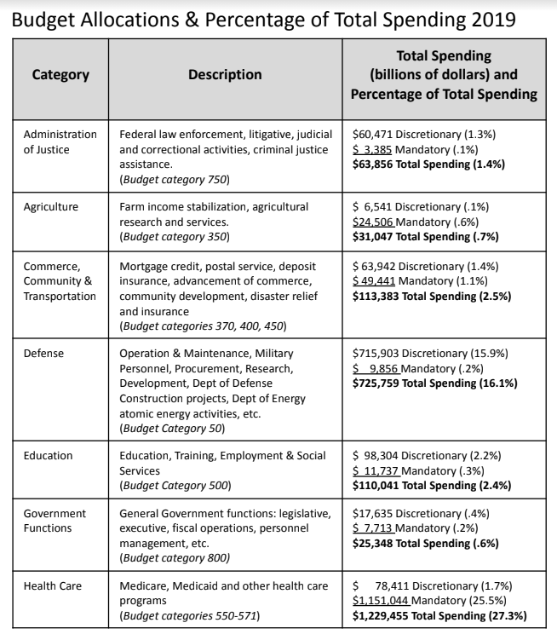
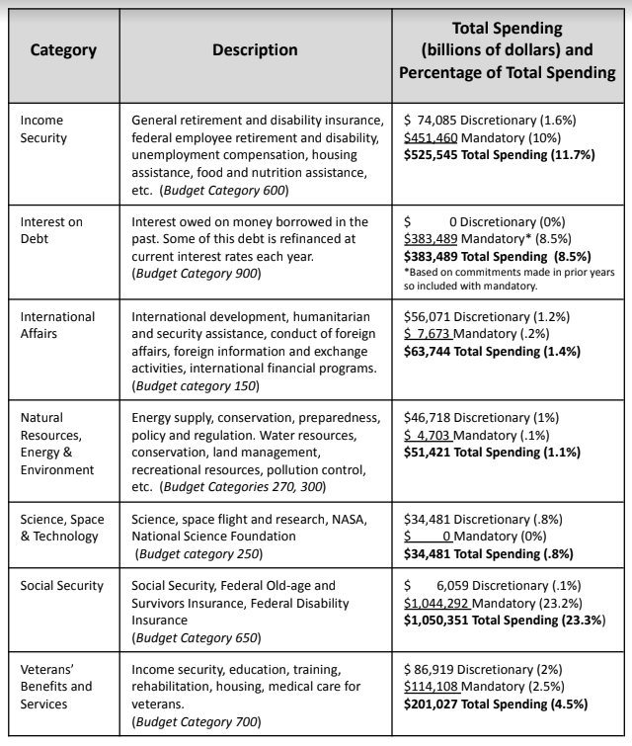
Definitions of Categories

Slide 94
COVID-19 Fiscal Responses Around the World
This lesson gives students a chance to compare the U.S. fiscal policy response to COVID-19 with other countries.
Activity 2 of this lesson guides students to the International Monetary Fund site detailing policy responses to COVID-19.
Students are guided to use a T Chart to compare the U.S. response to another country (assigned by the teacher).
This lesson should give students a larger perspective on the U.S. response & builds nicely on the To The Penny activity.

Slide 95
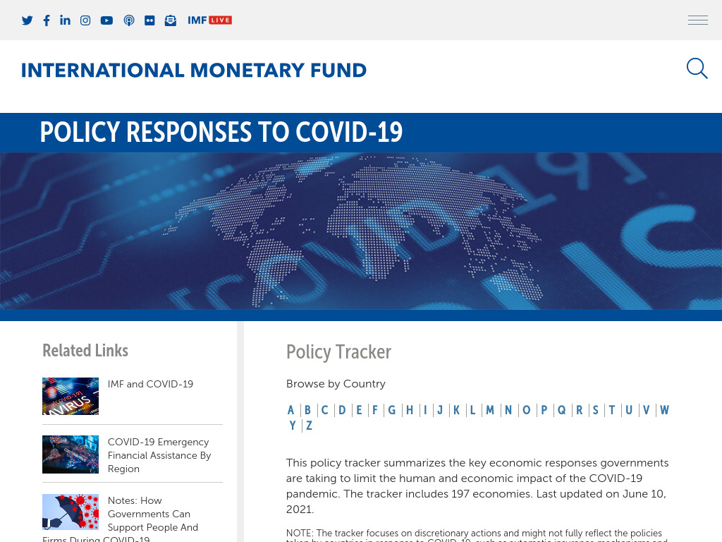

Slide 97
Why would policymakers react this way?
It is hard to argue that people in charge of economic policy/enacting economic policy spent A LOT of money in the recovery efforts from COVID…
(both fiscal policy AND monetary policy)
Why would they react in this fashion, what caused such quick and decisive action?

Slide 98
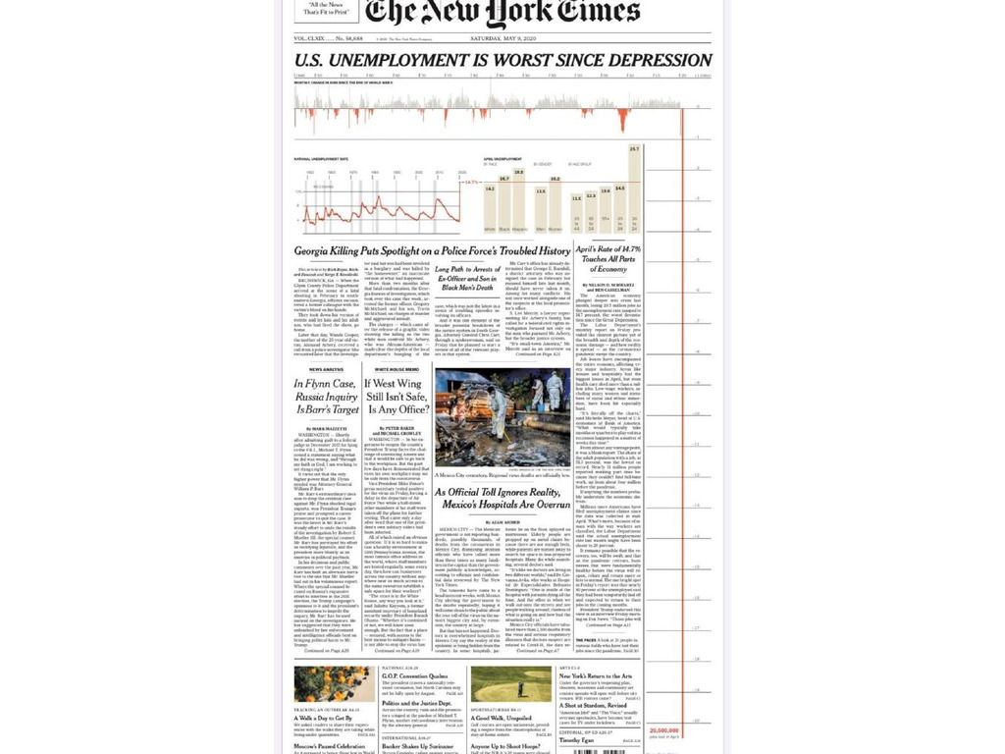

Slide 99
What is a K shaped recovery?
Looking at the groups hurt the most by the recession.

Slide 100
Why Doesn’t COVID-19 Affect Everyone Equally?
Which region has the highest concentration of distressed zip codes?
Which region has the highest degree of prosperity?
The blue zones are areas of prosperity
Prior to the arrival
of the virus, many Americans were already struggling
financially.
The different shades of brown denote zip codes experiencing
varying degrees of
economic distress.

Slide 102
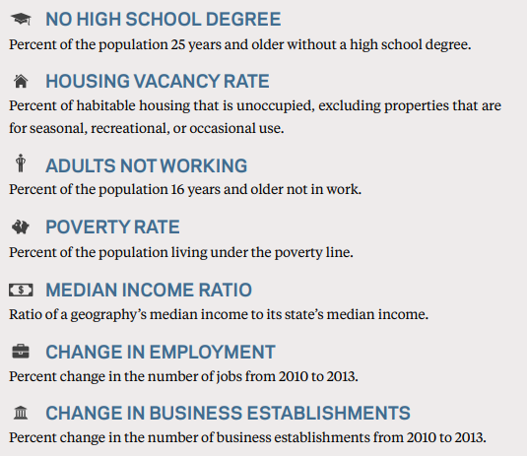

Slide 103
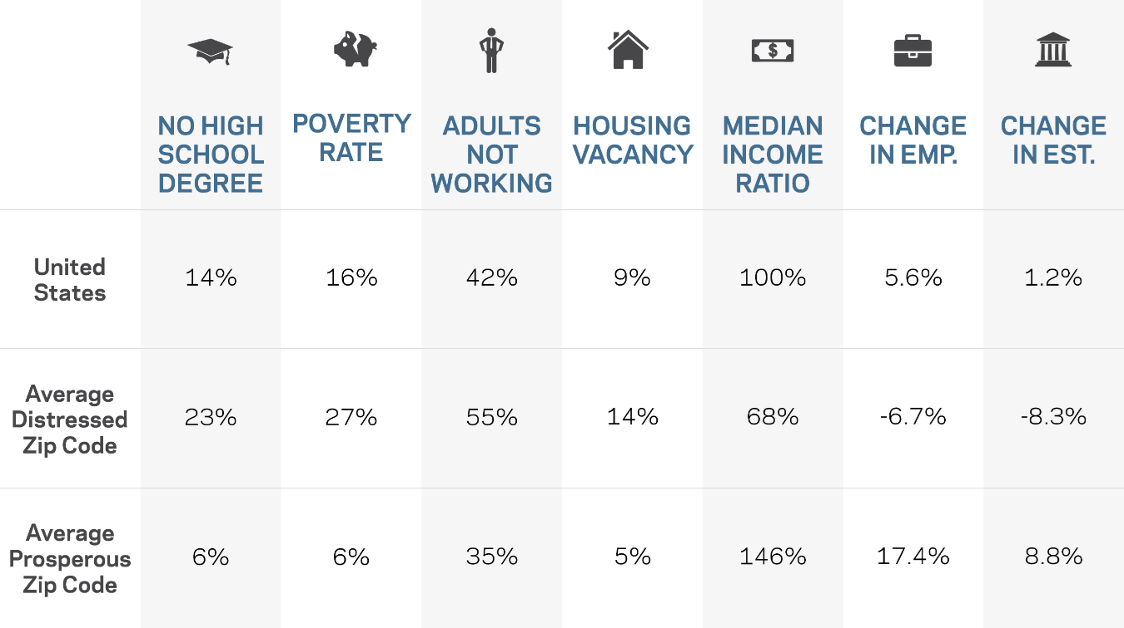
Which disparity stands out the most for you between prosperous and distressed communities (last two rows)?
Source: EIG’s Distressed Communities Index, 2016

Slide 105
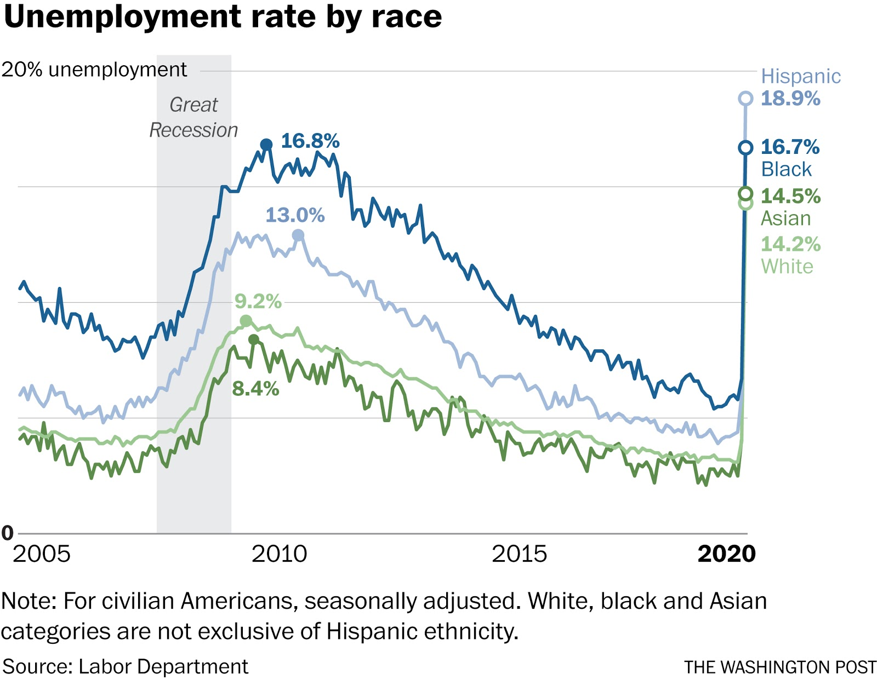
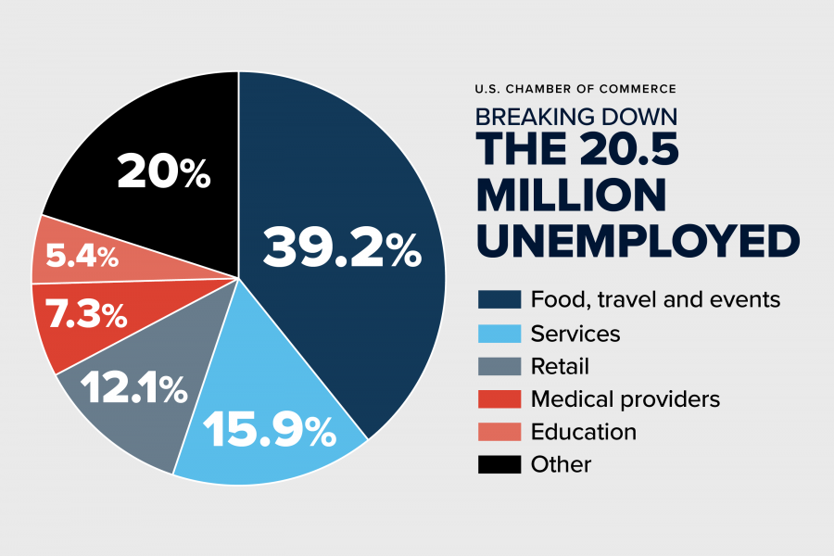
Pandemic Unemployment

Slide 106
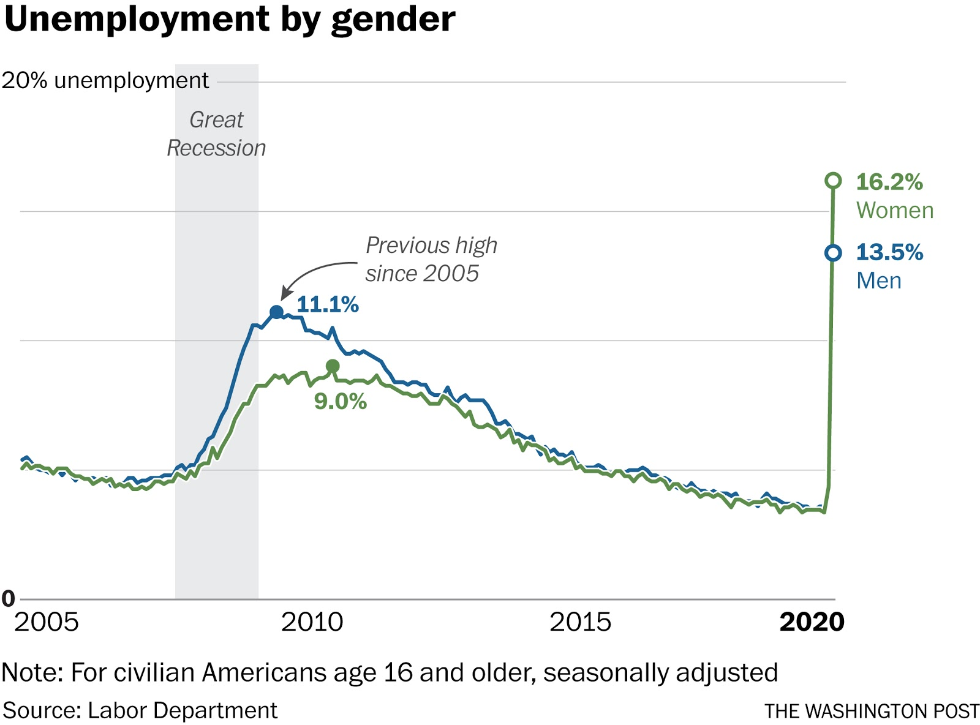
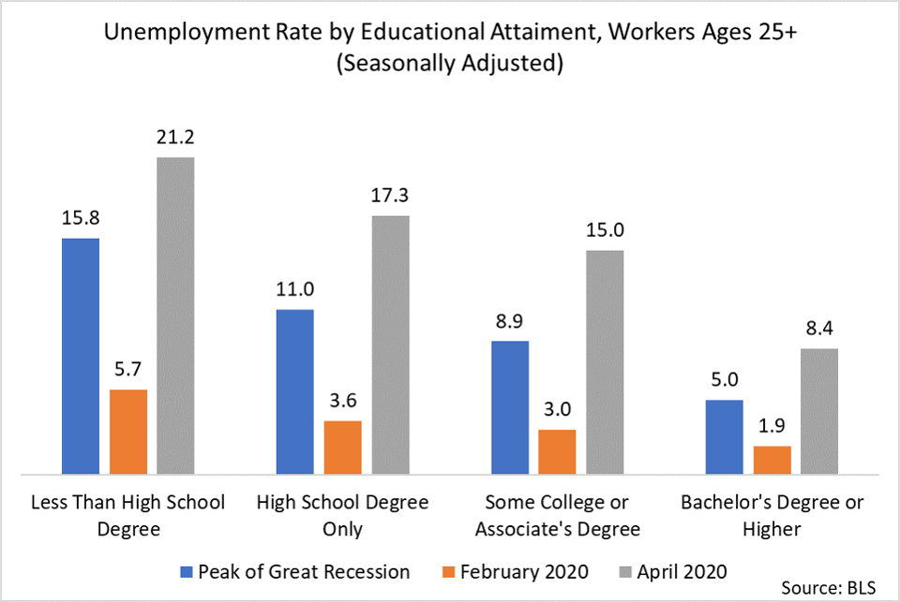
Pandemic Unemployment

Slide 107
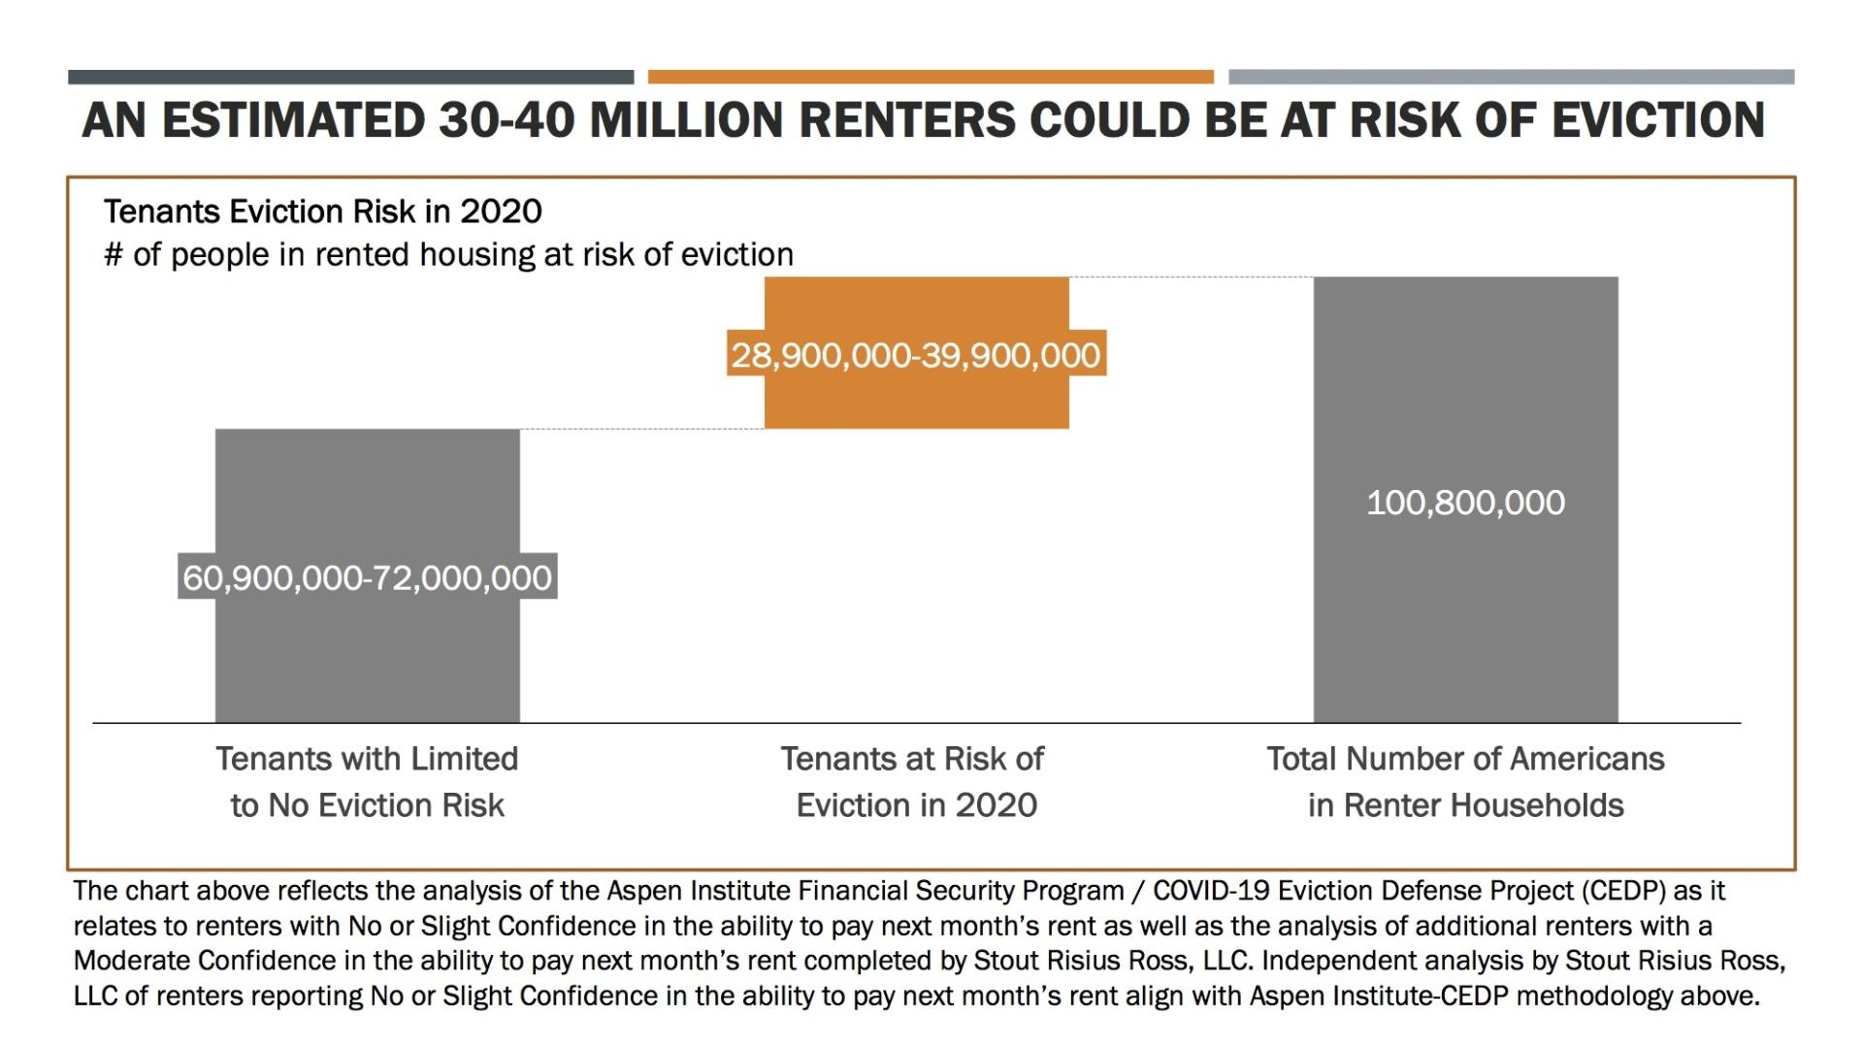
One in four renters spent more than half their income on housing in 2018

Slide 108
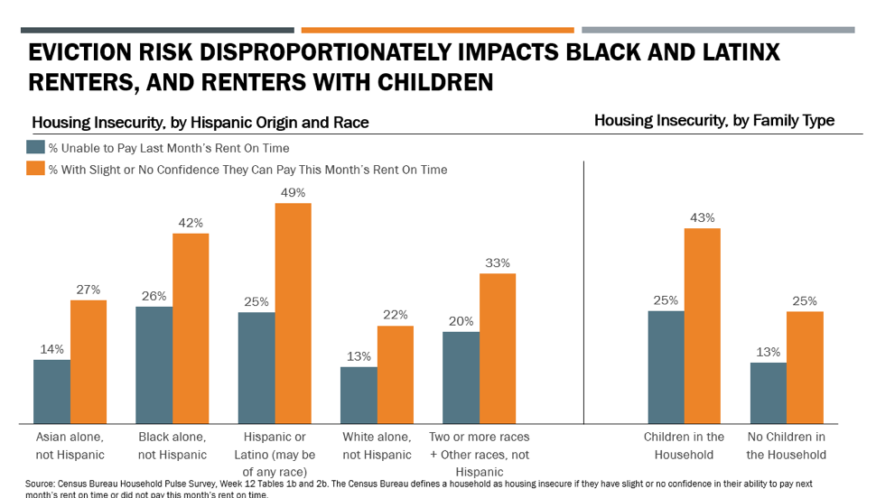
Nearly half of Black and Hispanic renters have slight or no confidence in their ability to pay next month’s rent on time.

Slide 109
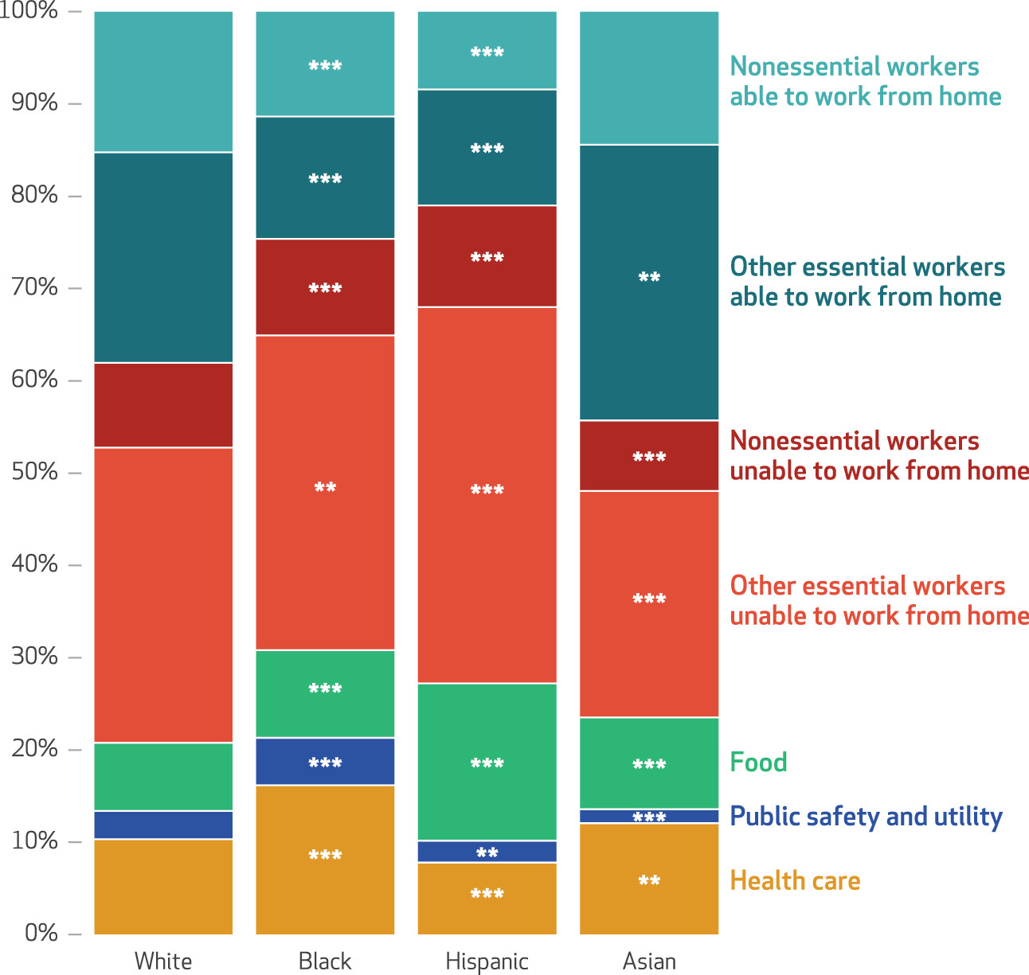
Job Characteristics
These job characteristics suggest the possibility of disparities in employment-related infection risk across race and ethnicity.

Slide 110
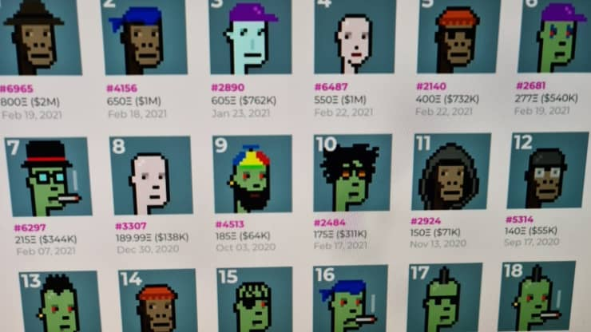
Some people have money to burn
$600,000
Digital avatars
listed as
non-fungible tokens (NFTs)
on CryptoPunks.
Notice the prices…

Slide 111
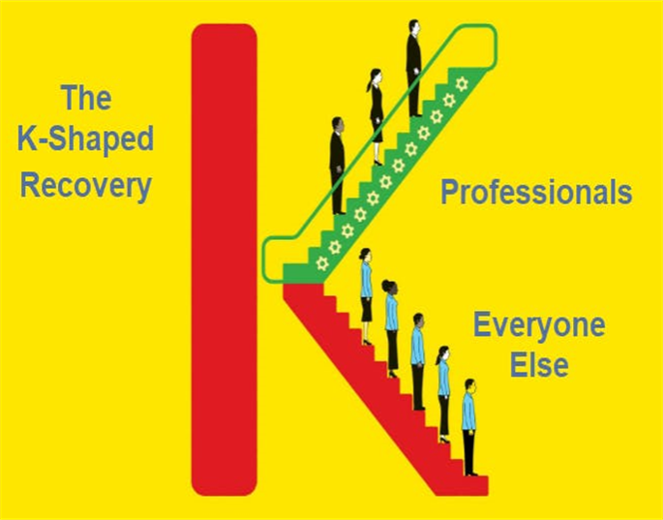
A “K” Shaped Recovery Illustrates The Post-COVID Divide
Wealthy and middle-class asset holders have retained or resumed their jobs.
And the value of their assets, like stock portfolios and homes, has risen to all-time highs.

Slide 112
A “K” Shaped Recovery Illustrates The Post-COVID Divide
The average blue-collar worker or small business owner, and the half of the U.S. population not invested in the stock market, are witnessing unprecedented job losses and business closures.

Slide 113
Kahoot! Assessment
Join at www.kahoot.it or with the Kahoot! app.
Game pin will be posted in the chat.

Slide 114
Assessment Questions
How do you think the market will address the shipping traffic jams to reduce them in the future?
Do you think the US overspent on stimulus packages?
Do you think we need to produce semiconductors here to protect our industries and consumers?
Which activity was your favorite?
Which online resource do you think you will use?

Slide 115
References
High School Economics: Comparative Advantage
Bananas by Remy
Playful Economics: Specialization and Division of Labor
High School Economics: Econoland
Making Sense of the Federal Budget Debt and Deficits: To the Penny….coming soon from the Foundation on Economic Education!
Econedlink: COVID-19 Fiscal Responses Around the World
Econedlink: Why Doesn’t COVID-19 Affect Everyone Equally?

Slide 116
Thank You to Our Sponsors!

