Slide 1
And Introduction to Cryptocurrency
Cryptocurrency:
History, Booms & Busts
By
Cordelia Hammonds
Cordelia.Hammonds@apsk12.org

Slide 2
EconEdLink Membership
You can now access CEE’s professional development webinars directly on EconEdLink.org! To receive these new professional development benefits, become an EconEdLink member. As a member, you will now be able to:
Automatically receive a professional development certificate via e-mail within 24 hours after viewing any webinar for a minimum of 45 minutes
Register for upcoming webinars with a simple one-click process
Easily download presentations, lesson plan materials and activities for each webinar
Search and view all webinars at your convenience
Save webinars to your EconEdLink dashboard for easy access to the event
You may access our new Professional Development page here

Slide 3
Professional Development Certificate
To earn your professional development certificate for this webinar, you must:
Watch a minimum of 45-minutes and you will automatically receive a professional development certificate via e-mail within 24 hours.
Accessing resources:
You can now easily download presentations, lesson plan materials, and activities for each webinar from EconEdLink.org/professional-development/

Slide 4
Agenda
Cryptocurrency History/ Lesson 1
Crypto to Currency/ Lesson 2
Bust & Boom Crypto/ Lesson 3
Assessments

Slide 5
Objectives
To provide and present ideas, as well as resources, to facilitate cryptocurrency lessons.
To provide interesting and editable handouts to facilitate cryptocurrency education.

Slide 6
Contents
I. What is cryptocurrency?
  Crypto Timeline & Cryptology & Blockchains
    Lesson Plan 1
  Crypto to Currency
    Lesson Plan 2 – Is cryptocurrency a viable currency?
II. What are Booms and Bust of Cryptocurrency?
I. Lesson Plan 3 – Trends & Volatility

Slide 7
National Standards
Lesson 1 &2 – Standard 11
Students will understand:
Money makes it easier to trade, borrow, save, invest, and compare the value of goods and services.
Lesson 3 – Standard 5 ( Financial Literature)
Students will understand:
There risk and returns associated with investment; as well factors the many factors impacting investment decisions.

Slide 8
Georgia State Standards
(SSEMA2 Explain the role and functions of the Federal Reserve System. )
Explain the roles/functions of money as a medium of exchange, store of value, and unit of account/standard of value.
(SSEPF2 Explain that banks and other financial institutions are businesses that channel funds from savers to investors. )
c. Give examples of the direct relationship between risk and return.
d. Evaluate the risk and return of a variety of savings and investment options, which includes savings accounts, certificates of deposit, retirement accounts, stocks, bonds, and mutual funds.

Slide 9
Resources
Assessments 5 Guiding Questions (list discussion prompts)
Lesson Plan 1 Worksheets & PPT
Lesson Plan 2 Worksheets & PPT
Lesson Plan 3 Worksheets & PPT

Slide 10
How familiar are you with cryptocurrency?
A lot
Somewhat
Slightly
Not at all

Slide 11
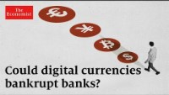

Why Study Cryptocurrency?
Why Study Cryptocurrency?
The idea of digital currency is becoming mainstream. Major businesses and banks are analyzing the risk and returns of digitizing currency. Some nations and companies have taken the leap into cryptocurrency investment.
Volatility
Ease of Accessibility
Lower Cost and Decentralization
Diverse Platforms

Slide 12

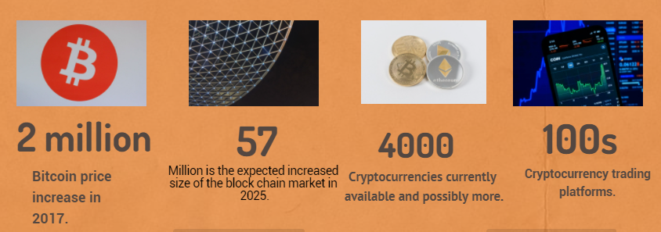

CRYPTO FUN FACTS:

Slide 13
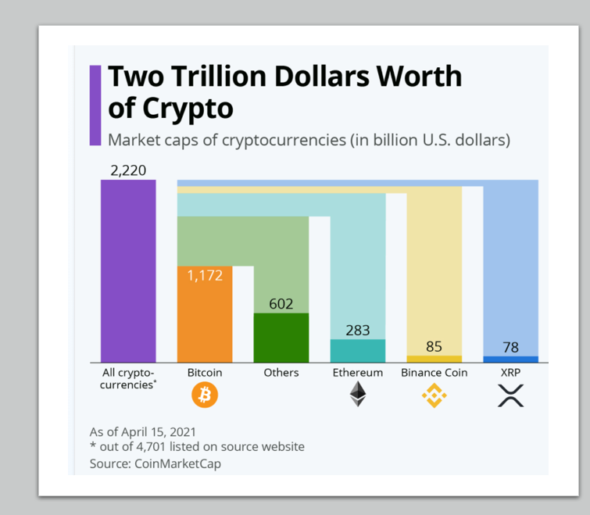
The cryptocurrency market has grown over 1000% since 2008, and the creation of Bitcoin.
Cryptocurrency has been considered as a mostly speculative market, soon to bust but it is proving those predictions wrong.

Slide 14
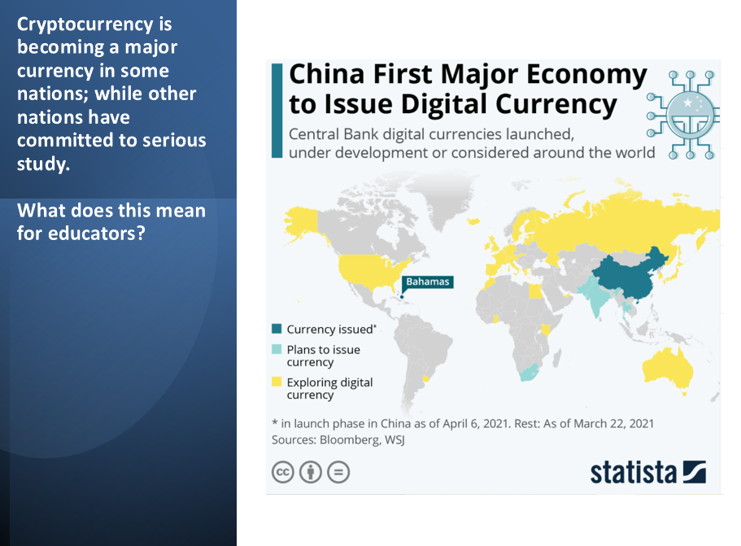

Slide 15
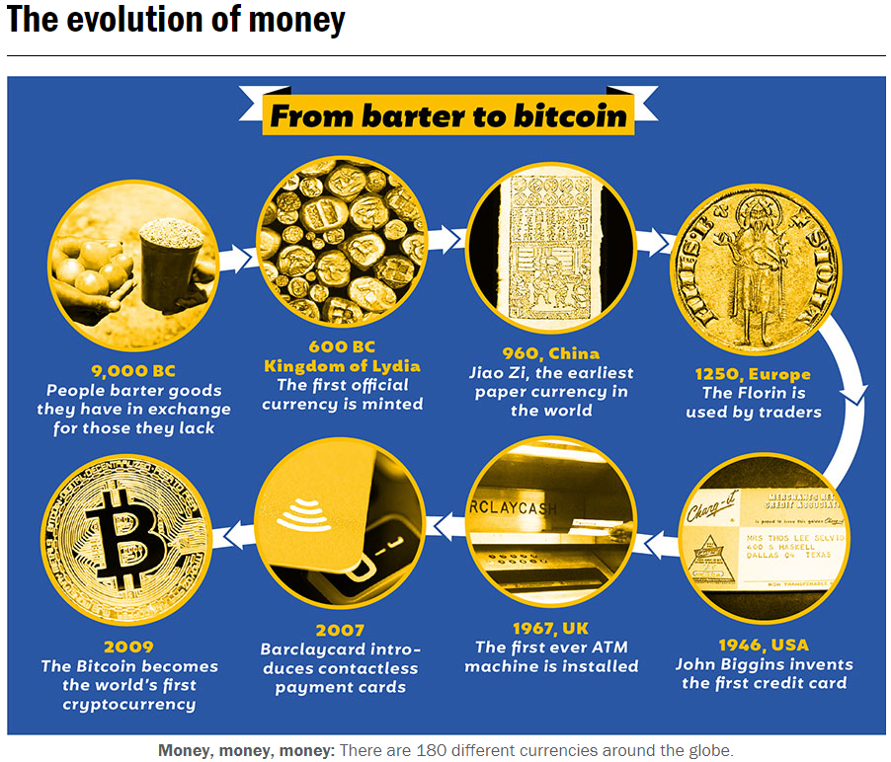
We, (You and I), are experiencing the
Evolution of Currency

Slide 16

Crypto Basics & Resource Outline
The major advent of basic blockchain technology in the 1970s by MIT professors Ron Rivest, Adi Shamir and Leonard Adleman and perfected in the 1990s by Satoshi Nakamoto is significant in the creation of cryptocurrency.
Why?
Blockchains are unique records of transactions written in cryptography or coded language.
The cryptic coded signature on each block is called a hash which allows for each block to be protected.
Miners manage the programs.
Blockchain
What is Bitcoin?
Bitcoin Forks
Crypto Trade Platforms
Diverse Cryptocurrency

Slide 17
Lesson Plan 1, Part 1: Introduction to Cryptocurrency
Central Question: “What are the origins of cryptocurrency?”
Lesson Summary:
Students will use digital guided notes and infographic to discover the history and creation of cryptocurrency.
Objectives:
To describe the history of cryptocurrency as a trending digital currency.
Procedures: Teacher will use editable Nearpod to deliver lesson, infographic activity and quiz. Power Point with notes and resources are attached.
Links & Resources
Nearpod: https://share.nearpod.com/e/xa0XyJCaFhb
Power Point: What is Cryptocurrency?
Handout & Infographic: Introduction to Cryptocurrency and Infographic
Assessment (In Nearpod): Quiz 1 What is Cryptocurrency?

Slide 18
Do you believe Cryptocurrency is a Viable Currency?
Yes
No

Slide 19
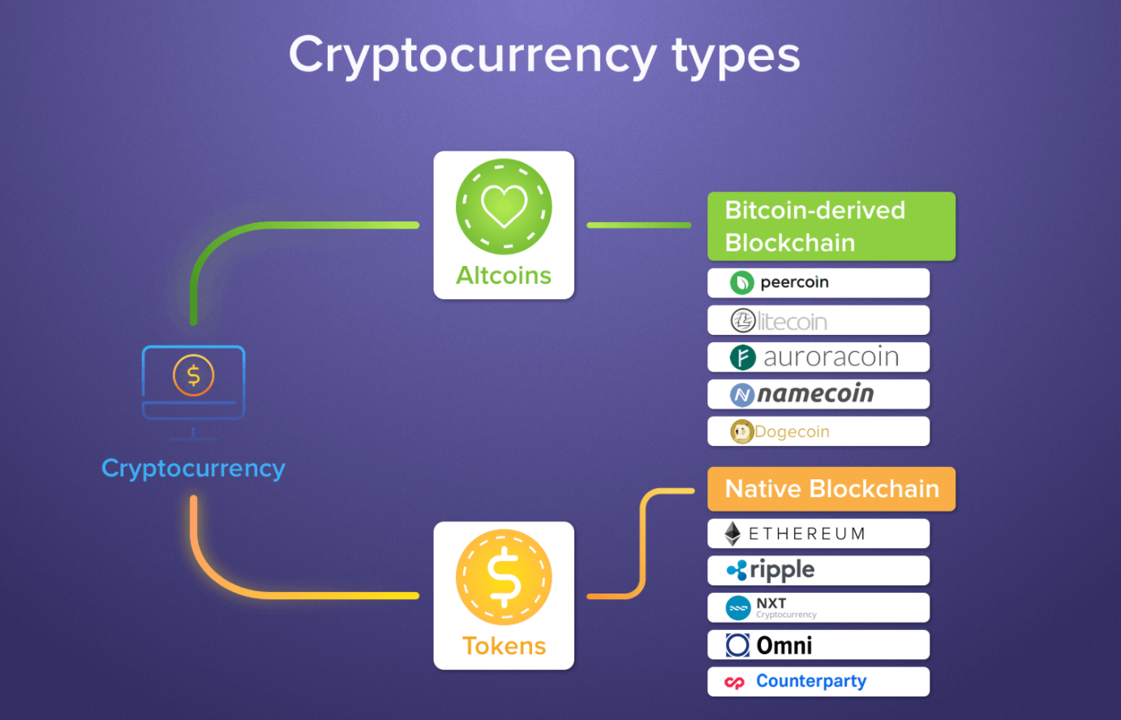
All Cryptocurrency is NOT used for payment purposes.
Crypto Types
Cryptocurrency is divided into two forms:
Altcoins, mostly used for payment.
Tokens, mostly used for diverse purposes such as “smart contracts” and application use, to represent an important item.
Choices:

Slide 20
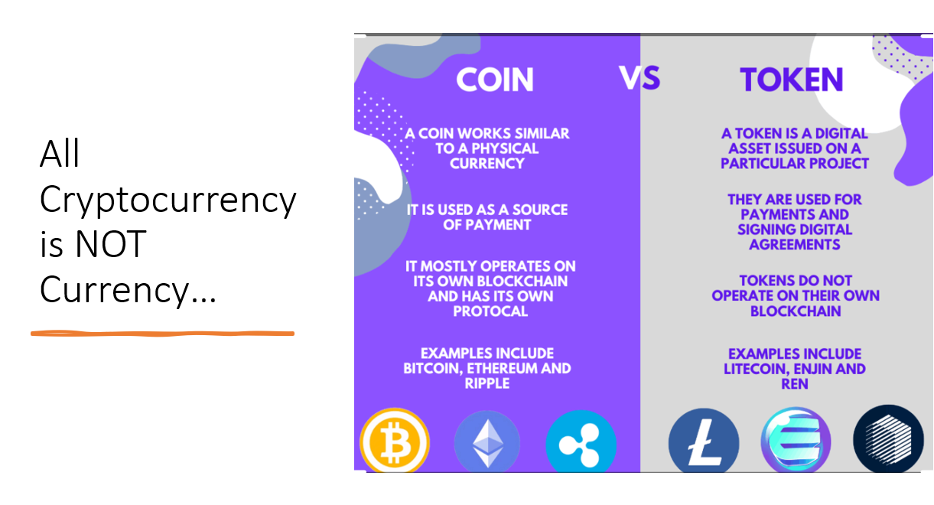

Slide 21
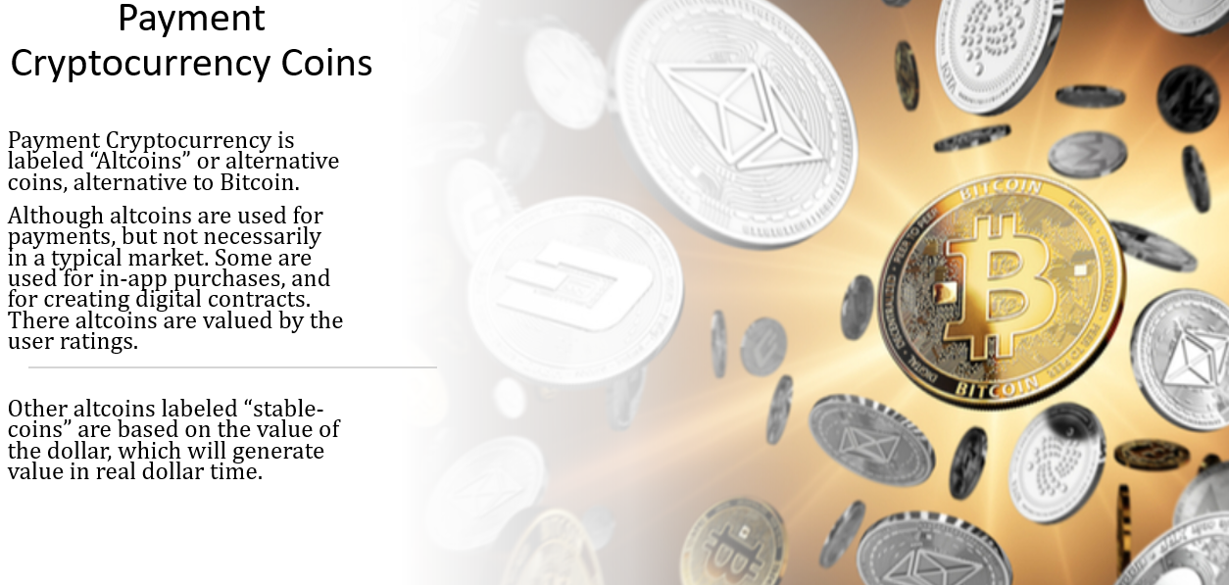

Slide 22
Lesson Plan 1, Part 2: Introduction to Cryptocurrency
Central Question: In what ways does cryptocurrency demonstrate the characteristics and functions of currency?
Lesson Summary:
Students will decide as Federal Reserve members if cryptocurrency measures up to the functions of currency by.
Objective: The student will determine and judge chosen currency status of stable coins and forms of cryptocurrency using chart and readings.
Procedures: Teacher can use editable Nearpod to deliver lesson, quiz and activity or use editable Power Point notes and handout to work through lesson.
Links & Resources
Article: The Federal Reserve and Cryptocurrency
Handouts: Federal Reserve and Cryptocurrency Rating.docx
Power Point: Crypto to Currency
Nearpod: https://share.nearpod.com/e/zga40XYgFhb
Assessment (in Nearpod): Lesson Plan 2 Assessment

Slide 23
Do you believe the US will adopt a cryptocurrency in the next ten years?
Yes
No

Slide 24
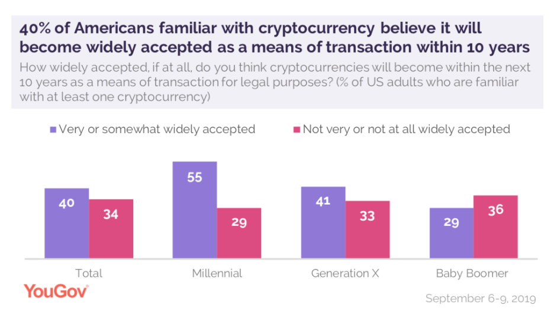

Slide 25
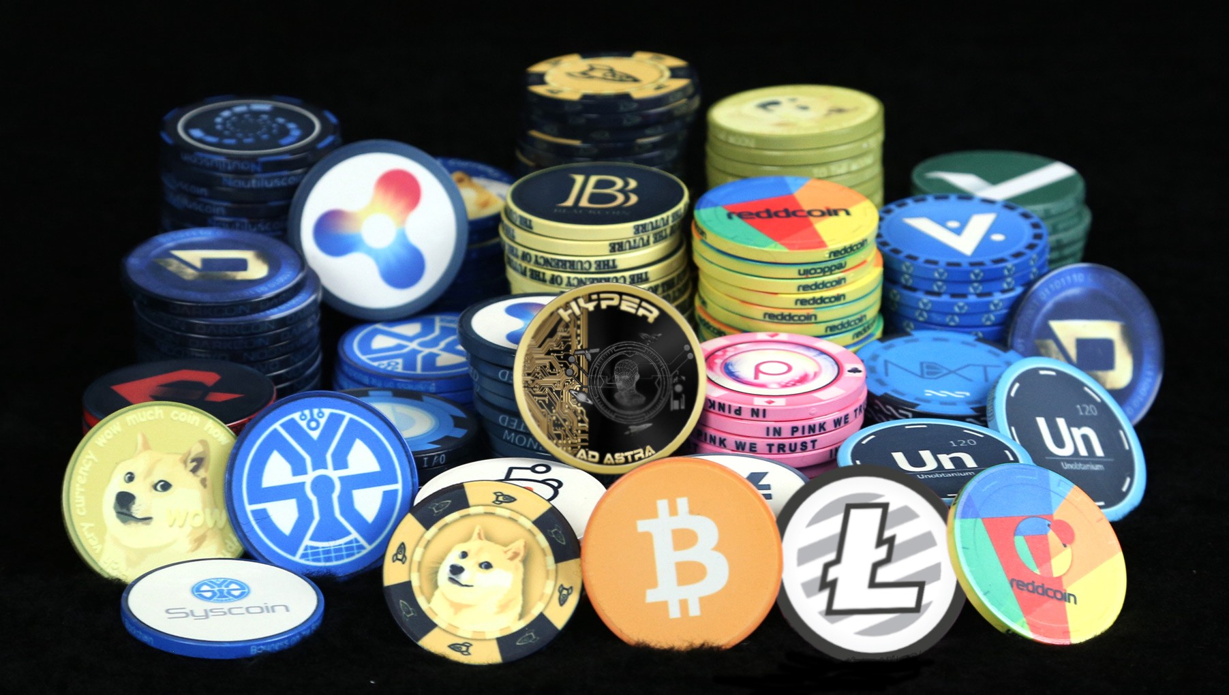
Ease of Use
Decentralized
No Double Spend
Diverse Usage
Ease of Ability to Invest
The recent craze can be attributed to the inherent nature of cryptocurrency...
Crypto
Characteristics
Notes:
https://www.youtube.com/watch?v=Cwgw6dqMY6k

Slide 26
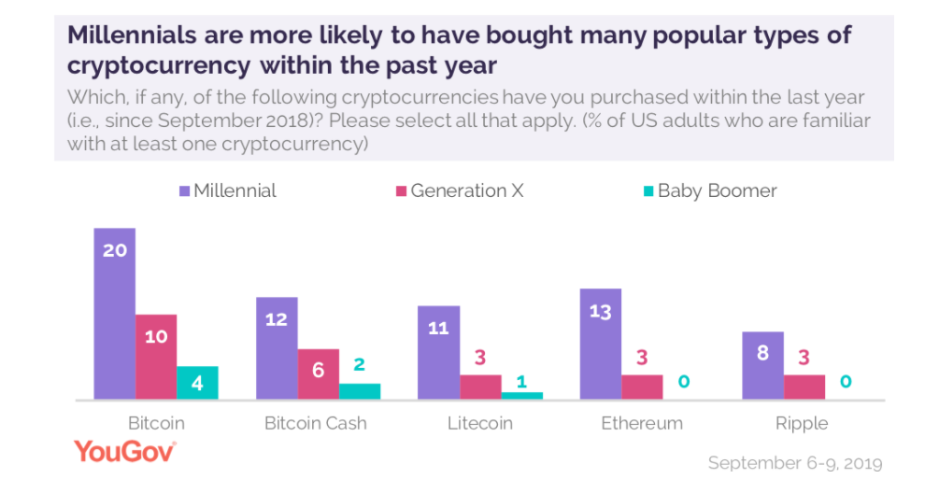
New Class of Investors Created…
According to the Wall Street Journal…”One in four customers who traded crypto so far in 2021 on the Robinhood Markets Inc. platform is a woman,” said Christine Brown, chief operating officer of Robinhood Crypto.
Over the past two years, digital trading platform eToro Group Ltd. said the number of female crypto traders in the U.S. on its platform has jumped by half, to about 20% of all users in the U.S.

Slide 27
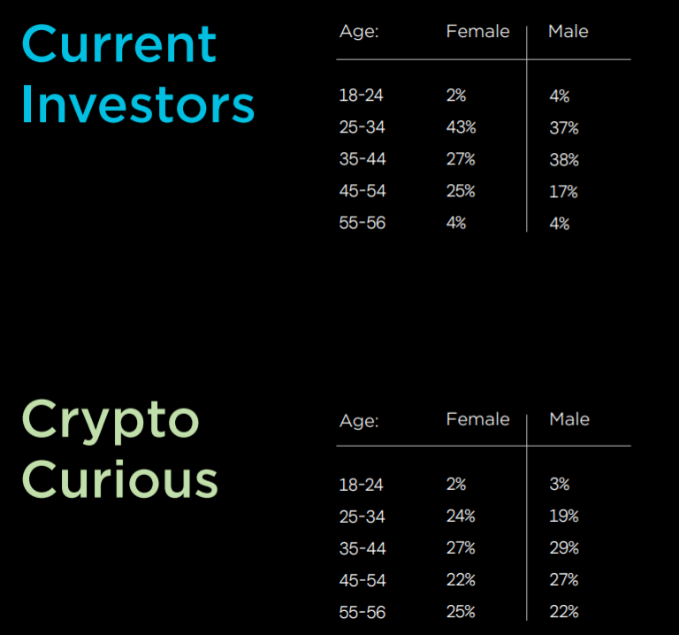


Financial Influencer Suze Orman advises investors to invest at a low rate due to volatility

Slide 28

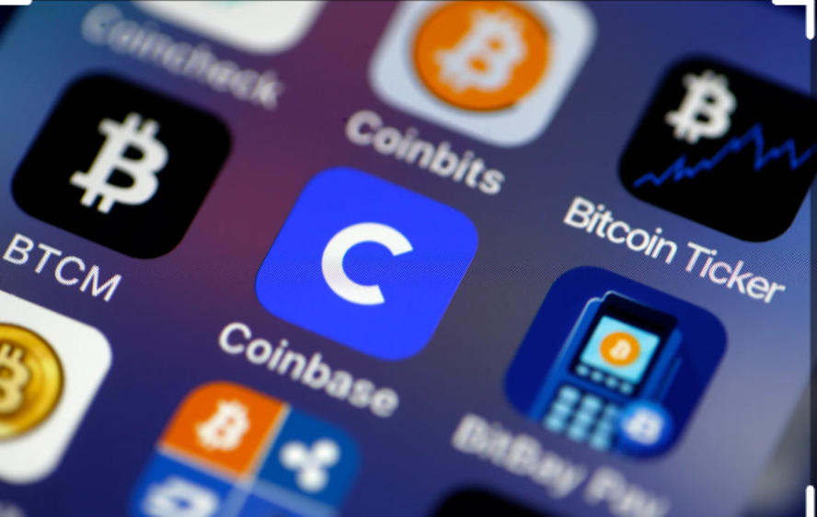

What’s So Hot about Crypto?
Technology
Cryptocurrency is available on electronic wallets which makes it easy to access.
Accessibility
Cryptocurrency is extremely accessible as a result of online transactions.
Volatility
The cryptocurrency market is extremely volatile for many reasons, such as speculation and supply and demand factors

Slide 29



So, is volatility really bad?
CNBC Finance Bitcoin Volatility
Volatility is the 30-day return in an asset.
Volatility indicates movement in the market which is often caused by shifting factors related to supply and demand. These factors can be caused by: change in preference or taste, market pressure, supply or/and variety of an item.
Cryptocurrency does not differ, in this respect.

Slide 30
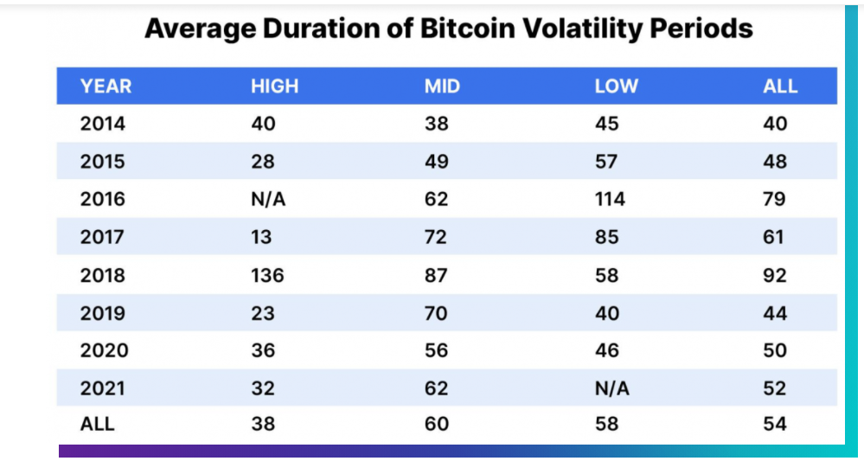
Volatility Explained
The cryptocurrency market has demonstrated high volatility at various times which is over 100%.
Volatility is divided into three categories –
high (100%-), average (50%-100%), and low (0-50%)

Slide 31
Lesson Plan 2: Crypto to Currency
Central Question: What are the current cryptocurrency trends? Why are certain groups more attracted to cryptocurrency than other groups?
Lesson Summary:
Using the guided notes and trend poster, students will analyze cryptocurrency trends.
Students will decide volatility of cryptocurrency using charted data; and advise a client on crypto-investment.
Objective:
To identify engaging trends of cryptocurrency; to analyze cryptocurrency as an investment option.
Procedures:
Students will break into pairs to complete the currency chart using a rubric and assigned cryptocurrency informational handout. Students will share in the open class forum.
Links & Resources
Power Point: Boom and Bust of Cryptocurrency
Guided Practice: Trending Volatility.docx
Nearpod: https://share.nearpod.com/e/a0ARAgLmFhb
Assessment: Lesson Plan Assessment 3

Slide 32
Lesson Plan 3: Is Cryptocurrency an ideal investment?
Procedures: Teacher begins lesson by asking students to collaborate about, “What is a trend?” After discussion, students will describe and discuss the trends behind cryptocurrency through teacher notes and discussion. Students will use trendline handout to assess the “real-time” trends of cryptocurrency.
Lastly, students will use the trendline and their notes to advise a client cryptocurrency investment by providing one warning, two encouraging facts, and a final overall statement on crypto-investment.
Links & Resources
Power Point: Boom and Bust of Cryptocurrency
Guided Practice: Trending Volatility.docx
Nearpod: https://share.nearpod.com/e/a0ARAgLmFhb
Assessment: Lesson Plan Assessment 3
Central Questions: What are the current cryptocurrency trends? Why are certain groups more attracted to cryptocurrency than other groups? How does trending volatility affect the cryptocurrency market?
Lesson Summary:
Using the guided notes and trend poster, students will examine the trends and volatility of cryptocurrency.
Students will decide volatility of cryptocurrency using charted data; and advise a client on crypto-investment.
Objective:
To identify engaging trends of cryptocurrency; and to analyze cryptocurrency as an investment option.

Slide 33
References
Cryptocurrency Definition (investopedia.com) https://www.caminofinancial.com/what-is-cryptocurrency/ https://learn.easycrypto.ai/history-of-cryptocurrency/ https://www.cnbctv18.com/cryptocurrency/a-timeline-of-bitcoins-journey-from-2008-to-2021-9395091.htm | https://www.youtube.com/watch?v=bBC-nXj3Ng4 https://www.youtube.com/watch?v=Cwgw6dqMY6k https://www.youtube.com/watch?v=41JCpzvnn_0 https://explorer.theday.co.uk/briefings/the-evolution-of-money-explorer

Slide 34

CEE Affiliates
https://www.councilforeconed.org/resources/local-affiliates/

Slide 35




Thank You to Our Sponsors!

Slide 36

https://bit.ly/CEEConference2021

