Slide 1
Personal Finance
Presented by
Brett Burkey, Director of Education FCEE
July 12 and 13/2-5 pm bburkey@fcee.org

Slide 2
EconEdLink Membership
You can now access CEE’s professional development webinars directly on EconEdLink.org! To receive these new professional development benefits, become an EconEdLink member. As a member, you will now be able to:
Automatically receive a professional development certificate via e-mail within 24 hours after viewing any webinar for a minimum of 45 minutes
Register for upcoming webinars with a simple one-click process
Easily download presentations, lesson plan materials and activities for each webinar
Search and view all webinars at your convenience
Save webinars to your EconEdLink dashboard for easy access to the event
You may access our new Professional Development page here

Slide 3
Professional Development Certificate
To earn your professional development certificate for this webinar, you must:
Watch a minimum of 45-minutes and you will automatically receive a professional development certificate via e-mail within 24 hours.
Accessing resources:
You can now easily download presentations, lesson plan materials, and activities for each webinar from EconEdLink.org/professional-development/

Slide 4
Agenda/Day 1
The Economics Behind Financial Decisions
Introduction to Budgeting
History of the American Consumer
Lifestyle Inflation

Slide 5
Agenda/Day 2
The Influence of Amazon and Instagram
Types of Credit
Credit Reports
Instruments of Investing

Slide 6
Objectives
Present the content in a sequence that will allow students to build on past knowledge
Provide resources that are classroom ready and engaging

Slide 7
National Standards
Earning Income
Buying Goods and Services
Saving
Using Credit
Financial Investing

Slide 8
Assessment Questions
Why is it so difficult for Americans to save?
What are the influences on the American consumer that make it so challenging to budget?
What are the different types of credit?
What is the difference between a credit score and credit report?
What are the different investment instruments and how do young people get started?

Slide 9

CEE Affiliates
https://www.councilforeconed.org/resources/local-affiliates/

Slide 10




Thank You to Our Sponsors!

Slide 11
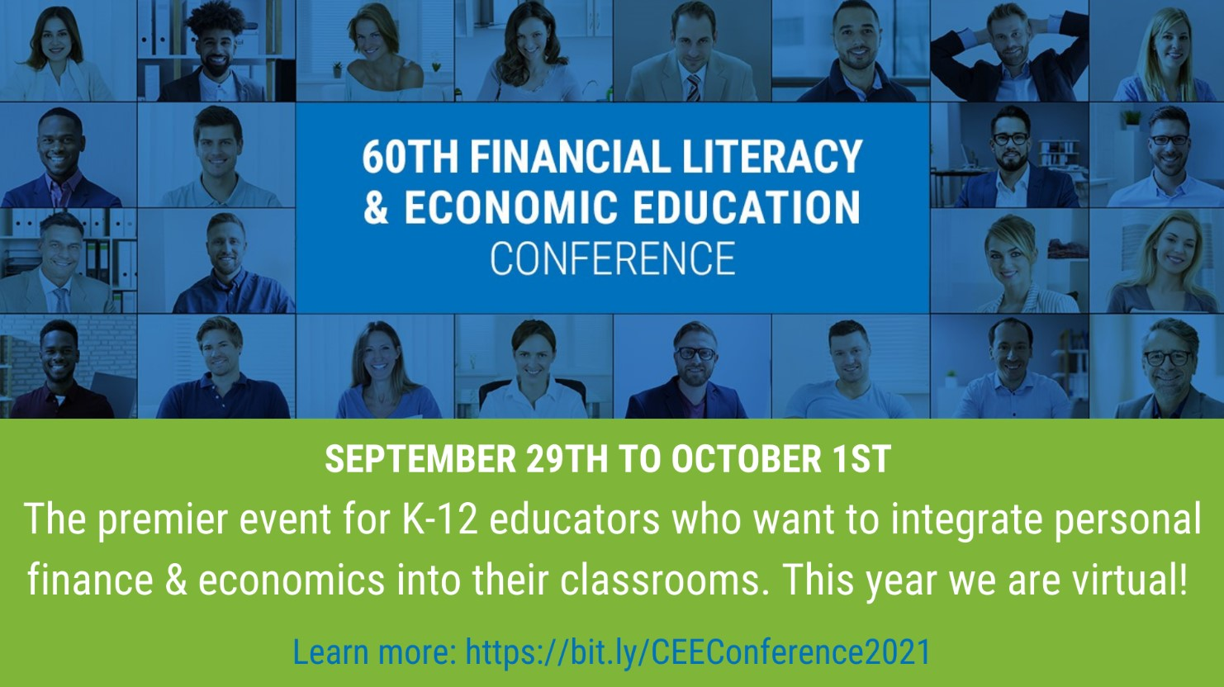
https://bit.ly/CEEConference2021

Slide 12
60th Financial Literacy and Economic Education Conference
September 29th - October 1st, 2021
2-7 PM ET Daily
$20 discount for Summer Institute attendees
Register
https://councilforeconed2021.us2.pathable.com/
Promo Code
CEE60SI
SEE YOU THERE!!!

Slide 13
How did we do? Let us know!
Please complete our survey: https://www.surveymonkey.com/r/SummerInstitute2021

