Slide 1

Mixing It Up:
Unique Review Games
Presented by Andrew Menfi
August 10th, 2021 amenfi3@gmail.com

Slide 2
EconEdLink Membership
You can now access CEE’s professional development webinars directly on EconEdLink.org! To receive these new professional development benefits, become an EconEdLink member. As a member, you will now be able to:
Automatically receive a professional development certificate via e-mail within 24 hours after viewing any webinar for a minimum of 45 minutes
Register for upcoming webinars with a simple one-click process
Easily download presentations, lesson plan materials, and activities for each webinar
Search and view all webinars at your convenience
Save webinars to your EconEdLink dashboard for easy access to the event
You may access our new Professional Development page here

Slide 3
Professional Development Certificate
To earn your professional development certificate for this webinar, you must:
Watch a minimum of 45-minutes and you will automatically receive a professional development certificate via e-mail within 24 hours.
Accessing resources:
You can now easily download presentations, lesson plan materials, and activities for each webinar from EconEdLink.org/professional-development/

Slide 4
Objective
Engaging, unique review games that can be used in any classroom setting [Digital/Hybrid/In Person]

Slide 5



Slide 6
Agenda
Game #1: Jenga
Game #2: Bingo
Game #3: Meme Game
Game #4: Speed Run
Game #5: Hands On Deck
Game #6: The Picture Game
Game #7: Spot The Lie
Game #8: Digital Scavenger Hunt
Game #9: Lightning Round
Game #10: Escape The Room

Slide 7


National Standards
STANDARDS 1-20

Slide 8

State Standards
New York:
  9.1 Through 12.4

Slide 9



Game #1: Jenga
  Group Trivia
  Wrong Answer → Jenga Tower
  Fallen Tower → Other Groups Benefit
    Points/Prize

Slide 10


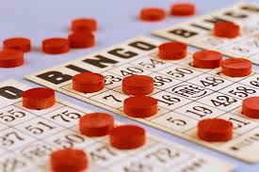
Game #2: Bingo
  Study Guide / Key Terms List
  Fill Blank Bingo Card With Terms
  DESCRIBE Terms
    Winner: Points / Prize

Slide 11
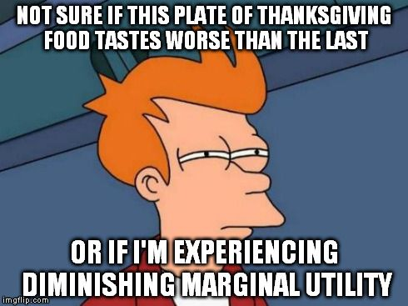


Game #3: Meme Game
  Give Students Memes → Explain The Joke
  Give Students Terms → Make Best Meme
    Meme Generator
    [https://imgflip.com/memegenerator]

Slide 12



Game #4: Speed Run
  Print Out Key Terms → Put On Class Walls
  DESCRIBE Terms → Slap Correct Term
  Individual / Groups / VERSUS

Slide 13



Game #5: Hands On Deck
  Terms on Notecards → One Set Per Group
  DESCRIBE Terms → Walk With Arms Out
  Race To Put Correct Term In One Hand
    +/- Points for Correct/Incorrect

Slide 14
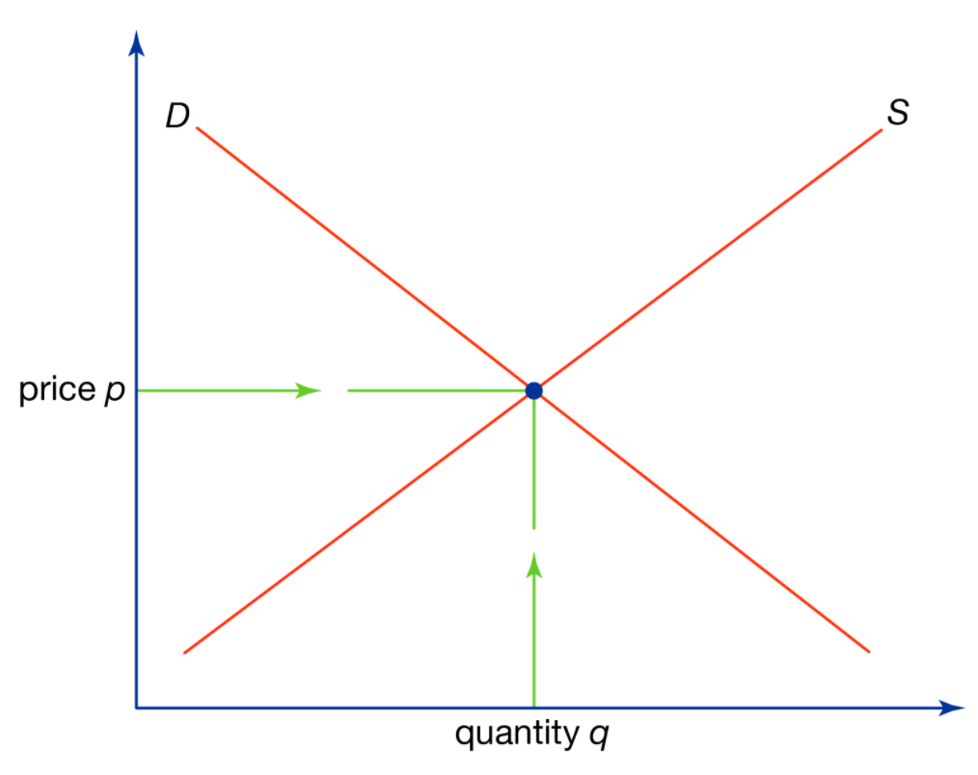


Game #6: The Picture Game
  Create Images For Key Terms
  Match Key Terms With Images
    Points/Prize
Market Price
Incentive
Scarcity

Slide 15
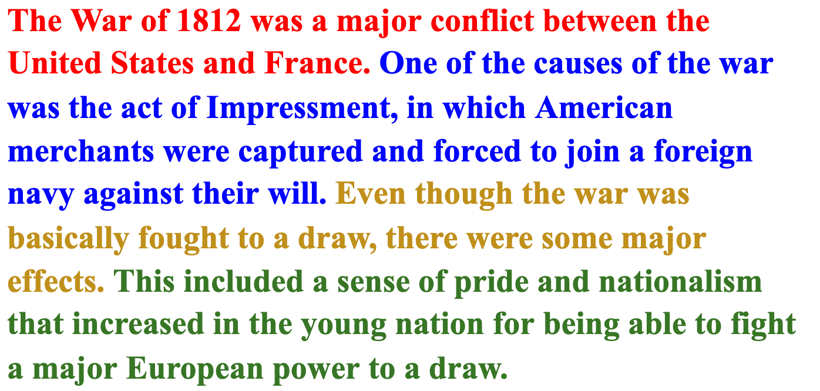

Game #7: Spot The Lie
  Read/Write Short Paragraph
    Contains One Falsehood
  Identify the Lie
  Kahoot Optional [Color Coded]

Slide 16


Game #8: Digital Scavenger Hunt
  Questions Answered In Digital Classroom
    Videos [Timestamp]
    Presentations [Slide Numbers]
    Documents [Specific Details]
    Assignments [Dates]

Slide 17


Game #9: Lightning Round
  Questions & Challenges [Randomized]
  Time Limit [Points Awarded]
Online
In Person

Slide 18



Game #10: Escape The Room
  Google Forms [Response Validation]
  Mix of Content & Silly Questions
  Winner → Fastest Team

Slide 19

Contact & Questions?
Andrew Menfi
Social Studies Teacher
New Visions Charter High School
for Advanced Math & Science
amenfi3@gmail.com
Thanks For Your Time!

Slide 20

https://bit.ly/CEEConference2021

Slide 21

CEE Affiliates
https://www.councilforeconed.org/resources/local-affiliates/

Slide 22




Thank You to Our Sponsors!

