Slide 1

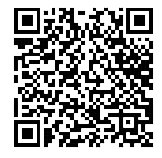
The Economics of the Music Industry
Tools to Liven Your Classroom
Presented by Susanna Pierce McConnell
May 26, 2021 smcconnell@eanesisd.net
Handout for Participants

Slide 2
EconEdLink Membership
You can now access CEE’s professional development webinars directly on EconEdLink.org! To receive these new professional development benefits, become an EconEdLink member. As a member, you will now be able to:
Automatically receive a professional development certificate via e-mail within 24 hours after viewing any webinar for a minimum of 45 minutes
Register for upcoming webinars with a simple one-click process
Easily download presentations, lesson plan materials and activities for each webinar
Search and view all webinars at your convenience
Save webinars to your EconEdLink dashboard for easy access to the event
You may access our new Professional Development page here

Slide 3
Professional Development Certificate
To earn your professional development certificate for this webinar, you must:
Watch a minimum of 45-minutes and you will automatically receive a professional development certificate via email within 24 hours.
Accessing resources:
You can now easily download presentations, lesson plan materials, and activities for each webinar from EconEdLink.org/professional-development/

Slide 4
National Standards
Standard 4: Incentives:
  People usually respond predictably to positive and negative incentives.
Standard 8: The Role of Prices:
  Prices send signals and provide incentives to buyers and sellers. When supply or demand changes, market prices adjust, affecting incentives.

Slide 5

Overview
Intro: Who are you listening to?
My Connection to the Topic
The Economics of the Music Industry
  Pre-Covid-Post Covid
    Economic Insights, Media, Strategies
Reflection

Slide 6
Let’s connect!
Who’s on your playlist?

Slide 7
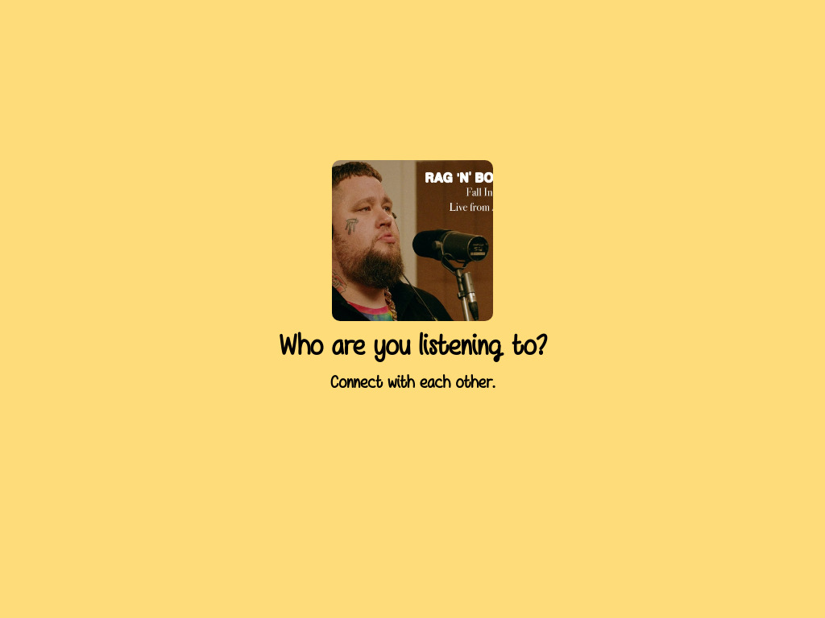
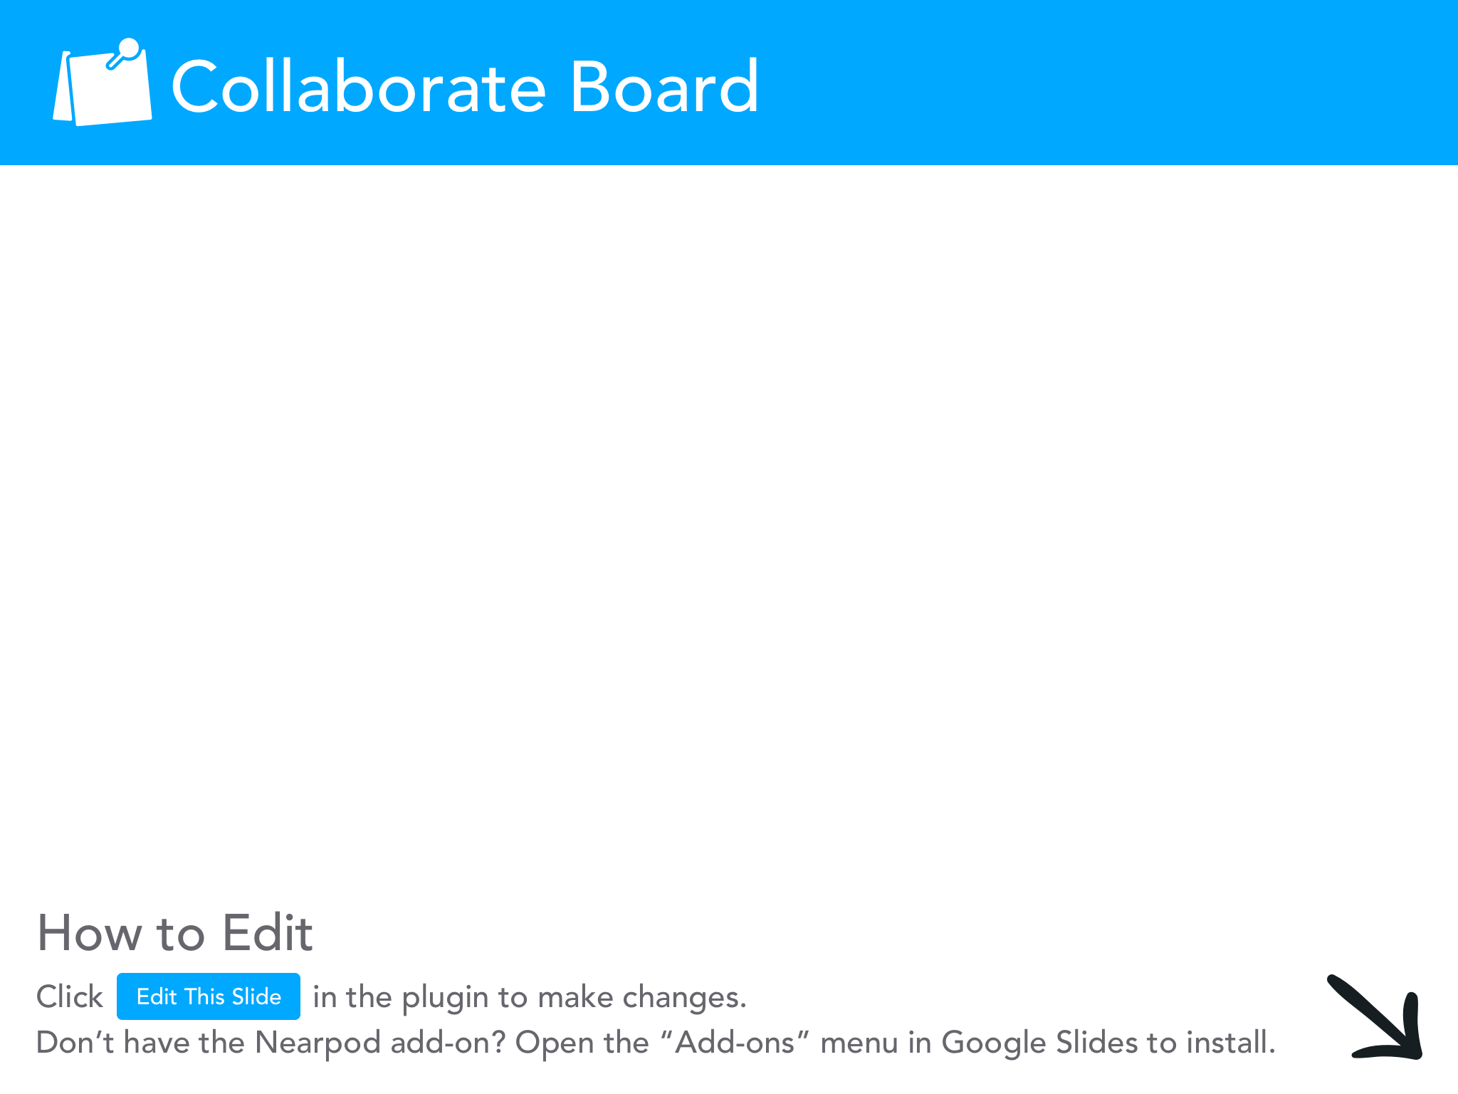

Slide 8
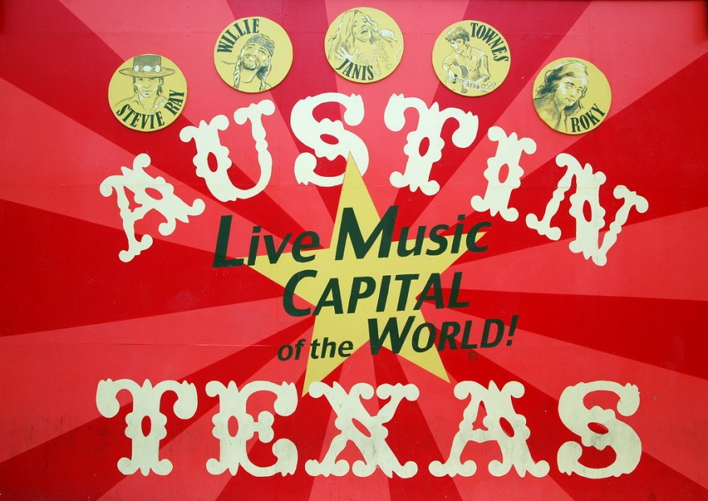
Why is the topic relevant to me?
Student Answer: “Music seems to be one of the few things the entire world can love and care about.”

Slide 9
What will you learn?
Objectives
Participants will:
  internalize the multiple connections the music industry has to economics.
  connect with relevant media associated with the topic.
  participate in engaging strategies to facilitate classroom discussions about the real world.
  reflect on the implementation into their own classroom.

Slide 10
How will we get there?
Topic/Era | Economic Insights | Media to Reinforce | Teaching Strategy
The Importance
Digital Revolution
Early Pandemic
Mid to Late Pandemic
The Future
Ultimate Goal: Classroom Implementation

Slide 11

Why should you study this topic? (Relevance)
Econ. Connections, Media, Strategy

Slide 12
Importance: The Economic Impact
Younger consumers are spending more time listening to streamed music or participating with music on social media.
The music industry supports almost 2.5 million jobs in the US.
The US exports $9.8 billion (2018) of music.

Slide 13
How can you show this to students?
Media + Strategy

Slide 14
Media + The 3 Whys
Media (Infographic)
Strategy: The 3 Whys
RIAA Music Facts 2018 (Infographic)
Details important facts to highlight the contributions the music industry has to our consumers and the overall economy
The 3 Whys
Used to create purpose or relevance in studying a topic
Why does it matter to you, to your community, and to the world?

Slide 15
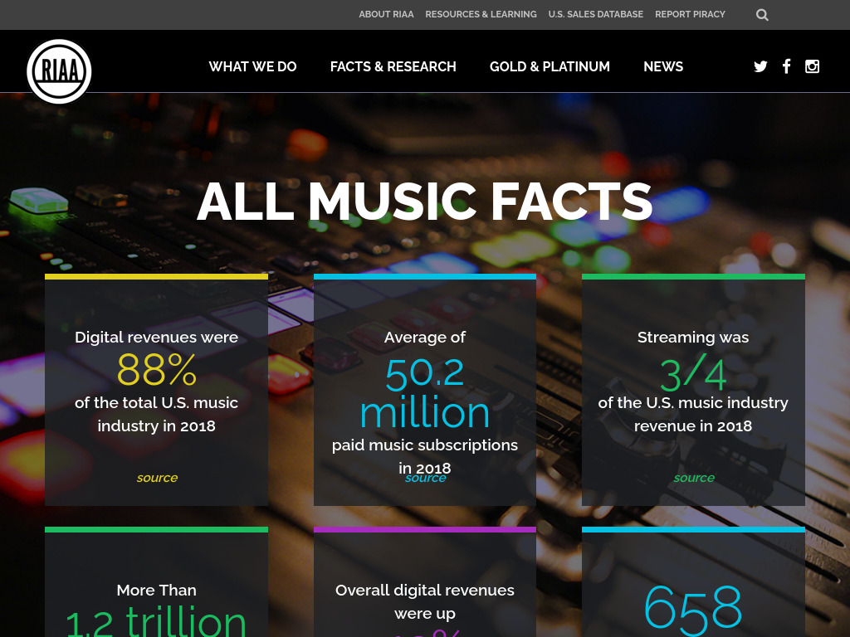
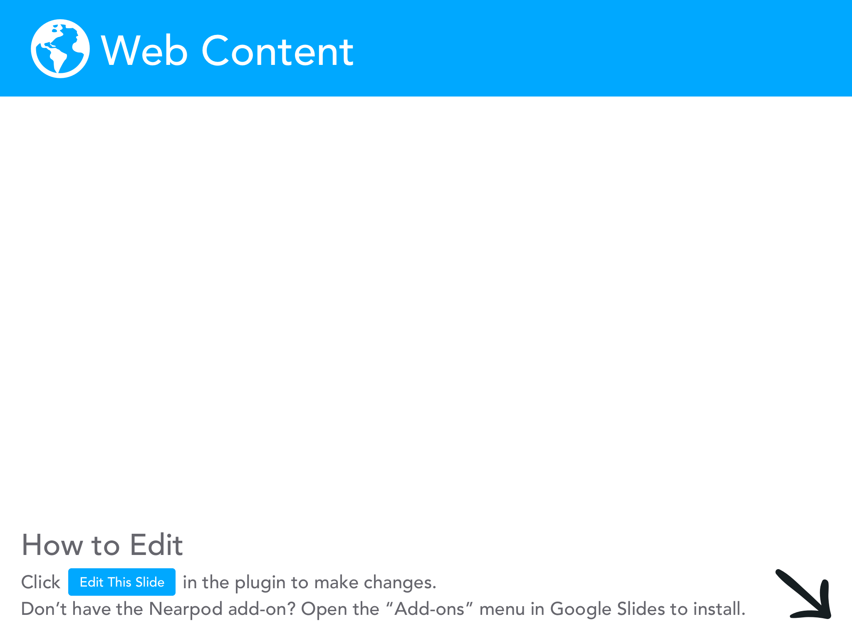

Slide 16
Strategy: The 3 Whys
You | Pianist Music is a part of my daily life (Apple Music) Live music
Community | ACL attracts ~400,000 people a year Austin earned over $280 million in 2018 Shady Grove shut down due to Covid
World | Global music industry is worth $50 billion dollars, with 50% of the money coming from concerts. 75% of musicians’ incomes come from concerts

Slide 17
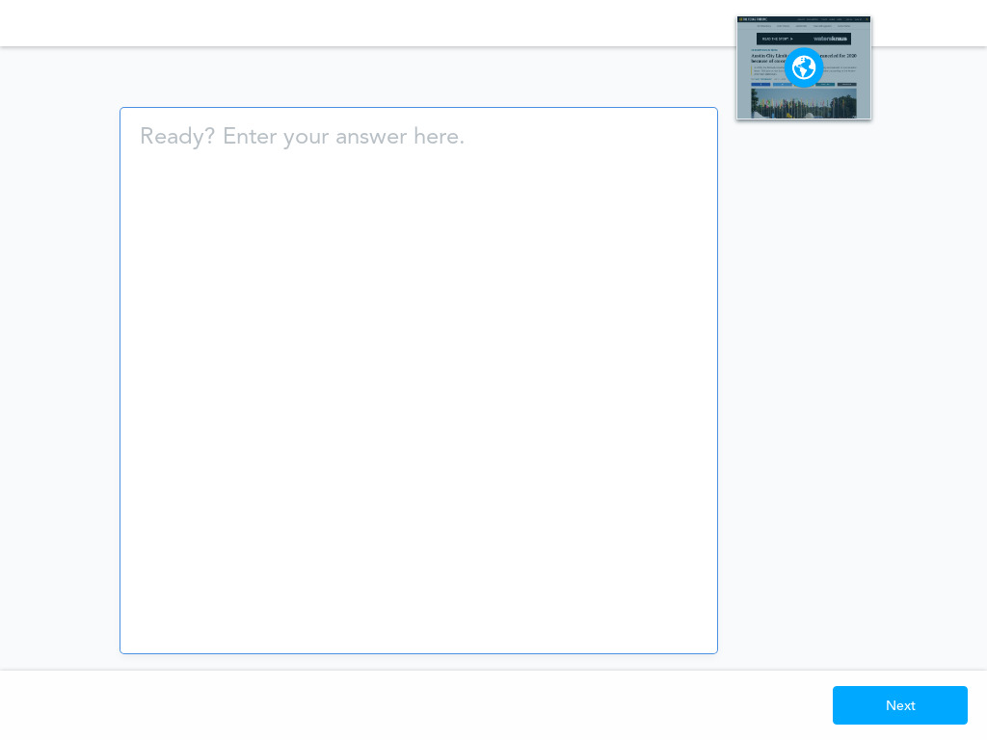
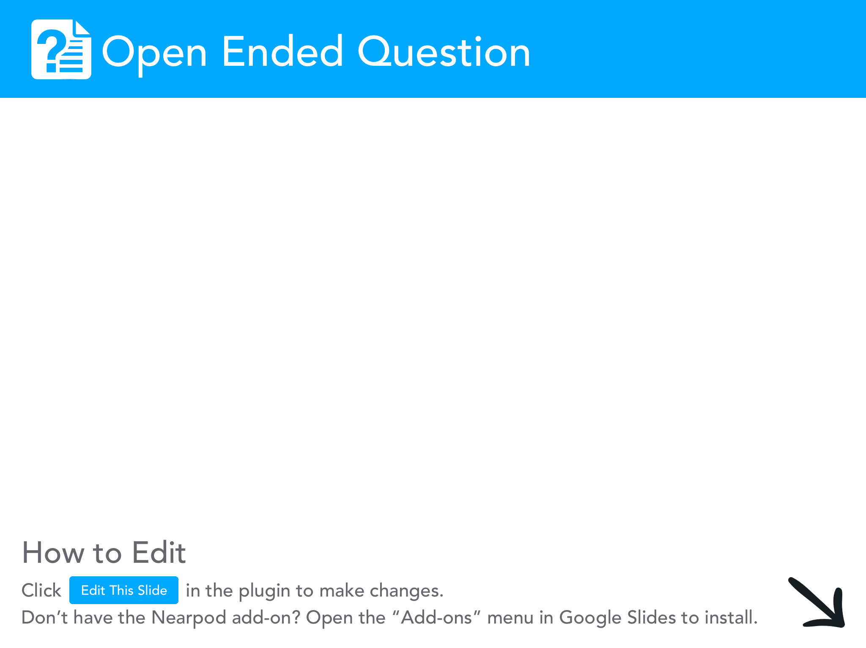

Slide 18
How did the digital revolution impact the music industry?
Econ. Connections, Media, Strategy

Slide 19
The Digital Revolution (early 2000s)
The increasing consumption of digital music with streaming services has decreased income for musicians, but increased revenue for record labels and streaming platforms.
An experience-based economy increased demand for festival and concert tickets, pushing up prices, and revenue for artists.

Slide 20
How can you show this to students?
Media + Strategy

Slide 21

Media + SIT Protocol
Media (Video)
Strategy: S-I-T Protocol
The Economist: Why are music festivals so expensive?
Details how technology has impacted music and an experience-based economy impacted the consumer
SIT Protocol
Used to process engaging information from a resource
What is significant, interesting, and troubling?
Notes:
1:50-2:40

Slide 22
Strategy: S - I - T Analysis
Significant | Online streaming reduced earning for artists Festival prices rose 50 times in 38 years incentive to tour more, produce less
Interesting | Ariana Grande earned $8 million @ Coachella (2019) Jimmy Hendrix earned $125,000 @ Woodstock (1969)
Troubling | Experience-based economy shifted consumer preferences to enjoy “experiences” more than actual albums What happens in the pandemic?

Slide 23
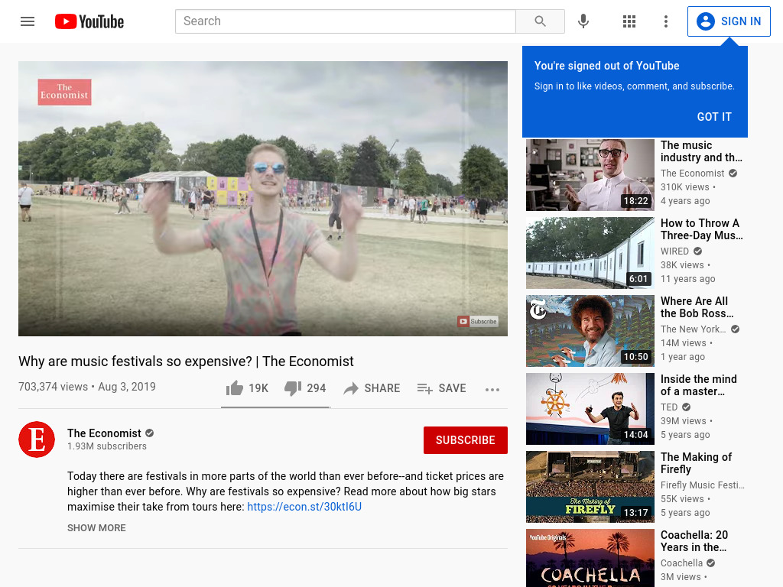
Notes:
1:50 -

Slide 24
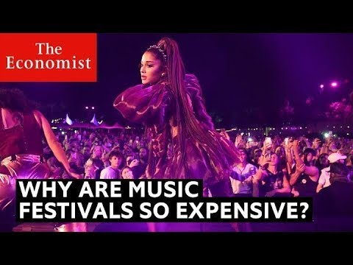
Why are music festivals so expensive? (1:50-2:42)

Slide 25
What’s something significant you heard?
Strategy Modelled: Send in the chat!

Slide 26
How did the early stages of the pandemic impact the music industry?
Econ. Connections, Media, Strategy

Slide 27
Early Pandemic
Concerts and festivals were cancelled during lockdowns, creating massive unemployment.
Many concert halls and venues lost significant revenue from decreased ticket sales with lockdowns and social distancing.

Slide 28
How can you show this to students?
Media + Strategy

Slide 29
Media + See, Think, Wonder
Media (Image)
Strategy: See, Think, Wonder
NYTimes: Concert Hall Image
Shows an image of a concert hall in Germany that is ⅕ full during lockdown
See, Think, Wonder
Used to promote thoughtful interpretation and stimulate curiosity
What do you see, think, and wonder?

Slide 30
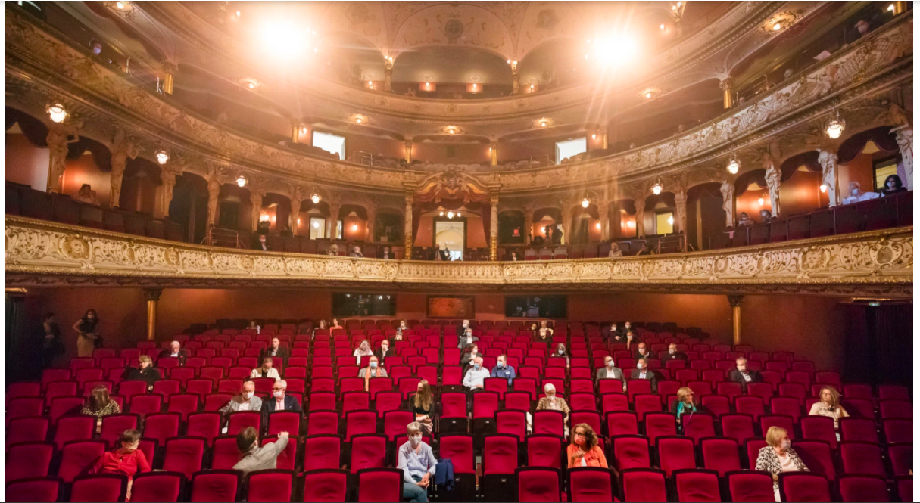
Chat: What do you see, think, and wonder?
Submit your answers to each question in the chat.

Slide 31
Strategy: See, Think, Wonder
See | Red seats that are empty People with masks facing a stage
Think | A theater is having a concert with social distancing Theater is earning significantly less revenue
Wonder | How did actors in the creative arts continue to make money? How will the pandemic impact the venue-based sector in the future? Which venues have been forced to shut down?

Slide 32
How did the continued pandemic impact the music industry?
Econ. Connections, Media, Strategy

Slide 33
Mid-Late Pandemic
The cancellation of concerts and festivals in many cities negatively impacted connected businesses and urban economies.
Technology enabled many musicians to transform the “live music” experience with augmented reality to recreate demand in the market.
Notes:
$9 billion dollar loss

Slide 34

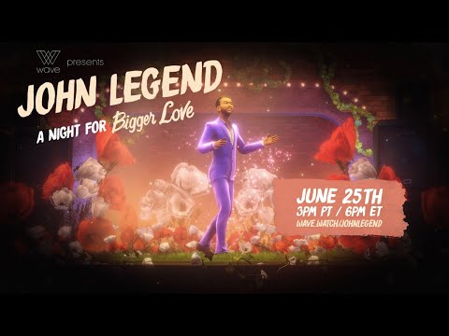
David Guetta: Live Streamed
16 MILLION VIEWS!
John Legend VR Concert

Slide 35
How can you show this to students?
Media + Strategy

Slide 36
Media + Questioning
Media (Article + Podcast)
Strategy: Questioning
Business Insider: DJs and the Pandemic
Discusses the rise of streaming virtual concerts
The Indicator: Live Music Blues
Discusses the multiplied negative impact cancelled events have on local economies
Facing History: Level of Questions
Promotes text-based conversations between students around relevant questions
I read/saw… and I’m wondering...

Slide 37
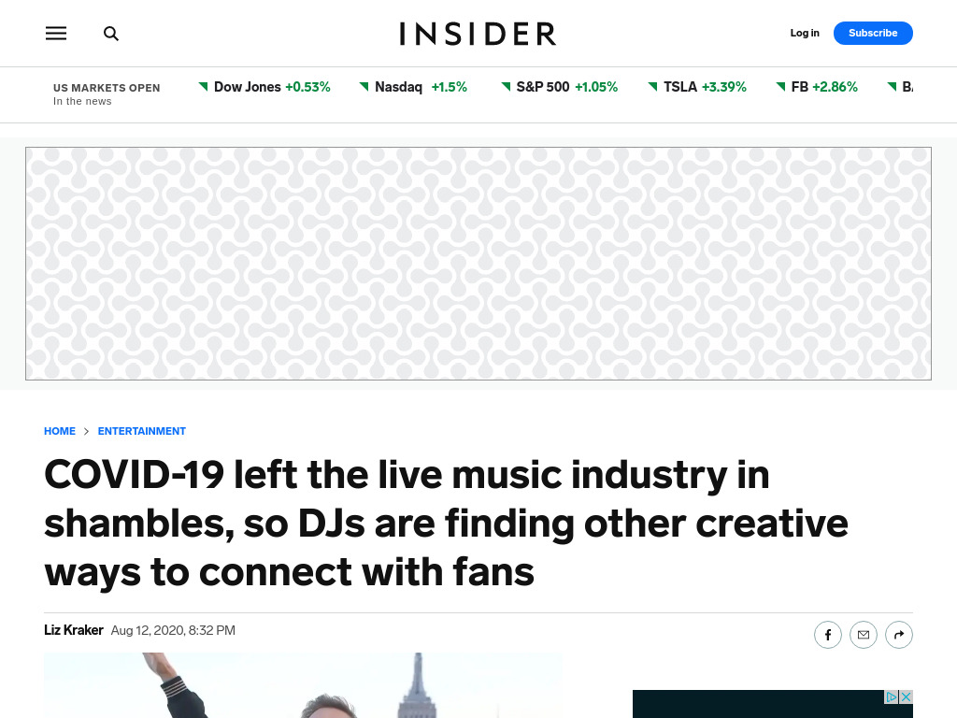

Slide 38
Strategy: It Says… I’m Wondering
Media | It Says... | I’m Wondering...
Podcast | “music festivals and concerts have exploded into a $12 billion business” | What will happen to live concerts in the future?
Article | “49 million people tuned into David Guetta's United At Home concerts” | How will the rise of live streaming concerts and festivals impact local economies?

Slide 39
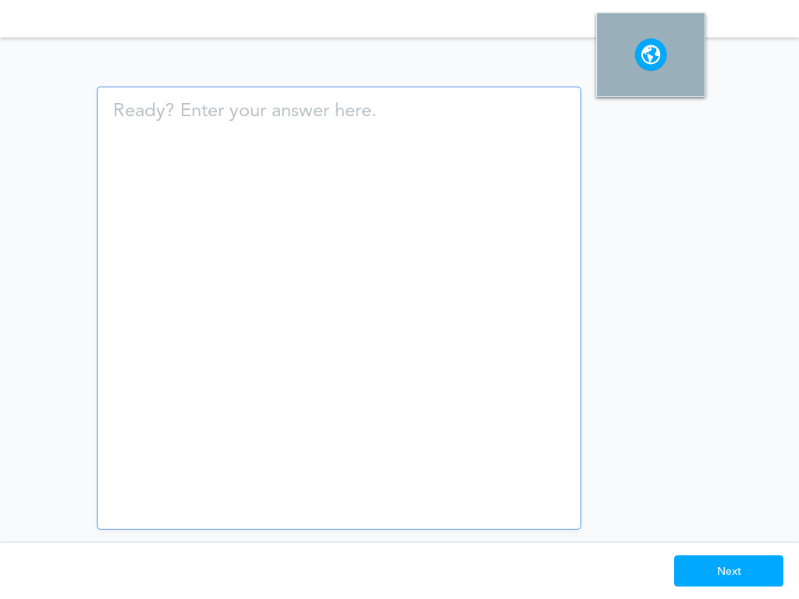

Slide 40
What will happen to the industry in the future?
Econ. Connections, Media, Strategy

Slide 41
Post Pandemic
Consumer confidence is gradually returning to the live music market, but it’s uncertain if and when it will match pre-pandemic levels.
Artists will continue to creatively use technology to attract listeners and increase demand for music.
Notes:
Recorded music grew by $1 billion dollars

Slide 42
How can you show this to students?
Media + Strategy

Slide 43
Media + Questioning
Media (Article)
Strategy: “Virtual” 4 Corners
Reuters: Barcelona 5,000 person rock concert
Discusses the first large concert in Europe post-pandemic
Facing History: 4 Corners
Promotes student application of knowledge and frames an argument
Strongly Agree, Agree, Neutral, Disagree, Strongly Strongly Disagree

Slide 44
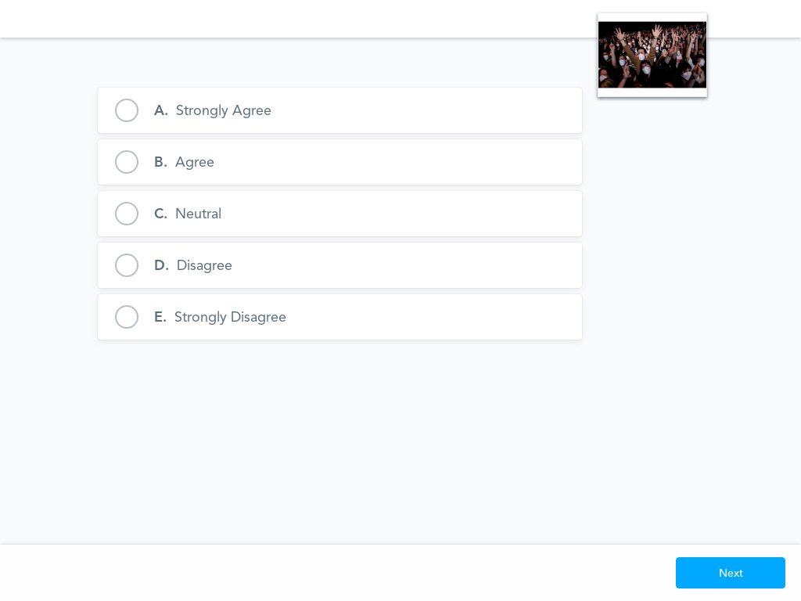
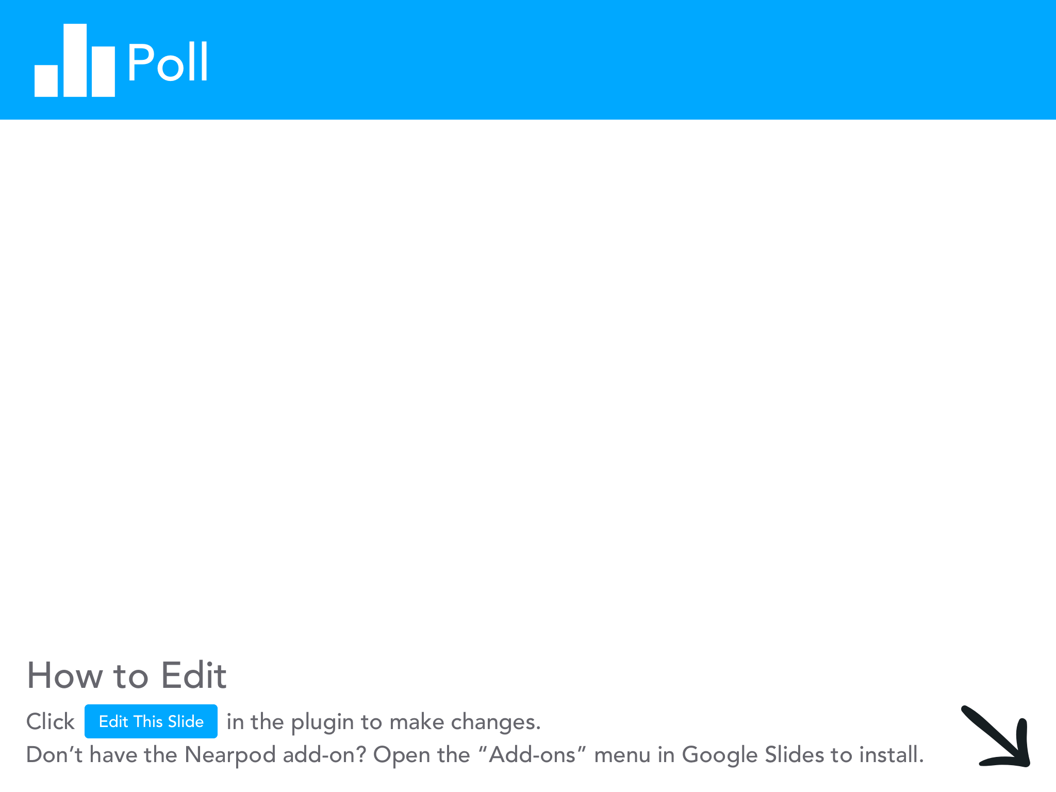

Slide 45
Summary
Economic Insights
Application to the Classroom
The music industry impacts individuals, local and regional communities, and the global economy.
The pandemic greatly impacted the industry.
Technology has changed and will continue to change the music industry.
Media to learn as an inquiry based introduction, lesson, or series of lessons
  infographic, videos, articles, podcasts
Strategies to engage in reflection and discussions
  The 3 Whys; SIT; See, Think, Wonder; Online Discussion Questioning; 4 Corners

Slide 46
Reflection: How can you apply this into your classroom?
Econ. Connections, Media, Strategy

Slide 47
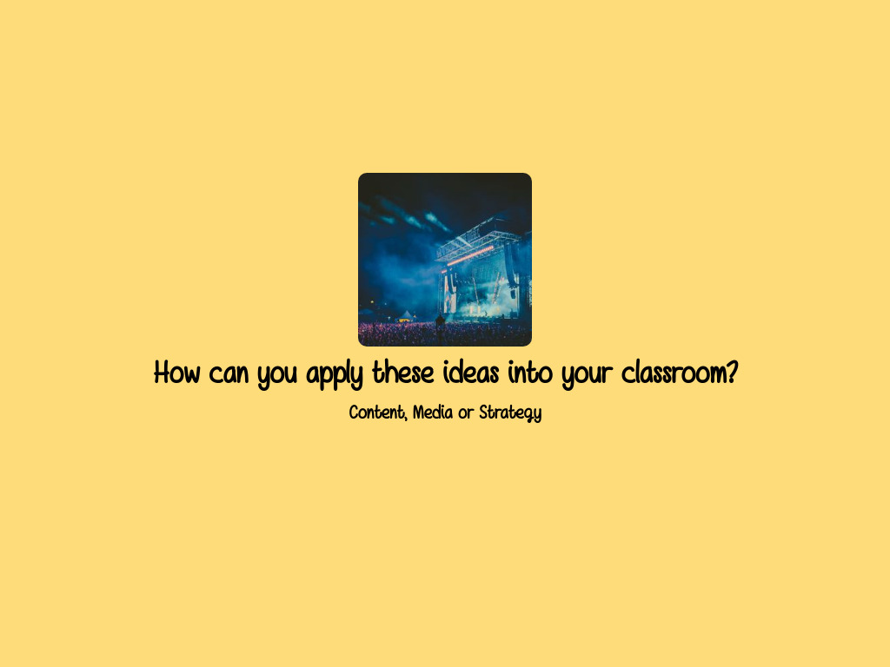

Slide 48
Strategy Descriptions
The 3 Whys: Project Zero: The 3 Whys
See, Think, Wonder: Project Zero: See, Think, Wonder Description
Significant, Interesting, Troubling: Facing History: S-I-T Protocol
Level of Questions: Facing History: Level of Questions
Four Corners: Facing History: 4 Corners

Slide 49
Media References
Texas Tribune: ACL Cancelled
NY Times Image of Concert Halls
The Indicator Podcast: Live Music Industry Blues
The Economist Video: Why Music Festivals are So Expensive?
The Economist Video: The Digital Revolution and the Music Industry
Forbes: Music Streaming + Music Industry
Washington Post: Release of Albums in Covid 19
NBC News: Musician Responses to the Pandemic
Business Insider: DJs and the Pandemic
Rolling Stone: Recorded Music Growth in Covid
OECD: Culture Shock During Covid
Reuters: Barcelona Rock Concert with 5,000
We Forum: Covid 19 and the Music Industry

Slide 50

CEE Affiliates
https://www.councilforeconed.org/resources/local-affiliates/

Slide 51




Thank You to Our Sponsors!

