Slide 1
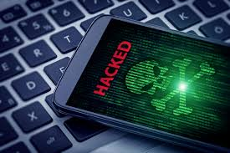
THIS IS JEOPARDY!:
Games to Teach about Cybercrimes, Schemes and Scams
Doug Young
June 17th, 2021
doug.n.young@gmail.com

Slide 2
EconEdLink Membership
You can now access CEE’s professional development webinars directly on EconEdLink.org! To receive these new professional development benefits, become an EconEdLink member. As a member, you will now be able to:
Automatically receive a professional development certificate via e-mail within 24 hours after viewing any webinar for a minimum of 45 minutes
Register for upcoming webinars with a simple one-click process
Easily download presentations, lesson plan materials and activities for each webinar
Search and view all webinars at your convenience
Save webinars to your EconEdLink dashboard for easy access to the event
You may access our new Professional Development page here

Slide 3
Professional Development Certificate
To earn your professional development certificate for this webinar, you must:
Watch a minimum of 45-minutes and you will automatically receive a professional development certificate via e-mail within 24 hours.
Accessing resources:
You can now easily download presentations, lesson plan materials, and activities for each webinar from EconEdLink.org/professional-development/

Slide 4
National Standards
Protecting and Insuring: Loss of assets, wealth, and future opportunities can occur if an individual’s personal information is obtained by others through identity theft and then used fraudulently. By managing their personal information and choosing the environment in which it is revealed, individuals can accept, reduce, and insure against the risk of loss due to identity theft.
Using Credit: Students will understand that credit allows people to purchase goods and services that they can use today and pay for those goods and services in the future with interest. People choose among different credit options that have different costs. Lenders approve or deny applications for loans based on an evaluation of the borrower’s past credit history and expected ability to pay in the future. Higher-risk borrowers are charged higher interest rates; lower-risk borrowers are charged lower interest rates.

Slide 5
Virginia State Standard
The student will demonstrate knowledge of personal finance and career opportunities by examining the financial responsibilities of citizenship, including evaluating common forms of credit, savings, investments, purchases, contractual agreements, warranties, and guarantees.

Slide 6
Objectives
Students will be able to:
  List ways individuals and companies attempt to gain money and personal information from others for fraudulent uses.
  Explain how individuals can protect themselves from identity theft and other scams.
  Provide suggestions on where to obtain information on scams.
  Give information on where to report scams.

Slide 7
Agenda
What’s a Scam and Cybercrime
“Scam Speak” with Formative Assessment
Terms, Concepts, and Jargon
References
Ways to use Jeopardy in class, for hybrid classes or students out of class
Customizing the “Jeopardy Template” for your personal teaching Tool Kit
Summative Assessments

Slide 8
What makes a scam a “Scam”?
As you watch this video, what makes this a scam?
https://www.youtube.com/watch?v=i4nCy6Xs6R8
How are the scammers attempting to obtain information and money?
When and how do scams occur?
How will you know if you have been a victim of a scam?
FFFL, Lesson 19 Lesson 19.1 - Don’t be scammed!
  https://www.econedlink.org/resources/dont-be-scammed/
  Read each of the scenarios presented and decide which are examples of a scam and which are not. Then list the clues that made you think that a scenario was a scam.

Slide 9
Cyber/Scam Speak
Banking/Overpayment
Brute Force
Catfish
Charity Fraud
Child Identity Theft
Credit Repair Scheme
Dating/Romance
Drive-by Download
Identity Freezes
Ghosting
Grandkid
Hash Busters
Home Repair
I.D. Theft (Driver’s License) etc.
IRS Imposter
Keylogger
Lottery/Sweepstake
Malware/Malvertising
Man-in-the-middle attack
Money mule
Online Shopping Theft
Payday Loans
Pharming
Phishing
Ransomware
Rent to Own
Scareware
Skimming
Smishing
Social Security Theft
Spear-phishing
Spoofing
Spyware
Synthetic Identity Theft
Ticket (Super Bowl, etc.)
Vishing
You’ve Won
Whaling

Slide 10
Scam Speak Assessment
Have students either individually or in groups or 2-3, pick a scam or cyber crime and have them research the topic answering basic questions we should all ask ourselves.
  Is this an organization or company you are familiar with (bank, fund, etc.)?
  Is there a problem or prize (computer virus, etc.)?
  Are they asking you to act immediately to their offer?
  Will they provide you with a phone number, address or URL?
  Don’t provide any personal or financial information?
  Share you want to check their legitimacy and will be in touch once verified
Have them present their findings either digitally, or newsprint. Have them include visuals, charts, graphs or links to websites on topic.

Slide 11
Other Important Terms
Federal Trade Commission
Deter, Detect, Defend (3 D’s)
Shredding
Experian, Equifax, Trans Union
www.annualcreditreport.com
Mnemonic Passwords
Pyramid Schemes (Ponzi, Madoff, etc.)

Slide 12
References
70+ common online scams used by cyber criminals and fraudsters-
https://www.comparitech.com/vpn/avoiding-common-scams-schemes/
Common scams and schemes used by cyber criminals
Identity Theft Resource Center - https://www.idtheftcenter.org/
A non-profit organization established to empower and guide victims, business and government to minimize risk and mitigate consumers, he impact of identity compromise and crime
Netflix: Spycraft - https://decider.com/show/spycraft/
Spycraft is an 8-part docuseries that examines the different ways countries have spied on each other and gathered intelligence over the decades. Different methods are examined in each episode.
ProPublica: What Facebook Knows About You-
https://www.propublica.org/article/breaking-the-black-box-what-facebook-knows-about-you How companies are profiling (monetizing) you
Basics of Cybercrime- https://study.com/academy/topic/basics-of-cybercrime.html
Multiple Videos on Cybercrime- Search on “Videos on Cybercrime for Students”

Slide 13
Ways to Use Jeopardy
The Jeopardy game (and Kahoot) can be used in class in multiple ways, in a hybrid situation or sent to students at home who missed class or are ill.
As an introduction, just using the categories to start to create a dialogue with questions about:
  Personal experiences
  Fears or other’s experiences
  What do you know and/or should avoid when online?
  Stories you’ve read about Target, Colonial Pipe Line, et al.
Take the questions and answers from each category and create Kahoot, an Ed-Tech trivia game. Each category can be used to introduce, or check work they have been doing, on content topics.
https://www.econedlink.org/resources/introduction-to-kahoot/
As a review, prior to or as part of a final “Summative Assessment.”

Slide 14

Managing Money | Banking and Saving | Debt | Credit Scores | Investing | Plastic Money Cards
100 | 100 | 100 | 100 | 100 | 100
200 | 200 | 200 | 200 | 200 | 200
300 | 300 | 300 | 300 | 300 | 300
400 | 400 | 400 | 400 | 400 | 400
500 | 500 | 500 | 500 | 500 | 500
FINAL QUESTION

Slide 15
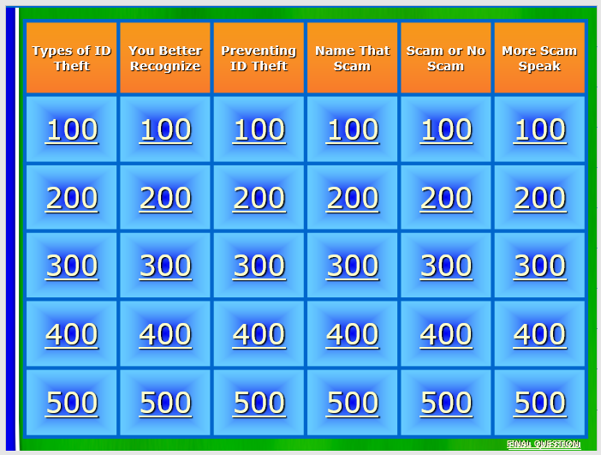

Slide 16
Kahoot Ed-tech Game
1. Scammers pretend to be interested in you. They ask for your e-mail and later ask for financial help to come visit you.
  A. Lottery Scam D. Banking Scam
  B. Charity Scam E. Romance Scam
  C.. Ticket Scam
2. You receive a phone call claiming you won a prize but require a fee to collect it and/or e-mail, address or phone number to contact you. Name the scam.
  A. Lottery Scam D. Banking Scam
  B. Charity Scam E. Romance Scam
  C. Ticket Scam
3. Your are sent a counterfeit check that looks real. Scammer tells you to deposit the check but asks you to “refund” a portion as they have sent you too much money. Name the scam.
  A. Lottery Scam D. Banking Scam
  B. Charity Scam E. Romance Scam
  C. Ticket Scam
4. A scammer sets up a fake organization, especially after disasters. They ask you to contribute to otheir fund which sounds similar to other well-known organizations. Name the scam.
  A. Lottery Scam D. Banking Scam
  B. Charity Scam E. Romance Scam
  C. Ticket Scam
5. At the “Super Bowl” scalpers sell tickets which seem to be legitimate as they have a bar codes and logos for the event. For the tickets they ask for cash or a credit card. Name the scam.
  A. Lottery Scam D. Banking Scam
  B. Charity Scam E. Romance Scam
  C. Ticket Scam

Slide 17
Kahoot Ed-tech Game (Answers)
1. Scammers pretend to be interested in you. They ask for your e-mail and later ask for financial help to come visit you.
  A. Lottery Scam D. Banking Scam
  B. Charity Scam E. Romance Scam
  C.. Ticket Scam
2. You receive a phone call claiming you won a prize but require a fee to collect it and/or e-mail, address or phone number to contact you. Name the scam.
  A. Lottery Scam D. Banking Scam
  B. Charity Scam E. Romance Scam
  C. Ticket Scam
3. Your are sent a counterfeit check that looks real. Scammer tells you to deposit the check but asks you to “refund” a portion as they have sent you too much money. Name the scam.
  A. Lottery Scam D. Banking Scam
  B. Charity Scam E. Romance Scam
  C. Ticket Scam
4. A scammer sets up a fake organization, especially after disasters. They ask you to contribute to otheir fund which sounds similar to other well-known organizations. Name the scam.
  A. Lottery Scam D. Banking Scam
  B. Charity Scam E. Romance Scam
  C. Ticket Scam
5. At the “Super Bowl” scalpers sell tickets which seem to be legitimate as they have a bar codes and logos for the event. For the tickets they ask for cash or a credit card. Name the scam.
  A. Lottery Scam D. Banking Scam
  B. Charity Scam E. Romance Scam
  C. Ticket Scam

Slide 18
Scam Assessment
A local senior citizen center director contacts you. She is concerned that some of its members are not knowledgeable about “Identity Theft” or scams and may be taken advantage of. She asks you to make a presentation at a local senior center about scams and identity theft.
Prepare a 5 to-10 minute visual and written presentation that includes at least two examples of ways people could be scammed.
List suggestions learned from your classwork, or personal research about how they can protect themselves from scams. Gives websites where one can find information on a particular scam, and lists whom a person should contact if they think they have been scammed.

Slide 19
Cybercrime Assessment
You can simply be doing whatever you usually do online, and without any warning, cybercrime can strike. Choose one of the scenarios below:
  Your online account is frozen and you need $200 to unlock it.
  Your Facebook account has been hacked and pictures that weren’t on your account suddenly appear.
  Your savings account has been drained of over $1,000.
Or, choose one of the topics from the “Scam Speak” list:
For whichever topic you choose, do in depth research on the cybercrime stating the issue, what happens and how to combat the incident and either:
  Write an article for your school newspaper about your findings.
  Prepare a wall poster for outside your classroom for other students.
  Prepare a Kahoot game on the topic.
  Do a power point presentation for sharing with the class.

Slide 20

CEE Affiliates
https://www.councilforeconed.org/resources/local-affiliates/

Slide 21




Thank You to Our Sponsors!

