Slide 1
Using Games to Explore Essential Financial Challenges
Doug Young June 10th, 2021 doug.n.young@gmail.com

Slide 2
EconEdLink Membership
You can now access CEE’s professional development webinars directly on EconEdLink.org! To receive these new professional development benefits, become an EconEdLink member. As a member, you will now be able to:
Automatically receive a professional development certificate via e-mail within 24 hours after viewing any webinar for a minimum of 45 minutes
Register for upcoming webinars with a simple one-click process
Easily download presentations, lesson plan materials and activities for each webinar
Search and view all webinars at your convenience
Save webinars to your EconEdLink dashboard for easy access to the event
You may access our new Professional Development page here

Slide 3
Professional Development Certificate
To earn your professional development certificate for this webinar, you must:
Watch a minimum of 45-minutes and you will automatically receive a professional development certificate via e-mail within 24 hours.
Accessing resources:
You can now easily download presentations, lesson plan materials, and activities for each webinar from EconEdLink.org/professional-development/

Slide 4
National Standards
Students will understand that: People cannot buy or make all the goods and services they want; as a result, people choose to buy some goods and services and not buy others. People can improve their economic wellbeing by making informed spending decisions, which entails collecting information, planning, and budgeting.
Students will understand that: Credit allows people to purchase goods and services that they can use today and pay for those goods and services in the future with interest. People choose among different credit options that have different costs. Lenders approve or deny applications for loans based on an evaluation of the borrower’s past credit history and expected ability to pay in the future. Higher-risk borrowers are charged higher interest rates; lower-risk borrowers are charged lower interest rates.
Students will understand that: Saving is the part of income that people choose to set aside for future uses. People save for different reasons during the course of their lives. People make different choices about how they save and how much they save. Time, interest rates, and inflation affect the value of savings.
https://www.councilforeconed.org/wp-content/uploads/2013/02/national-standards-for-financial-literacy.pdf

Slide 5
N.Y. State Standards
12.E1 INDIVIDUAL RESPONSIBILITY AND THE ECONOMY: Individuals should set personal financial goals, recognize their income needs and debt obligations, and know how to utilize effective budgeting, borrowing, and investment strategies to maximize well-being. 12.E1a In making economic decisions in any role, individuals should consider the set of opportunities that they have, their resources (e.g., income and wealth), their preferences, and their ethics. 12.E1b Sound personal financial (money management) practices take into account wealth and income, the present and the future, and risk factors when setting goals and budgeting for anticipated saving and spending. Cost-benefit analysis is an important tool for sound decision making. All financial investments carry with them varying risks and rewards that must be fully understood in order to make informed decisions. Greater rewards generally come with higher risks. 12.E1c Managing personal finance effectively requires an understanding of the forms and purposes of financial credit, the effects of personal debt, the role and impact of interest, and the distinction between nominal and real returns. Predatory lending practices target and affect those who are least informed and can least afford such practices. Interest rates reflect perceived risk, so maintaining a healthy credit rating lowers the cost of borrowing.

Slide 6
Objectives
Identify the elements of a typical monthly family budget including income, living expenses, savings and net worth.
Understand the financial risk versus return costs offered by banks, including compounding of investments and loans.
Classify goals as short, mid or long-term and see how debt and budgeting impacts these goals.
Describe the characteristics of the five main types of plastic money cards and the costs and benefits associated with each.
Know the 3 main credit reporting agencies and their tracking of debt.
Know how credit scores are created, the characteristics of a score and its impact.
Know the basics of investing needed for financial stability and wealth growth.

Slide 7
Agenda
Lessons on Managing Money
Budgeting: Know Your Numbers
Understanding “risks versus returns” when investing
Strategies, Concepts and Jargon
Customizing “Jeopardy Template” for in- class and hybrid use
Formative Assessments
Playing “Wall Street Jeopardy”
Kahoot Game
Summative Assessment

Slide 8
References
Managing Your Money
https://www.econedlink.org/resources/managing-your-money/
Credit Reports and Credit Scores
https://www.econedlink.org/resources/credit-reports-and-credit-scores/
Getting Out of Debt
https://www.econedlink.org/resources/getting-out-of-debt/
What is Credit?
What is Credit?
https://www.econedlink.org/resources/what-is-credit/
Learning, Earning and Investing https://www.econedlink.org/resources/what-is-a-stock-lesson-demo/ https://www.econedlink.org/resources/what-is-a-bond-lesson-demo/ https://www.econedlink.org/resources/what-are-mutual-funds-lesson-demo/

Slide 9
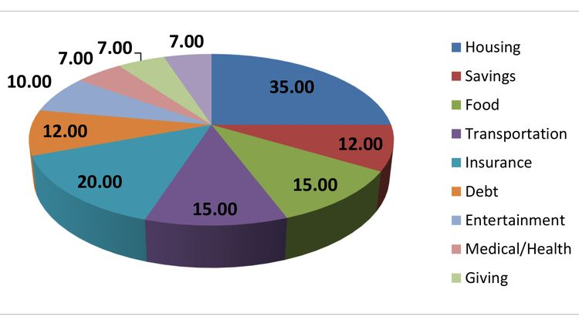
Sample Family Budget
https://criticalcommons.org/view?m=3nlomZhMc “Ka Ching” by CXO-CBX
https://www.youtube.com/watch?v=GXE_n2q08Yw “For the Love of Money” by The O’Jays
https://www.youtube.com/watch?v=GvQmDIcd4SU “Money (That’s What I Want) by Barret Strong

Slide 11
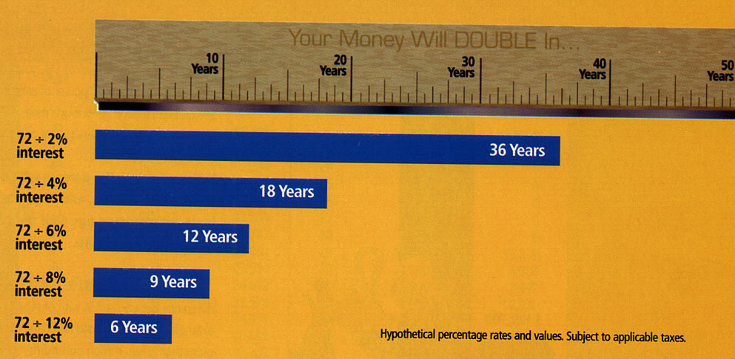
The Rule of 72
……states that 72 divided by the interest rate will result in the number of years it will take your investment to double…...
https://www.econedlink.org/resources/compound-interest-calculator/

Slide 12
Vocabulary
A.P.R.
Bonds
Budgeting
C.D.’s, Money Market Funds
Commercial Bank
Compounding Interest
Credit Card
Credit Union
Credit Reports (components)
Credit Score (components)
Debit Card
Deposit/Withdrawal
Dividends/Capital Gains
F.D.I.C.
Fraud in Investing
Federal Reserve Bank
Gift Card
Goal Setting (short – long)
Gross v. Net Pay
Investing and Saving
Monthly Living Expenses
Mutual Funds
Net Worth
Overdraft
Predatory Lenders
Pre-paid Card
Rule of 72
Stocks/Bonds/ Mutual Funds
Store Cards
4 C’s for a loan

Slide 13
Wall Street Animals | Types of Stocks | Stock Markets | Market Jargon | Investment Fraud | Types of Investment
100 | 100 | 100 | 100 | 100 | 100
200 | 200 | 200 | 200 | 200 | 200
300 | 300 | 300 | 300 | 300 | 300
400 | 400 | 400 | 400 | 400 | 400
500 | 500 | 500 | 500 | 500 | 500
FINAL QUESTION

Slide 14
Managing Money | Banking and Saving | Debt | Credit Scores | Investing | Plastic Money Cards
100 | 100 | 100 | 100 | 100 | 100
200 | 200 | 200 | 200 | 200 | 200
300 | 300 | 300 | 300 | 300 | 300
400 | 400 | 400 | 400 | 400 | 400
500 | 500 | 500 | 500 | 500 | 500
FINAL QUESTION

Slide 15
Category Change: Credit Reports
1. Which of the following is not a credit reporting agency?
A. Experian C. Fair Issac Company
B. Trans Union D. Equifax
2. Which of the following terms DOES NOT appear on a credit report?
A. Salary C. Credit information
B. Social security D. Bankruptcies, if any.
3. Which of the following terms DOES appear on a credit report?
A. Race C. Marital Status
B. Education D. Debts owed
How long do most items, good or bad, remain on a credit report?
A. One year C. Seven years
B. Five years D. Ten years
5. Which of the following is not one of the four stages of investing?
A. Earning C. Growing
B. Saving D. Spending

Slide 16
Answers: Credit Reports
1. Which of the following is not a credit reporting agency?
A. Experian C. Fair Issac Company
B. Trans Union D. Equifax
2. Which of the following terms DOES NOT appear on a credit report?
A. Salary C. Credit information
B. Social security D. Bankruptcies, if any.
3. Which of the following terms DOES appear on a credit report?
A. Race C. Marital Status
B. Education D. Debts owed
How long do most items, good or bad, remain on a credit report?
A. One year C. Seven years
B. Five years D. Ten years
5. Which of the following is not one of the four stages of investing?
A. Earning C. Growing
B. Saving D. Spending

Slide 17
Kahoot Lesson
1. Monthly costs (good debt) which you need to pay to survive in life?
A. Net Worth B. Living Expenses C. Housing
D. Net Pay E. Five or More
2. Your assets (savings, stocks, bonds, etc.) minus your debt is known as:
A. Net Worth B. Living Expenses C. Housing
D. Net Pay E. Five or More
3. Wages you actually receive after taxes are deducted?
A. Net Worth B. Living Expenses C. Housing
D. Net Pay E. Five or More
4. A long term goal is on that is usually needs how many years to accomplish?
A. Net Worth B. Living Expenses C. Housing
D. Net Pay E. Five or More
5. The average American spends most of their monthy income (25-30%) on this need?
A. Net Worth B. Living Expenses C. Housing
D. Net Pay E. Five or More

Slide 18
Kahoot Answers
1. Monthly costs (good debt) which you need to pay to survive in life?
A. Net Worth B. Living Expenses C. Housing
D. Net Pay E. Five or More
2. Your assets (savings, stocks, bonds, etc.) minus your debt is known as:
A. Net Worth B. Living Expenses C. Housing
D. Net Pay E. Five or More
3. Wages you actually receive after taxes are deducted?
A. Net Worth B. Living Expenses C. Housing
D. Net Pay E. Five or More
4. A long term goal is on that is usually needs how many years to accomplish?
A. Net Worth B. Living Expenses C. Housing
D. Net Pay E. Five or More
5. The average American spends most of their monthly income (25-30%) on this need?
A. Net Worth B. Living Expenses C. Housing
D. Net Pay E. Five or More

Slide 19
Summative Assessments
1. Have students test their budget knowledge playing “Budget Odyssey”: https://econedlink.org/resources/budgetodyssey/. When complete, check for understanding by discussing the following questions.
What is income (net v. gross) and why the difference?
What is a fixed v. variable expense? Provide two examples for each
Five reasons why is it important to establish a balanced budget?
2. Research a local financial institution to determine the specific services they provide. Write a few paragraphs explaining how they would advise a fictitious family to use the services offered to solve a family’s financial dilemma.
3. Have students form groups of 2-3. Create a questionnaire with each student interviewing at least 2-3 adults. Questions might be on the number of credit cards, the interest rates on each, their credit score, the three credit reporting agencies and “Utilization Rate” of existing credit. Have students use butcher block paper to record answers and then discuss. The results will be amazing.

Slide 20
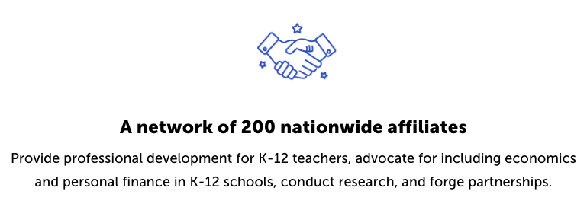
CEE Affiliates
https://www.councilforeconed.org/resources/local-affiliates/

Slide 21
Thank You to Our Sponsors!

