Slide 1
Using Tech Tools to Teach:
ThingLink
Presented by Kathy Pondy, Arizona Council on Economic Education
July 28, 2021 kathy.pondy@azecon.org

Slide 2
EconEdLink Membership
You can now access CEE’s professional development webinars directly on EconEdLink.org! To receive these new professional development benefits, become an EconEdLink member. As a member, you will now be able to:
Automatically receive a professional development certificate via e-mail within 24 hours after viewing any webinar for a minimum of 45 minutes
Register for upcoming webinars with a simple one-click process
Easily download presentations, lesson plan materials and activities for each webinar
Search and view all webinars at your convenience
Save webinars to your EconEdLink dashboard for easy access to the event
You may access our new Professional Development page here

Slide 3
Professional Development Certificate
To earn your professional development certificate for this webinar, you must:
Watch a minimum of 45-minutes and you will automatically receive a professional development certificate via e-mail within 24 hours.
Accessing resources:
You can now easily download presentations, lesson plan materials, and activities for each webinar from EconEdLink.org/professional-development/

Slide 4
Agenda
Introduction to Thinglink
Why Thinglink
Creating a ThingLink - Demonstration
Questions

Slide 5
Objectives
Participants will be given an overview of ThingLink
Participants will explore examples of Thinglink use in the classroom
Participants will learn the steps to create a ThingLink presentation

Slide 6

https://www.thinglink.com/en-us/

Slide 7
What is ThingLink?
Web based tool to turn images into interactive learning experience
Rich media can be easily linked or tagged
Keeps students engaged while limiting likely distractions

Slide 8
Cool Things to Know about Thinglink
Easy to tag websites, videos, voice over, uploaded photos for an all-in-one place learning experience
Immersive Reader – more than 60 languages
Virtual Fieldtrip

Slide 9
ThingLink in the Classroom
Appropriate for grades K - 12
Flexible across platforms (web and app based, iOS and Android) with or without wireless
With Premium, student rosters can be connected
Can be connected to Google Forms – think formative assessment ideas

Slide 10


Slide 11

Creating a ThingLink
Have your idea in mind
Create folder on your desktop to save images you will use
Create a doc/spreadsheet containing links to other items to be added
Create ThingLink account
Choose type of ThingLink
Edit your ThingLink
Share your ThingLink

Slide 12
ThingLink Accounts
Free or Premium for teachers
Free or Premium for districts

Slide 13

Ideas for Your Classroom
Virtual Field Trips
Bookshelf
Display student work
Tech Tips/FAQ about tech tools
Introducing new content
Escape Room

Slide 14
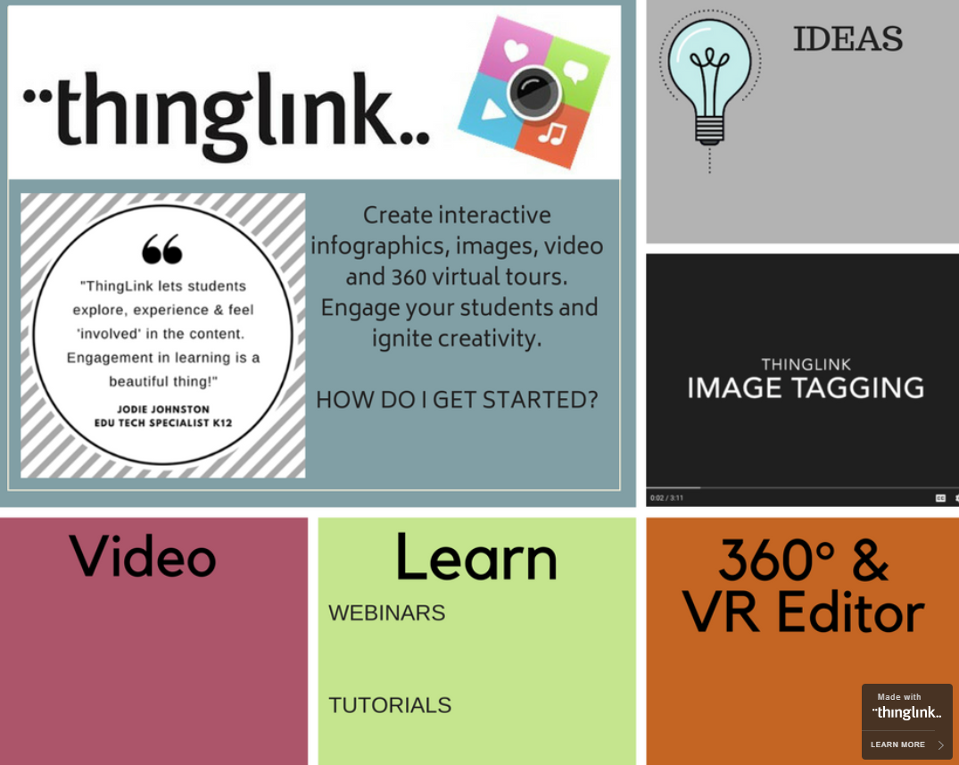

Slide 15
Great Uses for ThingLink
WebQuest
https://www.gettingsmart.com/2013/01/10-innovative-ways-to-use-thinglink-in-the-classroom/
5 Best Practices
https://www.gettingsmart.com/2012/08/5-ways-use-thinglink-teaching-learning/
Escape Room
https://www.instructables.com/Digital-Escape-Rooms-With-ThingLink-Google-Forms/

Slide 16

Questions?
Kathy Pondy
Director of Student Programs
Arizona Council on Economic Education
Kathy.pondy@azecon.org

Slide 17

CEE Affiliates
https://www.councilforeconed.org/resources/local-affiliates/

Slide 18

https://bit.ly/CEEConference2021

Slide 19




Thank You to Our Sponsors!

