Slide 1
Using Tech Tools to Teach: Padlet and Classroom Screen Presented by Teresa Mungai, Arizona Council on Economic Education August 4, 2021 Teresam@azecon.org

Slide 2
EconEdLink Membership
You can now access CEE’s professional development webinars directly on EconEdLink.org! To receive these new professional development benefits, become an EconEdLink member. As a member, you will now be able to:
Automatically receive a professional development certificate via e-mail within 24 hours after viewing any webinar for a minimum of 45 minutes
Register for upcoming webinars with a simple one-click process
Easily download presentations, lesson plan materials and activities for each webinar
Search and view all webinars at your convenience
Save webinars to your EconEdLink dashboard for easy access to the event
You may access our new Professional Development page here

Slide 3
Professional Development Certificate
To earn your professional development certificate for this webinar, you must:
Watch a minimum of 45-minutes and you will automatically receive a professional development certificate via e-mail within 24 hours.
Accessing resources:
You can now easily download presentations, lesson plan materials, and activities for each webinar from EconEdLink.org/professional-development/

Slide 4
Agenda
Tech Tools Overview
Hands-on Activity
Questions

Slide 5
Objectives
Participants will be given an overview of Padlet and Classroom Screen
Participants will take part in an interactive activity using Padlet and Classroom Screen

Slide 6
What is it?
How can I access it?
How can I use it?

Slide 7
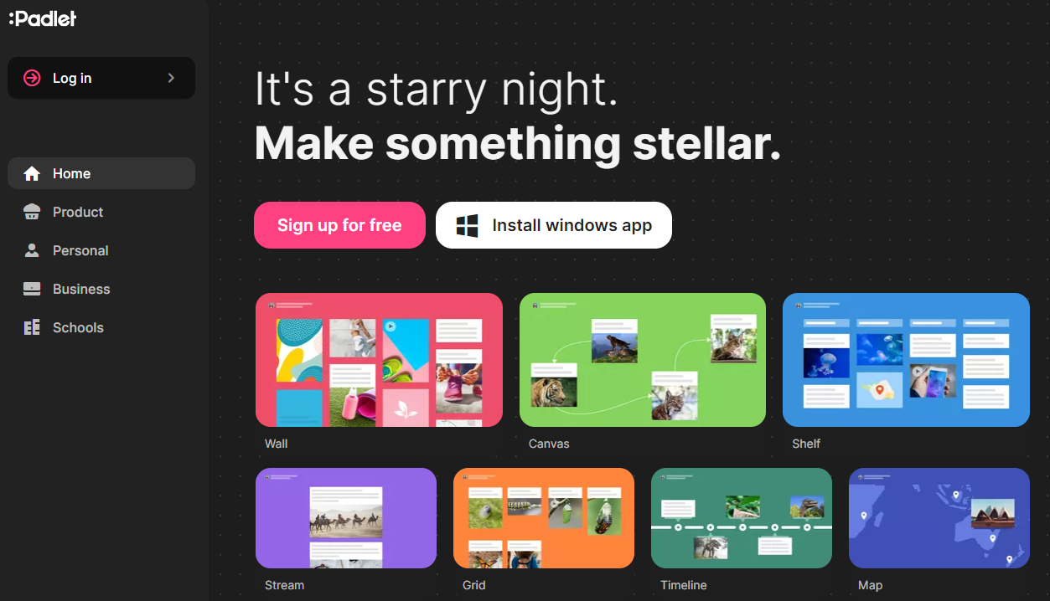
What is it?
Padlet is a free online tool for sharing information and a discussion board
How can I access it?
www.padlet.com

Slide 8
Let’s Practice!
Notes:
Competition Goods - https://padlet.com/teresa_mungai/utcpjmmfoh2nr6cp
Practice: https://padlet.com/teresa_mungai/44c2poqzxgpiicri

Slide 9
Sample Lesson Activities
If you would like copies of any of these activities, please email me at teresam@azecon.org.

Slide 10
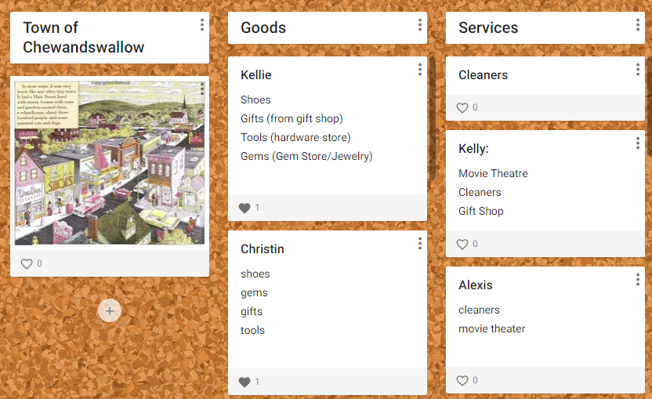
K-2 Lesson Sample
If you would like copies of any of these activities, please email me at teresam@azecon.org.

Slide 11
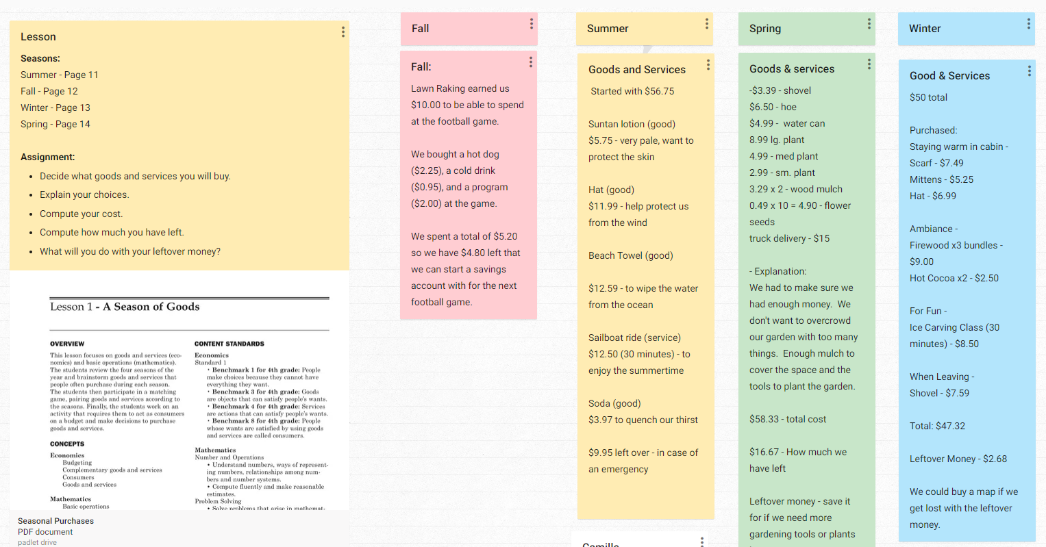
3-5 Lesson Sample
If you would like copies of any of these activities, please email me at teresam@azecon.org.

Slide 12
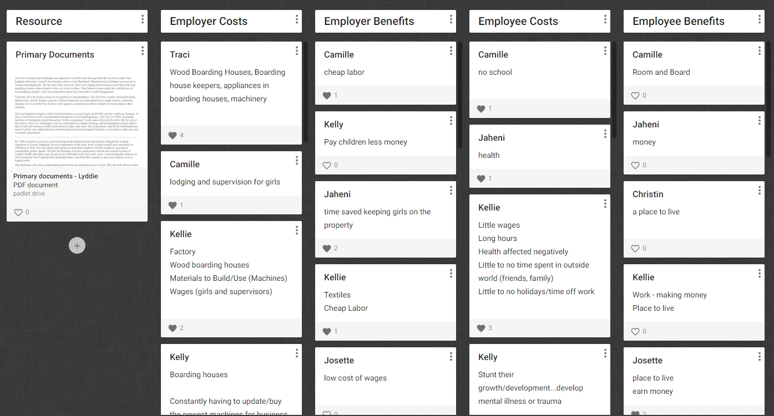
6-8 Lesson Sample
If you would like copies of any of these activities, please email me at teresam@azecon.org.

Slide 13
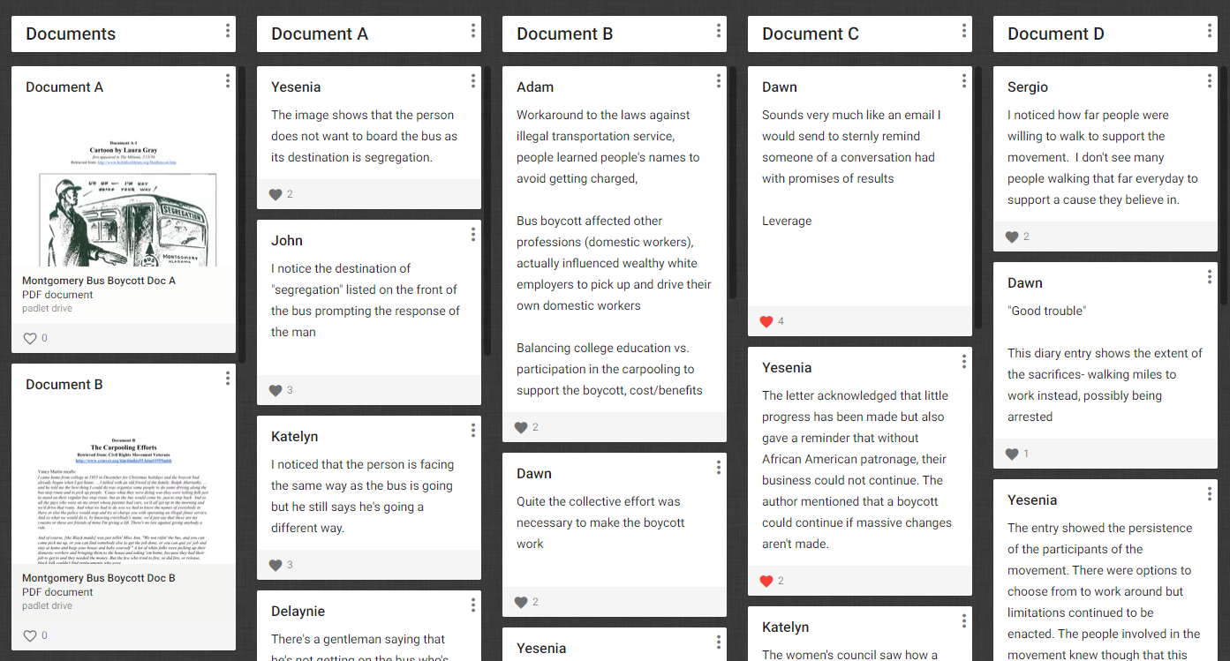
9-12 Lesson Sample
If you would like copies of any of these activities, please email me at teresam@azecon.org.

Slide 14
What is it?
How can I access it?
How can I use it?

Slide 15
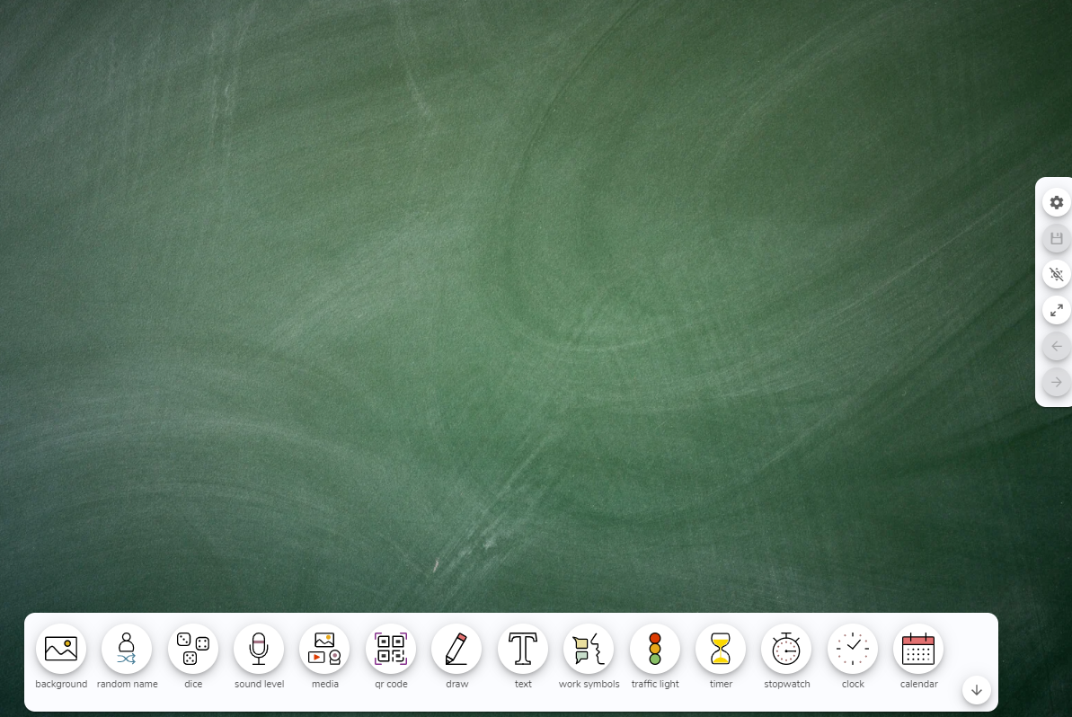
What is it?
Classroom Screen is a tool for giving your students visual cues and a classroom assistant
How can I access it?
www.classroomscreen.com

Slide 16
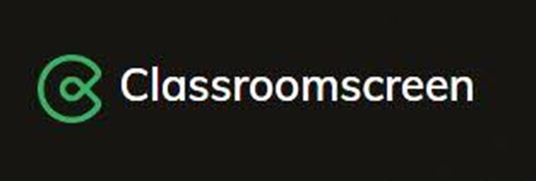
Let’s Practice!

Slide 17
Questions?
Teresa Mungai
Director of Programs
Arizona Council on Economic Education
teresam@azecon.org

Slide 18
References
Padlet: www.padlet.com
Classroom Screen: www.classroomscreen.com

Slide 19
CEE Affiliates
https://www.councilforeconed.org/resources/local-affiliates/

Slide 20
https://bit.ly/CEEConference2021

Slide 21
Thank You to Our Sponsors!

