Slide 1
Using Tech Tools to Teach Jamboard Presented by Teresa Mungai July 7, 2021 Teresam@azecon.org

Slide 2
EconEdLink Membership
You can now access CEE’s professional development webinars directly on EconEdLink.org! To receive these new professional development benefits, become an EconEdLink member. As a member, you will now be able to:
Automatically receive a professional development certificate via e-mail within 24 hours after viewing any webinar for a minimum of 45 minutes
Register for upcoming webinars with a simple one-click process
Easily download presentations, lesson plan materials and activities for each webinar
Search and view all webinars at your convenience
Save webinars to your EconEdLink dashboard for easy access to the event
You may access our new Professional Development page here

Slide 3
Professional Development Certificate
To earn your professional development certificate for this webinar, you must:
Watch a minimum of 45-minutes and you will automatically receive a professional development certificate via e-mail within 24 hours.
Accessing resources:
You can now easily download presentations, lesson plan materials, and activities for each webinar from EconEdLink.org/professional-development/

Slide 4
Agenda
Tech Tool Overview
Hands-on Activity
Questions

Slide 5
Objectives
Participants will be given an overview of Jamboard.
Participants will take part in an interactive activity using Jamboard.

Slide 6
What is it?
How can I access it?
How can I use it?

Slide 7
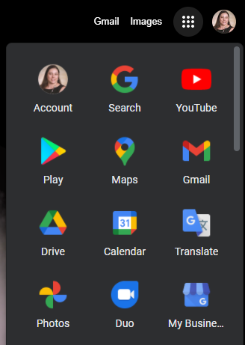
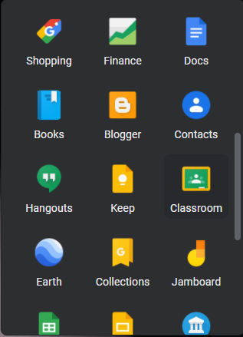
What is it?
Jamboard is whiteboard application that is part of the Google Suite.
How can I access it?

Slide 8
Let’s Practice Using It!

Slide 9
Sample Lesson Activities
If you would like copies of any of these activities, please email me at teresam@azecon.org.

Slide 10
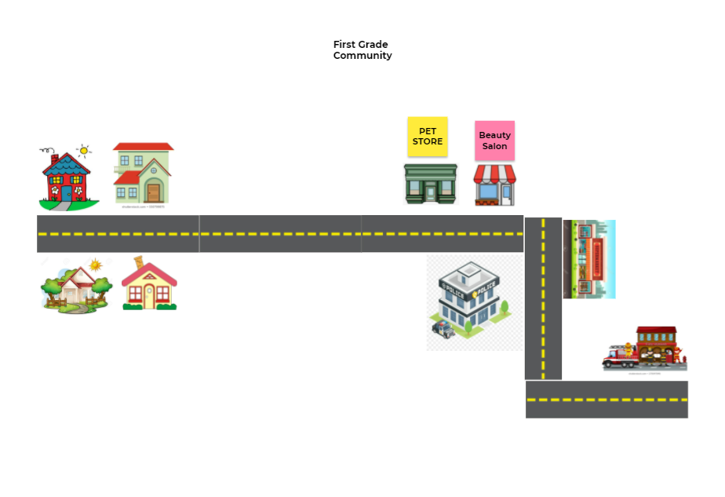
K-2 Lesson Sample
If you would like copies of any of these activities, please email me at teresam@azecon.org.

Slide 11
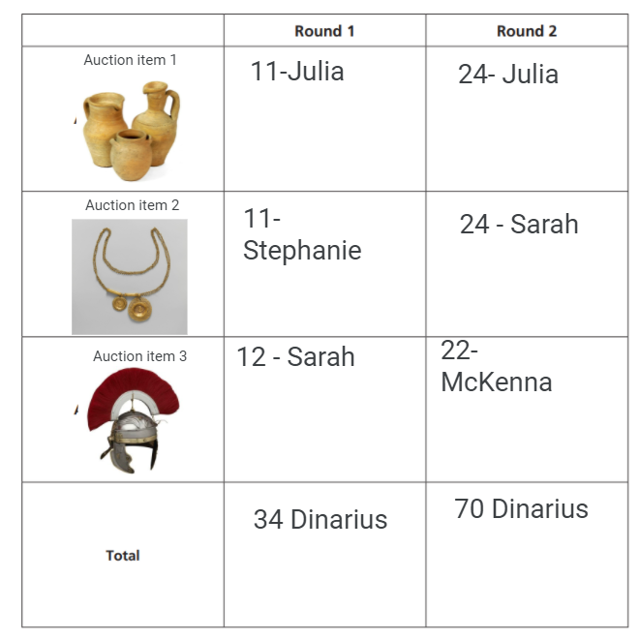
6-8 Lesson Samples
If you would like copies of any of these activities, please email me at teresam@azecon.org.

Slide 12
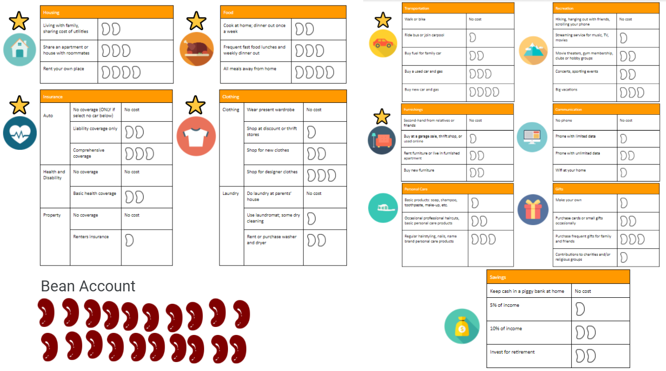
High School Lesson Samples
If you would like copies of any of these activities, please email me at teresam@azecon.org.

Slide 13
Questions
Teresa Mungai
Director of Programs
Arizona Council on Economic Education
teresam@azecon.org

Slide 14
References
https://jamboard.google.com/

Slide 15
CEE Affiliates
https://www.councilforeconed.org/resources/local-affiliates/

Slide 16
Thank You to Our Sponsors!

Slide 17
https://www.councilforeconed.org/events/conference/

