Slide 1
Using EdTech Tools to Teach: EdPuzzle Presented by Teresa Mungai, Arizona Council on Economic Education June 23, 2021 Teresam@azecon.org

Slide 2
EconEdLink Membership
You can now access CEE’s professional development webinars directly on EconEdLink.org! To receive these new professional development benefits, become an EconEdLink member. As a member, you will now be able to:
Automatically receive a professional development certificate via e-mail within 24 hours after viewing any webinar for a minimum of 45 minutes
Register for upcoming webinars with a simple one-click process
Easily download presentations, lesson plan materials and activities for each webinar
Search and view all webinars at your convenience
Save webinars to your EconEdLink dashboard for easy access to the event
You may access our new Professional Development page here

Slide 3
Professional Development Certificate
To earn your professional development certificate for this webinar, you must:
Watch a minimum of 45-minutes and you will automatically receive a professional development certificate via e-mail within 24 hours.
Accessing resources:
You can now easily download presentations, lesson plan materials, and activities for each webinar from EconEdLink.org/professional-development/

Slide 4
Agenda
Tech Tool Overview
Hands- On Activity
Questions

Slide 5
Objectives
Participants will be given an overview of EdPuzzle
Participants will take part in interactive activities using EdPuzzle

Slide 6
What is it?
How can I access it?
How can I use it?

Slide 7
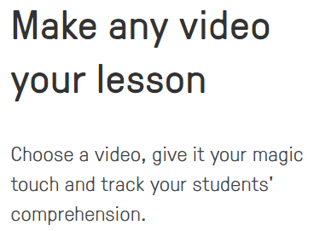
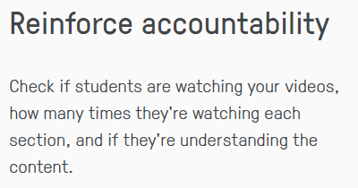
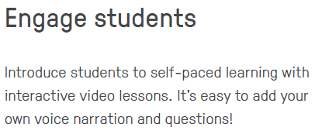

Slide 8
Let’s Check It Out!!
www.edpuzzle.com

Slide 9
Let’s Do A Lesson!
Supply
Demand
and

Slide 10
Questions?
Teresa Mungai
Director of Programs
Arizona Council on Economic Education
teresam@azecon.org

Slide 11
References
www.edpuzzle.com

Slide 12
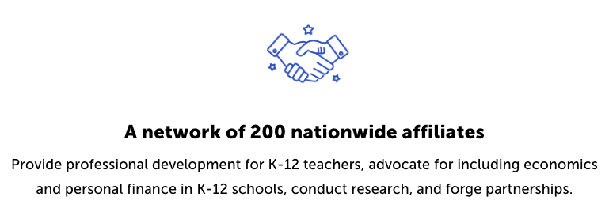
CEE Affiliates
https://www.councilforeconed.org/resources/local-affiliates/

Slide 13
Thank You to Our Sponsors!

Slide 14
http://bit.ly/CEEConference2021

