Slide 1
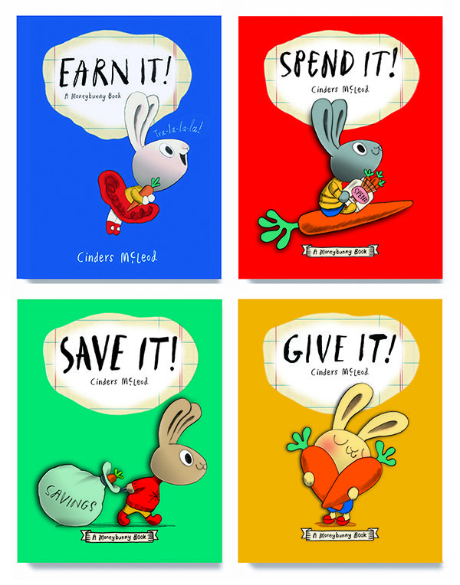
Bunnyland:
Economics and Personal Finance Lessons for the Primary Classroom
Lynne Farrell Stover
July 20, 2021 stoverlf@jmu.edu

Slide 2
EconEdLink Membership
You can now access CEE’s professional development webinars directly on EconEdLink.org! To receive these new professional development benefits, become an EconEdLink member. As a member, you will now be able to:
Automatically receive a professional development certificate via e-mail within 24 hours after viewing any webinar for a minimum of 45 minutes
Register for upcoming webinars with a simple one-click process
Easily download presentations, lesson plan materials and activities for each webinar
Search and view all webinars at your convenience
Save webinars to your EconEdLink dashboard for easy access to the event
You may access our new Professional Development page here

Slide 3
Professional Development Certificate
To earn your professional development certificate for this webinar, you must:
Watch a minimum of 45-minutes and you will automatically receive a professional development certificate via e-mail within 24 hours.
Accessing resources:
You can now easily download presentations, lesson plan materials, and activities for each webinar from EconEdLink.org/professional-development/

Slide 4
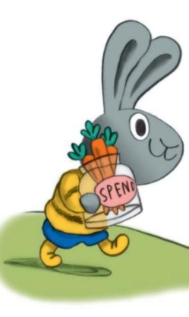
Agenda
In this webinar we will discover a set of new picture books that engage young students as they learn about:
Opportunity Cost
Entrepreneurship
Productive Resources
Money
Choices
Human Capital
Also provided:
Hands on lessons and activities
Websites providing support materials
Related standards
Annotated bibliography
Q & A opportunities

Slide 5
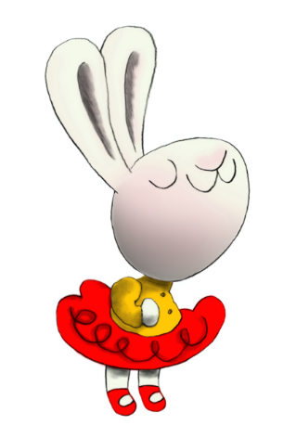
Objectives
Teachers will be able to:
Review basic economic concepts.
Explore a set of new picture books (copyrights 2017-2020) and learn how to identify the economic concepts found in them.
Learn how to use book content to teach age appropriate lessons and activities based on the featured concepts.

Slide 6
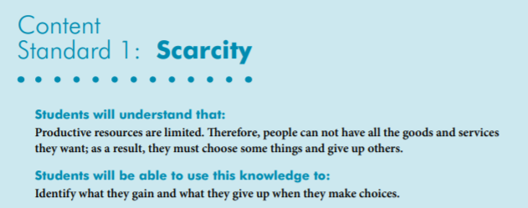

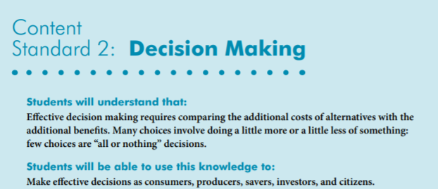
National Standards
https://www.councilforeconed.org/wp-content/uploads/2012/03/voluntary-national-content-standards-2010.pdf

Slide 7

State Standards
Virginia HISTORY & SOCIAL SCIENCE Standards of Learning
K.8 The student will match simple descriptions of work that people do with the names of those jobs.
K.9 The student will
a) recognize that people make choices because they cannot have everything they want; and
explain that people work to earn money to buy the things they want.
1.8 The student will explain that people make choices because they cannot have everything they want.
1.9 The student will recognize that people save money for the future to purchase goods and services.
2.8 The student will describe natural resources (water, soil, wood, and coal), human resources (people at work), and capital resources (machines, tools, and buildings).
2.10 The student will explain that scarcity (limited resources) requires people to make choices about producing and consuming goods and services.
3.10 The student will identify examples of making an economic choice and will explain the idea of
opportunity cost (what is given up when making a choice).

Slide 8
Using Children’s Literature to Teach Economics
It is to be noted that by using children’s picture books to teach in the content areas we are providing students with engaging background information that encourages them to relate to concepts, improve vocabulary, and promote reading and writing skills.
Children’s literature offers many interdisciplinary possibilities including those of economics and personal finance.
These titles are part of the Moneybunnies series by author Cinders McLeod.

Slide 9
Featured Economic Concepts
Choice- An act of selecting or making a decision when faced with two or more alternatives.
Entrepreneur - The person who organizes, operates and assumes the risk for a business venture.
Human Capital- Intangible assets possessed by individuals, including knowledge, talent, skills, health and values (also known as human resources).
Money – Any generally accepted medium of exchange.
Opportunity Cost - The real cost of a choice. It is the next best alternative that is given up—the lost opportunity.
Productive Resources- Things used in the production of goods and services including: Natural Resources (gifts of nature that are present without human intervention), Human Resources (the quantity and quality of human effort directed toward producing goods and services) and Capital Resources (manmade resources such tools, buildings, and vehicles used in production).
Wants - A desire that can be satisfied by consuming or using a good or service.
Wage- Payments for labor services that are directly tied to time worked or pieces produced.

Slide 10

Lesson Features
Reading information
Story Synopsis
Structured Lesson Plan
Assessment
Cross-Curricular Enrichment Activities
YouTube Reading Link
Discussion Questions

Slide 11
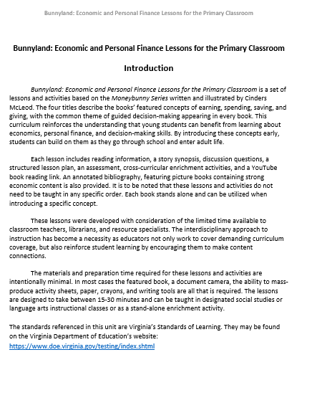
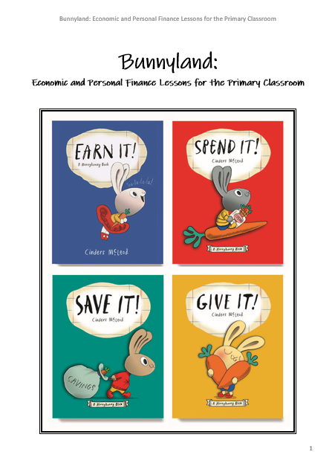
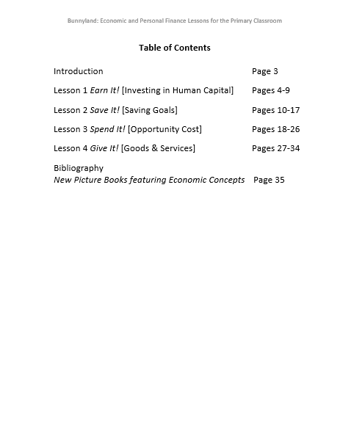

Slide 12

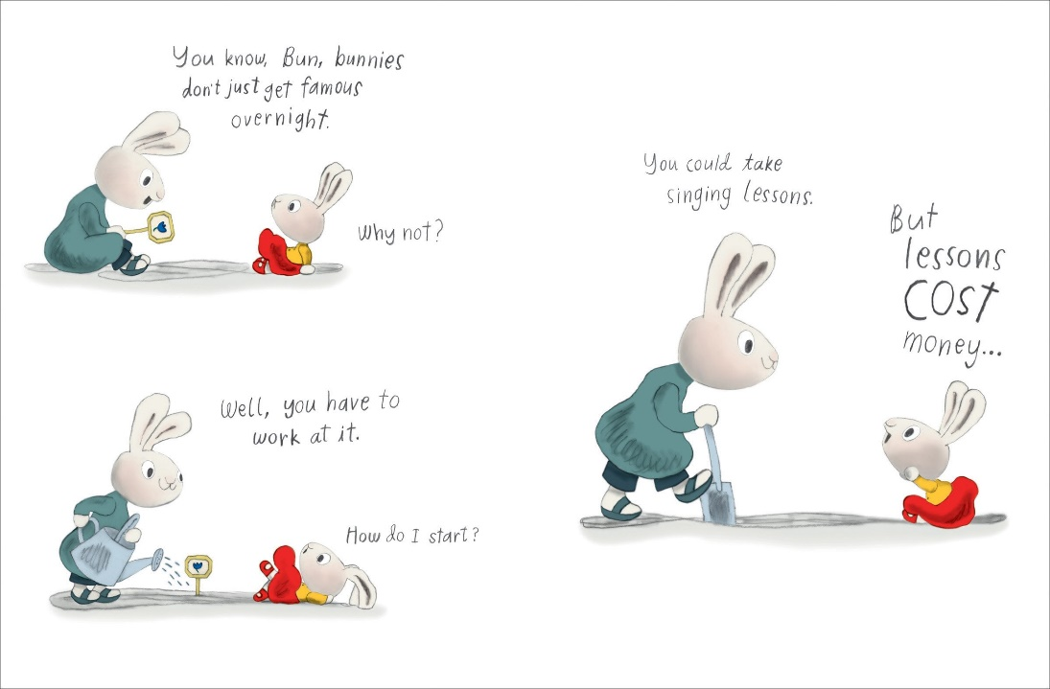
Investing in Human Capital
Publisher: Penguin
Copyright Date: 2017
Reading Level: 2.0
Interest Level: PK-2

Slide 13
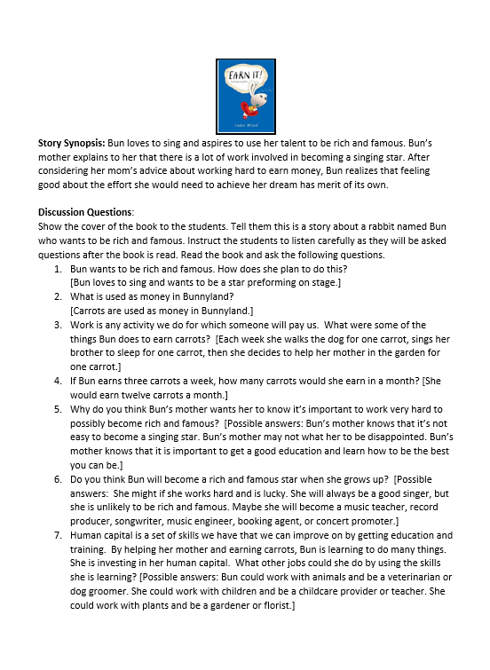

Earn It!

Slide 14
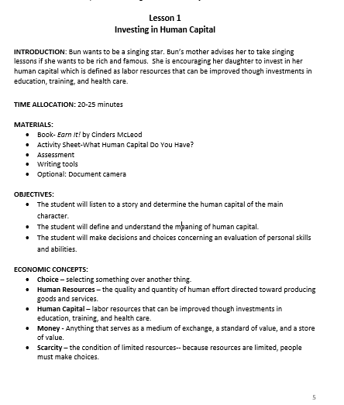
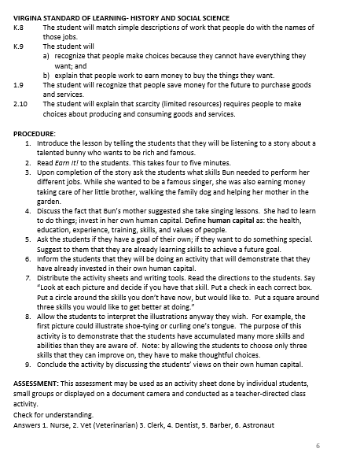
Quick Introduction

Slide 15
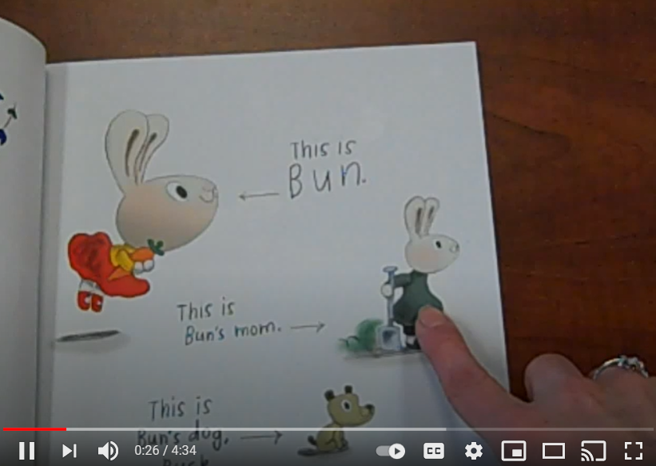
ENRICHMENT & EXTENSION
Art – Create a class collage using photos, drawings, words, and clippings from old magazines that depicts different kinds of jobs.
Creative Problem Solving- Challenge the students to create a class ABC Book that contains a job for every letter in the alphabet.
Online Resources: Exploring Human Capital with Primary Children: What We Learn in School Does Matter. Bonnie T. Meszaros and Mary C. Suiter. Social Studies and the Young Learner 27 pp. 30–32 ©2014 National Council for the Social Studies.
https://www.socialstudies.org/system/files/publications/articles/yl_27011430.pdf
YouTube Book Reading Link: https://www.youtube.com/watch?v=3ceVZG2SsGs (4:34 Reading Time)

Slide 16
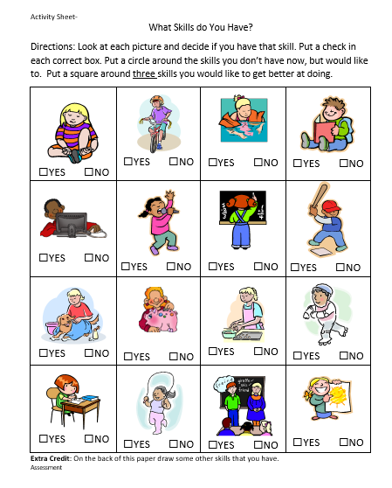

Activity Sheet

Slide 17
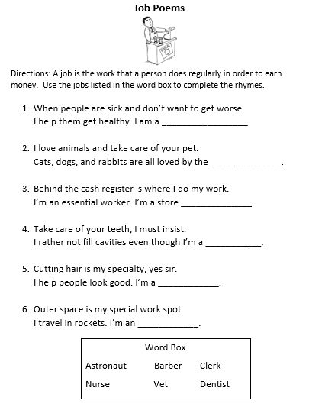

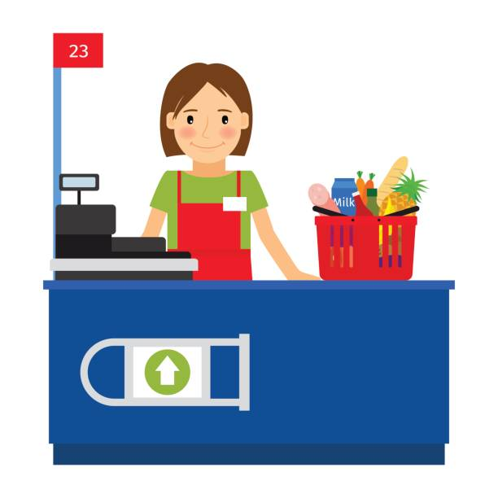
Assessment

Slide 18
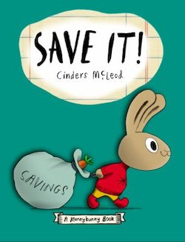
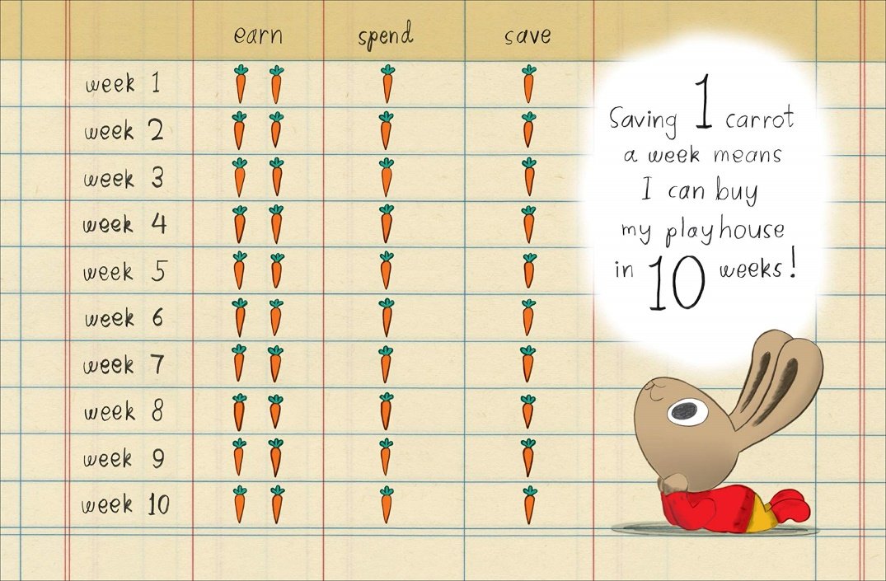
Saving Goals
Publisher: Penguin
Copyright Date: 2019
Reading Level: 1.0
Interest Level: PK-2

Slide 19
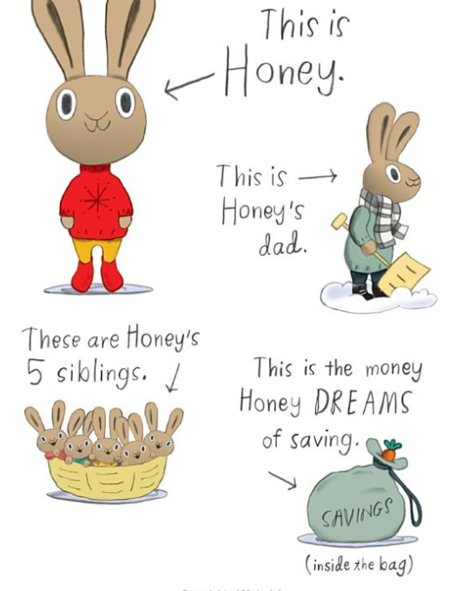
Save It!
Story Synopsis: Honey works hard taking care of her five younger siblings, for which she earns two carrots a week. She would really like to have a quiet place of her own.
Her father suggests she save her money to buy her own playhouse. After some creative problem solving, Honey decides to save a portion of her weekly allowance.
This method might take a while longer, but she will still be able to enjoy some of her favorite treats.

Slide 20
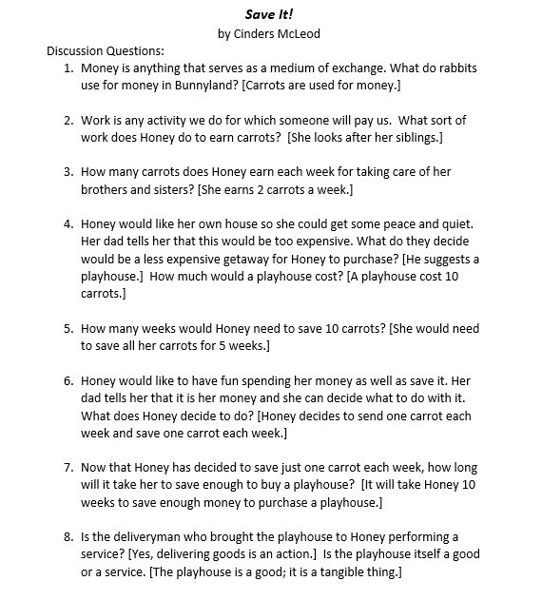
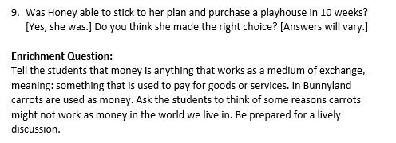

Discussion Questions

Slide 21
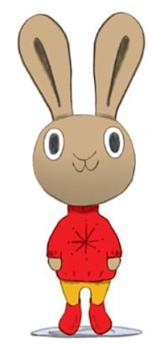
ENRICHMENT AND EXTENSION
Rhyming – Tell the students that in this story Honey, bunny, and money are rhyming words. They sound alike. Challenge them to think of other words in the story and find words that rhyme with them. Possible words include: Dad, Earn, Playhouse, Save, and Spend.
Creative Problem Solving – Carrots are money in Bunnyland. We save our money in banks and credit unions where it is safe. Do you think there are banks in Bunnyland? If so, what would they look like? Would there be wallets and pocketbooks in Bunnyland? What do you think they would look like?

Slide 22
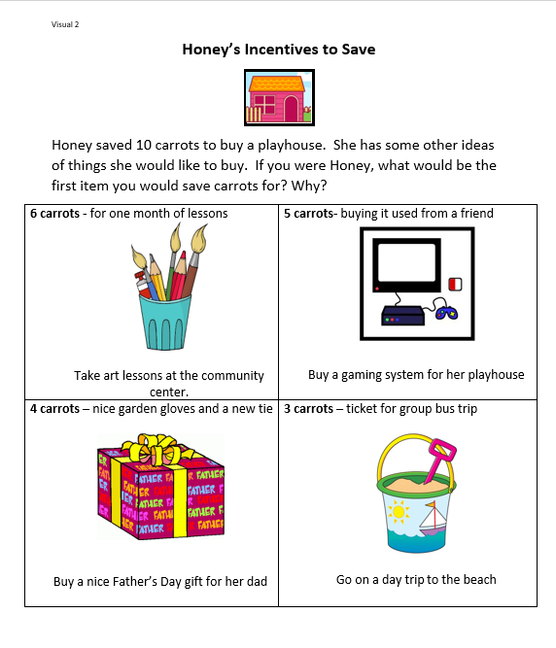
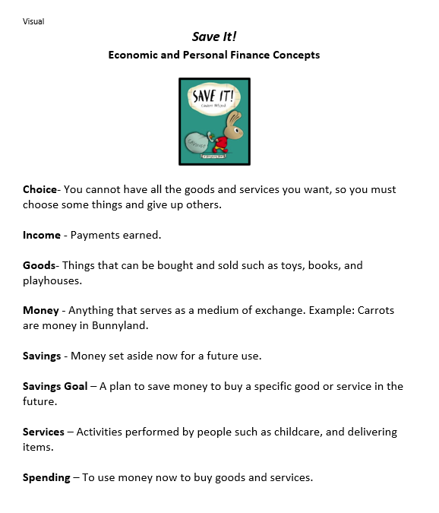
Visuals

Slide 23
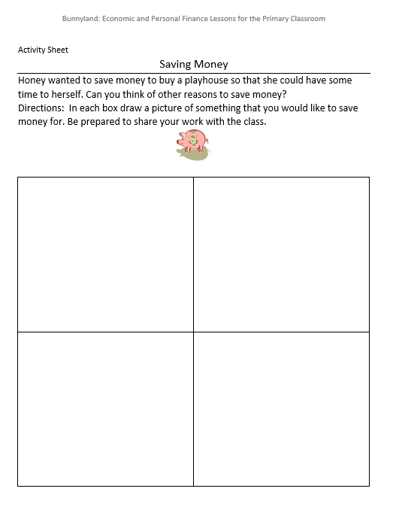

Activity Sheet

Slide 24
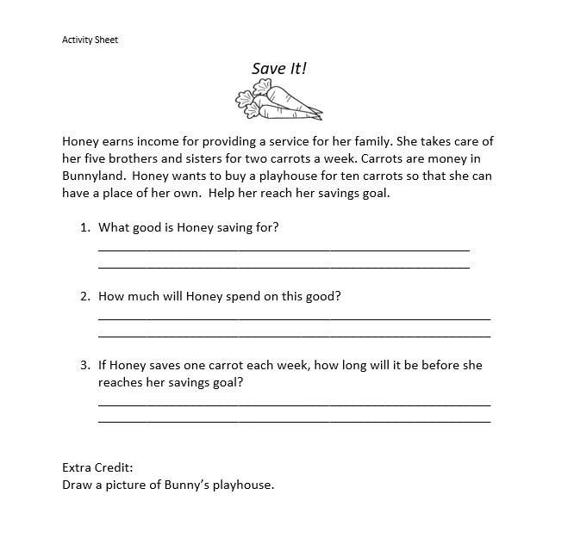
Assessment

Slide 25
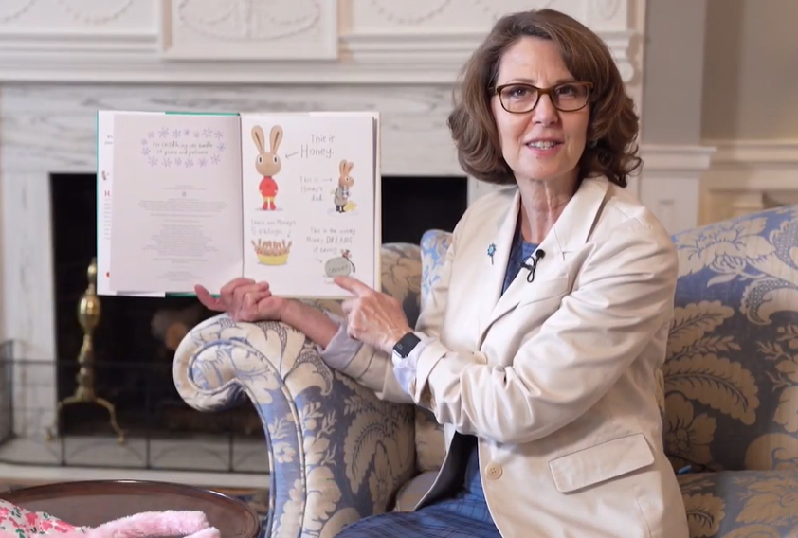
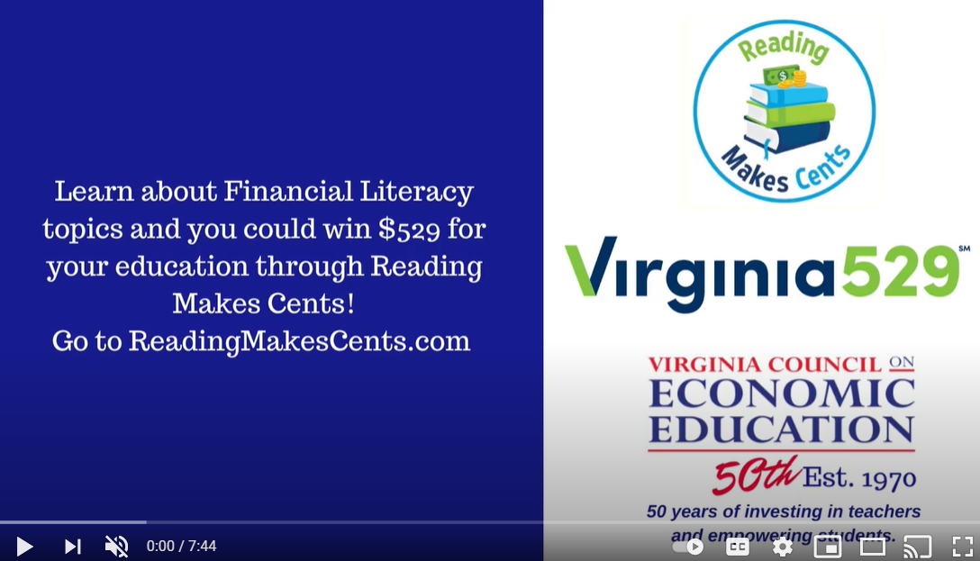
Unintended Consequences?
First Lady Northam reading "Save It!" https://www.youtube.com/watch?v=1BDayN0lEEY (7:45 Reading Time)

Slide 26
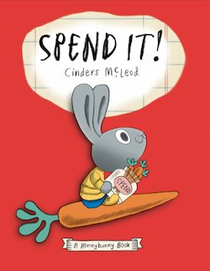
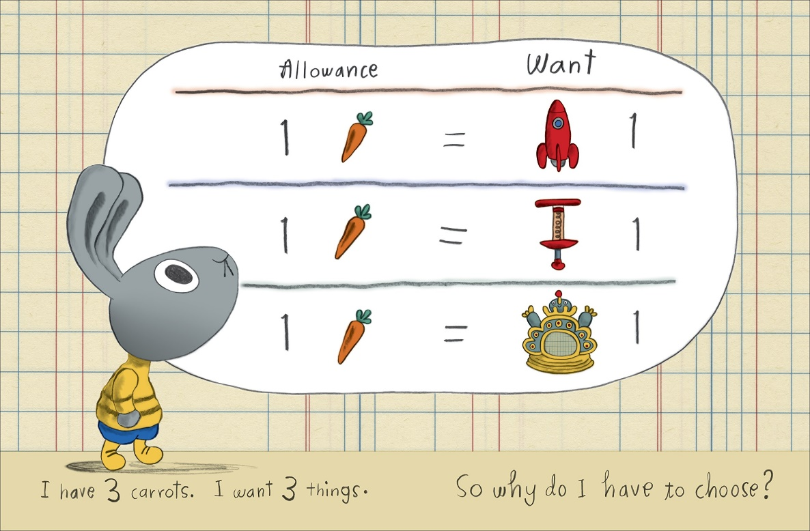
Opportunity Cost
Publisher: Penguin
Copyright Date: 2019
Reading Level: 1.0
Interest Level: PK-2

Slide 27
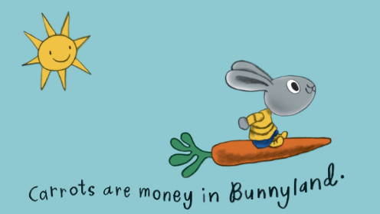
Spend It!
STORY SYNOPSIS: Sonny gets three whole carrots a week for his allowance and wants to buy everything with it! But he soon discovers his money won't go that far, and his mom tells him he needs to make some choices.
That doesn't sound like much fun to Sonny, especially when he learns that the bouncy castle he's been eyeing goes for ONE HUNDRED carrots. Ridiculous!
But eventually, after a little math and a little more thinking, he has a blast discovering what's really important to him and worth spending his carrots on.

Slide 28
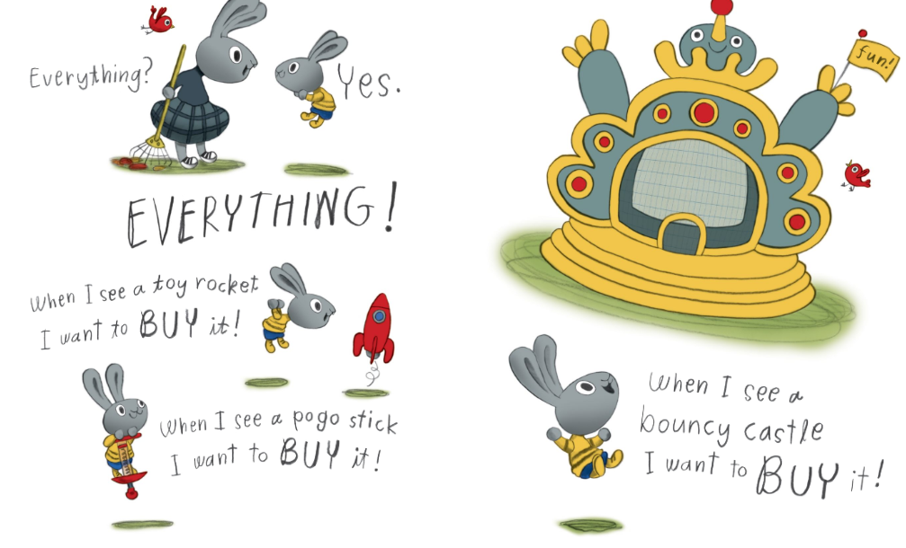
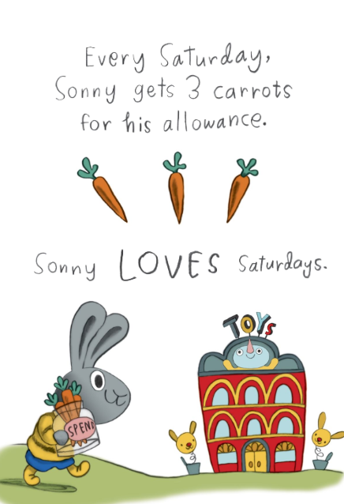
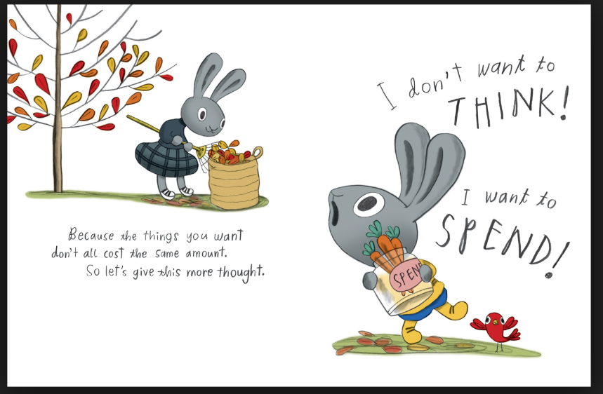
Sonny is a relatable character…

Slide 29
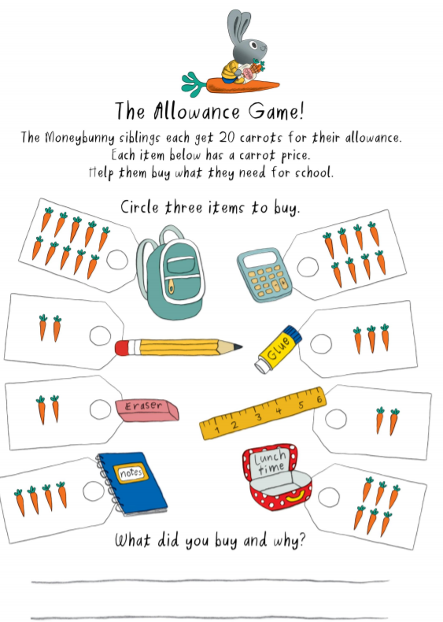
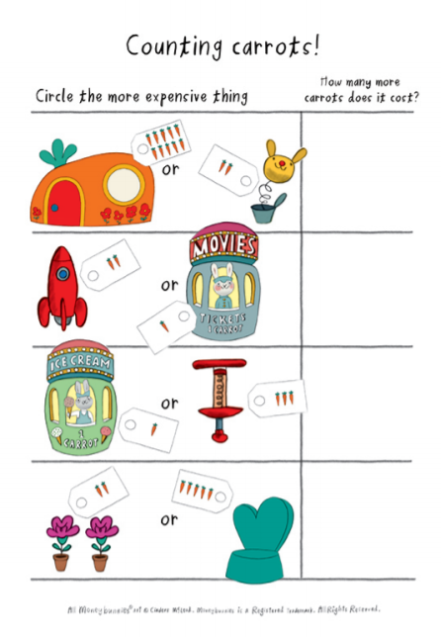

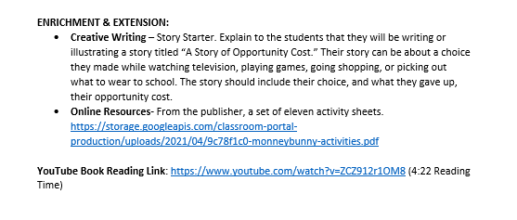

Slide 30






Spend It! Color Sheets

Slide 31
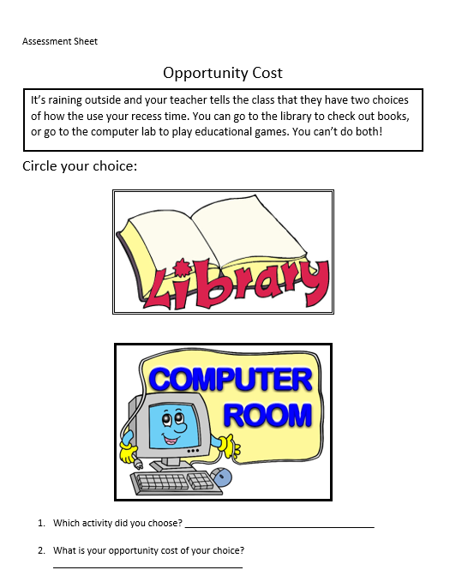
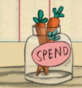
Assessment Activity

Slide 32

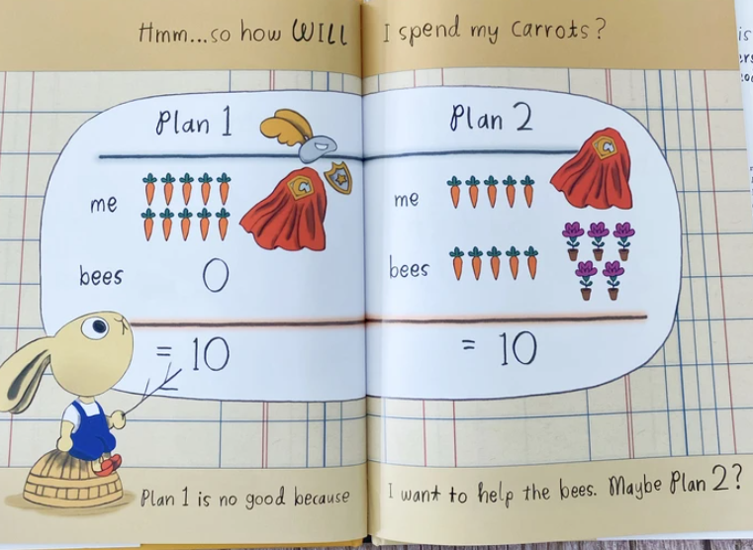
Goods & Services
Publisher: Penguin
Copyright Date: 2020
Reading Level: 2.0
Interest Level: PK-2

Slide 33
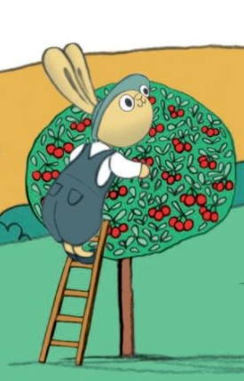
Give It!
Story Synopsis: When Chummy’s grandmother gives him ten carrots for his birthday, he has to make some decisions.
He definitely wants to help others, but he is not sure of the best way to do so.
With some sensible discussion, informative graph making and charitable consideration, he makes a choice that will have an impact on others and the environment.

Slide 34
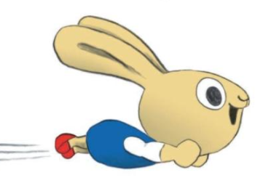
ENRICHMENT & EXTENSION
Art – Chummy wanted to be a superhero and save the world. Create a superhero who specializes in helping others. Give him/her a special name like Captain Charity or Great Giver. Draw a picture of this new super hero.
Class Charitable Activity – Encourage students to bring in an donate coins to put in a glass jar. Once the jar is full, decide on a local charity to donate it to, such as an animal shelter or a food pantry.
Science – Chummy chose to use his carrots to plant flowers for honeybees. Ask the students why bees are important. Information about this topic is provided by Virginia Agriculture in the Classroom in a K-2 unit, “The Amazing Honey Bee”. https://va.agclassroom.org/matrix/lesson/print/686/
YouTube Book Reading Link: https://www.youtube.com/watch?v=lCuBSL-njsM
(3:35 Reading Time)

Slide 35
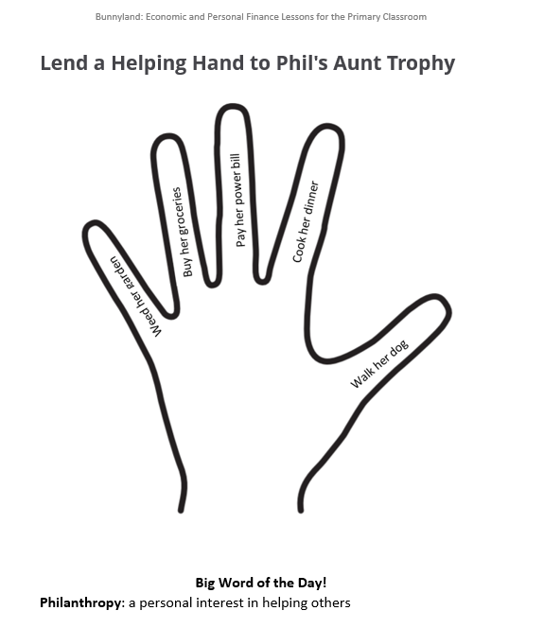
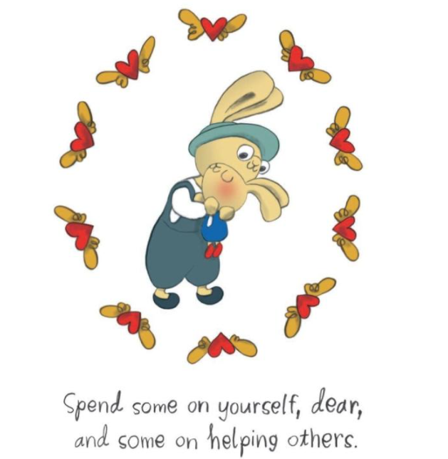

Visual

Slide 36
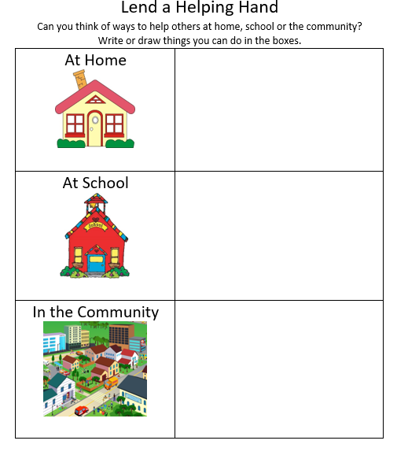
Activity Sheet

Slide 37
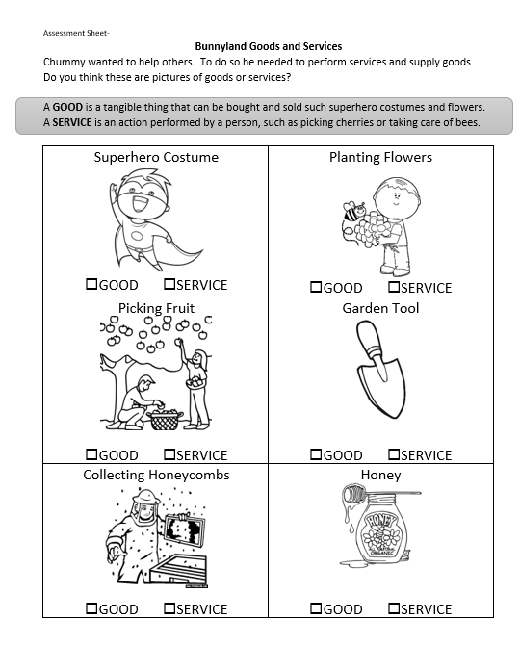
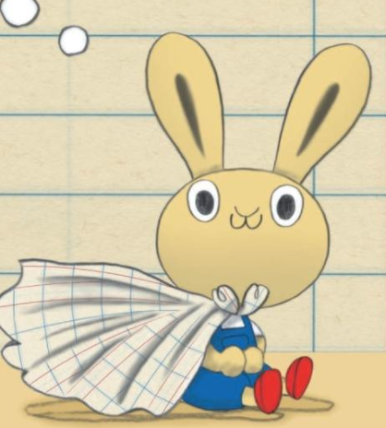
Assessment

Slide 38
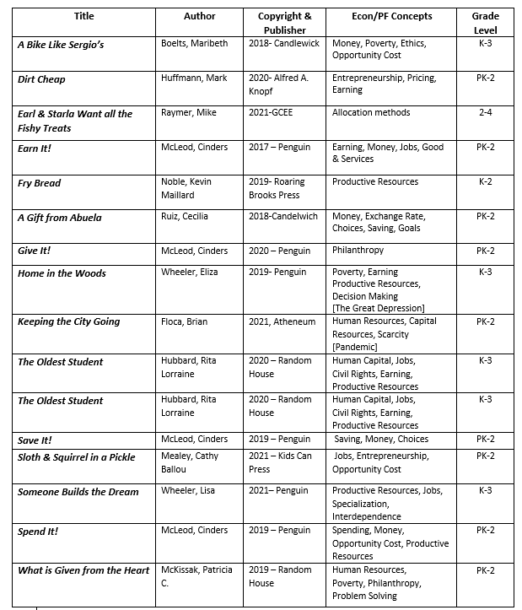

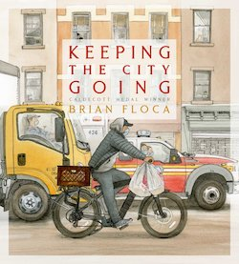
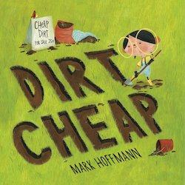



New Children’s Picture Books

Slide 39
Assessment/Reflection Questions
What are the benefits of using children’s literature to teach economics and personal finance?
Is the availability to online readings of the featured books helpful? If so, in what way?
Is using a children’s book more difficult with online instruction?
How can picture books be used with older students?
Do you know of any new titles that can be added to the bibliography?

Slide 40

References
Earn It! Reading | https://www.youtube.com/watch?v=3ceVZG2SsGs
Save It! Readings | https://www.youtube.com/watch?v=-x97ApD-Cd0 (3:19 Reading Time) https://www.youtube.com/watch?v=1BDayN0lEEY (7:45 Reading Time)
Spend It! Reading | https://www.youtube.com/watch?v=ZCZ912r1OM8 (4:22 Reading Time)
Give It! Reading | https://www.youtube.com/watch?v=lCuBSL-njsM
Publisher Activity Sheets | https://storage.googleapis.com/classroom-portal-production/uploads/2021/04/9c78f1c0-monneybunny-activities.pdf
“The Amazing Honey Bee” Unit | https://va.agclassroom.org/matrix/lesson/print/686/
Virginia Standards of Learning | https://www.doe.virginia.gov/testing/index.shtml
National Content Standards in Economics | https://www.councilforeconed.org/wp-content/uploads/2012/03/voluntary-national-content-standards-2010.pdf

Slide 41

CEE Affiliates
https://www.councilforeconed.org/resources/local-affiliates/

Slide 42

https://bit.ly/CEEConference2021

Slide 43




Thank You to Our Sponsors!

