Slide 1
Preparing for the
AP Micro Exam:
Externalities and Firms
Presented by Kathleen Brennan
May 10, 2021 kbrennan@mountsaintmary.org

Slide 2
EconEdLink Membership
You can now access CEE’s professional development webinars directly on EconEdLink.org! To receive these new professional development benefits, become an EconEdLink member. As a member, you will now be able to:
Automatically receive a professional development certificate via e-mail within 24 hours after viewing any webinar for a minimum of 45 minutes
Register for upcoming webinars with a simple one-click process
Easily download presentations, lesson plan materials and activities for each webinar
Search and view all webinars at your convenience
Save webinars to your EconEdLink dashboard for easy access to the event
You may access our new Professional Development page here

Slide 3
Professional Development Certificate
To earn your professional development certificate for this webinar, you must:
Watch a minimum of 45-minutes and you will automatically receive a professional development certificate via e-mail within 24 hours.
Accessing resources:
You can now easily download presentations, lesson plan materials, and activities for each webinar from EconEdLink.org/professional-development/

Slide 4
Agenda
Overview of AP Micro Exam
Externalities
Example Problems
Resources for Review
Questions?

Slide 5
Objectives
Review positive and negative externalities in the context of the AP Micro exam.
Obtain resources that can be used to prepare students for AP Micro exam.
questions on externalities.
Answer

Slide 6
AP Micro Exam Dates
Wednesday, May 12 @ 12:00 PM EDT
Friday, May 28 @ 4:00 PM EDT
Tuesday, June 8 @ 4:00 PM EDT

Slide 7
AP Micro Exam
Section I: Multiple Choice
60 questions, 70 minutes, 66% of Exam Score
Section II: Free Response
3 questions, 60 minutes, 33% of Exam Score
1 long- 50% of section score
2 short- each worth 25% of section score

Slide 8
Order of FRQs on Digital Exam
Short free-response question
Short free-response question
Long free-response question
- Students cannot go back to questions they have already answered, nor skip ahead on the digital exam
- Calculators are ONLY permitted on the digital exam

Slide 9
Digital/Remote AP Exams
Information for Digital/Remote AP Exams
Students are permitted to install the app on their own computer at cb.org/ap2021examapp
Digital practice on the app is now available
Three days prior to exam, students will complete exam set-up for EACH digital exam
On day of exam, students must check in 30 minutes prior to exam

Slide 10
AP Classroom
AP Central

Slide 11
AP Microeconomics Exam
Basic Economic Concepts (12-15%)
Supply and Demand (20-25%)
Production, Cost, and Perfect Competition (22-25%)
Imperfect Competition (15-22%)
Factor Markets (10-13%)
Market Failure and the Role of Government (8-13%)

Slide 12
Unit 6: Market Failure and the Role of Government
6.1 Socially Efficient and Inefficient Market Outcomes
6.2 Externalities
6.3 Public and Private Goods
6.4 The Effects of Government Intervention in Different Market Structures
6.5 Inequality

Slide 13
6.1 Socially Efficient and
Inefficient Market Outcomes

Slide 14

Demand and Supply
109
8
7
6
5
4
3
2
1
MC = S
MB = D
1 2 3 4 5 6 7 8 9 10

Slide 15
Demand and Supply
109
8
7
6
5
4
3
2
1
Supply
Price
Equilibrium results in an efficient outcome with no deadweight loss
Demand
Quantity
1 2 3 4 5 6 7 8 9 10

Slide 16
Benefits and Costs
109
8
7
6
5
4
3
2
1
MC
Not
Enough
(MB>MC)
MB
1 2 3 4 5 6 7 8 9 10

Slide 17
Benefits and Costs
109
8
7
6
5
4
3
2
1
MC
Too Much
(MC>MB)
MB
1 2 3 4 5 6 7 8 9 10

Slide 18
Important Concepts
MB = MC
MSB = MSC allocative efficiency
Deadweight loss– underproducing or overproducing
Socially optimal or allocative efficiency Qd = Qs
Perfectively competitive firms = allocatively efficient
Imperfectly competitive firms- not allocatively efficient

Slide 19
Market Failures
Externalities
Public Goods
Imperfect Competition
Unequal Distribution of Income

Slide 20
6.2 Externalities

Slide 21
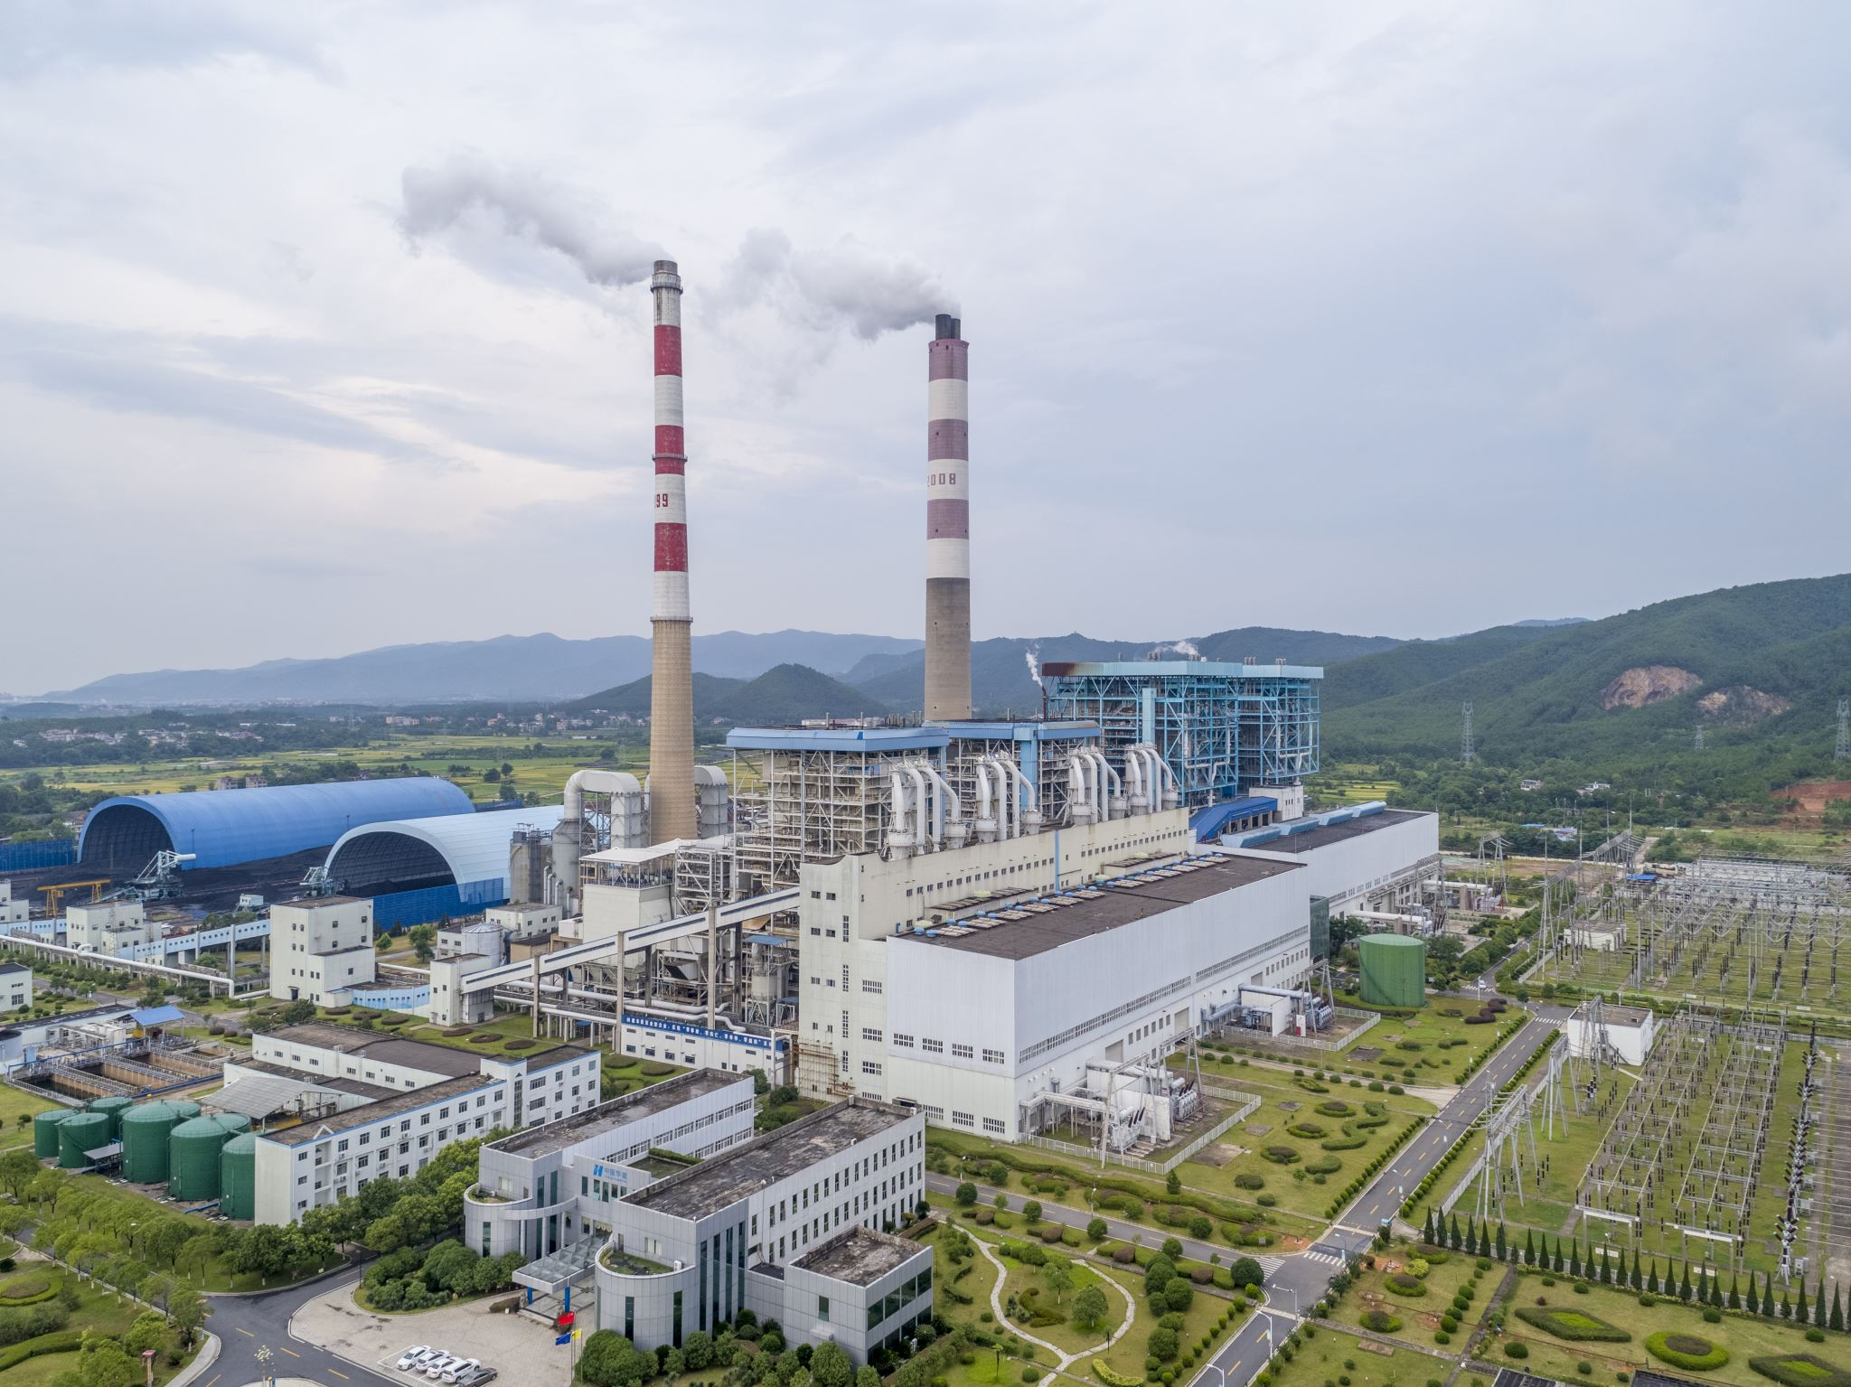
Negative Externalities
A transaction between a buyer and seller that has a spillover cost to a third party.

Slide 22
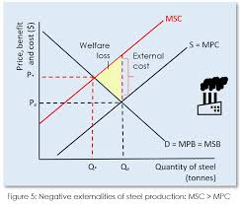
Negative Externality
Microeconomicsap.com

Slide 23
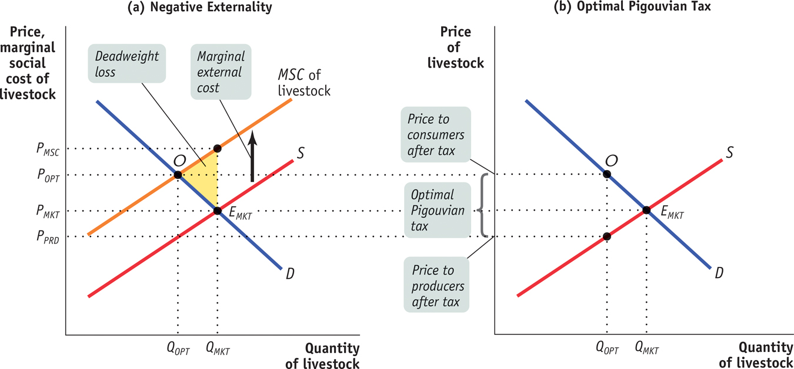
Correcting for a Negative Externality
Krugman: AP Economics

Slide 24

Positive Externalities
A transaction between a buyer and seller that has a third-party spillover benefit to society.

Slide 25
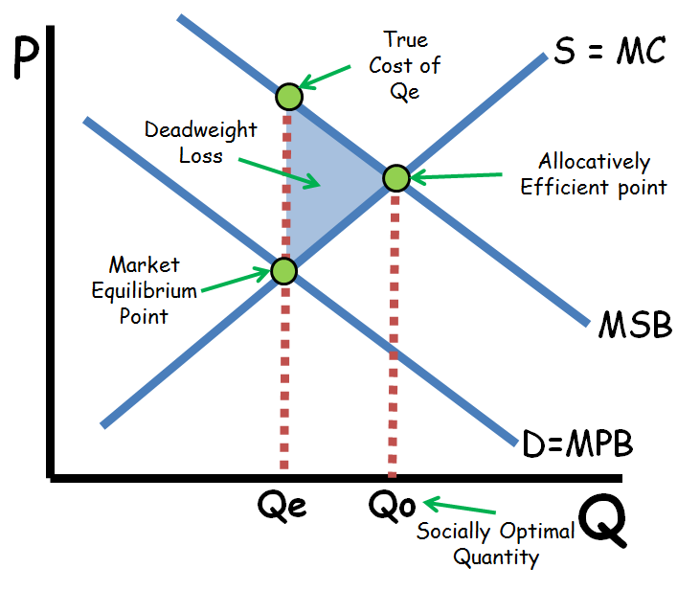
Positive Externality
Reviewecon.com

Slide 26
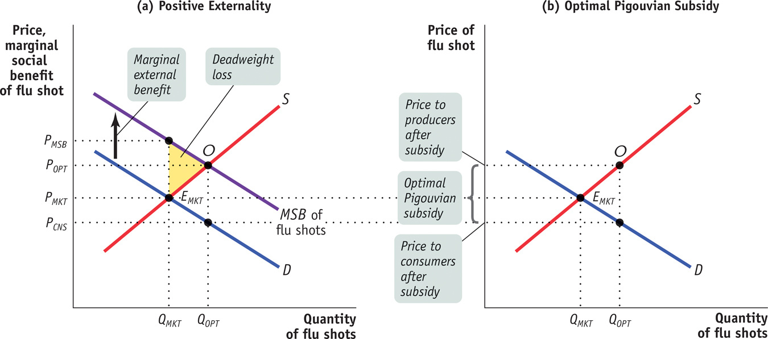
Correcting for a Positive Externality
Krugman AP Economics

Slide 27
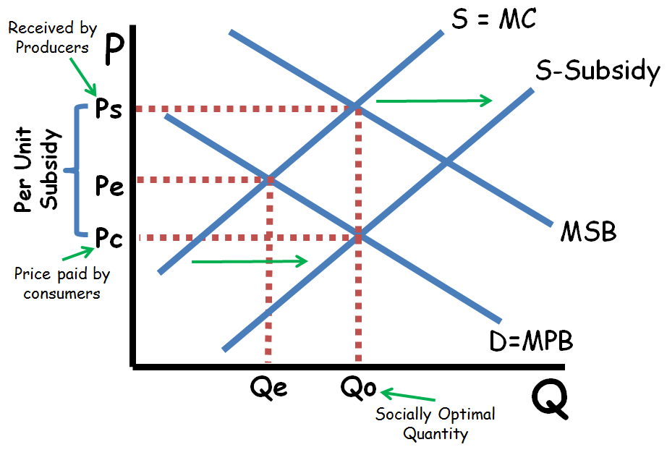
Correcting for a Positive Externality
Reviewecon.com

Slide 28
Government Interventions
Quantity Restrictions (quotas)
Regulation
Per unit taxes
Per-unit subsidies

Slide 29
Sample Questions

Slide 30
AP Classroom
AP Central

Slide 31
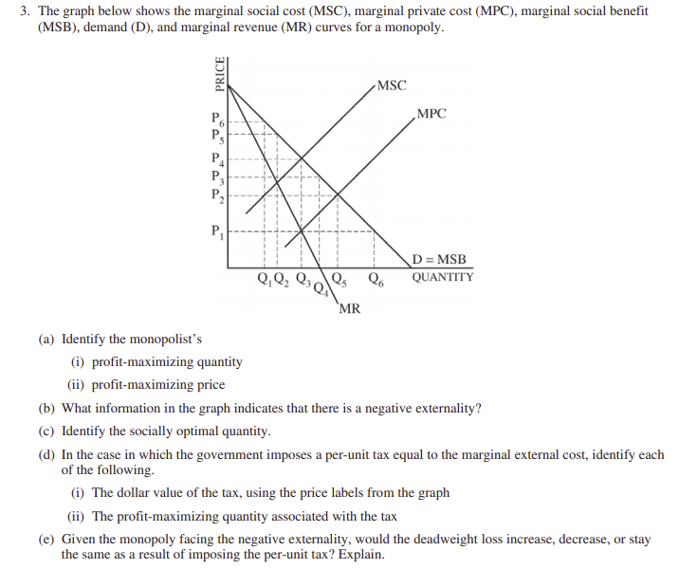
(2017) FRQ #3
a. Q3, P4
b. MSC>MPC
c. Q3 (MSB=MSC)
d. P4 – P1, Q2
e. DWL increases since Q3 is socially optimal Q, and now it is less

Slide 32
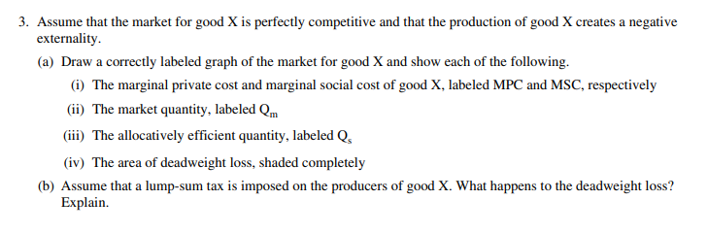
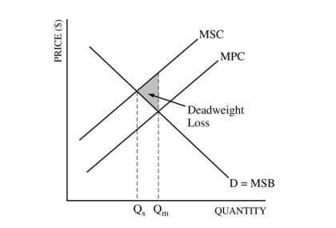
(2011) FRQ #3
b. Deadweight loss doesn’t change because MC doesn’t change.

Slide 33
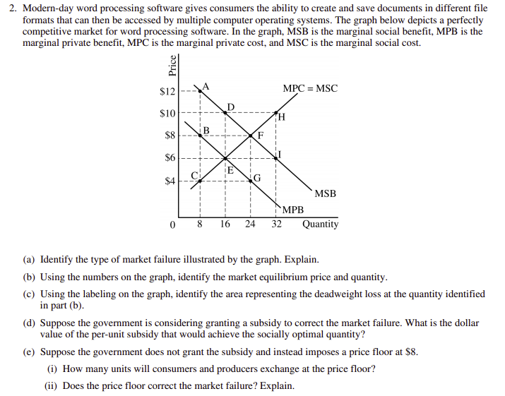
(2018) FRQ #2
Positive externality, MSB>MPB
16, $6
DEF
$4
8 units, DWL increases

Slide 34
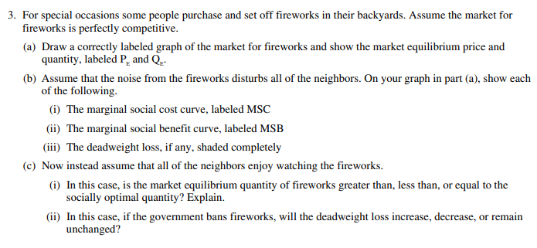
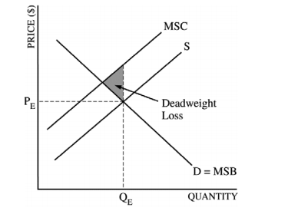
(2013) FRQ #3
c. i. Market equilibrium is less than socially optimal since the fireworks generate a positive externality
ii. DWL increases

Slide 35
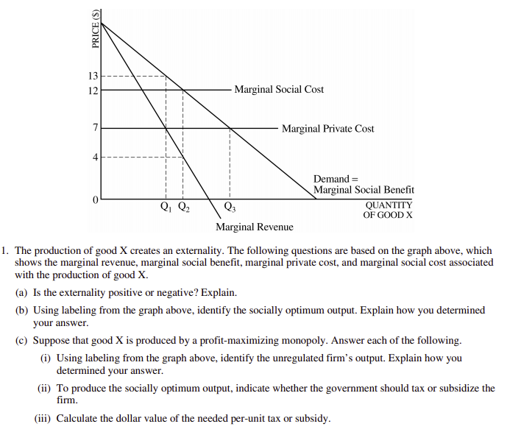
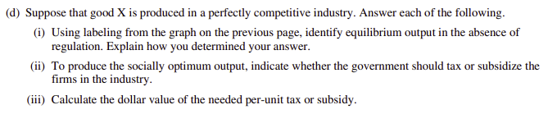
(2004) FRQ #1
Negative externality, MSC>MPC
Q2, where MSB=MSC
i. Q1, MR=MPC
ii. Subsidy
iii. $3
i. Q3,whereMPC=MSB(Demand)
ii. Tax
iii. $5 (12-7)

Slide 36
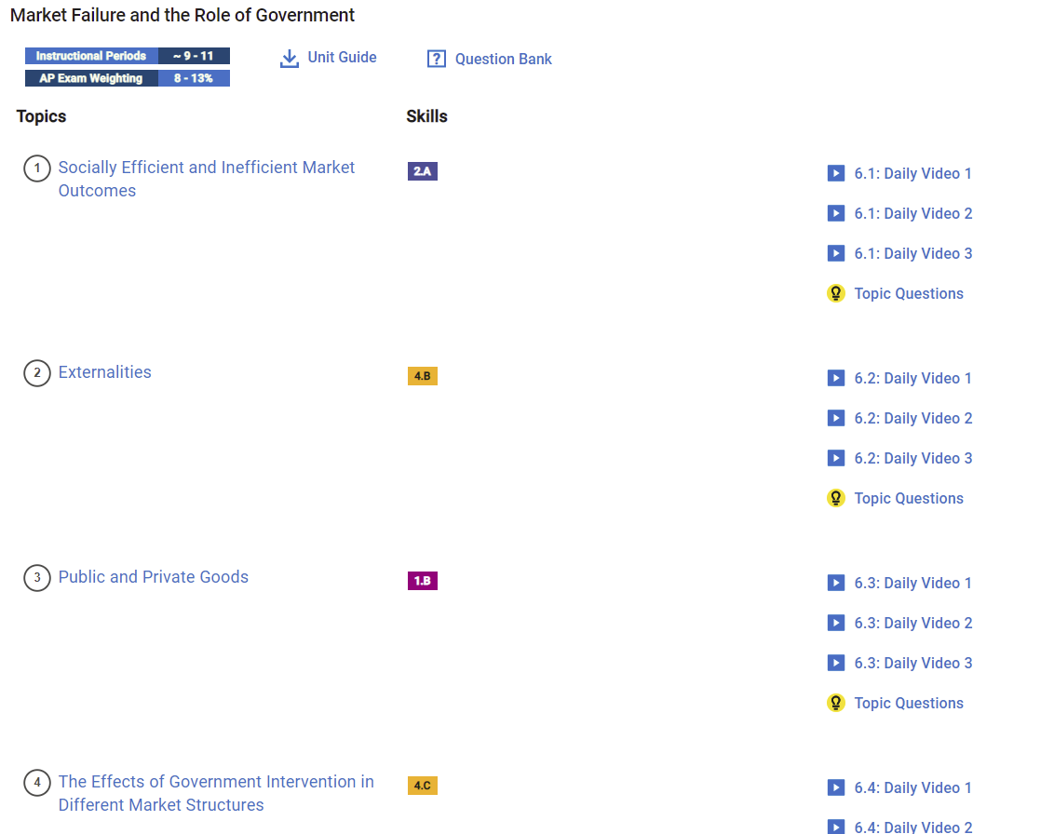
AP Classroom

Slide 37
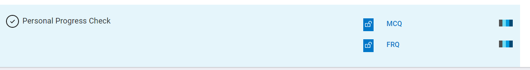
Personal Progress Checks for Each Unit

Slide 38
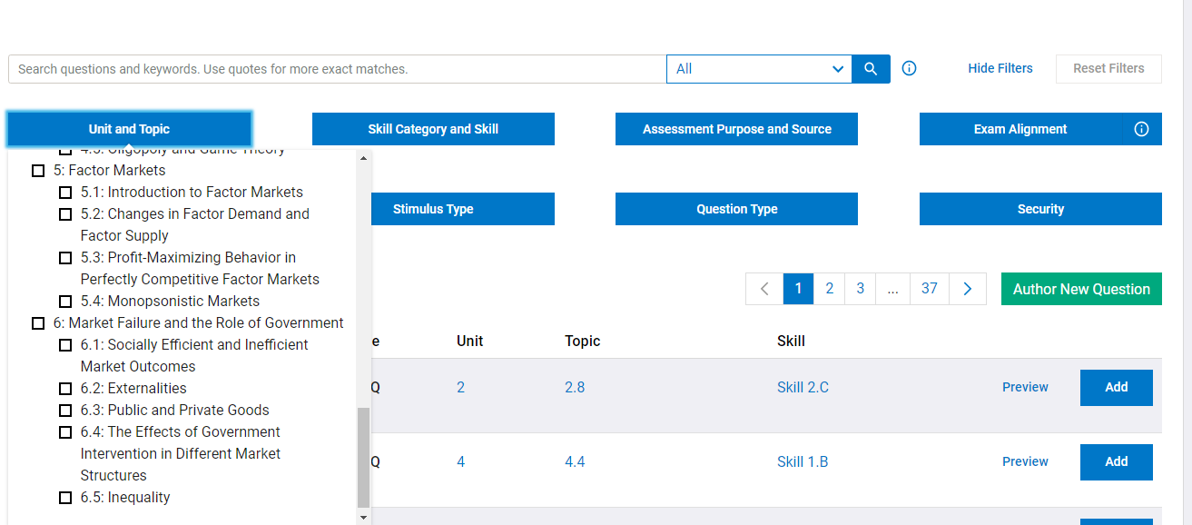
AP Question Bank

Slide 39
AP Microeconomics Resources
Review Econ
ACDC Micro 6.2
ACDC Negative Externalities
ACDC Positive Externalities
ACDC Micro Topics

Slide 40
Additional Resources
AP Micro Review- Gabe Ren
Kahn Academy
Every AP Micro Graph Explained
Jason Welker-https://www.econclassroom.com/wp-content/uploads/2012/04/AP-Micro-Exam-study-guide.pdf
AP Micro Cue Card- Sally Dickson

Slide 41

CEE Affiliates
https://www.councilforeconed.org/resources/local-affiliates/

Slide 42




Thank You to Our Sponsors!

