Slide 1
Microeconomics 203: Market Structures and Types of Businesses Presented by Alex Lamon
CEE Master Teacher June 16th, 2020 @AlexMLamon
lamonteach@gmail.com

Slide 2
EconEdLink Membership
You can now access CEE’s professional development webinars directly on EconEdLink.org! To receive these new professional development benefits, become an EconEdLink member. As a member, you will now be able to:
Automatically receive a professional development certificate via e-mail within 24 hours after viewing any webinar for a minimum of 45 minutes
Register for upcoming webinars with a simple one-click process
Easily download presentations, lesson plan materials, and activities for each webinar
Search and view all webinars at your convenience
Save webinars to your EconEdLink dashboard for easy access to the event
You may access our new Professional Development page here

Slide 3
Professional Development Certificate
To earn your professional development certificate for this webinar, you must:
Watch a minimum of 45-minutes and you will automatically receive a professional development certificate via e-mail within 24 hours.
Accessing resources:
You can now easily download presentations, lesson plan materials, and activities for each webinar from EconEdLink.org/professional-development/

Slide 4
Agenda
Introducing market structures to your students
Perfect competition activity & practice
Monopoly activity & practice
Oligopoly activity & practice
Monopolistic competition activity & practice
Notes:
This is an overview of simulations to supplement and support what you already do with practice and traditional/direct instruction.
chocolate activity overview guide
monopoly - oil simulation
oligopoly - question of trust, family feud
mono comp - differentiation project
perfect comp -

Slide 5
Objectives
Take away activities and formative assessment that you can easily implement in your classroom
Reflect on best practices for implementation
Toolbox session: take what you need, modify, and leave the rest!

Slide 6
National Standards
The level of competition in an industry is affected by the ease with which new producers can enter the industry, and by consumers’ information about the availability, price and quantity of substitute goods and services. (9.2)
Some market structures are dominated by large firms, often competing against only a few other firms. Prices in such markets may be higher than they would be in more competitive markets. (9.3)
Collusion among buyers or sellers reduces the level of competition in a market. Collusion is more difficult in markets with large numbers of buyers and sellers. (9.4)
The introduction of new products and production methods is an important form of competition and is a source of technological progress and economic growth. (9.5)

Slide 7
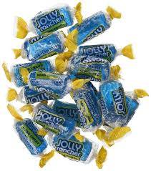
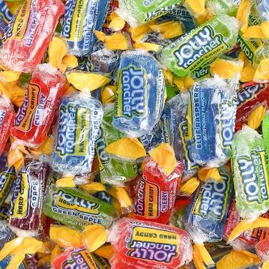
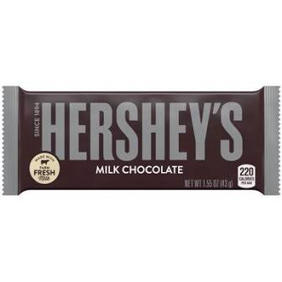
Introducing Market Structures
Candy purchasing activity
Notes overview

Slide 8
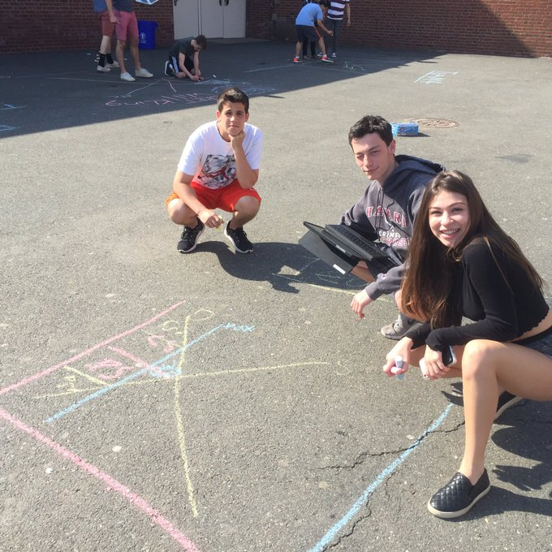
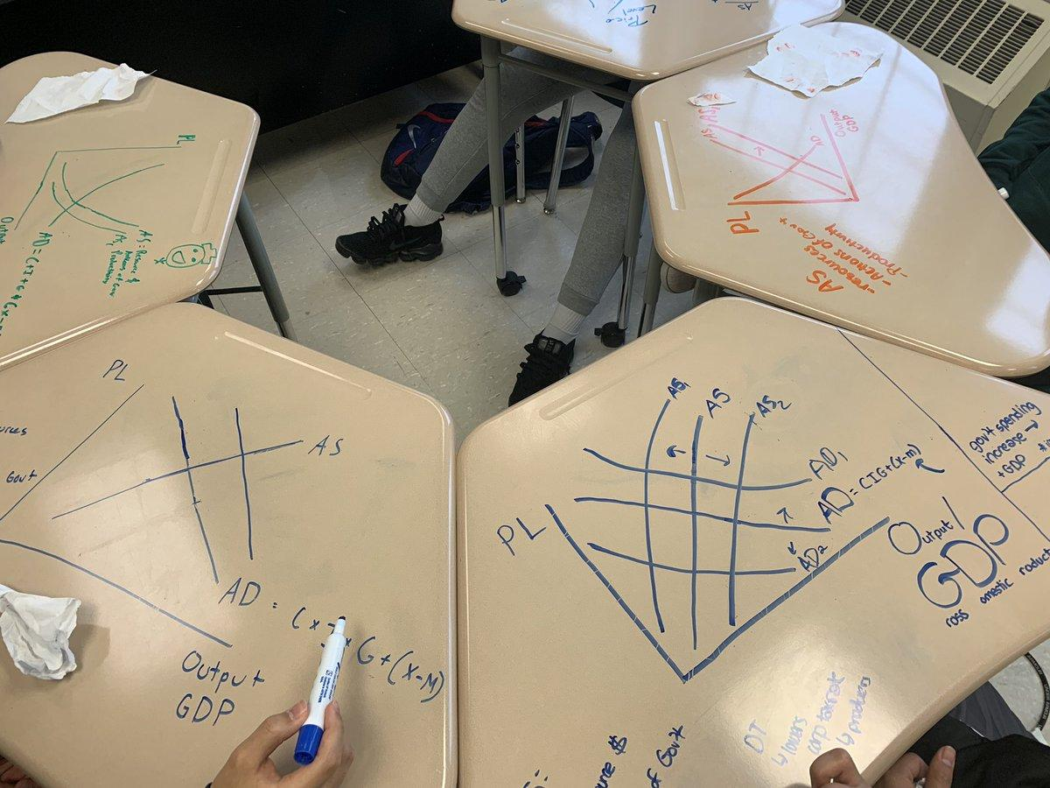
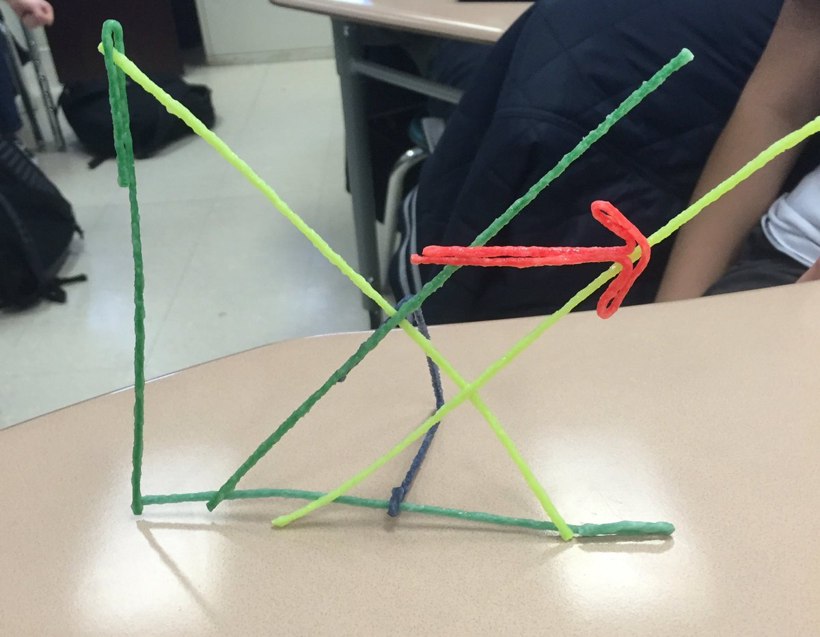
Perfect Competition
Activity: Graphs, Graphs, Graphs!
Making practice fun through: sidewalk chalk, desk graphs, Wikistix, collaborative whiteboards, peer feedback

Slide 9
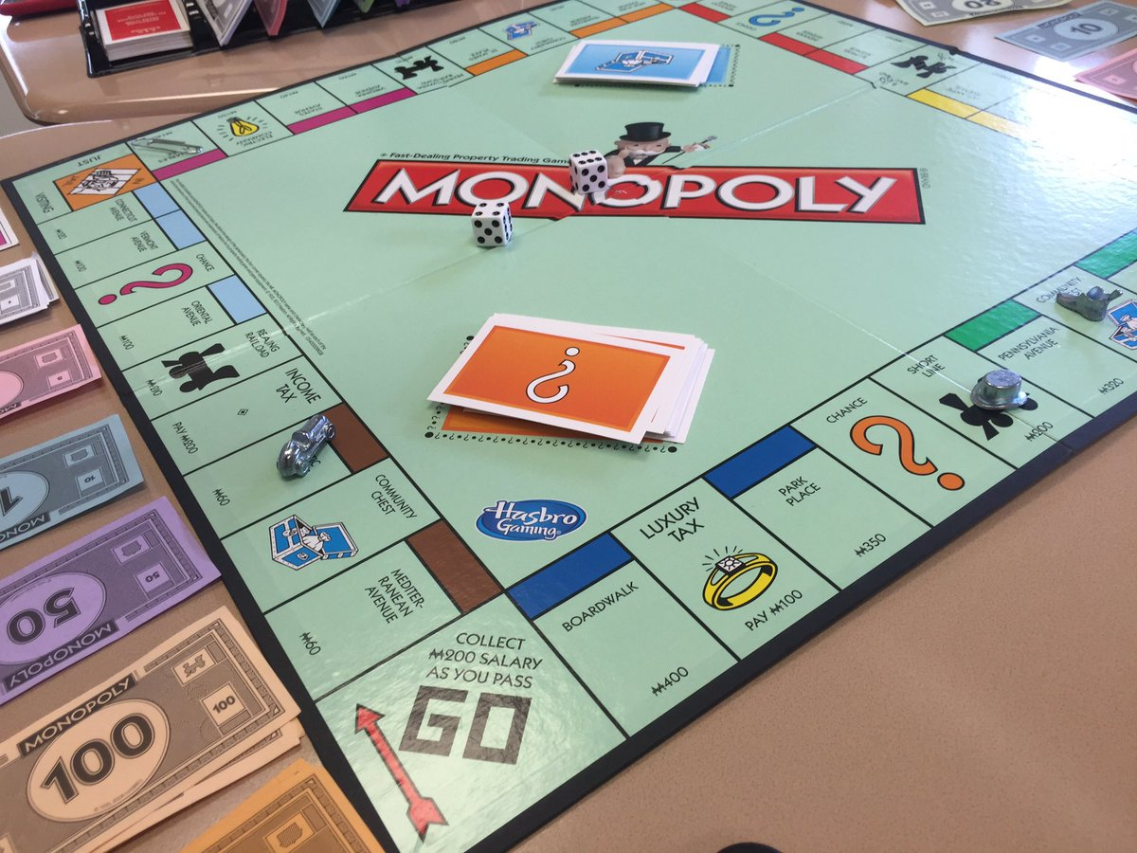
Monopoly
Activity: ‘Question of Trust’ simulation
Materials: Simulation production cards (print for 6 rounds), scoresheet, trust certificate & telegram, slides
Luxottica example
Do you play monopoly?

Slide 10
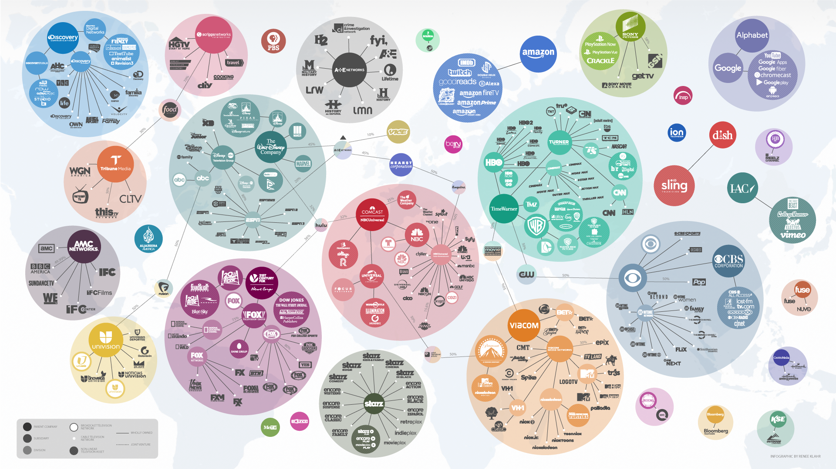
(Bonus) Conglomerates

Slide 11
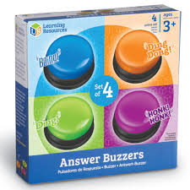
Oligopoly
Activities: Evolution of Trust, Family Feud, current events
A Beautiful Mind
Dilbert's Prisoner's Dilemma
Golden Balls Split or Steal

Slide 12
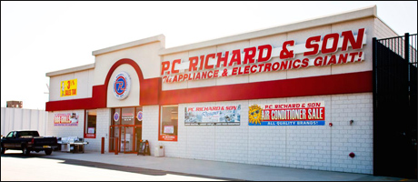
Monopolistic Competition
Activity: Mono Comp Differentiation

Slide 13
Thank you!
Enjoy some well-deserved time off!! @AlexMLamon
lamonteach@gmail.com

Slide 14
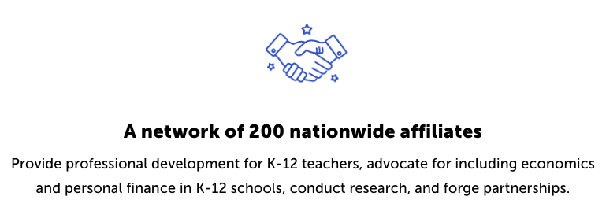
CEE Affiliates
https://www.councilforeconed.org/resources/local-affiliates/

