Slide 1
Preparing for the AP Micro Exam: Aggregate Supply and Aggregate Demand Presented by Matthew Gherman 6/7/21 mgherman@schools.nyc.gov

Slide 2
EconEdLink Membership
You can now access CEE’s professional development webinars directly on EconEdLink.org! To receive these new professional development benefits, become an EconEdLink member. As a member, you will now be able to:
Automatically receive a professional development certificate via e-mail within 24 hours after viewing any webinar for a minimum of 45 minutes
Register for upcoming webinars with a simple one-click process
Easily download presentations, lesson plan materials and activities for each webinar
Search and view all webinars at your convenience
Save webinars to your EconEdLink dashboard for easy access to the event
You may access our new Professional Development page here

Slide 3
Professional Development Certificate
To earn your professional development certificate for this webinar, you must:
Watch a minimum of 45-minutes and you will automatically receive a professional development certificate via e-mail within 24 hours.
Accessing resources:
You can now easily download presentations, lesson plan materials, and activities for each webinar from EconEdLink.org/professional-development/

Slide 4
National Standards
20.1: Fiscal policies are decisions to change spending and taxation levels by the federal government. As fiscal policies, these decisions are adopted to influence national levels of output, employment, and prices.
20.2 In the short run, increasing federal spending and/ or reducing taxes can promote more employment and output, but these polices also put upward pressure on the price level and interest rates. Decreased federal spending and/or increased taxes tend to lower price levels and interest rates, but they reduce employment and output levels in the short run.
20.4 The federal government’s annual budget is balanced when its revenues from taxes (and other sources) equal its expenditures. The government runs a budget deficit when its expenditures exceed its revenues. The government runs a surplus when its revenues exceed its expenditures.

Slide 5
State Standards
12.E4a Policy makers establish economic goals related to economic indicators, including the Gross National Product (GNP), Gross Domestic Product (GDP), Consumer Price Index (CPI), employment and interest rates, and aggregate supply and demand.
12.E4b The president and Congress determine fiscal policy by establishing the level of spending and taxing in the annual budget. Some tax programs are designed to provide incentives to individuals and businesses that influence private sector spending, saving, and investment.
12.E4c The Federal Reserve is the government institution responsible for managing the nation’s monetary policy, including regulating the amount of money in circulation and interest rates.

Slide 6
Agenda
Aggregate Demand
First Version of Aggregate Supply
SRAS AND LRAS to have a better working model of economy – new Keynesian model
Using this model to illustrate:
Economic Gaps
Closing Recessionary Gap
Demand Pull/Cost Push Inflation
Return to LRAS in long run
Assessment Questions

Slide 7
Objectives
Understanding slopes and shifts
Understanding where we are vs. where we should be

Slide 8
Part I: Aggregate demand

Slide 9
Opening Discussion
Opening Discussion:
What are the three types of ways that Consumers (we) can spend money? Which is best?
Student responses: Cash, Credit, Debit
Follow up Question: Which is best?
Discuss: depends on level of responsibility (credit to cash)
Transition: These are the ways we can spend our money; we are going to take a look at all of the ways money is spent in the economy with Aggregate Demand

Slide 10
Aggregate Demand: Total Spending in the Economy

Slide 11
AD Composition
Aggregated Demand = total spending/total demand in the economy: C+I+G+X
*notice: it the same formula as RGDP*
Aggregate Demand function is an inverse function between the price level and output: as the price level rises, the level of output demanded decreases.

Slide 12
Why is it downward sloping?
1) Wealth effect (C):
When the price level increases, the value of assets such as cash and checking-account balances falls. These assets will purchase fewer goods when prices are higher. The real value (or purchasing power) of the assets thus declines and people buy less. Likewise, when the price level falls, the purchasing power of people's assets increase, and they buy more.

Slide 13
Why is it downward sloping?
Interest Rate Effect (I):
Money Demanded: When the price level increases, the real quantity of money (its purchasing power) decreases. People need more money even to continue their current consumption levels. This increases the demand for money from banks, which leaves banks with less money, which will lead banks to increase their nominal interest rate.
Fisher’s Hypothesis: As banks expect inflation, they will add expected inflation to the real interest rate. The higher interest rates leads to a decrease in real GDP as households and firms put off major investment spending until future periods when the interest rate might be lower. (Likewise, a decrease in the price level decreases interest rates and increases real GDP).

Slide 14
Why is it downward sloping?
3) Net export/foreign trade effect (NX):
When the price level in one country increases, the prices of imports from other countries become relatively less expensive. At the same time, exports from the country whose price level rose become relatively more expensive. Thus, more imported goods and services are purchased, and fewer exports are sold. Domestic firms will also find it relatively more profitable to invest abroad. The decrease in exports and the increase in imports resulting from a higher price level lead to a decrease in real GDP (and vice versa).
When the price level of one country increases, there is a decrease in exports as well as a demand for imports which decreases GDP. However, when our price level is low and another country's is high, we export more and import less -- increasing our GDP

Slide 15
AD Shifts
Shifts occur when there is an autonomous change to the ability and willingness of spending in either C+I+G+Nx
Task: Have students read the chart and then answer the questions.
Main thing is recognizing which aspect of AD is being affected and then how (positively or negatively in spending) it is being effected
Questions are more for holistic application of C+I+G+Nx into larger macroeconomic concepts

Slide 16
Part II: SRAS AND LRAS

Slide 17
Classical Model
Jean Baptiste Say: …Supply creates its own demand
When products are created, the wage to buy those products is also created.
Production will respond to changes in price level and changes in inventory
Inventory, wages and input costs adjust to change in prices
Lower prices will drive down input costs, which will result in lower wages and allow businesses to produce more
**Aggregate Supply is a singular vertical curve***

Slide 18
Classical Model

Slide 19
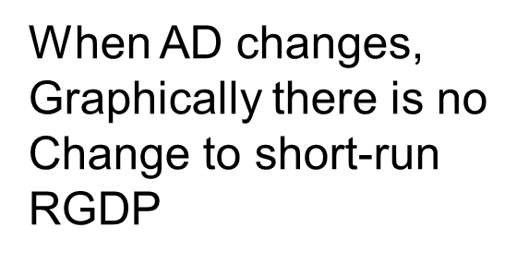
Classical Model

Slide 20
John Maynard Keynes’ Theory
Problem: The Great Depression illustrates:
4 years into depression; prices are at lowest; no increase in production.
Great Depression: 1920’s already experienced maximum investment spending…all of this capital was still there in 1929, so businesses would not have incentive to do more investment spending.
Keynes:
Recessions are caused by a decrease in Consumer Spending and a decrease in Aggregate Demand
Classical model is incorrect: Aggregate Supply is upward slopping; reflecting that price = profit and the ability to break even
Input costs are sticky (wages, rent, insurance, etc.), so don’t change with the price level
Businesses will decrease production as price level decreases

Slide 21
Re-visualizing the Graph

Slide 22
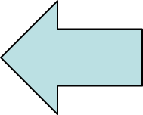
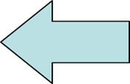
Keynes Recessionary Graph

Slide 23
Keynes Recessionary Gap

Slide 25
SRAS vs. LRAS
Short Run
Long Run
Where we are producing short run
Affected by PL (price = profit)
Shifts: any changes to input costs, short term resources, expectation of prices
Where we want to be/Full Employment
Not affected by PL b/c all resources are fully employed – RGDP is constant
Shifts: Same as PPC – any long term/permanent changes to the QUALITY/QUANTITY of resources/technology

Slide 26
Fiscal Policy Implication
"To dig holes in the ground," paid for out of savings, will increase, not only employment, but the real national dividend of useful goods and services.”
- Keynes, The General Theory
Can manipulate the G in AD to have multiplied impact on “C” in AD which will have a multiplied affect on RGDP to close economic gaps.

Slide 27
Fiscal Policy Implication
Government can’t trust the “animalistic spirit” of business
Government needs to use its powers of taxes and spending to improve consumer spending (changing disposable income)
As incomes change, people spend a portion of that income (marginal propensity to consume)
This has a multiplier effect

Slide 28
Multiplier Effect

Slide 29
Multiplier Effect
Initial spending keeps becoming another person’s income
That person’s income becomes spending
Which becomes another person’s income
Initial change in government spending has a multiplied effect on Aggregate Demand and Total GDP
Can Deficit Spend but can deficit spend responsibly
Know the Recessionary Gap; know the MPC or “marginal propensity to consume,” aka how much of our change in income do we spend”; know the amount to spend

Slide 30
Graphical Illustration

Slide 31
Keynes to President Franklin Roosevelt, 1933
“I do not mean to impugn the social justice and social expediency of the redistribution of incomes aimed at by N.I.R.A. [National Industrial Recovery Administration] and by the various schemes for agricultural restriction. The latter, in particular, I should strongly support in principle. But too much emphasis on the remedial value of a higher price-level as an object in itself may lead to serious misapprehension as to the part which prices can play in the technique of recovery. The stimulation of output by increasing aggregate purchasing power is the right way to get prices up; and not the other way round.”

Slide 32
Keynes to FDR, 1938
The recovery was mainly due to the following factors:
(i) the solution of the credit and insolvency problems, and the establishment of easy short-term money
(ii)the creation of an adequate system of relief for the unemployed
(iii) the public works and other investments aided by Government funds or guarantees
(iv) investment in the instrumental goods required to supply the increased demand for consumption goods
(v)the momentum of the recovery thus initiated.

Slide 35
Part III: Illustrating Inflation

Slide 36
Demand Pull Inflation
Increase in total spending (AD) in the economy
Not necessarily bad at first
Increase in ability and willingness to spend = increase in production and rise in prices
Becomes bad when too much money starts to chase too few goods and services…Spending is greater than production

Slide 37
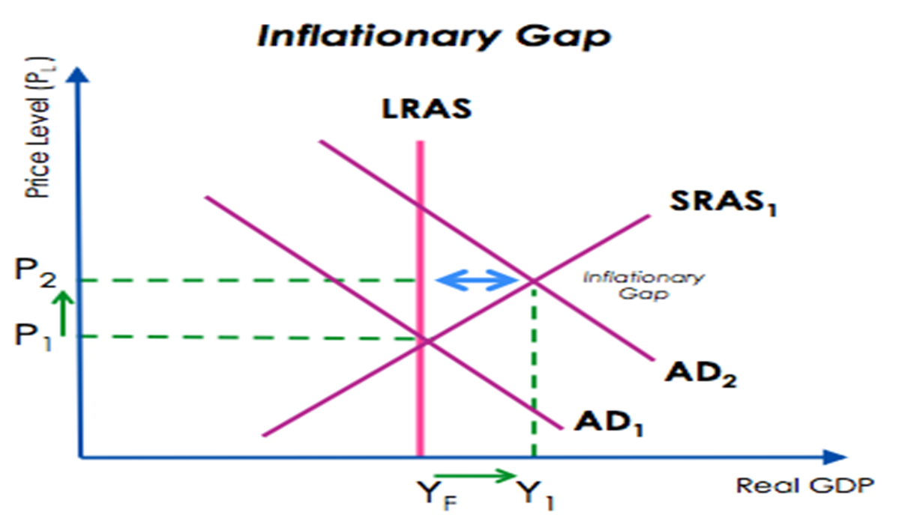

Slide 38
Cost Push Inflation
Bad
Increase in the cost of resources
Increase in expectation of prices
Decrease in businesses ability and willingness to produce
Decrease in production leads to higher prices and more unemployment
STAGFLATION! Worst economic condition

Slide 39
The Inflation Spiral
Self-sustaining upward trend in general price levels due to interaction of demand pull and cost push inflation
“Wage-price spiral”
High cost of living prompts demands for higher wages
This pushes production costs up forcing firms to increases prices
This in turn triggers calls for fresh wage increases ... and so on

Slide 40
Part IV: Illustrating Natural Recovery

Slide 41
Recovery From Recession
1) With unemployment increasing, nominal wages will decrease as people will be willing to work for less. This will lead to a decrease in input costs and will shift SRAS to the right, back to LRAS because inputs are now decreasing and businesses can produce more for less
OR
2) With the price level decreasing, businesses will expect lower future prices, and increase supply now before prices drop too low, returning AS back to equilibrium

Slide 42
Recovery from Inflation
Inflationary conditions with the price level begin increasing.
2) Workers will begin to demand higher nominal wages, which will in the long run cause input costs to increase. This will shift SRAS to the left, back to LRAS because their inputs are too high, and now have to lay-off resources.
OR
3) With price level increasing, businesses will expect higher future prices, and reduce supply now to produce more later; returning SRAS back to equilibrium.

Slide 43
Keynes on Adam Smith
“[Government controls must be used] not to defeat but to implement the wisdom of Adam Smith”
“I find myself moved, not for the first time, to remind contemporary economists that the classical teaching embodied some permanent truths of great significance…There are in these matters deep under currents at work, natural forces, one can call them, or even the invisible hand, which are operating towards equilibrium…If we reject the medicine from our systems altogether, we may just drift on from expedient to expedient and never get really fit again.”

Slide 44
Assessment Questions
Keynes Free Response Question
The country of Econoland is experiencing two quarters of consecutive negative growth and 9% unemployment…
a) Draw the economic situation on the Full Employment (LRAS/AS/AD) graph. Label the current situation Y1 and PL1
b) Draw the situation on a Production Possibilities Curve, assuming the nation produces capital and consumer goods. Label the point where the economy is at “x”

Slide 45
Assessment cont’d
c) Assume the government has calculated that the recessionary gap is $450 billion dollars and we know the MPC of the population is .9.
What type of fiscal policy would be most appropriate?
How much money will the government have to spend to close the recessionary gap using only deficit spending?
If the government only deficit spends, how will this affect the national budget? The national debt?
If the government were to only use tax cuts to close the recessionary gap, how much would the government have to cut taxes by?
Assume the government wants to balance its budget while it closes the recessionary gap. How much money should the government spend? How much money should the government tax? Explain.

Slide 46
Assessment Cont’d
d1) Draw the effects of the fiscal policy on the graph on part a
d2) Draw the effects of the fiscal policy on the graph from part b. Label the new point “y”

Slide 47
Assessment cont’d
e) Assume the government chooses not to take any policy action, what will happen to:
SRAS in the long run? Explain.
LRAS in the long run? Explain.

Slide 48
CEE Affiliates
https://www.councilforeconed.org/resources/local-affiliates/

Slide 49
Thank You to Our Sponsors!

