Slide 1
Fundamentals of AP Economics:
Price and Elasticity of Demand
Presented by Theodore Opderbeck
3/9/21 opderbeckt@waldwickschools.org

Slide 2
EconEdLink Membership
You can now access CEE’s professional development webinars directly on EconEdLink.org! To receive these new professional development benefits, become an EconEdLink member. As a member, you will now be able to:
Automatically receive a professional development certificate via e-mail within 24 hours after viewing any webinar for a minimum of 45 minutes
Register for upcoming webinars with a simple one-click process
Easily download presentations, lesson plan materials and activities for each webinar
Search and view all webinars at your convenience
Save webinars to your EconEdLink dashboard for easy access to the event
You may access our new Professional Development page here

Slide 3
Professional Development Certificate
To earn your professional development certificate for this webinar, you must:
Watch a minimum of 45-minutes and you will automatically receive a professional development certificate via e-mail within 24 hours.
Accessing resources:
You can now easily download presentations, lesson plan materials, and activities for each webinar from EconEdLink.org/professional-development/

Slide 4
Agenda
Discuss the concept of elasticity of demand as it relates to the AP Economics curriculum.
Explore formative and summative assessment options and EdTech resources to maximize student understanding.
Introduce dynamic learning activities and lesson plans to reinforce content.

Slide 5
Objectives
To explore how consumers and producers make decisions regarding price and how elasticity shapes those decisions.
To investigate resources to construct digital formative and summative assessments to reinforce learning and prepare for the AP test.
To apply the concept of elasticity to real world national and international examples.
To introduce dynamic learning activities and project ideas to engage the students.

Slide 6
National Standards
Council for Econ Ed Standard 8: Role of Prices - Prices send signals and provide incentives to buyers and sellers. When supply or demand changes, market prices adjust, affecting incentives.
Council for Econ Ed Standard 2: Decision Making - Effective Decision Making requires comparing the additional costs of alternatives with additional benefits.
https://www.councilforeconed.org/wp-content/uploads/2012/03/voluntary-national-content-standards-2010.pdf

Slide 7
State Standards
NYS Social Studies 12.E2b
The choices of buyers and sellers in the marketplace determine supply and demand, market prices, allocation of scarce resources, and the goods and services that are produced. In a perfect world, consumers influence product availability and price through their purchasing power in the product market. Product market supply and demand determine product availability and pricing.
http://www.nysed.gov/common/nysed/files/programs/curriculum-instruction/ss-framework-9-12.pdf

Slide 8

Question of the Day
In which of the following years was a gallon of gasoline (national average) the highest relative price in today’s dollars?
1974
1982
2014
2008

Slide 9
Question of the Day
In which of the following years was a gallon of gasoline (national average) the lowest relative price in today’s dollars?
1933
2001
1986
1999

Slide 10
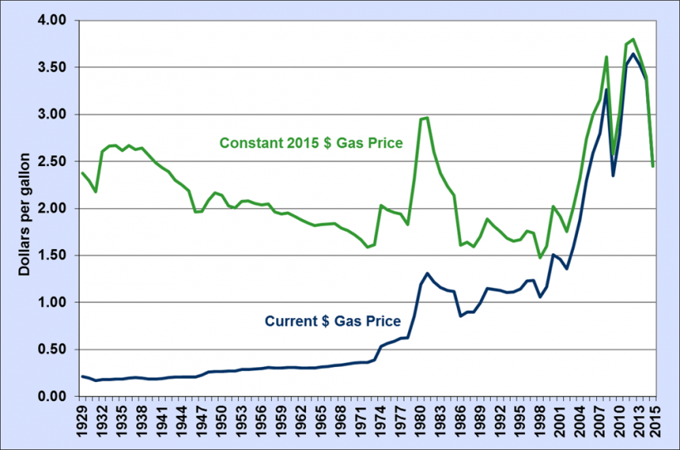

Slide 11
Economics and Cross Curricular Applications
Markets/ Supply and Demand
Consumer Choice and Business Allocation Decisions
Price Signals
Math/ Statistics
History
Politics

Slide 12

AP Economics Curriculum
Microeconomics:
Unit Two: Supply and Demand
Demand
Supply
Elasticity
Market Equilibrium, Disequilibrium, and Adjustments
Government Intervention in Markets

Slide 13
AP Economics College Board Curriculum/Resources
https://apcentral.collegeboard.org/courses/ap-microeconomics/course
https://apcentral.collegeboard.org/courses/ap-macroeconomics/course

Slide 14
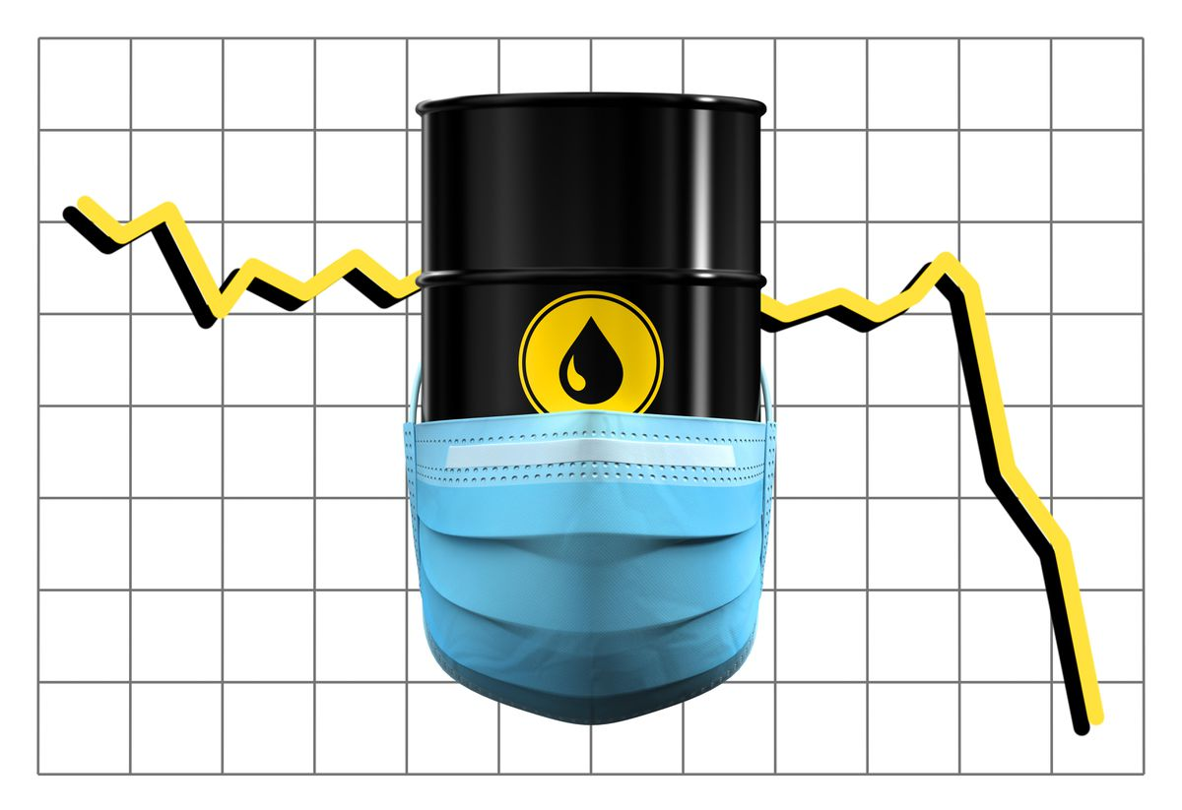




Slide 15

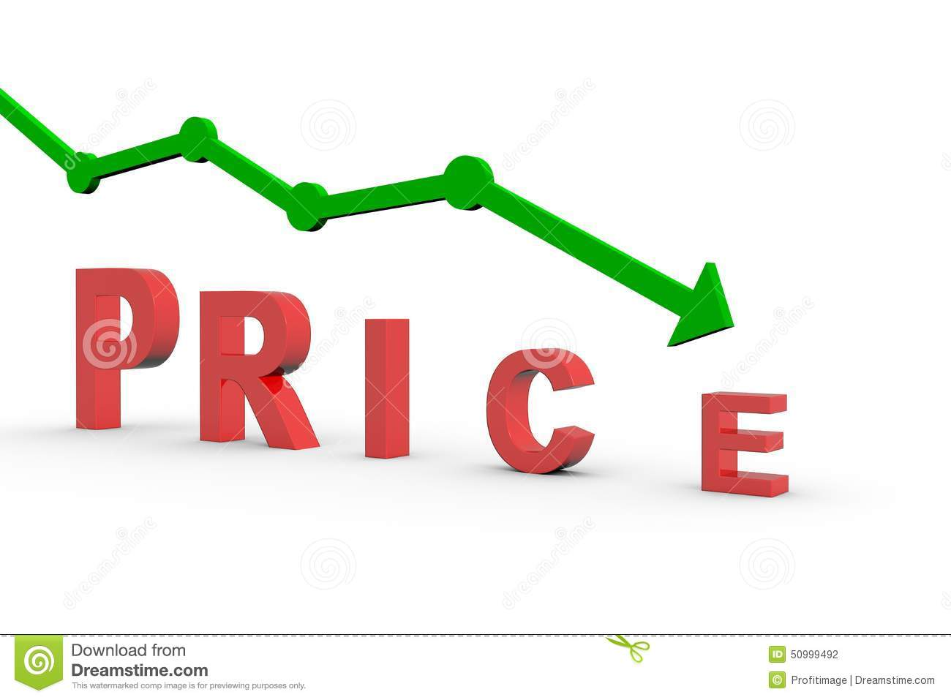
Elasticity
How responsive are consumers to changes in price?
To what extent will the quantity demanded change, when the price of a good or service changes?

Slide 16






Elasticity

Slide 17
Elasticity
If the percentage change in quantity demanded is greater than the percentage change in price, demand is considered to be elastic.
If the percentage change in quantity demanded is less than the percentage change in price, demand is considered to be inelastic.
If the percentage change in quantity demanded is the same as the percentage change in price, demand is considered to be unit elastic.

Slide 18
Elasticity
Elastic: Consumers are highly responsive to price changes.
Inelastic: Consumers are relatively less responsive to price changes.
Examples of elastic goods?
Examples of inelastic goods?

Slide 19
Elasticity
What factors influence the elasticity of demand for specific goods and services?
How many close substitutes are there for a good/service?
How much of a typical consumer’s budget does the good or service take up?
How much time do consumers have to make a decision?

Slide 20


Slide 21


Slide 22
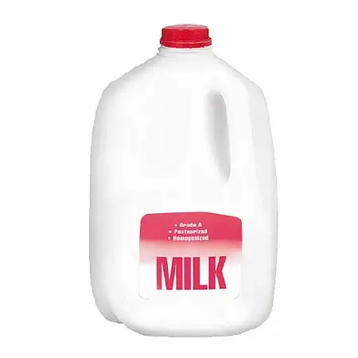

Slide 23


Slide 24


Slide 25


Slide 26
If the absolute value of the answer is greater than 1, demand is elastic
If the absolute value of the answer is less than 1, demand is inelastic
If the answer is equal to 1, demand is unit elastic
Calculating Elasticity:
Q2 - Q1
_______
Q1
____________
P2 - P1
______
P1
% change in quantity demanded / % change in price

Slide 27
Example:
The price of a subway fare is $3. At this price, the quantity demanded is 100.
The price increases to $4, and the quantity demanded drops to 80.
Is demand for subway fares elastic or inelastic?

Slide 28
80 - 100 -20
_______ /2 = ___ /2 = -.056
80 + 100 180
__________ ____ ___ = [-.8] = 0.8
4 - 3 1
____ /2 = __ /2 = .07
4 + 3 7

Slide 29
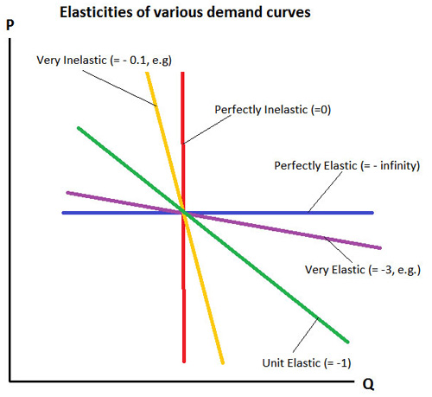

Slide 30

Elasticity
Total Revenue Test
Total Revenue = Price x Quantity Sold
Demand is elastic if:
Price increases, total revenue decreases
Price decreases, total revenue increases
Demand is inelastic if:
Price increases, total revenue increases
Price decreases, total revenue decreases

Slide 31
Elasticity
Total Revenue Example:
The price of a subway fare is $3. At this price, the quantity demanded is 100.
The price increases to $4, and the quantity demanded drops to 80.
Total Revenue 1 = $3 x 100 = $300
Total Revenue 2 = $4 x 80 = $320
Price increased and total revenue increased = _____________

Slide 32
Elasticity
Why is the concept of elasticity so important in the “real world,” especially for business firms?

Slide 33

Income Elasticity
A measurement of how responsive consumers are to various goods and services when income levels increase and decrease.

Slide 34
Income Elasticity
This measurement is used to determine if a good/service is “normal” or “inferior” and to what degree.
Normal: when income increases, demand increases; when income decreases, demand decreases
Inferior: when income increases, demand decreases; when income decreases, demand increases.

Slide 35





Normal Goods
Inferior Goods

Slide 36
Calculating Income Elasticity:
Q2 - Q1
_______
Q1
____________
Income 2- Income 1 /
Income 1
If the answer is negative, then the good/service is inferior
If the answer is positive, then the good/service is normal
If the answer is <1 the good is income inelastic
If the answer is >1 the good is income elastic
% change in quantity demanded / % change in income

Slide 37
Sample Problem: Income Elasticity of Demand
Suppose the national income level is $50,000…
At that level of income, consumers demand 10,000 cruises. Now, assume the income level increases to $60,000 and consumers demand 14,000 cruises.
What is the income elasticity of demand for cruises? Are cruises normal or inferior and income elastic or income inelastic?

Slide 38

14,000 - 10,000 / 10,000
____________________
60,000 - 50,000 / 50,000
Answer = .25 / .20 = 1.25
Normal, Income Elastic

Slide 39
Cross Elasticity of Demand
This measurement is used to determine if a good/service is a complement or substitute good in comparison to another good/service
Complementary goods: the price of good “A” goes up, quantity demanded for good “A” decreases, quantity demanded for good “B” decreases
Substitute goods: the price of good “A” goes up, quantity demanded for good “A” decreases, quantity demanded for good “B” increases

Slide 40
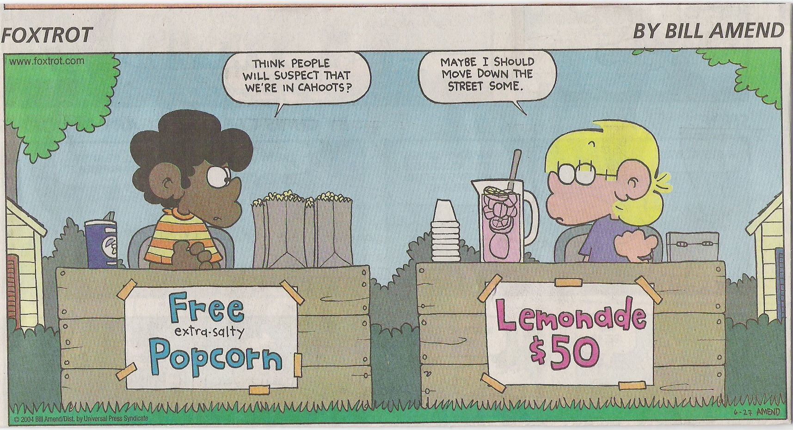
When the price of one good/service changes, how does that affect the demand for another good/service…?

Slide 41







Complements
Substitutes

Slide 42
Calculating Cross Elasticity:
Q2 - Q1 / Q1 of Good “B”
__________________
P2 - P1/ P1 of Good “A”
If the answer is negative, then the goods/services are complementary
If the answer is positive, then the goods/services are substitutes
% change in quantity demanded of Good “B” /
% change in price of Good “A”

Slide 43
Sample Problem: Cross Elasticity
Suppose the price of coffee is $2 per cup.
The quantity demanded for donuts is 100. If the price of coffee goes up to $3 per cup, the quantity demanded for donuts is 80.
What is the cross elasticity of demand, and what does that indicate about the coffee and donuts?

Slide 44

80 - 100 / 100
____________________
3 - 2 / 2
Answer = -.20 / .50 = -.40
Complements

Slide 45

Supply Elasticity
This measurement is used to determine how responsive suppliers are to price changes.

Slide 46
If the answer is greater than 1, supply is elastic
If the answer is less than 1, supply is inelastic
If the answer is equal to 1, supply is unit elastic
Calculating Supply Elasticity:
Q2 - Q1
_______
Q1
____________
P2 - P1
______
P1
% change in quantity demanded / % change in price

Slide 47
Sample Problem: Supply Elasticity
Suppose that wheat is selling for $5 per bushel.
At that price farmers supply 500 bushels. If the price of wheat increases to $8 per bushel, farmers supply 600 bushels.
What is the supply elasticity of wheat?

Slide 48

600 - 500 / 500
____________________
8 - 5 / 5
Answer = .40 / .60 = .67
Supply is inelastic

Slide 49
Elasticity
Activities:
Students create a tutorial video on the issue of elasticity. In the video, they must teach the concept and interview at least two small business owners regarding their pricing decisions.
Students create an original skit centered on the concept of elasticity in which they portray consumers’ and producers’ reactions to pricing decisions.
Students choose a product and survey consumers regarding their reactions to various prices. The students then compile a table of data and corresponding graphs and conclude whether the product’s demand is elastic or inelastic.

Slide 50
Elasticity
Econ Ed Link Lessons/ Webinars
https://www.econedlink.org/resources/price-elasticity-from-tires-to-toothpicks/
https://www.econedlink.org/resources/strategies-for-teaching-supply-demand-and-elasticity/
https://www.econedlink.org/resources/elasticity-of-demand-video-and-quiz/

Slide 51

Elasticity
Khan Academy Tutorials:
https://www.khanacademy.org/economics-finance-domain/microeconomics/elasticity-tutorial

Slide 52
Elasticity
Mr. Clifford’s Economics:
https://www.youtube.com/watch?v=HHcblIxiAAk
https://www.youtube.com/watch?v=nAT_shQGlIk

Slide 53
Formative Assessment Options
Nearpod: www.nearpod.com
Quizlet Live: www.quizlet.com
Kahoot: www.kahoot.com
Gimkit: www.gimkit.com
Blooket: www.blooket.com

Slide 54
b.socrative.com
Room: Opderbeck

Slide 55
References
https://www.investopedia.com/terms/e/elasticity.asp
https://www.khanacademy.org/economics-finance-domain/microeconomics/elasticity-tutorial
https://mru.org/courses/principles-economics-microeconomics/elasticity-demand-definition

Slide 56

CEE Affiliates
https://www.councilforeconed.org/resources/local-affiliates/

Slide 57




Thank You to Our Sponsors!

Slide 58





We’ve gone Virtual!
Teach Economics?
Your students may have what it takes to compete in the nation’s only high school economics competition!
Why Play?
• Fun team learning experience
• Great for college applications
• No other challenge like this
• Online participation makes access easy
• Chance for cash prizes
How it Works
Teams register
Teachers enroll team(s) of 3- 4 high school students from the same school. Multiple teams allowed.
Teams compete within their state
Compete to win your state competition for a
chance to advance to the National Semi-Finals.
National Semi-Finals: May 3-20, 2021
Teams answer multiple-choice questions on macroeconomics, microeconomics, and international & current events.
National Finals: May 22-24, 2021
Teams analyze an economic issue and present their solution. Top teams engage in the Finals Quiz Bowl where they face-off answering questions to claim the National Title.
Two divisions based on experience level
David Ricardo for first-time competitors who have taken no more than one economics course.
Adam Smith for returning competitors, AP, International Baccalaureate, and honors students.
Register Today at NationalEconomicsChallenge.org

Slide 59





FIND YOUR LOCAL COMPETITION
AND REGISTER TODAY!
The National Personal Finance Challenge is a competition that provides high school students with an exciting and motivating opportunity to build, apply, and demonstrate their knowledge of money management.
Through online exams and a personal finance simulation, teams showcase their expertise in earning income, buying goods and services, saving, using credit, investing, as well as protecting and insuring.
Teams of up to four students, with one teacher/coach, can qualify to represent their state at the National Personal Finance Challenge by winning their local competition.
NATIONALS
Semi-Finals: First round elimination via online multiple-choice questions.
Finals: Case study round virtually co-hosted by the Cleveland Fed on June 3.
personalfinancechallenge.org

Slide 60

The 2021 Sloan Teaching Champion Award
Winners receive:
A cash award of $5,000
A cash award of $2,500 for their school to support economic education
Recognition at our annual Visionary Awards convening.
This award promotes economic education by honoring three outstanding teachers who incorporate exemplary teaching techniques that improve their students’ economic understanding in and out of the classroom.
This award is open to New York metropolitan area high school teachers of all subjects, not just teachers of economics. Applicants must demonstrate how they integrate economics into their teaching.
Sound like you or someone you know?
Applicants must teach in one of the
Twelve New York state counties (New York, Kings, Bronx, Richmond, Queens, Nassau, Suffolk, Westchester, Putnam, Rockland, Orange and Dutchess)
Eight New Jersey counties (Bergen, Passaic, Essex, Hudson, Middlesex, Union, Morris, Monmouth), or the
Two Connecticut counties (Fairfield and New Haven)
Application will be launched on Friday February 19th 2021
You can access the application here.
CONTACT
Please feel free to e-mail us at rrivera@councilforeconed.org
with any questions you have.

