Slide 1
Fundamentals of AP Economics 403:
Resource Allocation and
Economic Systems
Presented by Theodore Opderbeck
2/8/21 opderbeckt@waldwickschools.org

Slide 2
EconEdLink Membership
You can now access CEE’s professional development webinars directly on EconEdLink.org! To receive these new professional development benefits, become an EconEdLink member. As a member, you will now be able to:
Automatically receive a professional development certificate via e-mail within 24 hours after viewing any webinar for a minimum of 45 minutes
Register for upcoming webinars with a simple one-click process
Easily download presentations, lesson plan materials and activities for each webinar
Search and view all webinars at your convenience
Save webinars to your EconEdLink dashboard for easy access to the event
You may access our new Professional Development page here

Slide 3
Professional Development Certificate
To earn your professional development certificate for this webinar, you must:
Watch a minimum of 45-minutes and you will automatically receive a professional development certificate via e-mail within 24 hours.
Accessing resources:
You can now easily download presentations, lesson plan materials, and activities for each webinar from EconEdLink.org/professional-development/

Slide 4
Agenda
Discuss the concepts of resource allocation and economic systems as they relate to the AP Economics Curriculum.
Explore formative and summative assessment options and EdTech resources to maximize student understanding.
Introduce dynamic learning activities and lesson plans to reinforce content.

Slide 5
Objectives
To explore the major ways that comparative economic systems allocate scarce resources.
To investigate resources to construct digital formative and summative assessments to reinforce learning and prepare for the AP test.
To apply the concepts of comparative economic systems and resource allocation to real world national and international examples.
To introduce dynamic learning activities and project ideas to engage the students.

Slide 6
National Standards
Council for Econ Ed Standard 3: Allocation - Students will understand that different methods can be used to allocate goods and services. People acting individually or collectively must use which methods to use to allocate different kinds of goods and services.
Council for Econ Ed Standard 2: Decision Making - Effective Decision Making requires comparing the additional costs of alternatives with additional benefits.
https://www.councilforeconed.org/wp-content/uploads/2012/03/voluntary-national-content-standards-2010.pdf

Slide 7
State Standards
NYS Social Studies 12.E3: The Impact of American Capitalism in a Global Economy. There are various economic systems in the world. The United States operates within a mixed, free market economy that is characterized by competition and a limited role of government in economic affairs. Economic policy makers face considerable challenges within a capitalist system, including unemployment, inflation, poverty, and environmental consequences.
http://www.nysed.gov/common/nysed/files/programs/curriculum-instruction/ss-framework-9-12.pdf

Slide 8
Question of the Day
The U.S. has the highest total GDP in the world. Which nation/sovereign microstate has the highest per Capita GDP?
Luxembourg
Switzerland
Liechtenstein
Monaco

Slide 9
Question of the Day
Which of the following nations has the highest top progressive income tax rate at 57%?
Canada
Sweden
Denmark
Norway

Slide 10
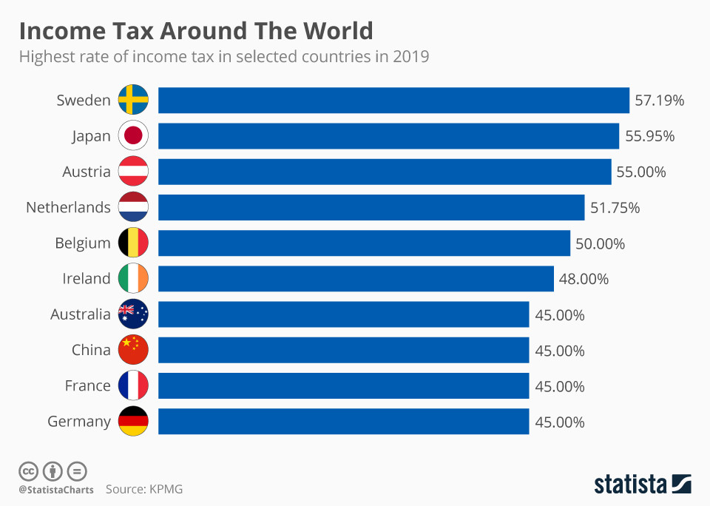

Slide 11
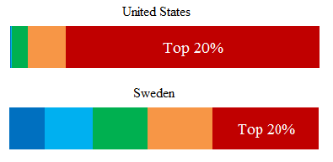

Slide 12

Of the following, which nation has a 0% income tax?
Mongolia
Guatemala
Macau
Bahamas

Slide 13


Slide 14


Slide 15
Economics and Cross Curricular Applications
Scarcity and Opportunity Cost
Comparative Economic Systems
Resource Allocation Models
Fiscal Policy
Political Science
History/ Global Studies
Sociology

Slide 16
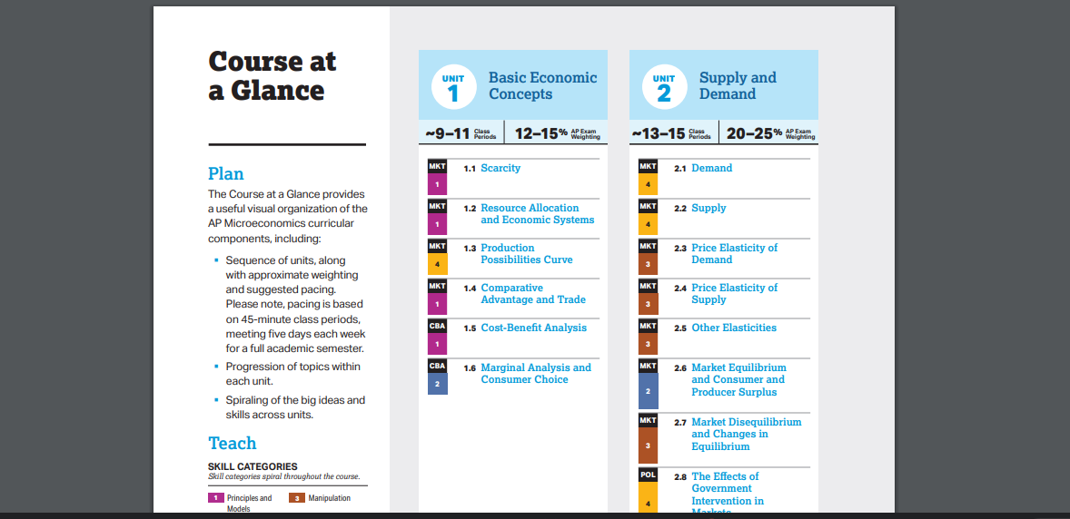
AP Economics Curriculum

Slide 17
AP Economics College Board Curriculum and Resources
https://apcentral.collegeboard.org/courses/ap-microeconomics/course
https://apcentral.collegeboard.org/courses/ap-macroeconomics/course

Slide 18
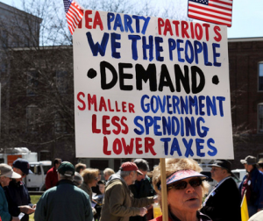

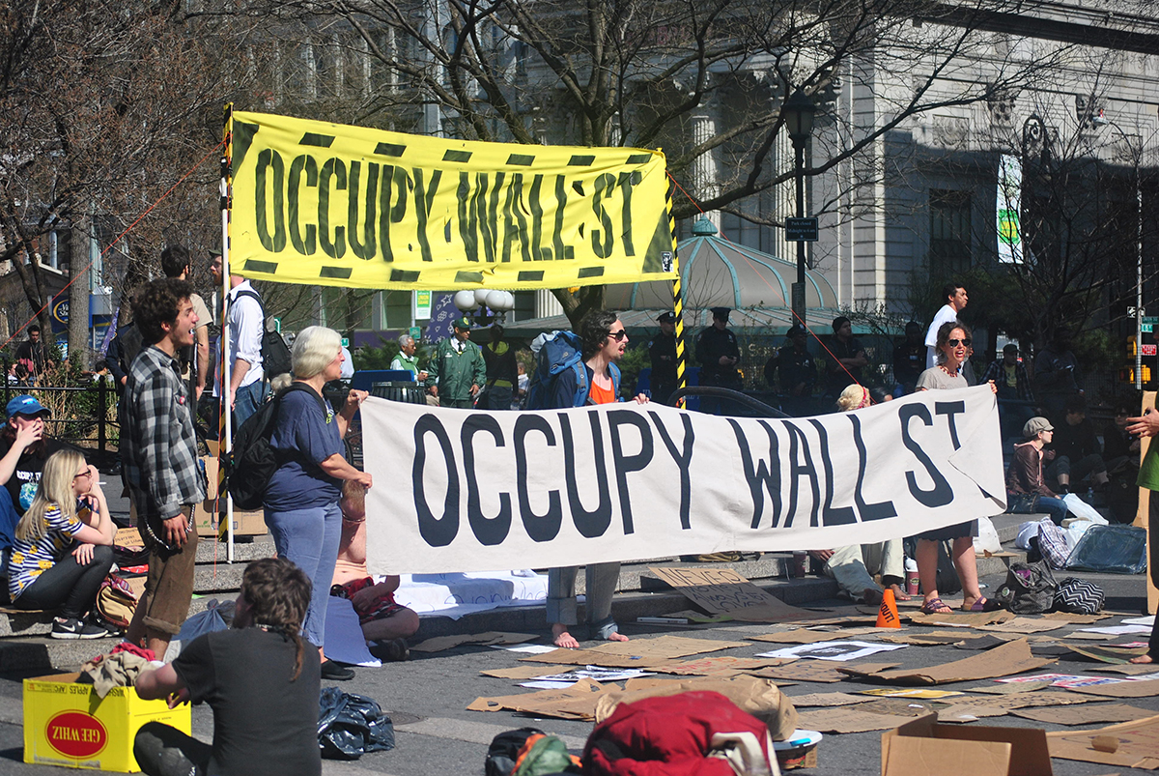
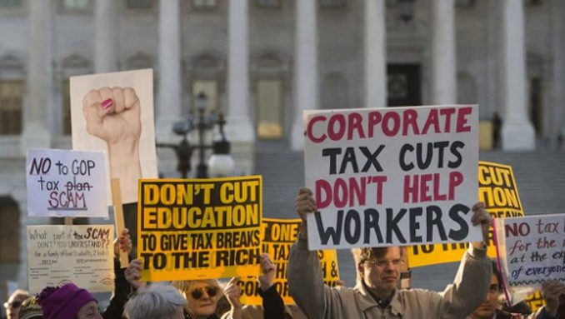

Slide 19
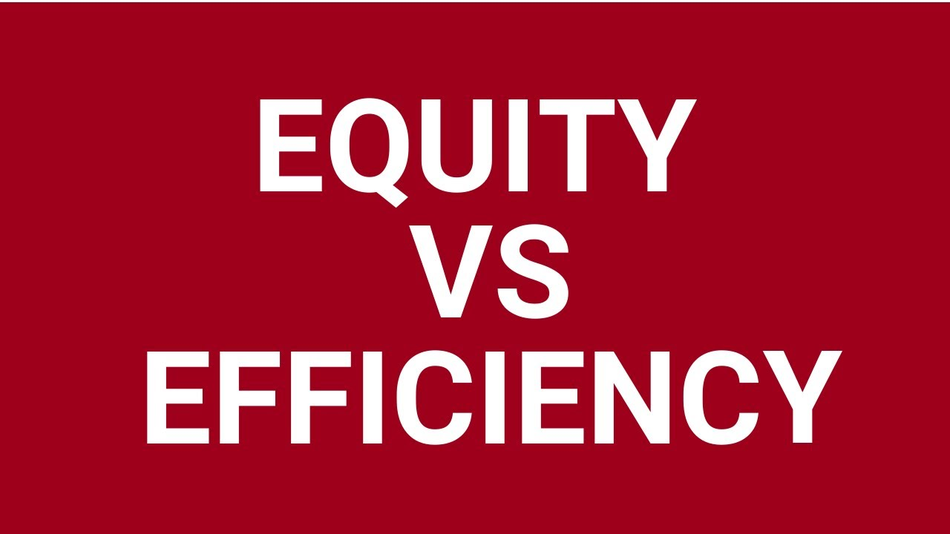
The “Big Tradeoff”:
Economic Efficiency vs. Economic Equity

Slide 20
Three Economic Questions
What goods and services will be produced?
How will those goods and services be produced?
For whom will the goods and services be produced?

Slide 21
1. What Goods and Services Will Be Produced?
Given the reality of scarcity, an economy cannot produce goods and services to meet all needs and wants.
An economy must decide what goods and services are most wanted and most needed.
Ex: Moving forward, the U.S. economy may need to decide whether to continue developing fossil fuels or invest in alternative energy.

Slide 22
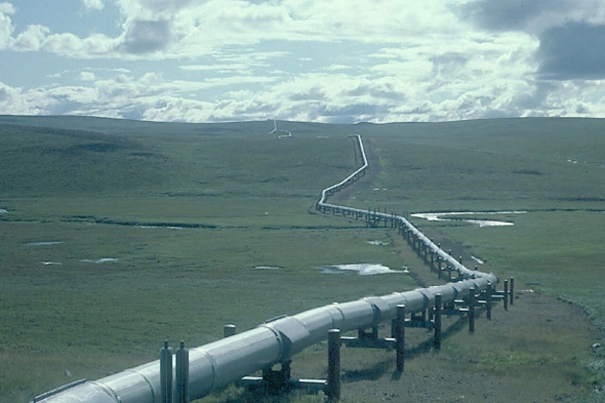
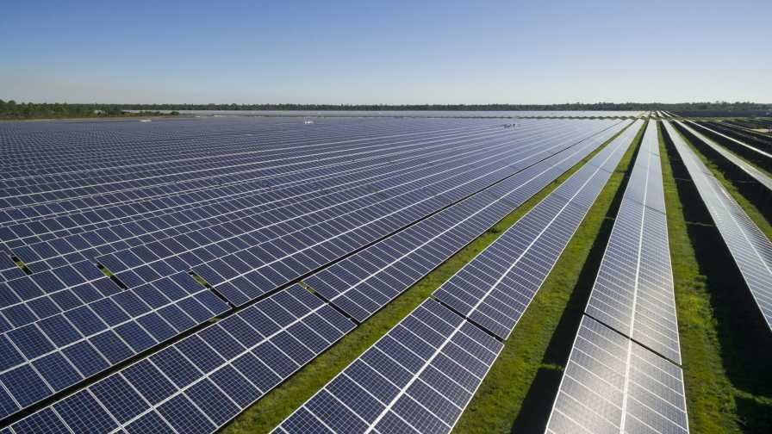
Article Review for Student Discussion
https://docs.google.com/document/d/1SBvWeNzYN_rGawsJ6zv2Kv9nnTfZL94dOKVNn47DB6A/edit?usp=sharing

Slide 23
2. How Will the Goods and Services Will Be Produced?
What methods and means should businesses utilize to produce the goods and services?
Ex: To what extent does working remotely impact employee productivity?

Slide 24


Slide 25
How Will the Goods and Services Will Be Produced? (Learning Activity)
Student Activity: Research whether employees are more or less productive while working remotely.
Have groups of students create a short data-backed presentation as if they are a consulting firm providing advice to a business.

Slide 26
How Will the Goods and Services Will Be Produced? (Learning Activity Cont’d)
Modern Research: cs/#:~:text=Several%20studies%20over%20the%20past,and%20are%2047%25%20more%20productive.
https://www.forbes.com/sites/chriswestfall/2020/05/20/new-survey-shows-47-increase-in-productivity-3-things-you-must-do-when-working-from-home/?sh=3ee6621a80dc

Slide 27
3. For Whom Will the Goods and Services Will Be Produced?
Who should be able to consume the goods and services that are produced?
Which allocation method will be used?
Ex: Will people with the most wealth compete for the goods and services, or will the government allocate them more equitably?
  Free market or “democratic socialism?”

Slide 28
Student Activity: Government’s Role in the Economy
“Value Line”
Value Line Activity:
Project a series of value based statements (one at a time)
On a paper or using a digital tool, students place an x on a “value line” with DISAGREE on one end and AGREE on the other end. They then record one reason for their position.
After a minute or so, students get up and stand on an “imaginary value line” in your classroom with DISAGREE on one side and AGREE on the other. They can stand on any point of the continuum even right in the middle if that’s where they fall.
Have students discuss their reasoning with someone close to them. Then have them find a new person from the other side of the line and discuss their reasoning. Come together after each statement and discuss as a class.

Slide 29

Student Activity: Government’s Role in the Economy
“Value Line”
EXAMPLE OF VALUE LINE STATEMENTS:
https://docs.google.com/presentation/d/1h_h9lYQU7qDY-fi4tM0lxWDrG71he5djxuPmDsyO_9g/edit?usp=sharing

Slide 30
Major Economic Systems Defined
Traditional Economy: a system of production and allocation that depends on customs, history and honored beliefs and values.
Characteristics:
  Little change or innovation
  High degree of craftsmanship
  Reliance on habit and ritual
  Strong gender roles
  Usually characterized by higher degrees of poverty, illiteracy, infant mortality and lower life expectancy.
  Typically utilized by subsistence-based societies

Slide 31

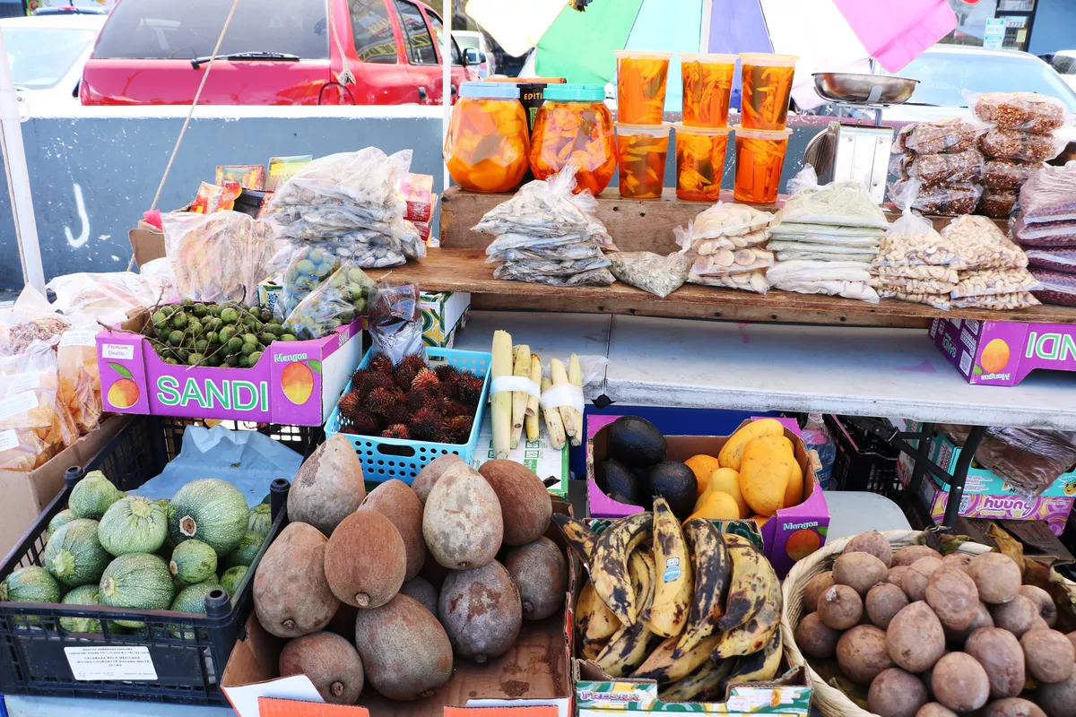
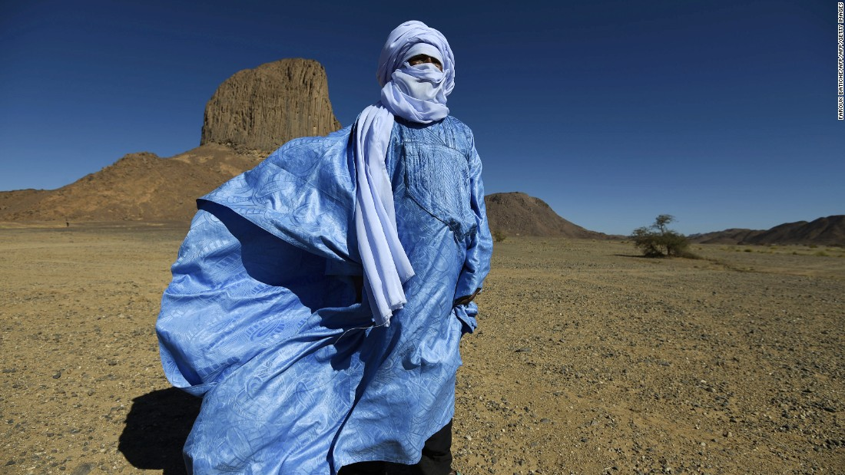

Examples of Traditional Economies

Slide 32
Traditional Economies - Questions to Consider
Note: Can be used for think-pair-shares, polling questions or small group discussions.
What are some of the pros and cons of traditional economies?
Do traditional economies choose a traditional economic system or are there barriers to change?
Can you think of any “traditional” aspects of the U.S. economy?
-Google Classroom Poll
-www.polleverywhere.com
-NearPod or PearDeck Poll

Slide 33
Major Economic Systems Defined
Command Economy: an economic system where the government dictates the means of production and distribution.
Characteristics:
  No private ownership of resources or property
  The government makes all decisions regarding production and distribution
  Usually associated with totalitarian political systems
  Lack of basic human rights and freedoms
  In theory: the elimination of social classes
  High degree of specialization of labor

Slide 34

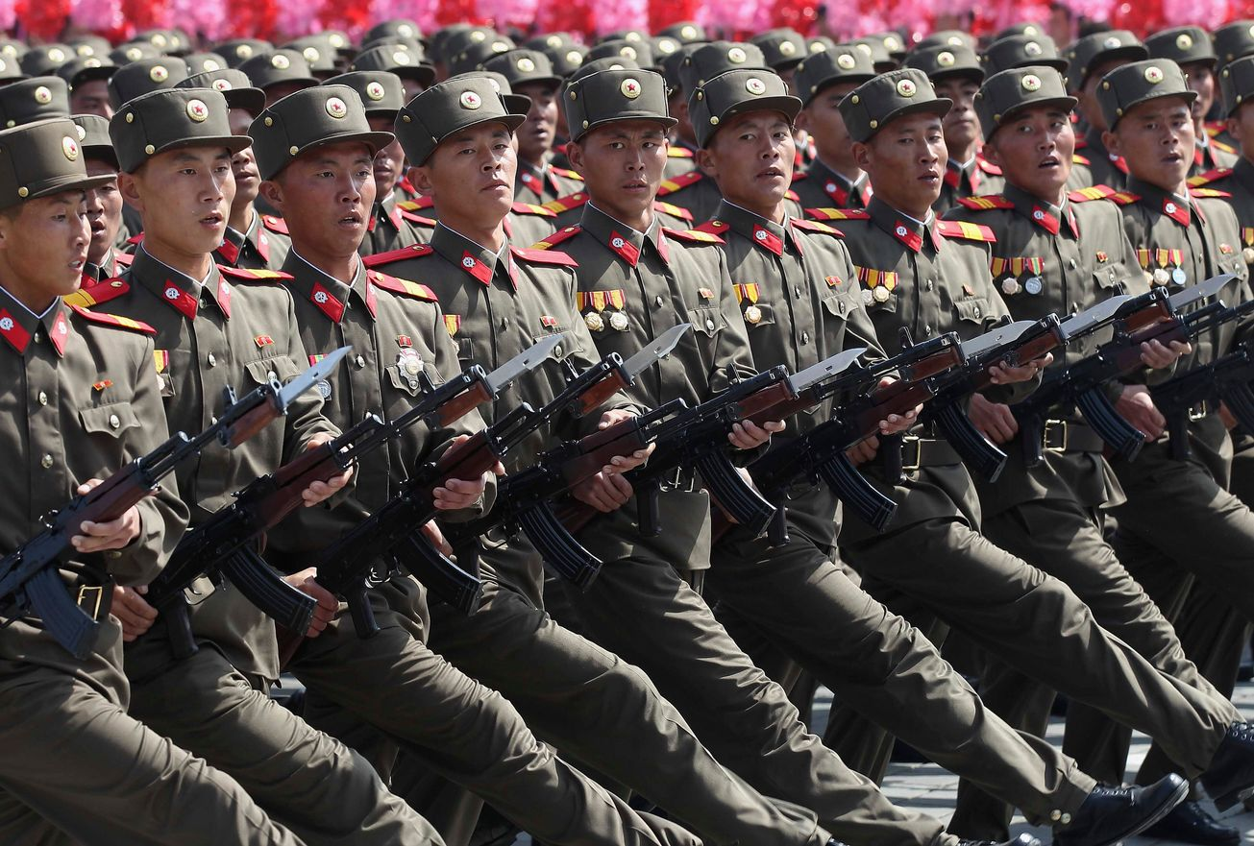

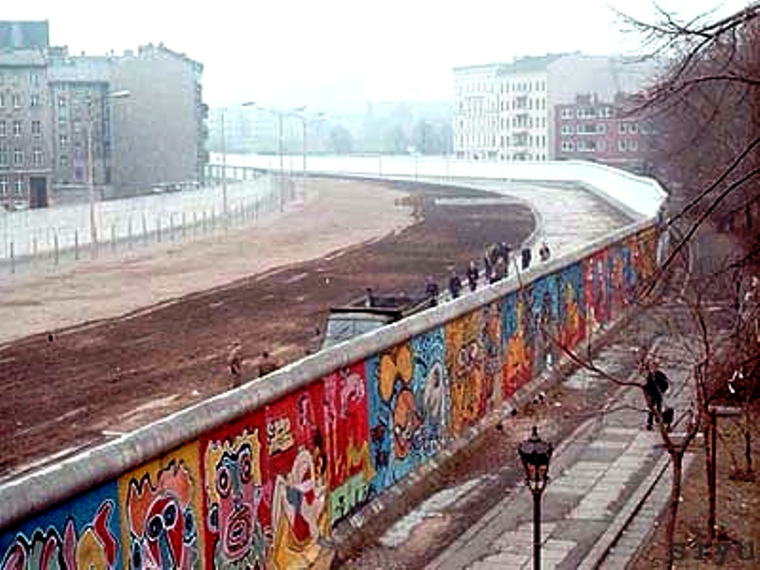

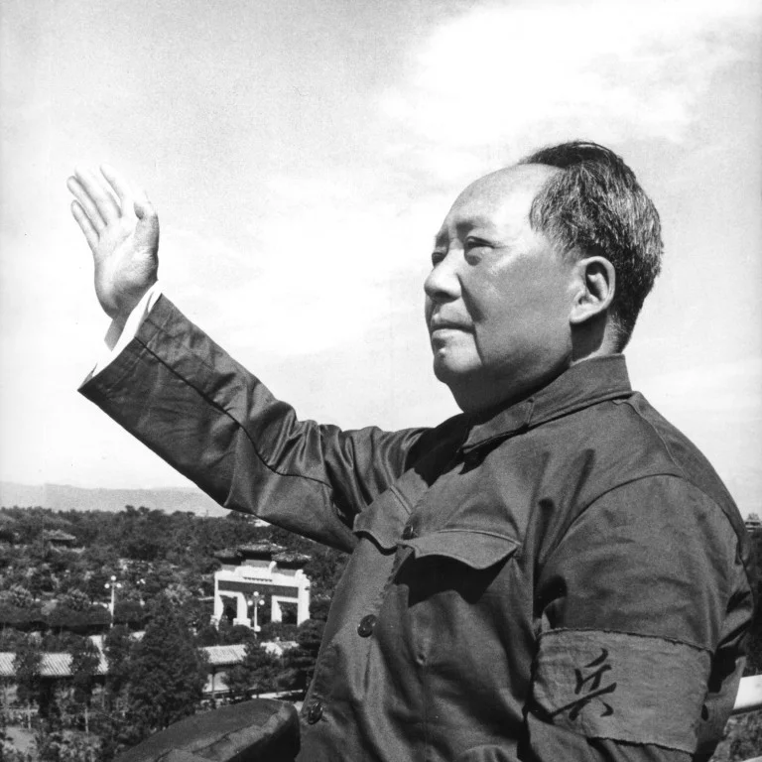

Slide 35
Command Economies - Questions to Consider
Note: Can be used for think-pair-shares, polling questions, or small group discussions.
What are some of the pros and cons of command economies?
Why do command economies typically lead to a denial of human rights and freedom?
Can you think of any “command” aspects of the U.S. economy?

Slide 36
Major Economic Systems Defined
Free Market Economy: a system that relies on the free exchange between buyers and sellers with little or no government intervention.
Characteristics:
  Constant change and innovation
  Prices and production dictated by supply and demand
  Prices act as “signals”
  Laissez Faire - hands off by the government
  Economic and political freedom
  Little security and predictability
  High degree of competition
  Private property ownership rights

Slide 37
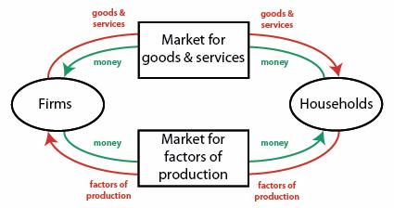
Market Economy and “Circular Flow”

Slide 38
Lesson Plan Idea: Circular Flow Activity
Randomly choose two or three students to represent a “firm.” The rest of the class represents “households”
The firms produce and sell a product such as pretzels and purchase labor. The households produce and sell labor and purchase pretzels.
Give the firm and the students who represent households some fake money. The households purchase pretzels but in order to sell them the firm must purchase labor to deliver them to the households. The price of the pretzels and the price of the labor are determined by free market forces of supply and demand.
As long as households are purchasing money flows to firms which is used to purchase labor.
Take note of any factors that could lead to a slowdown (recession) of spending on either end and debrief.

Slide 39


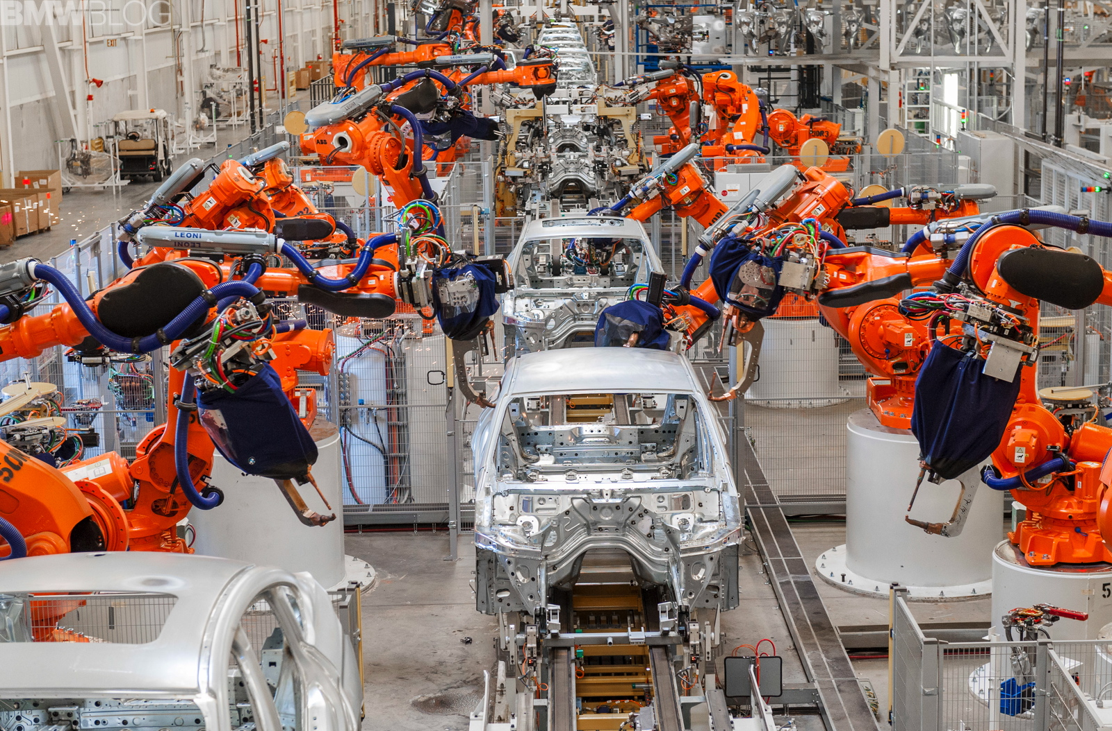
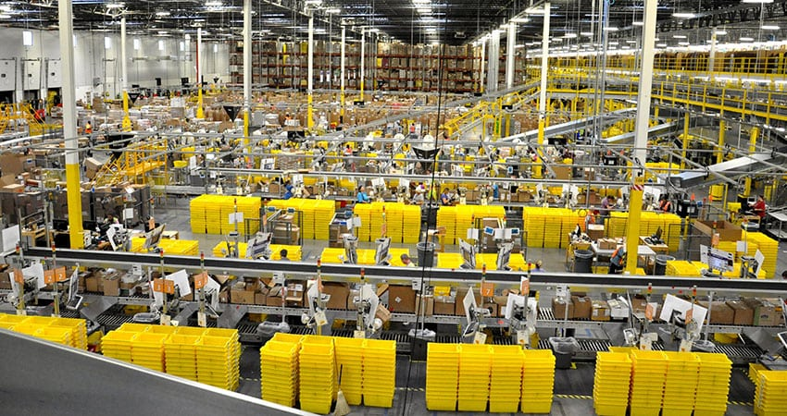

Slide 40
Market Economy - Questions to Consider
Note: Can be used for think-pair-shares, polling questions or small group discussions.
What are some of the pros and cons of market economies?
Is competition more of a beneficial or harmful force in an economic system?
Why do market systems sometimes lead to higher degrees of income inequality? Is it worth it?

Slide 41
Lesson Plan Idea: Pasta Necklace Simulation
Divide students into teams of 5-6 students per group.
Distribute a box of each type of pasta to each group: ditalini, rigatoni, ziti, penne
Distribute a ruler, dental floss and a scissors to each group.
Explain that they will compete to see how much money they can make by producing necklaces and bracelets out of pasta and dental floss by progressing through each economic system.
Project the following or give as a handout: https://docs.google.com/document/d/1L4rMbcBefKi-EYvP-Mtt0VMaENigUW8-IR3wbMoEljw/edit?usp=sharing

Slide 42
Lesson Plan Idea: Pasta Necklace Simulation Cont’d
First round: 15 minutes. Each group MUST abide strictly to the rules for a traditional economy. At end of 15 mins. each group adds up the total production ($5 per bracelet completed)
Second round: 15 minutes. Each group MUST abide strictly to the rules for a command economy. At end of 15 mins. each group adds up the total production ($50 for a quota of 5 necklaces)
Third round: 15 minutes. Each group cqn now produce any combination in any way according to the rules for a market economy. At end of 15 mins. each group adds up the total production ($5 per bracelet completed and $10 per necklace completed)
NOTE: See handout on previous page for rules.

Slide 43
Lesson Plan Idea: Pasta Necklace Simulation Cont’d
After three rounds groups add up total dollar amount of production. The group with the most cumulative total after three rounds wins!
Debrief with this organizer:
https://docs.google.com/document/d/1zzhBSBT7loN2FX5JvMUl3sGxgasCa9tDZcmWJgdrcrU/edit?usp=sharing

Slide 44
Mixed Economies
Mixed Economy: an economic system that balances a free market with some degree of government control/ involvement.
Characteristics:
Most modern economies are “mixed” with some degree of government involvement
Some economies lean more to the free market side and some lean more towards the “command” side
Can you think of any examples of the “mixed” nature of the U.S. economy?

Slide 45
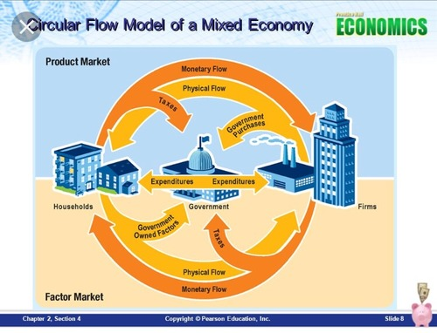
Circular Flow: Mixed Economy

Slide 46
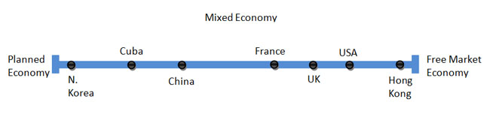
Mixed Economy Continuum
https://www.statista.com/statistics/256965/worldwide-index-of-economic-freedom/

Slide 47
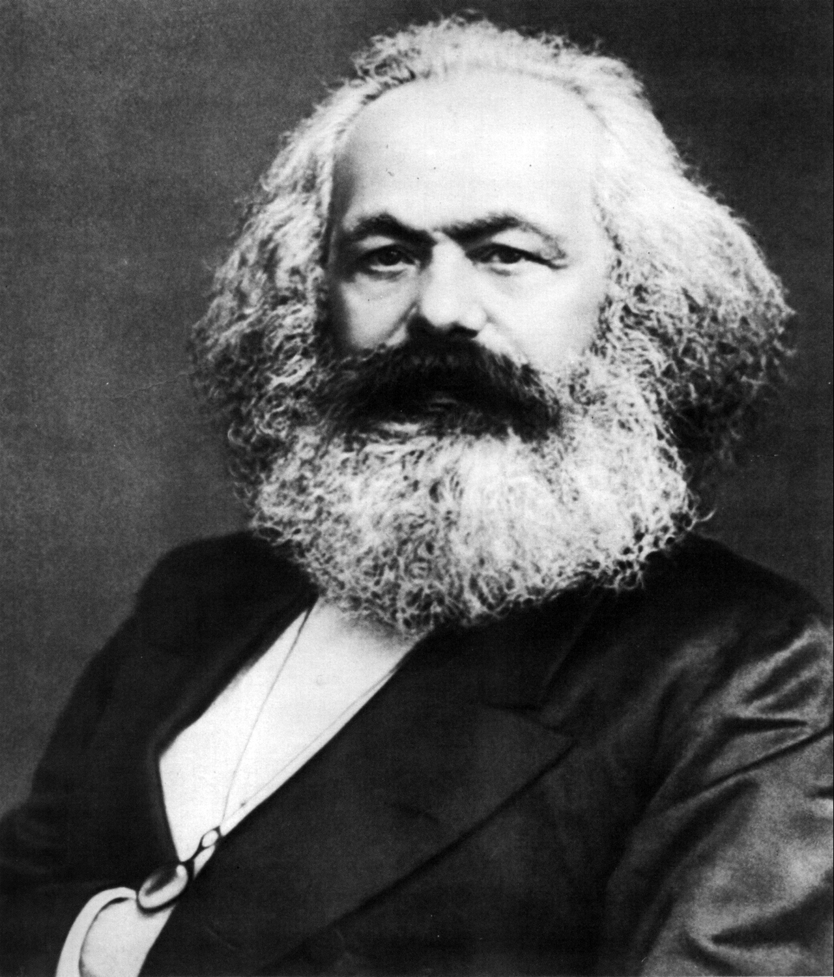

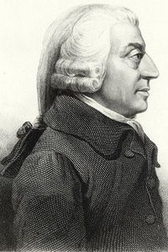
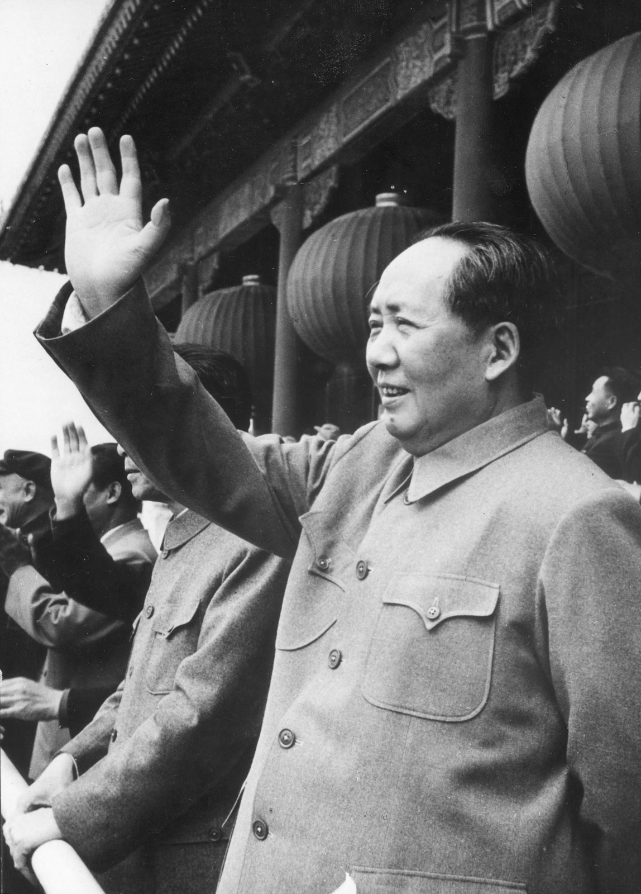
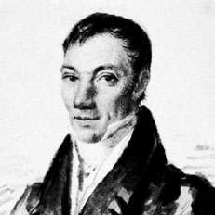
Economic Systems: History and Economic Thought
https://docs.google.com/document/d/1apuRTyUgrdCwDINUpnM_tf2fVuF7TE_l5Yjarj3cR4U/edit?usp=sharing

Slide 48
Lesson Plan Idea: Economic System Research
Jigsaw
In groups students choose a country. They analyze that nation’s economic system using the following as a guide: https://docs.google.com/document/d/1pv556AbnbdIDWEB5nVZCC16By4_c-ElqVfOwowvs6kY/edit?usp=sharing
Students then participate in a “circle in a circle” jigsaw.
Directions on the next slide…

Slide 49
Jigsaw Cont’d
Create an inner circle of the research groups and and a corresponding outer circle with the same number of groups. For instance, three inner groups and a circle of three outer groups around them.
Have the outer and inner groups face each other and give them 10 minutes to present their research to each other. When ten minutes is up, have the outer group rotate so they face a new inner group. Repeat the presentation process until all the groups have met up with each other.
Debrief with a whole group discussion and use big focusing questions as prompts.

Slide 50
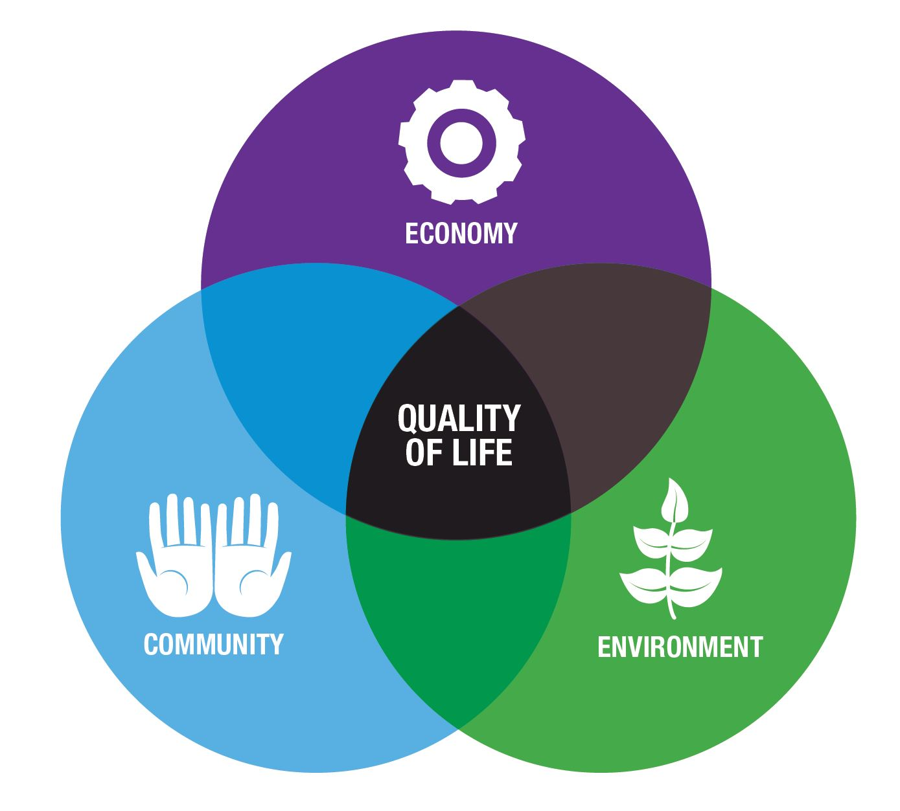
Variation on Lesson:
Economic Systems and Quality of Life
https://www.usnews.com/news/best-countries/quality-of-life-rankings
Have students choose a nation on the list and summarize the major indicators to share with the class.
Students can act as “representatives” and present why their nation has the highest quality of life.

Slide 51
Other Lesson Plan Ideas
The Island Game: http://hrlibrary.umn.edu/edumat/sustecon/others/islandgame.htm
Federal Reserve Bank of St Louis: https://www.frbatlanta.org/education/publications/extra-credit/2015/fall/lessons-and-activities/high-school/basic-economic-concepts/economic-systems-infographic-activity

Slide 52
Review Questions - Socrative
Socrative.com
Room Name: Opderbeck

Slide 53
Formative Assessment Options
Nearpod: www.nearpod.com
Quizlet Live: www.quizlet.com
Kahoot: www.kahoot.com
Gimkit: www.gimkit.com
Blooket: www.blooket.com

Slide 54
References
https://www.khanacademy.org/economics-finance-domain/ap-microeconomics/basic-economic-concepts
https://education.howthemarketworks.com/comparative-economic-systems/
https://corporatefinanceinstitute.com/resources/knowledge/economics/economic-system/

Slide 55

CEE Affiliates
https://www.councilforeconed.org/resources/local-affiliates/

Slide 56




Thank You to Our Sponsors!

