Slide 1
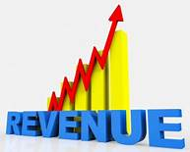
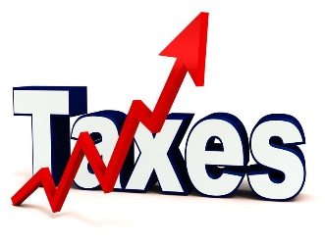

Microeconomics 202: Government Intervention- Price and Quantity Controls, Tariffs, Excise Taxes, Subsidies
Presented by Teri Fischer
June 9, 2020

Slide 2
EconEdLink Membership
You can now access CEE’s professional development webinars directly on EconEdLink.org! To receive these new professional development benefits, become an EconEdLink member. As a member, you will now be able to:
Automatically receive a professional development certificate via e-mail within 24 hours after viewing any webinar for a minimum of 45 minutes
Register for upcoming webinars with a simple one-click process
Easily download presentations, lesson plan materials, and activities for each webinar
Search and view all webinars at your convenience
Save webinars to your EconEdLink dashboard for easy access to the event
You may access our new Professional Development page here

Slide 3
Professional Development Certificate
To earn your professional development certificate for this webinar, you must:
Watch a minimum of 45-minutes and you will automatically receive a professional development certificate via e-mail within 24 hours.
Accessing resources:
You can now easily download presentations, lesson plan materials, and activities for each webinar from EconEdLink.org/professional-development/

Slide 4
Agenda
Let's take a look at…
1. Taxes and see their effect on prices, output and the economy as a whole.
2. What happens to Consumer and Producer Surplus?
3. Why is there Dead Weight Loss?
4. What happens to Revenue collected?

Slide 5
National Standards
STANDARD 4: INCENTIVES . . . . People usually respond predictably to positive and negative incentives.
STANDARD 16: ROLE OF GOVERNMENT AND MARKET FAILURE . . . . . . There is an economic role for government in a market economy whenever the benefits of a government policy outweigh its costs

Slide 6
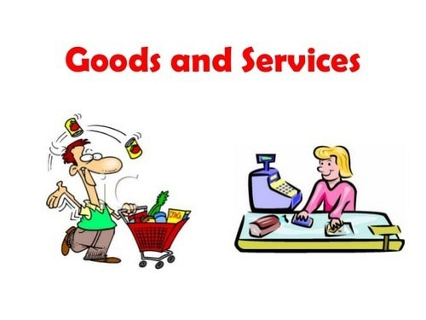
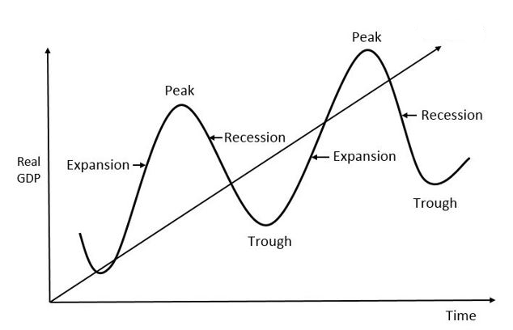

Why are Taxes Necessary?
Provide Goods and Services
Control the Economy
Control Behavior
Correct Income Inequality

Slide 7
What are the different types of taxes?
“Progressive tax is the concept that a taxpayer should pay higher taxes if he earns more income and lower taxes if he earns less. In the U.S., people are taxed based on what tax brackets they fall into, with higher income ranges correlating to a higher percentage. Progressive taxes are the main tool used by governments to reduce income inequality”- Bankrate

Slide 8
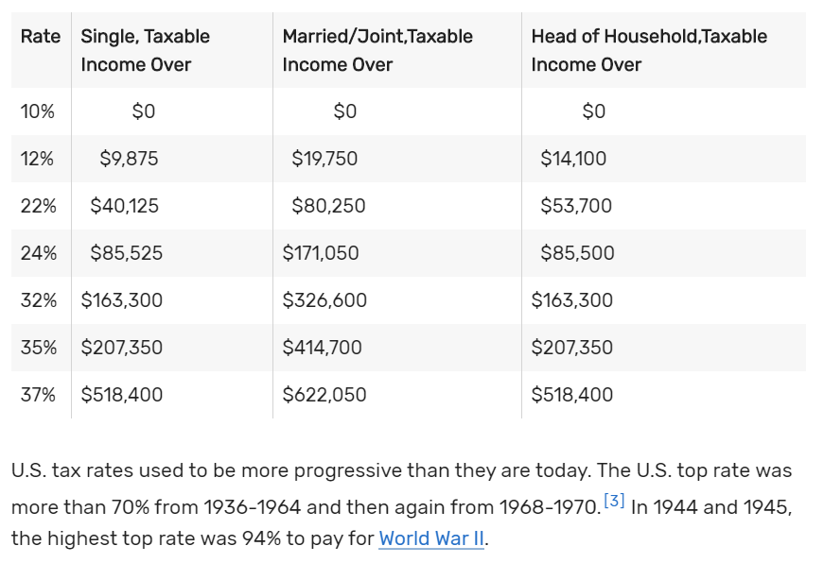
United State Tax Rate 2020

Slide 9
Progressive taxation improves the poor’s purchasing power and stimulates the economy.
Progressive tax systems improve the poor's ability to purchase everyday items as well, increasing economic demand.
A study by Economy.com found that every dollar spent on food stamps stimulates $1.73 in demand because that $1 creates a ripple effect.→→→
A dollar spent at the grocery store pays for the food, but it also helps to pay the clerk's salary, the truckers who haul the food, and even the farmer who grew it. →→→
The clerks, truckers, and farmers then make purchases of their own, which pays even more employees and workers. With strong demand, there's no need to lay off employees.
The goal of progressive taxation is to stimulate the economy and make sure every citizen has a minimum standard of living. Over the long run, it lowers health care costs and provides a strong labor force.

Slide 10
Taxes that are NOT Progressive!
The Social Security tax is the opposite of progressive.﻿ First, it's paid at the same rate, regardless of income. Employees pay 6.2% of their income, and their employers match this for a total of 12.4%. Business owners pay 12.4% in the form of self-employment tax.
Employees and business owners don't have to pay the tax on income above a certain level, called the Social Security wage base. The wage base was $132,900 in 2019. Those who earned more than this didn't have to pay the Social Security tax on this portion of their incomes.
Tax deductions are also regressive. The standard deduction is a fixed amount that's subtracted from taxable income, regardless of income.¹⁵
﻿ SALES TAX is regressive

Slide 11

Investment Income Taxes
The net investment income tax applies to estates and trusts when their adjusted gross incomes for the year exceed the dollar amount at which the highest tax bracket begins. Grantor trusts and trusts that are exempt from income taxes, such as charitable remainder trusts, are exempt from the net investment income tax. In most cases, taxes on grantor trusts trickle down to and are payable by the individual—the grantor—who formed and maintains them.
Net investment income can be capital gains, interest, or dividends.

Slide 12
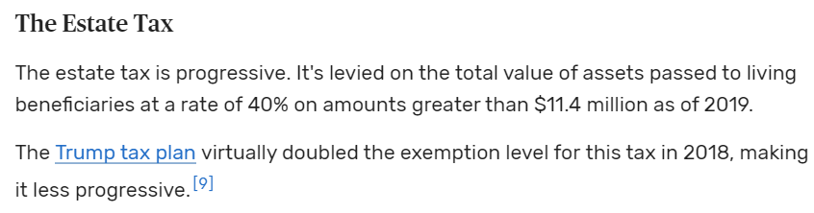
The Estate Tax

Slide 13
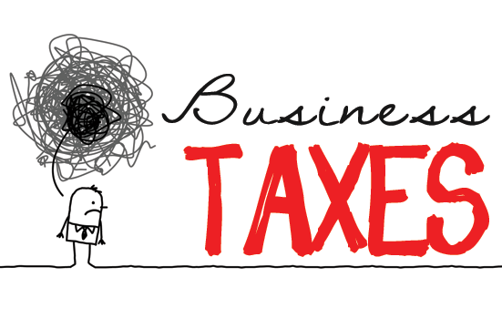
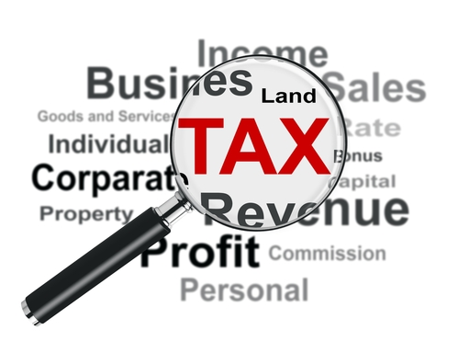
Tax breaks for the wealthy have a much weaker effect.
Business tax breaks only generate 33 cents for every revenue dollar lost according to economy.com.
https://www.thebalance.com/progressive-tax-definition-examples-4155741

Slide 14
Excise Tax
Excise taxes are taxes paid when purchases are made on a specific good, such as gasoline. Excise taxes are often included in the price of the product. There are also excise taxes on activities, such as on wagering or on highway usage by trucks. One of the major components of the excise program is motor fuel.
Excise taxes are sometimes used to charge taxes on goods or services deemed by society as unnecessary or even harmful. A "sin tax" is applied to the price of things like alcohol and cigarettes, to compensate governments for the cost of dealing with the use of harmful or luxury items

Slide 15
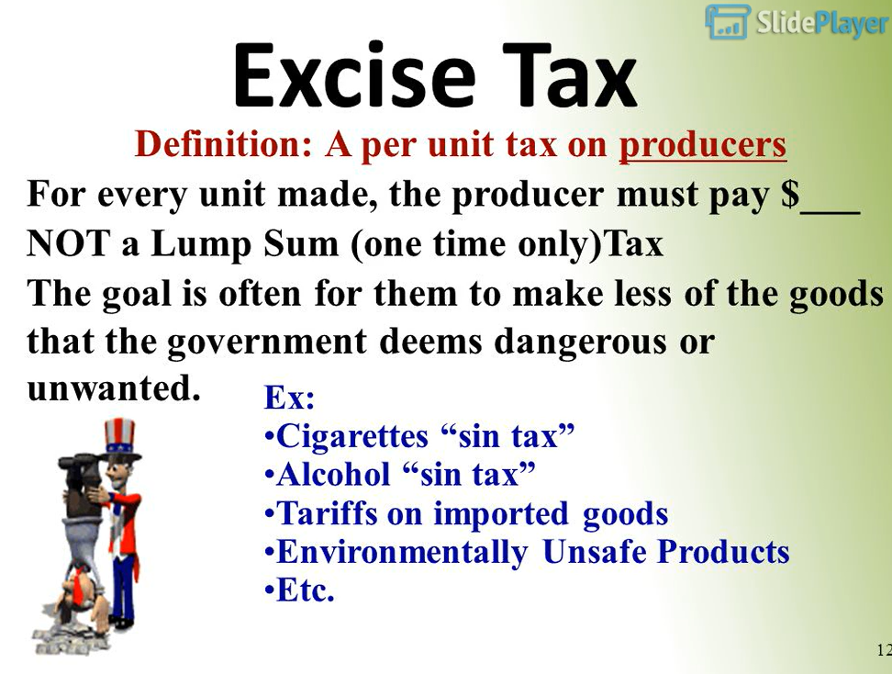
https://slideplayer.com/slide/8414635/

Slide 16
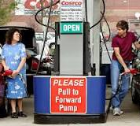
Regressive Tax
A regressive tax takes a higher percentage of earnings from lower-income people than those with higher incomes. Most regressive taxes aren't income taxes. They take a larger proportion from low-income people because they have less money left over after the tax.

Slide 17
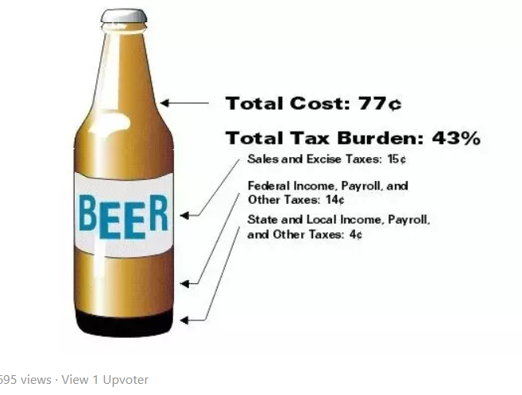
Imported Beer – What Taxes Do We Pay?

Slide 18
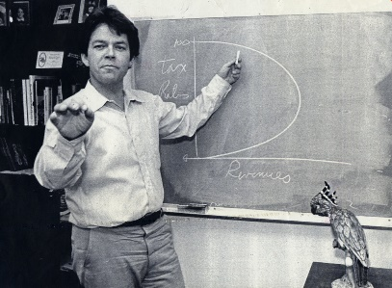
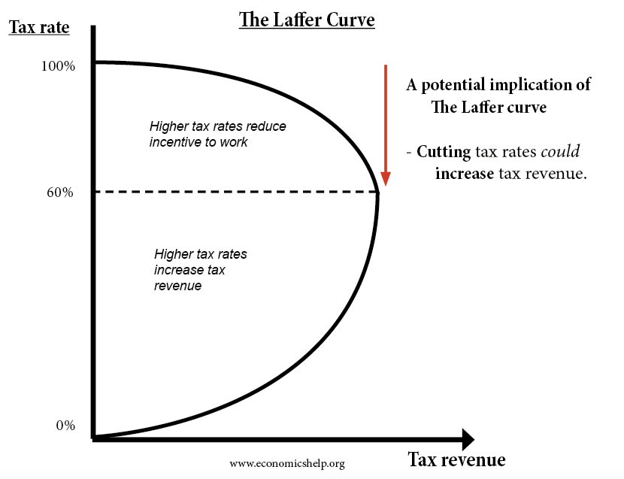
Laffer Curve
https://www.youtube.com/watch?v=FCk2-QVqCck
The Laffer Curve is a theory that states lower tax rates boost economic growth. This supported the Reaganomics of Supply Side Economics in 1979.
The curve is used to illustrate Laffer's argument that sometimes-cutting tax rates can increase total tax revenue

Slide 19
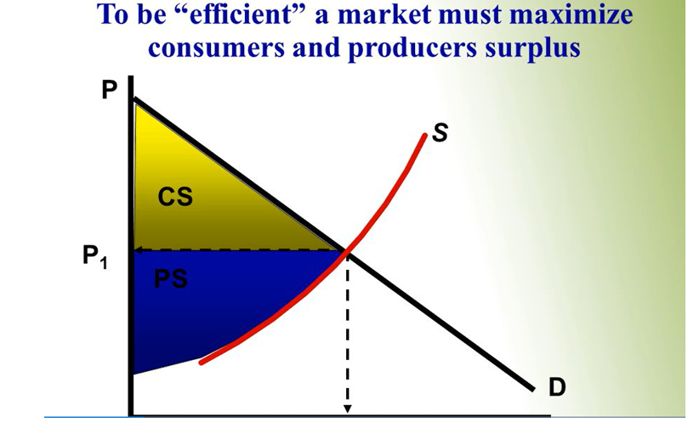
-Are Price Controls Good or Bad for the Economy?
-Why Does Government Need to Get Involved?

Slide 20

Government Action
Government needs to get involved because they feel that the PRICE set by the market is NOT FAIR!

Slide 21
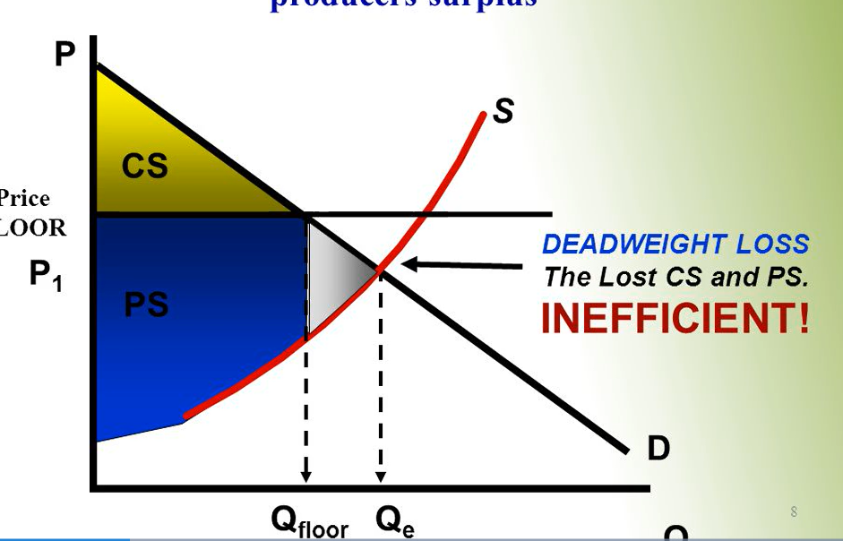
Price Floor =
Lowest Allowed Price
This is an example of Minimum Wage…
Government does not feel that $5 an hour is a FAIR WAGE.

Slide 22
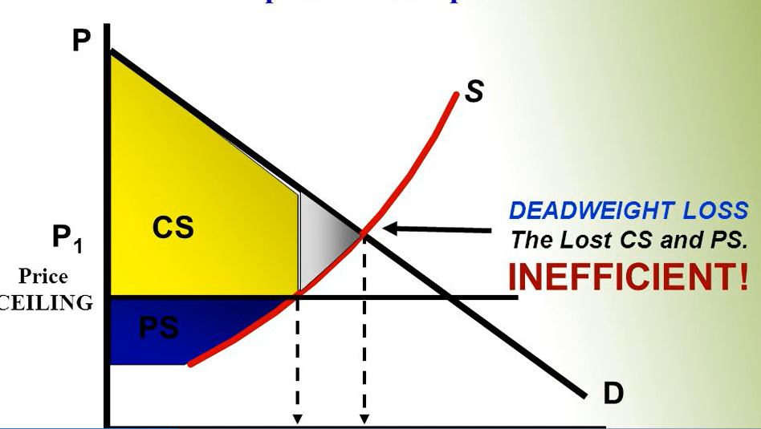
Price Ceiling =
Highest Allowed Price
This is the HIGHEST allowed price set by the government for FAIRNESS
…This is an example of RENT CONTROL.

Slide 23
When Government sets a tax, should it be concerned with who pays the tax?
Should the burden of the tax be on the consumer?
Should the burden of the tax be on the producer?
Elasticity of demand answers that question!

Slide 24
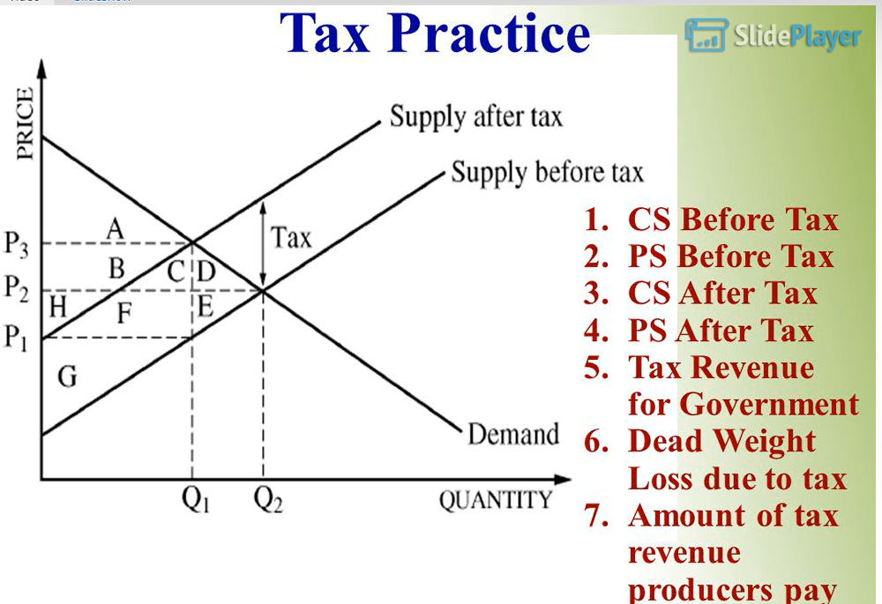
1. ABCD
2. HFEG
3. A
4. G
5. BCHF
6. DE
7. HF

Slide 25
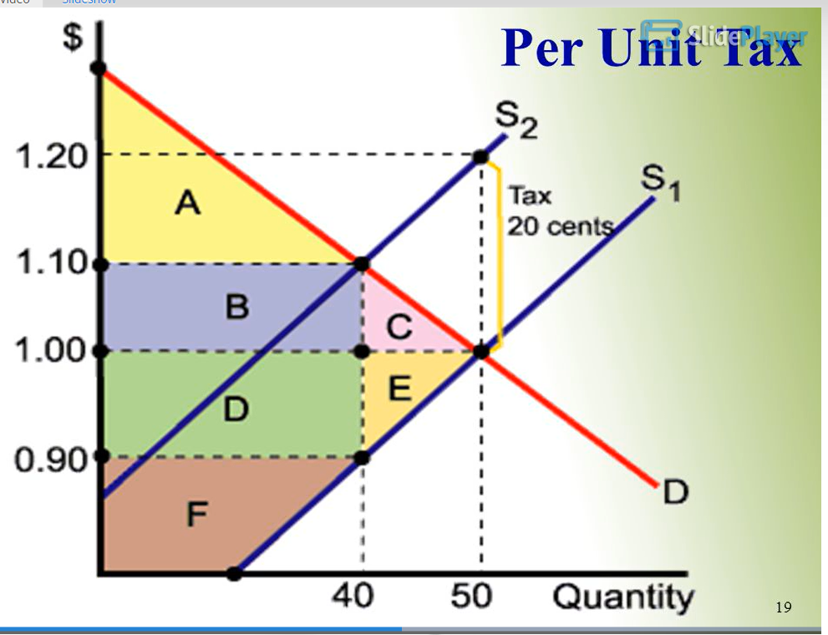
Consumer and Produce
Share the Tax Burden
1. Consumer surplus before the tax = ABC
2. Producer Surplus before the tax = DEF
3. The Tax = BDCE
4. The Consumer and Producer share the tax equally -> 10 cents each
5. The CS after the tax = C
6. The PS after the tax = F
7. DWL = CE

Slide 26
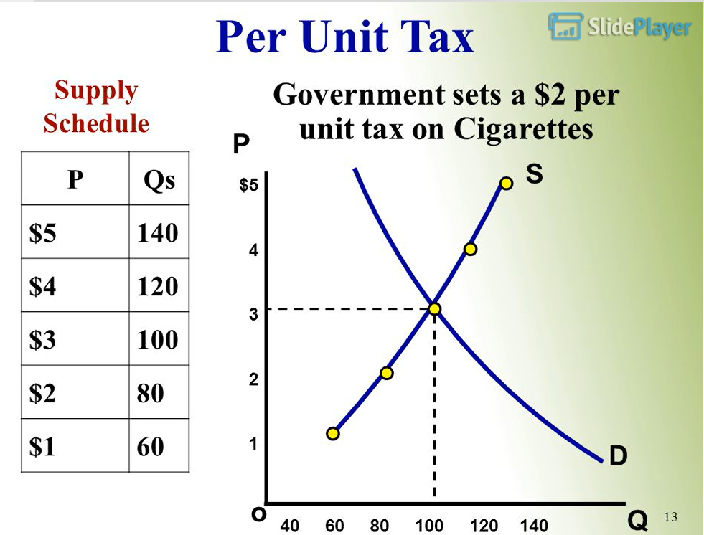
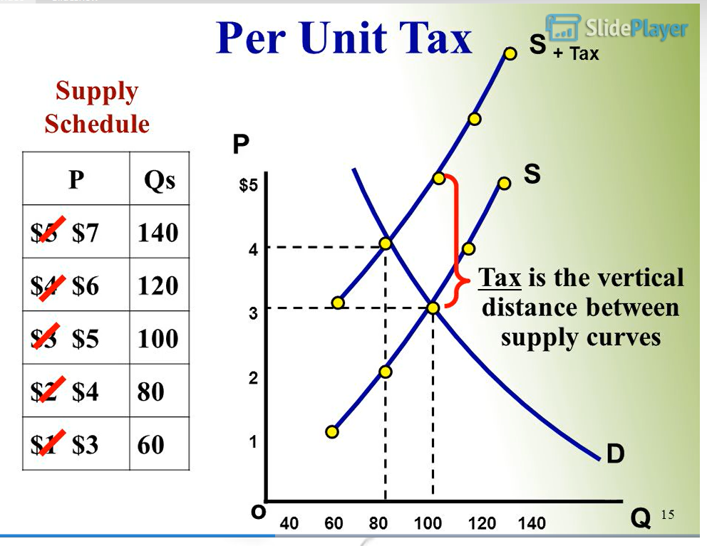
Product of Cigarettes being taxed @ $2/ pack

Slide 27
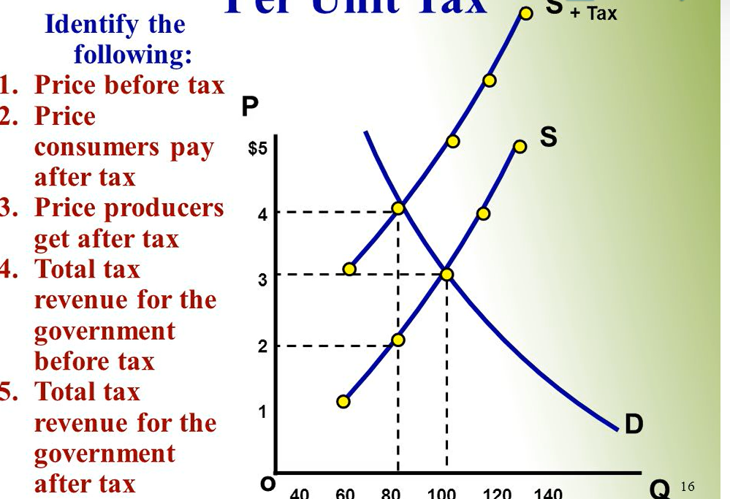
1. $3
2. $4
3. $2
4. 0
5. $2 x 80 = $160
DWL-20x$2/2=$20
Loss of Sale is 20 units.

Slide 28
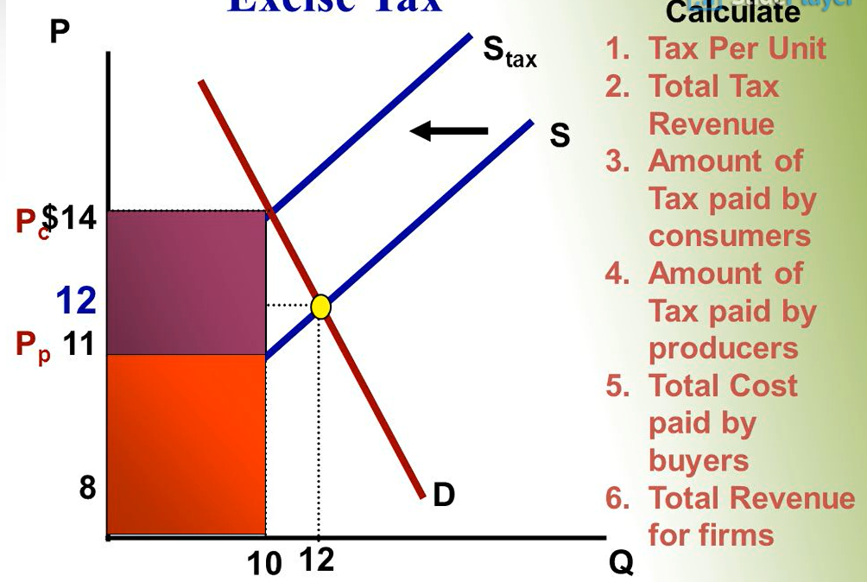
1. $3
2. $3 x 10=$30
3. $2
4. $1
5. $2 x 10 = $20
6. $11 x 10=$110

Slide 29
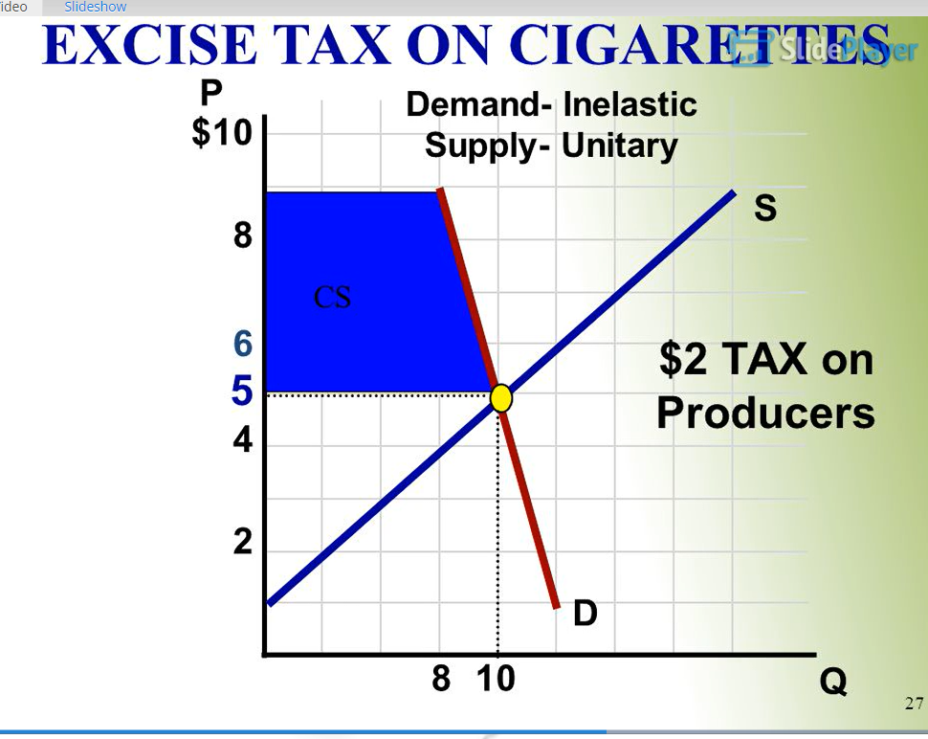

Slide 30
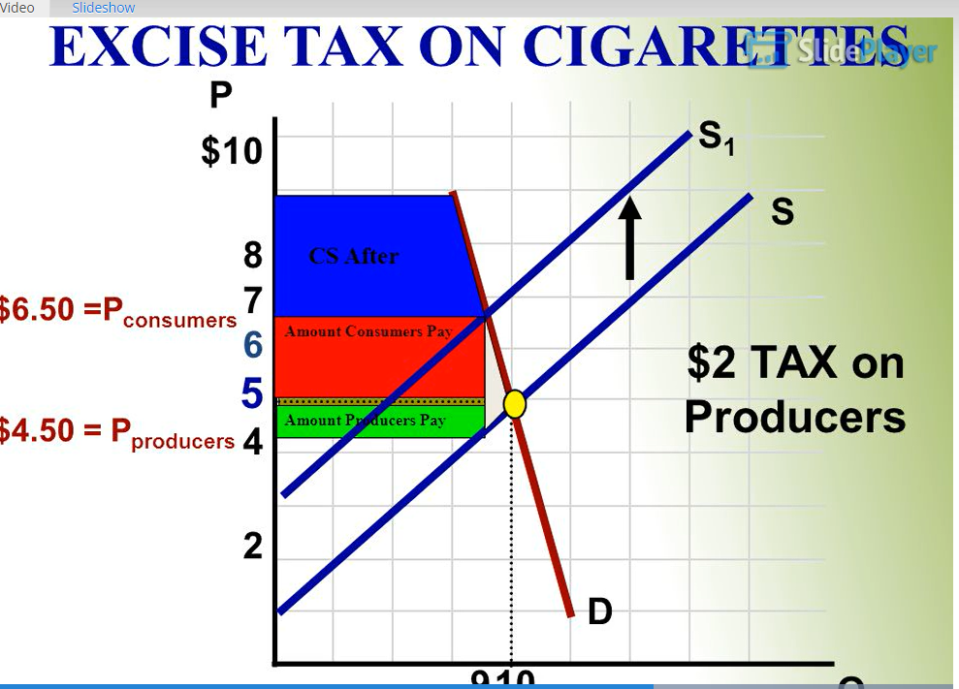
Who pays the bulk of the tax?
Consumer b/c the demand is inelastic
(no substitute and necessity)

Slide 31
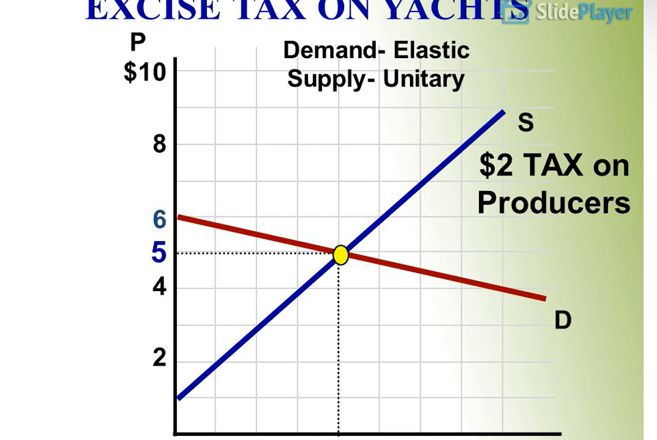
Are Yachts elastic or inelastic demand?

Slide 32
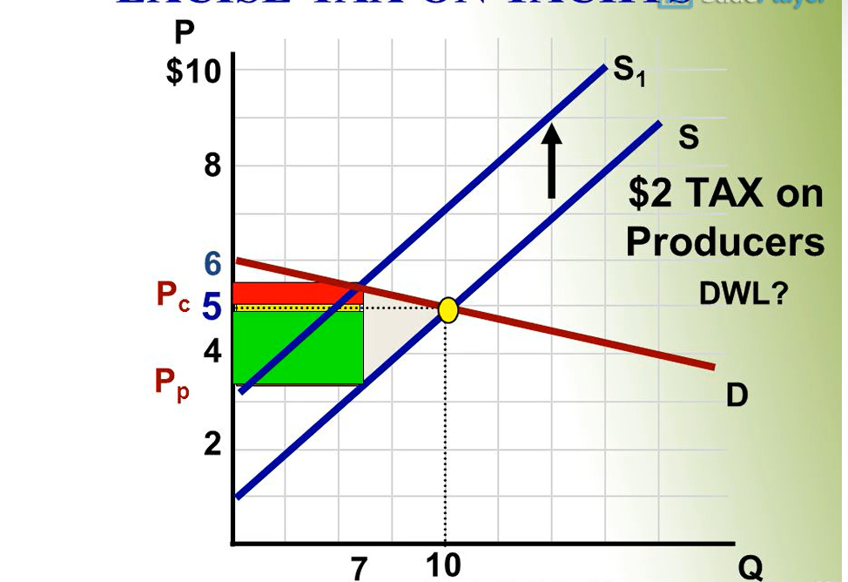
Who pays the bulk of the tax?
Producer pays because it is an ELASTIC demand.
Huge Loss of Sales due to the tax.

Slide 33
Tax Question
The state of New York needs more spending revenue this year to cover its budget deficit. They decide to tax cereal and aresurprised to see how little revenue was raised. You were brought in as a consultant to analyze the situation. Explain the reasoning behind this using elasticity, efficiency loss and total tax revenue collection.
Use a correctly labeled graph to show your explanation.

Slide 34
Tax Question
The state of Connecticut needs to raise revenue to help repair and build new school construction projects. The State has many options available to choose. Analyze the following options using elasticity, loss of efficiency and total revenue tax collection. The State narrowed their decision between these two options:
A. Sales tax
B. Cigarettes tax

Slide 35
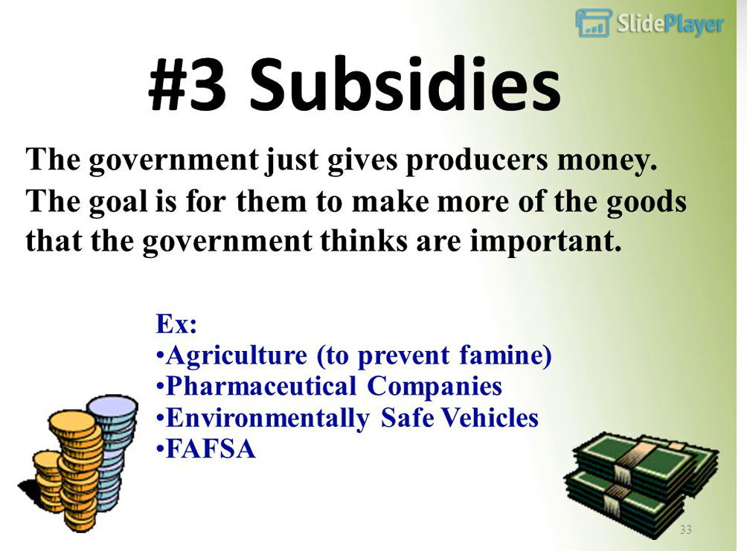

Slide 36
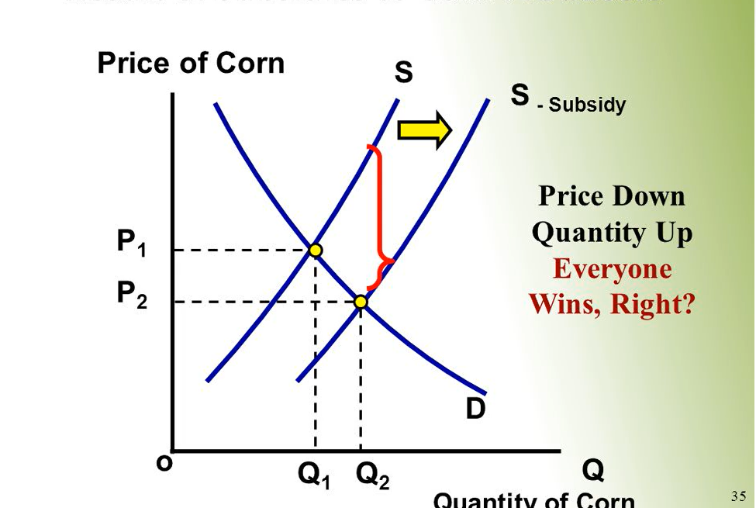
Why Does Everyone Win?

Slide 37
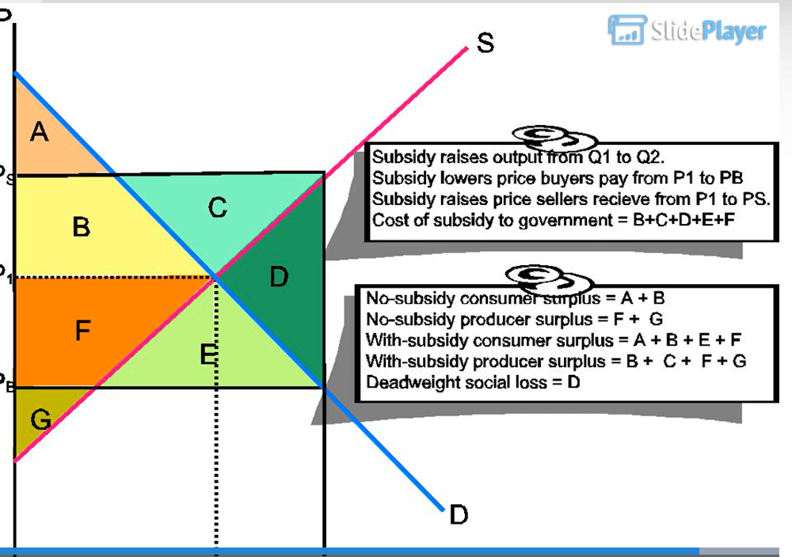

Slide 38
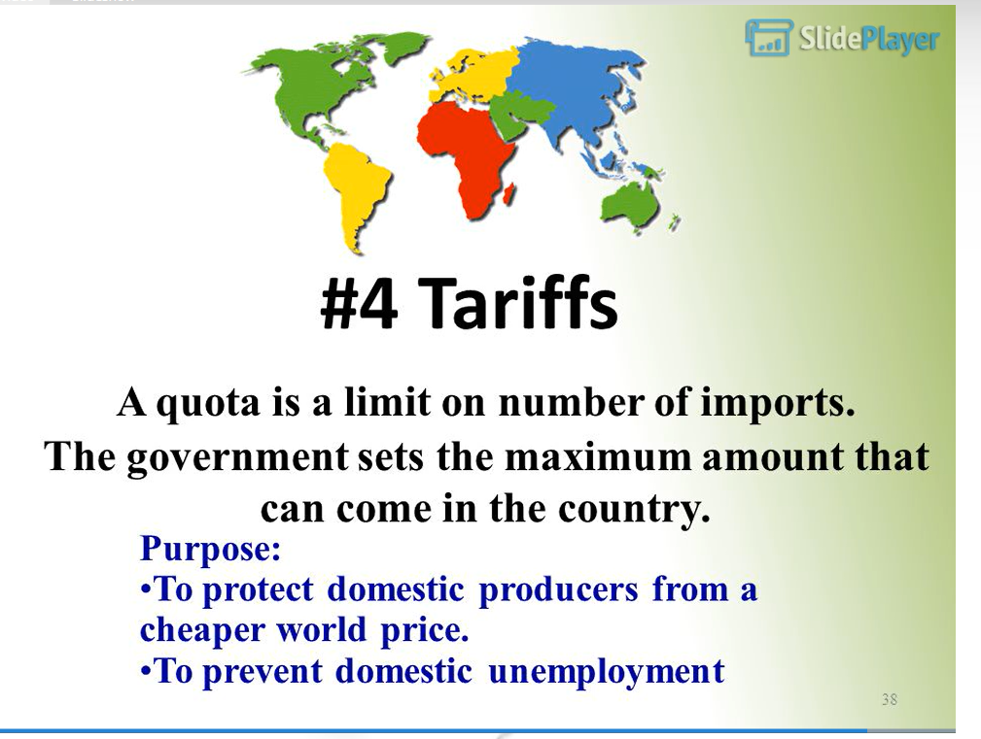

Slide 39
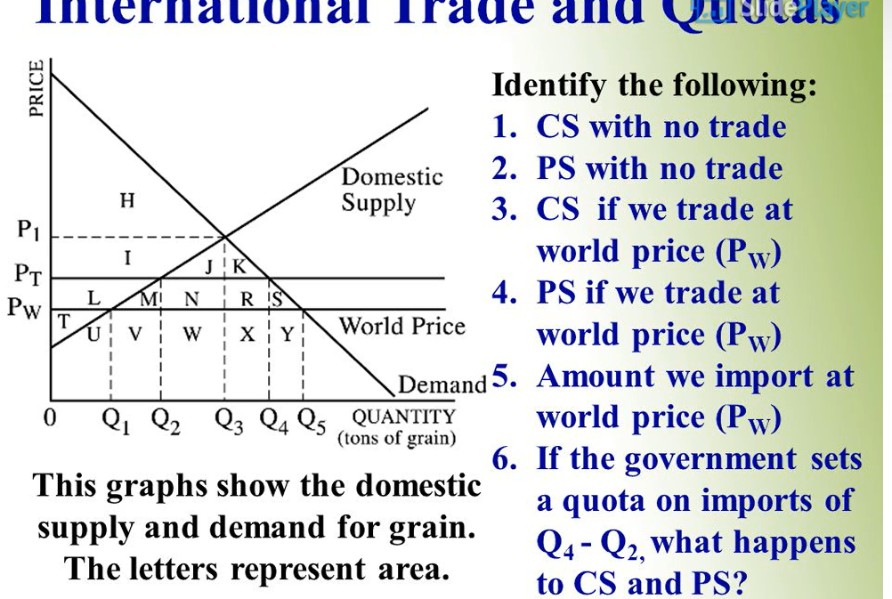
1. HL
1. HL
2. ILT
3. HILMNRS
4. T
5. Q5-Q1
6. CS will decrease and PS increase

Slide 40
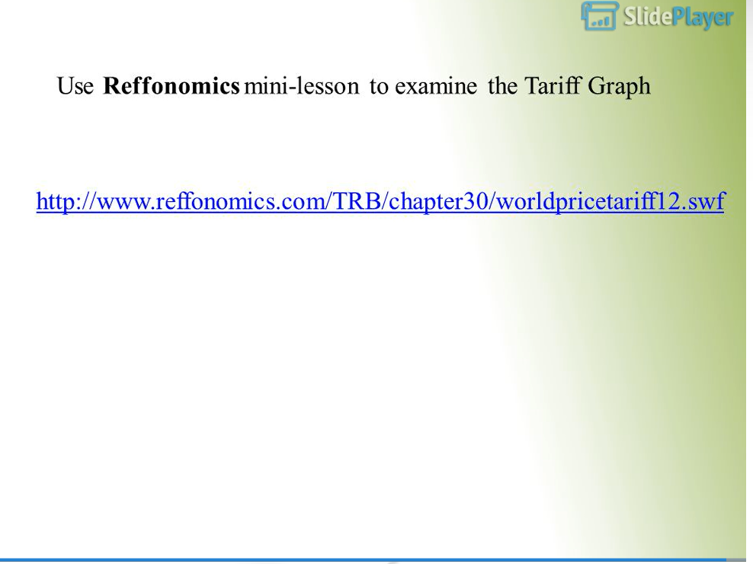

Slide 41
The End
-Taxes and Subsidies can lead to many debates in class
-Thank you for joining me this evening.
-Stay Safe and Healthy
Thank you!
.

Slide 42

CEE Affiliates
https://www.councilforeconed.org/resources/local-affiliates/

