Slide 1
Tawni Hunt Ferrarini, PhD Presenter 17 May 2021 tferrarini@lindenwood.edu tawni.org

Slide 2
EconEdLink Membership
You can now access CEE’s professional development webinars directly on EconEdLink.org! To receive these new professional development benefits, become an EconEdLink member. As a member, you will now be able to:
Automatically receive a professional development certificate via e-mail within 24 hours after viewing any webinar for a minimum of 45 minutes
Register for upcoming webinars with a simple one-click process
Easily download presentations, lesson plan materials and activities for each webinar
Search and view all webinars at your convenience
Save webinars to your EconEdLink dashboard for easy access to the event
You may access our new Professional Development page here

Slide 3
Professional Development Certificate
To earn your professional development certificate for this webinar, you must:
Watch a minimum of 45-minutes and you will automatically receive a professional development certificate via e-mail within 24 hours.
Accessing resources:
You can now easily download presentations, lesson plan materials, and activities for each webinar from EconEdLink.org/professional-development/

Slide 4
Agenda
Overview
Key learning objectives
Foundational standards
Starter discussion
Teaching and learning strategies
Formative and summative assessments
Resources (provided along the way)
Once over lightly

Slide 5
Overview
The U.S. economy is one of the world’s largest markets.
The modeling of currency markets is an important application of living in a global society.
The investigation of currency markets provides students with another encounter with the laws of supply and demand, increasing their proficiency in using them to understand and explain the world beyond the classroom.
When teaching product- or resource-market models and analysis, advance students economic reasoning skills by introducing the currency markets early.
Reinforce the analysis of the net macro effects of fiscal and monetary policy on the macroeconomy through an investigation of policy influences on net-exports, price levels, and rates of interest.
Add the international sector to the private and public sectors of the macroeconomy early or include it frequently in the student’s study.

Slide 6
Objectives
Apply market fundamentals to analyze the exchange of currencies
Graph currency markets using a demand and supply model
Recognize the changing value of currency
Identify the source of these changes as they relate to monetary and fiscal policy

Slide 7
Foundation – National Standards and AP Macro Unit 6
Resources:
Voluntary National Content Standards in Economic. Available at: https://www.councilforeconed.org/wp-contentploads/2012/03/voluntary-national-content-standards-2010.pdf on May 16, 2021.
AP Macro Unit 6 Open Economy – International Trade and Finance. Available at https://apcentral.collegeboard.org/pdf/ap-macroeconomics-course-and-exam-description.pdf?course=ap-macroeconomics on May 16, 2021.

Slide 8
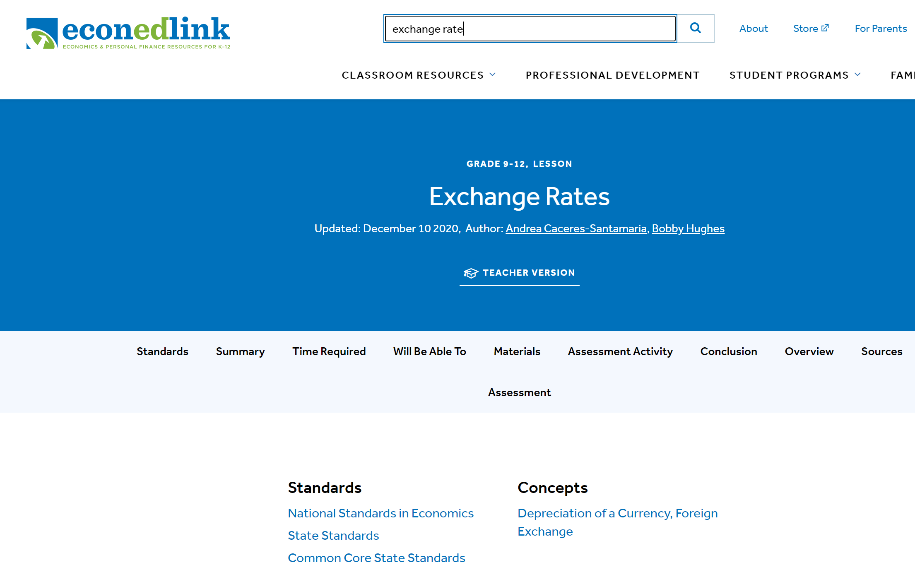
Standards: National to State to Common Core State
(cont’d) Foundation - National Standards and AP Macro Unit 6
Resource: Available at https://www.econedlink.org/resources/exchange-rates/ on May 16, 2021

Slide 9
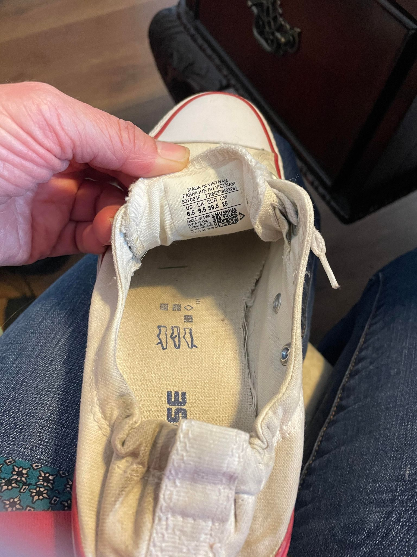
Starter Discussion
Look at your shoes or another article of clothing close by.
List it, and identify the country of origin of its producers.
For example, my Converse sneakers were produced in Vietnam using textiles from Vietnam…

Slide 10
Teaching and Learning Strategies
Shift students from looking at their clothes to applying their economic knowledge and using their skills to describe the how their shoes got on their feet.

Slide 11
Imports/Exports
The Difference
Goods and services produced in other countries but purchased by U.S. consumers or businesses are IMPORTS
Goods and services produced in U.S. but purchased by consumers or businesses in other countries are EXPORTS

Slide 12
Things you should know how to do as you prepare for the “real world”...
1. Explain the relationship between net exports and net capital outflows.
2. Establish links between saving, investment and international flows.
3. Define the exchange rate and identify the one consistent with purchasing-power parity.

Slide 13
Relationship between net exports and net capital outflows
Define net exports of goods and services.
Define net capital flows of assets.
Establish a link between the two.
Evaluate how this link impacts the health and wealth of the macroeconomy.

Slide 14
Recall net exports in the GDP equation. Identify the correct definition of net exports.
Choose which represents net exports in the GDP equation:
The purchase of foreign assets by domestic residents minus the purchase of domestic assets by foreigners.
The purchase of domestic assets by foreigners minus the purchase of foreign assets by domestic residents.
Export of goods and services less imports.
Imports of goods and services less exports.

Slide 15
What are net exports in the GDP equation?
Choose which represents net exports in the GDP equation:
The purchase of foreign assets by domestic residents minus the purchase of domestic assets by foreigners.
The purchase of domestic assets by foreigners minus the purchase of foreign assets by domestic residents.
Exports of goods and services less imports.
Imports goods and services less exports.

Slide 16
Trade Matters - Key Terms
Trade balance is the value of a nation’s exports of goods and services minus the value of its imports, also called net exports.
Trade deficit exists if imports exceed exports.
Trade surplus exists if exports exceed imports.
Balanced trade exists if they are equal.

Slide 17
Circle all factors that can influence net exports of goods and services
The tastes of U.S. consumers for domestic and foreign goods
Relative price levels - the prices of domestic U.S. goods relative to foreign goods
The incomes of U.S. consumers at home relative to abroad
The cost of transporting goods from country to country
Exchange rates (what it takes in U.S. currency to buy foreign currencies)
Trade policies, domestic subsidies, fiscal policy, monetary policy, and bureaucracy

Slide 18
Circle all factors that can influence net exports of goods and services
The tastes of U.S. consumers for domestic and foreign goods
Relative price levels - the prices of domestic U.S. goods relative to foreign goods
The incomes of U.S. consumers at home relative to abroad
The cost of transporting goods from country to country
Exchange rates (what it takes in U.S. currency to buy foreign currencies)
Trade policies, domestic subsidies, fiscal policy, monetary policy, and bureaucracy

Slide 19
Problems & Applications + (increase); - (decrease), NC (no change)

Slide 20
Scenarios
When a British scholar spends a year at Harvard University as a visiting scholar, she spends money buying American goods and services.
So, U.S. exports increase, imports are unchanged, and net exports increase.
When students in Paris flock to see the latest movie from Hollywood, foreigners are buying a U.S. good.
So, U.S. exports increase, imports are unchanged, and net exports increase.
When your uncle buys a new Volvo, an American is buying a foreign good.
So, U.S. exports are unchanged, imports increase, and net exports decrease.
When your aunt buys a novel by a British author from a local bookstore, an American is buying a foreign good.
So, U.S. exports are unchanged, imports increase, and net exports decrease.
When a Canadian citizen shops at a store in northern Vermont to avoid Canadian sales taxes, a foreigner is buying U.S. goods.
So, U.S. exports increase, imports are unchanged, and net exports increase.

Slide 21
Net exports versus net capital flows
New Term
Net capital outflows or NCO (stocks, bonds, real estate, and other assets)
The purchase of foreign assets by domestic U.S. residents minus the purchase of domestic assets by foreigners
Net exports (NX)
Export of goods and services (EX) less imports in the GDP equation
GDP = Y = C + Ig + G + NX

Slide 22
The Flow of Financial Resources
Net Capital Outflow
Net capital flows include:
The purchase of foreign assets by domestic residents minus the purchase of domestic assets by foreigners.
Assets include stocks, bonds, buildings, and more.
Foreign direct investment occurs when a capital investment is owned and operated by a foreign entity.
Foreign portfolio investment involves an investment that is financed with foreign money but operated by domestic residents.

Slide 23
(cont’d) Net Capital Outflow
The net exports of any country are the difference between the value of its exports and the value of its imports.
However, net capital outflow refers to the difference between the purchase of foreign assets by U.S. residents and the purchase of U.S. assets by foreigners.

Slide 24
Net exports versus net capital outflows and inflows (NFFI)
NCO = Purchase of foreign assets by U.S. residents minus the purchase of U.S. assets by foreigners
NX = Ex - Im

Slide 25
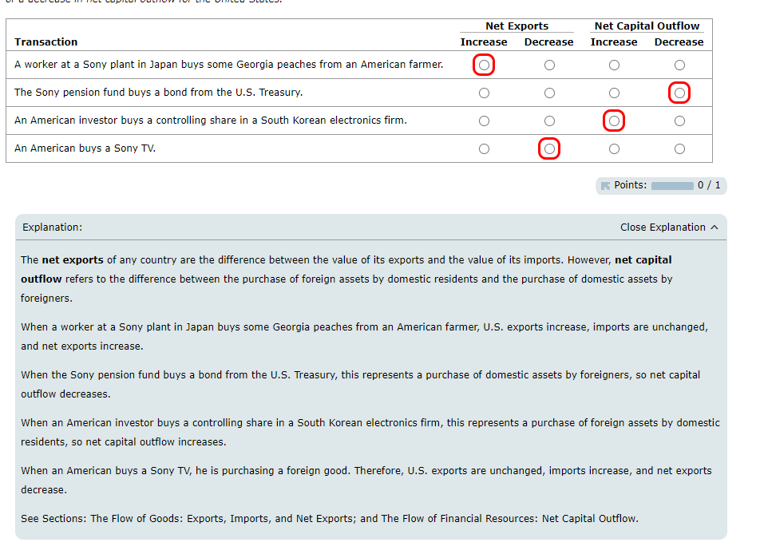

Slide 26
For an economy, net exports must be equal to net capital outflow…
Net capital outflows are influenced by these and other factors:
The real interest rates being paid on foreign assets relative to U.S. assets.
Perceived economic and political risks of holding assets abroad relative to the U.S.
The government policies that affect foreign ownership of foreign assets relative to the U.S. Policies include monetary, fiscal, and trade policies.

Slide 27
Going Beyond Domestic Possibilities
Every international transaction involves exchange.
When a seller country transfers a good or service to a buyer country, the buyer country trades some asset to pay for the good or service.
For example, the U.S. has been operating with a trade deficit
Net capital inflows have made this possible where the purchase of U.S. assets by foreigners has been greater than the purchase of foreign assets.

Slide 28
Link between saving, investment and international flows…
Recall:
Y = GDP = C + Ig + G + NX
Y - C - G = Ig + NX
National Savings = Ig + NX
National Savings = Ig + Net Capital Outflows

Slide 29
Defining the Exchange Rate
The nominal exchange rate is the rate at which a person can trade the currency of one country for the currency of another.
The real exchange rate is the rate at which a person can trade the goods and services of one country for the goods and services of another.

Slide 30
Purchasing- Power Parity
Purchasing-power parity states that a unit of any given currency should be able to buy the same QUANTITY of goods in all countries.
Example: A can of soda costs $1.75 USD in the United States and 42 pesos in Mexico
The peso–dollar exchange rate is:
42 pesos/$1.75 USDs or 24 pesos per $1 USD

Slide 31
Currency Appreciation or Depreciation
A currency is said to appreciate if it can purchase more of another currency.
It is said to depreciate if it purchases less.
Economists focus on real considerations and quantity matters.
Economists make it REAL. They focus on quantities.

Slide 32
Put on your worldly hat

Slide 33
Happy (+) or Unhappy (-) with an appreciation of the U.S. dollar

Slide 34
U.S. “teacher” pension funds holding U.K. government bonds would be unhappy if the U.S. dollar appreciates. U.S. holders of U.K. debt would get fewer dollars for each British pound of interest income. In general, investments in foreign countries are better off if the foreign country's currency appreciates.
U.S. agricultural industries would be unhappy if the U.S. dollar appreciates and other currencies depreciates. U.S. prices are higher. This increases the cost of purchasing U.S. exports and reduces export sales.
American tourists planning a trip to France would be happy if the U.S. dollar appreciates. They get more euros for each U.S. dollar, making their vacation less expensive.
An American firm planning to expand its operation overseas would be happy if the U.S. dollar appreciates. It would get more units of the foreign currency for each U.S. dollar. It, therefore, can expand its operation overseas at lower costs.

Slide 35
More things you should know how to do as you prepare for the “real world”...
4. Describe the market for foreign-currency exchange. 5. Contrast a country's nominal exchange rate with its real exchange rate.
6. Determine the implications of purchasing-power parity on exchange rates. 7. Investigate the influences of policies on exchange rates.

Slide 36
Reminder: Important Relationship
The net exports of any country are the difference between the value of its exports and the value of its imports.
However, net capital outflow refers to the difference between the purchase of foreign assets by U.S. residents and the purchase of U.S. assets by foreigners.

Slide 37
Net capital outflow equals net exports…
Imbalances in the net capital outflow (NCO) are associated with imbalances in the trade balance (or net exports, NX).
Each exchange that affects the net capital outflow, also affects net exports in the same amount.
For U.S. is running a trade deficit, it does so by financing the net purchase of goods and services by selling assets to nonresidents.

Slide 38
Countries that Run Trade Deficits
Countries that run trade deficits must attract more foreign capital in their countries than what goes out of their countries in assets
Deficit-spending countries fund the deficits through net capital inflows

Slide 39
Exchange Rates – Nominal vs Real
Nominal rate of exchange is the rate at which a person can trade the currency of one country for another. It determines number of units of foreign currency one currency can purchase
Real rate of exchanges adjusts for price differentials. Real rates show how much quantity can be acquired in different countries using their currencies.

Slide 40
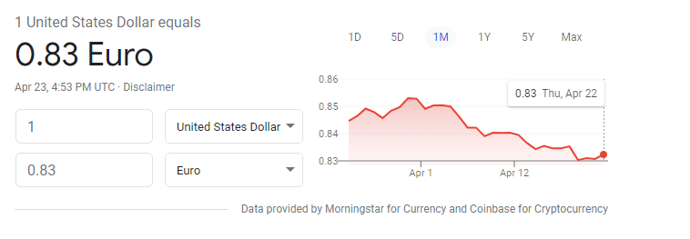
Nominal Rate - Actual Exchange Rate
The actual exchange rate for the USD or the foreign currency cost (€) of the USD.

Slide 41
Nominal Rate to Real Exchange Rate (RER)
The RER between two currencies is the product of the nominal exchange rate (the dollar cost of a euro) AND the ratio of prices between the two countries (CPI_{US}/CPI_{EU})
The core equation is RER=eP*/P_{US}, where, in our example,
e is the nominal dollar-euro exchange rate,
P* is the average price of a good in the euro area, and
P_{US} is the average price of the good in the United States.

Slide 42
Purchasing- Power Parity
This “law of one price” states the price for good should be the same at every country or regional trading location.
For example, the price of a Big Mac should be the same whether paid in USDs or another country’s currency

Slide 43
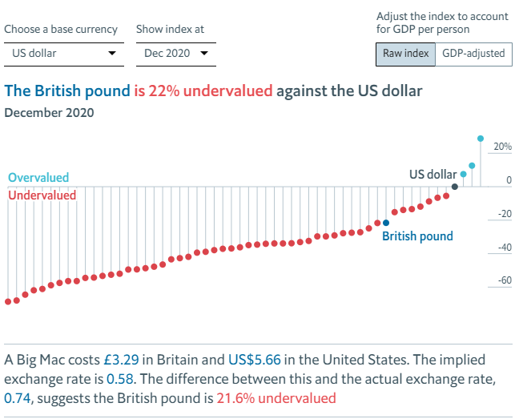
One Big Mac Is Purchased in Two Countries with the actual or nominal rate of US$1 = £0.74. Let’s make it real...
RER=eP*/P_{US}

Slide 44
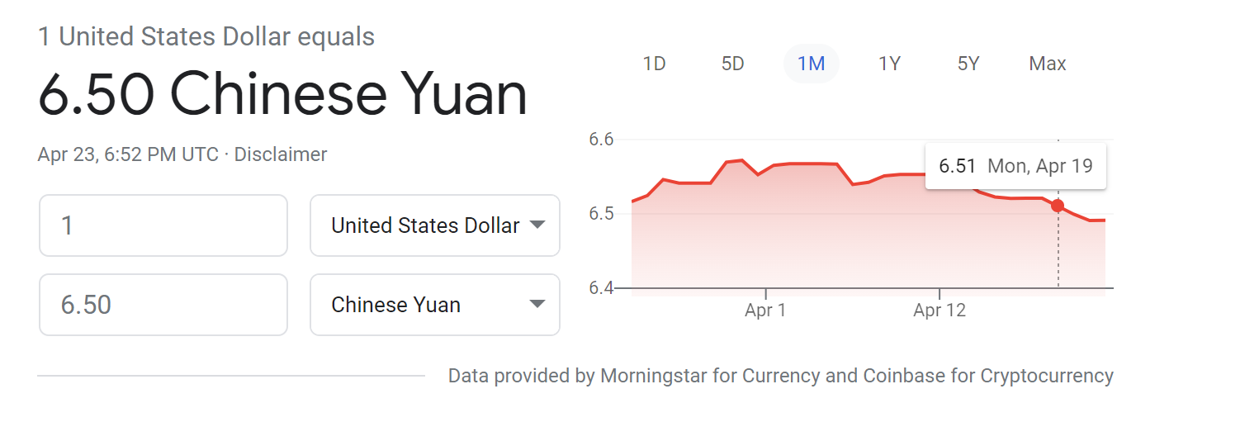
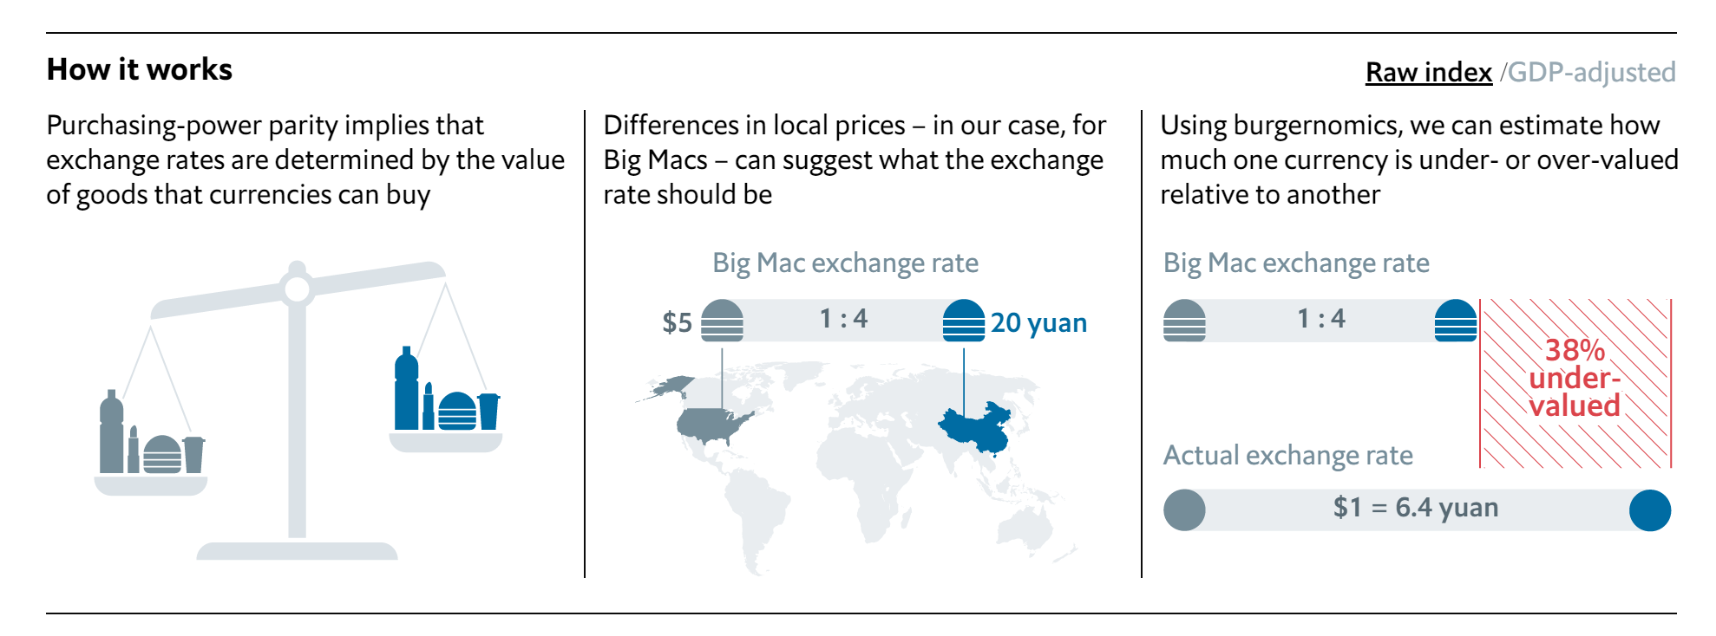
Nominal exchange rate: the dollar-yuan cost
Turning to China...
$1 USD = 6.5 yuan
“In Dec 2020, a Big Mac cost 22.40 yuan in China and US$5.66 in the United States. The implied exchange rate is 3.96. The difference between this and the actual exchange rate, 6.48, suggests the Chinese yuan is 38.9% undervalued.”
The Economist

Slide 45
Implications of the PPP
Purchasing-power parity means that the nominal exchange rate between the currencies of two countries will depend on the price levels in those countries.
If a dollar buys the same amount of goods and services in the United States (where prices are measured in dollars) as it does in China (where prices are measured in yuan), then the nominal exchange rate (the number of yuan per dollar) must reflect the price variances in the two countries.

Slide 46
PPP & Price Variances Connected to Policy Adjustments
Because the nominal exchange rate depends on the price levels, it must also depend on the money supply and money demand in each country.
If the central bank increases the supply of money in a country and raises the price level, it also causes the country’s currency to depreciate relative to other currencies in the world. The demand for the U.S. dollar decreases.
When a central bank prints large quantities of money, that money loses value both in terms of the goods and services it can buy and in terms of the amount of other currencies it can buy.

Slide 47
PPP & Price Variances Connected to Policy Adjustments
Because the nominal exchange rate depends on the price levels, it is also impacted by fiscal policy in each country.
Similarly, if an expansionary fiscal policy raises prices through increased government spending and/or by reducing taxes while the macroeconomy operates at or close to its potential level, a country’s currency will depreciate as price levels rise.
Finally, if a restrictive trade policy raises price levels, a country’s currency decreases.

Slide 48
PPP
Purchasing-power parity does tell us about exchange rates.
Large and persistent movements in nominal exchange rates typically reflect changes in price the price level at home relative to that abroad.
Trade restrictions, domestic subsidies, and other policy differentials are not directly accounted for in the PPP. There are currency repercussions associated with policy changes.

Slide 49
Formative and Summative Assessments
AP Macroeconomics Unit 6
EconEdLink
Econ LowDown

Slide 50
CEE Affiliates
https://www.councilforeconed.org/resources/local-affiliates/

Slide 51
Thank You to Our Sponsors!

