Slide 1
The GameStop Short Squeeze: Navigating A Complex Current Event With Your Students Presented by Andrew Menfi 02/18/2021 amenfi3@gmail.com

Slide 2
EconEdLink Membership
You can now access CEE’s professional development webinars directly on EconEdLink.org! To receive these new professional development benefits, become an EconEdLink member. As a member, you will now be able to:
Automatically receive a professional development certificate via e-mail within 24 hours after viewing any webinar for a minimum of 45 minutes
Register for upcoming webinars with a simple one-click process
Easily download presentations, lesson plan materials and activities for each webinar
Search and view all webinars at your convenience
Save webinars to your EconEdLink dashboard for easy access to the event
You may access our new Professional Development page here

Slide 3
Professional Development Certificate
To earn your professional development certificate for this webinar, you must:
Watch a minimum of 45-minutes and you will automatically receive a professional development certificate via e-mail within 24 hours.
Accessing resources:
You can now easily download presentations, lesson plan materials, and activities for each webinar from EconEdLink.org/professional-development/

Slide 4
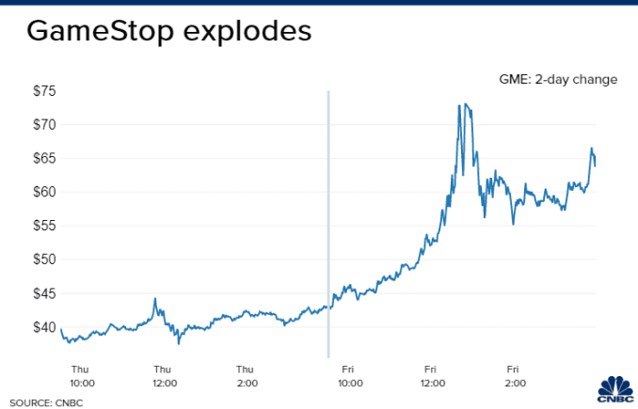
Objective
How to use the “GameStop Short Squeeze” in our classes

Slide 5
Agenda
What is the GameStop short squeeze?
How do we explain the GameStop short squeeze?
What activities can we do with students to engage with this current event?

Slide 6
National Standards
STANDARD 8: ROLL OF PRICES
STANDARD 10: INSTITUTIONS
STANDARD 12: INTEREST RATES
STANDARD 16: ROLL OF GOVERNMENT & MARKET FAILURE

Slide 7
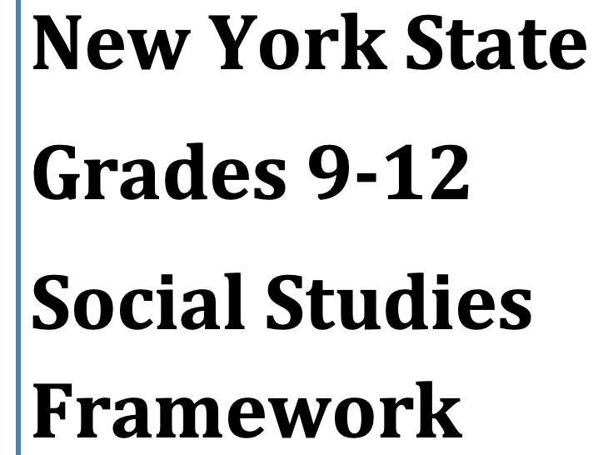
State Standards
New York:
12.E1 INDIVIDUAL RESPONSIBILITY AND THE ECONOMY

Slide 8
Part 1: What is the GameStop Stock Short Squeeze?

Slide 9
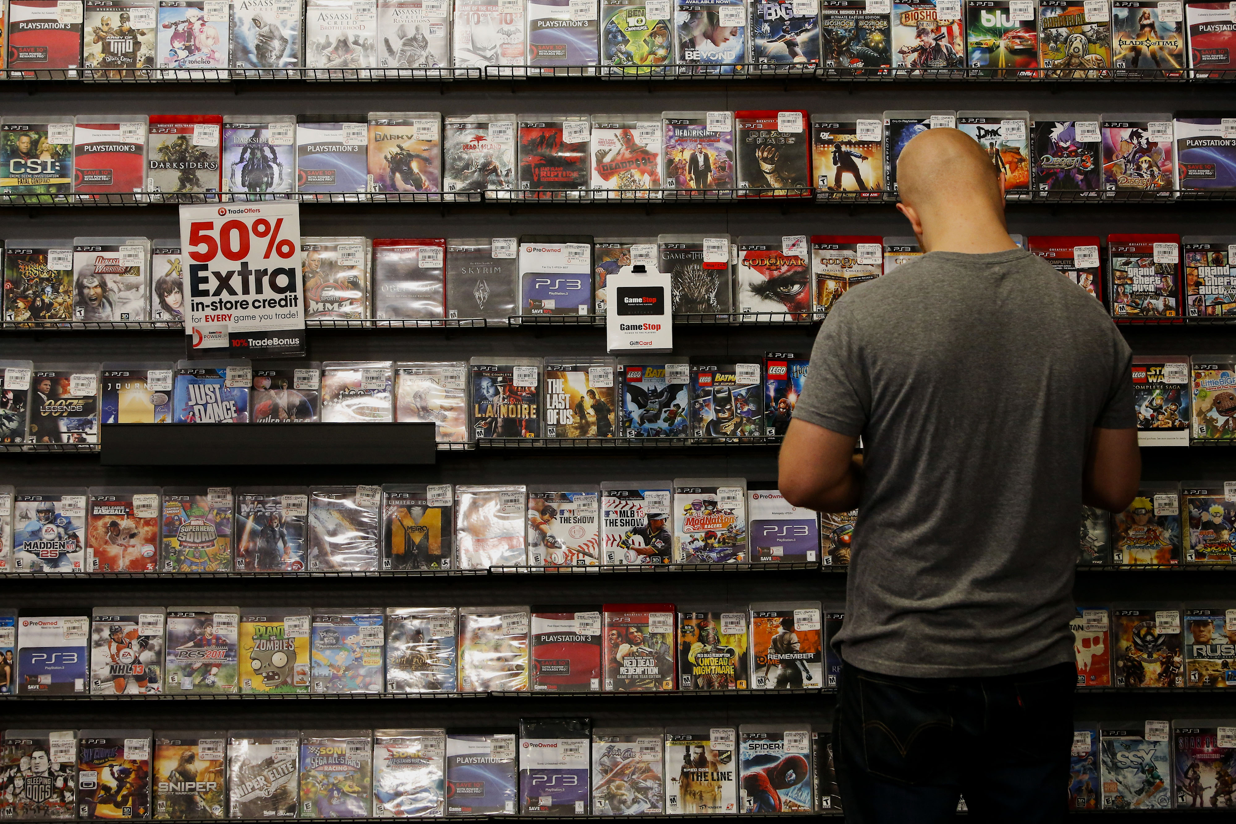
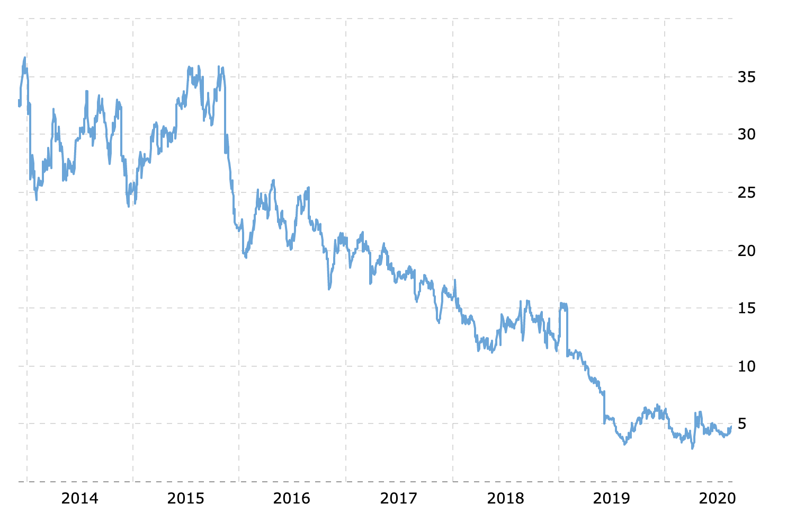
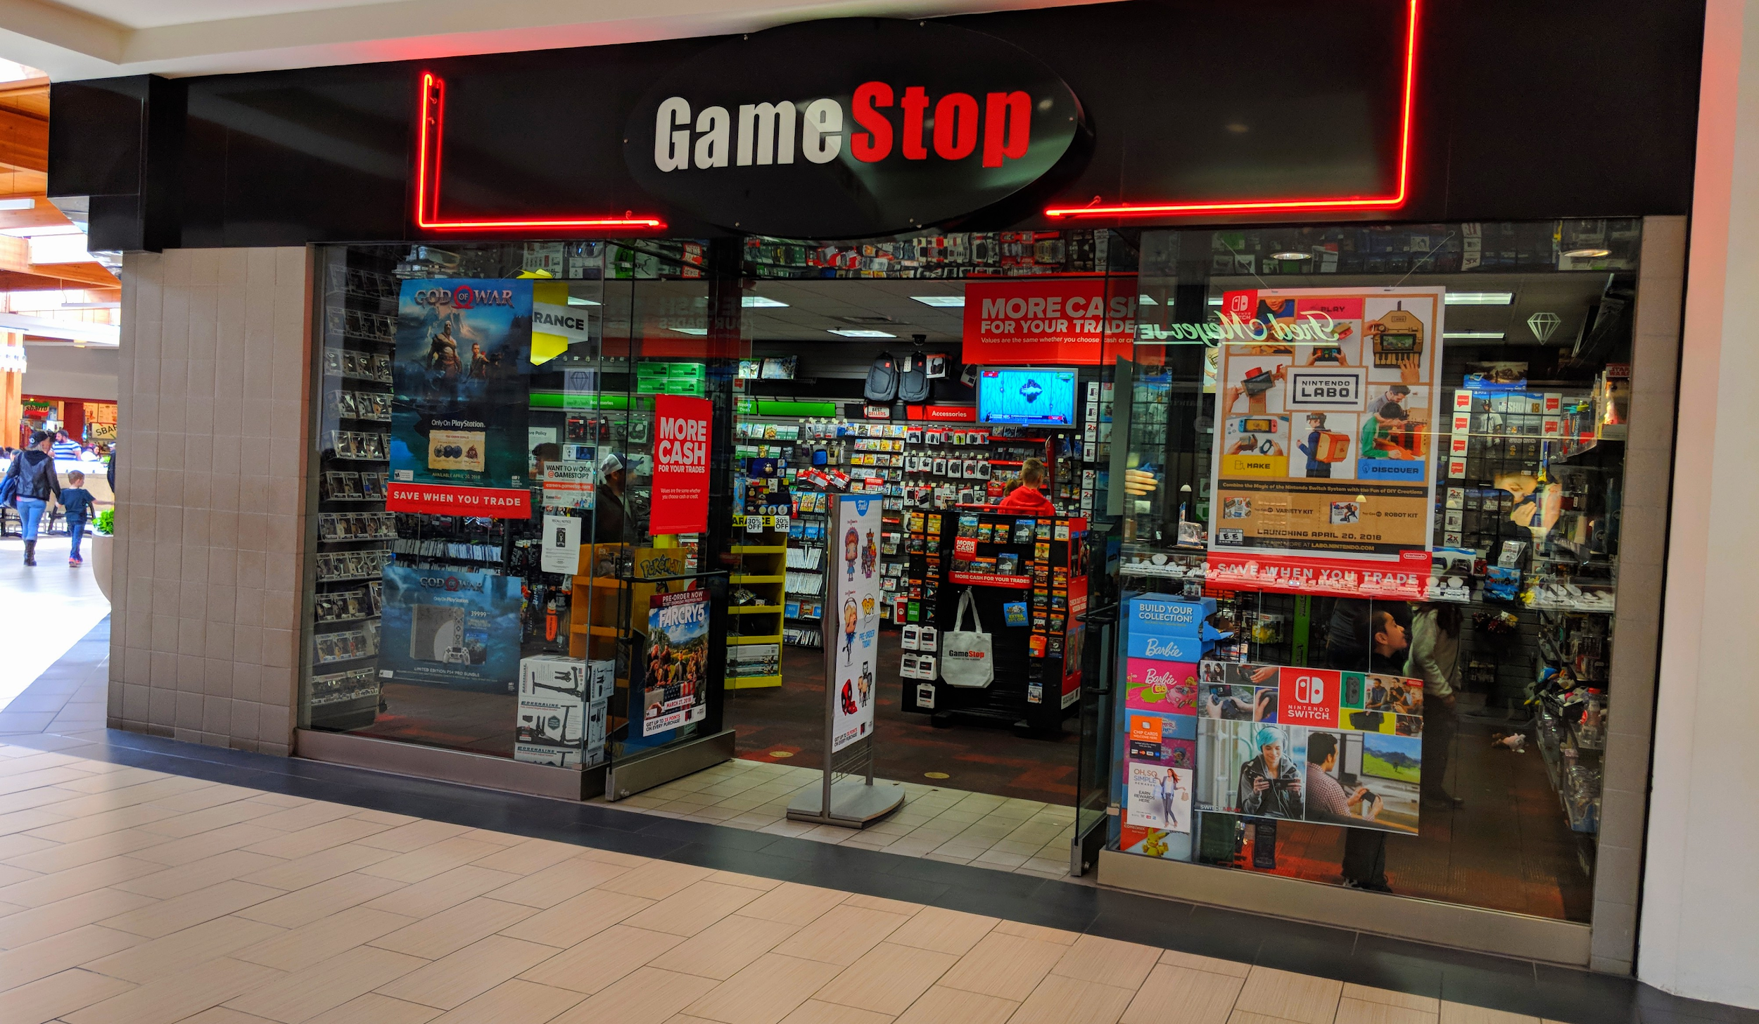
GameStop [GME]
Difficulties
$32.80 → $2.57

Slide 10
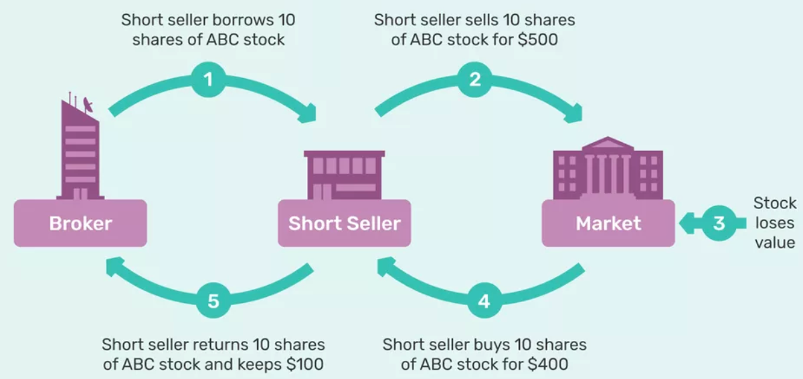
Short Selling
Borrow → Sell →Buy back
Bet on a share to fall

Slide 11
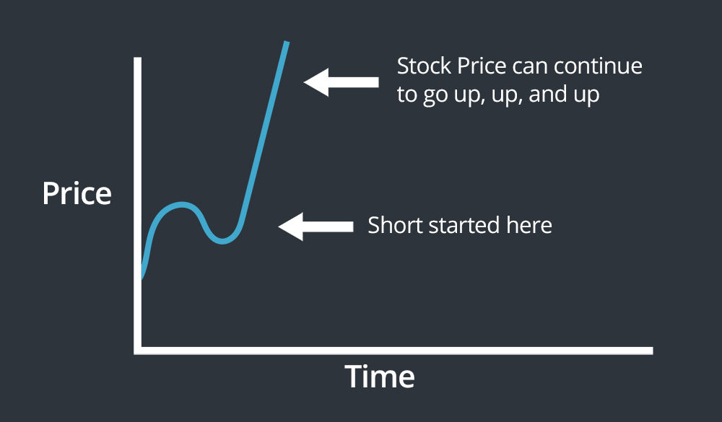
Short Selling [Dangers]
Interest Payments
Infinite Risk

Slide 12
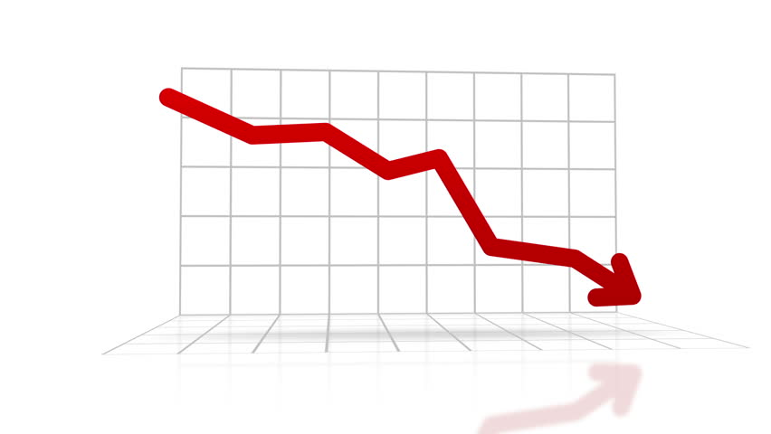
Short Selling & GameStop [GME]
Melvin Capital

Slide 13
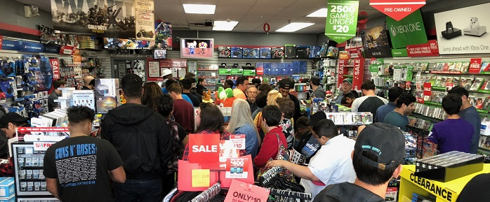
GameStop: Promising Investment?
Ryan Cohen [CHEWY]
Online Transition
Holiday Cash Infusion

Slide 14
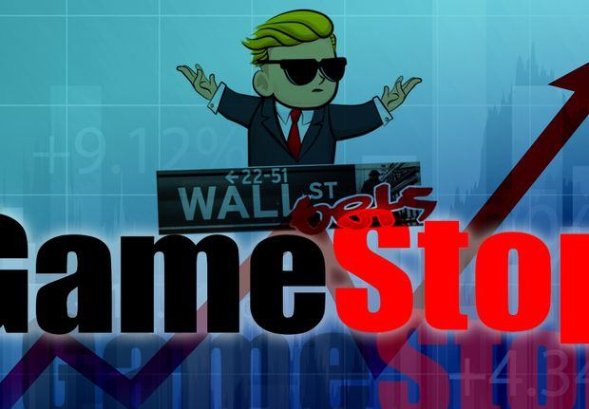
Reddit: [r/wallstreetbets]
High Risk Transactions
Investment Memes
GameStop: Undervalued

Slide 15
The Price Manipulation Duel
Reddit: r/wallstreetbets
Buying shares [Price ↑]
Investment Firms
Shorting more shares [Price ↓]

Slide 16
The Short Squeeze
140% GameStop shares sold short
Eventually they will have to buy back the shares they borrowed...at any price

Slide 17
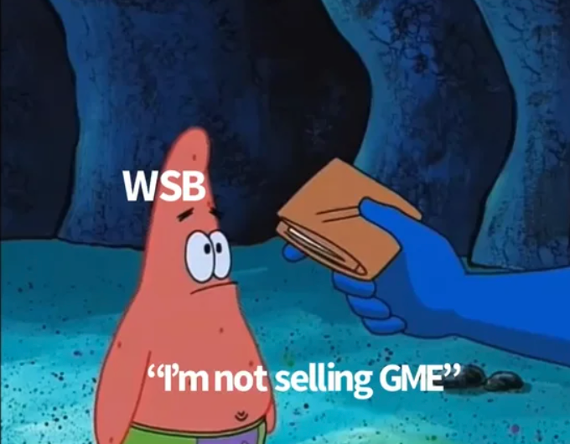
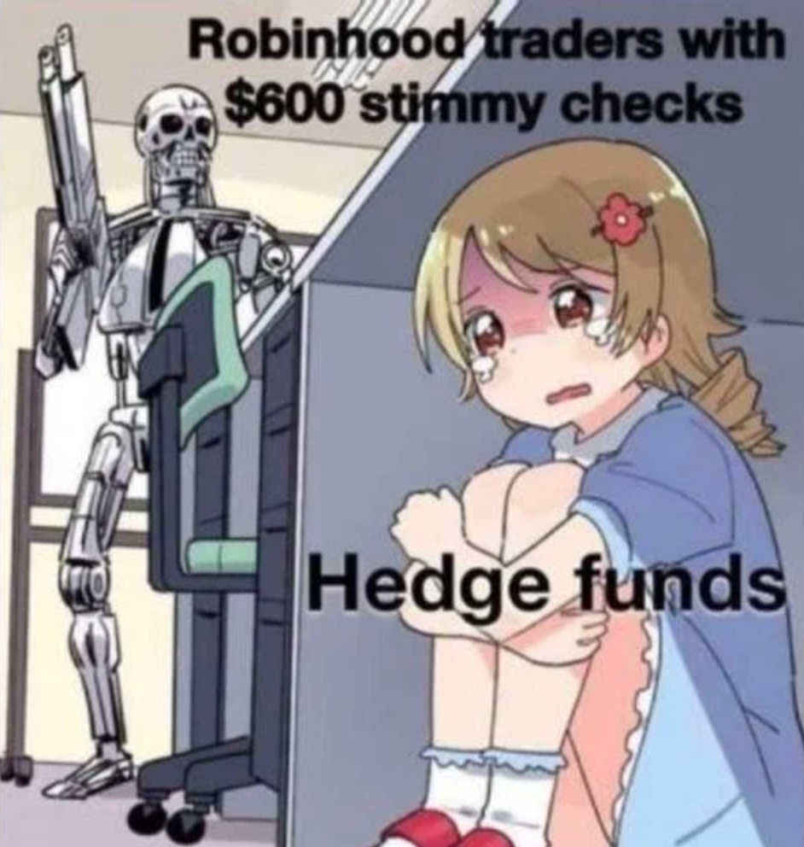
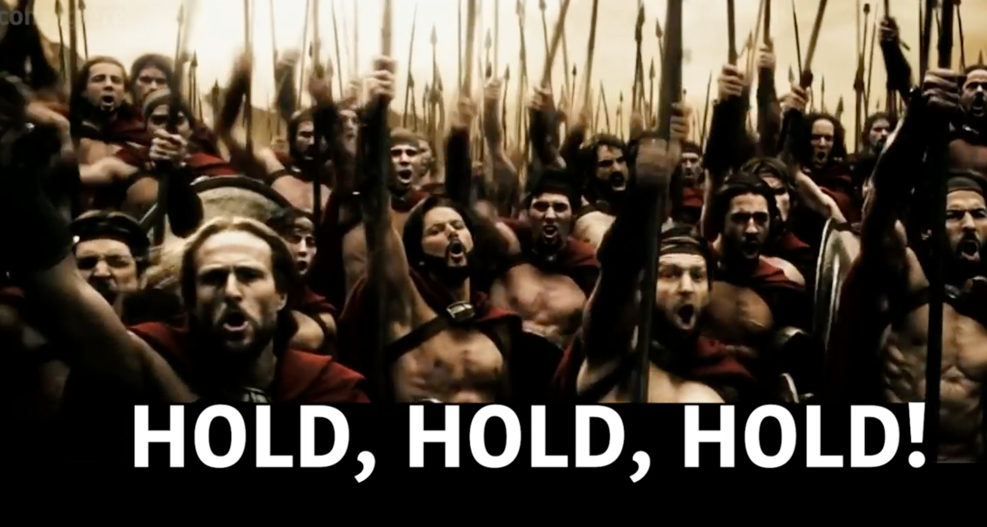
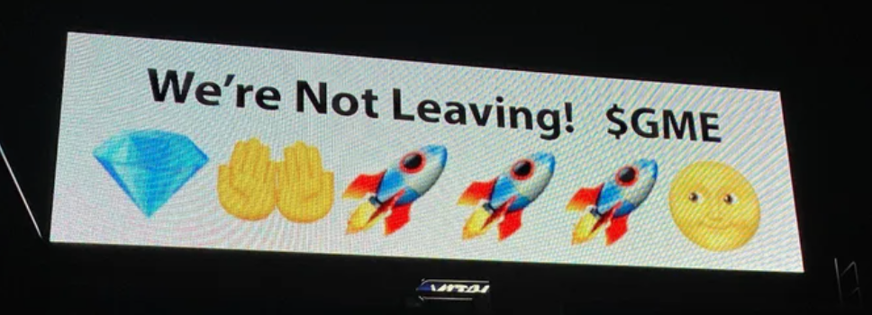
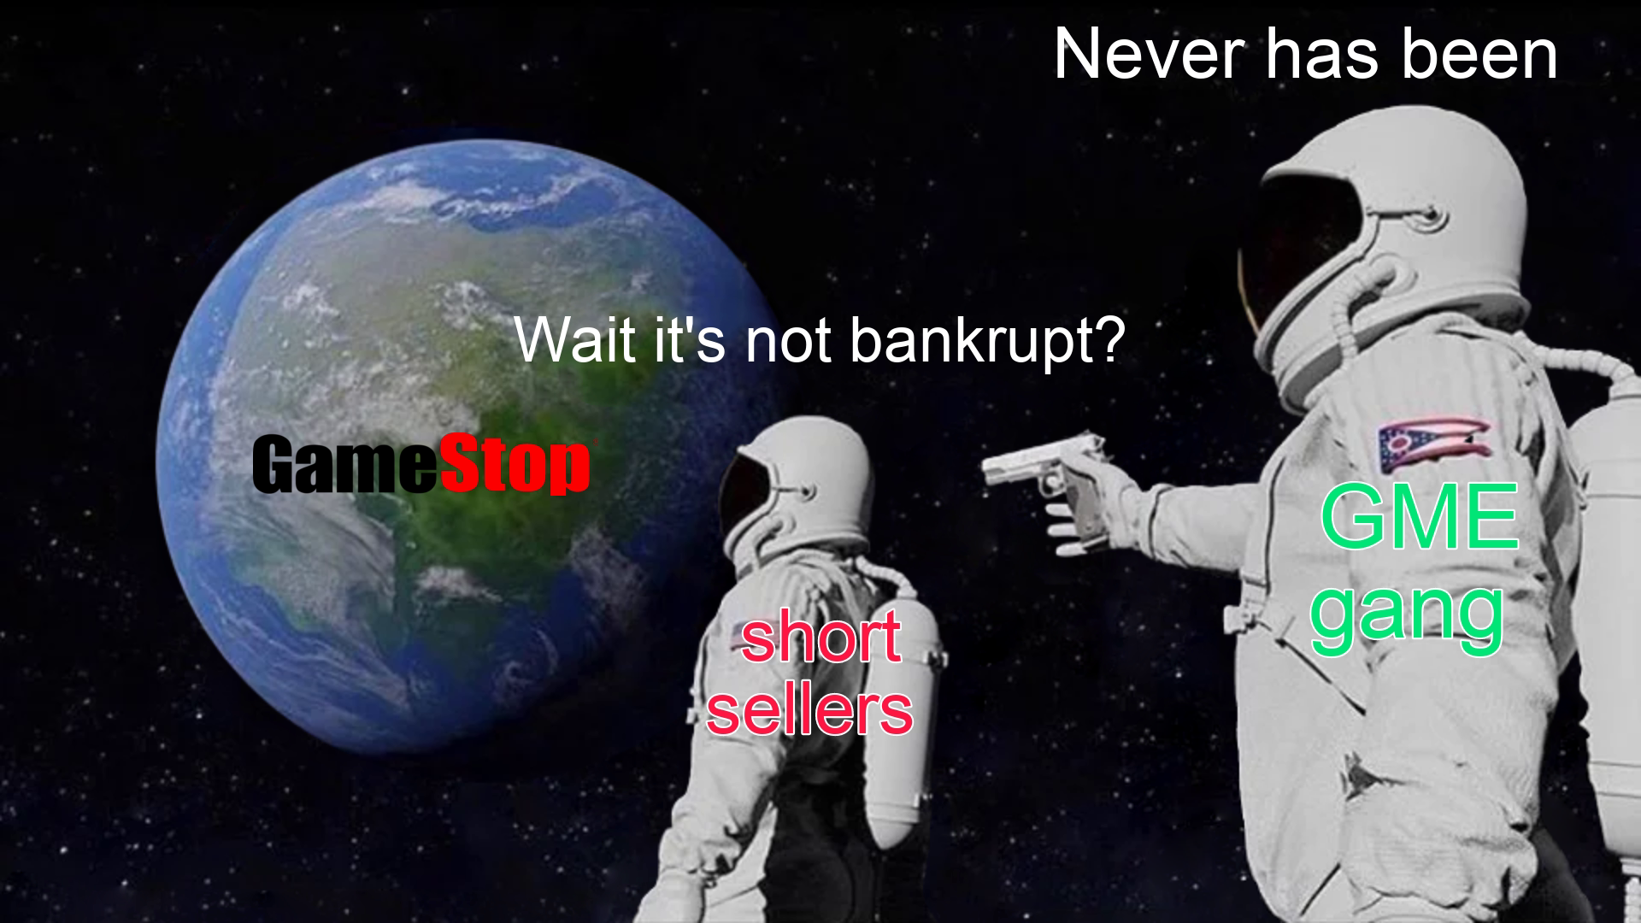
The Short Squeeze [The Memes] Factory]
Notes:
S

Slide 18
The Short Squeeze
The Cycle
Independent traders buy MORE GameStop
Short Sellers buy back the stock they borrowed
Price of GameStop goes up

Slide 19
The Short Squeeze
The Cycle
Independent traders buy MORE GameStop
Short Sellers buy back the stock they borrowed
Price of GameStop goes up

Slide 20
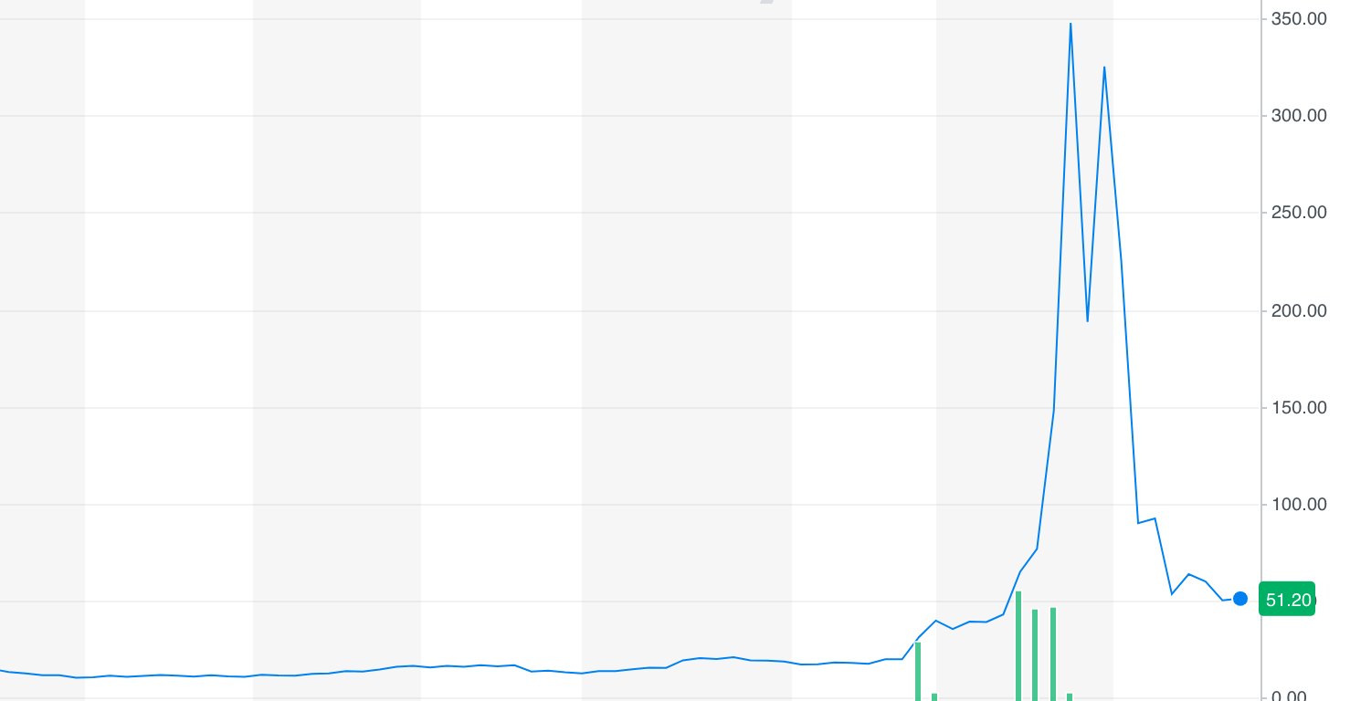
The Short Squeeze [Result]
$2.57 → $483.00 [19,000% Increase]

Slide 21
Result [Short Sellers]
$70 Billion Losses [5,000+ firms]
Melvin Capital [30% Loss]
Notes:
one of the top 10 biggest losses in a single trade

Slide 22
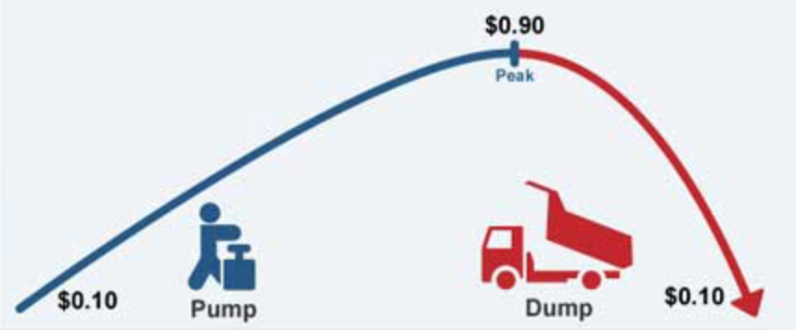
Result [Shareholders]
Gains & Losses
Notes:
one of the top 10 biggest losses in a single trade

Slide 23
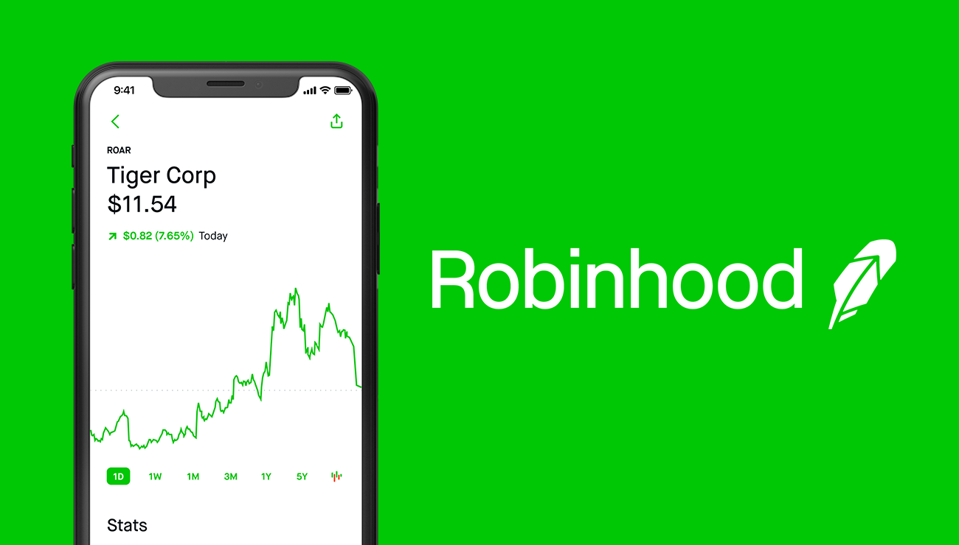
Controversies
Robinhood [Halted Purchasing]
X
Notes:
Did not have the collateral to back all of these risky volatile trades

Slide 24
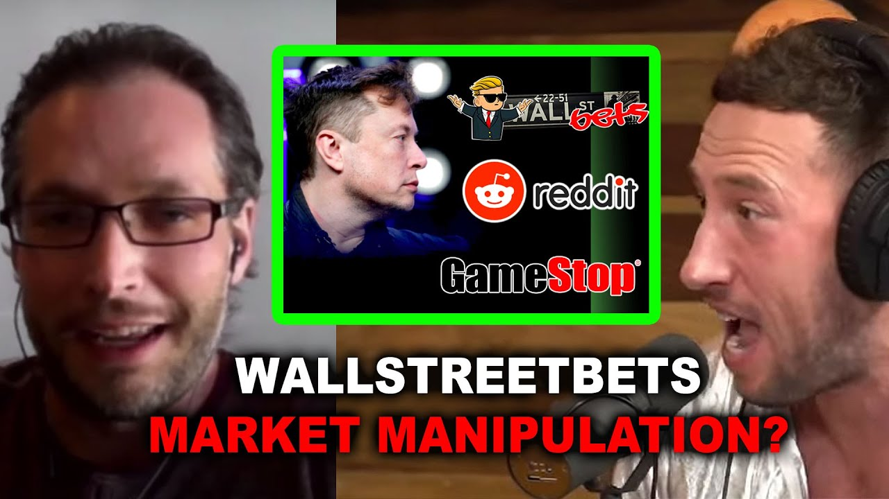
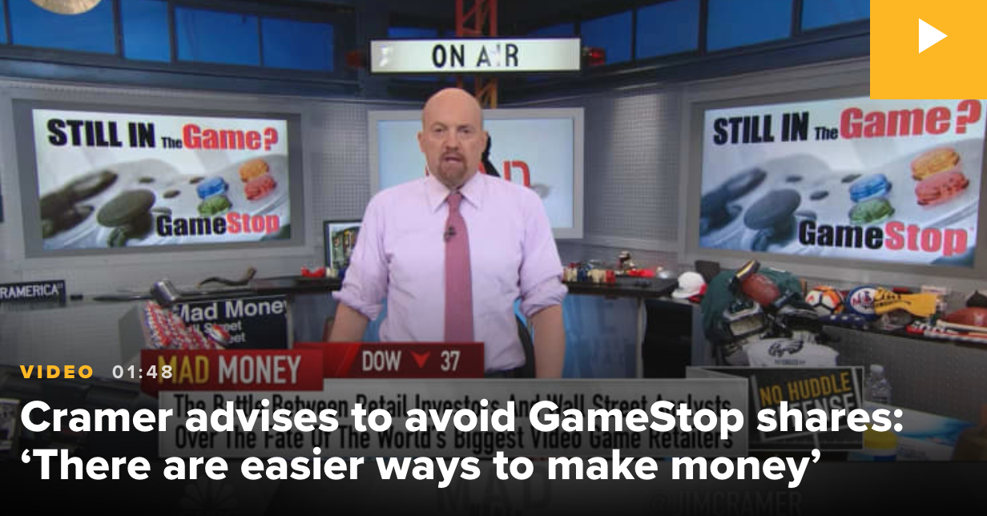
Narrative #1
Independent Traders
Reckless / Market Manipulators

Slide 25
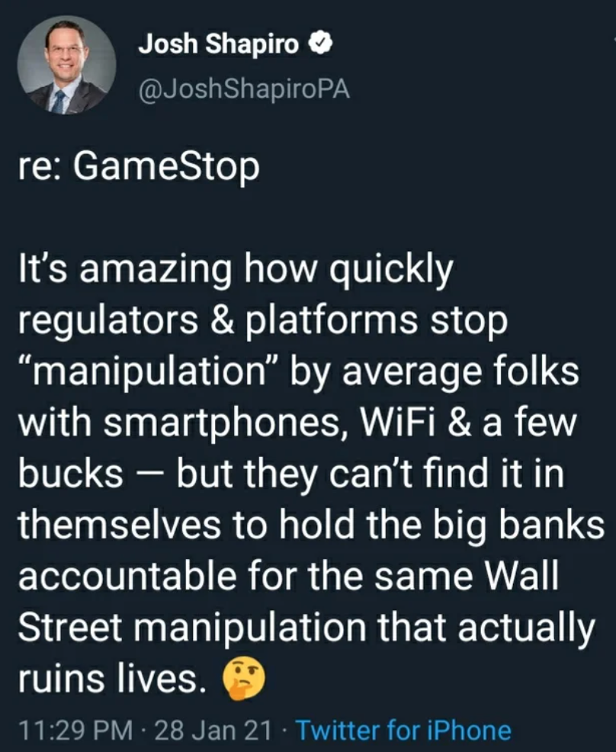
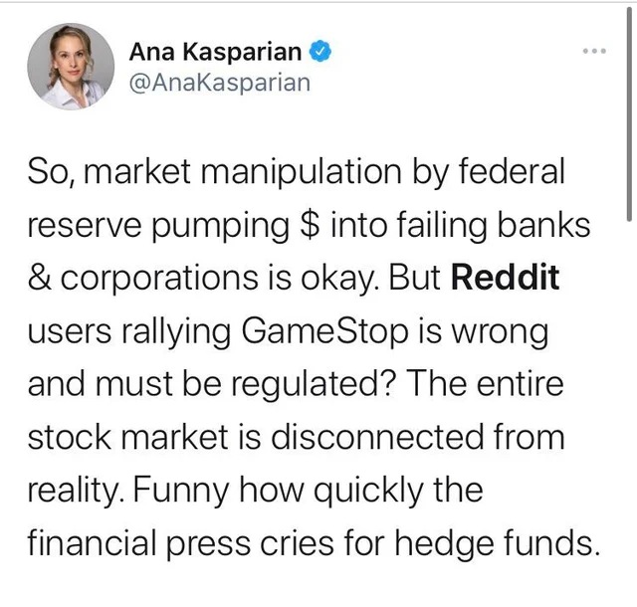
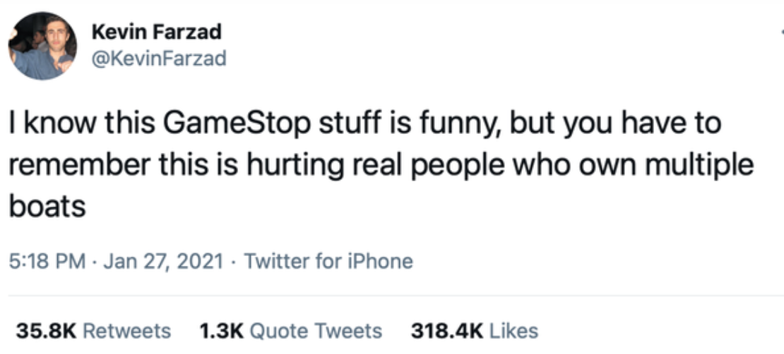
Narrative #2
Investment Firms
Hypocrites / Greedy

Slide 26
Questions?

Slide 27
Part 2: How Do We Explain The GameStop Short Squeeze?

Slide 28
Less Is More

Slide 29
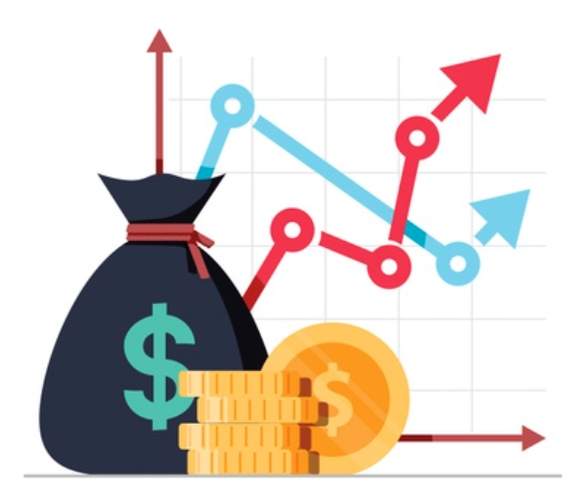
Be Cautious With Outside Sources

Slide 30
Video Resource
Vlogbrothers [Hank Green]
“The GameStop Short Squeeze In 4 Minutes”

Slide 31
Part 3: What Activities Can We Do With Students About The GameStop Short Squeeze?

Slide 32
Trial By Jury
Wallstreetbets
Investment firms
Robinhood

Slide 33
Debate/Discussion/Argument Writing #1
Is short selling good or bad for society?

Slide 34
Debate/Discussion/Argument Writing #2
Are the independent traders of r/wallstreetbets heroes or villains? Both? Neither?

Slide 35
Debate/Discussion/Argument Writing #3
Was this an intelligent investment?
At the time [No hindsight]

Slide 36
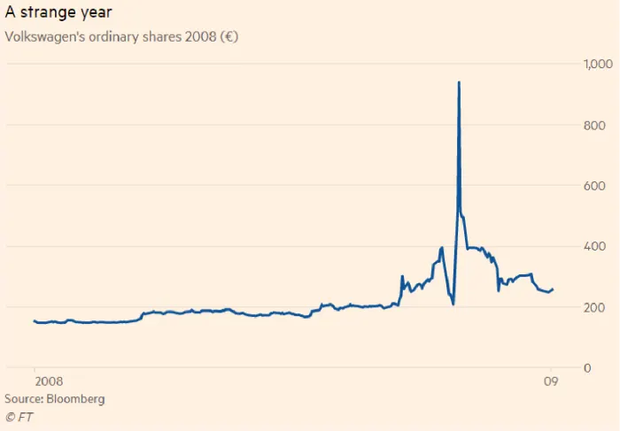
Compare/ Contrast Lesson
Volkswagen

Slide 37
Meme Analysis Lesson
Which was the most effective?
Explain the joke

Slide 38
Webquest
Questions on stock prices/dates/etc.

Slide 39
Questions?

Slide 40
CEE Affiliates
https://www.councilforeconed.org/resources/local-affiliates/

Slide 41
Thank You to Our Sponsors!

Slide 42
We’ve gone Virtual!
Teach Economics?
Your students may have what it takes to compete in the nation’s only high school economics competition!
Why Play?
• Fun team learning experience
• Great for college applications
• No other challenge like this
• Online participation makes access easy
• Chance for cash prizes
How it Works
Teams register
Teachers enroll team(s) of 3- 4 high school students from the same school. Multiple teams allowed.
Teams compete within their state
Compete to win your state competition for a chance to advance to the National Semi-Finals.
National Semi-Finals: May 3-20, 2021
Teams answer multiple-choice questions on macroeconomics, microeconomics, and international & current events.
National Finals: May 22-24, 2021
Teams analyze an economic issue and present their solution. Top teams engage in the Finals Quiz Bowl where they face-off answering questions to claim the National Title.
Two divisions based on experience level
David Ricardo for first-time competitors who have taken no more than one economics course.
Adam Smith for returning competitors, AP, International Baccalaureate, and honors students.
Register Today at NationalEconomicsChallenge.org

Slide 43
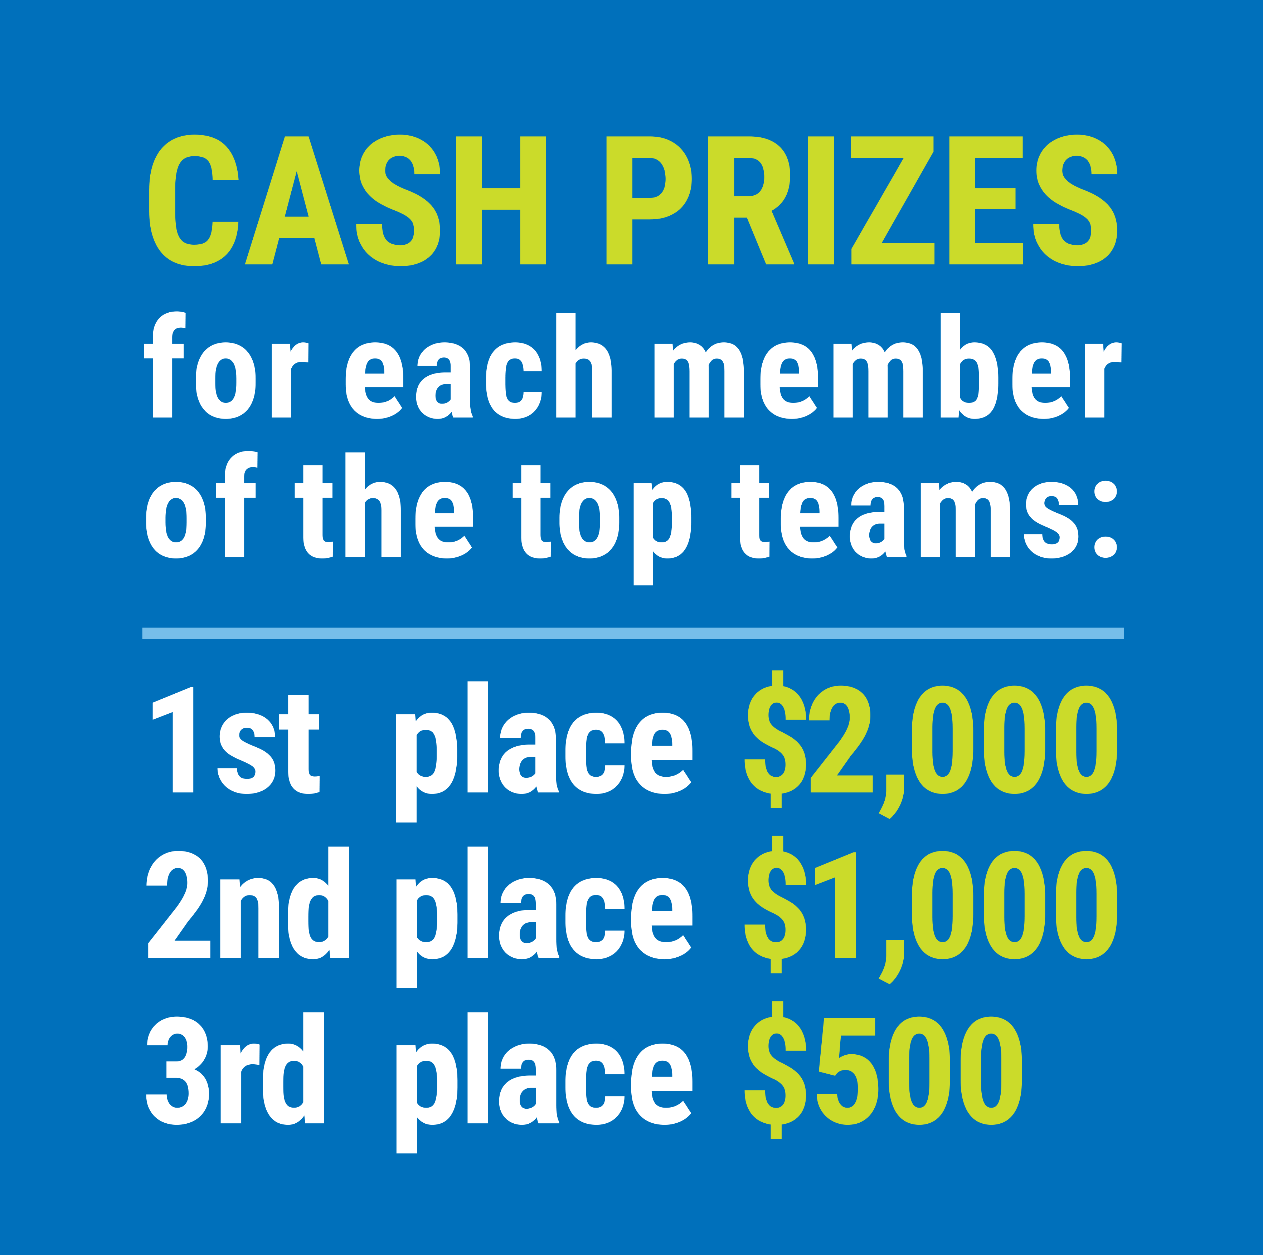
FIND YOUR LOCAL COMPETITION AND REGISTER TODAY!
The National Personal Finance Challenge is a competition that provides high school students with an exciting and motivating opportunity to build, apply, and demonstrate their knowledge of money management.
Through online exams and a personal finance simulation, teams showcase their expertise in earning income, buying goods and services, saving, using credit, investing, as well as protecting and insuring.
Teams of up to four students, with one teacher/coach, can qualify to represent their state at the National Personal Finance Challenge by winning their local competition.
NATIONALS
Semi-Finals: First round elimination via online multiple-choice questions.
Finals: Case study round virtually co-hosted by the Cleveland Fed on June 3.
personalfinancechallenge.org

Slide 44
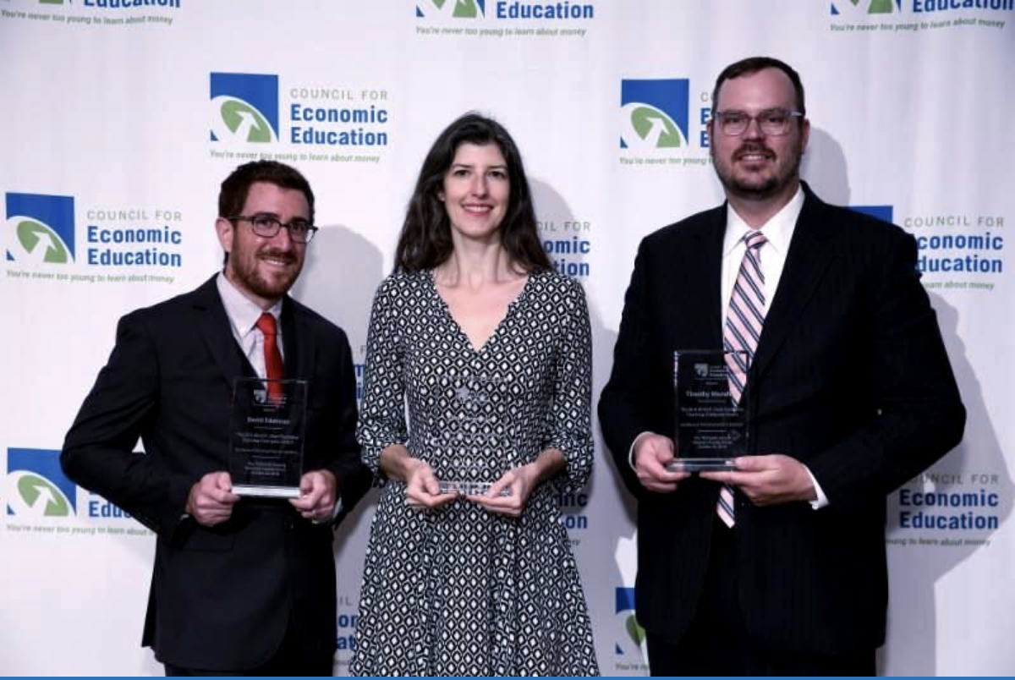
The 2021 Sloan Teaching Champion Award
Winners receive:
A cash award of $5,000
A cash award of $2,500 for their school to support economic education
Recognition at our annual Visionary Awards convening.
This award promotes economic education by honoring three outstanding teachers who incorporate exemplary teaching techniques that improve their students’ economic understanding in and out of the classroom.
This award is open to New York metropolitan area high school teachers of all subjects, not just teachers of economics. Applicants must demonstrate how they integrate economics into their teaching.
Sound like you or someone you know?
Applicants must teach in one of the
Twelve New York state counties (New York, Kings, Bronx, Richmond, Queens, Nassau, Suffolk, Westchester, Putnam, Rockland, Orange and Dutchess)
Eight New Jersey counties (Bergen, Passaic, Essex, Hudson, Middlesex, Union, Morris, Monmouth), or the
Two Connecticut counties (Fairfield and New Haven)
Application will be launched on Friday February 19th 2021
You can access the application here.
CONTACT
Please feel free to e-mail us at rrivera@councilforeconed.org
with any questions you have.

