Slide 1
Weighing the benefits and costs of a stimulus

Slide 2
Concepts to know: Debt vs. Deficit
Federal budget deficit – measured typically over the course of one year, a deficit occurs when the federal government’s outlays (payments) are larger than its receipts (funds paid to government).
Implication: The U.S. must borrow to fund the deficit. The United States Treasury borrows the funds by selling U.S. Treasury Bills, Notes, and Bonds. The Treasury must pay interest on these securities.
National debt – is the total amount owed by the United States government due to the accumulation of deficits over many years.
Implication: Budget deficits increase the debt as more is owed. Budget surpluses decrease the debt as funds are repaid.

Slide 3
Concepts to know: Interest Rate
Interest rate – is the amount a borrower pays to the lender for a loan. The interest rate is expressed as a percentage of the amount owed.

Slide 4
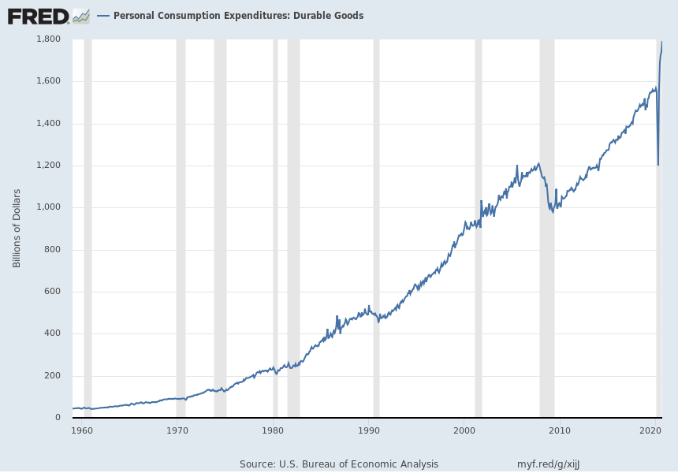
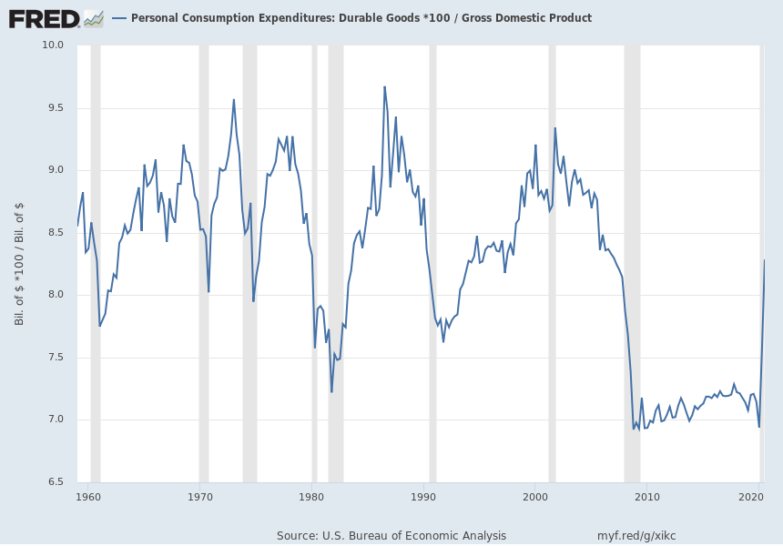
Concepts to know: As Percentage of GDP
Personal Consumption Expenditures Since 1960
Personal Consumption Expenditures as a Percentage of GDP Since 1960

Slide 5
Concepts to know
Personal Consumption Expenditures (Durables) Since 1960
Personal Consumption Expenditures as a Percentage of GDP Since 1960
Will generally increase because of:
Inflation (when expressed in dollars)
Growth in the economy
Looking at this graph does not tell very much.
Is not sensitive to inflation.
By dividing by GDP, the statistic shows how big something is relative to the economy size.

Slide 6
Event to know: CARES Act
Enacted March 27, 2020
Included (only parts of the entire law):
Cash payment to individuals
Federal Pandemic Unemployment Compensation increases unemployment payments
Paycheck Protection Program for small businesses to take loans that may be forgiven if the business retains its employees
Help for large businesses like the airlines
Aid for state and local governments
Aid to hospitals

Slide 7
Goals
What are the immediate benefits of an expansionary fiscal policy or fiscal stimulus during a recession like the COVID-19 recession?
How large or important are these benefits?
What are the long-run costs of an expansionary fiscal policy or fiscal stimulus during a recession like the COVID-19 recession?
How large or important are these costs?
Is a fiscal stimulus a useful tool to counteract the effects of the current Covid-19 recession?

Slide 8
Focus Groups and Task Groups

Slide 9
Focus Group Questions
Does the economy currently need more stimulus?
Are households, businesses, and state and local governments stressed and in need of help?
Based on historical levels and future projections, are high interest rates currently a concern?
Based on current and historical measures, are interest payments currently a concern to the overall federal budget?
Did the CARES Act expense have a big impact on the budget deficit and national debt?
Does a one-time intervention such as the CARES Act have a continued effect on the long-term deficit or debt? What government programs are likely to contribute to increased deficits and federal debt in the future?

Slide 10
Final Question for Task Group
First, each member of the task group will relay the main question posed to their focus group and discuss the focus group’s consensus.
Second, after six focus questions have been discussed, the task group should discuss the final question:
After weighing the immediate benefits of a stimulus against stimulus’ long-term costs, is a fiscal stimulus a useful tool to counteract the effects of the current Covid-19 recession?

Slide 11
Stimulus?
Benefits
Moves economy towards potential GDP faster leading to a faster recovery of economic growth
Reduces unemployment
Helps reduce stress on households
Helps small and large businesses recover
Helps local and state governments provide services
Costs
Increases national debt
Increases interest paid in future by federal government
May hinder business borrowing for investment if interest rates rise

Slide 12
Questions to ask about the long-term costs of a stimulus on the debt
Do interest rates rise significantly to high levels because of the stimulus?
Are interest payments historically large relative to GDP?
What contributes to a rise in costs leading to a larger national debt?
One-time money stimulus programs
Ongoing programs
Can taxes be raised in the future to reduce the debt?

Slide 13
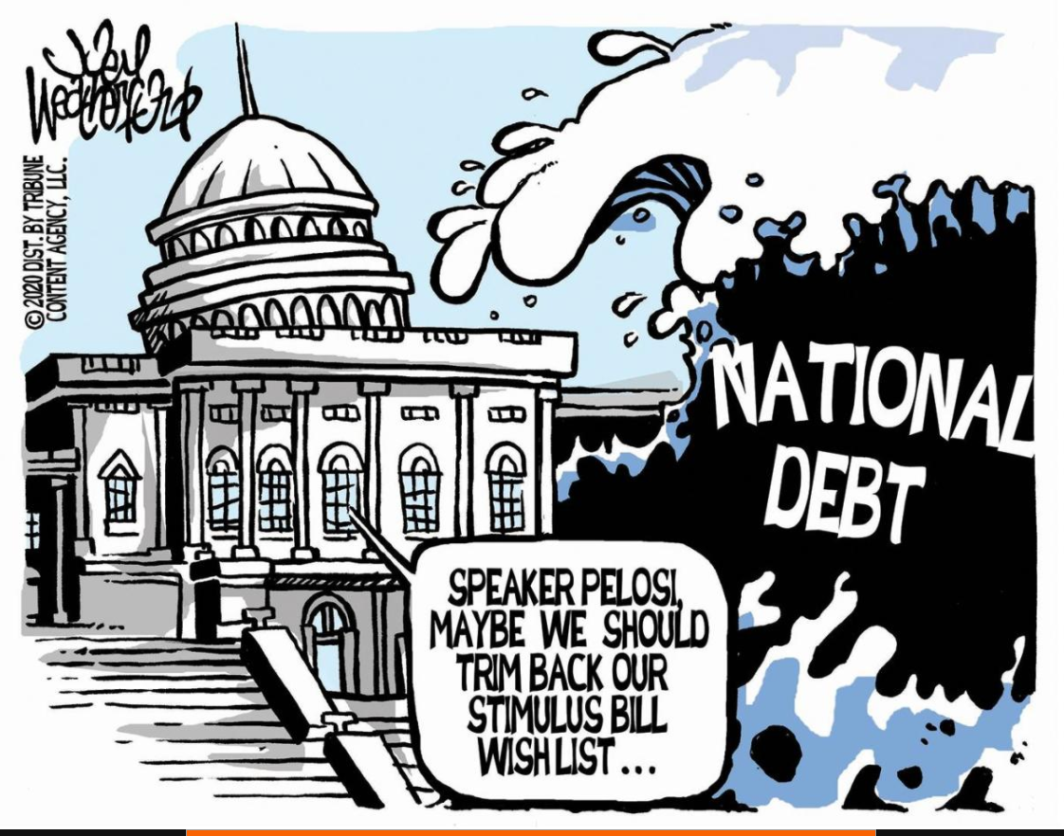
The Debate…
https://www.marketwatch.com/story/ted-cruz-is-asked-why-national-debt-is-paramount-to-republicans-only-when-a-democrat-is-in-the-white-house-11603831170 https://www.usnews.com/cartoons/deficit-and-budget-cartoons

Slide 14
Focus Group Questions (brief version):
Does the economy currently need more stimulus?
Are households and businesses stressed and in need of help?
Based on historical levels, are high interest rates currently a concern?
Based on current and historical measures, are interest payments currently a concern to the overall federal budget?
Did the CARES Act expense have a big impact on the national debt?
Does a one-time intervention such as the CARES Act have a continued effect on the long-term deficit or debt?

