Slide 1
Viewing Sustainability through an Economic Lens
z.umn.edu/MCEESustainability
Live Webinar: April 7, 2021

Slide 2
MINNESOTA COUNCIL ON ECONOMIC EDUCATION (MCEE)
Our Vision
To equip all Minnesotans with the economic and personal financial understanding needed to succeed in today's complex economy.
Teaching Teachers, Engaging Students, and Reaching Communities
mcee.umn.edu | mcee@umn.edu | 612.625.3727

Slide 3
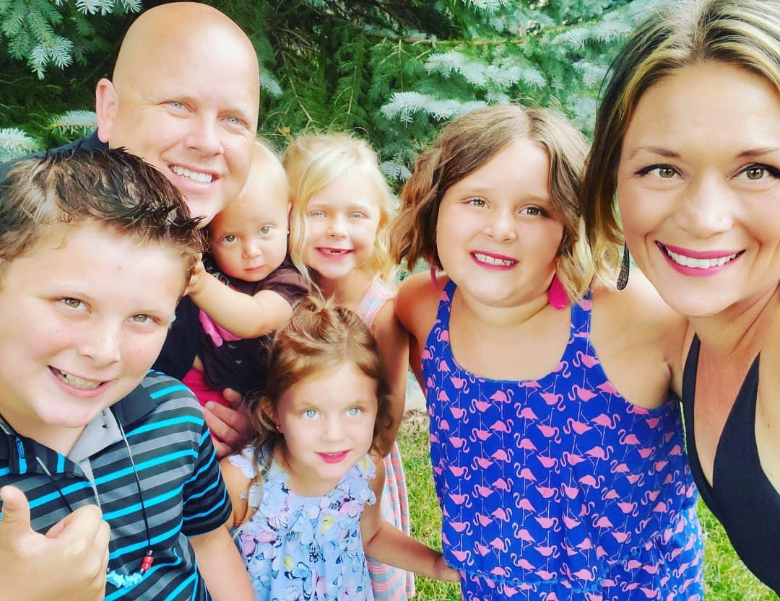
Emily Anderson
Married with 5 kiddos
Teacher at Blaine High School
12th grade Economics, College in the Schools Economics, and 12th grade U.S. Government and Politics
Minnesota Council on Economic Education Master Teacher

Slide 4
Introductions
Name
City/State
Grade(s)/Subject(s) Taught
Fun Fact

Slide 6
Webinar Objectives
Learn how to equip high school students with a basic understanding of selected sustainability issues and inspire them to champion innovative solutions to address environmental, ecological, and related economic challenges facing the planet and its people
Introduce teachers to the Sustainability & Economics curriculum by previewing sections of selected lessons

Slide 7
Agenda
Intro to Curriculum
Thinking Like an Economist
Lesson Overviews/Snippets
Water & Climate: A Diversity of Challenges on the African Continent
Food Production & Specialization: Some Pros & Cons
Fast Fashion & Externalities: What’s Your Waste Size?
Green GDP & Measuring Economic Growth
Questions/Application Ideas/Closing

Slide 8
The Curriculum
Viewing Sustainability through an Economics Lens:
How to be Green While Staying in the Black
For high school teachers in social studies, business, agricultural education, and science-related fields.
Goal: to equip high school students with a basic understanding of sustainability issues and inspire them to champion innovative solutions to address environmental, ecological, and related economic challenges facing the planet and its people.

Slide 9
PRE-LESSON Temperature Check
How comfortable are you with this goal?
(to equip high school students with a basic understanding of sustainability issues and inspire them to champion innovative solutions to address environmental, ecological, and related economic challenges facing the planet and its people)

Slide 10
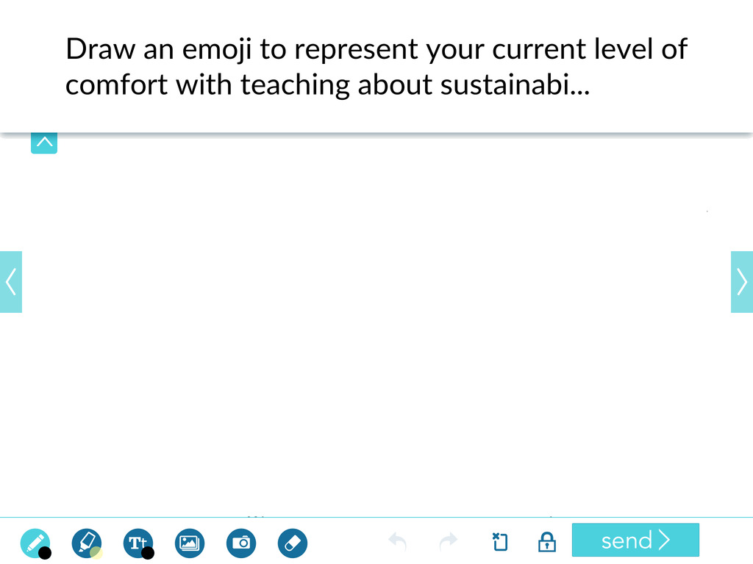
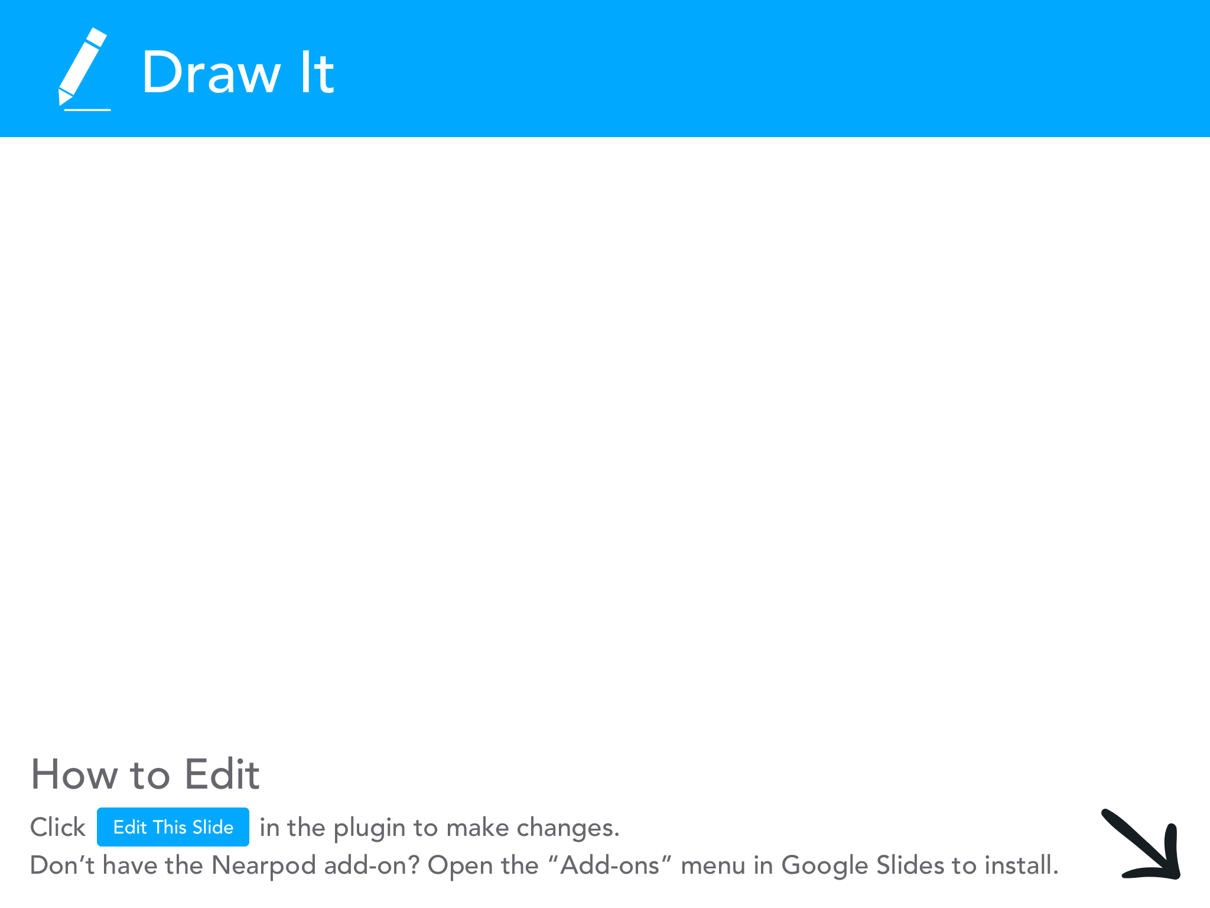

Slide 11
The Curriculum
Why we love it so much:
Written by high school master teachers and supported by university professors and research experts in economics and sustainability
One day lessons; substitutable
OR
Comprehensive sustainability infusion with a capstone project
Flexible content areas [Geo, Civics, Gov, Econ]
Curriculum is online in Google format so you can make a copy, edit, and assign in google classroom

Slide 12
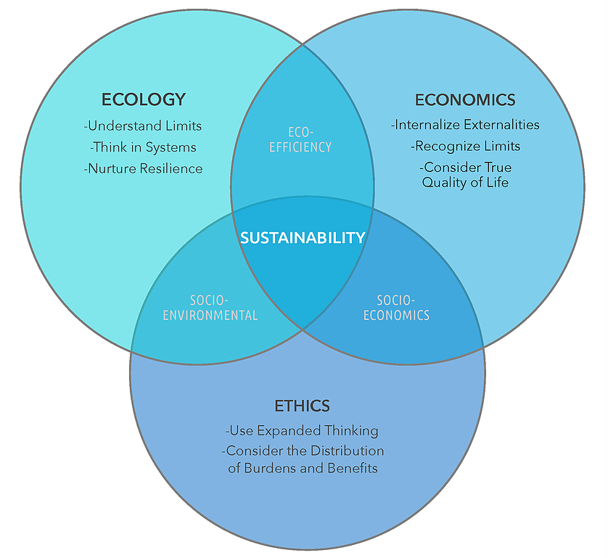
The Curriculum
Why we love it so much:
Holistic approach to teaching sustainability
‣ Integrates all three elements: ecology, ethics, and economics.
‣ Generates "co-benefits" or multi-solves to address several problems at once.
‣ Is regenerative by design. Solutions don't just limit harm, they improve communities and natural systems.

Slide 13
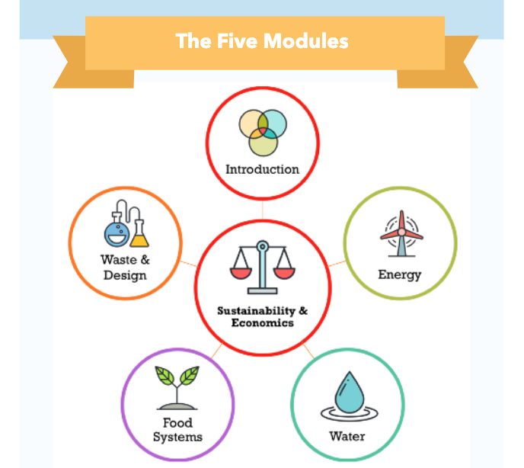
The Curriculum
Why we love it so much:
Holistic approach to teaching sustainability
‣ Introduces many current and important issues in sustainability
‣ 2 lessons in each module with different economic concepts
(micro, macro, and international)

Slide 14
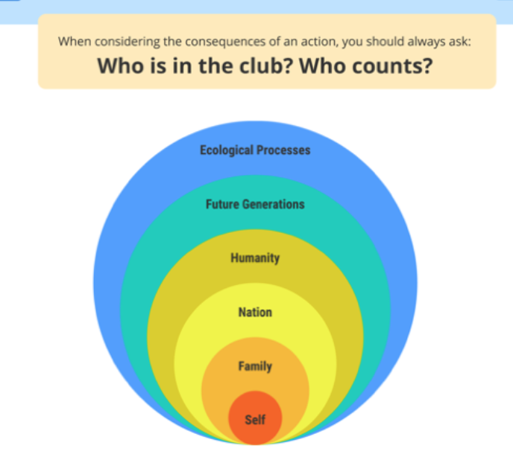
The Curriculum
Why we love it so much:
Holistic approach to teaching sustainability
‣ Addresses all levels of the “clam shell”. Encourages thinking
outside of self
‣ Social justice lens: distribution of costs and benefits
How can we be inclusive and equitable in a global economy?

Slide 15
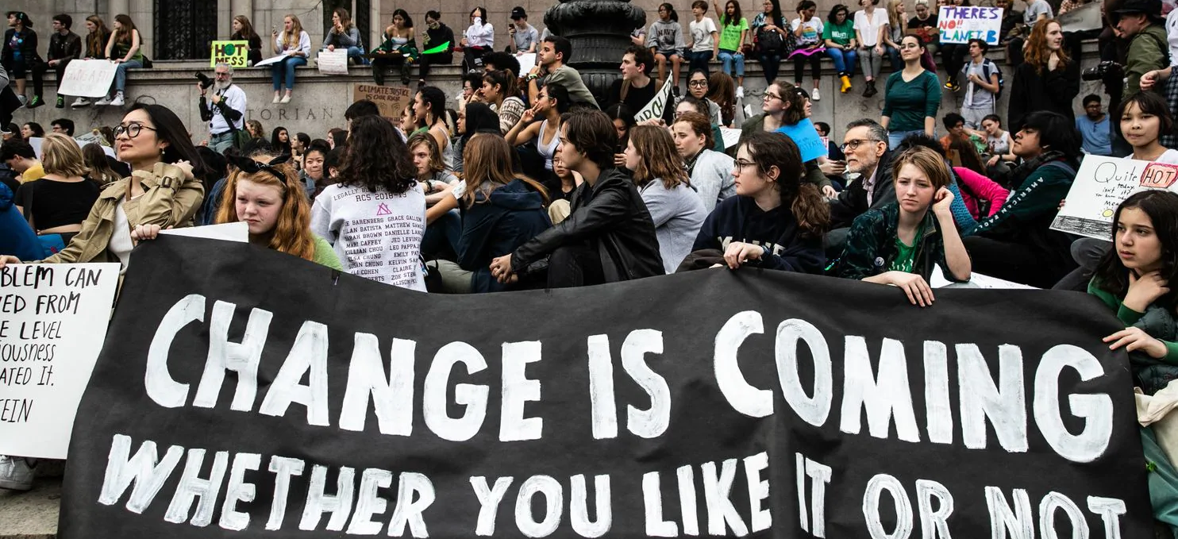
Thinking Like an Economist
“American democracy is ailing. Thinking like an economist can help”
Skim this article and identify a word/phrase that sticks out to you or captures the essence of the message.
Notes:
PASTE LINK IN CHAT:
https://docs.google.com/document/d/1bg0mAd3jVj_3dOh_c-P9PpHBgw0Co2aGri6PdQ1BFMQ/view

Slide 16
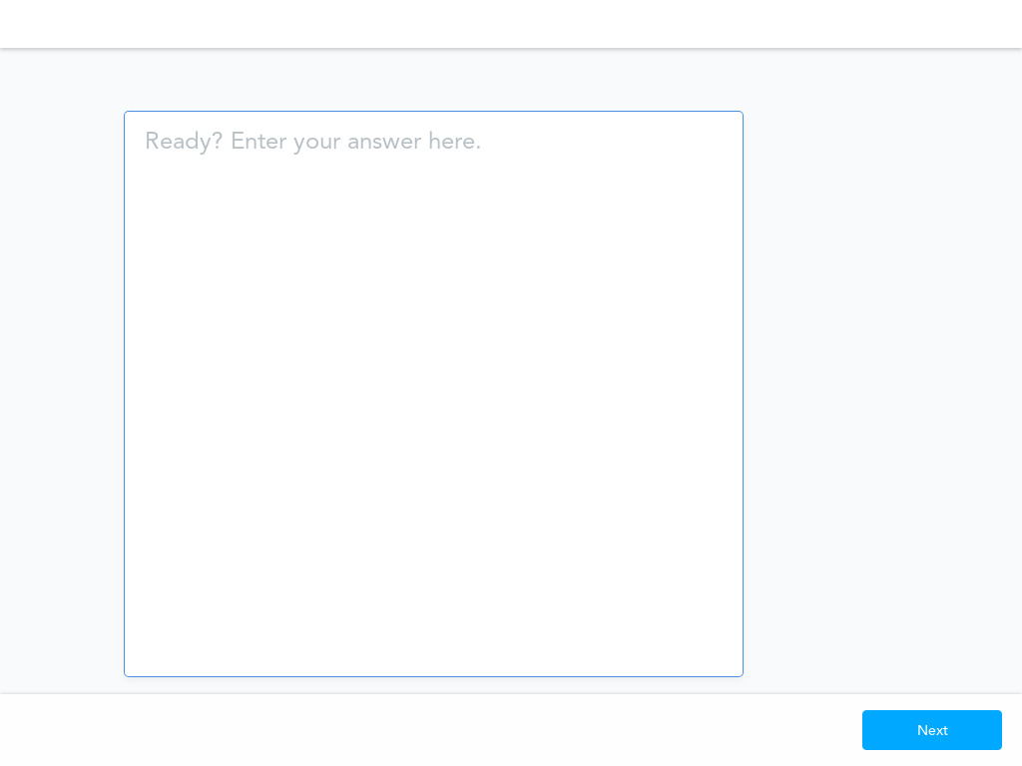

Slide 17
Thinking Like an Economist
Policies advocated by many on the left or the right are almost theological — unable to tolerate compromise.
Economics is about decision making: analyzing costs and benefits and choosing because of scarcity.
“Many today believe, with justification, that carbon use and climate change pose an imminent, existential threat to the planet.”
Pollution has a cost to the environment
Pollution also has a benefit to society: the emission of pollutants benefits people by allowing other activities to be pursued at lower costs.
Economic analysis: polluting without regard to environmental damage is extremely costly but zero pollution is also very costly-- so how much pollution (or clean up) is ideal?
The answer is not a simple yes or no, agree or disagree-- the answer is a complex analysis of data, ethical considerations, and imperfect decision making.

Slide 18
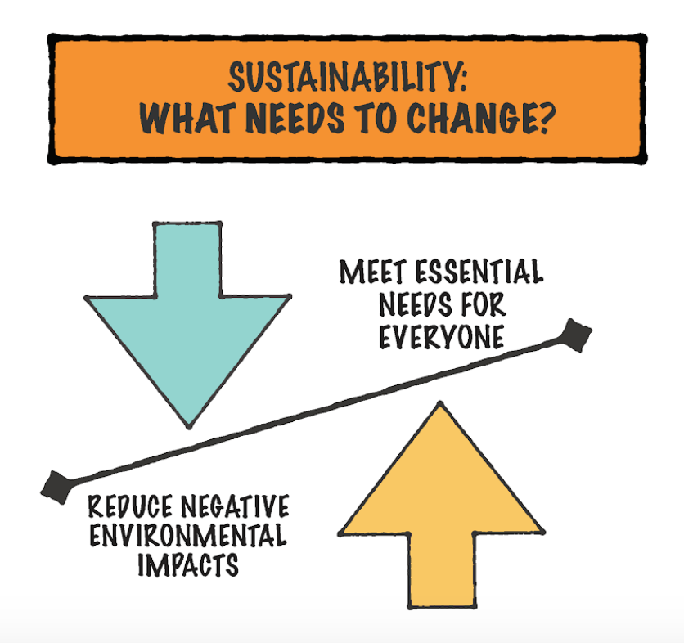
Thinking Like an Economist

Slide 19
Lesson #1: Water & Climate
z.umn.edu/MCEESustainability

Slide 20
Water & Climate: Challenges on the African Continent

Slide 21
Water & Climate: Challenges on the African Continent
Economic Benchmarks (MN)
9.2.3.3.1: Identify the incentives and trade-offs related to a choice made by an individual, household, organization or government; describe the opportunity cost of a choice; and analyze the consequences of a choice (both intended and unintended).
9.2.3.4.1: Explain how the availability of productive resources and technology limits the production of goods and services. [Impact of resource scarcity]

Slide 22
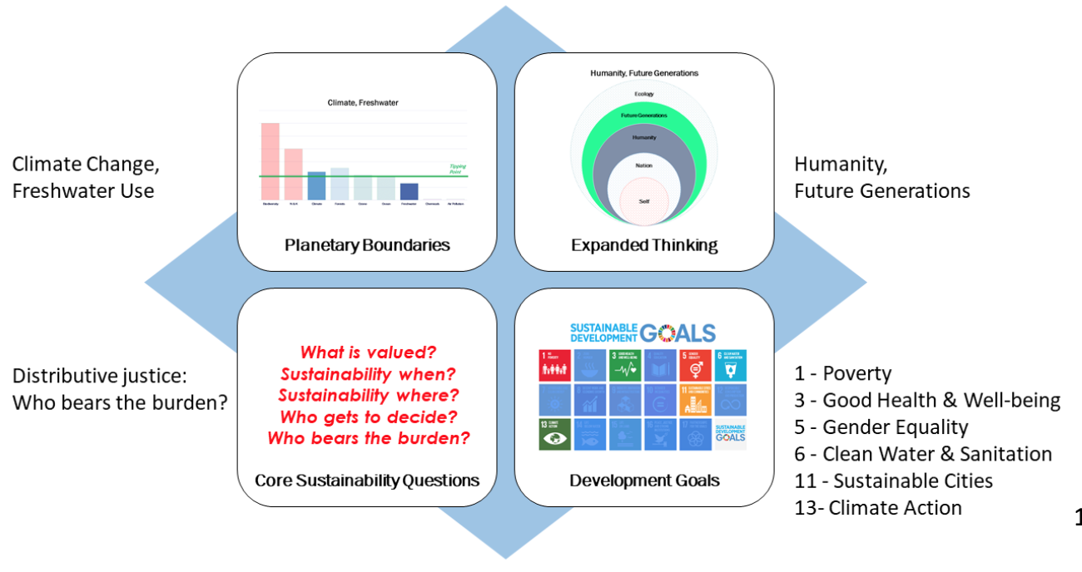
Water & Climate: Challenges on the African Continent
Sustainability Themes

Slide 23
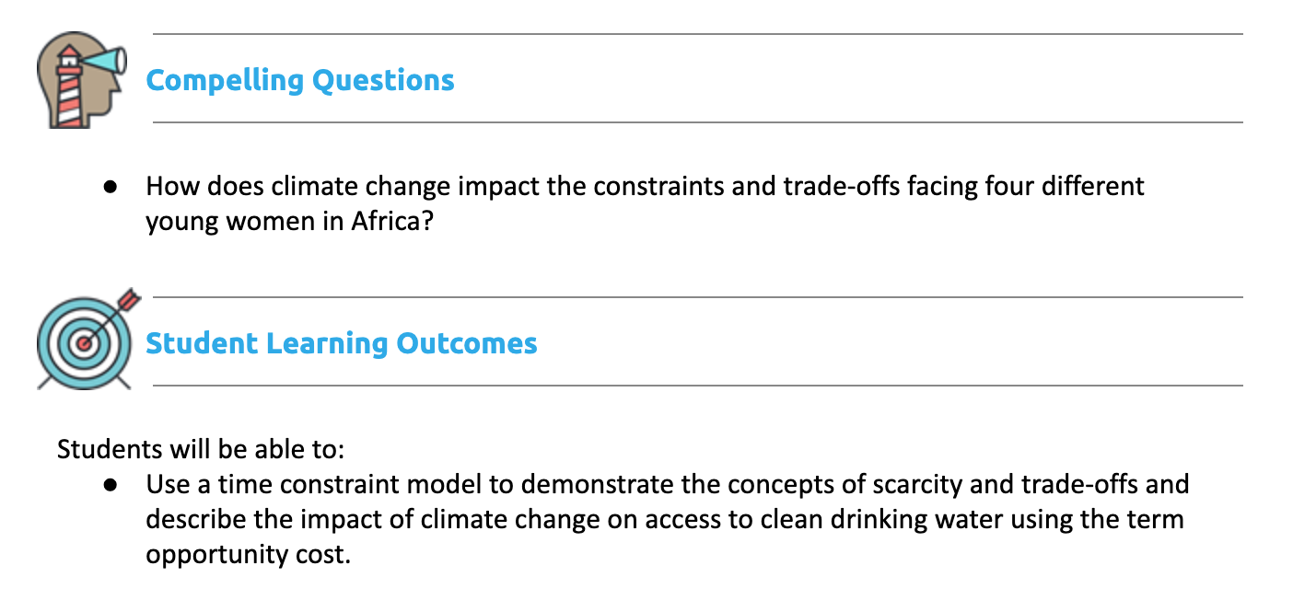
Water & Climate: Challenges on the African Continent

Slide 24
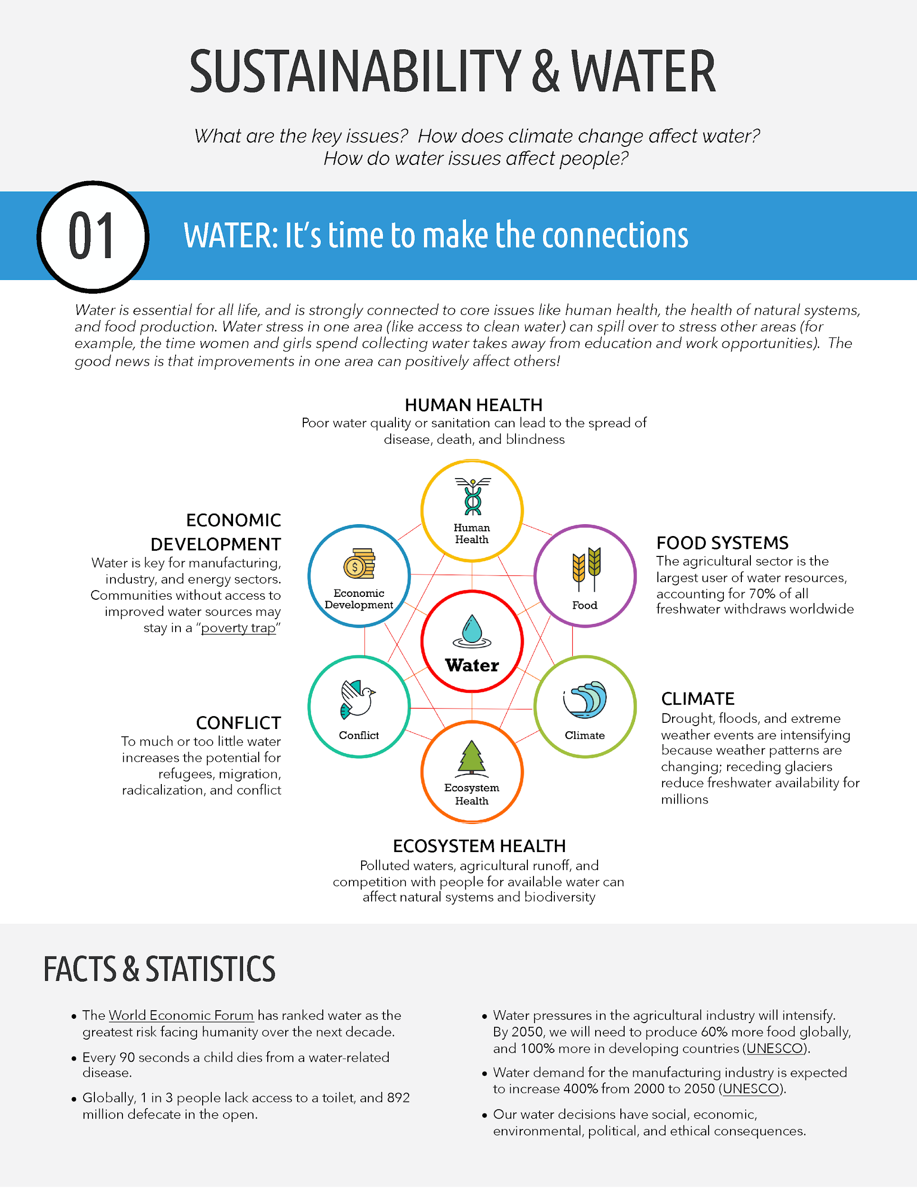
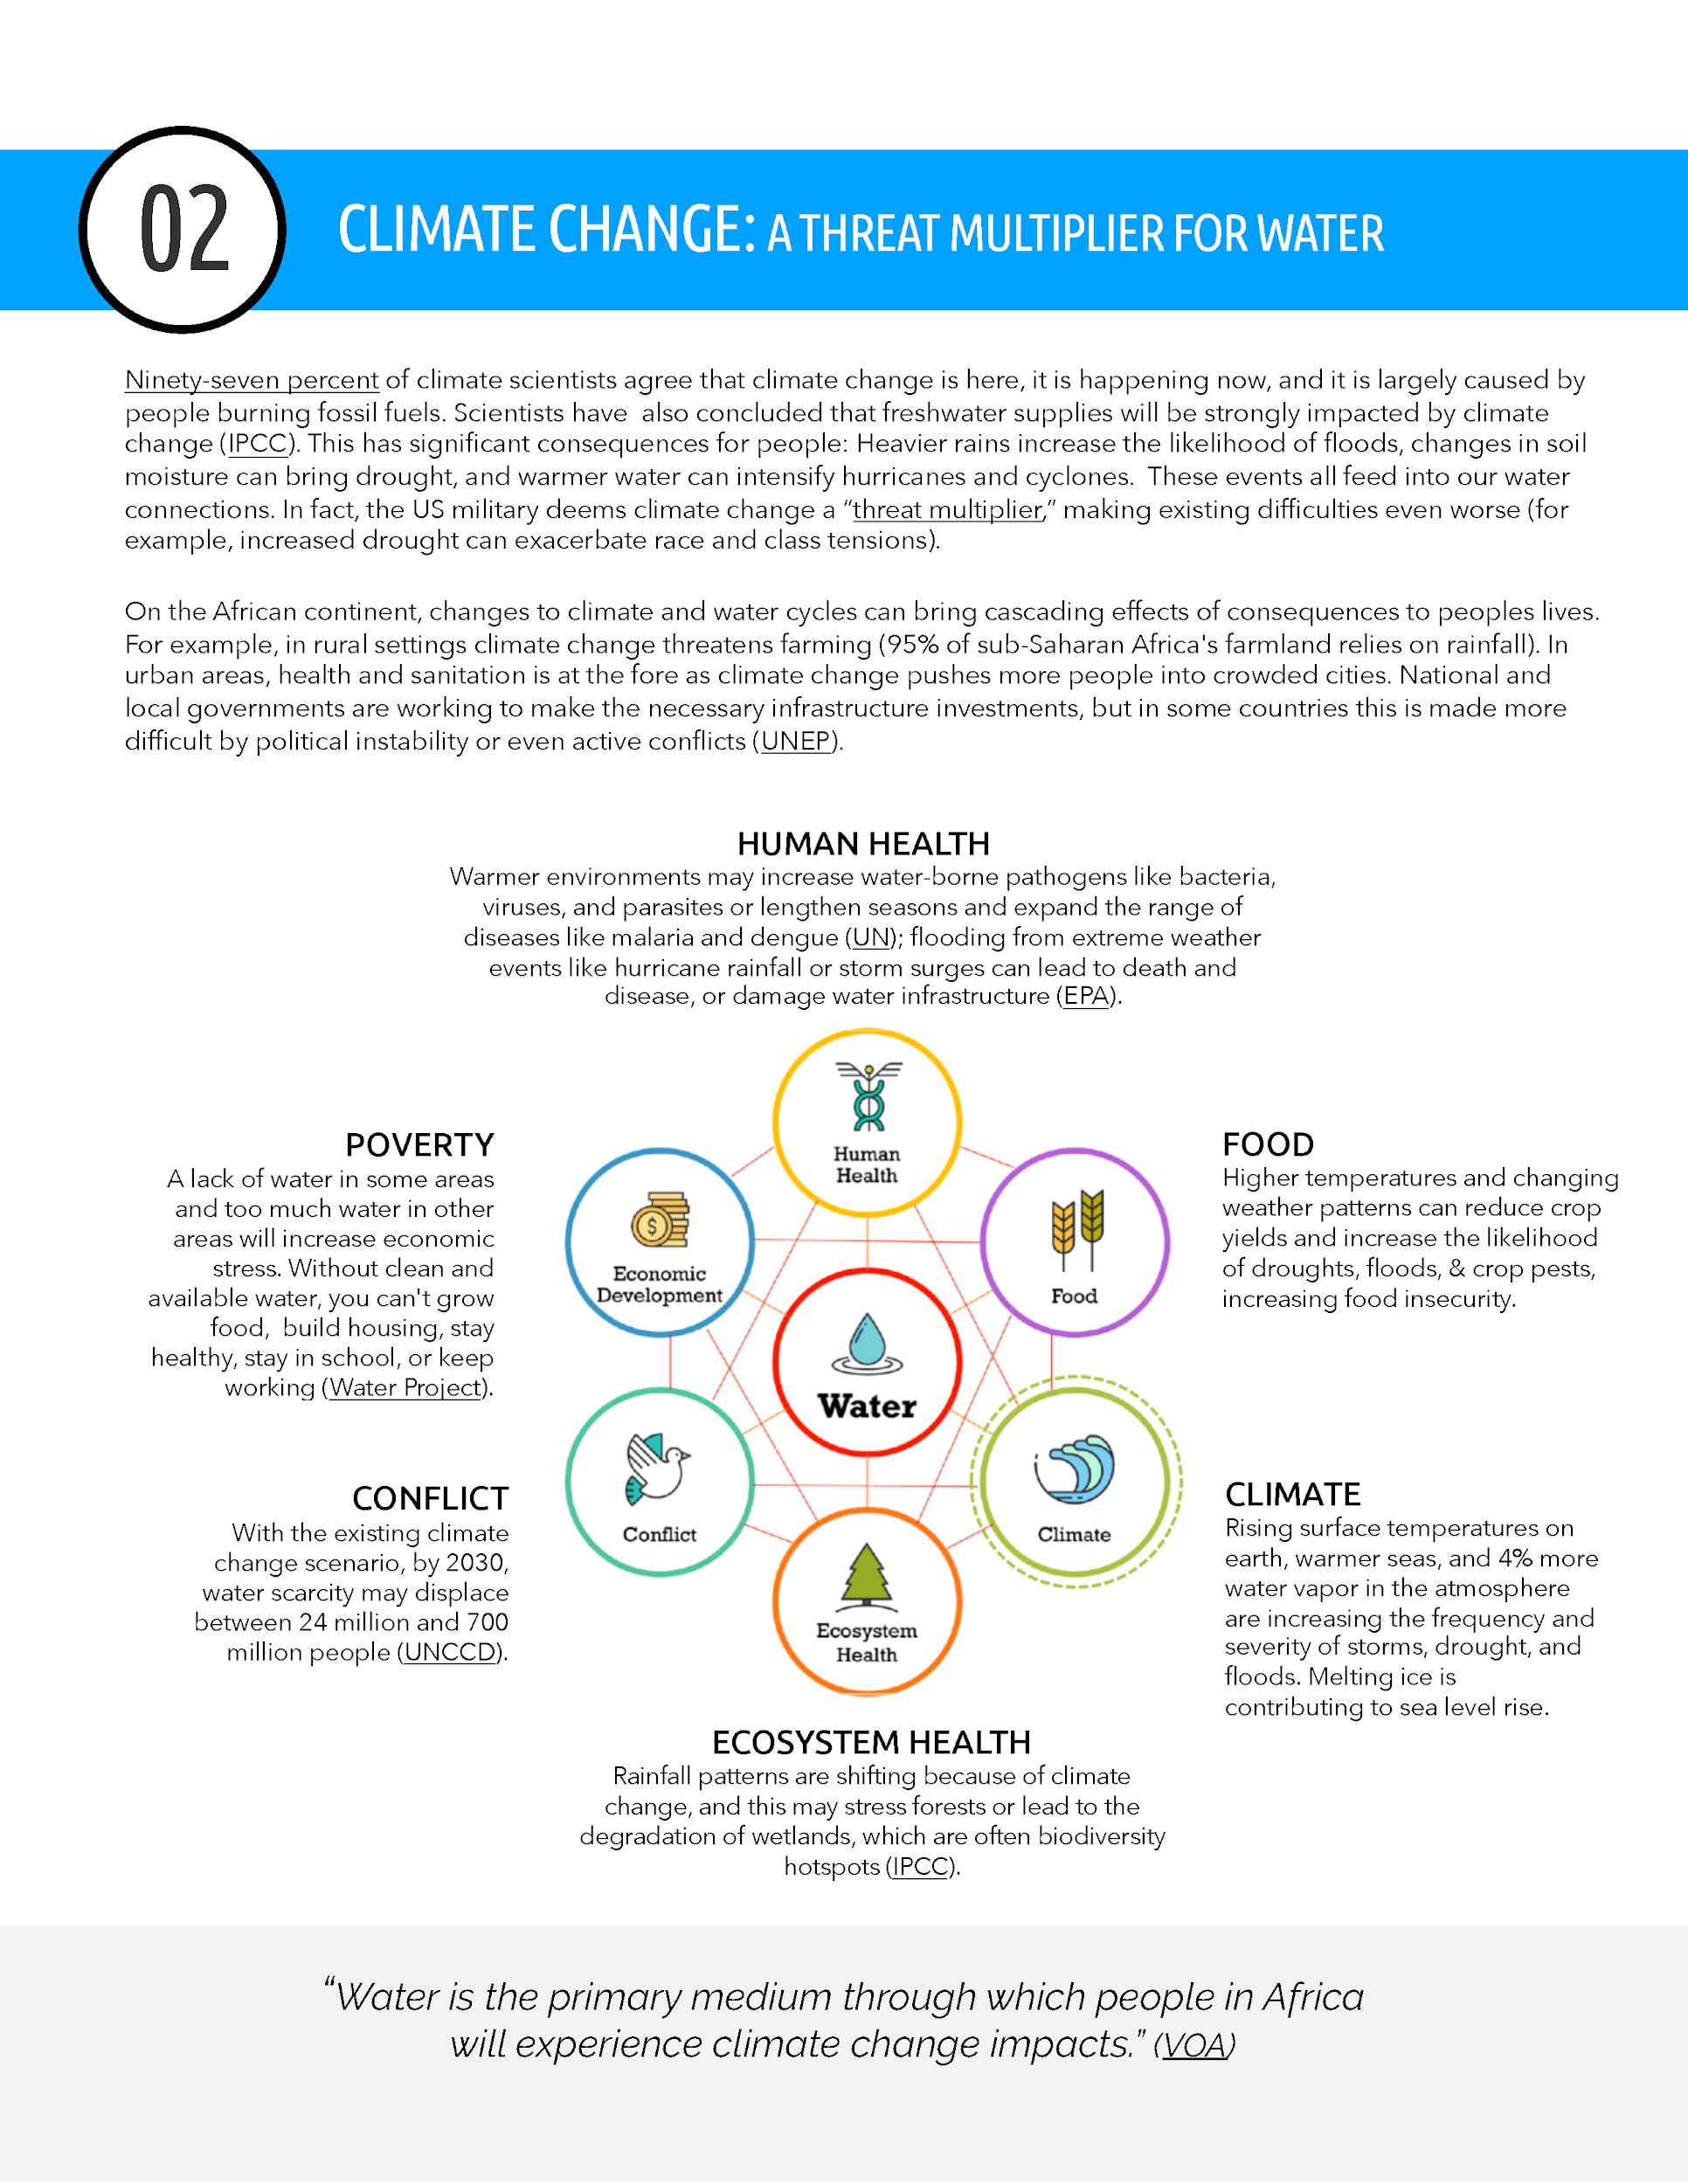
Intro to Sustainability Issues

Slide 25
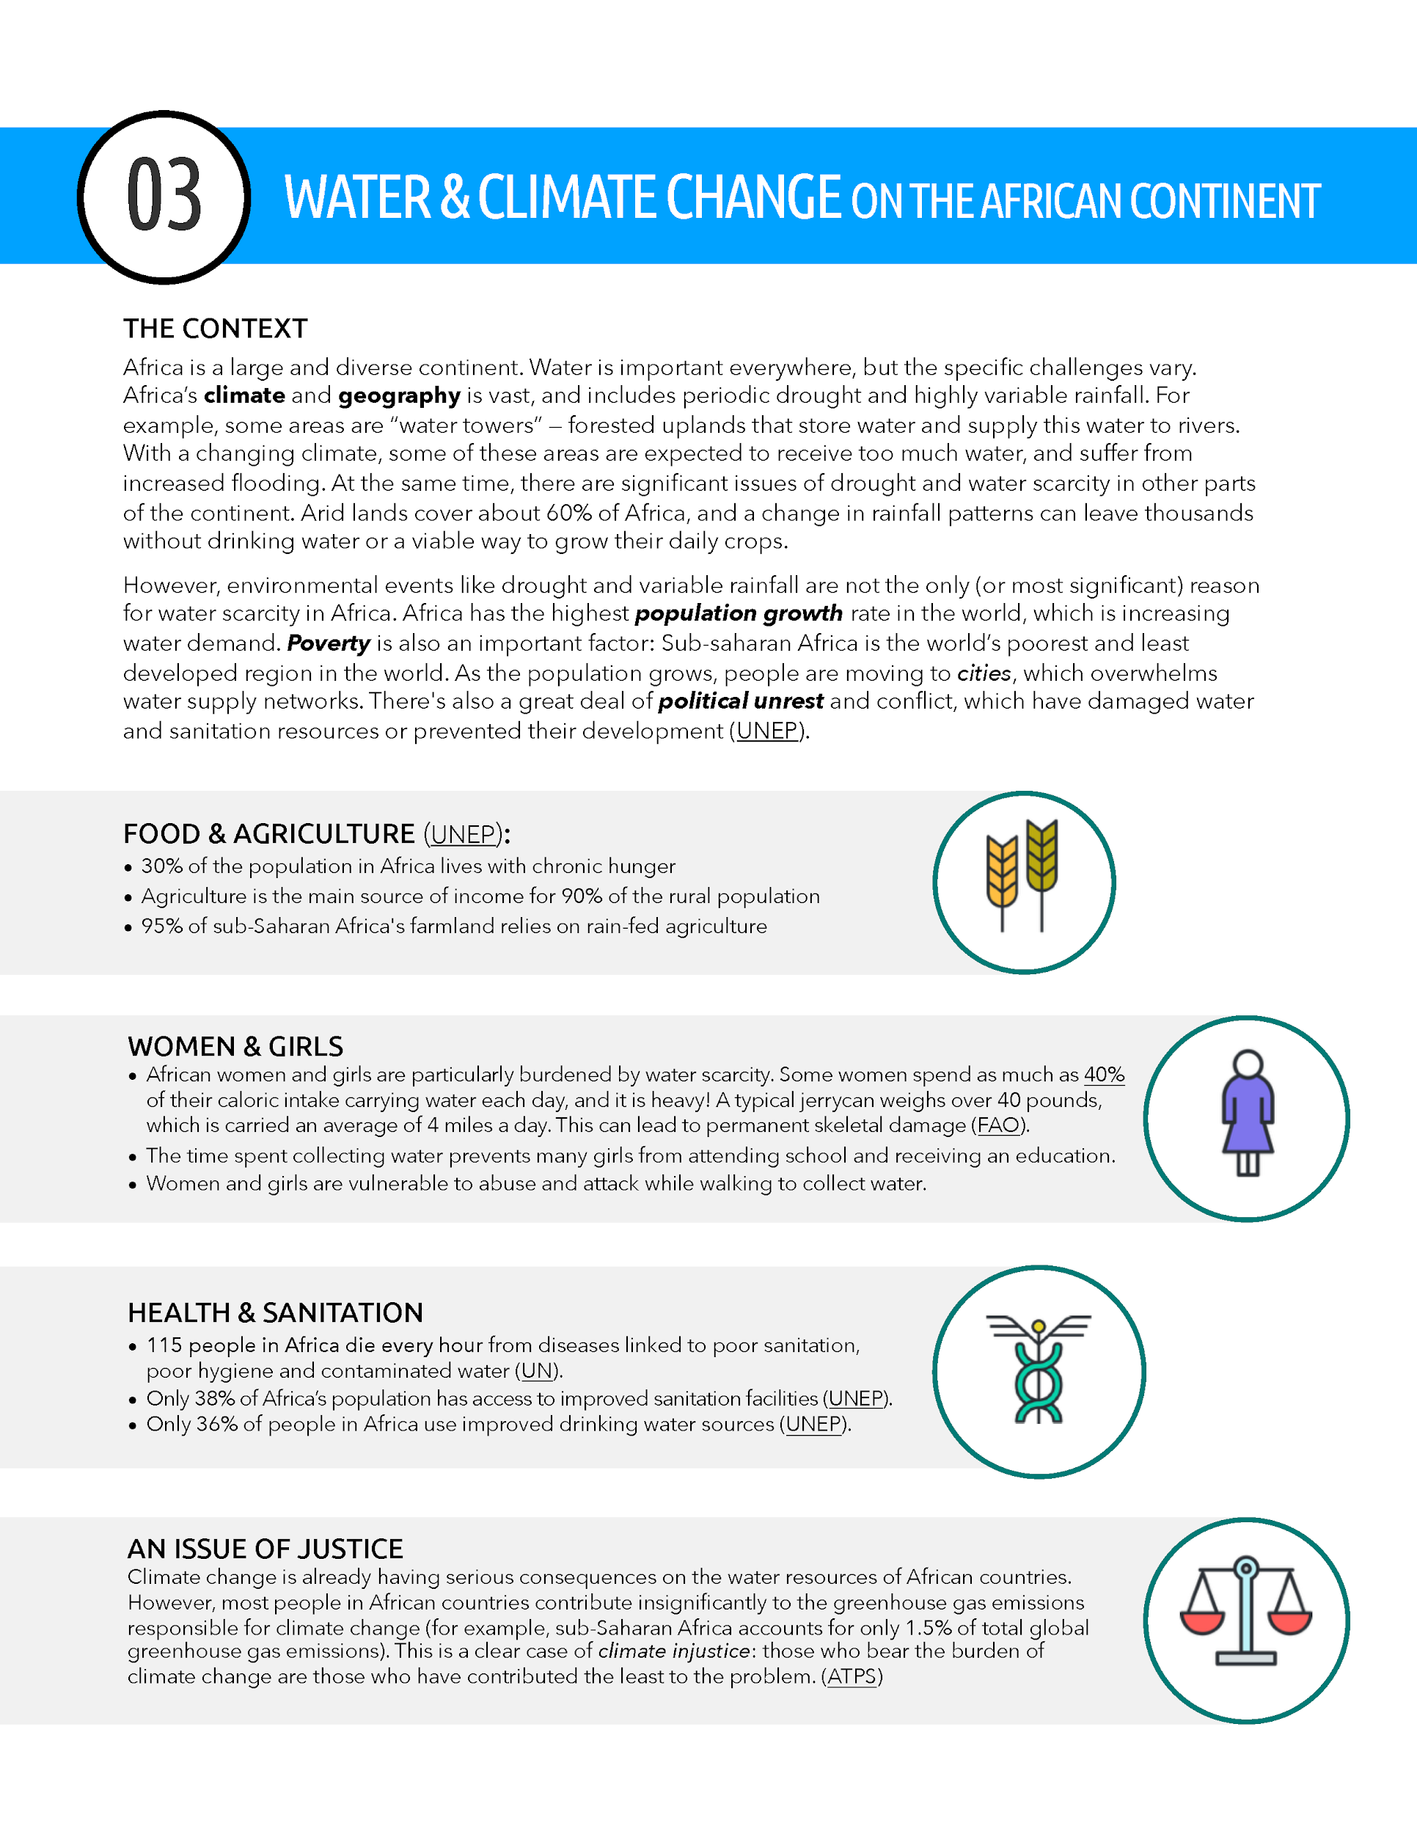
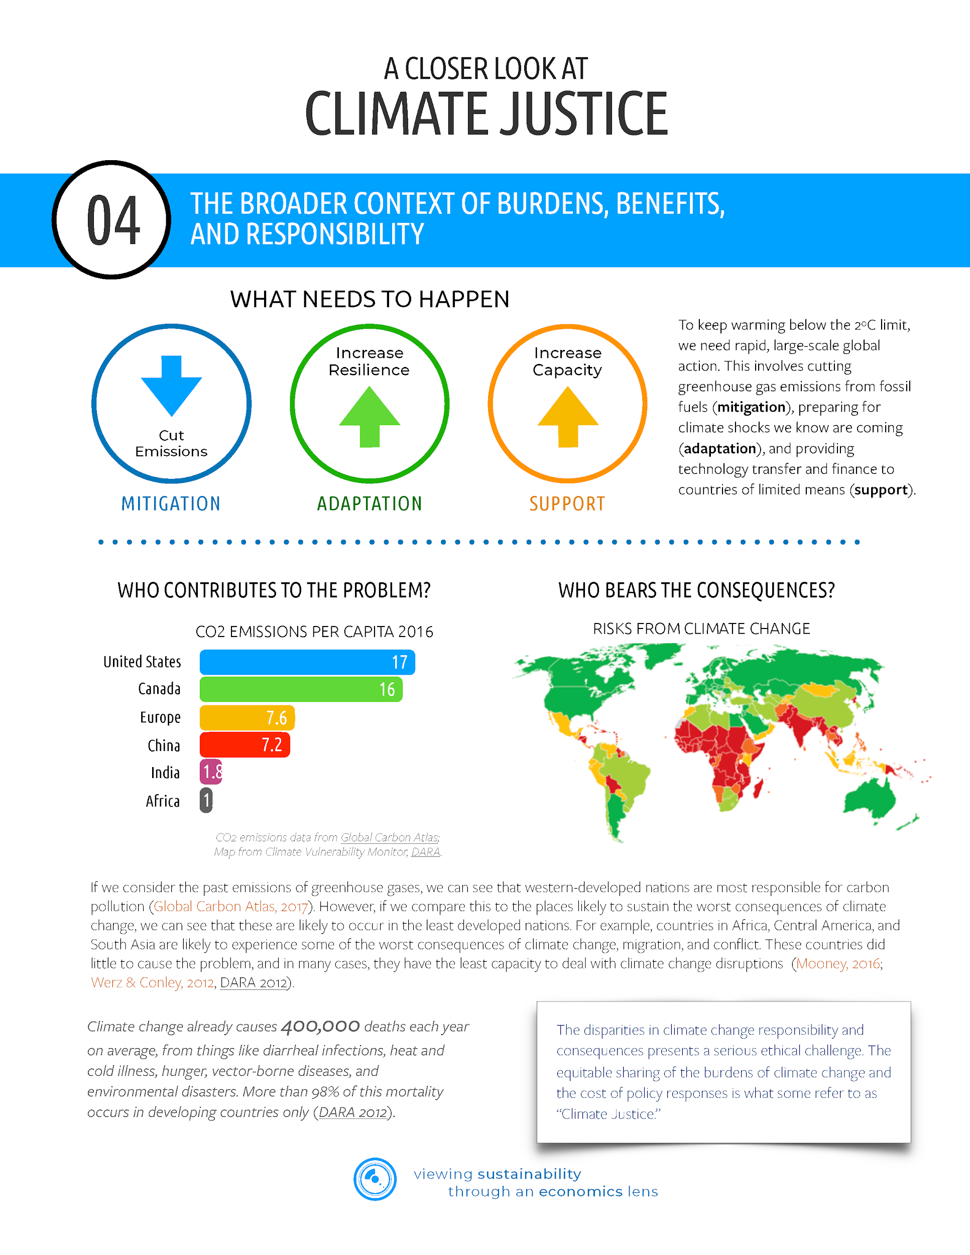
Intro to Sustainability Issues

Slide 26
Intro to Sustainability Issues
In your group, pair up and choose one of the four background readings.
Read your article and use the “Say Something” literacy strategy with your partner:
Rules for Say Something
With your partner, decide who will say something first.
When you say something, do one or more of the following:
Make a prediction
Ask a question
Clarify something you misunderstood
Make a comment
Make a connection
Your partner will comment on what you have shared, by doing one of the following:
Agreeing/disagreeing with your prediction
Answer your question or ask a follow-up question
Making an additional comment or connection

Slide 27
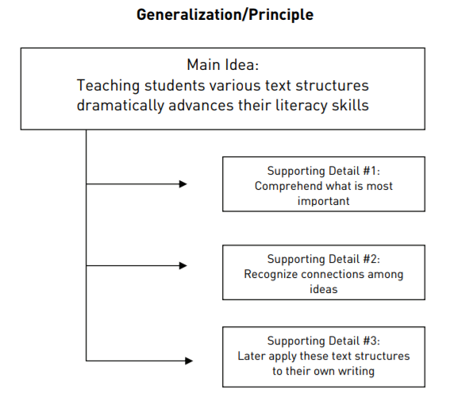
Water & Climate: Challenges on the African Continent
With your partner, sketch out the main idea of your reading:
Main idea of your article
Detail #1 that supports
Detail #2 that supports
Detail #3 that supports
Share out with the rest of your group

Slide 28
Time Constraint Model
Economics is not about money but rather about trade-offs.
The true cost of a good or service is its opportunity cost, what you give up in order to get the good or service.
We will be using this concept to think about the true cost of clean water: If you turn on a spout and clean water comes out, the opportunity cost is low. On the other hand, if you have to spend six hours securing clean water, it costs you the opportunity to work/sleep/play/go to school.
Let’s use this model to show opportunity cost...

Slide 29
What is the opportunity cost of getting higher grade on your test?
A
B
The forgone wages.
For instance, moving from a “C” to a “A” will cost you two hours of work which means $30 in forgone wages.
Studying
C
D
$15
$30
$45
$60
Working
Notes:
Q: What is the opportunity cost of getting higher grade on your test?
A: The forgone wages. For instance, moving from a “C” to a “A” will cost you two hours of work which means $30 in forgone wages.

Slide 30
Is it possible to get a “B” on your test and earn $15?
A
B
Yes.
Studying
C
D
$15
$30
$45
$60
Working
Notes:
Q: Is it possible to get a “B” on your test and earn $15?
A: Yes. (CLICK to show this point on the constraint.)

Slide 31
What if you earned $15 and got a “C” on your test?
A
You used your resource (time) inefficiently because this point is inside the constraint. You worked 1 hour and studied for 2 hours, which means you could have used 1 more hour out of the available 4 to either study or work.
B
Studying
C
D
$15
$30
$45
$60
Working
Notes:
Q: What would you say happened if you earned $15 and got a “C” on your test?
A: You used your resource (time) inefficiently because this point is inside the constraint. You worked one hour and studied for 2 hours, which means you could have used 1 more hour out of the available 4 to either study or work. (CLICK to show this point on the constraint.)

Slide 32
What happens if you lose your job and the best job you can find to replace it only pays $10/hour?
A
B
The time constraint rotates in.
Studying for all four hours is unchanged but the intercept where you are not studying at all and working for 4 hours moves from $60 to $40.
Studying
C
D
$15
$30
$40
$45
$60
Working
Notes:
Q: What happens if you lose your job and the best job you can find to replace it only pays $10/hour?
A: The time constraint rotates in. (CLICK to show.) The intercept where you are not working at all and studying for all four hours is unchanged but the intercept where you are not studying at all and working for four hours moves from $60 to $40.

Slide 33
Is it still possible to get a “B” on your test and earn $15?
A
B
No.
That is now outside of the choice set.
Studying
C
D
$15
$30
$40
$45
$60
Working
Notes:
Q: Is it still possible to get a “B” on your test and earn $15?
A: No, that is now outside of the choice set. (CLICK to show.)

Slide 34
Constraint Model
You have 10 hours available during the day which you could gather clean water your you and your family OR use to go to school and study.
If you spend all your available time, you can gather 20 gallons of water.
If you spend all your available time, you can earn an “A”.
Let’s use this information to construct a constraint with gallons of water on one axis and grades you could receive on the other...

Slide 35
What is the opportunity cost of 5 gallons of water?
A
B
One grade level earned through studying.
Studying
C
D
5
10
15
20
Gallons of Water
Notes:
Q: What is the opportunity cost of 5 gallons of water?
A: One grade level earned through studying.
(CLICK to show.)

Slide 36
A
Is it possible to gather 10 gallons of water and earn a C?
B
Yes
C
Studying
D
5
10
15
20
Gallons of Water
Notes:
Q: Is it possible to gather 10 gallons of water and earn a C?
A: Yes. (CLICK to show this point on the constraint.)

Slide 37
What happens to the constraint if climate change makes getting water more difficult and it now takes a full hour to gather one gallon of water?
A
B
C
Studying
The time constraint rotates in.
The intercept where you are only going to school is unchanged but the intercept where you are only gathering water rotates in; so that the most you can gather moves from 20 gallons to only 10 gallons.
D
5
10
15
20
Gallons of Water
Notes:
Q: What happens to the constraint if climate change makes getting water more difficult and it now takes a full hour to gather one gallon of water?
A: The time constraint rotates in. (CLICK to show.) The intercept where you are not gathering water at all and only going to school is unchanged but the intercept where you are only gathering water rotates in; so that the most you can gather moves from 20 gallons to only 10 gallons.

Slide 38
A
Is it still possible to gather 10 gallons of water and earn a C?
B
C
No, that is now outside of the choice set.
Studying
D
5
10
15
20
Gallons of Water
Notes:
Q: Is it still possible to gather 10 gallons of water and earn a C?
A: No, that is now outside of the choice set. (CLICK to show.)

Slide 39
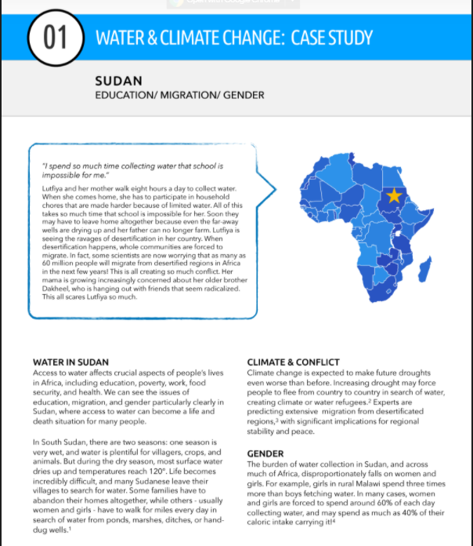
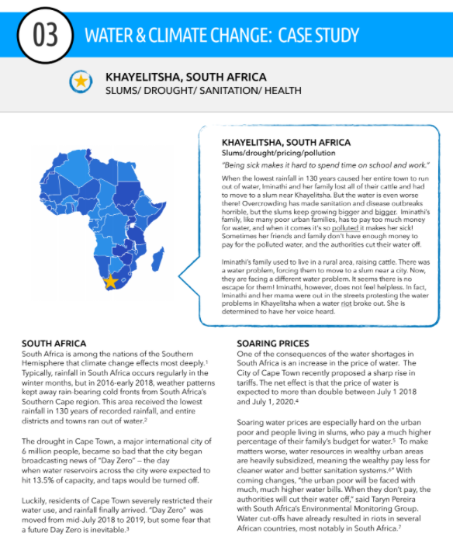
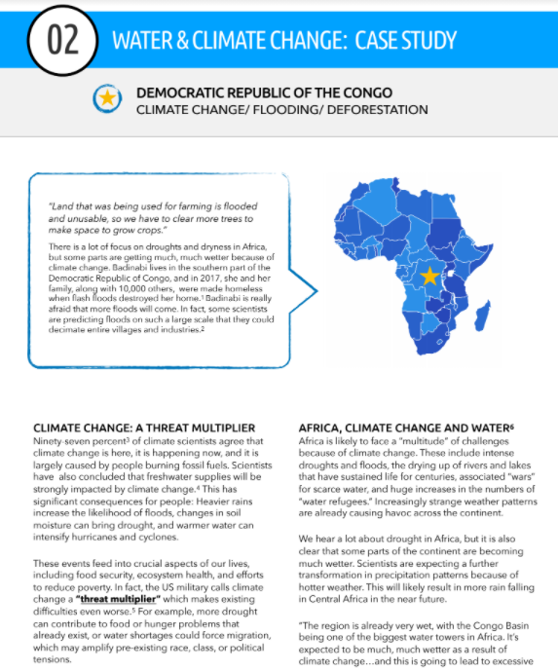
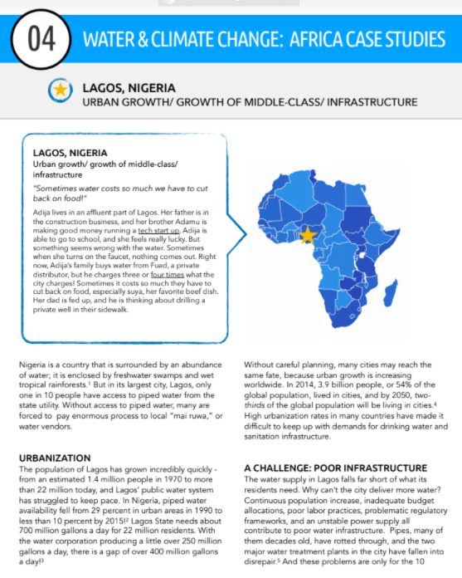
Case Study Vignettes

Slide 40
Applying the Model
With your partner, read the vignette of the number you were assigned from the background reading.
Identify one sentence that describes a tradeoff or an opportunity cost.
Draw a time constraint model to illustrate the opportunity cost or tradeoff you identified
Use the term “opportunity cost” in a sentence to describe the trade-off inherent in each story.

Slide 41
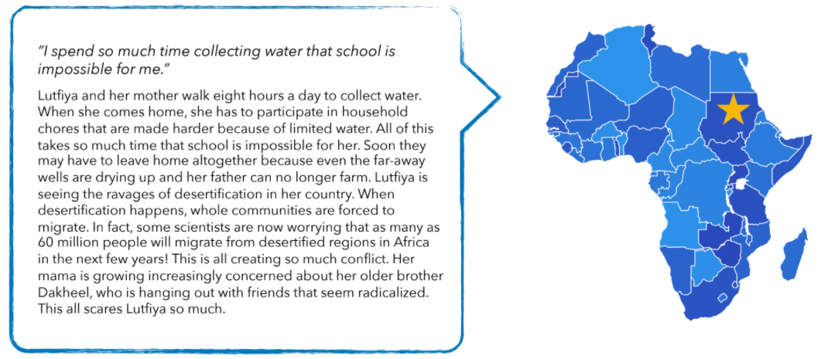
Vignette #1
LUTFIYA

Slide 42
Lutfiya: “All of this takes so much time that studying is impossible for her.”
A
B
On one axis is gallons of water, on the other axis grades achieved through studying.
Lutfiya is being pushed to the intercept where she is only gathering water and not studying at all.
The opportunity cost of water is Lutfiya’s learning.
C
Studying
D
5
10
15
20
Gallons of Water
Notes:
This is very similar to the example above. On one axis is gallons of water, on the other axis grades achieved through studying. Lutfiya is being pushed to the intercept where she is only gathering water and not studying at all. (CLICK to show.)
The opportunity cost of water is Lutfiya’s learning.

Slide 43
Vignette #2
IMINATHI

Slide 44
Iminathi: “Being sick makes it hard to spend time on school and work.”
A
B
Iminathi is describing her constraint shifting in. Rather than rotating like in the example above, being sick pushes in both intercepts.
She has less time to spend on all of her activities.
The opportunity cost of polluted water is health and productivity.
C
Studying
D
5
10
15
20
Gallons of Water
Notes:
Iminathi is describing her constraint shifting in. Rather than rotating like in the example above, being sick pushes in both intercepts. (CLICK to show.) She has less time to spend on all of her activities.
The opportunity cost of polluted water is health and productivity.

Slide 45
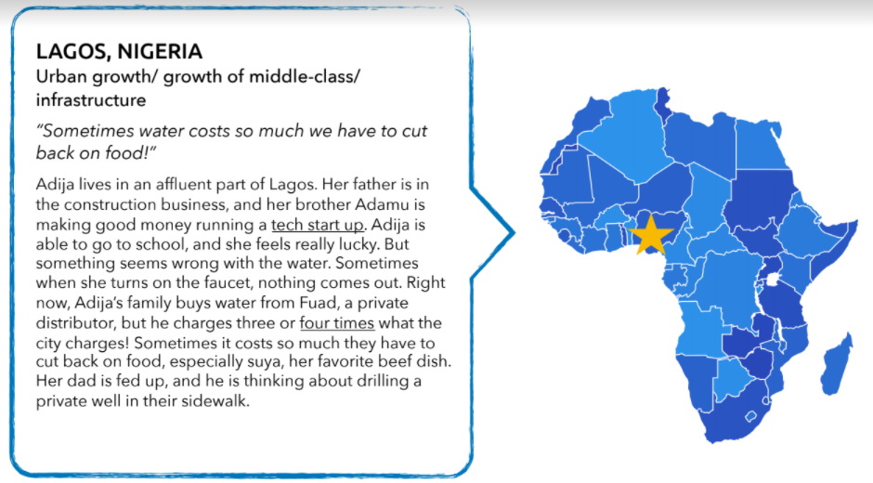
Vignette #3
ADIJA

Slide 46
Adija: “Sometimes it costs so much they have to cut back on food!”
10
8
Adija is describing a budget constraint. On one axis is gallons of water purchased and on the other axis is meals
This graph suggests that the price of water has gone up, but the price of food stays the same. If we assume that climate change has pushed up the price of food as well, it would make sense to model this as an inward shift, rather than the rotation shown.
For Adija’s family, the opportunity cost of water is forgone food.
6
Meals
4
2
4
8
12
16
20
Gallons of Water
Notes:
Economists use constraints to model all sorts of tradeoffs. While we focus on time constraints in this lesson, Adija is describing a budget constraint. On one axis is gallons of water purchased and on the other axis is meals (or some other unit of food). (Note: This graph suggests that the price of water has gone up, but the price of food stays the same. If we assume that climate change has pushed up the price of food as well, it would make sense to model this as an inward shift, rather than the rotation shown.)
For Adija’s family, the opportunity cost of water is forgone food. (CLICK to show.)

Slide 47
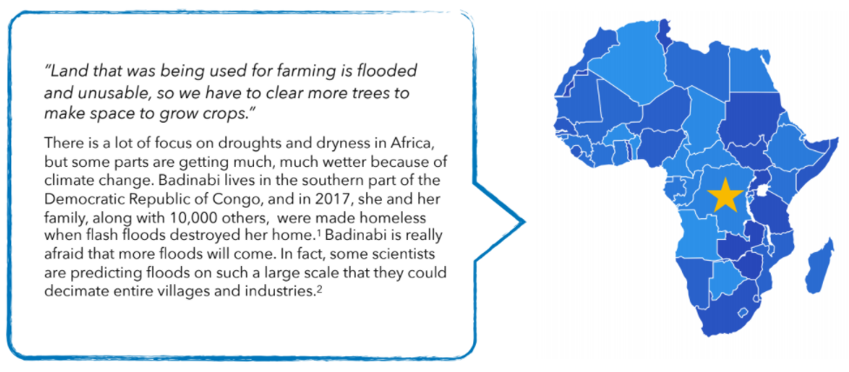
Vignette #4
BADINABI

Slide 48
Badinabi: “Land that was being used for farming is unusable and farmers have to clear trees to make space.”
Badinabi is describing a land constraint. On one axis is food (which comes from acres devoted to farming) and on the other axis is ecological protection (i.e. clean air, biodiversity or some other good that comes from leaving forrest and trees unharvested).
The opportunity cost of arable farmland is deforestation.
Food (from acres of farmland)
Ecological Protection (from acres of trees)
Notes:
Economists use constraints to model all sorts of tradeoffs. While we focuses on time constraints in this lesson, Badinabi is describing a land constraint. On one axis is food (which comes from acres devoted to farming) and on the other axis is ecological protection (i.e. clean air, biodiversity or some other good that comes from leaving forrest and trees unharvested).
The opportunity cost of arable farmland is deforestation. (CLICK to show.)

Slide 49
#Hashtag Closure Activity
Summarize a takeaway
#HashtagStyle

Slide 50
Additional Resources
Curriculum: http://tinyurl.com/sust-econ
Additional K-12 Resources: z.umn.edu/TeacherResources
Chapter reading: Building Comprehension Through Pre-, During-, and Post-Reading Strategies (teaching strategies used in this lesson)
Japan International Cooperation Agency article: Tanzania: So Much Water. So What’s the Problem?
Water for South Sudan videos: Water in South Sudan: A basic need, a human right
Food and Agricultural Organization of the United Nations: International Water Issues - Sudan
Voices of America article: Climate Change Threatens Africa’s Biggest Water Sources
The Water Project article: Rural and Urban Water Issues in Africa
Conserve Energy Future article: What is water scarcity?
Circle of Blue article, infographic and podcast: Africa’s Water Challenges
UN Sustainable Development Goal article: Clean Water and Sanitation: Why it Matters

Slide 51
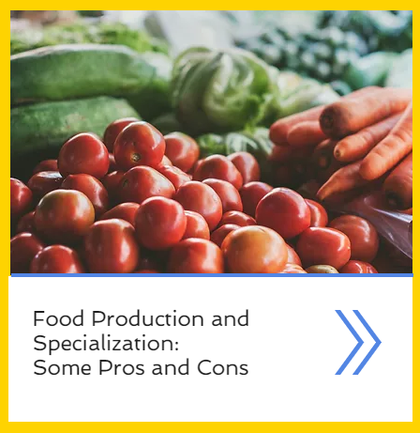
Lesson #2: Food Production & Specialization
z.umn.edu/MCEESustainability

Slide 52
Food Production & Specialization: Some Pros & Cons

Slide 53
Food Production & Specialization: Some Pros & Cons

Slide 54
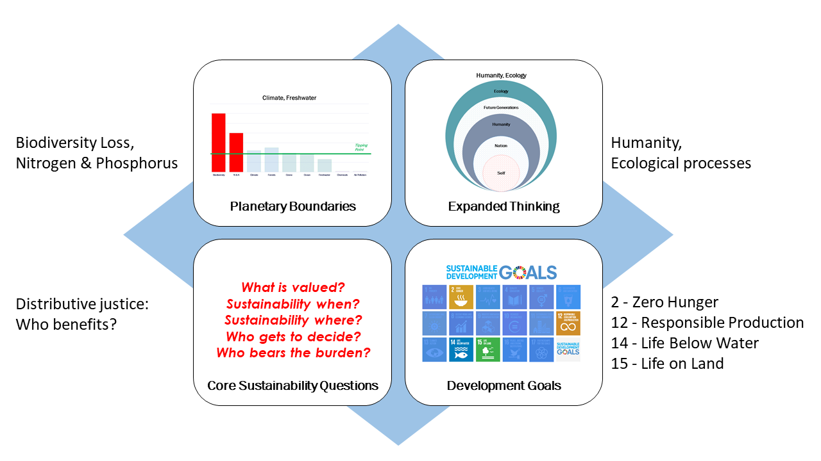
Food Production & Specialization: Some Pros & Cons
Sustainability Themes

Slide 55
Food Production & Specialization: Some Pros & Cons

Slide 56
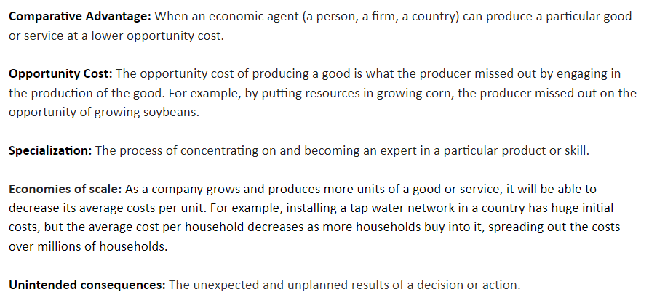
STEP 1: Introduce Concepts of Specialization and Economies of Scale
Review Key Economic Vocab

Slide 57
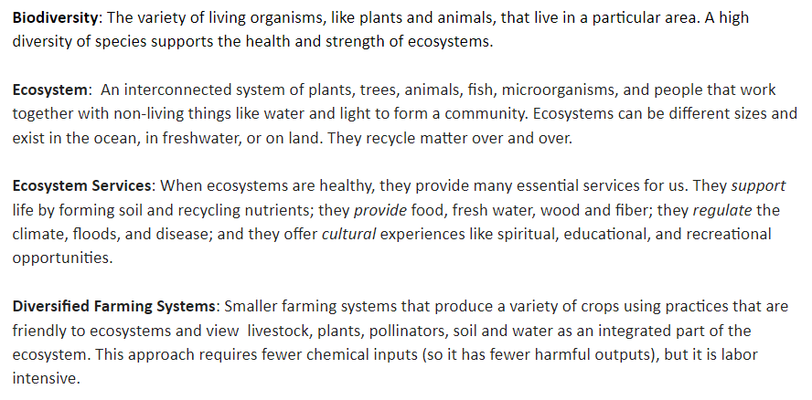
STEP 2: Introduce Topics of Agriculture
Go Over Key Sustainability Vocab

Slide 58
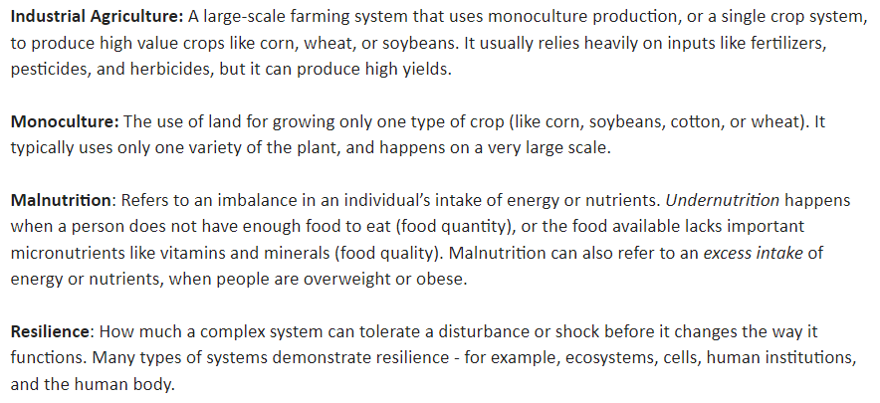
STEP 2: Introduce Topics of Agriculture
Go Over Key Sustainability Vocab

Slide 59
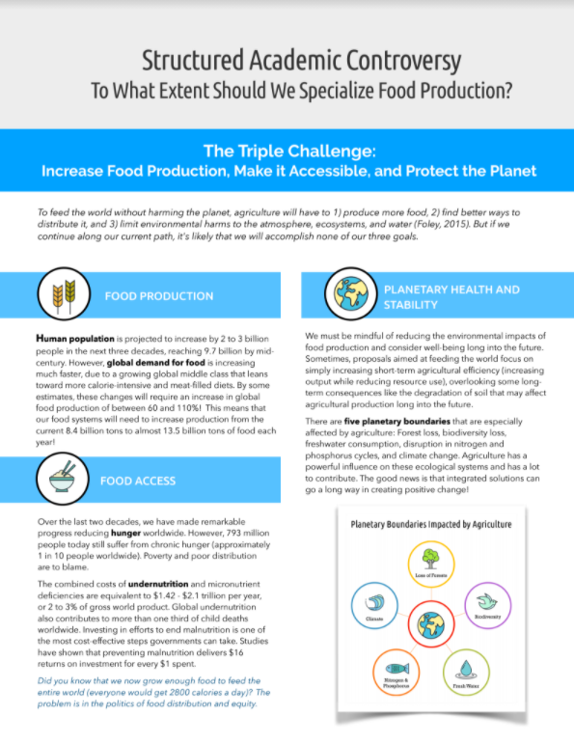
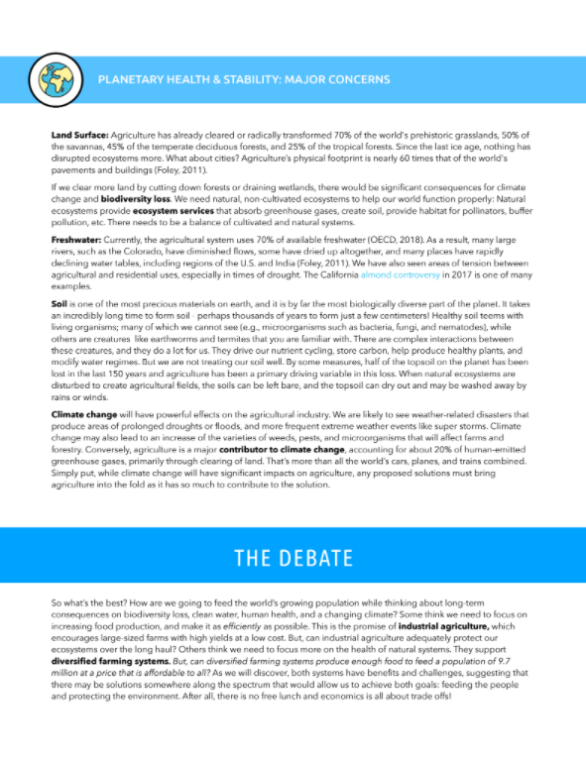
STEP 2: Introduce Topics of Agriculture
Read Overview/Backgrounder

Slide 60
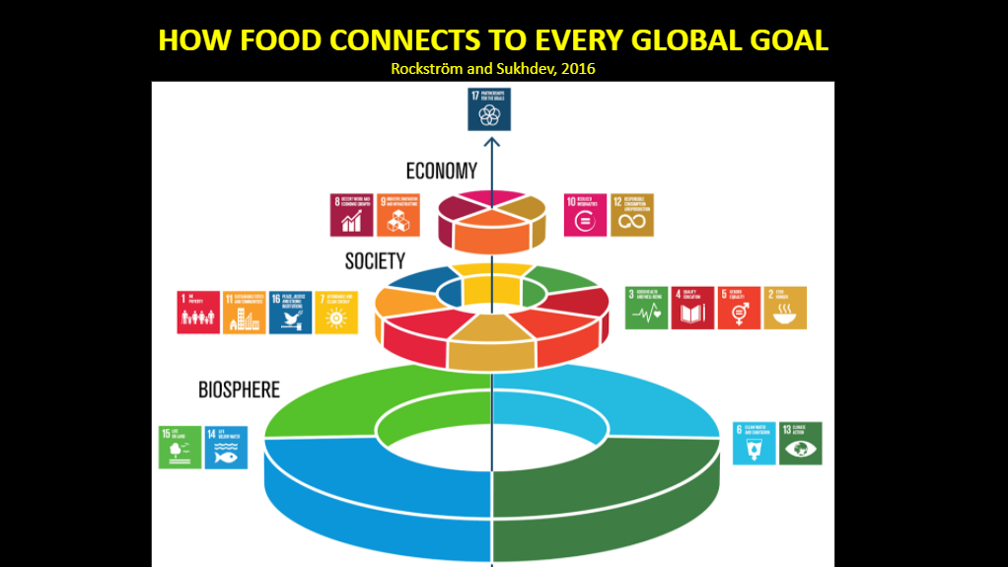
STEP 2: Introduce Topics of Agriculture
Go Over Slides

Slide 61
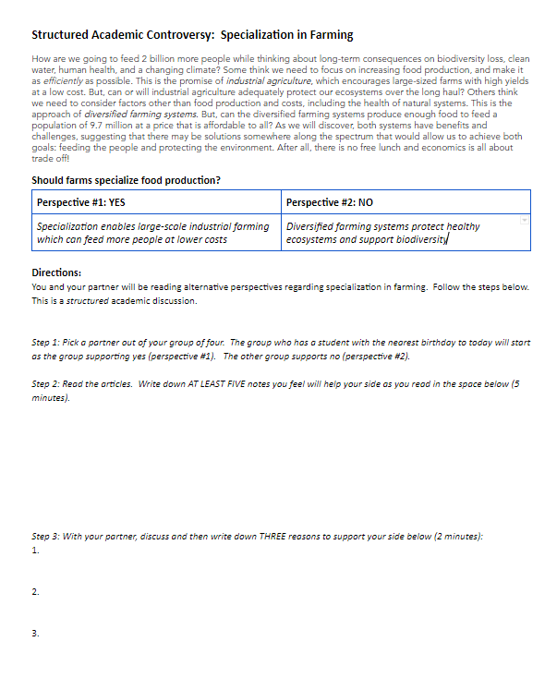
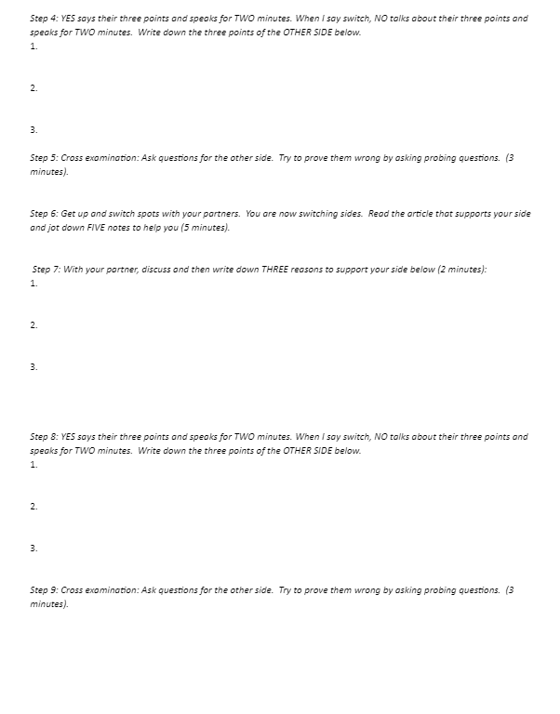
STEP 3: Make SAC Groups & Go Over Directions
Divide Students into Groups of 4, Distribute & Read SAC student directions

Slide 62
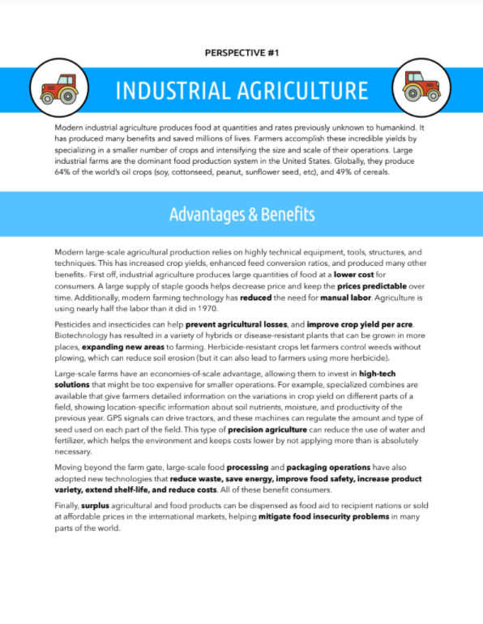
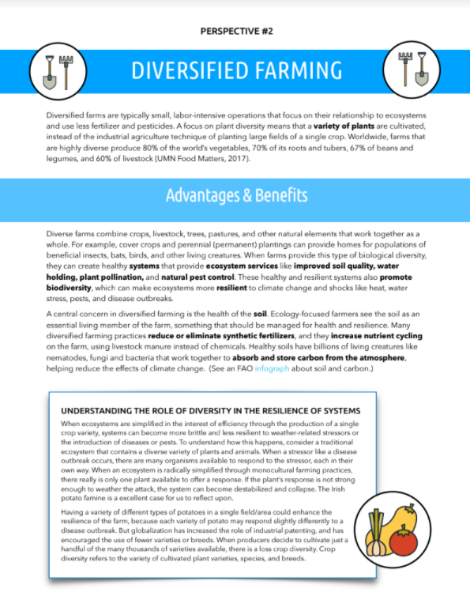
STEP 4: Students Read About Both Perspectives
Perspective #1: Industrial Agriculture Perspective #2: Diversified Agricultural Systems

Slide 65
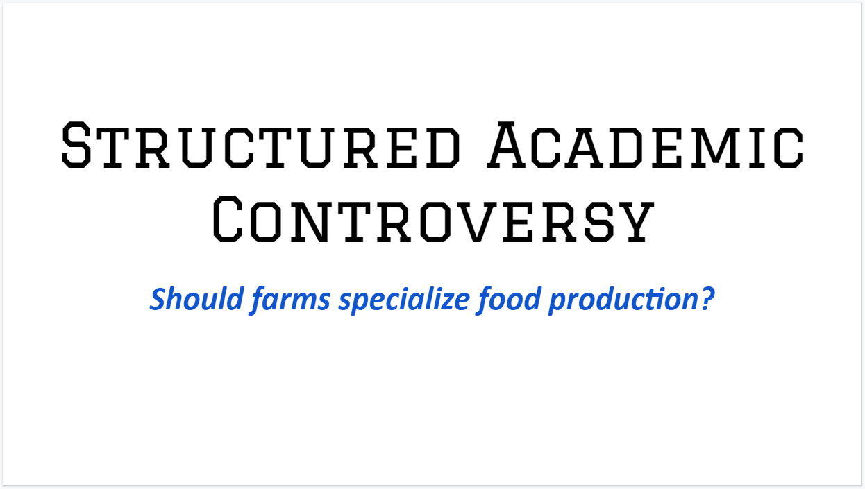
STEP 5: Structured Academic Controversy
Here is a slideshow that you can use that has instructions and timers built in.

Slide 66
STEP 6: Reflection & Closure
Reflection: Write a reflection that explains your experience in the structured academic controversy as well as your own opinion on the question you debated.

Slide 67
Optional Extension
Since this lesson also touches on the concept of comparative advantage, here is an extension that can be used to reinforce that.

Slide 68
WATERFALL Closure Activity
Type your answer/response into the chat but DON’T POST IT until the instructor says, “Waterfall!”
Practice: What’s your favorite color?
Practice #2: Name a food you prefer NOT to eat!
The Real Deal: Identify another application for the Structured Academic Controversy. (What is another debate topic you could use in a class you teach?)

Slide 69
Additional Resources
Curriculum: http://tinyurl.com/sust-econ
Additional K-12 Resources: z.umn.edu/TeacherResources
An excellent article on the debate between large industrial agriculture and small diversified farms from the Washington Post.
New York Times photographer George Steinmetz spent nearly a year traveling the United States photographing the industrialized food system. Check out the special issue “Super Size.”
Good article for diversified farming recently in the Star Tribune.
Food Matters (UMN): Well-designed web report with interactive graphs and data stories that detail the pros and cons of large industrial agriculture and small diversified farms.
Structured Academic Controversy citation: Johnson, David W. and Roger T. Johnson. "Critical Thinking Through Controversy." Educational Leadership, May 1988.
Fertilizing Nature: A Tragedy of Excess in the Commons by Good & Beatty, 2011.
The Contribution of Commercial Fertilizer Nutrients to Food Production by Stewart et al., 2005.
“Why Industrial Farms Are Good for the Environment” New York TImes, September 23, 2016.
Industrial Agriculture by the Union of Concerned Scientists.

Slide 70
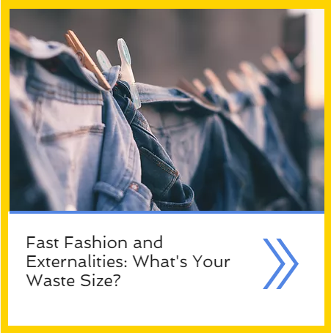
Lesson #3: Fast Fashion & Externalities
z.umn.edu/MCEESustainability

Slide 71
Fast Fashion & Externalities: What’s Your Waste Size?

Slide 72
Fast Fashion & Externalities: What’s Your Waste Size?
Economic Benchmarks (Minnesota)
9.2.4.8.2: Identify and analyze market failure caused by poorly-defined property rights or poorly enforced property rights, externalities, and public goods; evaluate the rationale and effectiveness of government attempts to remedy these problems.
Literacy in Social Studies Standards (Minnesota)
11.14.6.6: Use technology, including the Internet, to produce and publish writing to interact and collaborate with others.

Slide 73
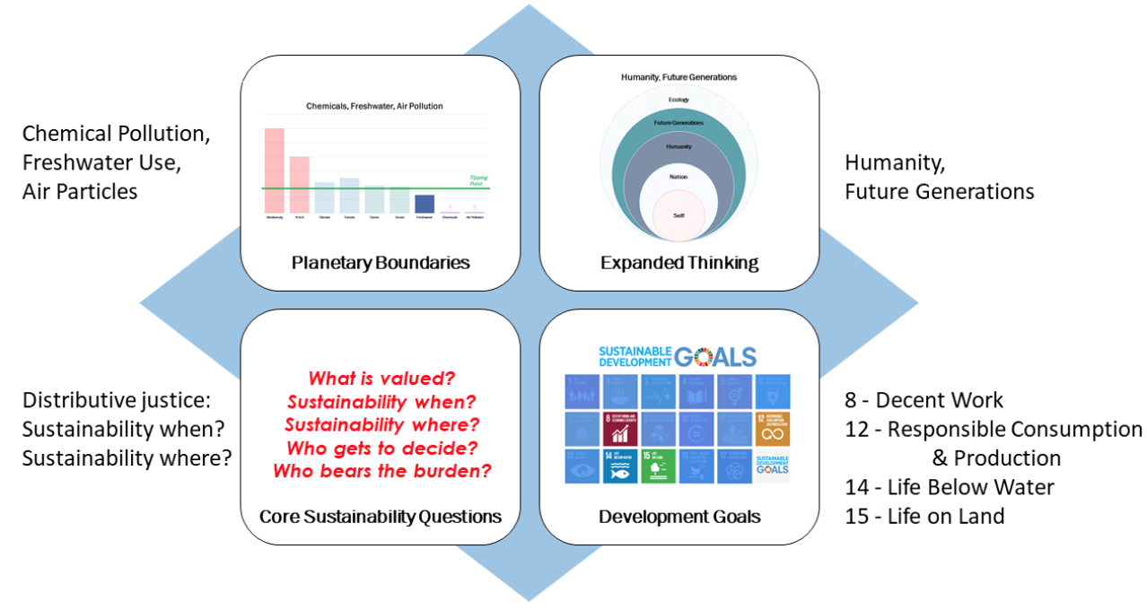
Fast Fashion & Externalities: What’s Your Waste Size?
Sustainability Themes

Slide 74
Fast Fashion & Externalities: What’s Your Waste Size?

Slide 75
Intro Discussion
Step 1:
How often do you buy clothes and what drives your decisions?
How influential is social media/ marketing? Does it work?
How do producers know what to make and how much to charge?

Slide 76
POLL: What is your highest priority when
shopping for clothes?
Fit
Price/ value
Color
Stylish/ trendy
Brand name
“How do you shop for clothes?” Intro Presentation

Slide 77
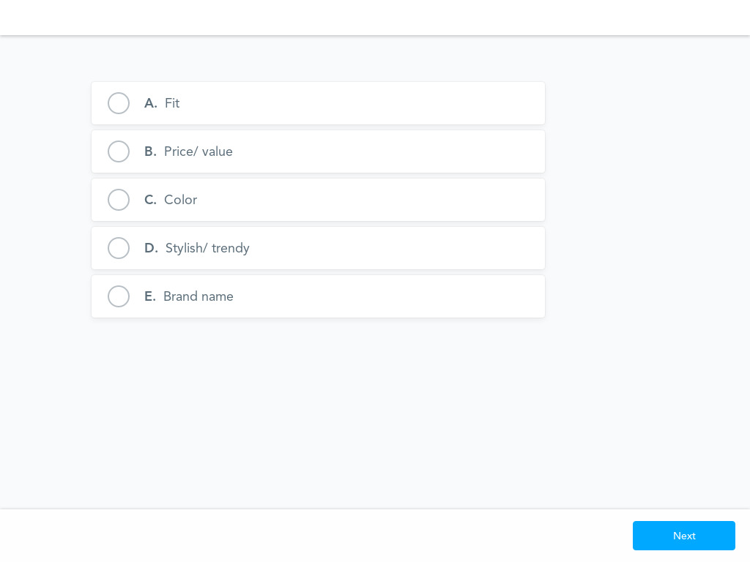
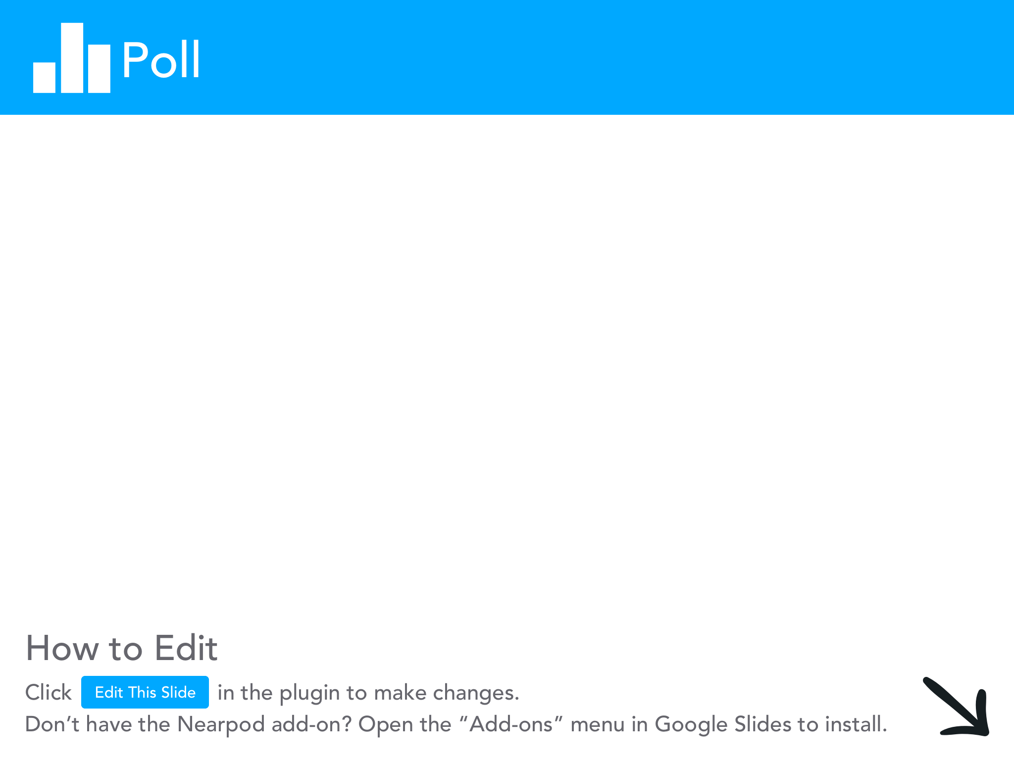

Slide 78
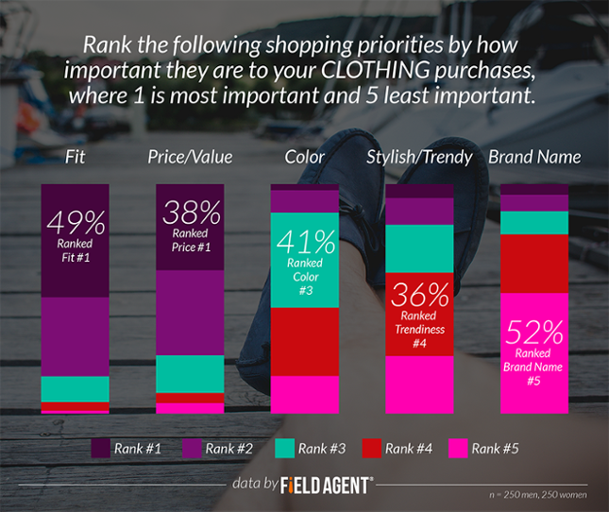

Slide 79
How do producers know what to make and how much to charge?
Questions to ask kids:
What materials do you need to make clothing? How much do those things cost?
How do producers know what things to actually make?
What factors do producers consider when putting a price on clothing?

Slide 80
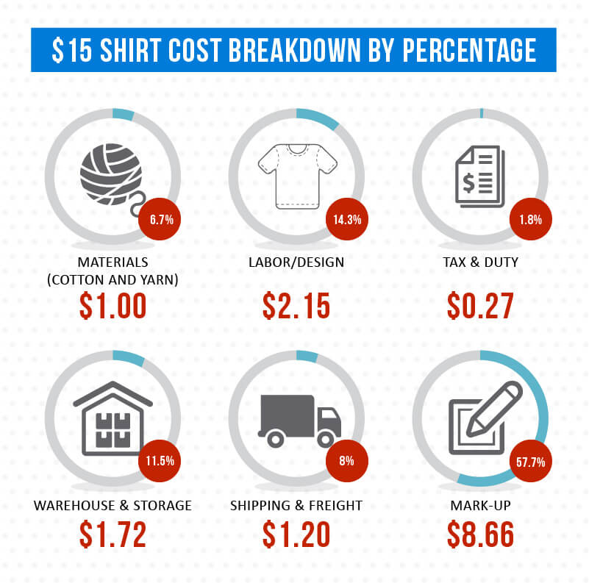
What Does a Shirt
Really Cost?
The final price you see for a shirt is a combination of factors to make sure all participating companies make money and can continue producing and distributing product.
Forbes Article
US vs. Bangladesh
https://graincreative.com/shirt-cost-breakdown/

Slide 81
FAST FASHION & EXTERNALITIES:
What’s Your Waste Size?
Step 2:
Organize students into groups of 3 or 4 and provide a Fast Fashion Worksheet and Fast Fashion Clues Handout (cut apart).
Students read through the clues and collectively decide:
What is the core problem in this clue?
Who is responsible for this problem?

Slide 82
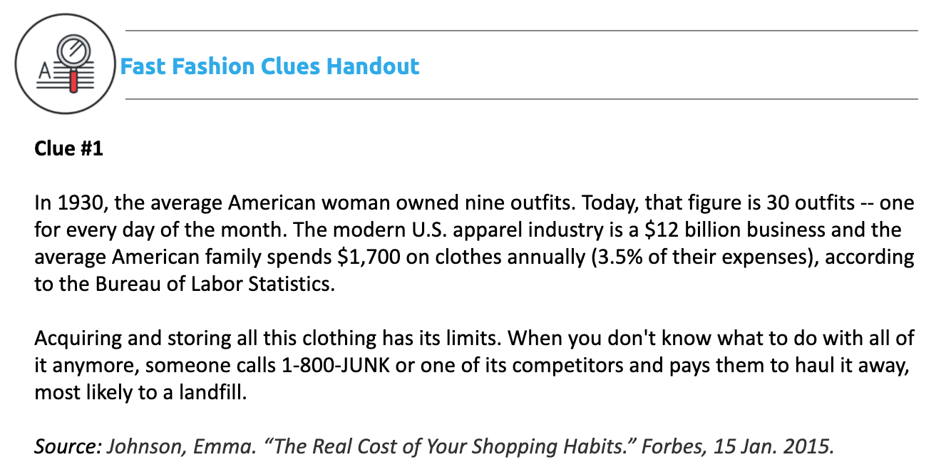
POLL:
Who is the source of the problem?
Consumers
Clothing Manufacturers
Clothing retailers (ex: H&M)
Recycling programs (ex: Goodwill)
Cotton growers
Textile and chemical producers
Oil and coal producers

Slide 83
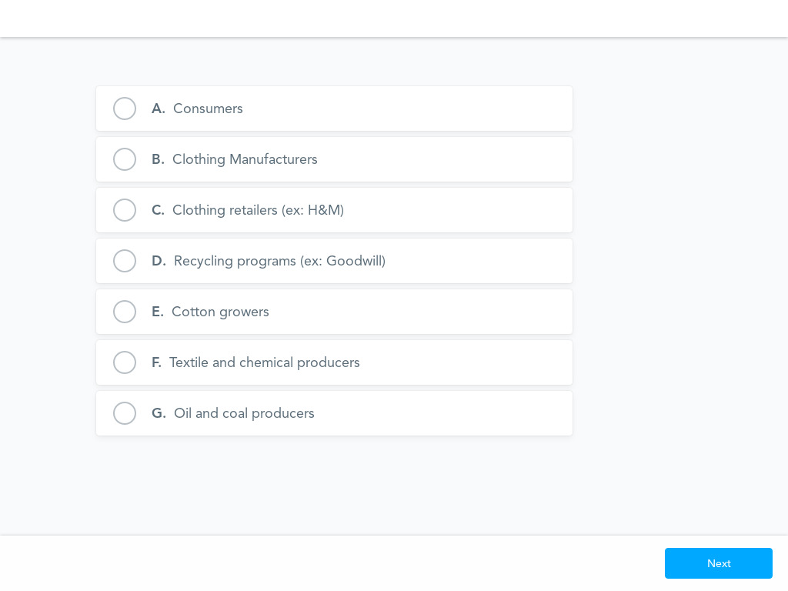

Slide 84
POLL:
Who is the source of the problem?
Consumers
Clothing Manufacturers
Clothing retailers (ex: H&M)
Recycling programs (ex: Goodwill)
Cotton growers
Textile and chemical producers
Oil and coal producers

Slide 86
FAST FASHION & EXTERNALITIES:
What’s Your Waste Size?
Step 3:
Introduce the concept of externalities: costs that are incurred by someone other than the buyer or seller.
In addition to the private costs that producers incur (i.e. materials, wages, capital), there are social costs that are incurred bystanders or future generations (i.e. pollution, landfills).

Slide 87
FAST FASHION & EXTERNALITIES:
What’s Your Waste Size?
Step 3:
Use the questions on the back of the Fast Fashion Worksheet to identify private costs and social costs (externalities) of fast fashion.
*In order for markets to be efficient we must consider all of these costs!!!

Slide 88
Fast Fashion: Private Cost or Externality?
NOT an externality: You are paying to haul the clothes to the landfill so you bear the cost of the pollution. Students could still argue that the cost to bring the clothes to the landfill is insufficient compared to the level of waste created.

Slide 89
Fast Fashion: Private Cost or Externality?
Externality
The pollution from untreated chemicals affects rivers and oceans that people outside of the apparel industry use.

Slide 90
Fast Fashion: Internalizing the Externalities
Pigouvian Taxes
May be too advanced for regular classes!
The Economist article: Pigouvian taxes
Video: Pigouvian Taxes in Economics
“Nudge” people towards smarter consumption (Behavioral Economics)
World Bank blog: Nudge for good: How insights from behavioral economics can improve the world— and manipulate people
UN Environment blog: Nudge to Action: Behavioural Science for Sustainability
United Nation Development Programme: Behavioural Insights at the United Nations – Achieving Agenda 2030

Slide 91
The Cost of Fast Fashion: Who is to Blame?
Debrief:
What are some strategies you considered when holding that group accountable for paying for those costs?
What were your personal feelings as you worked through the clues and discussed them as a group?

Slide 92
Extension Ideas
Externalities are at the root of a lot of issues in environmental economics. Consider:
Our overuse of plastic bags:
Khan Academy video: Negative externalities and the market for plastic bags
Academic journal article: Using nudges to reduce waste? The case of Toronto’s plastic bag levy
Or the recent push to eliminate plastic straws:
CNN article: The last straw: Is time up for this plastic relic?
This lesson touches on the impact on garment workers. Consider a lesson that explores sweatshops in more detail as a good extension after this one.

Slide 93
Vocab Matching Formative Assessment
Match the term to the definition!

Slide 94
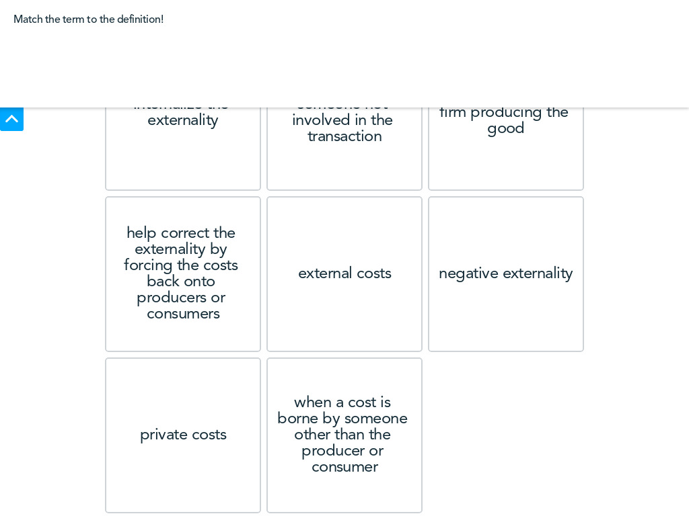

Slide 95
Additional Resources
Curriculum: http://z.umn.edu/MCEESustainability
Additional K-12 Resources: z.umn.edu/TeacherResources
The argument for economic thinking Washington Post article
Lesson plan geared towards AP Microeconomics: When Markets Fail
Video: Episode 5 in the Economic Lowdown Video Series explains externalities, how costs and benefits sometimes affect bystanders, and uses of taxes and subsidies to "internalize" externalities.
Initiative bring together businesses, governments, innovators, and citizens: Making Fashion Circular (Ellen MacArthur Foundation)
Reading: Introduction to the Coase Theorem
Lesson plan: NPR’s Planet Money makes a t-shirt

Slide 96
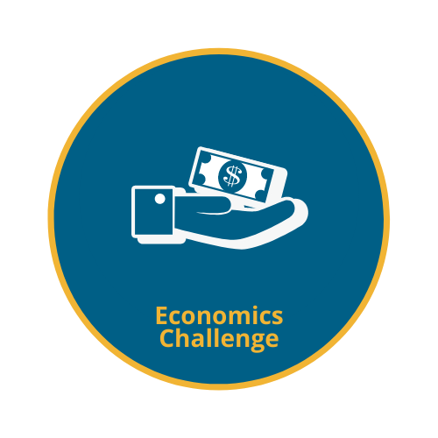
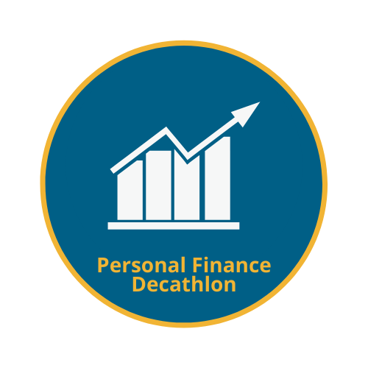
MCEE FREE Student Competitions Gr. K-12
Looking for ways to connect your classroom content in economics and personal finance to real-world scenarios and applications? Struggling to incentivize student engagement and foster critical-thinking skills? Looking for some easy extra credit opportunities to provide for your students?
Learn More! z.umn.edu/21StudentComp

Slide 97
MCEE FREE Student Summer Program Gr. 9-11
Combining personal finance with college preparation skills, College Dollars & Sense is designed to offer students a chance to see themselves in college and understand how their personal finances will affect their lives after high school and in the workforce.
In this one-week summer program, students are introduced to personal finance concepts, learn strategies for affording and saving for college, experience life on a major university campus, and interact with students, professors, and business leaders while developing the skills they need to succeed after high school.
Learn More! z.umn.edu/MCEE-CDS

Slide 98
Thank You
Emily Anderson | Emily.Anderson@ahschools.us
mcee.umn.edu | mcee@umn.edu | 612.625.3727

