Slide 1
What is the role of state governments in emergency situations, like a pandemic?

Slide 2
Essential Dilemma
Can state governments’ responses to the COVID-19 pandemic prioritize the health and safety of citizens while also focusing on economic stability?

Slide 3
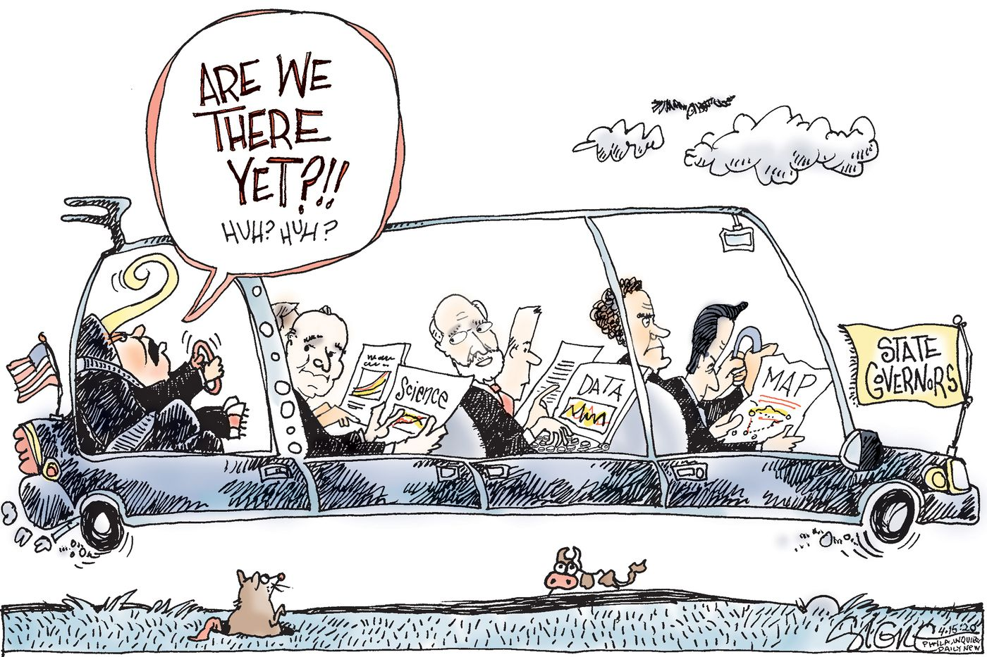
REMOVE SLIDE
What is the main idea the illustrator is seeking to convey?
What actions do you believe the illustrator of this cartoon is in favor of?
Notes:
Source: https://fusion.inquirer.com/opinion/cartoons/governors-andrew-cuomo-tom-wolf--20200415.html
What is the main idea the illustrator is seeking to convey? (Answers will vary, but should include an explanation that selected state governors are pictured in the front of the limo. These politicians are holding newspapers that say “data,” “map,” and “science” that convey the message that the governors are relying on these resources to drive their responses to the pandemic. President Trump is pictured as a “backseat driver” who is shouting “Are we there yet?!” to the governors, which is intended to capture the President’s desire to reopen the economy.)
What actions do you believe the illustrator of this cartoon is in favor of? (Answers will vary, but students should support their claims with details from the cartoon.)

Slide 4
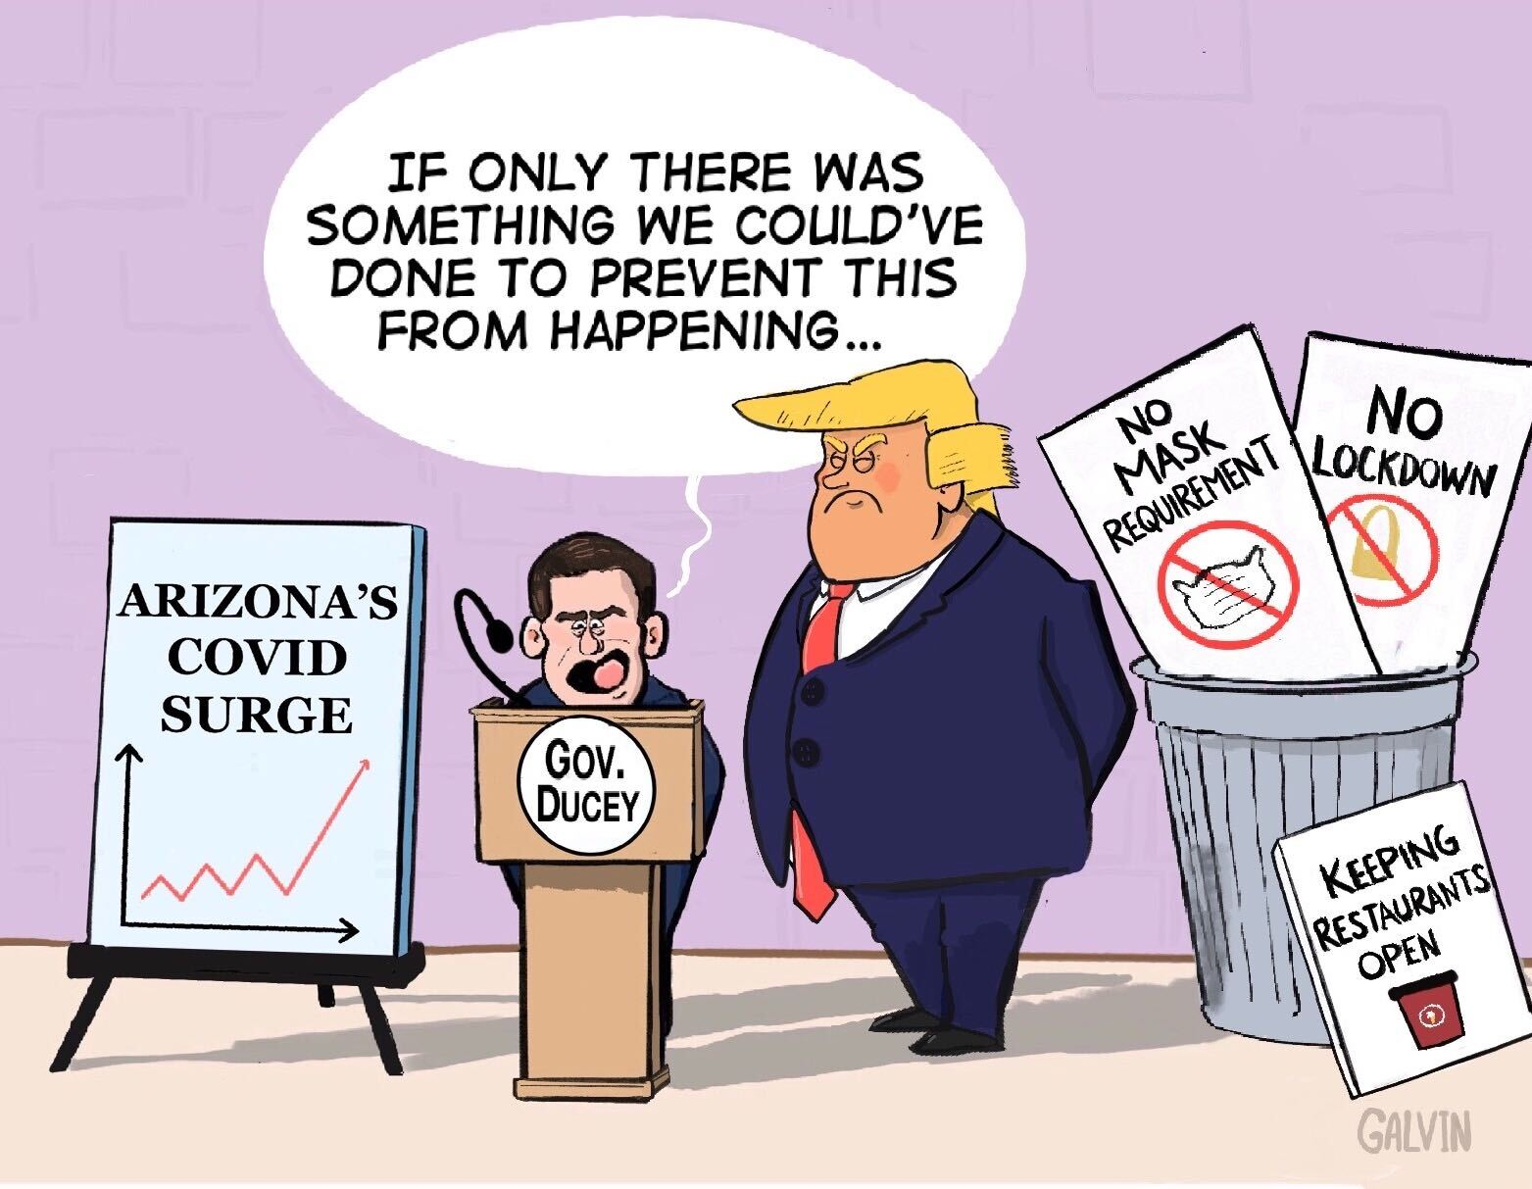
REMOVE SLIDE
What is the main idea the illustrator is seeking to convey?
What actions do you believe the illustrator of this cartoon is in favor of?
Notes:
Source: https://coppercourier.com/story/cartoon-ducey-if-only-something-done-to-prevent-this/
What main idea is the illustrator seeking to convey in this cartoon? (Answers will vary, but may include an explanation that identifies the response of Arizona’s governor to the COVID-19 pandemic. The governor is defending himself against public criticism about his handling of the crisis. In the background, students may notice signs labeled “no mask requirement” and “no lockdown” in the trash can, indicating that the governor did not embrace these practices to slow the spread of the virus. Students may also cite the influence of the federal government on state level decisions, as President Trump is pictured as a looming figure over Arizona’s Governor Ducey.)
What actions do you believe the illustrator of this cartoon is in favor of? (Students may list many different actions, but their answers should be supported by images and messages in the cartoon. For example, students may state that the cartoonist believes the governor should have done more to mitigate the crisis, but did not take the threat of the virus seriously, and thus, did not order mask requirements or lockdowns. Instead, as the sign propped up on the trash can indicates, the governor opted to keep businesses open.)

Slide 5
State Governments’ Responses to COVID-19 Pandemic
State open status score
Mask requirements
School reopening status
Unemployment rates from March 2020, April 2020, and present
Decline in state revenues 2021
Percent Change in Real GDP by State
Trend in COVID-19 Cases & Deaths

Slide 6
Cost-Benefit Analysis of Reopening States
What is it? Weighing pros and cons (of seen and unseen factors) when making a decision.
Costs of Reopening
additional deaths and hospitalizations
risk of repeated outbreaks and closures
return to heavy traffic
political implications
Benefits of Reopening
reduction in unemployment
increase in tax revenue when people return to work
reduced need for future stimulus?
save small businesses

Slide 7
Information for South Carolina
State | State Open Status Score | Mask Requirements | School Reopening Status | Unemployment Rates March 2020, April 2020, Current | Percent Change in Real GDP by State,Q1 2020 - Q 2 2020 | Projected Decline in State Revenues 2021 | Trend in COVID-19 Cases and Deaths | Emoji Ratings and Cost-Benefit Analysis
South Carolina | 6 | yes* executive order for state govt offices; encouraged local govts to adopt Many local governments have allowed mask mandates to expire. | Yes; District plans submitted to State Department of Education; CARES Act funding allocated to DOE to distribute to districts to combat spread of COVID-19 in schools. | March 2020 3.2% April 2020 12.8% September 2020 5.1% | -32.6% | 6-10% | increasing | 💹 - Initial dip in economic activity (unemployment and % change in real GDP met by recovery) 📊 - Upward trend in COVID-19 cases 💣 - Decline in state revenues, lack of local government mask ordinance renewals, and rise in cases may be a ticking time bomb 🙈-States are going into this blind. SC may value the benefit of economic recovery over the potential health costs, but results remain to be seen.

Slide 8
Instructions for Group Activity
In your groups, take turns sharing out information related to the state research assignment (Activity 1: Emoji Ratings for States’ COVID-19 Responses)
Take 1 - 2 minutes per student to share the overview of their assigned state.
After everyone has spoken, discuss how the economic, health, and openness indicators demonstrate the use of cost-benefit analysis by the states when making COVID related decisions.
Work together to assign each state four emoji ratings based on the information you collected in Activity 1 and the cost-benefit discussion above. Support your emojis with evidence from your research. For example:
😷 masks are mandated by state and/or local governments
🔋 the state’s economy has shown signs of recovery - unemployment rates have decreased and only small declines in state tax revenue are anticipated

Slide 9
Notices What trends do you see as you examine the emoji ratings? What similarities and differences do you notice in states’ approaches to cost-benefit analysis when making COVID related decisions? Which states have overall positive emoji ratings? Negative? | Wonders What might explain the trends that you notice? What factors may account for the positive and negative emoji ratings for some states? What questions do you still have?

