Slide 1
Taxation for College Counselors by Intuit
Presented by:
Ruben Rivera, Phd.
Director of Professional Development, Council for Economic Education

Slide 2
EconEdLink Membership
You can now access CEE’s professional development webinars directly on EconEdLink.org! To receive these new professional development benefits, become an EconEdLink member. As a member, you will now be able to:
Automatically receive a professional development certificate via e-mail within 24 hours after viewing any webinar for a minimum of 45 minutes
Register for upcoming webinars with a simple one-click process
Easily download presentations, lesson plan materials and activities for each webinar
Search and view all webinars at your convenience
Save webinars to your EconEdLink dashboard for easy access to the event
You may access our new Professional Development page here

Slide 3
Professional Development Certificate
To earn your professional development certificate for this webinar, you must:
Watch a minimum of 45-minutes and you will automatically receive a professional development certificate via e-mail within 24 hours.
Accessing resources:
You can now easily download presentations, lesson plan materials, and activities for each webinar from EconEdLink.org/professional-development/

Slide 4
Agenda
Webinars on TurboTax Recap
Introduction to TurboTax
Taxation for College Access
Tax Case Study
FAFSA Overview and 1040

Slide 5
Ruben Rivera, PhD
Director of Professional Development
Council for Economic Education
High School teacher for 10 years
College Counselor
College Access and Success Manager for the Children’s Aid Society
Director of Professional Development at the Council for Economic Education
Notes:
Ryan Slide
Jared bio -
Jared leads Intuit’s Financial Readiness program aiming to empowering students to make smart money decisions and own their financial futures. As an Innovation Catalyst with deep expertise in Personal Finance Jared serves as a Board Member for the Jump$tart Coalition, a committee member for the NY State Comptroller on Personal Finance, and has been tasked with designing the Congressional Award’s first ever Personal Finance Program.”
Elaine bio -

Slide 6
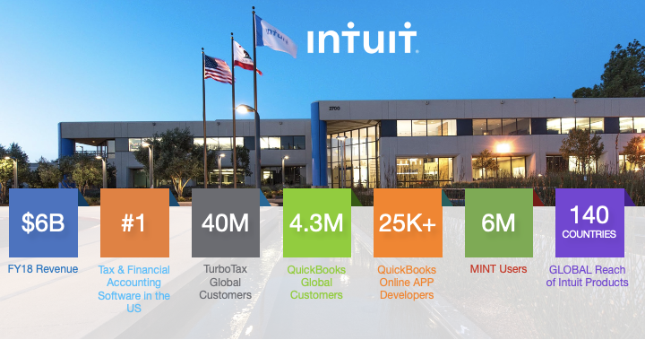

Slide 7
What is Mint?
Your fictional financial life, in one place, that’s easy to understand
Easily create personalized budgets
Set short and long term goals
Ability to track monthly bills
Analyze and develop smart spending behaviors
Understand your credit score and ways to improve
Business Insider’s #1 budgeting app in 2018, 2019, 2020
Notes:
Use this divider when using Title Option 2

Slide 8
Financial Fitness For Life
Financial Fitness for Life (3rd edition) helps you prepare students for life beyond the classroom by presenting lessons and activities based on real-world economics and personal finance concepts
Updated lesson plans with slides
1 new lesson plan for Paying Post-Secondary Education
17 ready-to-use EdTech tools
6 new activities using real-world tools in partnership with Intuit
https://store.councilforeconed.org/

Slide 9
Financial Fitness For Life

Slide 10
Further Related Content on EconEdLink.org Resource
Resource

Slide 11
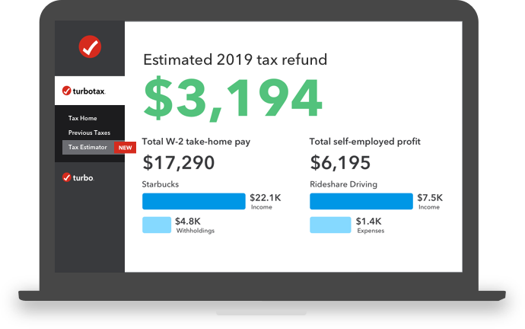
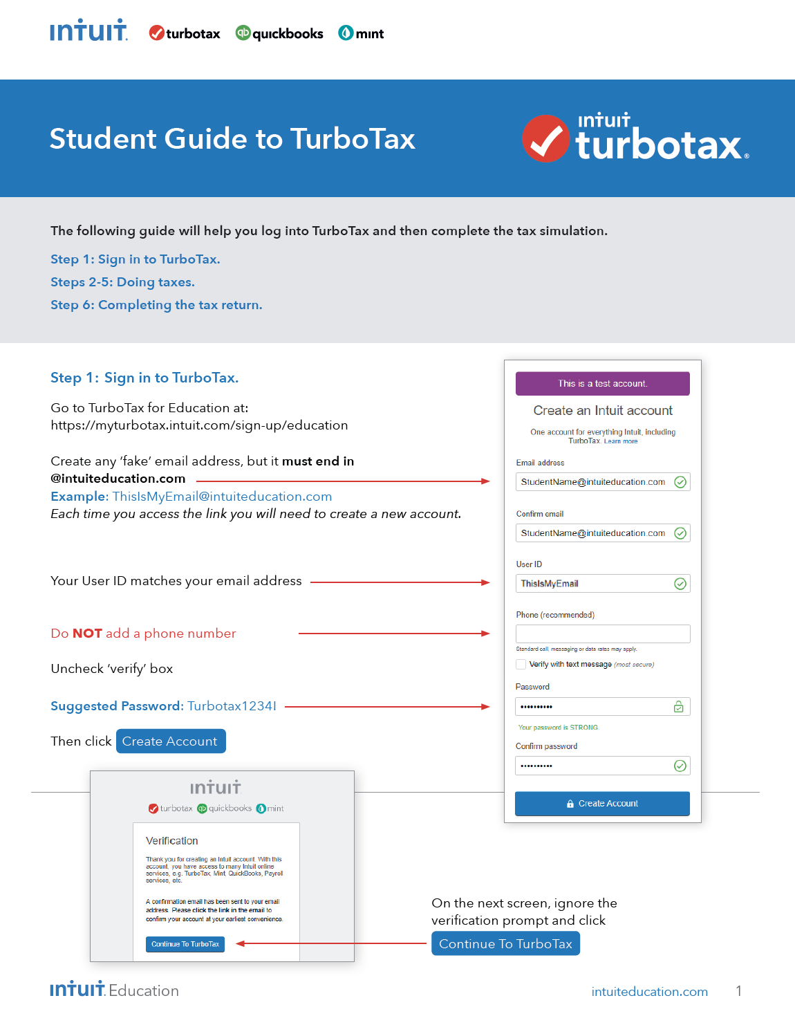
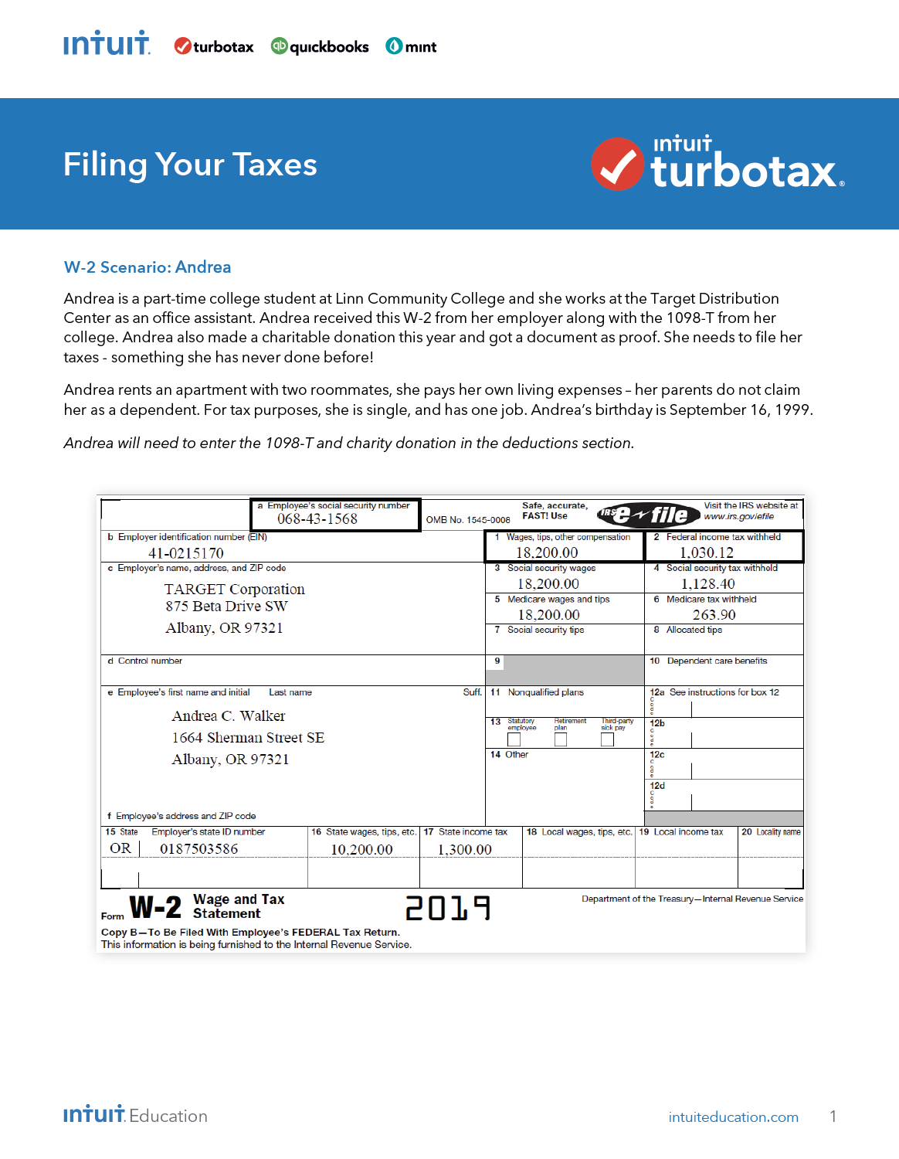
What is TurboTax?
Practice filing fictional taxes, in easy and relevant ways
Demystify Tax Day Anxiety
Uses IRS Free File Program through Freedom File Alliance
Fictional W2 Scenarios
Federal and State Returns
Notes:
Use this divider when using Title Option 2

Slide 12
TurboTax and College Counselors

Slide 13
Which of these is most important for College Fit?
Poll
Academics
2. Social
3. Financial
4. All Equal
Notes:
Use this divider when using Title Option 2

Slide 14
College Counselor resources:
https://mycollegecorner.com/
Additional Resources:
Finding the Right College Fit: College and Credit
Finding the Right College Fit: Inflation and Saving Affect Paying for College
Vocabulary Words:
E.F.C. - Expected Family Contribution
A.G.I. - Adjusted Gross Income
FAFSA - Free Application for Federal Student Aid
Income Tax Paid - The total amount of taxes paid as stated on a W2 form
1040 form - The IRS form 1040 is one of the official documents that U.S. taxpayers can use to file their annual income tax return

Slide 15
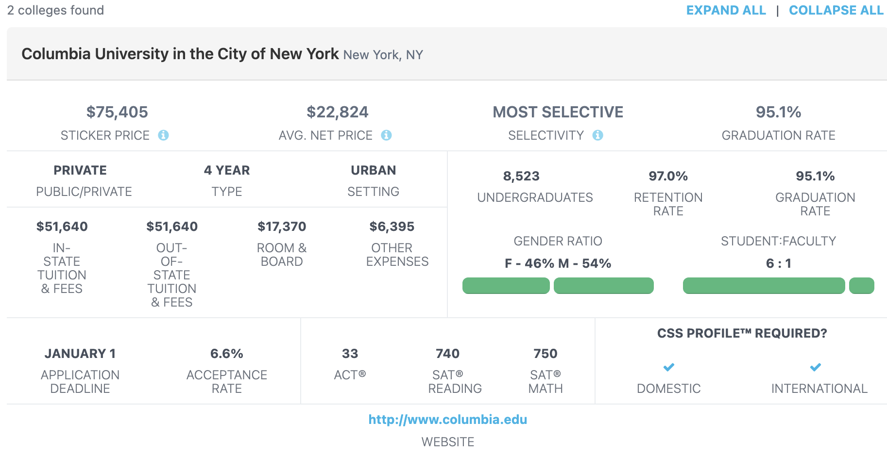

Slide 16
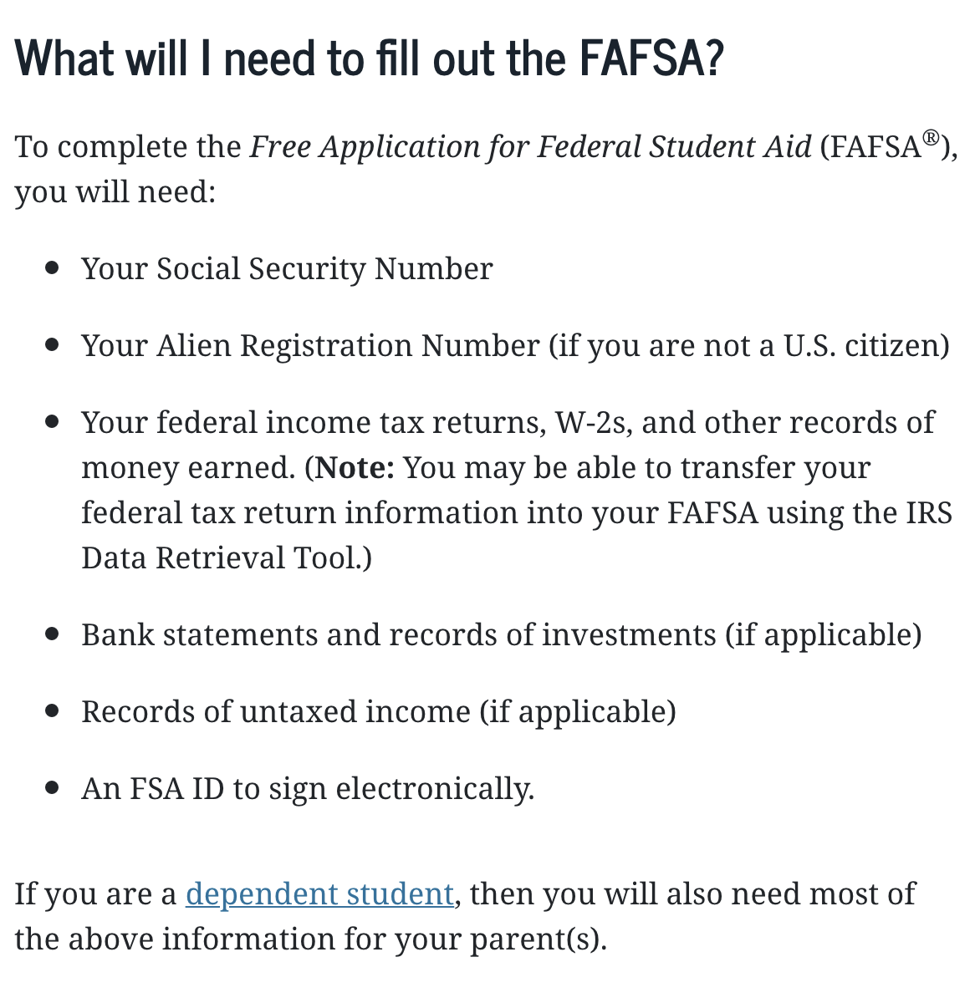

Slide 17
To file a FAFSA students should know or have access to:
Social Security Number
Marital Status
College or University they are interested in attending
If they have dependents, their information
How many people live in the household
Demographic Information
Parent or guardian 2019 Completed Tax Return (IRS 1040)
Their completed tax return (if applicable)
Link to IRS tool

Slide 18
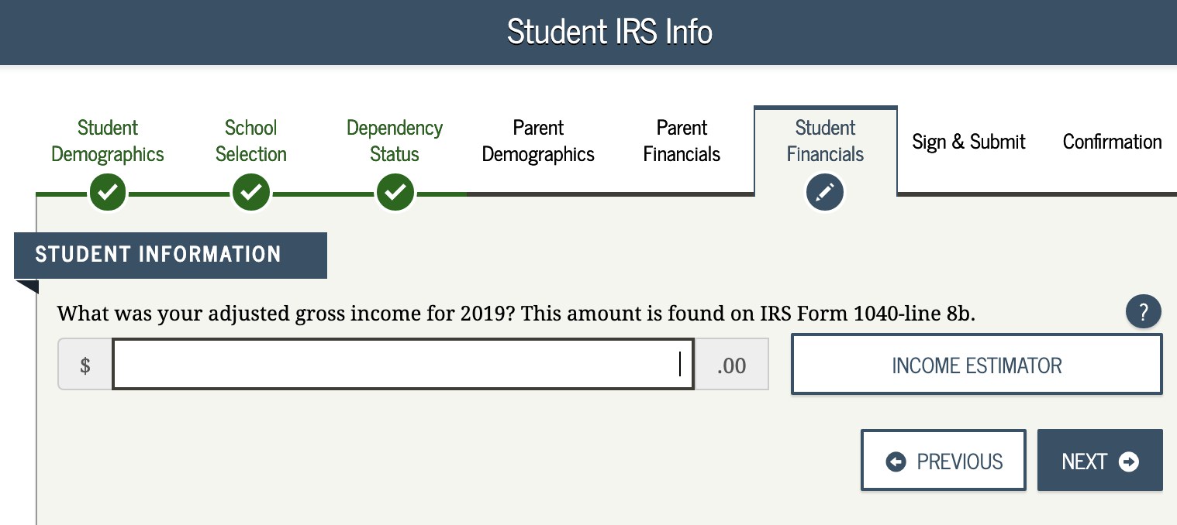
Some FAFSA questions:

Slide 19
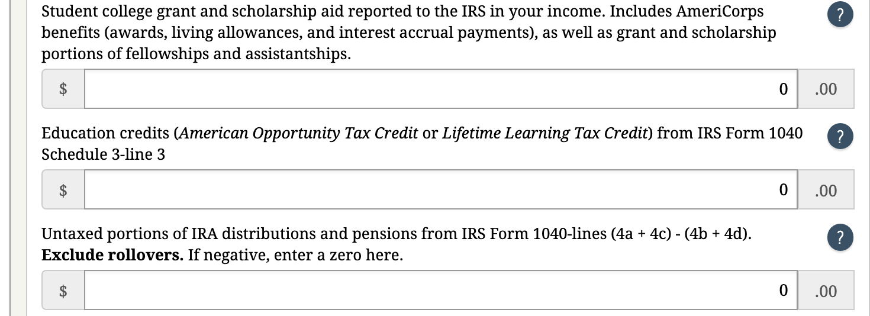
Some FAFSA questions:

Slide 20
TurboTax
Curriculum & Simulation Demo

Slide 21
Intro to Taxes
Guiding Questions:
What Is Form W-2?
A W-2 form, also known as the Wage and Tax Statement, is the document an employer is required to send to each employee and to the Internal Revenue Service (IRS) at the end of the year. A W-2 reports the employee's annual wages and the amount of taxes withheld from their paychecks. A W-2 employee is someone whose employer deducts taxes from their paychecks and submits this information to the government.
2) What Information Does a W-2 Include?
Every W-2 has the same fields, no matter the employer. W-2 forms are divided into state and federal sections since employees must file taxes on both levels. There are fields that provide the employer's information, including the company’s federal Employer Identification Number (EIN) and the employer's state ID number. The remaining fields mostly focus on the details of the employee's income from the previous year.
Source: Investopedia
Notes:
Use this divider when using Title Option 2

Slide 22
Intro to Taxes
Case study 1 - Ezra Daniels.
(Using W2’s)
Complete Resource Activity on TurboTax
Notes:
Use this divider when using Title Option 2

Slide 23
Exploring the 1040 Form

Slide 24
Thank You!
Rrivera@councilforeconed.org

