Slide 1
National Personal Finance Challenge Webinar Series Standard 6: Protecting and Insuring Presented by Dr. Julie Heath and Susan McNamara julia.heath@uc.edu; mcnamarasa@vcu.edu

Slide 2
Professional Development Certificate
To earn your professional development certificate for this webinar, you must:
Watch a minimum of 45-minutes and you will automatically receive a professional development certificate via e-mail within 24 hours.
Once you receive your certificate, please submit it to your administrator for approval. Professional Development standards can differ from state to state
Accessing resources:
You can now easily download presentations, lesson plan materials, and activities for each webinar from EconEdLink.org/professional-development/

Slide 3
Agenda
Overview of Standard 6: Protecting and Insuring
Demonstration of Lessons
Lesson 1: Don’t Be Scammed
Lesson 2: Managing Risk
Tie-in to National Personal Finance Challenge Case Study Competition

Slide 4
Objectives
Teachers will
Understand the scope and depth of Standard 6: Protecting and Insuring, including specific concepts;
Be able to demonstrate Standard 6: Protecting and Insuring to their students using the two lessons presented;
Synthesize Standard 6: Protecting and Insuring and the lessons to create actionable plans for classroom engagement.

Slide 5
Standard 6: Protecting and Insuring
People make choices to protect themselves from the financial risk of lost income, assets, health, or identity. They can choose to accept risk, reduce risk, or transfer the risk to others. Insurance allows people to transfer risk by paying a fee now to avoid the possibility of a larger loss later. The price of insurance is influenced by an individual’s behavior.

Slide 6
Standard 6: Protecting and Insuring
People make choices to protect themselves from the financial risk of lost income, assets, health, or identity. They can choose to accept risk, reduce risk, or transfer the risk to others. Insurance allows people to transfer risk by paying a fee now to avoid the possibility of a larger loss later. The price of insurance is influenced by an individual’s behavior.

Slide 7
Important Concepts
Types of Insurance
Health
Life
Auto
Renters
Disability

Slide 8
Important Concepts
Insurance Terms
Deductible
Co-pay
Premiums
Liability/collision, etc.
Moral hazard

Slide 9
Important Concepts
Scams
Types
Government agencies/legislation

Slide 10
References
National Standards for Financial Literacy
https://www.councilforeconed.org/resource/national-standards-for-financial-literacy/#sthash.11CbykLO.dpbs

Slide 11
EconEdLink Membership
You can now access CEE’s professional development webinars directly on EconEdLink.org! To receive these new professional development benefits, become an EconEdLink member. As a member, you will now be able to:
Automatically receive a professional development certificate via e-mail within 24 hours after viewing any webinar for a minimum of 45 minutes
Register for upcoming webinars with a simple one-click process
Easily download presentations, lesson plan materials and activities for each webinar
Search and view all webinars at your convenience
Save webinars to your EconEdLink dashboard for easy access to the event
You may access our new Professional Development page here

Slide 12
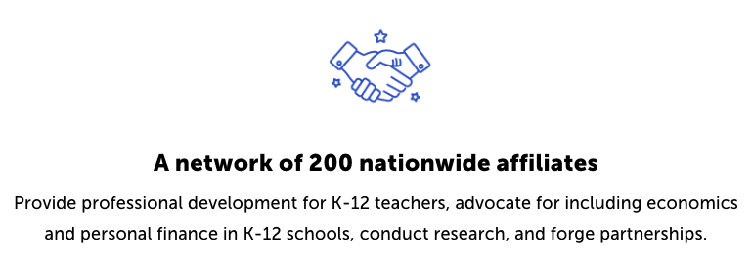
CEE Affiliates
https://www.councilforeconed.org/resources/local-affiliates/

