Slide 1
National Personal Finance Challenge Webinar Series Standard 3: Saving Presented by Dr. Julie Heath and Susan McNamara julia.heath@uc.edu; mcnamarasa@vcu.edu

Slide 2
Professional Development Certificate
To earn your professional development certificate for this webinar, you must:
Watch a minimum of 45-minutes and you will automatically receive a professional development certificate via e-mail within 24 hours.
Accessing resources:
You can now easily download presentations, lesson plan materials, and activities for each webinar from EconEdLink.org/professional-development/

Slide 3
Agenda
Overview of Standard 3: Saving
Demonstration of Lessons
Lesson 1: Compound Interest
Lesson 2: Financial Institutions and Services
Tie-in to National Personal Finance Challenge Case Study Competition

Slide 4
Objectives
Teachers will
Understand the scope and depth of Standard 3: Saving, including specific concepts;
Be able to demonstrate Standard 3: Saving to their students using the two lessons presented;
Synthesize Standard 3: Saving and the lessons to create actionable plans for classroom engagement.

Slide 5
Standard 3: Saving
Saving is the part of income that people choose to set aside for future uses. People save for different reasons during the course of their lives. People make different choices about how they save and how much they save. Time, interest rates, and inflation affect the value of savings.

Slide 6
Standard 3: Saving
Saving is the part of income that people choose to set aside for future uses. People save for different reasons during the course of their lives. People make different choices about how they save and how much they save. Time, interest rates, and inflation affect the value of savings.

Slide 7
Important Concepts
Time Value of Money
Present/Future values
Meaning
Applications
Inflation/interest rates and effect on value (real/nominal)

Slide 8
Important Concepts
Federal Reserve
Determination of interest rates
System

Slide 9
Important Concepts
Savings Instruments
Types: IRAs, 401(k)s, Roth
Insured

Slide 10
Important Concepts
Benefits/Costs
Employer incentives/instruments
Objectives

Slide 11
References
National Standards for Financial Literacy
https://www.councilforeconed.org/resource/national-standards-for-financial-literacy/#sthash.11CbykLO.dpbs

Slide 12
EconEdLink Membership
You can now access CEE’s professional development webinars directly on EconEdLink.org! To receive these new professional development benefits, become an EconEdLink member. As a member, you will now be able to:
Automatically receive a professional development certificate via e-mail within 24 hours after viewing any webinar for a minimum of 45 minutes
Register for upcoming webinars with a simple one-click process
Easily download presentations, lesson plan materials and activities for each webinar
Search and view all webinars at your convenience
Save webinars to your EconEdLink dashboard for easy access to the event
You may access our new Professional Development page here

Slide 13
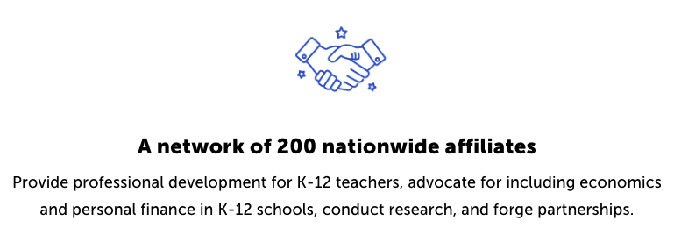
CEE Affiliates
https://www.councilforeconed.org/resources/local-affiliates/

